Slide 1
caGrid Portal
caGrid Users Meeting
May 15, 2008
Joshua Phillips - SemanticBits, LLC
joshua.phillips@semanticbits.com

Slide 2
caGrid Portal - Agenda
Portal Overview (5 min.)
Advertising you service to the Portal (15 min.)
Advertising Q&A (10 min.)
Query data services through the Portal (15 min.)
Query Q & A (10 min.)
General Portal Questions or Comments from Users (5 min.)

Slide 3
caGrid Portal - Overview
Features
  Discovery (map, directory, keyword search)
    Services, Participants, Points-of-contact
  Service Metadata Exploration
  Data Service Query
  Query Sharing
  caGrid Account Registration
  Grid Status Overview
  News and Events

Slide 4
caGrid Portal - Advertising
Relationship to index service
How the portal handles service metadata
Service configuration
Where to find the right URLs
Troubleshooting

Slide 5
caGrid Portal and Index Service
IndexService1
Portal
IndexService2
Portal
DB
The portal can point to multiple index service instances. But it is usually configured to point to only one. Metadata is cached in local database.

Slide 6
Available Portal Instances
NCI Production Grid
  Portal: http://cagrid-portal.nci.nih.gov
  Index: http://cagrid-index.nci.nih.gov:8080/wsrf/service/DefaultIndexService
OSU Training Grid
  Portal: http://portal.training.cagrid.org
  Index: http://cagrid01.bmi.ohio-state.edu:8080/wsrf/services/DefaultIndexService
NCI Staging Grid (NCI only)
  Portal: http://cagrid-portal-stage.nci.nih.gov
  Index: http://cagrid-index-stage.nci.nih.gov:8080/wsrf/services/DefaultIndexService
NCI QA Grid (NCI only)
  Portal: http://cagrid-portal-qa.nci.nih.gov
  Index: http://cagrid-index-qa.nci.nih.gov:8080/wsrf/services/DefaultIndexService

Slide 7
Where to find caGrid URLs
On the caGrid wiki:
  http://www.cagrid.org/wiki/CaGrid:ProductionGrid_caGrid1.2
In the caGrid source distribution:
  caGrid 1.1
    share/resources/target_grids/<grid_name>/service_urls.properties
  caGrid 1.2
    repository/target_grid/<grid_name>-<version>/service_urls.properties
Selecting the target grid:
  http://www.cagrid.org/wiki/CaGrid:How-To:ChangeTargetGrids

Slide 8
Service Types
Analytical Services
  expose ServiceMetadata (service description & hosting research center)
Data Services
  expose ServiceMetadata and DomainModel
AA
Analytical
Data

Slide 9
Metadata displayed by the portal
Service Metadata
  Service Description
    name, description, version, caDSR reg. status and workflow
    points of contact
    Service Contexts
      operations, context properties
  Hosting Research Center
    display name, short name, address
    points of contact
Domain Model
  UMLClasses
  Semantic Metadata
For more details:
  http://www.cagrid.org/wiki/CaGrid:MetadataModels

Slide 10
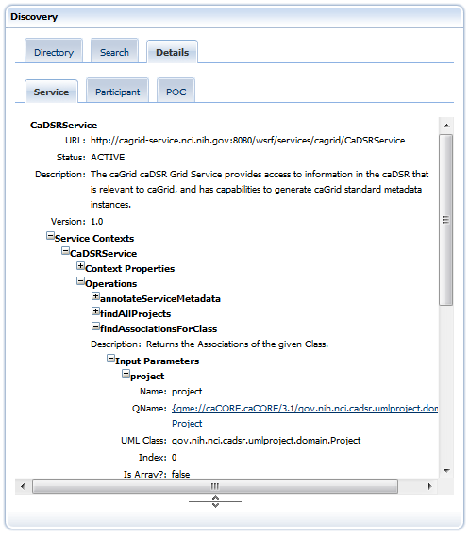
Service Metadata

Slide 11
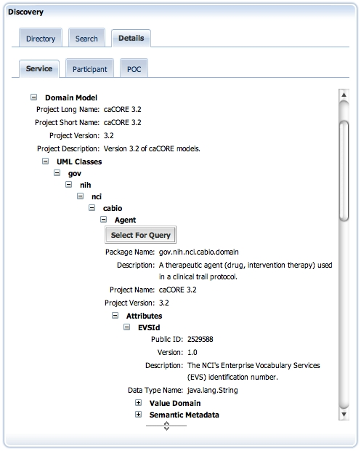
Domain Model

Slide 12
Service Configuration
In your development environment:
  deploy.properties
  jndi-config.xml
  etc/<service>_registration.xml
  etc/serviceMetadata.xml
  etc/domainModel.xml
Deployed (Tomcat):
  $CATALINA_HOME/webapps/wsrf/WEB-INF/etc/caGrid_<service>

Slide 13
deploy.properties
#Service Deployment Properties
#Sat May 03 11:13:40 CDT 2008
index.service.index.refresh_milliseconds=300000
perform.index.service.registration=true
index.service.url=http\://cagrid-index....rvices/DefaultIndexService
service.deployment.prefix=cagrid
index.service.registration.refresh_seconds=600

Slide 14
jndi-config.xml
<jndiConfig xmlns="http://wsrf.globus.org/jndi/config">
<service name="cagrid/MyCaGridSvc">
<resource name="configuration”
type=”org.some.service.MyCaGridSvcResourceConfiguration">
<resourceParams>
<parameter>
<name>factory</name>
<value>org.globus.wsrf.jndi.BeanFactory</value>
</parameter>
<parameter>
<name>performRegistration</name><value>true</value>
</parameter>
<parameter>
<name>registrationTemplateFile</name>
<value>etc/cagrid_MyCaGridSvc/MyCaGridSvc_registration.xml</value>
</parameter>
<parameter>
<name>serviceMetadataFile</name>
<value>etc/cagrid_MyCaGridSvc/serviceMetadata.xml</value>
</parameter>
<parameter>
<name>domainModelFile</name>
<value>etc/cagrid_MyCaGridSvc/domainModel.xml</value>
</parameter>
</resourceParams>
</resource>
...

Slide 15
etc/<service>_registration.xml
<?xml version="1.0" encoding="UTF-8" ?>
<ServiceGroupRegistrationParameters ...>
<ServiceGroupEPR>
<wsa:Address>http://cagrid-index..../DefaultIndexService</wsa:Address>
</ServiceGroupEPR>
<RefreshIntervalSecs>600</RefreshIntervalSecs>
<Content ...>
<agg:AggregatorConfig xsi:type="agg:AggregatorConfig">
<agg:GetMultipleResourcePropertiesPollType ...>
<agg:PollIntervalMillis>300000</agg:PollIntervalMillis>
<agg:ResourcePropertyNames>ns3:ServiceMetadata</agg:ResourcePropertyNames>
<agg:ResourcePropertyNames>ns7:DomainModel</agg:ResourcePropertyNames>
</agg:GetMultipleResourcePropertiesPollType>
</agg:AggregatorConfig>
<agg:AggregatorData/>
</Content>
</ServiceGroupRegistrationParameters>

Slide 16
serviceMetadata.xml
<ns1:ServiceMetadata xmlns:ns1="gme://caGrid.caBIG/1.0/gov.nih.nci.cagrid.metadata">
<ns1:serviceDescription>
<ns2:Service
description=”Informative information about this service.”
name=”MyCaGridSvc" version="1.2" ...>
...
<ns1:hostingResearchCenter>
<ns11:ResearchCenter
displayName=”My Hosting Center" shortName=”MyHostingCenter" ...>
<ns11:Address
country=”US" locality=”Rockville" postalCode=”20852"
stateProvince=”MD” street1="2115 East Jefferson Street #5000”/>
<ns11:pointOfContactCollection>
<ns11:PointOfContact
affiliation=”Admins-R-Us"
email=”admin@some.org"
firstName=”Joe" lastName=”Admin" phoneNumber=”3018675309"
role=”Administrator"/>
</ns11:pointOfContactCollection>
</ns11:ResearchCenter>
</ns1:hostingResearchCenter>
</ns1:ServiceMetadata>

Slide 17
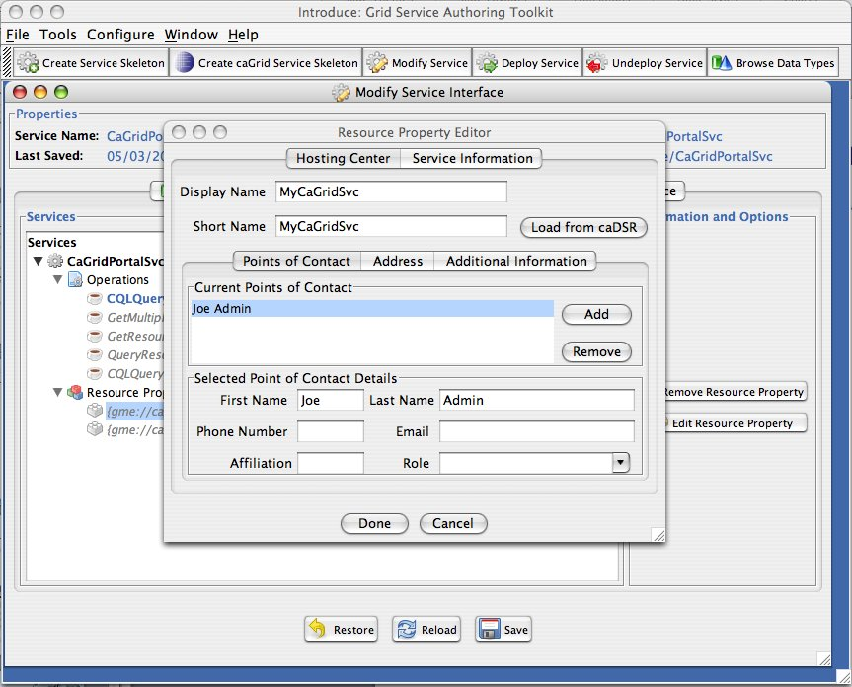
Editing Service Metadata - Introduce

Slide 18
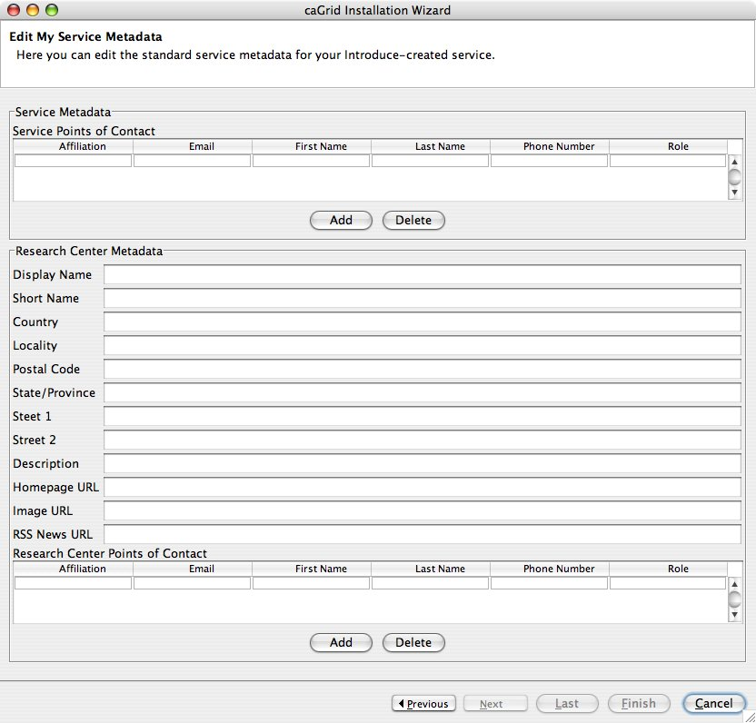
Editing Service Metadata - Installer

Slide 19
How the portal handles service metadata
Normal Lifecycle:
  When a new registration is found, it is cached in the portal database.
  The portal then periodically:
    checks if the service is active
    checks if the metadata has changed
  If the service is inactive for more than 4 days, it becomes hidden in the portal.
  If it subsequently becomes active, it automatically becomes visible once again.
Services can be immediately and permanently removed from the portal on request.
  Send an email to the NCI CBIIT application support (ncicb@pop.nci.nih.gov)
FAQ:
  http://www.cagrid.org/wiki/CaGrid:FAQ#Why_is_my_old_service_still_in_the_Portal.3F

Slide 20
Troubleshooting
Before emailing the caGrid users list...
  Check if you’ve reconfigured your service appropriately for the target grid.
  Read the relevant caGrid FAQs: http://www.cagrid.org/wiki/CaGrid:FAQ
    I'm having problems with advertisement/registration, what should I do?
    Why doesn't my service appear on the Portal map?
    Why is my old service still in the Portal?
    Why is there a difference between the services registered in the Index service and the Portal?

Slide 21
Advertisement Questions?

Slide 22
Querying data services through the portal
Live demo.

Slide 23
Querying Questions?

