Slide 1
Simplifying Analytical Services Development
Using JASC – Java Analytical Service Container
Making Development Simpler, Quicker and Robust
Persistent Systems

Slide 2
Topics
Existing Patterns for developing Analytical Service
Issues with Pattern based solutions
Introduction to JASC
JASC Internals
Using JASC

Slide 3
Existing Patterns for Developing
Analytical Service
Issues with existing skeleton
Utilizing Factory Pattern
Using bi-directional caGrid-Transfer
Using Service-Pattern

Slide 4
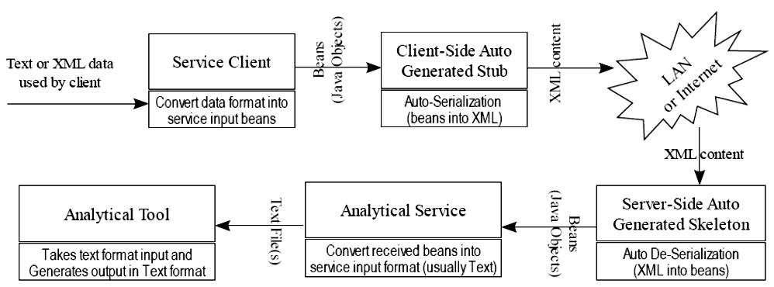
Anatomy of Object flow in Introduce default Analytical Service Skeleton
1
2
5
4
3
Inline Parameters
(1) & (4) All input objects kept in memory (NOT possible for large data)
(2) & (3) Serialization/de-serialization fails for large composite objects
(5) Cannot use instance variables; Implications: (a) Even simple program difficult to write; (b) Difficult to return multiple output from same analysis
Problematic Axis
Stateless Service

Slide 5
Avoiding Axis and Inline Parameters for huge objects
caGridTransfer Architecture & usage Questions (By Ted Liefeld, on 7-July, 2008 on caGrid User list)
  We are examining how to implement caGridTransfer in a new caGrid analytical service we are developing and have some architectural and implementation questions…
  … Since SNP/CN data can be very large … to avoid/delay memory issues serializing/deserializing the data
caGridTransfer Architecture Option #1: (serialized model)
Have caGrid clients serialize the objects from our registered model to a file. Zip the file … Pass the file to our caGrid service via caGrid transfer. Write custom deserializer to read the file & parse into the necessary GenePattern formats without loading it all into memory at once
caGridTransfer Architecture Option #2: (client side reformatting)
Create client libraries for the service with the caDSR registered classes and include a utility method to serialize the classes… use caGridTransfer to transfer a zip …
✵
Signifies some characteristic of JASC
Notes:
-----Original Message-----
From: caGrid Users discussion Forum [mailto:CAGRID_USERS-L@LIST.NIH.GOV] On Behalf Of Ted Liefeld
Sent: Monday, July 07, 2008 8:29 PM
To: CAGRID_USERS-L@LIST.NIH.GOV
Subject: caGridTransfer Architecture & usage questions
Hi,
we are examining how to implement caGridTransfer in a new caGrid analytical service we are developing and have some architectural and implementation questions we hope someone can help us with. Here is the details;
============================
**The service:* *
We are implementing GISTIC, an algorithm for finding repeated amplifications/deletions in SNP/cn data. The caGrid service will be a facade that receives data and parameters over caGrid, reformats the data into files and submits the request to a GenePattern server with the GISTIC module on it. This is the same pattern we have used for earlier GenePattern-based services. Since SNP/CN data can be very large, we are considering using caGridTransfer to pass data from caGrid clients to our caGrid service to avoid/delay memory issues serializing/deserializing the data.
**Architecture Option 1: (null case)* *
The service takes objects (from our registered model) directly in the service interface.
*pro*: easy to implement
*con*: likely to be limited to small datasets dues to inefficient transfer/serialization/desrialization of data
**caGridTransfer Architecture Option #2: (serialized model)* *
Have caGrid clients serialize the objects from our registered model to a file. Zip the file to compress it. Pass the file to our caGrid service via caGrid transfer. Write custom deserializer to read the file & parse into the necessary GenePattern formats without loading it all into memory at once.
*pro*: reduces memory usage, only slightly more complicated for clients.
*con*: custom deserializer likely to be a nuisance to write
Question: How do we provide a return value for a method that uses caGridTransfer for upload? Does this require a stateful service implementation and a separate method to get status (on callback
execution) and another to get the results, or can it be passed back in an out parameter (but then how do we know when the callback is done
executing?)
**caGridTransfer Architecture Option #3: (client side reformatting)* *
Create client libraries for the service with the caDSR registered classes and include a utility method to serialize the classes directly into the GenePattern formats. use caGridTransfer to transfer a zip of the GenePattern formatted files to the service.
*pro*: Simple for us to implement. Smallest data transfer requirement between client & server. Leaset memory needed for caGrid service impl.
*con*: Client's must use our utility classes to call our service.
Question: Does this break the semantics of the caGrid service interface since what is transfered over the wire is no longer the direct classes defined in the caDSR but is instead a derivation from them? Would this also be true of the zipped/compressed file for option 2?
Question: Return values as above?
============================
In all three options, the client memory load seems to be equivalent; ie it will need to be able to load all the objects it wants to send to the server at one time. This may be a limitation in real use.
Option 3 (client side reformatting) is my preference as it seems to have the best memory use profile, but it is not clear to me that the questions regarding the semantics would permit this. On the flip side, option 1 has solid semantics, but is likely to be unusable for any real-sized dataset unless both the client and service are running on large-memory machines with 64 bit OS's.
Thanks,
Ted
--
Ted Liefeld | Voice: (617) 252-1069
Cancer Genomics Informatics | Front desk: (617) 252-1900
Broad Institute | Fax: (617) 258 0903
7 Cambridge Center | Email: liefeld@broad.mit.edu
Cambridge, MA 02142 | http://www.broad.mit.edu/cancer

Slide 6
Unanswered Queries if directly using caGridTransfer
How do we provide a return value for a method that uses caGridTransfer for upload?
Does this require a stateful service implementation and a separate method to get status (on callback execution) and another to get the results, or can it be passed back in an out parameter (but then how do we know when the callback is done executing?)
Using client libraries: Does this break the semantics of the caGrid service interface since what is transferred over the wire is no longer the direct classes defined in the caDSR but is instead a derivation from them?
Would this also be true of the zipped/compressed file … ?
By Ted Liefeld
Notes:
All above queries by Ted Liefeld, are extracted from email included in previous slide.

Slide 7
caGrid Transfer and Inter-operability
Advice by Shannon Hastings (on 9-July, 2008)
As for now, I would make the following suggestions. I would make sure that for every method that you provide transfer capabilities to that you also provide the same method that takes in the real objects. This way your interfaces will be semantically clear and you will simply have an extra method for clients to utilize the transfer option. For example:
  DoX(MyBigObject obj);
  DoXwithTransfer(TransferReference ref);
  Advantages:
… I think the option that is the cleanest, but maybe not the fastest or smallest, is to have the client send over the same XML as would be deserialized from the object, except have that xml in a compressed file that you send. Then there will be no extra knowledge required on the client with respect to special data formats etc. …
✵
Discoverable to client via WSDL
Critical
Key idea
Notes:
-----Original Message-----
From: caGrid Users discussion Forum [mailto:CAGRID_USERS-L@LIST.NIH.GOV] On Behalf Of Shannon Hastings
Sent: Wednesday, July 09, 2008 2:43 AM
To: CAGRID_USERS-L@LIST.NIH.GOV
Subject: Re: caGridTransfer Architecture & usage questions
To add a little to what Justin said:
You have analyzed the tradeoffs well. As far as semantic interoperability.
This is a bit tricky as there is not yet any requirements for 3rd party transfers with respect to interoperability, however, you can assume that at some point in the future there will be some requirements as to the metadata which must be available or travel with the transfer and that this metadata will likely describe the data types semantically and syntactically.
As for now, I would make the following suggestions. I would make sure that for every method that you provide transfer capabilities to that you also provide the same method that takes in the real objects. This way your interfaces will be semantically clear and you will simply have an extra method for clients to utilize the transfer option. For example:
DoX(MyBigObject obj);
DoXwithTransfer(TransferReference ref);
As for what to actually transfer over the wire. I think this all depends on what you want your clients to do, as you have stated. I think the option that is the cleanest, but maybe not the fastest or smallest, is to have the client send over the same XML as would be deserialized from the object, except have that xml in a compressed file that you send. Then there will be no extra knowledge required on the client with respect to special data formats etc.
On 7/7/08 10:58 AM, "Ted Liefeld" <liefeld@BROAD.MIT.EDU> wrote:
> Hi,
>
> we are examining how to implement caGridTransfer in a new caGrid
> analytical service we are developing and have some architectural and
> implementation questions we hope someone can help us with. Here is
> the details;
>
>
> ============================
> **The service:* *
>
> We are implementing GISTIC, an algorithm for finding repeated
> amplifications/deletions in SNP/cn data. The caGrid service will be a
> facade that receives data and parameters over caGrid, reformats the
> data into files and submits the request to a GenePattern server with
> the GISTIC module on it. This is the same pattern we have used for
> earlier GenePattern-based services. Since SNP/CN data can be very
> large, we are considering using caGridTransfer to pass data from
> caGrid clients to our caGrid service to avoid/delay memory issues
> serializing/deserializing the data.
>
> **Architecture Option 1: (null case)* *
>
> The service takes objects (from our registered model) directly in the
> service interface.
> *pro*: easy to implement
> *con*: likely to be limited to small datasets dues to inefficient
> transfer/serialization/desrialization of data
>
>
> **caGridTransfer Architecture Option #2: (serialized model)* *
>
> Have caGrid clients serialize the objects from our registered model to
> a file. Zip the file to compress it. Pass the file to our caGrid
> service via caGrid transfer. Write custom deserializer to read the
> file & parse into the necessary GenePattern formats without loading it
> all into memory at once.
> *pro*: reduces memory usage, only slightly more complicated for clients.
> *con*: custom deserializer likely to be a nuisance to write
>
> Question: How do we provide a return value for a method that uses
> caGridTransfer for upload? Does this require a stateful service
> implementation and a separate method to get status (on callback
> execution) and another to get the results, or can it be passed back in
> an out parameter (but then how do we know when the callback is done
> executing?)
>
> **caGridTransfer Architecture Option #3: (client side reformatting)* *
>
> Create client libraries for the service with the caDSR registered
> classes and include a utility method to serialize the classes directly
> into the GenePattern formats. use caGridTransfer to transfer a zip of
> the GenePattern formatted files to the service.
> *pro*: Simple for us to implement. Smallest data transfer requirement
> between client & server. Leaset memory needed for caGrid service impl.
> *con*: Client's must use our utility classes to call our service.
>
> Question: Does this break the semantics of the caGrid service
> interface since what is transfered over the wire is no longer the
> direct classes defined in the caDSR but is instead a derivation from
> them? Would this also be true of the zipped/compressed file for option 2?
> Question: Return values as above?
>
> ============================
> In all three options, the client memory load seems to be equivalent;
> ie it will need to be able to load all the objects it wants to send to
> the server at one time. This may be a limitation in real use.
>
> Option 3 (client side reformatting) is my preference as it seems to
> have the best memory use profile, but it is not clear to me that the
> questions regarding the semantics would permit this. On the flip
> side, option 1 has solid semantics, but is likely to be unusable for
> any real-sized dataset unless both the client and service are running
> on large-memory machines with 64 bit OS's.
>
> Thanks,
>
> Ted
--
Shannon Hastings
Co-Director
Software Research Institute
Department of Biomedical Informatics
Ohio State University, Columbus, OH
Lab: (614) 292-9485
Office: (614) 292-9461

Slide 8
In Favor of Stateful Service
After 3 months
21-Oct, 2008 “Ted Liefeld” to “York Yao”:
  … From our research, at this point it is necessary to make a stateful service using caGridTransfer in order to be able to both upload a source file and download a result …
✵
Notes:
-----Original Message-----
From: caGrid Users discussion Forum [mailto:CAGRID_USERS-L@LIST.NIH.GOV] On Behalf Of Ted Liefeld
Sent: Tuesday, October 21, 2008 3:48 PM
To: CAGRID_USERS-L@LIST.NIH.GOV
Subject: Re: how to avoid serialization/deserialization in analytical service?
York,
in the ICR Analysis Service Best Practices (ASBP) working group we have
been discussing this issue as well. From our research, at this point it
is necessary to make a stateful service using caGridTransfer in order to
be able to both upload a source file and download a result. Your timing
is quite good as we just released a demo service to help people learn
how to do this. Instructions (and discussion) are available here;
https://gforge.nci.nih.gov/docman/index.php?group_id=326&selected_doc_group_id=4128&language_id=1
The doc includes a link to a SVN repository where you can download the
demo service
https://gforge.nci.nih.gov/svnroot/genepattern/trunk/genepattern/cabig_ey2_2008/asbp/htp/gridbidirectionaltransfer/
By using a stateful service, and preserving the state only in the
resource (as defined in the stateful service example, and our example
above), the framework will ensure that the resource contents are unique
to each client. If you copy our example, you should be able to get this
behavior easily, and be free to focus on your actual service implementation.
Feel free to email me directly (or through this list) if you have any
questions
Ted
York Yao wrote:
> Hi,
>
> I have a simple method in an analytical service:
>
> public double max(double[] data) throw RemoteException;
>
> When the data array is huge, the serialization and deserialization
> take up lots of time, and make these service virtually unusable. For
> example, if there are 30000 double numbers, it take about 10 seconds
> for conversion, 1ms for calculation; if there are 200000 double
> numbers, it takes over a minutes for conversion, while still take 1ms
> for calculation.
>
> My question is whether there is way to avoid the
> serialization/deserialzation process (transfer binary data directly)?
>
> I have looked into the caGrid Transfer extension. Its upload
> capability can only return boolean (whether the upload is successfully
> or not). If I use the transfer service to upload data, I still need a
> second call to perform calculation and return results. Since the web
> service is stateless, I will have to manage state by myself, which is
> quite difficult since my analytical service is not secured, it cannot
> track who calls which methods.
>
> Can you share your experience and thoughts in tackling this problem?
>
> Thanks a lot!
>
> York
--
Ted Liefeld | Voice: (617) 252-1069
Cancer Genomics Informatics | Front desk: (617) 252-1900
Broad Institute | Fax: (617) 258 0903
7 Cambridge Center | Email: liefeld@broad.mit.edu
Cambridge, MA 02142 | http://www.broad.mit.edu/cancer

Slide 9
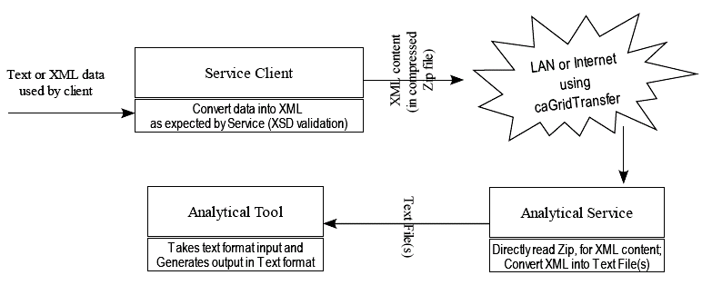
Analytical Service Architecture with caGrid-Transfer
2
1
3
1
Problematic Axis, skipped
(1) XML Stream based custom serializer/de-serializer;
Data loaded in memory in chunks
(2) Large objects sent via caGrid-Transfer,
(3) Using Factory-Pattern, create stateful services
State data to be kept by container, as resource (state in XML doc)
Optional Inline Parameters
Stateful Service (Indirectly)
Class instance variables cannot be used
Less steps BUT more efforts to code

Slide 10

In both cases:
XML contains Serialized objects, as per registered types (XSD) in caDSR
XML contents is carried in method invocation (SOAP)
With Beans
(default)
✵
XML contents are zipped and carried by caGrid-Transfer service
Without Beans
(caGrid Transfer)
XML Validation performed by XML parser using registered XSD types

Slide 11
Service Pattern - another approach
Objective: eliminating serialization/de-serialization, so that huge data may be passed to service
Analysis: (https://cabig-kc.nci.nih.gov/CaGrid/KC/index.php/Speeding_up_operations_with_inputs_that_contain_large_amounts_of_data_via_caGrid_Transfer)
  Good example for sample implementation of very-simple analytical service
    For services that accepts only one input and one output parameter only
    Unidirectional caGrid-Transfer usage (from client to service only)
  Automatic resource clean-up (input file received and output stored in resource-properties)
  Uses Java serialized objects (therefore platform dependent), being sent using caGrid-Transfer (anti-grid, anti-interoperable)
  Performs analysis on input data on caGrid-Transfer call back thread (Is caGT designed for this?)
  Assumes output is small enough, so no need to return output using caGrid-Transfer
  No exception handling
  No provision for client to track analysis progress
  No control on concurrency
Notes:
https://cabig-kc.nci.nih.gov/CaGrid/KC/index.php/Speeding_up_operations_with_inputs_that_contain_large_amounts_of_data_via_caGrid_Transfer
=========================================================
Speeding up operations with inputs that contain large amounts of data via caGrid Transfer
From CaGrid
Jump to: navigation, search
Contents
[hide]
1 Service Pattern: Speeding up operations with inputs that contain large amounts of data via caGrid Transfer
1.1 Pre-requisites for this article
1.2 Versioning
1.3 Overview
1.4 Pattern
1.5 Implementing the Pattern
Service Pattern: Speeding up operations with inputs that contain large amounts of data via caGrid Transfer
Contributors: York Yao, Justin Permar
Pre-requisites for this article
This article assumes the user is familiar with creating services via Introduce. In particular, the user has created a tutorial to create a stateful Grid service. If this is new to you, please refer to the tutorials page: http://www.cagrid.org/wiki/CaGrid:Tutorials.
Versioning
This steps in this article are accurate for Introduce 1.2 (caGrid 1.2).
Overview
There are cases when a service operation in an analytical service can take in a parameter that is “very large”. Consider the following service operation:
public double max(double[] data); When the data is “large”, e.g. over 100000 records, the serialization and de-serialization penalty is very heavy, thus the standard grid/web service is not practical. In general, what is considered “large” for you will depend upon the performance requirements of your application.
If you determine that calling a service operation with a large parameter takes an excessive amount of time, it will work well for you to transfer this large amount of data via the caGrid Transfer service. Please find more information about the Transfer service at the following URL: http://www.cagrid.org/wiki/CaGridTransfer. This document describes a pattern for converting the above service operation to use the Transfer service. Moving the data via the Transfer service eliminates the serialization/de-serialization process, avoiding this overhead. It is worth noting that applying this pattern to all service operations is not recommended. This is because for small arguments, the overhead of using the Transfer service is greater than the serialization/de-serialization overhead.
Pattern
The solution to avoid serialization/de-serialization of large amounts of data is to seperate the operation into several steps, but group them together using a stateful service context (WS-Resource Framework). In this case, data is moved via the Transfer service. Further information about stateful service contexts can be found here: http://www.cagrid.org/wiki/Introduce:1.2:UserGuide#Service_Contexts. Note that a service context is an implementation of a general factory pattern at the service level. More information about the factory pattern can be found here: http://www.cagrid.org/wiki/Introduce:1.2:DeveloperGuide#Utilizing_the_Factory_Pattern. Further information about the transfer service can be found here: http://www.cagrid.org/wiki/CaGridTransfer. The steps in the pattern include the following:
1. Create the analytical service client.
2. Create the service context by invoking a service operation that implements the factory pattern creating the context. A service context client handle is returned to the user.
3. Use the service context client handle to call a method on the context to obtain a transfer service context reference (Transfer context EPR).
4. Construct a transfer context client using the EPR.
5. Using the transfer context client, transfer your large data set to the service. When the upload is complete, the method call returns.
6. Using the service context client, call a second method on the service context to process the data. Results are saved in the resource associated with the service context. 7. Using the service context client, call a third method on the service context to retrieve the results.
Implementing the Pattern
The following steps can be used as a guide to implement the above pattern.
1. Create a new analytical service in Introduce via the “Create caGrid Service Skeleton” button. Name the service “ExampleService”. During service creation, click the “Advanced” tab and add the “caGrid Transfer” extension. Note, if you do not see this option, please refer to the following link to add the Transfer extension to Introduce: http://www.cagrid.org/wiki/CaGridTransfer:1.2:UsersGuide#Utilizing_the_Transfer_Service.
2. This is a stateful service invocation, so invoking the “max” method may take some time. As a result, we would like to check status of the operation and retrieve results when the operation is complete. To do this, we will create a Status type. Create a schema file (.xsd extension) with the following contents:
<?xml version="1.0" encoding="UTF-8"?> <schema targetNamespace="http://example.cagrid.nci.nih.gov/ExampleResult" xmlns:tns="http://example.cagrid.nci.nih.gov/ExampleResult" xmlns="http://www.w3.org/2001/XMLSchema"> <element name="Result" type="string"/> </schema>
3. Select the “Types” tab, click the “File System” sub-tab, and add the xsd file you just created. The “Result” type will appear in the types list on the left-hand side. Save the service.
4. Select the "Services" tab, then click "Add Service context" button. Uncheck the resource framework options labeled "lifetime" and "secure". Click "done". Save the service
5. Select “Resource Properties” under the service context you just created. Click the “Modify Resource Properties” button. Double-click the “Result” type and click the “Done” button. Save the service.
6. Select “Operations” under the service context. Click the “Add method” button. Create a new method named “max”, no input, the output is the “TransferServiceContextReference” type listed in the left-hand pane. Click Done. Save the service.
7. Create a second operation on the context named “getResult”. No input; output is a double(XMLSchema namespace). Click “Done”. Save the service.
8. Select “ExampleService” and click the “Add method” button. Name the method “createContext”. Input is empty; for the output select the client handle in the bottom-left of the window named “ExampleServiceContext”. Click “Done”. Save the service.
9. Exit out of Introduce and open your preferred Java editor. To get started quickly, you can import the service directory you created in Eclipse as a new project. In the next steps, you will implement the service operations and create a client to invoke your service. Edit the class gov.nih.nci.cagrid.example.context.service.ExampleServiceContextImpl. Replace the max() method implementation with the following:
public org.cagrid.transfer.context.stubs.types.TransferServiceContextReference max() throws RemoteException { try { final ExampleServiceContextResource resource = getResourceHome().getAddressedResource(); // create a data descriptor for the upload for the data to be uploaded DataDescriptor dd = new DataDescriptor(null, "Users Data"); // create a callback that will handle the data once it is uploaded DataStagedCallback callback = new DataStagedCallback() { public void dataStaged(TransferServiceContextResource tscResource) { File dataFileUserSentMe = new File(tscResource.getDataStorageDescriptor().getLocation()); // do something with this data try { System.out.println("reading data ..."); ObjectInputStream ois = new ObjectInputStream(new FileInputStream(dataFileUserSentMe)); double[] data = (double[]) ois.readObject(); System.out.println("data size: " + data.length); System.out.println("calculating max..."); double result = max(data); System.out.println("result: " + result); resource.setResult(Double.toString(result)); } catch (Exception e) { e.printStackTrace(); } } }; return TransferServiceHelper.createTransferContext(dd, callback); } catch(Exception e) { e.printStackTrace(); String msg = "Error during max()"; throw new RemoteException(msg); } }
10. Add the max() method used in the above code to the same class:
private double max(double[] data) { double curMax = 0.0d; if ((data == null) | (data.length == 0)) { throw new IllegalArgumentException("no data to process"); } for (double cur : data) { if (cur > curMax) { curMax = cur; } } return curMax; }
11. Replace the getResult() method with the following implementation:
public double getResult() throws RemoteException { ExampleServiceContextResource resource; try { resource = getResourceHome().getAddressedResource(); return Double.parseDouble(resource.getResult()); } catch (Exception e) { String msg = "Could not create ExampleServiceContextResource!"; e.printStackTrace(); throw new RemoteException(msg); } } 12. Edit the class gov.nih.nci.cagrid.example.service.ExampleServiceImpl. Edit the createContext method by adding the line at the end of the comments listed below:
// This is where the creator of this resource type can set whatever needs // to be set on the resource so that it can function appropriatly for instance // if you want the resouce to only have the query string then there is where you would // give it the query string. thisResource.setResult("N/A");
13. Build the service with “ant all”. Verify it builds successfully.
14. Deploy the caGrid Transfer service to your container: http://www.cagrid.org/wiki/CaGridTransfer:1.2:UsersGuide#Deploying_A_Service_That_Uses_caGrid_Transfer.
15. Deploy your service to the container.
16. Next, edit the client file and replace the main method with the following:
public static void main(String [] args){ System.out.println("Running the Grid Service Client"); try{ if(!(args.length < 2)){ if(args[0].equals("-url")){ ExampleServiceClient client = new ExampleServiceClient(args[1]); // place client calls here if you want to use this main as a // test.... ExampleServiceContextClient context = client.createContext(); TransferServiceContextReference ref = context.max(); TransferServiceContextClient tclient = new TransferServiceContextClient(ref.getEndpointReference()); System.out.println("start uploading data..."); double[] data = new double[200000]; for (int i=0; i<data.length; i++){ data[i] = Math.random(); } ByteArrayOutputStream bos = new ByteArrayOutputStream(); ObjectOutputStream oos = new ObjectOutputStream(bos); oos.writeObject(data); oos.close(); InputStream is = new ByteArrayInputStream(bos.toByteArray()); TransferClientHelper.putData(is, bos.size(), tclient.getDataTransferDescriptor()); // tell the resource that the data has been uploaded. // this will cause the callback function invoked, effectively perform the calculation System.out.println("calculating..."); tclient.setStatus(Status.Staged); //wait a bit for the server-side callback to complete. //alternatively, we can use notifications here to be informed //when the callback completes Thread.sleep(5000); //get the result! System.out.println("get result..."); double result = context.getResult(); System.out.println("result: " + result); } else { usage(); System.exit(1); } } else { usage(); System.exit(1); } } catch (Exception e) { e.printStackTrace(); System.exit(1); } }
17. Finally, run the service client against your service. If you’re using a Tomcat container on the default port, use the following service URL: http://localhost:8080/wsrf/services/cagrid/ExampleService.
Retrieved from "https://cabig-kc.nci.nih.gov/CaGrid/KC/index.php/Speeding_up_operations_with_inputs_that_contain_large_amounts_of_data_via_caGrid_Transfer"

Slide 12
Issues with Pattern based solution
Non-functional concerns
Multiple solutions for same problem – Wasting of efforts
Possibility of sub-standard implementation of best-practices
Lots of technologies to learn

Slide 13
Observed Issues with
Stateful and Bi-directional Transfer Pattern
✵
https://gforge.nci.nih.gov/docman/view.php/326/14516/BiDirectionalCaGridTransfer.doc
“There were several issues that needed to be overcome to make this demo work. These included;” (By Ted Liefeld)
  Cannot create callback objects on grid clients
    ... two transfer contexts … the download context needs to have its file provided immediately, which does not make sense if it is supposed to be created by processing the uploaded data.
  Must create stateful context
    … you need to have two interfaces, one which is just a factory, and then the other to do the work.
  Stateful context’s reuse instances
    … don’t store anything in static or instance variables as all client sessions share these. State should only be stored in a resource managed by the container, or passed in each time by the client..
  caGridTransfer reuses filenames
    … callback method must immediately rename file to prevent it from being overwritten by next client
  Order of operations not specified
    you must first call submitData() before you can getResults()
  Must model resources/import from XSD
All non-functional concerns
Notes:
Following is original Document from “Ted Liefeld” hosted at
https://gforge.nci.nih.gov/docman/view.php/326/14516/BiDirectionalCaGridTransfer.doc:
BiDirectional caGrid transfer
Preparation:
This demo service and client can be downloaded from
https://gforge.nci.nih.gov/svnroot/genepattern/trunk/genepattern/cabig_ey2_2008/asbp/htp/gridbidirectionaltransfer/
To use, you must first have a caGrid 1.2 installation and the transfer service installed. For details on these see
http://www.cagrid.org/wiki/CaGrid:How-To:UseCaGridInstaller_1-2
and
http://www.cagrid.org/wiki/CaGridTransfer
Background:
This example is a combination of the examples from the caGridTransfer link (above) and the StockTrader demo available at
http://www.cagrid.org/wiki/CaGrid:Tutorials#Tutorial_5:_Extended_service_creation_tutorial
Installation:
Once you have caGrid and the transfer service installed, and the example files downloaded, cd to the gridbidirectionaltransfer directory and use
ant clean deployTomcat
To install the example service into your caGrid deployment (this was developed on Tomcat btw). Restart your tomcat server and then to run the client
ant runClient
The example client will make three overlapping calls to the service each time sending and receiving data using caGrid transfer.
Discussion:
There were several issues that needed to be overcome to make this demo work. These included;
Cannot create callback objects on grid clients
This means that you cannot simply have a service that returns two transfer contexts, one for upload and one for download. While this is in fact possible to use, the download context needs to have its file or stream provided immediately, which does not make sense if it is supposed to be created by processing the uploaded data.
Must create stateful context
In introduce, you cannot make the top level service stateful, you an only do this by creating a second context which is stateful. Thus you need to have two interfaces, one which is just a factory, and then the other to do the work.
Stateful context’s reuse instances
The instance used in a stateful context is actually reused, so don’t store anything in static or instance variables as all client sessions share these. State should only be stored in a resource managed by the container, or passed in each time by the client.
caGridTransfer reuses filenames
If you have three clients calling the same interface and uploading data to the same (stateful) context instance, caGridTransfer uses the same file name each time. Therefore your callback method must immediately rename the file to prevent it from being overwritten by the next client
Order of operations not specified
In this example, you must first call submitData() before you can getResults(), but the only way to specify this is in the code or in the documentation.
Must model resources/import from XSD
Not a showstopper, but it would be nice to be able to specify a java bean class to use as a resource without having to model it and then generate an XSD first. This is a server-side only class and is not a part of the service’s API

Slide 14
Every implementation to independently follow CaGrid Best Practices
Use caGrid Transfer service when moving large data
  Use caGrid transfer for moving large sets of data around the Grid.
Write analytical services for scalability
  Using thread pools in analytical services for scalability¹.
Use the Globus best practices
  Concurrent invocations and synchronization
  Lease-based lifetime management
Enable logging on critical services
    Enable logging on Grid data services to monitor access to the data. A best practice is to write the users Grid identity to the log and save the log on backups.
Synchronize against the trust fabric
    Sync against your Grid GTS service regularly to ensure that any changes in the trust fabric are reflected on your Grid node. This can be done by using the SyncGTS service.
Important
Non-Functional
Requirements
Notes:
¹ Implementation of Thread pool is NOT fruitful if analytical service execution takes more than few minutes to complete. This is because creation of new thread just require fraction of a second, which is trivial as compare to total life-span of thread (few minutes or hours).
Note this is contrast to web-server, where a thread servicing a simple page might just need a millisecond to complete. Here creation of new thread, even if it takes millisecond, is significant overhead.
JASC uses thread-group, with lower priority than event-dispatch thread to perform analysis. Every analysis-session is run in different thread.
======================================================================
https://cabig-kc.nci.nih.gov/CaGrid/KC/index.php/CaGrid_Best_Practices
CaGrid Best Practices
======================================================================
This page documents best practices that community members have found useful when using caGrid. Please contribute new best practices and add detail to existing best practices.
Synchronize against the trust fabric
Sync against your Grid GTS service regularly to ensure that any changes in the trust fabric are reflected on your Grid node. This can be done by using the SyncGTS service.
Enable CQL and DCQL Validation
Configure data services to validate CQL and DCQL queries.
Enable logging on critical services
Enable logging on Grid data services to monitor access to the data. A best practice is to write the users Grid identity to the log and save the log on backups.
Use caGrid Transfer service when moving large amounts of data
Use caGrid transfer for moving large sets of data around the Grid.
Use a stateful Grid service for long-running Grid executions
Using a “job invocation” (service contexts) pattern in a stateful Grid service for executing analytical service operations (jobs) that take more than a few seconds to complete.
Write analytical services for scalability
Using thread pools in analytical services for scalability.
Use the Globus best practices
Please refer to Globus best practices.
Best Practices Contributors
Ron Price at the University of Utah
Retrieved from "https://cabig-kc.nci.nih.gov/CaGrid/KC/index.php/CaGrid_Best_Practices“
======================================================================
http://www.globus.org/toolkit/docs/4.0/best_practices.html
Globus Toolkit 4.0: Best Practices for Developing in GT4
======================================================================
Dynamic resource creation and the factory pattern
OGSI defined a standard create method for creating new grid services. The follow on, the WS Resource Framework, no longer defines such a mechanism. This does not mean that the factory pattern is not valuable. Rather, it was removed because any non-trivial create method tends to be application specific, a observation that leads to the conclusion that there is little value in standardizing this operation. We recommend the use of the factory pattern for dynamic creation of resources. In particular we recommend writing a factory service that provides a way to create new resources and allows users to inspect state information about the aggregation of all resources created by the factory service, e.g. the number of resources managed. In addition to the factory service one would write a service that interacts with the resource instances created by the factory service.
Scalability, recovery and resource persistence
Writing scalable (in the number of resources) and recoverable, i.e. give it the ability to survive a server crash and restart, resources takes a bit of careful planning. There are several potential pitfalls:
Since scalability relies upon using Java soft references it is important that resource do not keep hard references to any objects that would prevent the soft reference mechanism from working.
When recovering resources after a container restart it is often important to re-establish the current state of the process the resource represents, e.g. if the resource is monitoring a external entity via notifications it should query for the current state of the external entity upon restart.
Persisted resources need to be carefully written to avoid the following problem: If a service currently holds a hard reference to the resource and the resource is destroyed, i.e. the soft reference to the resource is removed from the resource home and the resource is removed from persistent storage, then the service holding the resource reference can still cause a call to the store persistence callback. Unless the store callback was written to prevent this, calling it will restore the destroyed resource.
For example: during a typical service operation, a service will lookup a resource using its resource home. At that point in time, the service holds a hard reference to the resource object. If another client of the service concurrently invokes a destroy operation on the same resource, thus removing the resource from the resource home and its state from persistent storage, the resource essentially becomes invalid. When this occurs it is important that the first service operation not invoke the resource's store method since doing so would inadvertently recreate (or resurrect) the resource.
To prevent this consider writing the resource's store and remove methods in such a way as to prevent recreating resource state that has been previously destroyed by another caller.
Resource implementers need to be careful when storing objects created by axis as part of the web service operation invocation and containing fields resulting from a xsd:any in the corresponding schema. These complex types have references to sizable objects associated with the Axis deserialization/data-binding process. To remove these reference replace the object by calling org.globus.wsrf.encoding.ObjectSerializer.clone(originalObject) and drop the reference to the original object.
Concurrent invocations and synchronization
The container does not provide automatic synchronization of concurrent requests. This means that service implementors need to write their services to deal with potential synchronization problems. If you service itself is stateless this means that if you will need to synchronize around access to the state captured in the resource. That being said, in a lot of scenarios you can expect a single client to drive most interactions with a given resource, in which case synchronization may not be an issue.
Lease-based lifetime management
We recommend that you make use of lease based resource lifetime management to avoid orphaned resources due to network outage and other failures. Lease based lifetime management is accomplished by specifying a initial lifetime in the resource creation operation followed by periodic updates to the lifetime using the setTerminationTime operation specified in the WS Resource Lifetime specification.
Resource Types and Services
Any given WSRF service can only have a single resource properties document schema associated with it. This implies a constraint on the type of resource a service can expose, i.e. resources exposed by a service must conform to the resource properties document schema associated with the service. Note that this does not necessarily mean that services can only expose resources of a single implementation type. There may of course be multiple implementation types as long as all of these types conform to the interface dictated by the resource property document schema. Also, the resource property document schema may have extensibility elements, allowing more flexibility in the resource implementation at the expense of reducing discoverability and implicitly predictability of interactions against resources exposed by such a service. That said, the Java WS Core implementations of the Resource Home interface only allow a single resource type.
In addition, services may interact with any type of resource, unconstrained by the resource property document schema, as long as these resources are not expose by the service. This occurs frequently in the standard factory pattern, where the factory creates and manipulates a resource, but the resource itself is exposed through a different service.
Messaging granularity
Our current performance profile for the Java WS Core component currently only allows for fairly coarse grained operations at a reasonable level of performance. While this statement is in relation to Java WS Core performance it is in reality relevant to any distributed applications: Remote invocations always cost more than local invocation (give infinite CPU power/memory) and should thus be treated differently than local invocations.
Choosing an authentication mechanism
GT4 provides a implementer with a choice of 4 authentication mechanisms: HTTPS (ie SSL/TLS), WS-Security with X.509 certificates, WS-Security Username/Password authentication and a GSSAPI based WS-Trust/SecureConversation/Security based mechanism. We recommend that service implementors try to support the greatest number of mechanisms possible. Generally, services that need both authentication and message protection should always allow any mechanism other than the username/password one.
The story is somewhat different on the client end of things. Whereas server side security configuration is mostly policy driven, clients actually have to pick a specific mechanism to implement. We recommend that clients use HTTPS whenever available, i.e. whenever the service URL indicates a HTTPS transport, but are able to fall back on WS-Security with X.509 certificates should the transport be a non-https one. This recommendation is based upon performance comparisons of HTTPS vs. WS-Security based mechanisms, which have shown HTTPS to be much higher performance, especially as the message payload grows.

Slide 15
Software Engineering concerns
Every analytical service is unique implementation of best-practices
    ( There are 33 in caBIG portal, more to come)
  caGrid best practices
  Globus best practices
  pattern (gridFTP, gridTransfer, Service or WS-Enumeration)
  Common non-functional requirements (more on this later)
Since Implementing best practices is responsibility of Analytical-Service developer
  All developers need to understand best-practices, and implement them to best of his/her ability (subjective measure, easy to violate)
  Developer with skill-set only in core Java cannot implement grid services
Consequence: Multiple solution for same problem
  wastage of efforts and resources
  Non-standard solution, Possible interoperability issues

Slide 16
Lots of Technologies to Learn
Must Learn to use:
  Web Services
  WSRF (Web Service Resource Framework) – set of specifications
    Resource Properties
    Resource Properties Life Cycle
    EPR (End Point Reference – WSRF addressing scheme)
    Event Notification, etc.
  Basics of Globus and caGrid, and thier API
  The Factory Pattern (http://www.cagrid.org/wiki/Introduce:1.2:DeveloperGuide#Utilizing_the_Factory_Pattern)
  caGrid Transfer
  Bi-directional caGrid Transfer pattern
Required for implementing non-functional concerns
Unnecessary Burden on analytical service developer

Slide 17
Introduction to Persistent’s JASC Solution
Java Analytical Service Container
Separation of Concerns
Tool based approach
Advantages
Things to do

Slide 18

Present application of JASC
GenePattern
CopyNumber
Service
CNAT
Service
DNA copy
Service
caB2B
GRID
Overlap Finder Across Sources
Service
Overlap Finder Across Samples
Service
Washington University’s five inter-operable caGrid analytical services
Interconnected by caGrid
Compatible with Generic GUI client, called caB2B (by design)

Slide 19
Main Idea – Separation of Concerns
✵
Non-Functional concerns
  Best practices – Globus and caGrid
  Transfer of data (huge, small with all possible associations)
  Redundant problems common across analytical services (such as concurrency, compression, progress monitoring, etc.)
  Possible to Implement once and use every time (for example JEE address non-functional concerns transaction, security, lifecycle, memory management, pooling, etc)
Responsibility of
JASC container
Functional concerns
  Specific to implementation of service, unlikely to be shared by any other service
    How to process specific data-types (custom serializer/de-serializer, input/output transformation code, input validation code)
    How to invoke analytical-tool being wrapped
    How to fetch data from external service if required
Responsibility of
Analytical Service Developer

Slide 20
Characteristics of Ideal tool for Analytical Service development
✵
No need to re-implement non-functional concerns
No skills required in (must for non-functional concerns)
  Java concurrency, threading, and extensive exception handling
  WSRF and related specifications
  caGrid and Globus
  Best practices
  caGrid Transfer
The only skill required should be:
  How to accept input in objects (or in file) – using core Java & XML
  Verify input as per domain checks – using core Java & XML
  Invoke analytical-tool (analysis) as per domain requirement
For example, for DNACopy, developer should only be concerned with how to identify invalid input, and invoke R-command to run analysis, and pick output from file
Useful
functional
Tasks

Slide 21
Common Non-Functional Requirements addressed by JASC
✵
Automatic Multi-session (one session one client)
  Developers develops service assuming one client existence
Working directory for each session (easy to invoke analytical-tool)
Compressed (Zip) XML – input and output
  Low bandwidth requirement, faster transmission
  Less temporary storage required for concurrent sessions
Automatic Exception handling; also when no method-call is in progress, but analytical-tool fails mid-way
Auto Tracking of analysis progress, and informing client
Auto Resource clean-up (remove analytical-tool’s temporary files, working directory, and objects)

Slide 22
Advantages for Service Developers
No change in WSDL or XSD
No need to use context resource properties – instead class instance variables may be used
Program simple Java class (no need to learn Globus/Introduce API)
No need to handle Exceptions by programmer
Deferred exception delivery (as client may disconnect after invoking analysis)
Exception Confinement, with no impact on other sessions
  If one session fails due to excepted or unexpected exceptions
  Out-of-memory faults experienced by a session
Trapping of Illegal calls from client (like request for output if analysis is in progress)

Slide 23
Advantages for Service Developers – 2
No need to implement for multiple client or concurrency – developer implements for only one client
Starvation Prevention (responsive application, thread priorities NOT managed by developer)
Lesser maintenance due to non-redundant code
Prevents state of sessions being mixed (like: output from one session wrongly delivered to another session)
Automatic type checking on received XML content via caGrid-Transfer
Promotes interoperability by monitoring XML content in and out of service – should be WSDL & XSD compliant
Easily returns multiple output files after analysis (using caGrid-Transfer)
No test code written by developers for non-functional concerns described above

Slide 24
Things to Do
Secure analytical service support
Automatic integration with Introduce generated analytical service Skeleton
Concurrency Control: Simultaneous in progress analysis
  Max number of concurrent analysis allowed per analytical-service
  Max number of concurrent analysis allowed per web-server
Removal of hung analytical-tool
  running in different thread
  running in child process
Test analytical-service out of Tomcat/Globus container
Announce analysis progress using WS-Notification

Slide 25
Understanding JASC Internals
Architectural View
Analyzer bean environment
Analyzer bean Life cycle
Events Sequence flow

Slide 26
Architectural Component View
Analytical Service =
Introduce generated skeleton + JASC + Analyzer bean
http
protocol
Analytical Service
Only Non-Functional Concerns
Client
Introduce
Generated
Skeleton
JASC
Container
Only Functional Concerns
setter
setter
putter
putter
Analyzer
Bean
Transfer via caGrid-Transfer
Shared
Input/Output HashMaps
XML contents
as per registered
XSD in caDSR
Local
method
call

Slide 27
Component View – 2
Client
*
1
Generated Skeleton (Axis & Globus framework)
1
*
JASC’s Session Manager
One instance
per Analytical-Service
1
*
JASC’s Session
One Client One Session
1
1
Java class implementing Analyzer interface
1
1
1
OR
1
Analytical tool in Java
Run Analysis in separate
thread (same JVM)
Analytical tool in ?
Run Analysis in
separate process

Slide 28
Execution Environment
Shared data in Hash Maps for:
Input Objects
Input Files (XSD type Verified)
Output Objects
Output Files (XSD type Verified)
Analysis Progress Status
Service Name
Analyzer Bean
Java class implementing Analyzer interface
Instance
Variables
Service Specific Deployment Properties
Exception History
Available due to:
“One Client - One Analyzer Bean Instance” policy
(Introduce-1.2 by default does NOT support this)
Separate Thread of Execution
Access to Environment is provided by JASC’s Session

Slide 29
Analyzer bean Life-Cycle
"Initial"
"Accepting Input"
"Waiting On Asynchronous Input Arrival"
"Validating Input"
"Fetching data from Other Service"
"Transforming Tool Input"
"Waiting For Tool to Finish"
"Transforming Tool Output"
"Results Available"
"Exception Available"
"Cleaning Up"
"Expired"
Analytical Service Life-Cycle as exposed to Client
JASC manages the life-cycle
JASC publishes state to clients
Analytical-Service developer NOT responsible

Slide 30
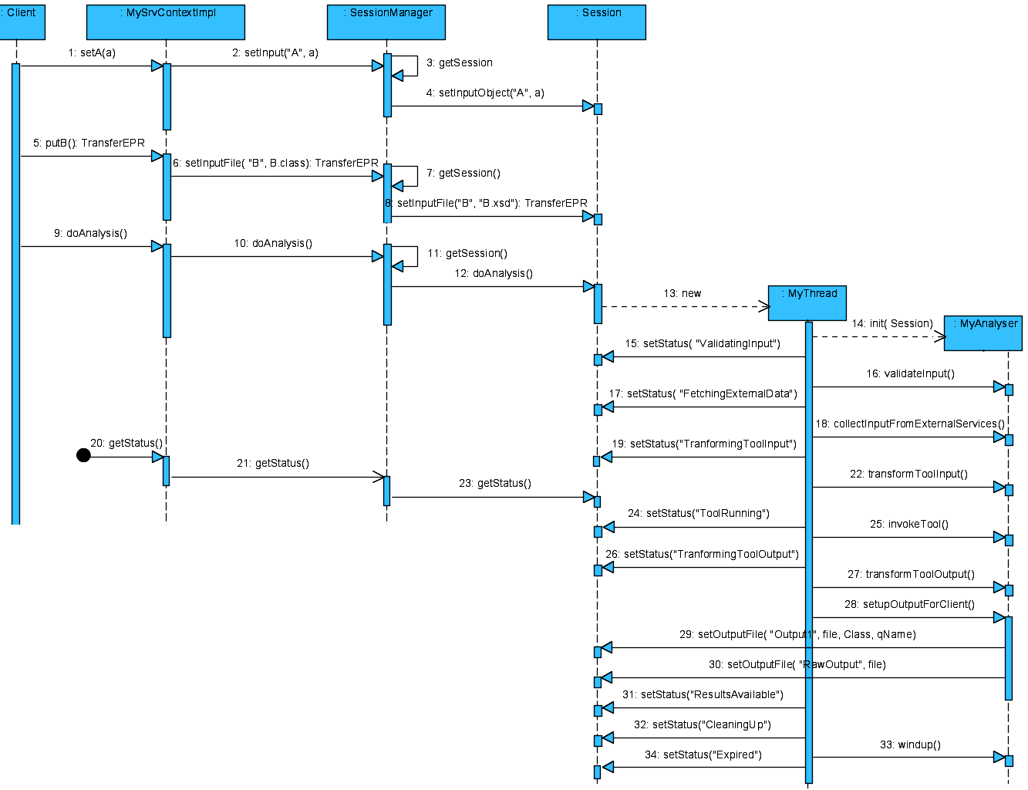
Sequence flow
Sequence Diagram – 1 Data and Control Flow in Analytical Service
Analyzer bean: Only Functional Concerns
Personal thread for Analyzer bean
JASC
this shaded region

Slide 31
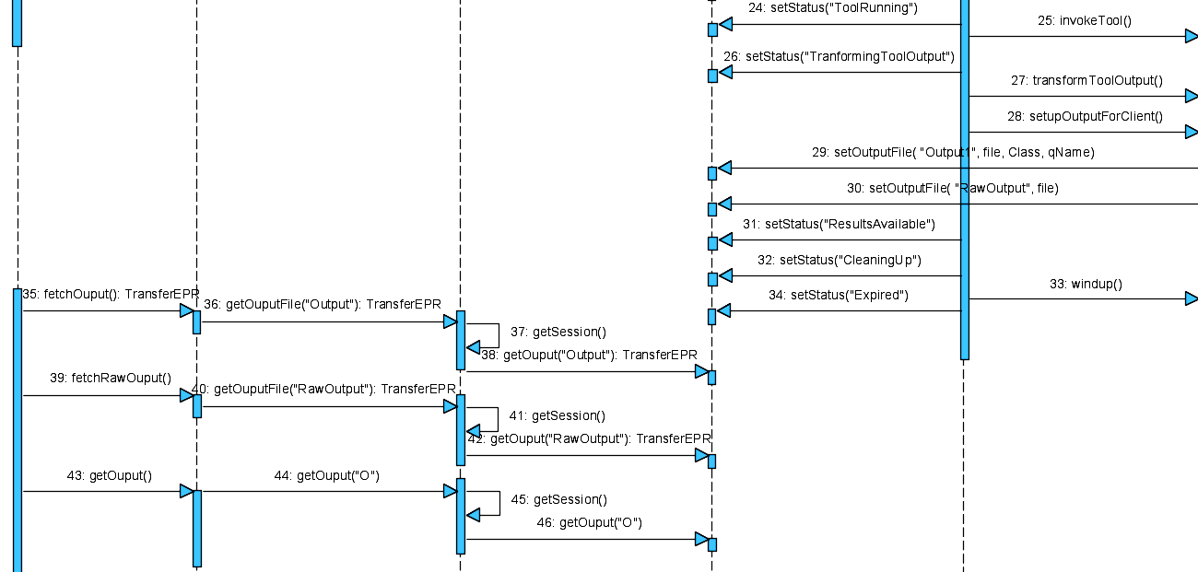
Sequence Diagram – 2 Data and Control Flow in Analytical Service
JASC
this shaded region
Anytime client can call getStatus(); JASC will respond
“Raw-Output” means Output generated by Analytical Tool
JASC and Analyzer-bean share common HashMap for data-exchange
Exception thrown by Analyzer will be logged, trimmed, wrapped, then forwarded to client. Session will then expire and analyzer-bean will be removed.

Slide 32
Forces help shaped JASC design 
Have caGrid clients serialize the objects from our registered model to a zip file …
Have an extra method for clients to utilize the transfer option ... no extra knowledge required on the client with respect to special data formats etc
Necessary to make a stateful service using caGridTransfer in order to be able to both upload … and download
… issues that needed to be overcome to make this demo work …
Data passing using caGrid, while implementing service directly work on serialized (XML) data
Separation of concerns: No need to re-implement non-functional concerns
Analytical service developer need only concern with skills to work with processing serialized data for analysis

Slide 33
Using JASC
Developing Analytical Services using Analyzer-bean
Analyzer Interface
Simple Analyzer bean
Integrating JASC in Skeleton

Slide 34
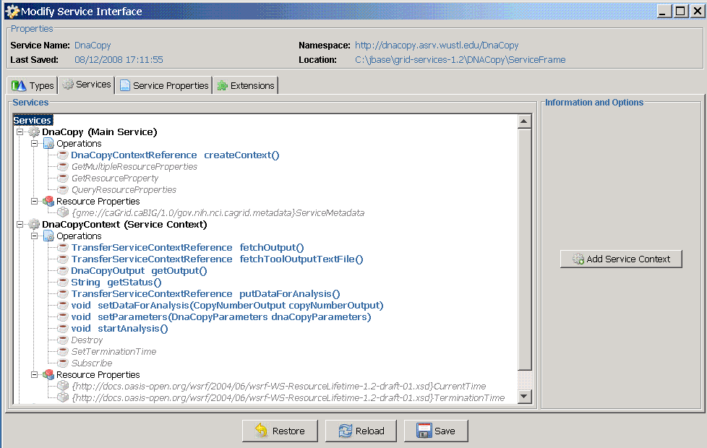
Example DNAcopy Service in Introduce-1.2
Unpaired fetch (No restriction on content)
Pair describing Input
type & mechanism

Slide 35
Using JASC
Step -1: Delegate all calls to JASC
  Implement Factory Pattern
  Modify Client to able to return Service-Context EPR
  Modify ServiceContextImpl.java and delegate all incoming method-calls to JASC’s SessionManager
  TODO: Automate this process; manually it takes 2-3 hours
Step -2: Implement Analyzer Interface
  Once doAnalysis() invoked by client
    Client cannot call setter now
    All setter values put in shared maps, in Session, for Analyzer
  After analysis, Analyzer should set output in shared maps
    JASC will provide output to client as required
Note: Three of our services, just took one week each of coding

Slide 36
Analyzer Interface
package gridas.jasc.servicesupport;
public interface Analyser {
// Perform initialization here:
void init(Session sess) throws Exception;
// If input need to be checked for validity (apart from XSD validation) it should be done here:
void validateInput() throws Exception;
// If service need to collect data from some external data-service:
void collectInputFromExternalServices() throws Exception;
// Do conversion from Service-input (XML) to analytical-tool input (text) here:
void transformToolInput() throws Exception;
// Invoke analytical-tool here, to perform actual analysis:
void invokeTool() throws Exception;
// Convert analytical-tool output (text) to service output (XML) :
void transformToolOutput() throws Exception;
// set Tool output and service output in session
void setupOutputForClient() throws Exception;
// perform any resource clean up here. Temporary directory NOT be cleaned/removed
void windup() throws Exception;
}

Slide 37
Sample Analyzer Bean Implementation
public class MyAnalyzer implements Analyzer{
private Session sess;
File fileTmpDir, fileToolInput;
File fileToolOutput, fileServiceXMLOutput;
public void init(Session sess) throws Exception {
this.sess = sess;
fileTmpDir = sess.getSessionWorkDir();
}
public void transformToolInput() throws Exception {
Service2ToolInputTransformer trn = new Service2ToolInputTransformer( sess.getInputFile(“input”));
fileToolInput = trn.transformationXMLtoToolInput();
}
Use Session instance to get input and set output
Freely use Instance variable.
One Client – One MyAnalyzer instance
Keep reference of session,
to access temp working dir name, get input objects & files.
Also to set output object & files.
Convert Service Input
received as File/Object
to Analytical-Tool input data

Slide 38
Analyzer Bean – 2
Invoke Analytical Tool here. It will convert input into output.
public void invokeTool() throws Exception {
MyAnalyticalToolInvoker tool = new MyAnalyticalToolInvoker( fileToolInput);
fileToolOutput = tool.runAnalysis();
}
public void transformToolOutput() throws Exception {
Tool2ServiceOutputTransformer trn2 =
new Tool2ServiceOutputTransformer( fileToolOutput);
fileServiceXMLOutput = trn2.transformationToolOutputToXML();
}
public void setupOutputForClient() throws Exception {
sess.setOutputFile("RawOutput", fileToolOutput);
sess.setOutputFile("Output", fileServiceXMLOutput, ServiceOutput.class, ServiceOutput.getTypeDesc().getXmlType());
}
...
} // End of analyzer bean
Convert analytical-tool output to XML (analytical service output), as per registered XSD type
Declare output in shared Maps that Client may ask for
Returns QName of expected return type

Slide 39
Integrating JASC into skeleton
Implement factory pattern
  Web-Service exposed: DNAcopy and DNAcopyContext
In DNAcopyContext: Modify constructor, as follows
  public DNAcopyContextImpl() throws RemoteException { …
  // etc-directoy path is required in order to create Session-Manager instance
  String etcPath = DNAcopyConfiguration.getConfiguration().getEtcDirectoryPath();
  // First parameter is name of the service, used when generating service using Introduce Wizard;
  // Second parameter is class that implements JASC “Analyzer” interface; main Service-Core-Logic class;
  sessMgr = new SessionManager(“DNAcopyService", MyAnalyzerBean.class, etcPath); }
In all generated methods, delegate call to JASC SessionManger instance
  public org.cagrid.transfer.context.stubs.types.TransferServiceContextReference putInput() {
  // Delegate this to session-manager; First param, nick name of Input (used as key in shared map)
  // Second parameter input type expected in incoming XML-Zip file;
  // Third parameter required to locate XSD file; This is used in validating incoming XML-Zip file;
  return sessMgr.setInputFile( “Input”, DNAcopyInput.class, DNAcopyInput.getTypeDesc());
  }

Slide 40
JASC Integration – 2
Delegating received Parameter to JASC
  public void setParameters( DNAcopyParameters dnaCopyParameters) {
  sessMgr.setInputObj(“parameters”,dnaCopyParameters);
  }
Delegating inquiry for input status to JASC
  public java.lang.String getStatus() throws RemoteException {
  // Delegate to Session-Manager; it will return service status as per bean life-cycle state.
  return sessMgr.getStatus();
  }
Delegating request for Analysis-Output (XML, Registered types)
// Companion method to getOutput(); It will return XML-Zip file as specified by return type in getOutput()
public org.cagrid.transfer.context.stubs.types.TransferServiceContextReference fetchOutput() {
// Delegate this to session-manager. Returns output registered by Analyzer-bean.
return sessMgr.getOutputFile(“output”);
}

Slide 41
Thank You
Questions?

