Slide 1
NHIN caBig Interoperability Demo

Slide 2
So What is the Nation-Wide Health Information Network (NHIN)?
NHIN Objective:
  Support the creation of a secure, nationwide, interoperable health information infrastructure that will connect providers, consumers, and others involved in supporting health and healthcare.
  Enable health information to follow the consumer and be available for clinical decision making
Run by the HHS Office of National Coordinator
Seeks to establish a federation of participating organizations sharing patient health information
  Health Information Exchanges
  Government Agencies (Va, DoD, NCI, Social Security Admin, …)
  Clinical Centers, Hospitals, and other healthcare providers
  Health Information System Vendors

Slide 3
The NCI Role
A patients clinical history can be important in their evaluation and treatment as part of a clinical trial
Data collected as part of cancer clinical trials can be an important part of the patients overall electronic health record and follow-on care.
NCI was asked to participate in a demonstration of:
  sharing clinically relevant patient information between organizations (DoD, NCI, Kaiser Permanente).
  Interoperability between the geographically distributed caBig participants and the NHIN participants

Slide 4

Interoperable Networks
Cleveland
Clinic
caImage
DoD
caB2B
Nationwide
Health
Information
Network
caLab
VA
Regional
HIE
CCTS
caBIG®
Network
IHS
caArray
caGrid-NHIN
Bridge
….
….
Kaiser
caNano
SSA
caTissue
By providing a bridge between the NHIN and caBIG® Network patient information can be exchanged and understood across both the clinical research and patient care domains
Notes:
This slide demonstrates the architecture of the interactions between the NHIN and caBIG. The infrastructure that caBIG utilizes for computable semantic interoperability is called caGrid. The caBIG team created a caBIG compatible wrapper around the NHIN services; creating a “bridge” between the NHIN and caGrid. One exciting element of our presentation today is that we will demonstrate interoperability at two levels; within an NHIE (using the caGrid infrastructure) and between NHIE’s using the NHIN. This paradigm, which is often called a network of networks demonstrates the flexibility of the caBIG infrastructure and a scalable model for integrating information at a variety of levels.

Slide 5

Demo Scenario – Part 1
MHS AHLTA
(National Naval Medical Center)
The researcher at Duke uses the C3PR application to request the patients treatment data from AHLTA at Bethesda Naval Medical Center via the CaGrid-NHIN Bridge.
CaGrid-NHIN Bridge initiates a Gateway-to-Gateway transaction between the NCI NHIN Connect Gate and the NHIN Gateway at MHS
MHS finds the patient and returns the patient summary report back to CCTS via the NHIN Gateway network and the CaGrid-NHIN Bridge.
CaGrid-NHIN Bridge
(NCI)
The researchers then uses the data to ascertain the patients eligibility for the clinical trial as managed in CCTS.
CCTS
(Duke)
Notes:
A TBD placeholder slide introducing the demo will be here. The following slides will be discussed at the meeting on 12-05-08.
BILL DYER DELIVERS LIVE DEMONSTRATION

Slide 6
Demo Scenario – Part 2
Kaiser Permanente EMR
(Oakland)
The physician at Kaiser Permanente requests patient’s medical records from the NHIN
The Kaiser Permanente-NHIN Connect Gateway initiates a request for medical records for the patient across the NHIN
MHS AHLTA
(National Naval Medical Center)
CaGrid-NHIN Bridge
(NCI)
The patient’s medical records regarding his participating in the clinical trial conducted by Duke are retrieved from the Duke CCTS via the CaGrid-NHIN Bridge and from the EMR system at Bethesda
CCTS
(Duke)
The NHIN Connect Gateway returns the medical records for Josh to the
Physician at Kaiser Permanente

Slide 7
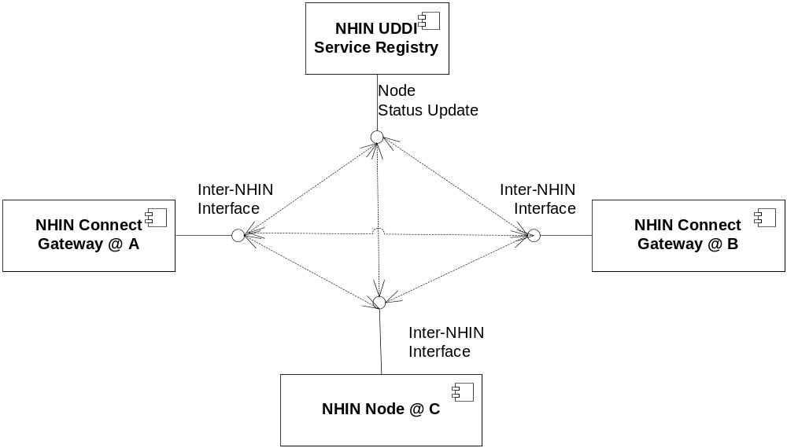
NHIN Architecture Overview
Specification Driven
  Each node implements one or more specified interfaces
  Specifications also define common required mechanisms (security, auditing, logging, etc…)
Services at each Node are registered at a central NHIN UDDI (QoS, WSDL, PoC, …)
Participants can build their own interfaces and implementations to spec or use the NHIN Connect Gateway

Slide 8
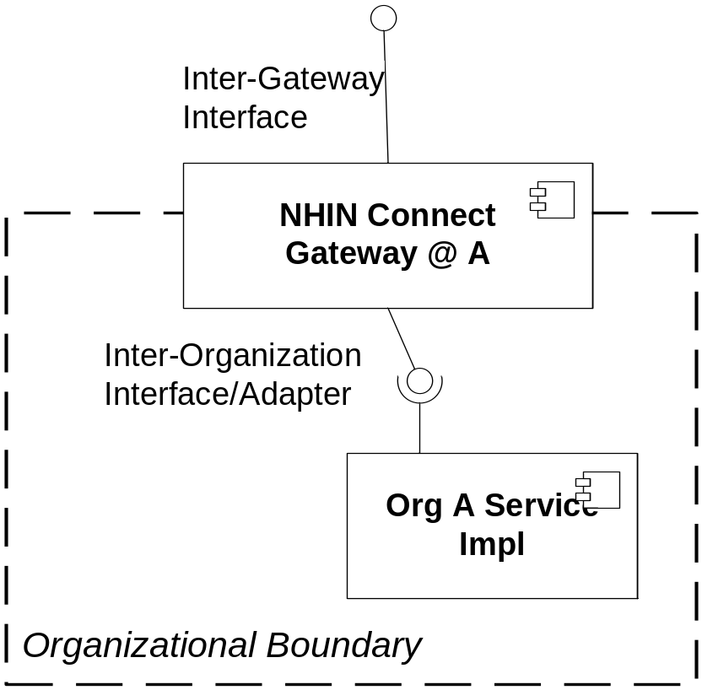
NHIN Connect Gateway
Based on Sun’s GlassfishESB/OpenESB
Provides implementations of specified interfaces and mechanisms.
Provides a interface/adapter framework that organizations can use to hook in their particular service implementations.
Manages the communications between other NHIN nodes and the NHIN UDDI.
NCI stood up an instance of the NHIN Connect Gateway as part of our solution.

Slide 9
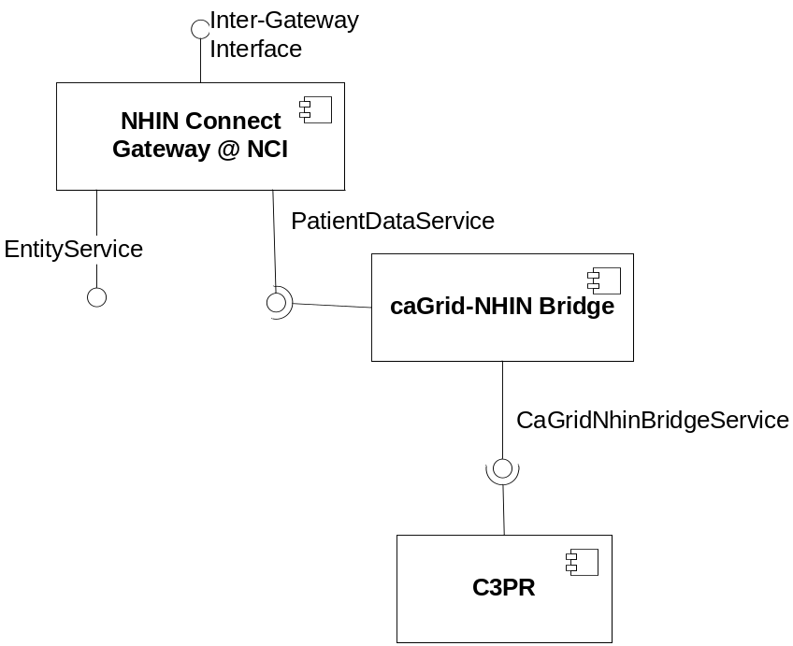
NHIN-caGrid Bridge - Overview
EntityService
  standard implementation interface hook for NHIN services
PatientDataService
  Adapter created for VA VistaWeb application.
  Provided a simpler WS interface
  Didn’t require SwA/MTOM support
  No Security mechanisms
CaGridNhinBridgeService
  Introduce generated wrapper service for PatientDataService
  Uses Axis2 client to call PatientDataService
  Uses GridTransfer to provide patient summary documents to C3PR
  C3PR uses standard caGrid client to provide patient lookup info and document id

Slide 10
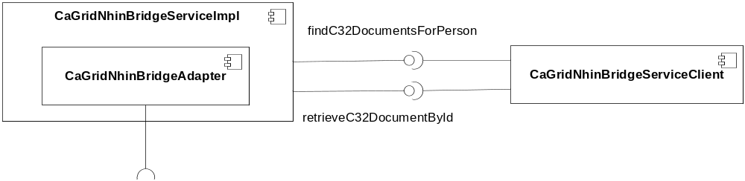
NHIN-caGrid Bridge Design
CaGridNhinBridgeAdapter to access the PatientDataService interface on the NHIN Connect Gateway
  Used an Axis2 WS client generated from Eclipse using the PatientDataService WSDL
Exposed 2 services for use by C3PR
  findC32DocumentForPerson – Found all C32 documents on the NHIN for a given NCI patient identifier. Returned a list of document Id’s
  retrieveC32DocumentById – Retrieved the requested C32 document from the NHIN participants and returned it via GridTransfer

Slide 11
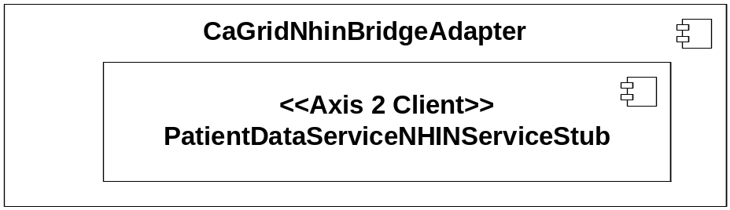
CaGridNhinBridgeAdapter
Using eclipse Ganymede make sure you download the latest Axis2 binaries and point eclipse to them (it's in the preferences->web services):
Create a Dynamic Web Project -> create a Web Service Client.
  Go through the wizard and point it to the WSDL of the producing service.
  Use the default Axis Data Binding (ADB) as it is pretty simple.
Export the project as a jar and copy to introduce/lib. This is the jar that contains the client (PatientDataServiceNHINServiceStub) used by the caGrid service ServiceImpl
Add the following jars to the introduce/lib
  activation-1.1.jar
  axiom-api-1.2.7.jar
  axiom-dom-1.2.7.jar
  axiom-impl-1.2.7.jar
  axis2-adb-1.4.1.jar
  axis2-kernel-1.4.1.jar
  backport-util-concurrent-3.1.jar
  wstx-asl-3.2.4.jar
  neethi-2.0.4.jar
  XmlSchema-1.4.2.jar
  geronima-stax-api_1.0_spec-1.0.1.jar

Slide 12
Providing Patient CT Data
For the demo a document repository provided with the NHIN Connect Gateway was used
A Patient Summary Report (C32) was created with test data and loaded into the repository
Kaiser Permanente then called using the standard NHIN interfaces for retrieving the document from NCI
In practice this information could come from a CTMS system or some other organization EMR.

Slide 13
NHIN Architectural Points of Interest
Use of an ESB for inter-NHIN plumbing management
Asynch Broadcasting of plumbing information
Common services repository for source of all service endpoints.

Slide 14
POI – NHIN Connect Gateway ESB
Manages Inter-NHIN interoperability
  Communications with the NHIN UDDI
  Authentication between NHIN nodes via SAML 2.0 based security with host x.509 certs
Provides standard implementations of operational plumbing
  Regulatory defined auditing and logging
  Conversion to NHIN defined Inter-NHIN wire-level message schema
Unique ID for each ESB/NHIN-Node
  Id (homeCommunity) is used to associate a patient with a patient repository (MPI)
  Allows for transaction tracking and communication auditing
Adapter Framework/Web Service for hooking up service implementations.
  Provides a much easier WSDL interface than the inter-NHIN WSDL
  ESB is JBI based so additional Service Engines and Binding Components can be added as needed.

Slide 15
POI – Asynch Plumbing
Each Node is aware of all other Nodes on the network
  When a new Node is added to the UDDI it’s information is broadcast to the other Nodes who then cache the info.
  When meta-data about a node is changed that info is broadcast to the other nodes in the network.
Adding new patients across the NHIN
  No centralized patient repository. Each organization keeps its own.
  When a new patient is added to a Node a message with patient info is sent to all other Nodes.
  Each Node is responsible for determining if they have info on that patient
  If so they Node will send a message to the original node saying they have the same patient
  The first Node then maps their patient ID to the unique id (homeCommunityID) for the other responding Nodes.
  When a node searches for a patient, it knows all the other nodes that also have information. They can then go to the UDDI to get the endpoint or use their local cache.

Slide 16
POI – Common Service Repository
Implements UDDI 3.0 and ebXML using Oracle Service Registry
Similar to the caGrid Index but mainly focused on endpoint management.
Pub/Sub based communications with NHIN nodes
  Each NHIN node implements interfaces to send and receive information from the repository
Not sure if there are periodic “ping” mechanisms for the repository to ascertain a nodes status

Slide 17
And Fun was had by All
NCI began the engagement with the NHIN in mid October of 08.
The NHIN forum was scheduled for Dec 16th 08.
NCI, NHIN, DoD, and Kaiser had basically 30 days to:
  Create a bridge between caGrid and the NHIN
  Modify C3PR to use the bridge and display the data
  Install a NHIN Connect Gateway at NCI
  Install the caGrid-NHIN bridge grid service at NCI
  Create all the data for the patient used in the demo
  Test and verify the implemented solution
  Develop the presentation material necessary for the demo.
It was a great team effort by all but especially by the NCI team
  Patrick McConnell and the Semantic Bits team
  Doug Hosier and the NCI System folks
  Bill Dyer and Christo Andonyadis for pulling the test data together
  George K for giving this the push and priority needed to get it done and for going though endless rehearsals and answering all the tough questions at the demo.
  Avinash for dropping this on me the day I got back from vacation

