Slide 1


Technology behind using Taverna in caGrid
caGrid user meeting
Stian Soiland-Reyes, myGrid
University of Manchester, UK
2009-03-19
http://www.mygrid.org.uk/dev/wiki/display/caGrid

Slide 2
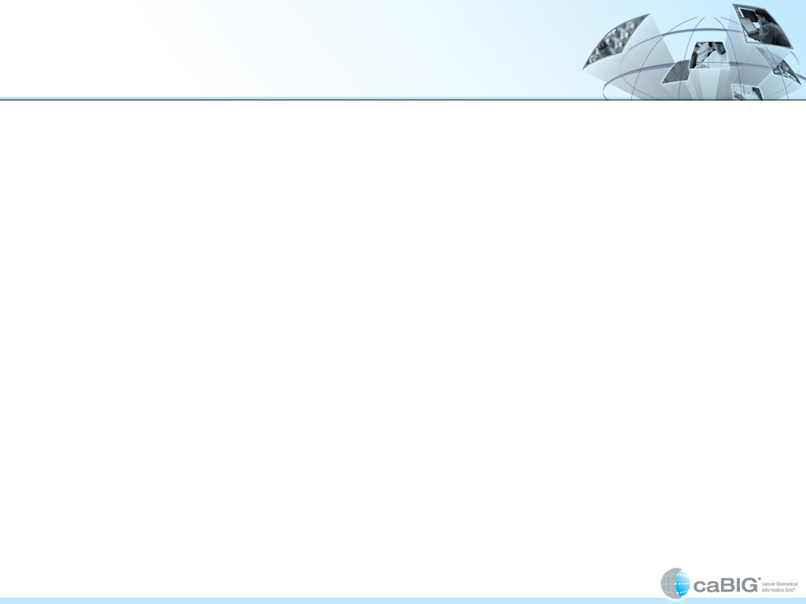
Agenda
History
  What worked out of the box
  caGrid plugin for Taverna
    Service discovery from Index Service
  Endpoint references (WSRF)
  Workflow as a service
    caGrid Workflow Execution service
    Remote execution from Taverna
    gRAVI-t - generating wf service
Future
  Access secured caGrid services
  Wrapping myGrid services
  And beyond…
    Tighter integration with caDSR
    Improve schema support for XML parsing/generating
    Workflow sharing
    Workflows in caGrid portal

Slide 3
What worked out of the box? (1)
caGrid services are exposed through Globus Toolkit 4 (GT4), typically using Axis (generated using tools such as Introduce)
Taverna 1 supported normal WSDL services out of the box. (Taverna’s WSDL support is based on Axis 1.4.)

Slide 4
What worked out of the box? (2)
Taverna 1 could already access many caGrid services that didn’t require security or used WSRF endpoint references
  by adding the WSDL location in the UI
Taverna has XML splitters for constructing and parsing complex types according to the XML schema of the service
  …although has issues with abstract classes

Slide 5
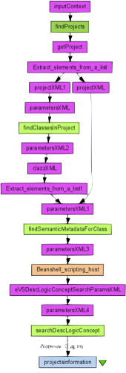
What worked out of the box? (3)
We have built example workflows and demonstrated Taverna to the caGrid community
Example workflow:
  Find projects in caDSR, get info
  Find classes by project
  Find semantic metadata by class
  Get concept information from EVS

Slide 6
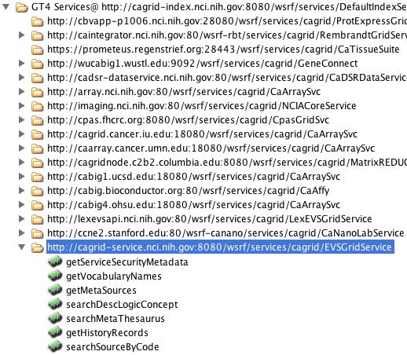
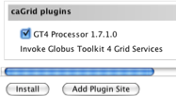
caGrid plugin for Taverna (1)
Discover/browse services registered in the caGrid Index Service from Taverna 1
Easy to install into Taverna:
Listing of all services:

Slide 7
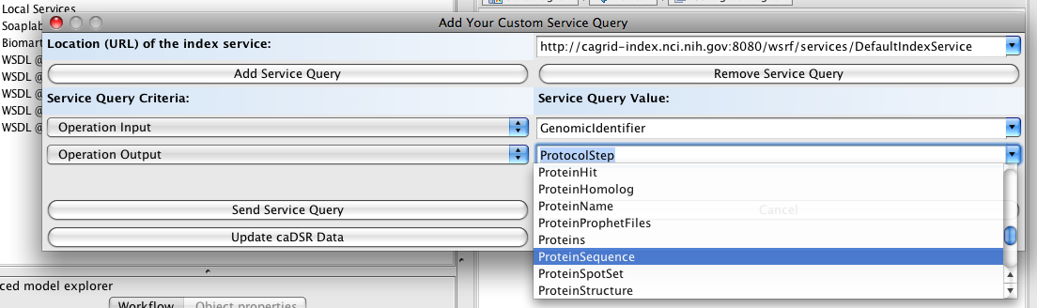
caGrid plugin for Taverna (2)
…or by semantic search:

Slide 8
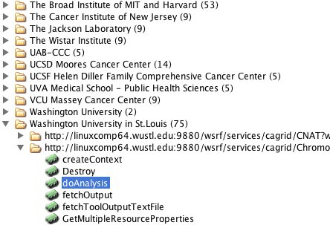
caGrid plugin for Taverna (3)
Newer plugin for Taverna 2 can also browse by provider:

Slide 9
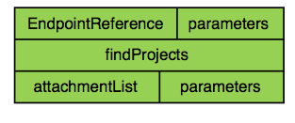

Taverna 2 WSRF-support
Taverna 2 also added support for WSRF endpoint refences
  Exposed in the workflow as an additional input port: EndpointReference
  Taverna will insert the magic headers

Slide 10
Running workflows locally
Normally Taverna workflows are executed by the client, ie. from the workbench user interface
  Easy for the user, quickly gets results (even intermediate results)
  But what about workflows that may take long to run, or that require more resources than your workstation?

Slide 11
caGrid Workflow
Execution Service (1)
Developed a caGrid service that can execute Taverna workflows
A generic WSRF service:
  Upload workflow definition
  Upload input data
  Wait for completion
  Retrieve results

Slide 12
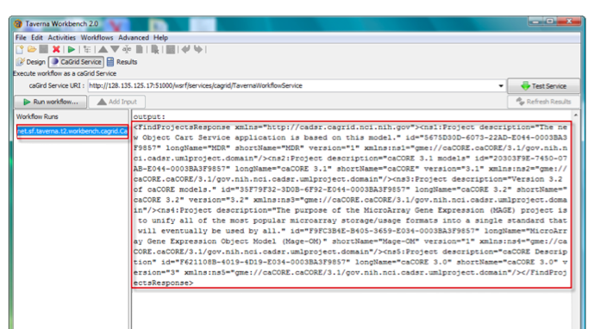
caGrid Workflow
Execution Service (2)
Can be invoked through a Taverna 2 plugin:

Slide 13
gRAVI-t:
Generating a workflow service (1)
Also developed an extension for gRavi to create a custom service for a given workflow
  The idea is taken from BPEL – what do you do with useful workflows? Why not expose them as true services?
  Such workflow services can be invoked by people not knowing about or even having Taverna

Slide 14
gRAVI-t:
Generating a workflow service (2)
Let’s say a user has a Taverna workflow she and others have found useful, and want to expose it as a service
gRAVI-t wraps the workflow as a WSRF service
Introduce deploys the generated service (GAR) to an installation of Globus Toolkit 4
Potential future: A Taverna plugin that automates the full generation and deployment

Slide 15
Future
The following slides will mainly describe the work that myGrid has been contracted to do for caGrid in 2009

Slide 16
Access secured caGrid services (GAARDS)
Develop Taverna support for GAARDS-secured caGrid services
  Two approaches to explore:
    Use caGrid client libraries (but need to be able to do generic SOAP calls from Taverna)
    Configure the Axis of Taverna to use caGrid security libraries (but needs to be compatible with non-secured non-caGrid services)

Slide 17
Wrapping and annotating existing myGrid services (1)
Selected two public analytical web services (provided by third parties) that are currently used in Taverna workflows
caGrid-enabling the services by wrapping them as a WSRF service
Wrapped services are annotated to meet Silver Level compatibility guidelines

Slide 18
Wrapping and annotating existing myGrid services (2)
Translate between the service’s native XML formats and the caDSR-registered data types exposed by the wrapped service
Wrapper invokes the original service using a standard SOAP library like CXF

Slide 19
Where do we go next?
Just some ideas..
  Tighter integration with caDSR
  Improve schema support for XML parsing/generating
  Workflow sharing
  Workflows in caGrid portal
  Guided workflow building using caGrid metadata
  Easily build CQL queries from Taverna

Slide 20
Any questions..?

