Slide 1
caGrid Workflow Examples
Wei Tan, Ravi Madduri
University of Chicago
{wtan, madduri}@mcs.anl.gov

Slide 2
An outline
Purpose of presentation
  How to use Taverna to build a caGrid workflow
  Examples of caGrid workflows built, and their scientific values
caGrid Workflows covered
  Data service workflow
    caDSR
    Protein sequence information query
  Data + analytical service
    Microarray clustering
    Lymphoma type classification

Slide 3
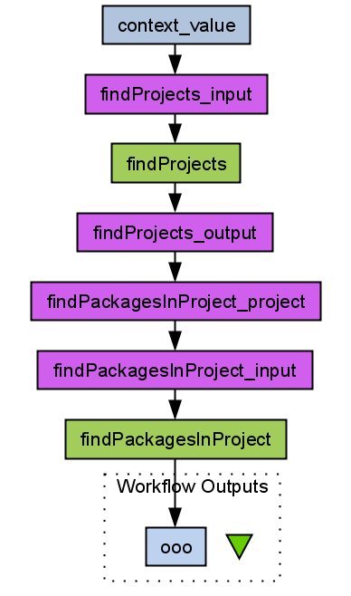
caDSR
Scientific value
  To find all the UML packages related to a given context (‘caCore’).
  Not a real scientific experiment.
    Simple.
    Important in caGrid.
Steps
  Querying Project object.
  Do data transformation.
  Querying Packages object and get the result.
How to build this workflow?
  A live demo.
Workflow
input
caGrid
services
“Shim”
services
Workflow
output

Slide 4
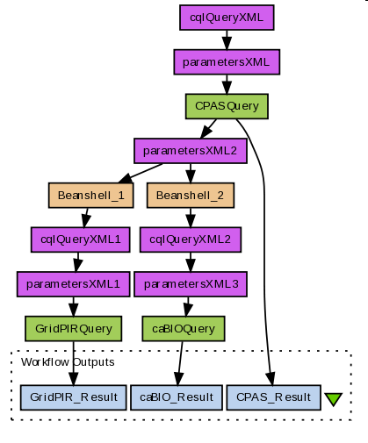
Protein sequence information query
Scientific value
  To query protein sequence information out of 3 caGrid data services: caBIO, CPAS and GridPIR.
  To analyze a protein sequence from different data sources.
Steps
  Querying CPAS and get the id, name, value of the sequence.
  Querying caBIO and GridPIR using the id or name obtained from CPAS.

Slide 5
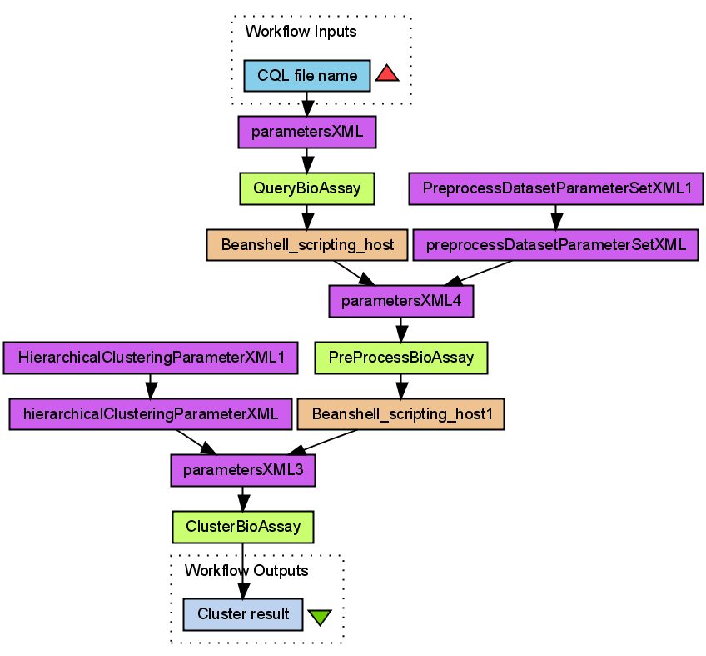
Microarray clustering*
Scientific value
  A common routine to group genes or experiments into clusters with similar profiles.
  To identify functional groups of genes.
Steps
  Querying and retrieving the microarray data of interest from a caArrayScrub data service at Columbia University
  Preprocessing, or normalize the microarray data using the GenePattern analytical service at the Broad Institute at MIT
  Running hierarchical clustering using the geWorkbench analytical service at Columbia University
Workflow in/output
caGrid services
others
“Shim” services
*Wei Tan, Ravi Madduri, Kiran Keshav, Baris E. Suzek, Scott Oster, Ian Foster. Orchestrating caGrid Services in Taverna. ICWS 08.

Slide 6
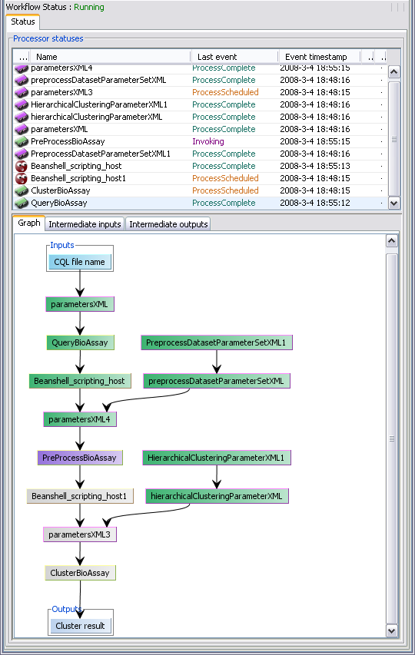
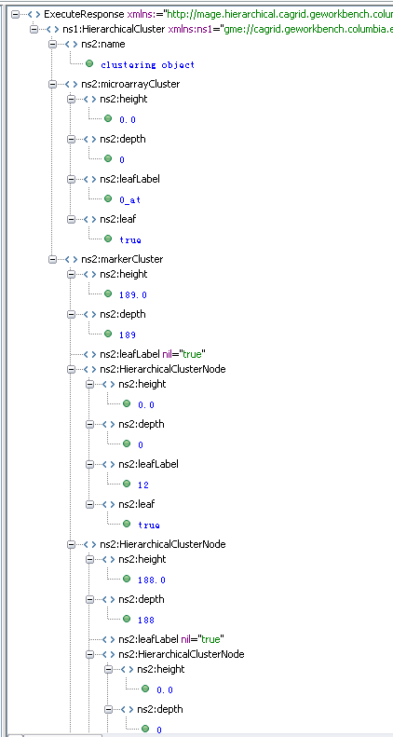
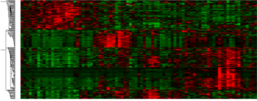
Execution trace
Execution result as xml
1936 gene expressions

Slide 7
Lymphoma type classification
Scientific value
  Using gene-expression patterns associated with DLBCL and FL to predict the lymphoma type of an unknown sample.
  Using SVM (Support Vector Machine) to classify data.
(Major) steps
  Querying training data from experiments stored in caArray.
  Preprocessing, or normalize the microarray data.
  Adding training and testing data into SVM service to get classification result.
*

Slide 8
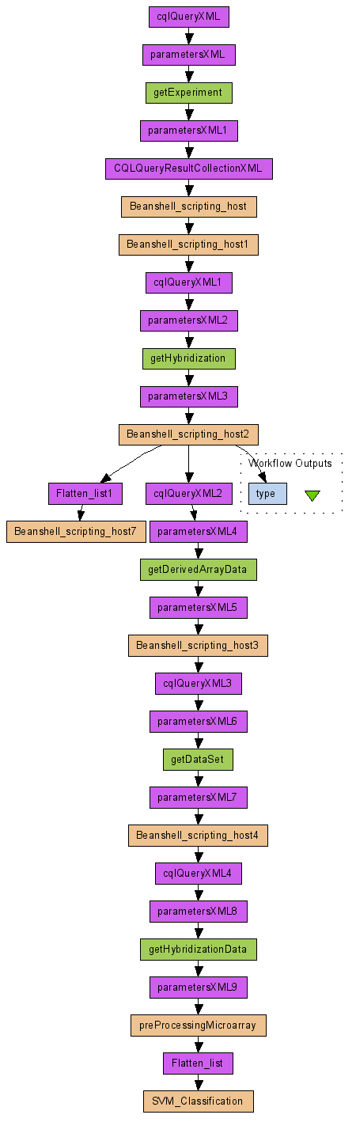

Slide 9
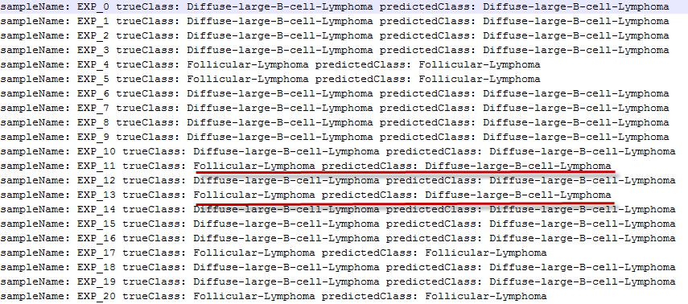
Lymphoma type classification
Result snippet
*Classification errors are highlighted.

Slide 10
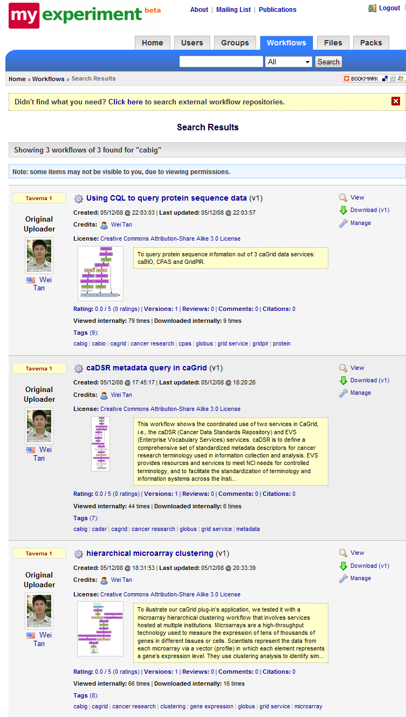
Summary
caGrid Workflows covered
  Data service workflow
    caDSR
    Protein sequence information query
  Data + analytical service
    Microarray clustering
    Lymphoma type classification
caGrid workflows are uploaded to myExperiment and accessible from:
http://www.myexperiment.org/workflows/search?query=cabig
Examples in this demo are included and we are continuously update it.
Users are welcomed to add their own.

