Slide 1

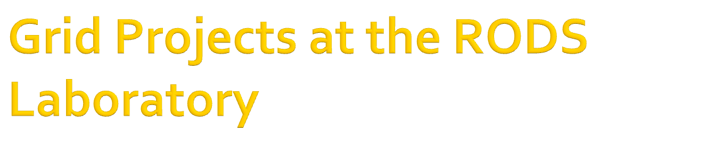
Jeremy Espino MD
Real-time Outbreak and Disease Surveillance Laboratory

Slide 2

Thomsun Sriburadej
Howard Su
Kevin Bui
Rich Tsui
John Levander

Slide 3

PAOH BIG – Pennsylvania Ohio BIosurveillance Grid
RODS GIPSE - Geocoded Interoperable Population Summary Exchange

Slide 4

Globus and caGrid
  Introduce
  GAARDS
    Dorian
    CDS Credential Delegation Service
  Index Service
Build Tools
  Ant
  Maven
  Ivy

Slide 5

Provide tools so that health departments can share data with each other: vital statistics, notifiable disease cases, syndromic counts
Fine grained security at the query level
Service proxy that aggregates results using delegated credentials

Slide 6

Dorian authentication, service authorization, method authorization
We added query authorization
Mechanism
  Implement org.globus.wsrf.security.authorization.PDP
  https://svn.rods.pitt.edu/repos/phgrid/big-ws/trunk/src/edu/pitt/rods/grid/services/service/globus/GenericAuthorization.java
  Insert implementation into the security descriptor
  https://svn.rods.pitt.edu/repos/phgrid/big-ws/trunk/etc/NotifiableDesease2-security-desc.xml

Slide 7

Client authorizes via Dorian
Client delegates credential to proxy service via service provided by CDS
Client calls Proxy Service
  Proxy Service calls CDS for credential.
  Proxy Service consults IndexService for available services in the grid by service name.
  Proxy Service makes requests to to services and return to client.

Slide 8

http://www.youtube.com/watch?v=GjoU82i5Vac

Slide 9

Geocoded Interoperable Population Summary Exchange
E.g., daily counts of respiratory cases in Pennsylvania for the past month
We created:
  RODS GIPSE Service
  RODS GIPSE Client
Used Ivy to consolidate the Ant and Maven builds

Slide 10

A standard grid service (.gar) built using Introduce

Slide 11

A standard grid client built using Introduce
Runs inside the RODS REST API Service.
Request grid proxy credentials on-the-fly from Dorian using user’s Dorian account information
Globus Toolkit Jars currently conflict with other SOAP clients we use in RODS. Plan is to isolate GIPSE client as a Tomcat application.

Slide 12

