Slide 1
caGrid Portal
What is it?
  Provides Web-based access to caBIG resources and information using the caGrid infrastructure.
How is it currently used?
  Querying data sources; viewing grid service metadata and status; diagnosing deployment issues; hosting community portlets

Slide 2
What’s new?
‘Beta’ Portal
  http://demo-portal.training.cagrid.org
More researcher-oriented and easier to use.
Provide high-level organization of data sets on the grid (Where’s the data!?).
Simplify data retrieval (querying).
Facilitate collaboration and secure data sharing.
Provide platform for sharing Web-based caBIG tools.

Slide 3
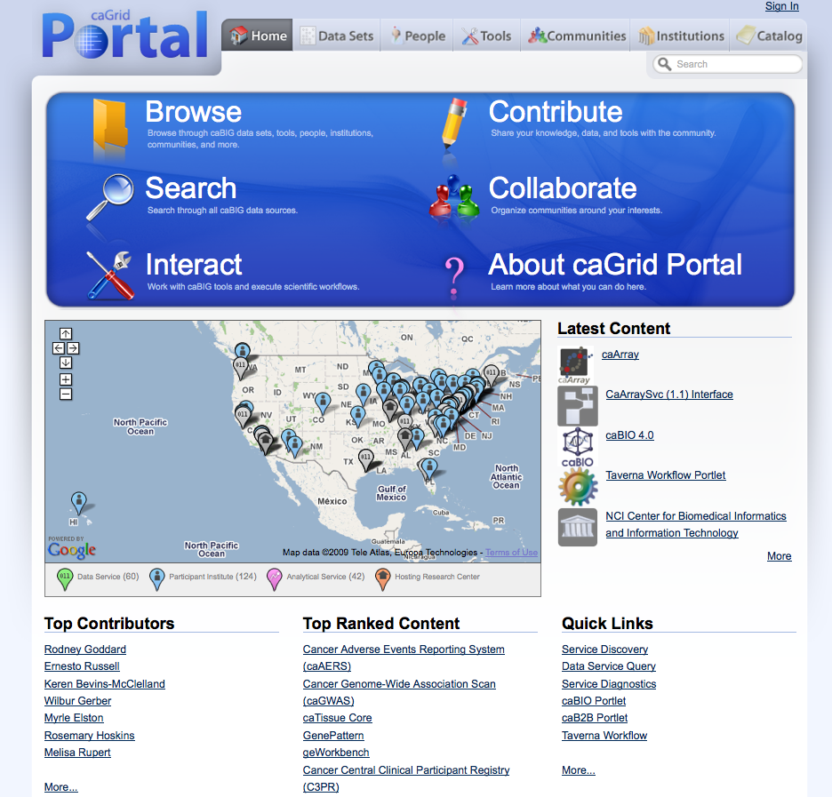
Researcher-oriented/Easier to use
Reorganized
Functionality
Reorganized
Content
New Portlets
User-Contributed
Knowledge

Slide 4
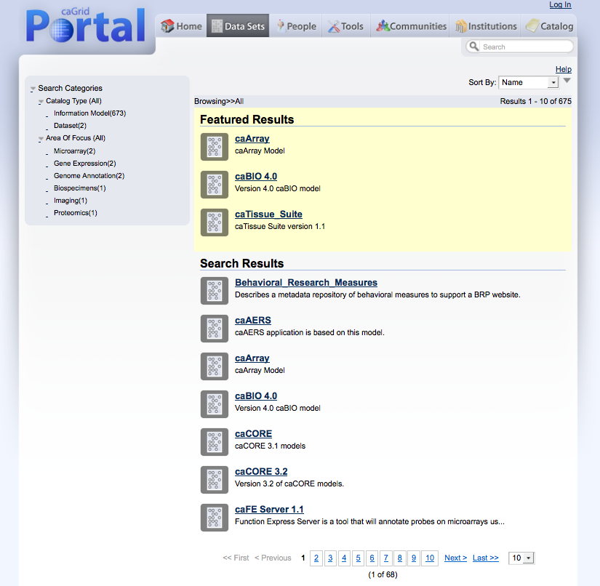
High-level organization of data sets
High-level Categories
Keyword Search

Slide 5
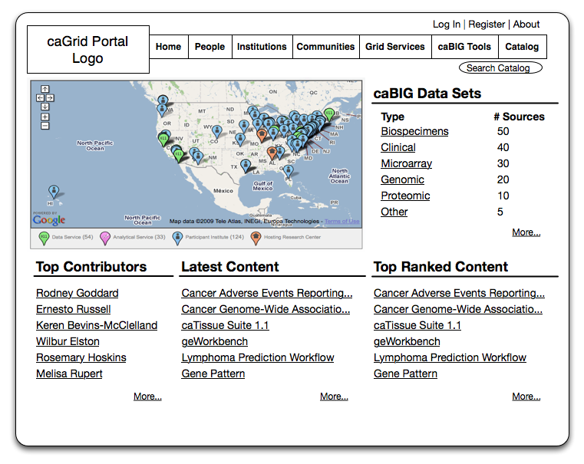
Where’s the data? (mockup 1)
Data Source Counts by Category

Slide 6
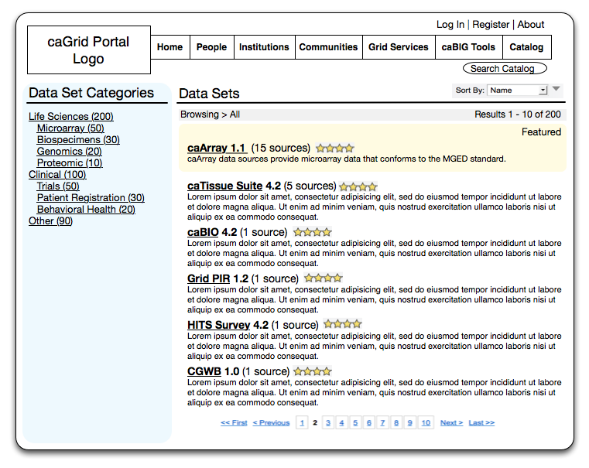
Where’s the data? (mockup 2)
Data Source Counts by ‘Data Set’
(Information Model)
Data Source Counts by Category

Slide 7
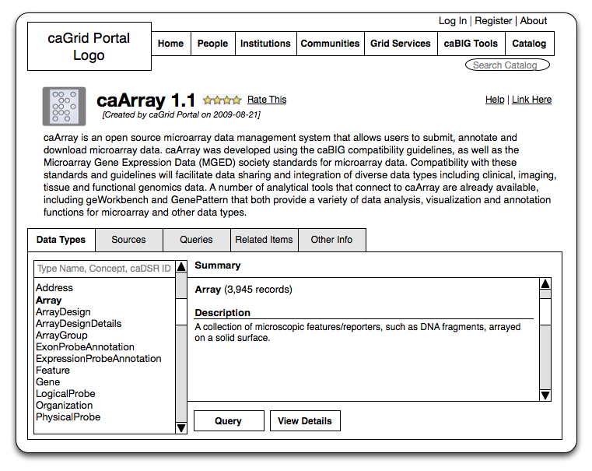
Where’s the data? (mockup 3)
Record Counts by
‘Data Type’
(UML Class)

Slide 8
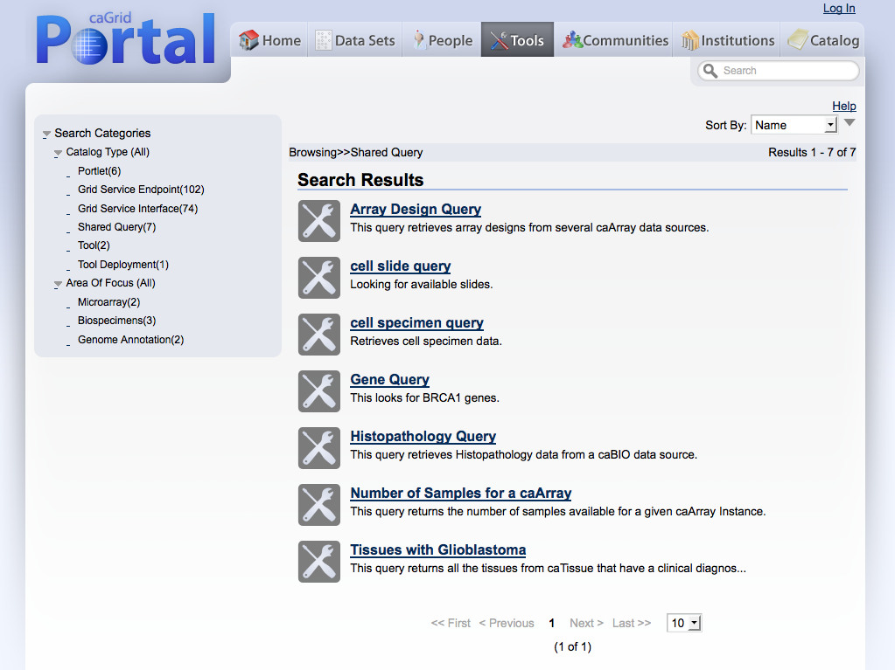
Simplified data retrieval (querying)
Queries contributed by users
Queries tagged with categories

Slide 9
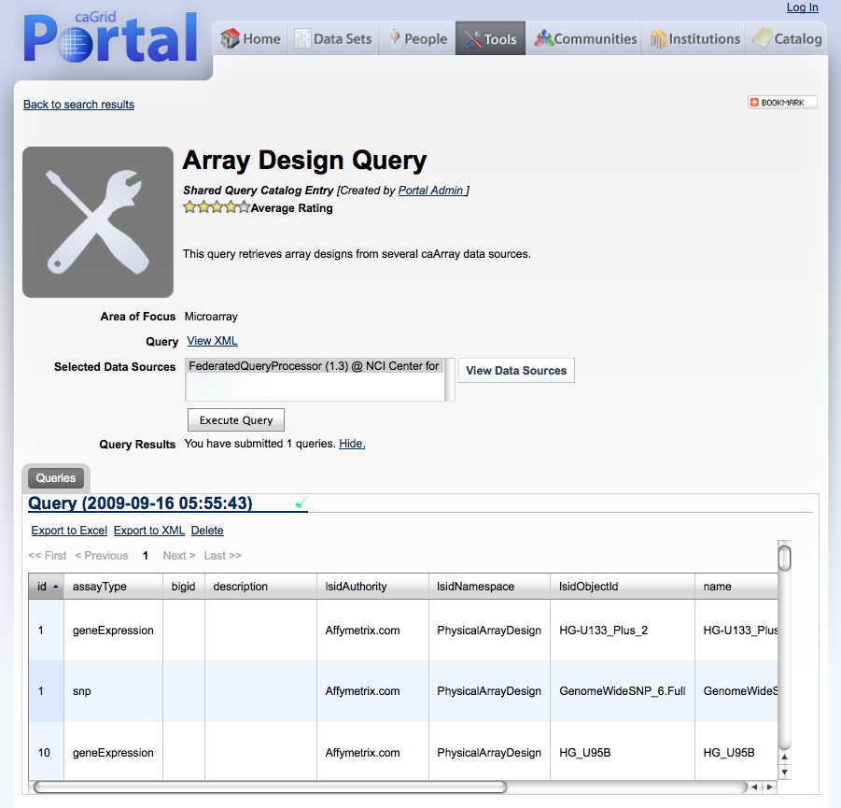
Simplified data retrieval (querying)
Queries tagged with ‘Area of Focus’
Query results can be saved or exported.

Slide 10
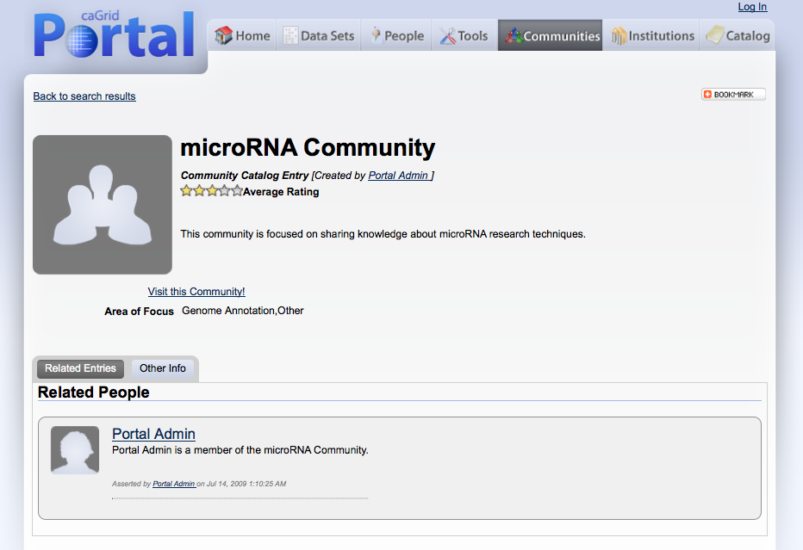
Collaboration and secure data sharing
Tagged with ‘Area of Focus’
Links to members’ catalog entry pages

Slide 11
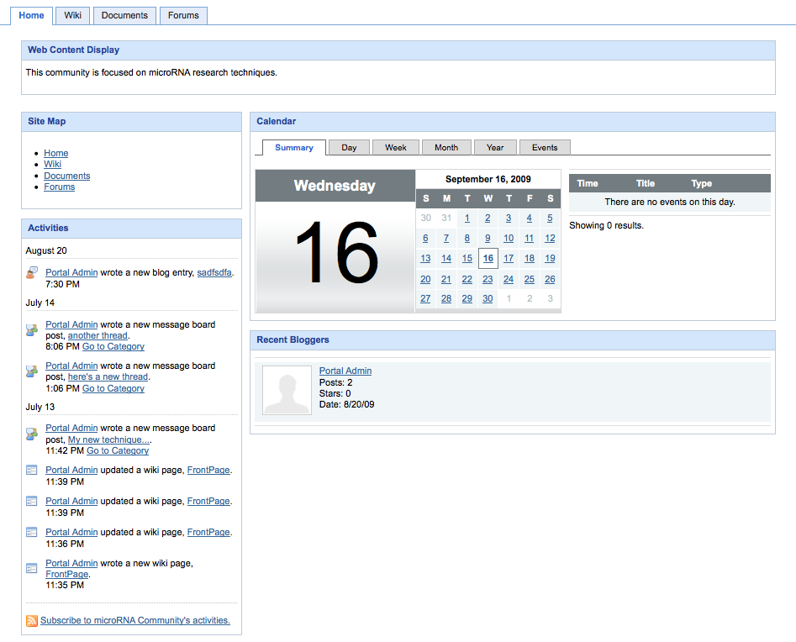
Collaboration and secure data sharing
Common collaboration tools
Page contents customizable per community and per user

Slide 12
Collaboration and secure data sharing
GridGrouper provides distributed group management on grid.
Grid service authorization based on group membership.
Manage group membership through portal.
  Portal Community -> Grouper Stem
  Portal User Group -> Grouper Group
Data source or tool provider keeps control.

Slide 13
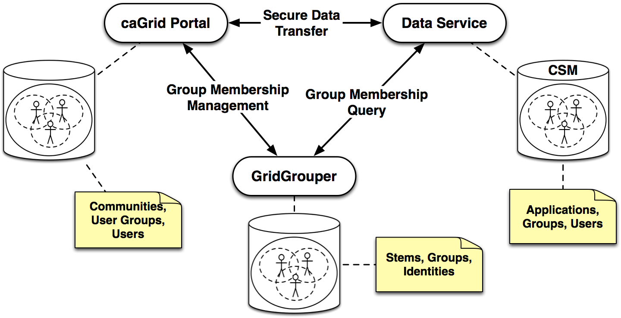
Collaboration and secure data sharing

Slide 14
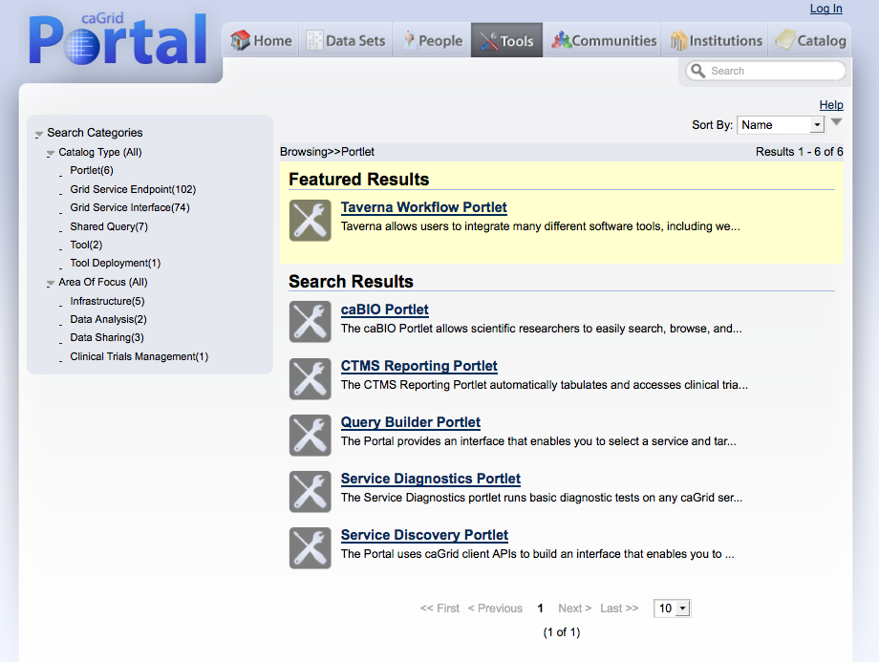
Platform for Web-based caBIG tools

Slide 15
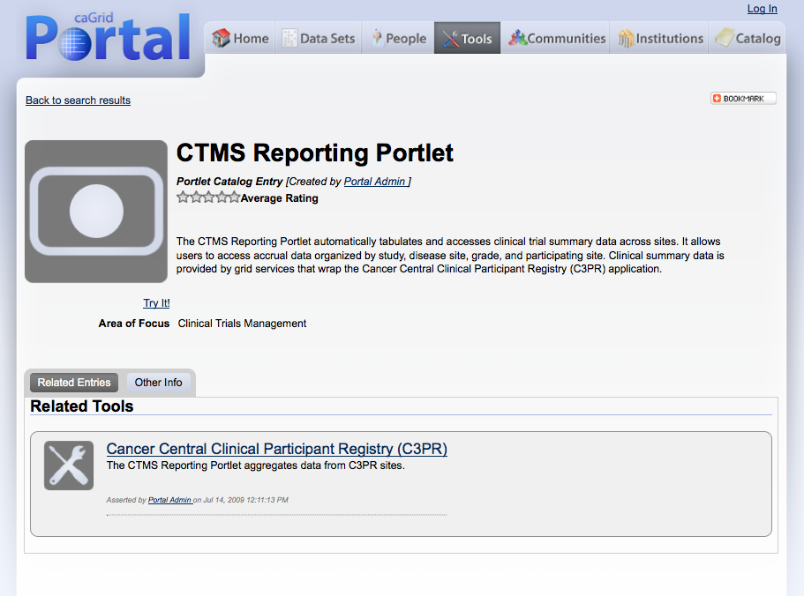
Platform for Web-based caBIG tools

Slide 16
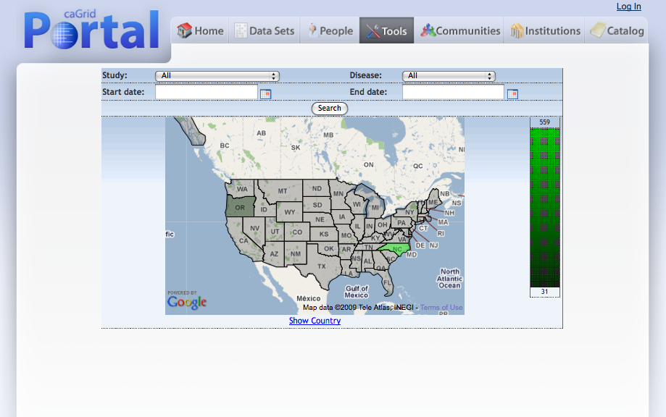
Platform for Web-based caBIG tools

Slide 17
Questions?

