Slide 1


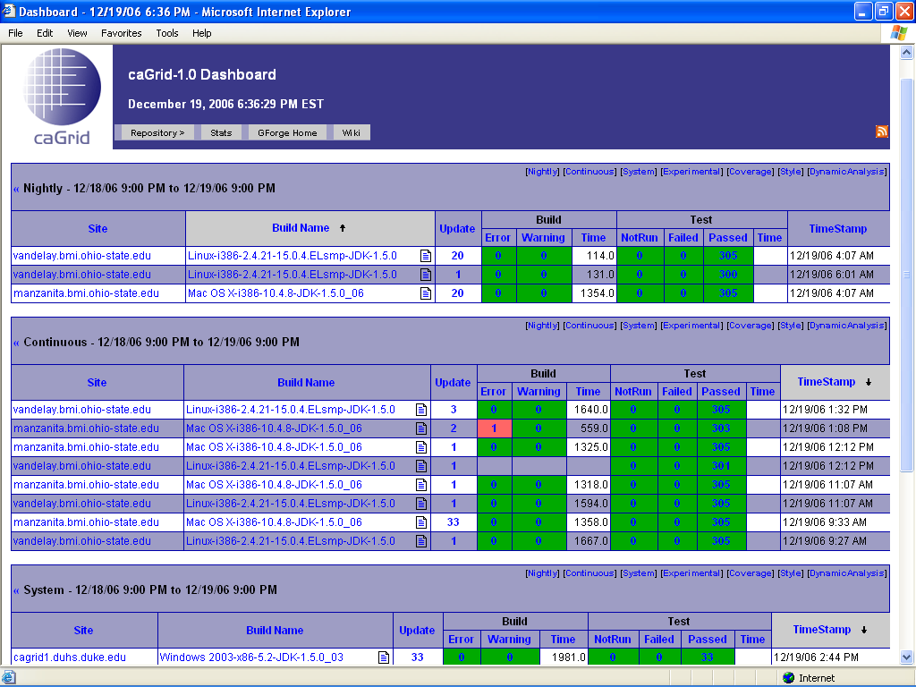
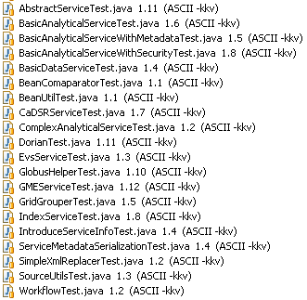

The caGrid 1.0 Testing Framework
Patrick McConnell and A. Jamie Cuticchia
Duke Comprehensive Cancer Center
Types of Testing
Unit Testing
  Validates individual modules or units of source code
  Independent from the other modules
  Mock objects used to test in isolation
Integration Testing
  Validates individual software modules
  Modules combined and tested as a group
  Does not rely on deployed modules
System Testing
  Validates deployed, running modules
  Detect defects in "inter-assemblages" and within the system as a whole
User Acceptance Testing
  Validates system from end-user perspective
  Final verification of the requirements of the system
Integration Testing
Haste testing framework for stateful tests
  StoryBook: contains a group of Stories
  Story: single test case composed of ordered Steps
  Step: the basic unit of a Story, which can perform actions and test the results of said action
caGrid Haste tests
  Create a new Globus container
  Deploy and configure services
  Startup container
  Invoke services, testing results
  Stop and delete container
Automated Testing
Use of software to control the execution of tests and reports
CruiseControl
  A framework for a continuous build process
  Executes “ant all” and “ant test” on a recurring, continuous basis
  Sends failures to developers by email
  Continuous and nightly builds/tests of the main caGrid trunk and the integration testing trunk
Dart
  Open-source, distributed, software quality system
  Results from a build/test sequence are transmitted to a central server
  The server produces concise dashboards, summarizing the current state of a software system
Testing Introduce-built Services
Setup test directory structure
test/services/SERVICE/test
resources/
0_methodName1/
0_input1.xml
1_input2.xml …
out.xml
1_methodName2/ …
Create new Story
  Use GlobusHelper and caGrid testing steps for managing the Globus container
  Use ServiceHelper for invoking the service based on inputs and outputs in directory structure
caGrid Testing
caGrid Unit Testing
  JUnit tests on Java classes
caGrid Integration Testing
  Deploys component(s), runs tests, tears down
caGrid System Testing
  Runs tests against deployed components on the caGrid NCICB dev and production tiers
caGrid User Acceptance Testing
  Reference implementations adopt and build caGrid-based applications before release
globus = new GlobusHelper();
port = Integer.parseInt(System.getProperty("test.globus.port", "8080"));
serviceDir = new File(System.getProperty("tumorregistry.dir",
".." + File.separator + "TumorRegistryDataService"
));
TumorRegistryConfigureStep configStep = new TumorRegistryConfigureStep(serviceDir);
Vector steps = new Vector();
steps.add(new GlobusCreateStep(globus));
steps.add(configStep);
steps.add(new GlobusDeployServiceStep(globus, serviceDir));
steps.add(new GlobusStartStep(globus, port));
try {
steps.addAll((new ServiceHelper("CaTRIPTumorRegistry", serviceDir)).getInvokeSteps());
} catch (Exception e) {
throw new RuntimeException("unable to add invoke steps", e);
}
steps.add(new GlobusStopStep(globus, port));
steps.add(new GlobusCleanupStep(globus));
steps.add(cleanupStep = new TumorRegistryCleanupStep(configStep));
return steps;
For More Information
caGrid
  https://cabig.nci.nih.gov/workspaces/Architecture/caGrid
Ant
  http://ant.apache.org/
JUnit
  http://www.junit.org
Haste
  http://atomicobject.com/pages/Haste
CruiseControl
  http://cruisecontrol.sourceforge.net
Dart
  http://public.kitware.com/Dart

