Slide 1
Grid Without Java:
Django on Jython caGrid Client Web Application
Saba S. Bokhari
November 17 2011
Notes:
----- Meeting Notes (11/16/11 18:32) -----
Hello, I'm SB, and I'm presenting a caGrid Client Web Application developed with Django on Jython.
We been asked if caGrid API can be implemented on languages other than Java, Specifically we had recommendations for languages and web frameworks like JR on R, Sc on L, and Django on Jython.

Slide 2
caGrid Client Web Application
Features
  Sync with the Trust Fabric
  Perform Grid Authentication
  List and Discover available Grid Services
  Perform CQL queries against Data Services
  Store CQL queries for future use
Notes:
----- Meeting Notes (11/16/11 18:32) -----
The Features of this caGrid client web application are

Slide 3
caGrid Client Web Application
Jython
  Java implementation of Python
Django
  Python Web Framework
Django-Jython
  Database Backends and Extensions
PostgreSQL
  Database
PyDev
  Eclipse plug-in for Python/Jython Development
Notes:
----- Meeting Notes (11/16/11 18:32) -----
Now this project specifically uses:
----- Meeting Notes (11/16/11 22:38) -----
Django-Jython: Django development on Jython

Slide 4
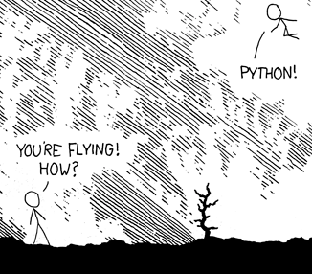
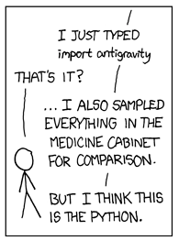
Jython
Why Jython?
  Jython is essentially Python
Notes:
----- Meeting Notes (11/16/11 18:32) -----
Jython is fun

Slide 5
Jython Advantages
Scope is defined by white space
Dynamic typing
  Don’t need to declare variable type
Code Length
  Jython code tends to be 2 – 10x smaller than Java
You can use Java jars and import caGrid Java classes
Notes:
----- Meeting Notes (11/16/11 22:36) -----
Instead of using braces to define scope, python instead uses white space, like tabbing and spacebar. It's a bit weird at first, but it'll end any arguments about whether a brace should be on the next line, or the same line.
It also utillizes dynamic typing, you don't have to specify variable type, as it is deduced at run time.
because of the things above and others, code length tends to be 2 -10 x shorter than java.
The best part is that you can use java jars and you can import caGrid Java classes. That's where it's especially
----- Meeting Notes (11/16/11 22:38) -----
beneficially to us, since all the caGrid APIs are implement in Java. So you basically have the best of both worlds you can use Python and still use Java Classes

Slide 6
Django
Python Web Framework
Based on the Model View Controller (MVC) Architecture
It can be more accurately called Model View Template (MVT) Architecture
  Model of the Database
  View: Callback Function for the URL
  Web Page Template
Notes:
----- Meeting Notes (11/16/11 22:40) -----
Django is Python Web Framework
It's based on MVC Architecture, but interprets it in a different way
----- Meeting Notes (11/16/11 22:47) -----
you can accurately describe it more as a MVT model, Model of the Database, the view is specifically the callback functions for the different urls. The template describes the webpage in html

Slide 7
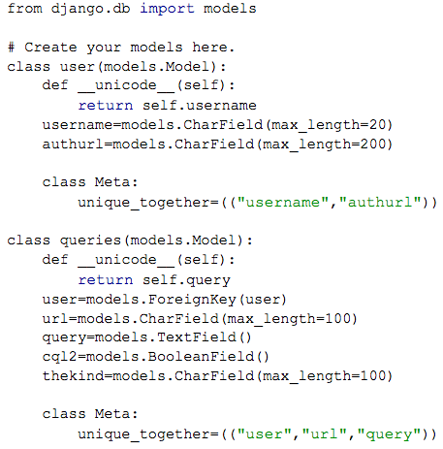
Django Model Example
Notes:
----- Meeting Notes (11/16/11 22:47) -----
this is a small example of the model.py file in a django project.
You don't have to go into the database and create tables via SQL and the like.
Instead you can just describe the model and django will set up the db for you. id/pk are automatically generated
user
queries, a user can have many queries

Slide 8
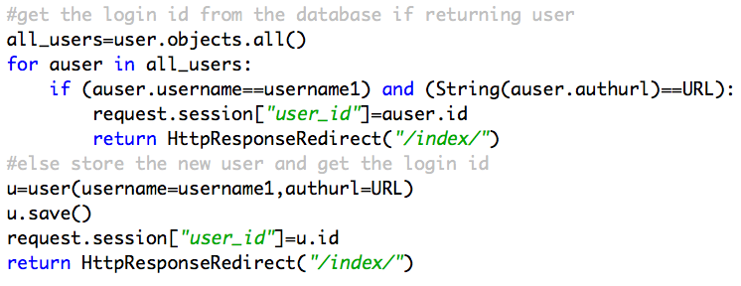
Use of Models in the View
Notes:
----- Meeting Notes (11/16/11 22:47) -----
You can also assess the database objects in the view code. in this case we grab all the users objects and so on and so on

Slide 9
Django View
Accessing HTML GET and POST data
  request.GET[‘username’]
Send a dictionary to the template with render_to_response
  return render_to_response(“a_template.html”,
  {login:True, lifetime:12})
Redirect to another URL:
  return HttpResponseRedirect(“/index/”)
Django Session Objects are used to store users and queries data
  request.session[‘user_name’]=username
Notes:
----- Meeting Notes (11/16/11 22:47) -----
in Django, there is a views.py file, that contains all the callback functions for the urls.
so here are a few special codes
dictionary not necessarily string to string. also pass database values

Slide 10
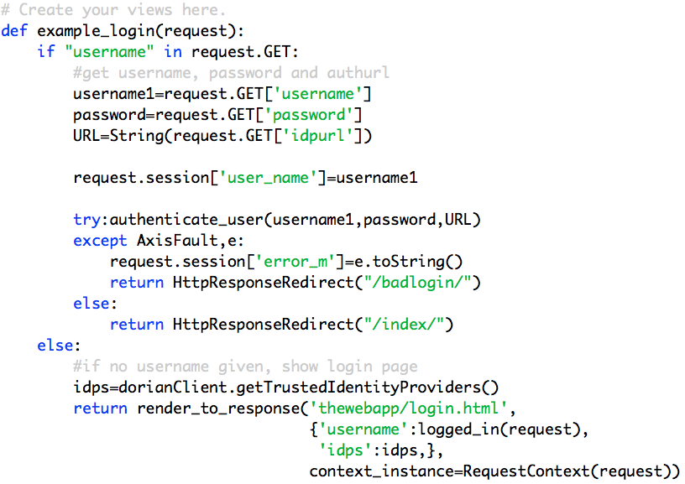
Django View Example - Login
Notes:
----- Meeting Notes (11/16/11 22:47) -----
go through it, mention the idps

Slide 11
Django Template Language
  Variables are covered with double braces
      {{a_variable}}
  Test if a variable was sent to the page
      {% if a_variable %}
  Iterate over list-like objects
      {% for a_item in items %}
  Some object methods can be used
      {{a_variable.getName}}
Notes:
----- Meeting Notes (11/16/11 23:10) -----
2) by the view
3) collection, sets so on
4) This include database models, so you could send a query object and get the queries.cql

Slide 12
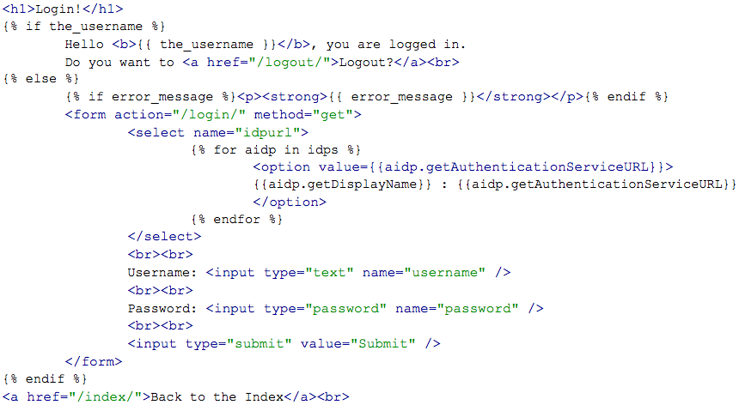
Django Template Example – Login
Notes:
Note
You can print the display name and authurl and send the auth url back

Slide 13
GridClient Demo
  http://localhost:8000/dataservices/

Slide 14
Tutorial
How to make your own Django on Jython web application
  https://cagrid.org/display/knowledgebase14/caGrid+Client+on+Django+on+Jython
Possible Improvements
  Use more views files
  Utilize more applications
  Make templates to hold commonly used template code
  CSS
Notes:
Tutorial on caGrid.org
Feel free to implement it and to make tweaks of your own.
Improvements
Utilize more views files, you don’t have to put all the call back function in one views file, you can have several , one for login, one for list services so on
Utilize more applications. Right now there’s one application in the django/jython project, you can have several applications each specializing on a special task, one for quering data services, another for list services, one for grid grouper
Applications can be transferred to different django projects, so users could develop specific django applications and share them.
The web app currently is not very glamourous CSS pages can be used for aesthetics

Slide 15
Problems
  Django Session Objects
      Can only store strings or
      objects that are easily pickleable/serializable
  Database restricted to PostgreSQL
      Has backends to support sqlite3, mySQL, oracle
  PyDev PermGen problem
    java.lang.OutOfMemoryError: PermGen space
Notes:
A few problems in using Django with Jython, Django session objects are picky, they can only store strings properly
Database is restricted to PostgreSQL, it’s supposed to be able to support these others, but I haven’t been able to implement them.
If you’re using PyDev for development, it has a permgen issue, it normally pops up if you’re doing changes very rapidly. It’s a known issue

Slide 16
Resources
Jython
  http://www.jython.org/
Django
  https://www.djangoproject.com/
Django-Jython
  http://code.google.com/p/django-jython/
Django Users Group
  http://groups.google.com/group/django-users
Contact Me
  Saba Bokhari : Saba.Bokhari@osumc.edu
Notes:
The user group is very helpful for django problems
Have any problems with the tutorial, please contact me.

Slide 17
Questions/Comments

