Slide 1
Current caGrid 1.0 Feature Highlights
Scott Oster, Shannon Hastings, Stephen Langella, David Ervin
Ohio State University
{oster,hastings,langella,ervin}@bmi.osu.edu
August 6th, 2007

Slide 2
Agenda
Overview (5 min)
Metadata Services (5 min)
Security Components (5 min)
Data Services (5 min)
Workflow (5 min)
Introduce (5 min)

Slide 3
caGrid Team
Ohio State University - Biomedical Informatics Department
  Dave Ervin
  Shannon Hastings
  Tahsin Kurc
  Stephen Langella
  Scott Oster - Chief Architect - caGrid
  Joel Saltz
University of Chicago/Argonne National Laboratory
  Ravi Madduri
  Ian Foster
SemanticBits, LLC.
  Joshua Phillips
Duke Comprehensive Cancer Center
  Patrick McConnell
Ekagra Software Technologies, Ltd.
  Vijay Parmar

Slide 4
caGrid Team (Continued)
Northern Taiga Ventures, Inc. (NTVI)
  Wendy Erickson-Hirons
Science Applications International Corporation (SAIC)
  Aynur Abdurazik
  Ye Wu
Terrapin Systems LLC (TerpSys)
  Chet Bochan
  Vanessa Caldwell
  Craig Fee
  Alan Klink
  Gavin Brennan
NCI - Center for Biomedical Informatics and Information Technology (CBIIT)
  Todd Cox
Booz Allen Hamilton
  Michael Keller
  Arumani Manisundaram
caGrid - Product Manager
  Avinash Shanbhag
  Director, Core Infrastructure Engineering
  NCI – Center for Biomedical Informatics and Information Technology (CBIIT)

Slide 5

What is caGrid?
A grid based software infrastructure consisting of services, toolkits, APIs, and applications
A production grid deployment of the core services provided by that infrastructure
A community of developers leveraging that grid and infrastructure to provide applications and services to the cancer research community

Slide 6
caGrid Components
Leverage existing technologies:
  caDSR, EVS, Mobius GME: Common data elements, controlled vocabularies, schema management
  Globus Toolkit (currently version 4.0.3)
    Core grid services infrastructure
    Service deployment, service registry, invocation, base security infrastructure
Additional Core Infrastructure
  Higher-level security services
  Grid service access to metadata components (caDSR, EVS, GME, etc)
  Workflow, Federated Query services
Service Provider Tooling (Introduce)
  Graphical service development and configuration environment
  Abstractions from grid service infrastructure for Data and Analytical services
  Deployment wizards
Client Tooling
  Installer
  High-level APIs for interacting with core components and services
  Graphical Tools (administration tools, sample applications, etc)

Slide 7
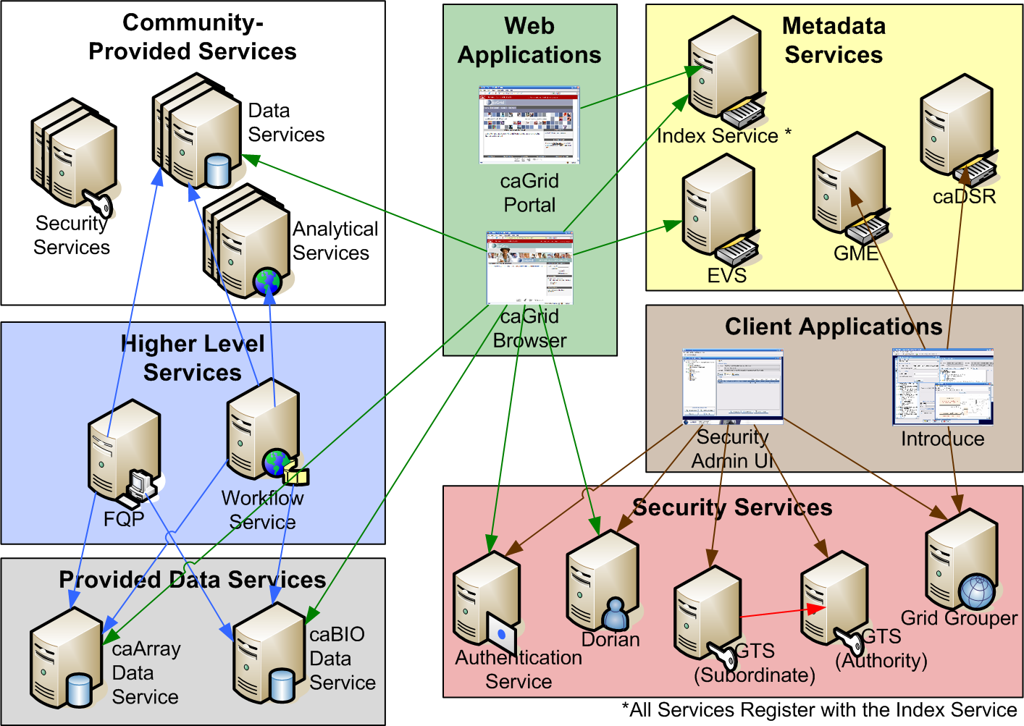
caGrid Production Environment

Slide 8
caGrid Community Involvement
caGrid itself provides no real “data” or “analysis” to caBIG™; its the enabling infrastructure which allows the community (that’s you!) to do so
Community members add value to the grid as applications, services, and processes (for example: shared workflows)
  caGrid provides the necessary core services, APIs, and tooling
The real “value” of the grid comes from bringing this information to the “end user”
Community members develop end user applications which consume of the resources provided by the grid

Slide 9
caGrid Projects
The caGrid release is oriented around a number of individual projects
Build process manages inter-project dependencies
Each project provides a specific set of functionality, and is self contained once caGrid is built
Grid Services:
  authentication-service, cadsr, dorian, evs, fqp, gme, gridgrouper, gts, index, syncgts, workflow, ws-naming, ws-transfer
Grid Service Components and Extensions:
  authz, bulkDataTransfer, cabigextensions, data, sdkQuery, sdkQuery32, service-security-provider, ws-enum, ws-handlesystem
Utilities and APIs:
  AntInstallerFramework, core, discovery, graph, gridca, metadata, metadatautils, opensaml
Applications:
  installer, introduce, portal, security-ui

Slide 10
Metadata Services
Cancer Data Standards Repository (caDSR)
  caBIG projects register their data models as Common Data Elements (CDEs) which are semantically harmonized and then centrally stored and managed the caDSR
  The caDSR grid service provides:
    Model discovery and traversal
    caGrid standard metadata generation capabilities
Enterprise Vocabulary Services (EVS)
  EVS is set of services and resources that address the need for controlled vocabulary
  The EVS grid service provides:
    Query access to the data semantics and controlled vocabulary managed by the EVS
Global Model Exchange (GME)
  GME is a DNS-like data definition registry and exchange service that is responsible for storing and linking together data models in the form of XML schema.
  The GME grid service provides:
    Access to the authoritative structural representation of data types on the grid
Globus Information Services: Index Service
  The Globus Information Services infrastructure provides a generic framework for aggregation of service metadata, a registry of running Grid services, and a dynamic data-generating and indexing node, suitable for use in a hierarchy or federation of services
  The Index grid service provides:
    Yellow and white pages for the grid

Slide 11
caGrid Security Components
Dorian
  Grid User Account Management
  Enables Identity Management and Federation
Authentication Service
  Provides a uniform authentication interface in which applications can be built on, and a framework for issuing SAML assertions for existing credential providers such that they may easily integrated with Dorian and other grid credential providers
Grid Trust Service (GTS)
  Creation and Management of a federated trust fabric.
  Supports applications and services in deciding whether or not signers of digital credentials/user attributes can be trusted.
Grid Grouper
  Grid Group / VO Management
  Enables Group/VO Based Authorization
Authorization Support
  Provides a framework to perform service authorization based on permissions from both the Common Security Module (CSM) as well as Grid Grouper groups
Security Communication Metadata
  Metadata providing the ability for two parties to negotiate a communication mechanism which meets the service’s requirements
Grid CA
  APIs and Command Line for platform independent certificate authority

Slide 12
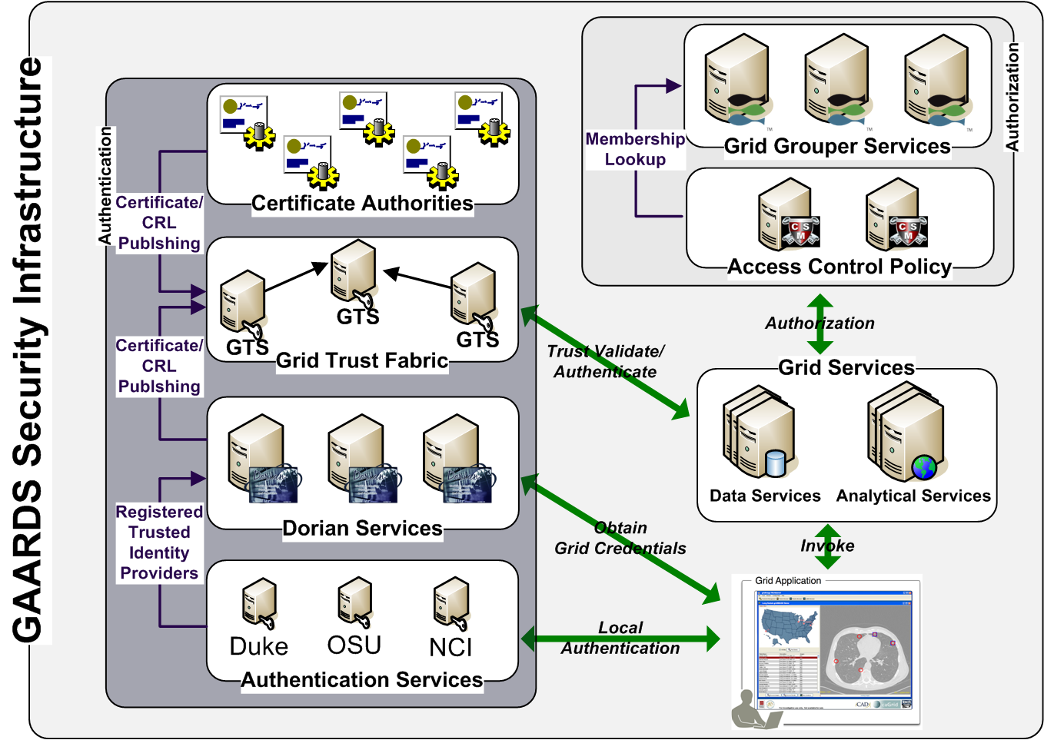
GAARDS Security Infrastructure

Slide 13
Data Service Overview
caGrid Data Services provide capability to expose silver data resources to the Grid
Specialization of caGrid grid services to expose data through a common query interface
  Meet all base service requirements of caGrid services
Present an object view of data sources
  Exposed objects are registered in caDSR and their XML representation in GME
  Data Service Metadata describes information model
  Queries made with CQL Query objects
    Results returned as objects nested in a CQL Query Result Set
Graphical Development tool, implemented as an extension to the Introduce Toolkit, is used to create the new grid service

Slide 14
Data Service Query Language
Specifies a target object (result) type and selects the instances which satisfy the specified properties and nested object properties
  Allows path navigation
  Provides logical grouping
  Provides name/predicate/value filtering on properties of objects
Recursively defined
Ability to return full Objects, Set of attributes, count of results, or distinct attribute values

Slide 15
Federated Query Processor
Provides a mechanism to perform basic distributed aggregations and joins of queries over multiple data services
As caGrid data services all use a uniform query language, CQL, the Federated Query Infrastructure can be used to express queries over any combination of caGrid data services
Federated queries are expressed with a query language, DCQL, which is an extension to CQL to express such concepts as joins, aggregations, and target services
Implemented as a stateful grid service, queries may be executed asynchronously and results retrieved at a later time
  Supports secure deployments wherein result ownership is enforced
Coupled with semantic discovery capabilities of caGrid, provides a powerful framework for data discovery, mining, and integration

Slide 16
Workflow Service
Provides capability to describe “orchestrations” of service invocations and data movement
  Uses existing defacto standard language: Business Process Execution Language (BPEL)
    Interoperability with other clients, editors, engines
Implemented as a stateful grid service, workflows can be created, stopped, paused, resumed, and cancelled and results retrieved at a later time
Coupled with semantic discovery, service metadata, and registration of data type structures in caGrid, provides a powerful framework for analyzing data
  Services can be dynamically discovered and federated queries can be invoked as part of a workflow

Slide 17
Introduce Overview
A framework which enables fast and easy creation of strongly typed and highly interoperable grid services
Provides a powerful extension system wherein specific functionality can be added to the service or service editing process
  Support for caDSR, GME, caGrid metadata, Data Services, and caGrid authorization services are all added this way
Abstracts all the details of the grid from the developer, allowing them to focus on the business logic being exposed
Provides a graphical environment

Slide 18
Service Development Process
Service developers first create a service using a simple wizard to specify information (target directory, type of service, service name, etc)
Next developer locate the data types they will use for inputs or outputs
  Can be discovered from the caDSR, GME, file system, etc
Operations are then defined that take some number of the data types as input, and produce some number as output
Metadata and Service Properties can be added and configured
The service’s security can be completely configured
Some or all of these steps may be automatically handled by extensions

Slide 19
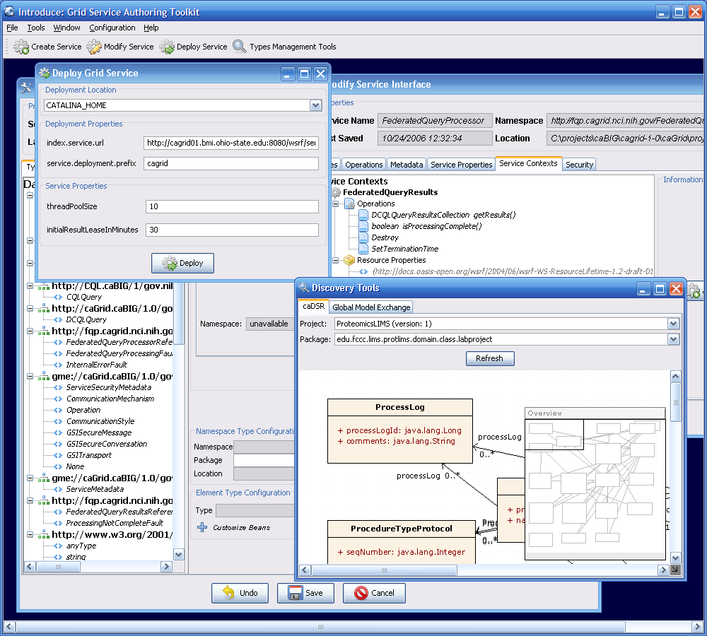
Introduce Graphical Development Environment
GUI for creating and manipulating a grid service
  Provides means of simple creation of service skeleton that a developer can then implement, build, and deploy
  Automatic code generation of complete caBIG compliant grid service which is configured to provide:
    Advertisement
    Standard Metadata
    Security
    Complete Client API

Slide 20
Current caGrid 1.0 Feature Highlights
Scott Oster, Shannon Hastings, Stephen Langella, David Ervin
Ohio State University
{oster,hastings,langella,ervin}@bmi.osu.edu
August 6th, 2007

