Slide 1
caGrid 1.0 Update
Architecture/VCDE Workspaces
Joint Face to Face
February 1st-2nd, 2006

Slide 2
Overview
caGrid Team
High Level Timeline
Use cases / Requirements
  Analytical Service Enhancements
  Data Service Enhancements
  Security Infrastructure Enhancements
  Metadata Management
  Workflow Middleware
  Object Identifiers
  caGrid 1.0 Portal/Monitor
  Workflow Adoption

Slide 3
caGrid 1.0 Goals
caGrid 1.0 “Production Release” focus
  caGrid 0.5 gaps
  caGrid infrastructure components that did not make it in 0.5
System Testing
Production Deployment
Migration Support for caGrid 0.5 services and users to caGrid 1.0
End User Guides
caBIG “Gold” compliance guidelines and specification

Slide 4
caGrid 1.0 Team
Ohio State University
  Analytical Service Enhancement
  Security Infrastructure
  Metadata Management
University of Chicago
  Workflow Middleware
  Object Identifiers
  Data Service Enhancement
Georgetown University
  caGrid 1.0 Portal
Duke University
  Workflow Architecture Adopter

Slide 5
Project Resources and Communication
caGrid 1.0 GForge Home:
  Feature Requests
  Bug Reports
  Discussion Forums
  Public Wiki
  Downloads / Source Repository
  http://gforge.nci.nih.gov/projects/cagrid-1-0/
caGrid Users Mailing List
  https://list.nih.gov/archives/cagrid_users-l.html
  cagrid_users-l@list.nih.gov
Architecture Workspace
  Community direction from Working Groups
  Report out and feedback during WS calls

Slide 6
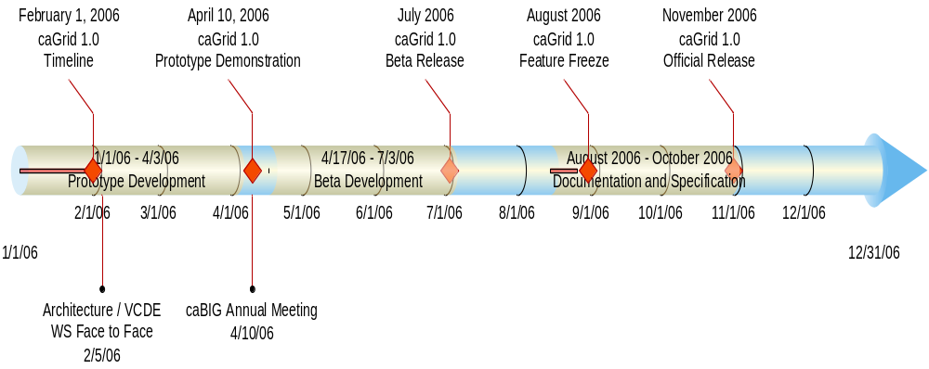
caGrid 1.0 Timeline

Slide 7
caBIG Annual Meeting Target
Integrated Scientifically Relevant Demonstration Scenario
  Creation of Grid services via Introduce
    Data and Analytical Services with “real world” overlapping data models
  Securely deployed services
  Obtain grid credentials using Dorian leveraging an Institutional Identity Provider
  Show Portal/Monitor geospatial view of services and metadata
  Create meaningful scientific workflow over services
    Query multiple data services, aggregate and iterate over results invoking analytics
  Execute and monitor workflow
  Display results

Slide 8
Introduce Service Creation Framework
Goal:
  Enable easy path to caBIG gold compatible service creation
  Streamlines bringing applications to the Grid
History
  Analytical Service Toolkit (caGrid 0.5)
    Used in building gold compatible analytical services.
caGrid 1.0
  It can be used to generate Analytical, Data, or completely custom services such as core services (security, metadata, etc)
  The Introduce created service framework handles all the basic core requirements that are expected of any caBIG grid service such as:
    Service advertisement
    Service metadata registration
    Security configuration
    Strongly typed interfaces
  Service Specifications will be created to specify functional requirements for those not wishing to use Introduce

Slide 9
Introduce Service Creation Framework
Basic Features:
  Supports creation of custom caBIG compatible grid services
    Including analytical, data, as well as purely custom
  Provides graphical service creation environment
  Takes user from service creation through deployment
  Enforces strongly typed interfaces via caDSR/GME type discovery
  Enables easy configuration for security, registration, and metadata publication

Slide 10
Introduce Features
Creates Globus based grid service
  Service Interface
  Client implementation
  Server stubbed implementation (developer adds business logic)
  Resource Properties for Service Metadata
  Index service registration configuration
  Method level and service level security configuration as well as client side security configuration
  Deployment configuration parameters
Deployment scripts and configuration files
Graphical and command line tools for all aspects
Creates an Eclipse project for quick and easy implementation (not required)

Slide 11
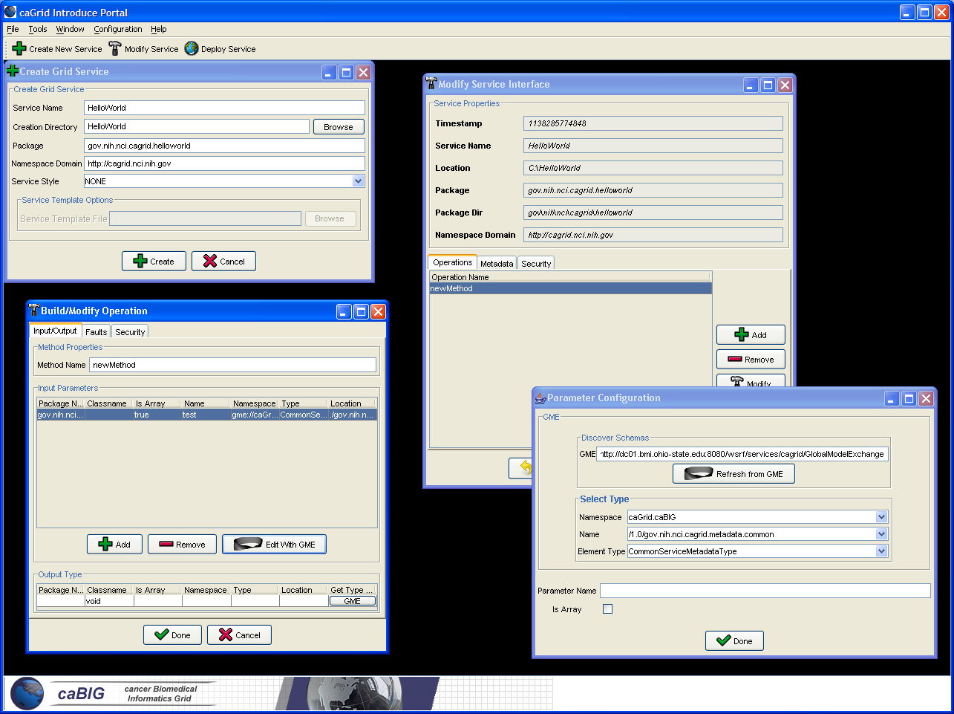

Slide 12
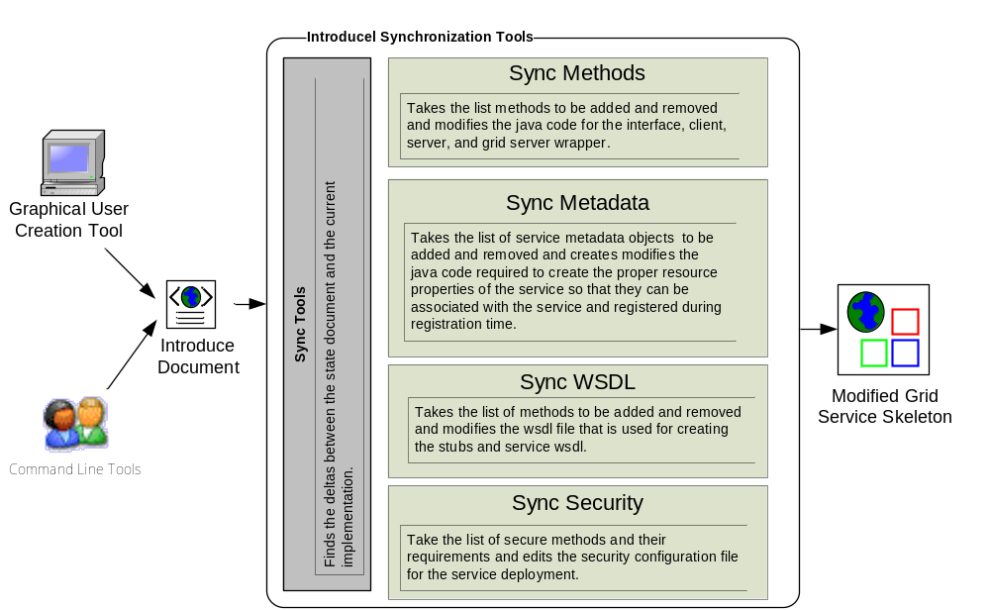
Overview of Current Introduce Framework

Slide 13
Data Services
Data Services work falls into two major categories
  Query Language Support
  Results delivery
Use Cases
Implementation Plans

Slide 14
Query Language Support
What query language support will be present?
  Need to review the work already done by the Query SIG
  Need to factor in any new requirements from new use cases
  Main question appears to be ease of use versus capabilities
    May be possible to implement the easier case over a more full featured alternative and allow the end user to use what is most appropriate.

Slide 15
Results Delivery
This will be tackled in four phases
  currently, results are delivered as strings
  Phase I: return a small number of typed objects in the response
  Phase II: Add WS-Enumeration support to allow “cursor” access when a large number of objects are returned.
  Phase III: For large binary data (i.e. images) return a typed “pointer” (LSID?) in the response and move the binary data out of band

Slide 16
Results Delivery (continued)
Fourth Phase is exploratory
  this would be purely an optimization issue
  Currently, If the data is not already stored in XML, it must be converted to XML, serialized, sent over the wire, deserialized, and possibly converted again.
  We want to investigate the possibility of moving the data in its native format out of band, and then do the object conversion locally and transparently to the application.

Slide 17
Use Cases
We have reviewed the use cases developed by the Query SIG
Need to flesh out and factor in, the new use cases that we just received, particularly the binary large object (blob) use cases and see how it affects the requirements of the query language.
A key factor in developing the requirements will be the complexity of queries that researchers feel they need.
Once we have a set of requirements from the researchers side, we need to factor in such things as ease of use for the researcher, ease of development for the service developer, “total cost of ownership” to NCI, extensibility for the future, etc..
Make a recommendation to NCI and proceed from there.
Would be interested in creating a Working Group of interested parties for this work.

Slide 18
Implementation Plans
By April we will
  Have the interfaces stable
  Have at least partial support for the Query Language functional
    Basics will be present, some features may be missing.
  Phase I of data delivery working

Slide 19
caGrid 1.0 Security
Goals:
  Focus is on getting the basic building blocks in place to facilitate the secure deployment of multi-institutional production applications.
  Leveraging/Extending work done in the Grid, caBIG, and other related communities to provide a enterprise solution.
  caGrid implementation efforts are not focused on policy but on providing the building blocks that the community can use for implementing policy.
  Streamlined integration within caGrid (via Introduce)
What will the infrastructure be based on?
  Relevant existing caGrid 0.5 security
  caGrid 0.5 lessons learned
  caBIG Security Evaluation White Paper
  Use cases submitted by the community
  Requirement Solicitation for caGrid Security
  Architecture Working Groups

Slide 20
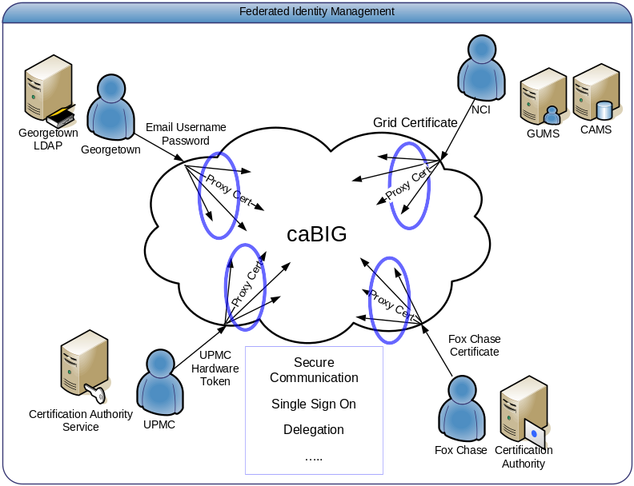
caGrid 1.0 Security – Areas of Focus
Federated Identity Management
  Enable users to use their institution provided identity for authenticating to the Grid.
Service Provider Credential Provisioning
  In order for services to invoke other services, they will need to have credentials.
  We want to provide a streamlined approach to credential provisioning
Authorization
  Authorization is finding out if the person, once identified, is permitted to have the resource.
  We want to empower service providers to make authorization decisions.

Slide 21
caGrid 1.0 Security – Areas of Focus
Building a Trust Fabric / Trust Management
  Grid Security is built on Trust
  User / Services are authenticated based on whether there credentials are signed by a trusted authority
Virtual Organizations
  Users with common attributes should be able to be grouped into organizations based on common characteristics, and should be able to manage resource usage, permissions, and group membership.
caGrid Integration
  Streamline all aspects of security into the service development and deployment process.
  Service Security will be configurable through the Introduce Toolkit.

Slide 22
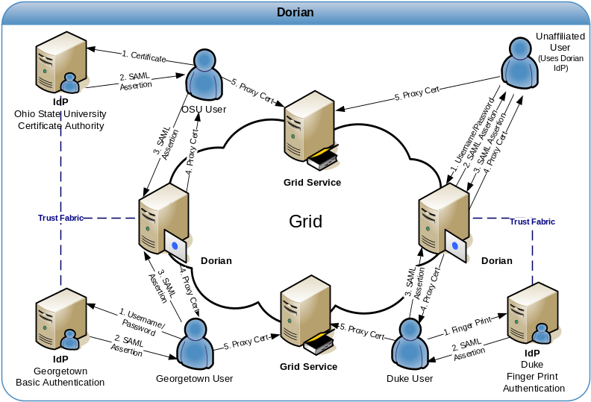
caGrid 1.0 Security – Status
Federated Identity Management
  GUMS redesigned and rename to Dorian to address Federated Identity Management Requirement.
  Prototype Completed.
Dorian
  Enables users to authenticate and create grid proxies via their institution’s Identity Provider (IdP)
  Internal Dorian IdP allows unaffiliated users or small institutions access to the grid.
  Internal Certificate Authority / ability to integrate with existing Certificate Authorities
  Administration Interface
    Configurable/Extensible User Policies
    User Management
    Trusted IdP Management

Slide 23
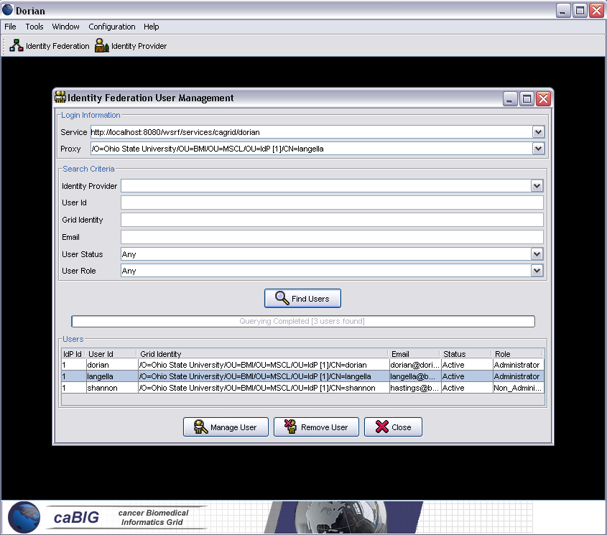
caGrid 1.0 Security – Status
Dorian Current Status
  Initial service implementation completed
  Integrated with Ohio State University IdP
  Initial administration portal completed
  ~ 100 Nightly Unit Tests
  Dorian technical paper completed.
Community Participation Needed
  Community standardization of the SAML authentication assertions.
    Probably will need a small working group with members from ARCH and VCDE
  Early adopters needed
    Integration between Cancer Center IdPs and Dorian

Slide 24
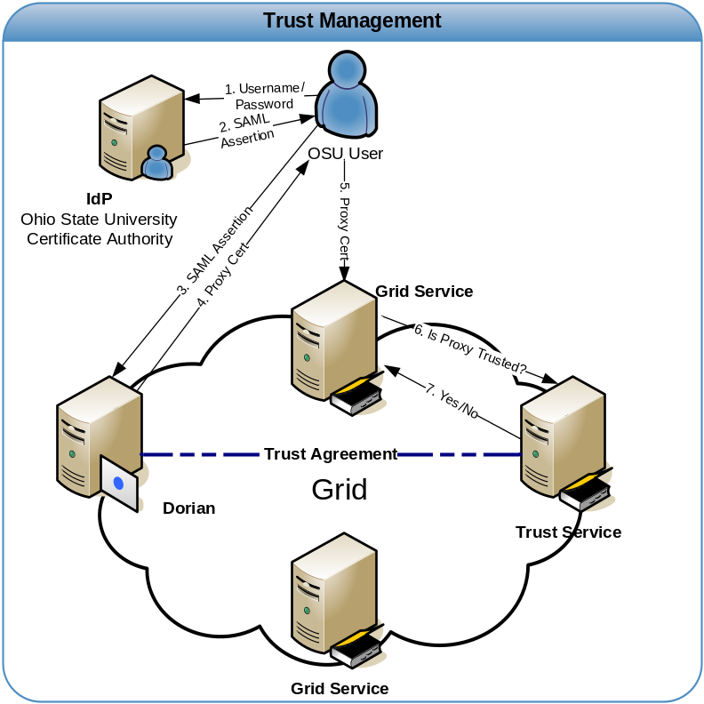
caGrid 1.0 Security – Status
Service Provider Credential Provisioning
  Middle of Design Phase
  Provide an online CA for provisioning credentials
  Integration with Introduce Toolkit
Trust Management
  Middle of Design Phase
  Create a Trust Service for Managing Trusted Authorities

Slide 25
caGrid 1.0 Security – Status
Authorization
  We will provide a callout mechanism which service providers can implement for providing custom authorization.
    Empowers authorization decisions to be made locally.
  Early Design Phase
  Discussing Possible Approaches and what is needed in terms of grid infrastructure.
  Working Group Proposed
Virtual Organizations
  Early Design Phase
  Discussing whether or not and what grid infrastructure is required
    Closely Related to Authorization

Slide 26
caGrid 1.0 Security – Annual Meeting
Federated Identity Management
  Initial Dorian Implementation Completed and Deployed
  Demonstration
Authorization
  Call back mechanism will be in place allowing locally made authorization decisions
  Design in Process.
Service Credential Provisioning
  Design In Process
  Prototyping
Trust Management
  Design In Process
  Prototyping
Introduce Integration
  Core Grid Security Integrated
  Demonstration

Slide 27
caGrid Metadata Infrastructure Goals
Advertisement and Discovery
  New standards for service metadata (VCDE Harmonized)
  Migration of Advertisement and Indexing Infrastructure
  Migration and Enhancements of Discovery API
Data Description Metadata Management
  GME Migration
  Grid Service Access to information in caDSR
  Incorporation of existing XML schemas
  LexGrid integration

Slide 28
Metadata: Advertisement and Discovery
Advertisement:
  The caGrid Grid Service Owner composes service metadata describing the service to the grid and publishes it to grid. The service metadata describes properties of the grid services that caGrid users and other grid services may query.
Discovery:
  A caGrid Researcher specifies search criteria describing a service. The research submits the discovery request to a discovery service, which identifies a list of services matching the criteria, and returns the list to the researcher.
Use Cases:
  Publish advertisement a Grid Service
  Remove advertisement of a Grid Service
  Update advertisement of a Grid Service
  Discover advertisement a Grid Service

Slide 29
Metadata: Data Description Metadata Management
GME
  GME is a DNS-like data definition registry and exchange service that is responsible for storing and linking together data models in the form of XML schema.
  caDSR data objects which travel the grid as XML do so in the format described in GME-registered schemas
  Tasks:
    Migration of service interface to Globus 4
    Incorporation of existing XML schemas
caDSR
  Tasks:
    Grid service interface to access high-level model information
    Process for tighter mapping between caDSR (objects) and GME (XML)
LexGrid
  Designed to bridge terminologies and ontologies with a common set of tools, formats and update mechanisms. Will make information in EVS available.
  Tasks:
    Support LexGrid team needs for metadata, discovery, and grid service.

Slide 30
Metadata Functionality for Annual Meeting
Service infrastructure for service metadata creation and advertisement
Index Service
GME Service
Preliminary Discovery API Migration

Slide 31
caGrid Workflow - High Level Objectives
Ability to compose workflows integrating data and analytic services in flexible patterns
Ability to record data provenance of results as by-product of workflow execution
Flexible control-flow patterns: loops, conditionals, iteration over collections
Robustness – recover and continue long running workflows after failures
Integration: specify workflows in graphical interfaces and
Workflows cognizant of data-type correctness of arguments passed

Slide 32
caGrid Workflow - Targeted Functionality
BPEL – Business Process Execution Language
  BPEL4WS - a standard for the low level control and composition of Web Services
Ability to run workflow of caGrid 1.0 services
  Grid security
  Pass resource references throughout workflow
Pre-check workflow for type correctness
Select services dynamically
Desired enhancements
  Optimize data flow: avoid central host bottlenecks
  Control of workflow execution: status, pause, resume, cancel
  Higher-level language to specify workflow: avoid tedium of coding BPEL directly

Slide 33
caGrid Workflow - Architecture Components
Workflow engine
  How many? where? how managed?
Workflow documents
  Workflow description forms and creation tools
Workflow Type checker
Workflow management client
  Required: submit, check status, cancel
  Desired: pause, resume
Service Descriptions
  Need to interface to the workflow tools
Service locator / selector
  Select specific service instances when choices are available
  Workflow Planner turns abstract workflow into concrete form

Slide 34
caGrid Workflow - Current use cases being studied
RProteomics Analysis
  [mzXML input] > [select] > [scanFeatures] >[bkgroundRemoval] >
  [ denoise ] > [align] > [translate] > (mzXML results)
  Seek flexible composition of these services
  Test ability to compare results across different approaches within a single workflow (iteration, nesting, WF pattern replication)
InVivo Image Analysis Use Case
  Image selection
  Diagnostic utility invocation(s)
  Result rendering
  Diagnostic result comparison
  Possible iteration (sweeps) over parameter spaces

Slide 35
caGrid Workflow - Implementation Plans
Phase I
  Adapt ActiveBPEL Open Source Engine to caGrid Services
  Security, WS-RF resource-passing conventions
caBIG Annual Meeting Target
  Create meaningful scientific workflow over services
  Query multiple data services, aggregate and iterate over results invoking analytics
Phase II
  Workflow control
  Workflow dynamics: service selection
  Type Checking
Phase III
  Scalability: multiple concurrent workflows
  Robustness: restartability, recoverability

Slide 36
caGrid 1.0 Data Identifiers Goals
Leverage the requirements and use cases from the Identifiers SIG.
Proceed with a “pragmatic” LSID naming scheme.
Architect and design a solid, secure backend infrastructure for the LSID Name=>Location resolution
Ensure that the data-movement integrates well with other Services (Data and Analytical)
Ensure that query and administrative identifier operations integrate with caGrid Security
Identify use case and deliverables for first prototype

Slide 37
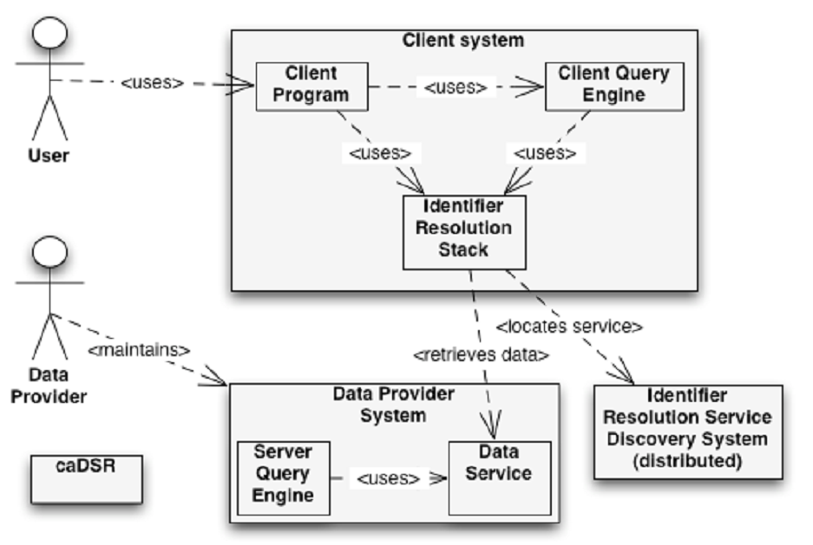
Selected Use Cases from Identifiers SIG
Retrieve Data by Identifier or list of Identifiers
Provide Identified Data
Move Data to new host
Inspect metadata of Identified Data

Slide 38
caGrid 1.0 Data Identifiers cont.
What will the infrastructure be based on? (no final decisions made yet…)
  Web service interfaces for the life-cycle management operations of Identifiers
  Name=>Location mapping in Handle System backend system
  Data movement based on Data Service data movement (e.g. OGSA-DAI, GridFTP, and maybe LSID interfaces)
Timeline
  End of February:
    Architecture, design and implementation document
    Detailed prototype deliverables

Slide 39
caGrid 1.0 Portal Overview
Create a portal for the grid
  A high level user interface to the grid
  Center directors might use for monitoring local caBIG adoption
  PI’s might use for to check tool availability
A Framework
  Will use a framework, either explicitly for portals or for more general web applications
  Several example ‘plugins’ to the framework will be developed, based on use cases
‘Orthogonal’ to the grid
  Portal functionality should not affect the grid
    Current use cases envision passive ‘plugins’, though they may be active in the future
  Changes to the grid may affect the portal
    Graceful degradation of service
Opt-in during installation
  During service installation, users may be prompted to participate in the monitoring system
  No sensitive data collected

Slide 40
caGrid 1.0 Portal Use Cases
Geospatial representation of grid nodes
  Users see the physical, geographic distribution of nodes within the grid.
  Example use: An investigator wants to know of any other local research institutions using caGrid resources for possible collaborative efforts.

Slide 41
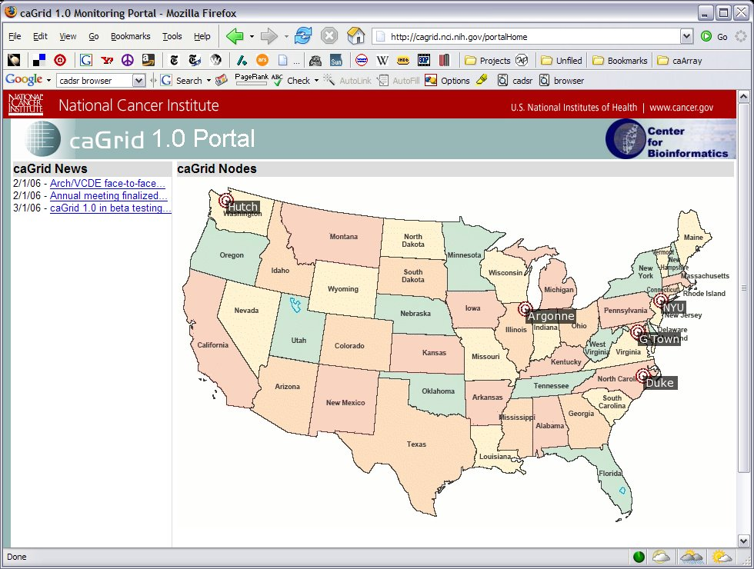
Portal Home Page Mockup – Geospatial Visualization

Slide 42
caGrid 1.0 Portal Use Cases
Node service enumeration and heartbeat, including history
  Users see a list of services each node offers, the current (or most recent) status of each service, and historic data on the availability of each service.
  Example use: an investigator is interested in using a grid service to submit many long running jobs, and can determine which grid resources are best suited based on historical data.

Slide 43
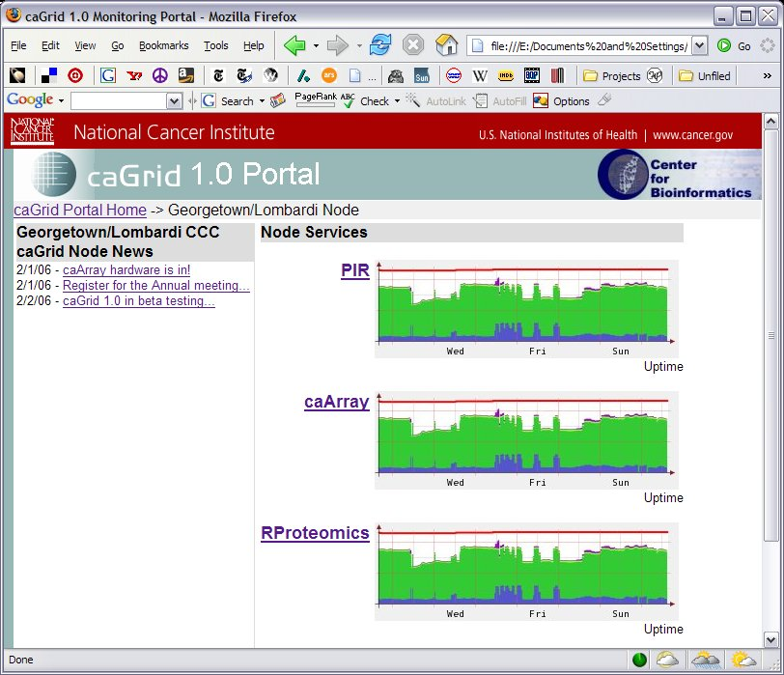
Portal Node Mockup – Service Enumeration

Slide 44
caGrid 1.0 Portal Use Cases
Node service metadata enumeration
  Users see a list of metadata associated with each service. Metadata is indexed across all grid services, and possibly versioned in some way.
  Example use: an investigator is interested in searching for all services which deal with a particular concept, or have a particular characteristic represented in metadata, such as all services which handle microarray data.

Slide 45
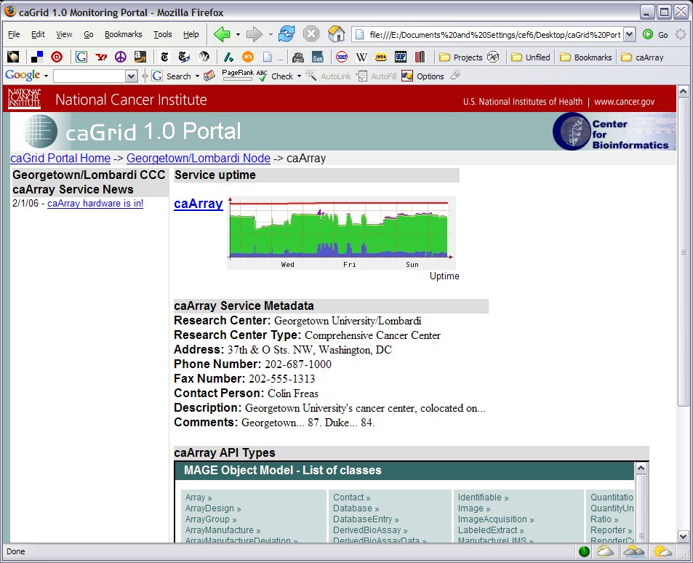
Portal Service Mockup – Service Metadata

Slide 46
Other Use Cases
Security Entity Visualization
  To allow users to quickly determine trust relationships between security entities on the grid
Draw linkages between systems that contain common CDEs thereby diagramming possible aggregations or data bridges.
  This could be one of several layers that could be added to the geographic layout of nodes.
  Another might be a security layer to visualize which services trust each other.
A user wishes to search based on a concept and its children.
  Example: someone wants to search for information about Cancer TNM Findings by Site (in the CAP protocol model). The client goes to NCIt and finds the 3 children (Breast Cancer TNM finding, Cutaneous Melanoma TNM Finding, and Prostate Cancer TNM Finding) and their children (probably about 10 concepts altogether). Assuming the CAP models were on the Grid it would find 4 possible classes instead of just one.

Slide 47
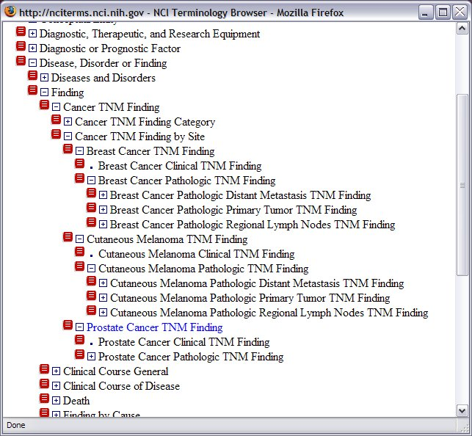
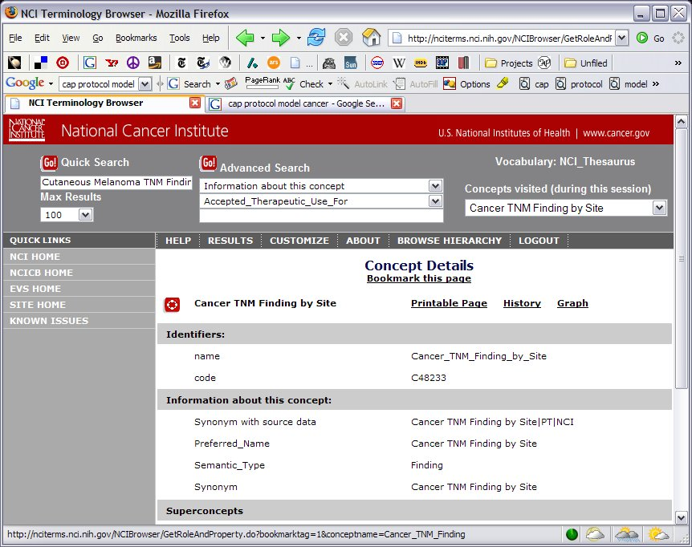
Current NCIt Implementation

Slide 48
caGrid Portal Development Plan
Use case solicitation concurrent with initial development
  Any other use cases based on what’s been presented here or suggested to be in the portal will be considered
  Current plan calls for use cases to be finalized over the next month or so
Evaluate several frameworks
  Tapestry
  Struts
  JBoss Portal
  Create ‘hello, world!’ grid prototype for each framework.
Alpha version development
  Backend grid components
    Rely heavily on Globus monitoring and discovery mechanisms
  Framework components
  User interface components

Slide 49
caGrid Portal at the caBIG Annual Meeting
At the annual meeting, a working version of several use cases should be ready
  Data feeding the system may be static in April

Slide 50
Duke’s Role in caBIG
ICR, VCDE, and Architecture participant
Architecture
  Liaison to ICR
  Formerly Workflow SIG Lead
  Formerly active in Data SIG
ICR
  Liaison to Architecture
  Active in Data/Analysis Tools SIG and Proteomics SIG
  Developer in proteomics SIG
VCDE
  Active in various interoperability reviews

Slide 51
Duke’s Role in caGrid
caGrid adopter
  Use case solicitation/drafting
    Binary data, metadata, provenance
  Document review
  Testing
    Introduce, analytical/data services, security, portal, etc.
  Code review
Workflow adopter
  Use case solicitation/drafting
  Document review
  Testing
    Each major milestone
    Also some home-grown multi-domain tests

Slide 52
Duke’s caGrid Role in the
Annual Meeting
Help provide use cases for demos
  Workflow, analytical, and data services
Help with deployment of demos
Help with testing of demos

Slide 53
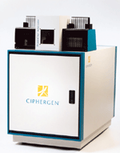

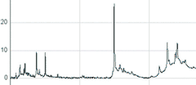
Potential Workflow Demo
Data Files
Samples
Instrumentation
Wet Lab
RProteomics
udwtW
(denoising)
Interpolation
alignx
(alignment)
Running Quantile
(bkg removal)
loess
(bkg removal)
Plot
MAD
(normalize)
Plot

Slide 54




Potential Services Demo
Grid Data Query
DWD
Grid Analysis Invocation

Slide 55
caGrid 1.0 Update
Architecture/VCDE Workspaces
Joint Face to Face
February 1st-2nd, 2006

