Slide 1
caGrid Technology Demonstration
caBIG Annual Meeting
April 9th-11th, 2006

Slide 2
What is caGrid?
Development project of Architecture Workspace, aimed at helping define and implement Gold Compliance
caGrid provides the core infrastructure needed for the Grid, tooling and APIs for clients, as well as tooling to provide “a way” to achieve Gold compliance

Slide 3
What will you see?
Graphically building queries to integrate semantically related data from multiple data services
Executing a parallel workflow over multiple caGrid services
Creating, Implementing, Deploying, and Invoking a new secure analytical service in a matter of minutes
Accessing a secure grid service by having your local institution vouch for your identity

Slide 4
caGrid
Data Service
caBIO
caGrid Data Service

Slide 5
caGrid
Data Service
caBIO
Taxon
Agent
Gene
Object Model Metadata

Slide 6
caGrid User
CQL query
caGrid
Data Service
caBIO
Taxon
Agent
Gene
Object Model Metadata

Slide 7
caGrid User
XML Resultset
caGrid
Data Service
caBIO
Taxon
Agent
Gene
Object Model Metadata

Slide 8
caGrid
Data Service
caGrid
Data Service
caBIO
PIR
Taxon
Gene
Agent
Gene
Protein
Object Model Metadata
Object Model Metadata

Slide 9
caGrid
Data Service
caGrid
Data Service
caBIO
PIR
Taxon
Gene
Agent
Gene
Protein
Object Model Metadata
Object Model Metadata

Slide 10
Federated Query Plan
caGrid
Federated Query Engine
CQL
CQL
caGrid
Data Service
caGrid
Data Service
caBIO
PIR

Slide 11
Federated Query Plan
caGrid
Federated Query Engine
XML Resultset
CQL
CQL
caGrid
Data Service
caGrid
Data Service
caBIO
PIR

Slide 12
Workflow demo overview
Standards-based workflow
  Business Process Execution Language (BPEL)
Data
  Object model registered in caDSR
  Pipe results between services
Federation
  caGrid 1.0 Data and Analytical Grid Services
  Data: Argonne
  Analytical: Duke and OSU
Iteration
  Iteration over set of objects, performing service invocation on each
Parallelism
  Divide processing between two different sites

Slide 13

Service-oriented Science via caGrid workflow
Data Service
@ uchicago.edu
Workflow script:
Fetch data from
data service in Chicago
Perform step 1
using service at Duke
Perform step 2
using service at OSU
Workflow
Results
Analytic service
@ duke.edu
Analytic service
@ osu.edu

Slide 14

caGrid workflow implementation
Data Service
@ uchicago.edu
<BPEL
Workflow
Doc>
<Workflow
Inputs>
link
BPEL
Engine
Analytic service
@ duke.edu
link
link
<Workflow
Results>
link
Analytic service
@ osu.edu
Each workflow is also a service
  Enacted by BPEL Engine
  Typically runs like a script (synchronous)
  Other powerful models are possible

Slide 15
Basic BPEL Workflow Model
Receive
Inputs
Assign
args
Invoke
Service
Assign
results
Send
results
Analytic
Service

Slide 16
BPEL Workflow Model – Parallelism (flows)
Assign
args
Invoke
Service
Assign
args
Invoke
Service
Assign
args
Invoke
Service
Assign
results
Receive
Inputs
Assign
args
Invoke
Service
Assign
args
Invoke
Service
Assign
args
Invoke
Service
Assign
results
Send
results
Assign
args
Invoke
Service
Assign
args
Invoke
Service
Assign
args
Invoke
Service
Assign
results

Slide 17

Workflow demo overview
CQL
5x
Argonne
Data Service
Duke
5x
5x
interpolate
removeBG
denoise
align
normalize
plot
iterate
10x
10x
OSU
10x
5x
5x
interpolate
removeBG
denoise
align
normalize
iterate
5x

Slide 18
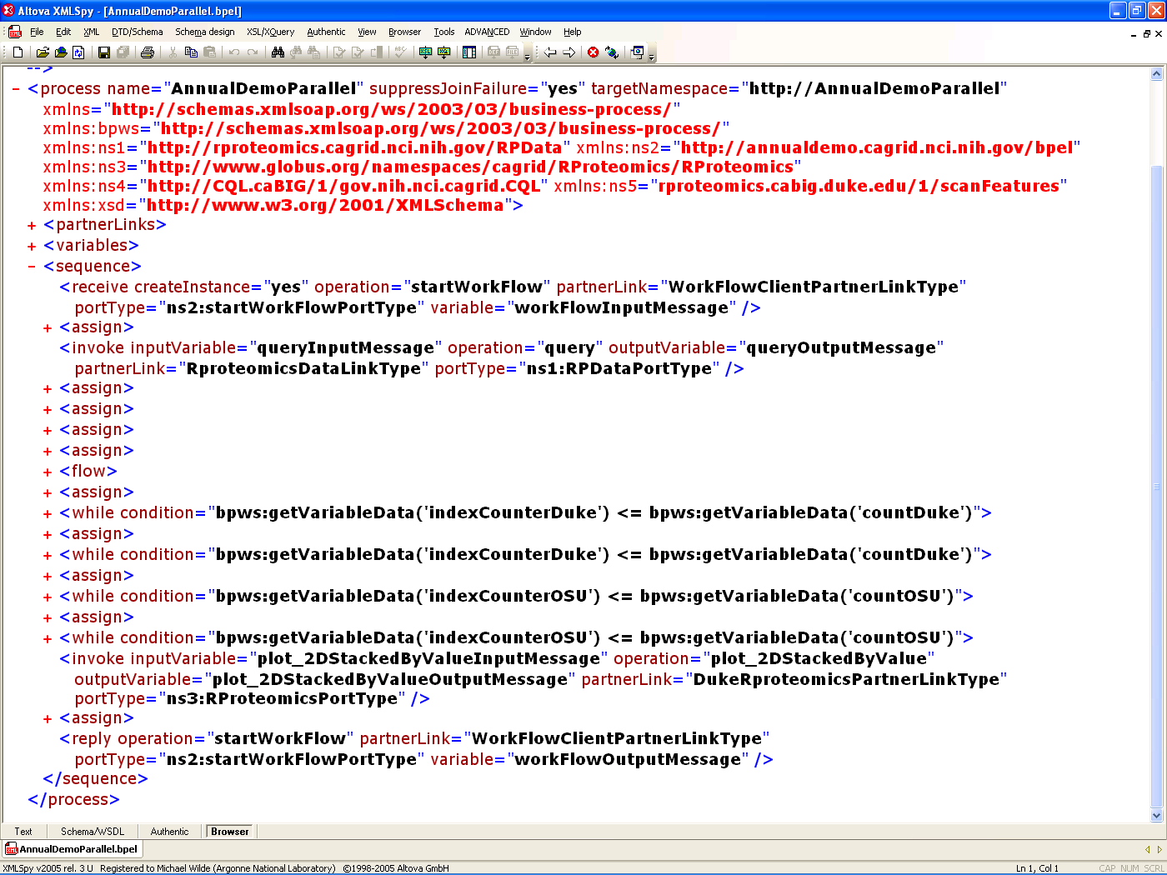
Workflow Document
</FOO>

Slide 19
CQL Query Passed to Workflow
<ns1:query xmlns:abpel-deser1="http://rproteomics.cagrid.nci.nih.gov/RPData"
xmlns:ns1="http://rproteomics.cagrid.nci.nih.gov/RPData">
<query xmlns:ns5="http://CQL.caBIG/1/gov.nih.nci.cagrid.CQL"
name="scanFeatures_query2.xml">
<ns5:Target xmlns:ns6="http://CQL.caBIG/1/gov.nih.nci.cagrid.CQL"
name="edu.duke.cabig.scanFeatures.ScanFeatures">
<ns6:Objects xmlns:ns7="http://CQL.caBIG/1/gov.nih.nci.cagrid.CQL"
name="edu.duke.cabig.scanFeatures.Attributes">
<ns7:Objects/>
<ns7:Group/>
<ns7:Property xmlns:ns9="http://CQL.caBIG/1/gov.nih.nci.cagrid.CQL“
name="project" predicate="equal" value="WorkflowDemo"/>
<ns7:Property xmlns:ns8="http://CQL.caBIG/1/gov.nih.nci.cagrid.CQL"
name="processingStep" predicate="equal" value="load"/>
</ns6:Objects>
</ns5:Target>
</query>
</ns1:query>

Slide 20
BPEL Workfow Document Excerpt
<receive createInstance="yes" operation="startWorkFlow“
partnerLink="WorkFlowClientPartnerLinkType“
portType="ns2:startWorkFlowPortType“
variable="workFlowInputMessage" />
<assign>
  <copy>
  <from expression=""1"" /> <to variable="indexCounterDuke" />
  </copy>
  <copy>
  <from part="parameters" query="/ns1:WorkFlowInputType/query"
  variable="workFlowInputMessage" />
  <to part="parameters" query="/ns1:query" variable="queryInputMessage" />
  </copy>
  </assign>
  <invoke inputVariable="queryInputMessage" operation="query“
  outputVariable="queryOutputMessage"
  partnerLink="RproteomicsDataLinkType" portType="ns1:RPDataPortType" />
  <assign>
  <copy>
  <from expression="count(bpws:getVariableData('queryOutputMessage', 'parameters',
  '/ns1:queryResponse')/response/ns4:CQLQueryResult) div 2" />
  <to variable="countDuke" />
  </copy>
  </assign>

Slide 21
BPEL Document – Iterate over a service call
<while condition="bpws:getVariableData('indexCounterDuke')
<= bpws:getVariableData('countDuke')">
<sequence>
  <assign> ... </assign>
  <invoke inputVariable=
  "denoise_waveletUDWTWByValueInputMessageDuke"
  operation="denoise_waveletUDWTWByValue"
  outputVariable=
  "denoise_waveletUDWTWByValueOutputMessageDuke"
  partnerLink="DukeRproteomicsPartnerLinkType“
  portType="ns3:RProteomicsPortType" />
  <assign> ... </assign>
  </sequence>
  </while>

Slide 22
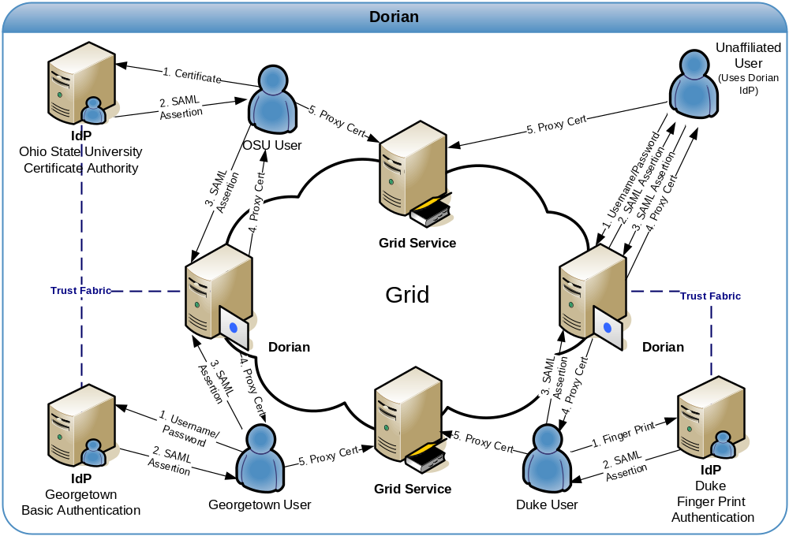
Dorian

Slide 23
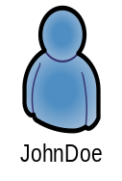



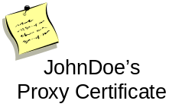

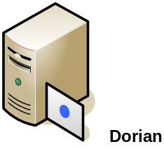


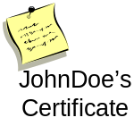
Dorian IFS – Proxy Creation
SAML
Assertion
Proxy Creation Workflow
  Client authenticates with Local IdP
  Client creates public/private key pair to use for grid proxy.
  Client requests Dorian to create a grid proxy.
  Dorian verifies that the SAML assertion provide by the user is signed by a Trusted IdP and that the user has a valid account.
  Dorian locates the uses grid credentials, private key and certificate
  Dorian uses the public key provided to create a proxy certificate and signs it with the users private key
  Dorian returns the proxy certificate to the user.
  The user may now use the proxy to authenticate to grid services
SAML Assertion
Username / Password
SAML Assertion
Signed

Slide 24
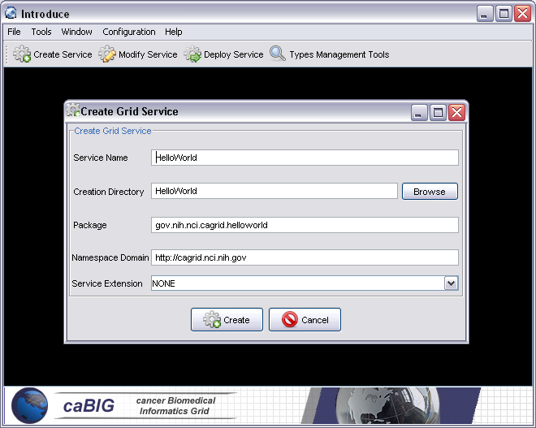
Introduce Service Authoring Toolkit
Service Creation
Populate required variables for service creation
  Name = published service name
  Creation Direction = directory to create the service skeleton
  Package = the root java package you wish to use for your service
  Namespace Domain = the namespace to be used to define the service interface and types

Slide 25
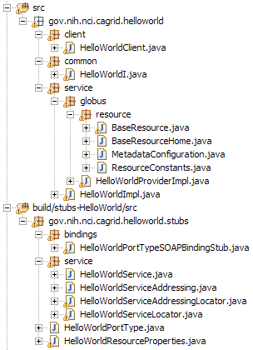
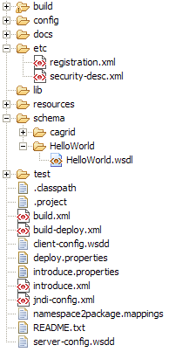
Created Skeleton Layout
= generated
= built
= developers
contribution

Slide 26
Created Skeleton Layout (cont)
= implements the developer
defined interface and calls into
the generated client port type
stub
= the developer defined grid
service interface
= manages the resources
(metadata) of this grid service
= implements the port type
and calls into the actual
clean unboxed interface
the developer defined
= developers implementation
of the defined interface

Slide 27
Created Skeleton Layout (cont)
= service metadata registration configuration
= describes the services security configuration
= services WSDL file
= configuration files for eclipse development
= ant build files
= client configuration file for axis
= deployment time service properties
= introduce representation of service
= JNDI service resources configuration
= namespace mappings for axis
= server configuration file for axis

Slide 28
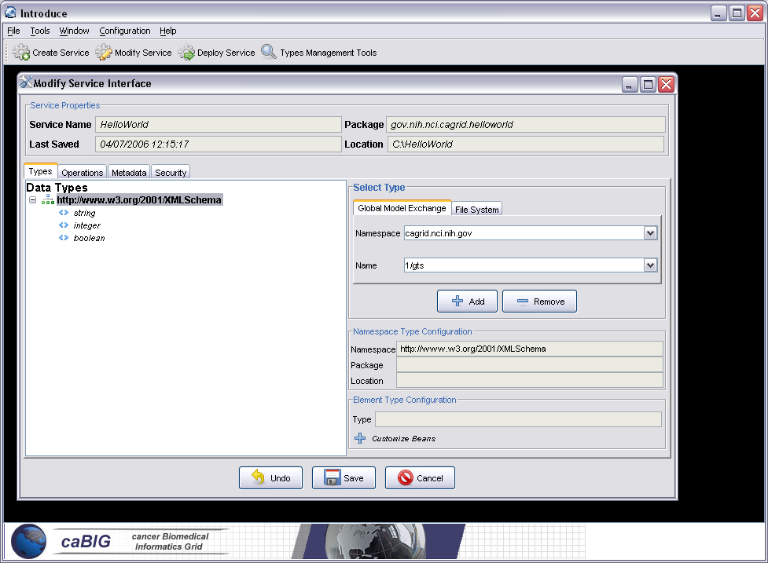
Introduce Service Authoring Toolkit
Discover Types
Using discovery tools a user can quickly obtain data models for the data types that they wish to use in this service. These data types can come from the caDSR, GME, or even the file system.

Slide 29
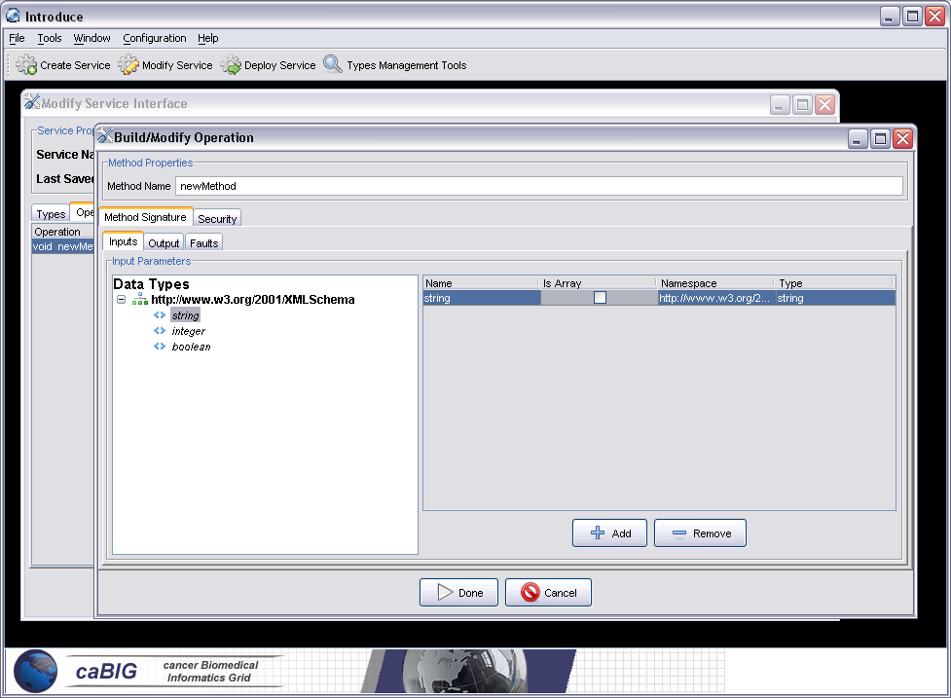
Introduce Service Authoring Toolkit
Add Operations
Using the selected types the user can easily design their strongly typed grid service interface by adding new methods, describing their signatures, and configuring any security settings

Slide 30
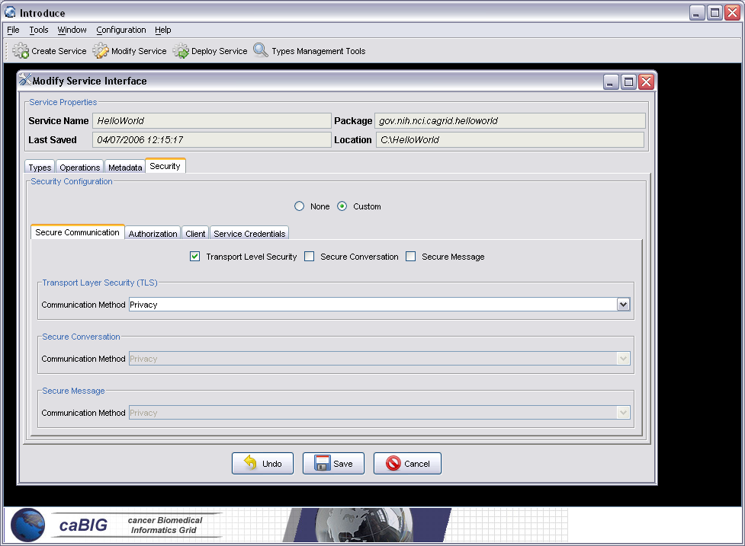
Introduce Service Authoring Toolkit
Service Security
Service level security settings can easily be configured to match your institutional or laboratorial security constraints, or used to create a custom security configuration

Slide 31
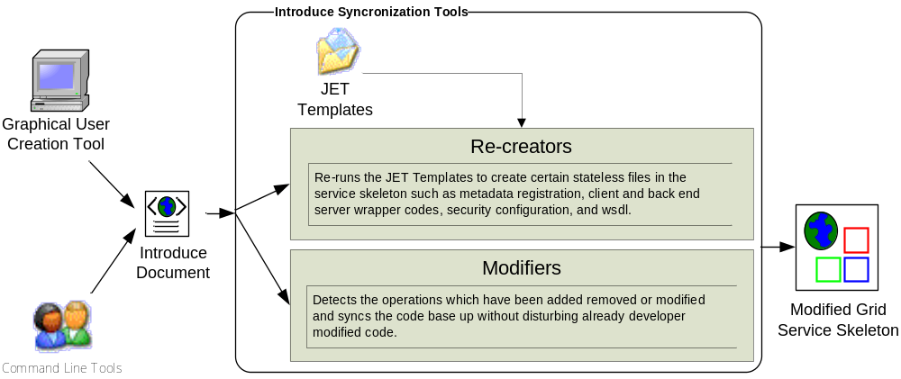
Introduce Service Modification Architecture

Slide 32
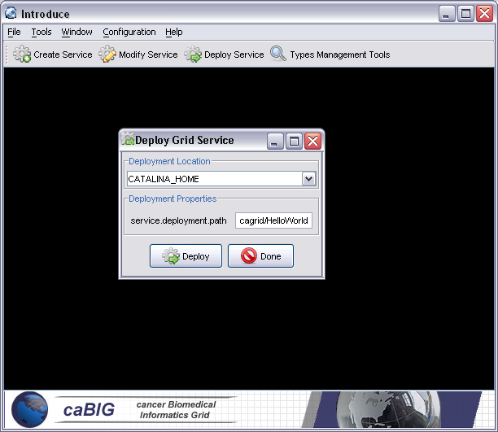
Introduce Service Authoring Toolkit
Service Deployment
Once the generated interface has been implemented the service can then be deployed to a service container so that it can be discovered and invoked

Slide 33
What didn’t you see?
Many more features and enhancements in the pipeline for caGrid 1.0
Higher-level APIs for interacting with data services, and a stronger integration with typing from caDSR/GME
Web accessible Grid Monitoring Portal, featuring geospatial rendering of available grid nodes
Service framework and APIs for grid unique identifiers
Many higher-level security infrastructure services and management capabilities
Integration with caDSR for data types discovery when building grid services
Extensive graphical configuration of caGrid services
Much more…

Slide 34
Project Resources and Communication
caGrid 1.0 GForge Home:
  Feature Requests
  Bug Reports
  Discussion Forums
  Public Wiki
  Downloads / Source Repository
  http://gforge.nci.nih.gov/projects/cagrid-1-0/
caGrid Users Mailing List
  https://list.nih.gov/archives/cagrid_users-l.html
  cagrid_users-l@list.nih.gov
Architecture Workspace
  Community direction from Working Groups
  Report out and feedback during WS calls

Slide 35
caGrid Team
Ohio State University - Department of BioMedical Informatics (http://bmi.osu.edu/)
  Dave Ervin
  Shannon Hastings
  Tahsin Kurc
  Stephen Langella
  Scott Oster
  Joel Saltz
Argonne National Lab / University of Chicago
(http://www.globus.org)
  William Allcock
  Jarek Gawor
  Ravi Madduri
  Frank Siebenlist
  Michael Wilde
Duke University
  A. Jamie Cuticchia
  Patrick McConnell
Georgetown University
  Colin Freas
  Paul A. Kennedy
  Chad La Joie
SAIC (http://www.saic.com)
  Manav Kher
Booz | Allen | Hamilton (http://www.bah.com)
  Arumani Manisundaram
  Michael Keller
  Reechik Chatterjee

Slide 36
caGrid Technology Demonstration
caBIG Annual Meeting
April 9th-11th, 2006

Slide 38
Backup Slides

Slide 39
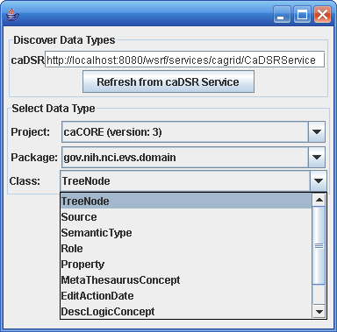
Introduce caDSR Type Browser

Slide 40
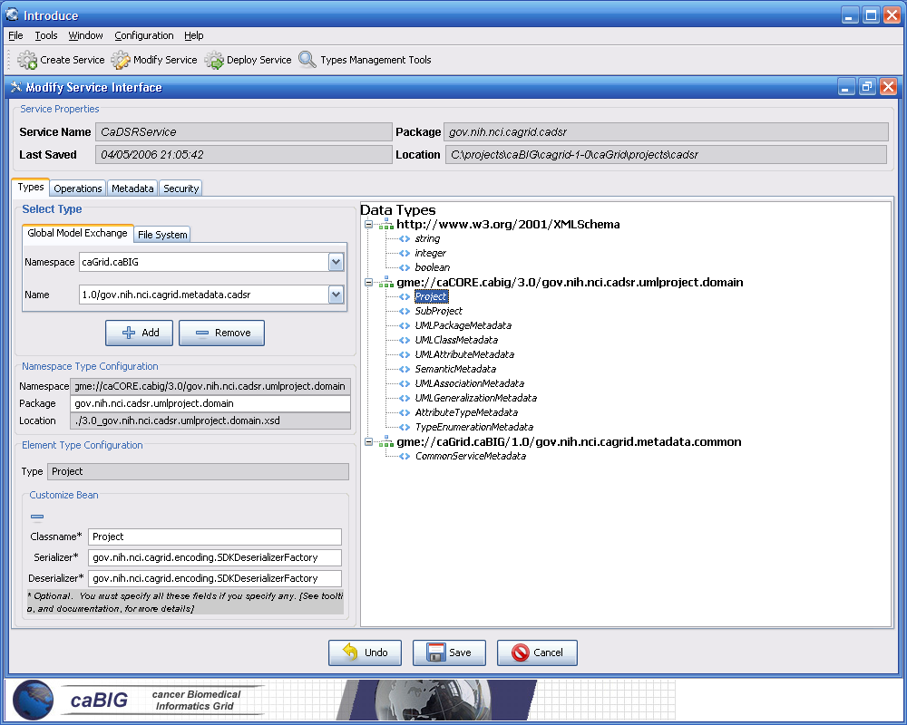
Using actual SDK Generated Objects in Introduce

