Slide 1
Overview of caGrid 1.0 Data Services
caBIG Architecture/VCDE Workspaces
Joint Face to Face
July 12-14, 2006
Scott Oster (oster@bmi.osu.edu)
Ohio State University

Slide 2
Agenda
Data Service Overview
Creating a Data Service with Introduce
Service Details
CQL
Query Example
Future Work

Slide 3
Data Service Overview
caGrid Data Services provide capability to expose silver data resources to the Grid
Specialization of caGrid grid services to expose data through a common query interface
  Meet all base service requirements of caGrid services
Present an object view of data sources
  Exposed objects are registered in caDSR and their XML representation in GME
  Queries made with CQL Query objects
    Results returned as objects (or identifiers) nested in a CQL Query Result Set
Graphical Development tool, implemented as an extension to the Introduce Toolkit, is used to create the new grid service

Slide 4
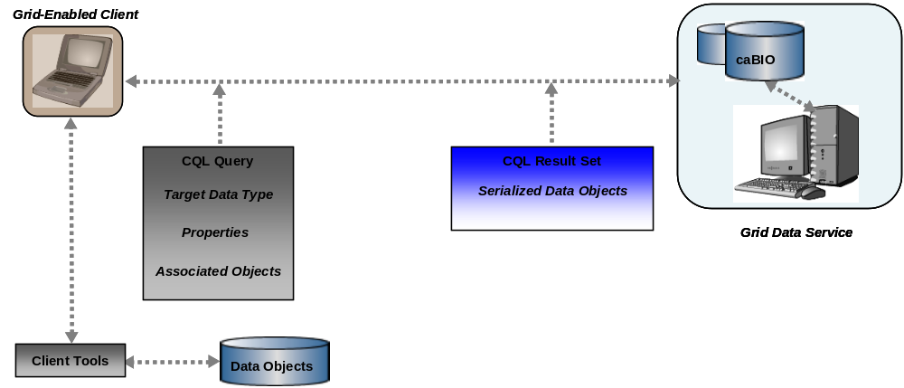
Conceptual Deployment View
Grid Clients query Data Services over the common grid service interface
Query using standard specification for query language
Results adhere to standard specification, and contain a collection of “registered” objects

Slide 5
Data Service Provided Components
Service providers required to use:
  Specification of Common Query Language
  Specification of Query Result format
  Specification of Data Service Metadata
  Definition of Data Service Grid Interface

Slide 6
Data Service Provided Components
Service providers may use:
  Library of reusable tools and utilities for accessing and processing Data Services
  Extensible Data Service Implementation Infrastructure
  “Out of the box” / ”no code” service implementation for caCORE SDK-created data resources
  Graphical Service Development Tools (Introduce)

Slide 7
Significant Improvements from caGrid 0.5
Unification of service framework (data and analytical)
  All caGrid services work the same on the grid
  All caGrid services can be created/modified/deployed with a common toolkit (Introduce)
  Complete security integration
  Able to customize data service by adding additional operations which enhance the data service for it’s particular use and still meet core interoperability requirements

Slide 8
Significant Improvements from caGrid 0.5
Strongly typed inputs and outputs (vs. string)
  The CQL language and query result format have been modeled and registered in the GME
    Will be registered in the caDSR
    Provide the strongly typed input and output of the data service “query” operation
  Use of only “Registered” Data Objects strictly enforced

Slide 9
Significant Improvements from caGrid 0.5 (cont.)
CQL enhancements
  CQL has been refactored to enhance it’s consistency, ease of use, and expressivity
API Enhancements
  Client API is now completely object oriented with several convenience utilities to help generate queries and manage typed results
  Standard serialization and deserialization configuration and APIs can now be used
Validation
  CQL queries can be validated for well-formedness, adherence to the CQL specification, and adherence to data service metadata (e.g. only exposed types are used)

Slide 10
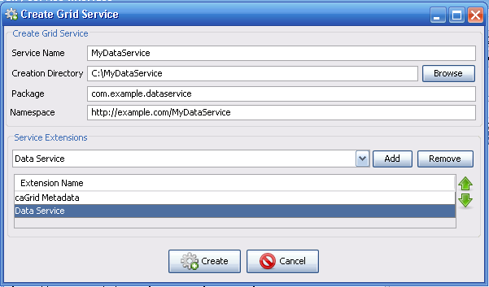
Creating a Data Service with Introduce
A Data Service can be created by adding the “Data Service” extension, when creating a Service

Slide 11
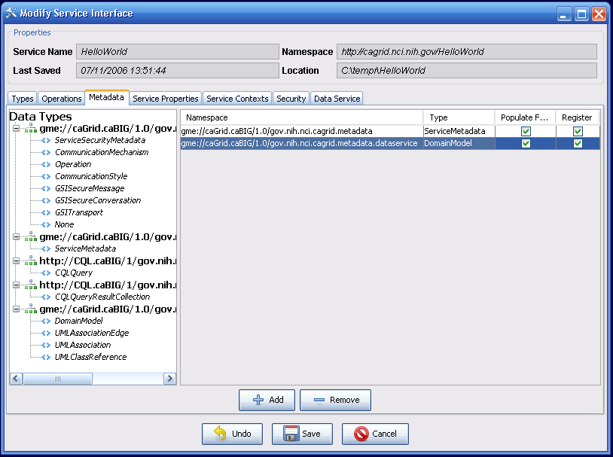
Creating a Data Service with Introduce cont.
The created Service has the necessary schemas for the data service inputs, outputs, and metadata

Slide 12
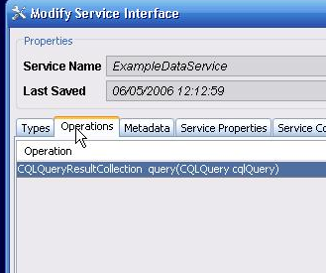
Creating a Data Service with Introduce cont.
The necessary “query” method is automatically defined for the Data Service

Slide 13
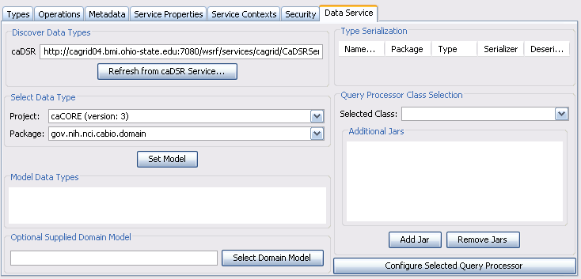
Service Modification
The service modification interface now includes a tab devoted to Data Service configuration.
  Using only this tab, a basic data service can be completely configured.

Slide 14
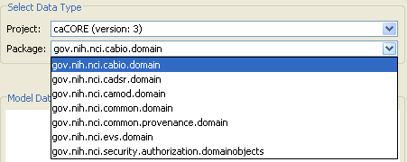
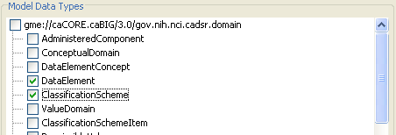
Service Modification (Cont.)
A project and package can be selected from the caDSR for the data service
The appropriate XML Schema is automatically retrieved from the GME
Data types to be used in queries are then selected from the Schema

Slide 15
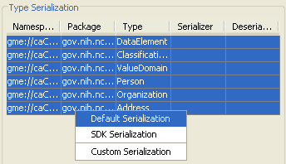
Service Modification (Cont.)
The selected data types appear in the types table, where serialization can be configured.
  A specialized serializer has been provided for types created with the caCORE SDK.

Slide 16
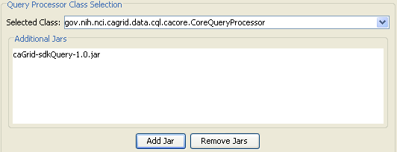
Service Modification (Cont.)
A query processor is selected by supplying the implementation Jar files and selecting a class from the drop down
  Only classes in the Jar files which implement the base CQL query processor interface are shown in the drop down
  Other classes can be manually specified
caCORE SDK query processor being selected from sdkQuery project

Slide 17
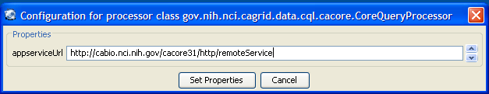
Service Modification (Cont.)
The selected query processor can be configured with the graphical interface as well.
  The configuration here appears as service properties available at runtime.

Slide 18
Data Service Query Interface
public abstract CQLQueryResults processQuery(CQLQuery cqlQuery)
throws MalformedQueryException, QueryProcessingException;
Data Provider’s only responsibility is to implement CQL over their local data resource
  A default implementation is provided for caCORE SDK created systems
caGrid provides grid service implementation to invoke provider’s CQL implementation
Service provides all features necessary for compliance, such as advertisement of data service metadata, and security integration

Slide 19
Data Service Client Tooling
APIs provided to discover available data services on the grid based on client-defined criteria (such exposed data models and concepts)
Object-Oriented API for building queries, querying a given data service, and processing the results
Client tools available to iterate query result sets
  Object iterator deserializes XML into registered objects (deserialization controlled by client configuration)
  XML iterator simply returns XML documents

Slide 20
Data Services Service Tooling
Introduce Extension adds functionality to both service creation and modification
  Creation adds query operation, necessary schemas, and metadata definition
  Modification adds CQL implementation, selected data model, and populates metadata
  Specialized client configured to support necessary custom serialization and any additional operations
    Generic Data Service Client can be used to communicate with ANY data service, but a service-specific client handles any non-default serialization without special coding, and contains any additional operations

Slide 21
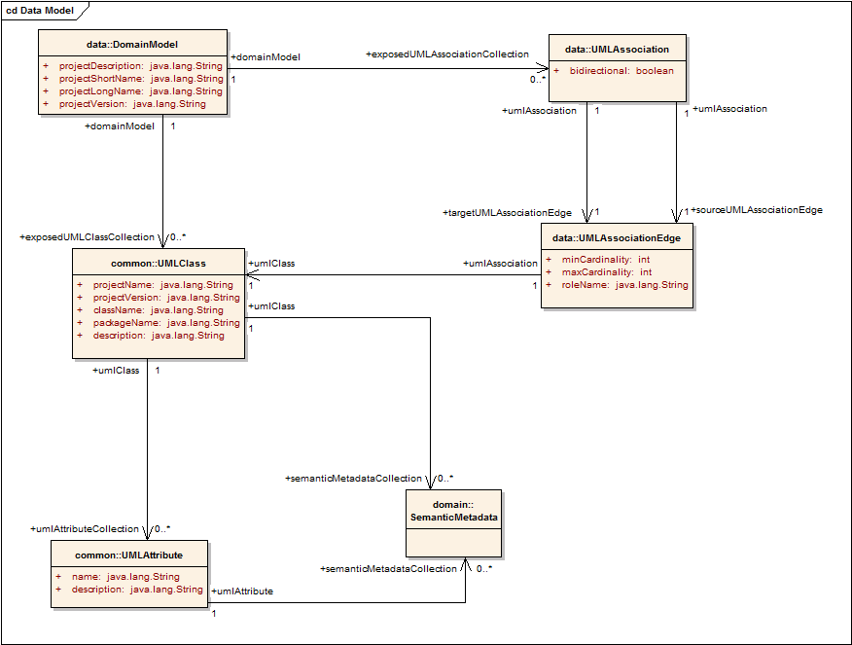
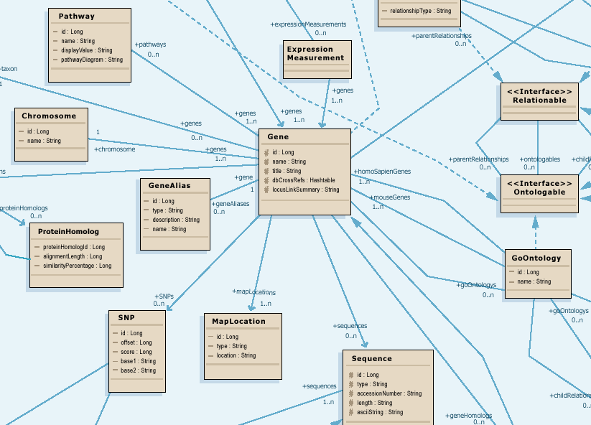
caGrid 1.0 Data Service Metadata
Standard metadata exposed by all Data Services describes the UML model being exposed, and contains links to semantic underpinnings
Provides information needed to formulate the Object-Oriented Query
Contains Semantic Information from EVS

Slide 22
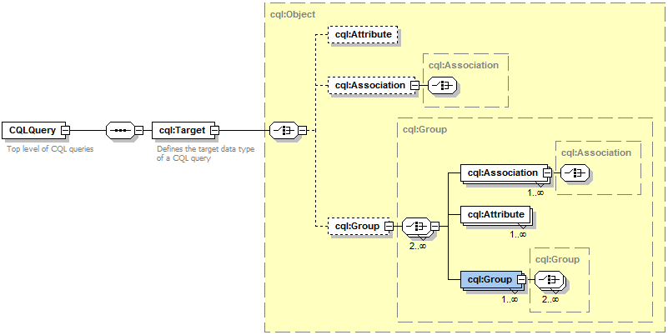
Data Service Query Language
Specifies a target object (result) type and selects the instances which satisfy the specified properties and nested object properties
Allows path navigation
Provides logical grouping
Provides name/predicate/value filtering on properties of objects
Recursively defined
Examples in CQL.doc

Slide 23
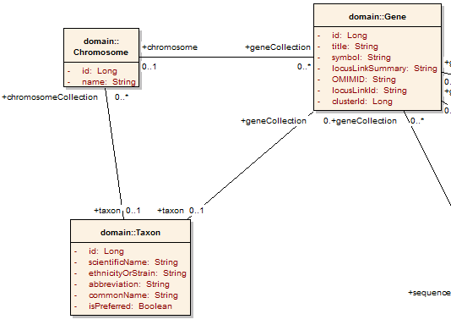
Example CQL Query
Return all Genes with a symbol beginning with BRCA and have an associated Taxon with an id equal to 6:

Slide 24
Example CQL Query
Return all Genes with a symbol beginning with BRCA and have an associated Taxon with an id equal to 6:
<CQLQuery xmlns="http://CQL.caBIG/1/gov.nih.nci.cagrid.CQLQuery"> <Target name="gov.nih.nci.cabio.domain.Gene"> </Target> </CQLQuery>

Slide 25
Example CQL Query
LIKE “BRCA%”
Return all Genes with a symbol beginning with BRCA and have an associated Taxon with an id equal to 6:
<CQLQuery xmlns="http://CQL.caBIG/1/gov.nih.nci.cagrid.CQLQuery"> <Target name="gov.nih.nci.cabio.domain.Gene"> <Attribute name="symbol" predicate="LIKE“ value="BRCA%"/> </Target> </CQLQuery>

Slide 26
Example CQL Query
LIKE “BRCA%”
Return all Genes with a symbol beginning with BRCA and have an associated Taxon with an id equal to 6:
<CQLQuery xmlns="http://CQL.caBIG/1/gov.nih.nci.cagrid.CQLQuery"> <Target name="gov.nih.nci.cabio.domain.Gene"> <Group logicRelation="AND"> <Attribute name="symbol" predicate="LIKE“ value="BRCA%"/> <Association roleName="taxon“ name="gov.nih.nci.cabio.domain.Taxon"> </Association> </Group> </Target> </CQLQuery>

Slide 27
Example CQL Query
LIKE “BRCA%”
Return all Genes with a symbol beginning with BRCA and have an associated Taxon with an id equal to 6:
<CQLQuery xmlns="http://CQL.caBIG/1/gov.nih.nci.cagrid.CQLQuery"> <Target name="gov.nih.nci.cabio.domain.Gene"> <Group logicRelation="AND"> <Attribute name="symbol" predicate="LIKE“ value="BRCA%"/> <Association roleName="taxon“ name="gov.nih.nci.cabio.domain.Taxon"> <Attribute name="id" predicate=“EQUAL“ value="6"/> </Association> </Group> </Target> </CQLQuery>
= 6

Slide 28
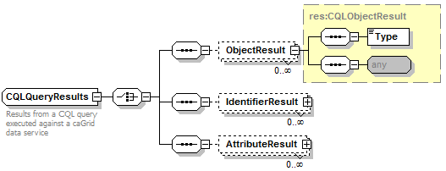
CQL Query Results
Contains an unbounded sequence of ObjectResults (attribute and identifier results not yet supported)
Each ObjectResult specifies its caDSR className and its XML representation
Client may access the XML of the Object directly, or have it deserialized into the appropriate Object
Format defined by the XML Schema of the targeted Object

Slide 29
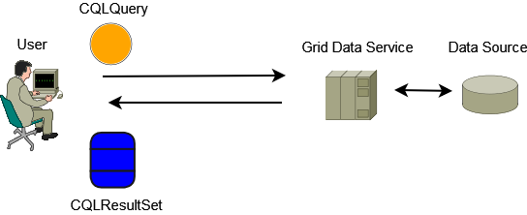
Data Service Query Scenario
Client builds a CQL Query, and invokes the query operation
CQL Query is serialized and submitted to the Grid Data Service
Grid Data Service deserializes the CQL Query Object and processes it
Data Source is queried by the Grid Data Service
Grid Data Service Builds a CQL Result Set
Result Set is serialized and returned to the client
Client deserializes result set
Result set is iterated with client tools to retrieve objects

Slide 30
Invoking a Data Service
A data service can be invoked using:
  Introduce generated client for your specific service (e.g. MyDataServiceClient)
    For instance, if you have additional operations you want to use
  Base Data Service Client (i.e. DataServiceClient)
    Can be used to query any data service
  Data Service Utilities (e.g.DataServiceHandle)
    Handle abstracts iteration of query results
  Directly as a grid service (e.g. using a web/grid service client toolkit such as Axis)

Slide 31
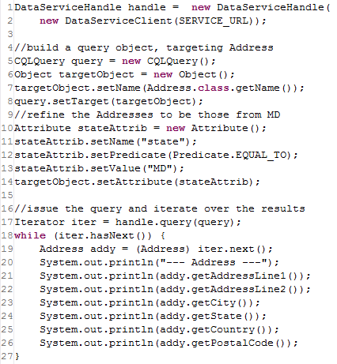
Example Use of Data Utilities
Line 1: Create a client to talk to the Data Service running at SERVICE_URL
  This could come from a discovery result
Lines 5-14: Construct our CQL Query
  Could have also loaded this from file/string
Line 17: Invoke the query operation
  The DataServiceHandle provides us with a Java Iterator instead of CQLQueryResults
Lines 18-27: Iterate over the results, printing them out
  Notice we get an actual Address object back on line 19

Slide 32
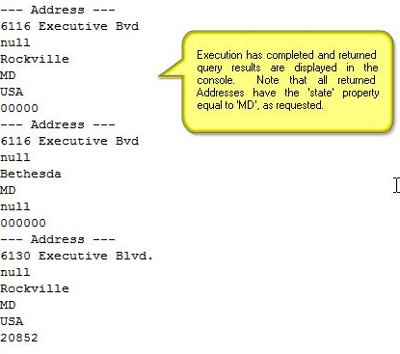
Example Output

Slide 33
Data Service Features Under Development
Componentized library being developed to facilitate limited federating and aggregating queries
Service-side Query Result Management (WS-Enumeration integration, data transfer, etc)
caGrid Identifiers Integration (return grid identifiers in place of materialized objects)
Result Delivery Specification (possible support for association traversal, attribute returns, range/limit operations)
Target data type restrictions:
  Presently, any type exposed in the service’s domain model may be queried for and returned.
  Future work will allow for restricting the returnable data types. This restriction will be exposed in the service’s metadata as well as the WSDL document so that users may more effectively query the data service.

Slide 34
Overview of caGrid 1.0 Data Services
caBIG Architecture/VCDE Workspaces
Joint Face to Face
July 12-14, 2006
Scott Oster (oster@bmi.osu.edu)
Ohio State University

