Slide 1
caGrid 1.0 Beta
Metadata Design
caBIG Architecture/VCDE Workspaces
Joint Face to Face
July 12-14, 2006
Scott Oster (oster@bmi.osu.edu) - Ohio State University
Ram Chilukuri (ram.chilukuri@semanticbits.com) - Semantic Bits
Denise Warzel (warzeld@mail.nih.gov) - NIH/NCI

Slide 2
Agenda
caGrid Metadata Infrastructure Overview
caGrid Use of caDSR
caDSR/GME Mapping Effort
caGrid Service Metadata Definition
Metadata Creation and Usage in Introduce

Slide 3
caGrid Metadata Infrastructure Goals
Support strongly typed grid
  Syntactic and Semantic interoperability
    Programmatic!
  Smooth transition from Application to Grid and back
Leverage wealth of existing metadata
Enable service Advertisement and Discovery

Slide 4
caGrid Metadata Infrastructure
Cancer Data Standards Repository (caDSR)
  Provides specification of data models used in the grid
Enterprise Vocabulary Services (EVS)
  Provides the semantic and conceptual underpinnings to the data models used in the grid
Global Model Exchange (GME)
  Provides an authoritative registry of structural format of data models used in the grid
Globus Information Services
  Provides a registry of running grid services, and a dynamic aggregation of their advertised metadata

Slide 5
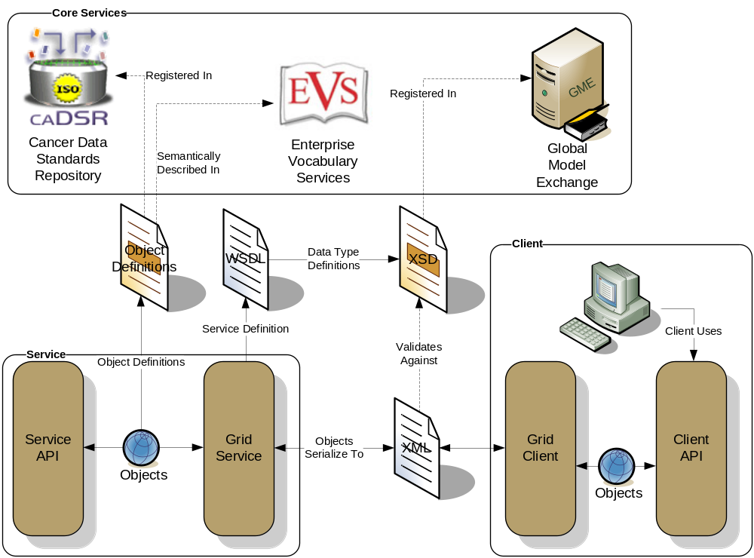
caGrid Data Description Infrastructure
Client and service APIs are object oriented, and operate over well-defined and curated data types
Objects are defined in UML and converted into ISO/IEC 11179 Administered Components, which are in turn registered in the Cancer Data Standards Repository (caDSR)
Object definitions draw from vocabulary registered in the Enterprise Vocabulary Services (EVS), and their relationships are thus semantically described
XML serialization of objects adhere to XML schemas registered in the Global Model Exchange (GME)

Slide 6

Cancer Data Standards Repository
Implementation of ISO/IEC 11179 Registry for Common Data Elements – units of semantic metadata
Client for Enterprise Vocabulary: metadata constructed from controlled terminology and annotated with concept codes
  Binds the structural data objects to their underlying semantics
Precise specification of Classes, Attributes, Data Types, Permissible Values: Strong typing of data objects.
Tools:
  UML Loader: automatically register UML models as metadata components
  CDE Curation: Fine tune metadata and constrain permissible values with data standards
  Form Builder: Create standards-based data collection forms
  CDE and UML Model Browser: search and export metadata components

Slide 7

Enterprise Vocabulary Services (EVS)
Controlled vocabulary resources for cancer research community
  Manages the concepts
NCI Thesaurus
  NCI reference terminology (public domain, open source)
  46,000 concepts covering agents, anatomy, biological processes, diseases, genes, gene products, and techniques/equipment
  Built using description logic
  Designed for application development: database coding, searching, and data mining
NCI Metathesaurus
  Online dictionary and thesaurus
  Adaptation of National Library of Medicine’s Unified Medical Language System (UMLS) Metathesaurus
  930,000+ concepts; 2,200,000 terms and phrases
  Built using lexical matching
  Designed for term mapping and document indexing across vocabularies

Slide 8

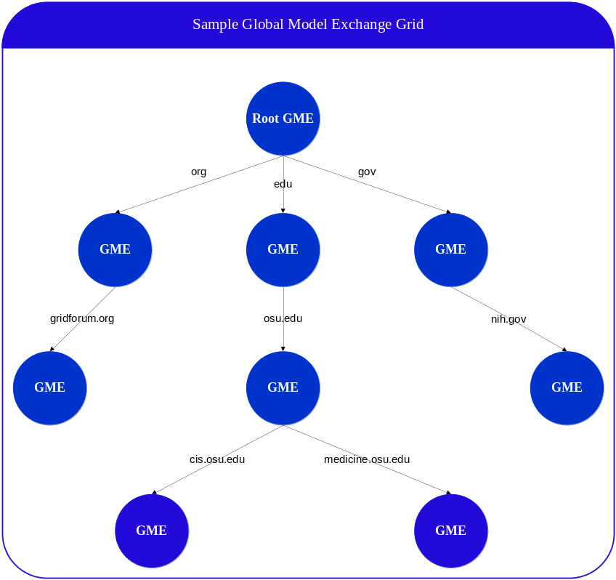
Global Model Exchange
GME is a DNS-like data definition registry and exchange service that is responsible for storing and linking together data models in the form of XML schema
Schemas describing data types can be extracted programmatically and used during service composition time as well as at runtime for data validation
DNS-like Architecture
Address issues such as:
  Changing data types
  Data type permanence
  Data type discovery

Slide 9
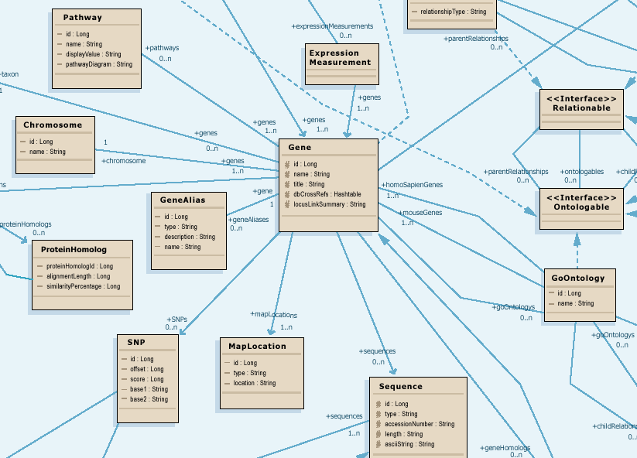
Modeling for Interoperability
Class diagram models target domain
Logical model is basis for semantic integration
Focus on attributes and relationships of domain objects

Slide 10
Data Model Meaning
What do all those data classes and attributes actually mean, anyway?
Data descriptors or “semantic metadata” required
Computable, commonly structured, reusable units of metadata are “Common Data Elements” or CDEs
NCI uses the ISO/IEC 11179 standard for metadata structure and registration

Slide 11

caDSR Mapping of UML to ISO/IEC 11179
UML Class is mapped to an Object Class
Attribute of a UML Class is mapped to a Property
Combination of UML Class and Attribute is mapped to Data Element Concept
Stereotyped caDSR Value Domain Class is mapped to a Value Domain, its attributes as permissible values
Combination of UML Class, Attribute and either it’s Datatype or Value Domain are mapped to Data Element (CDE)
UML Class and it’s attributes, including the Value Domain class and permissible values, are based on EVS concepts
UML Model/Project is mapped to Classification Scheme
Packages are mapped to classification scheme items
UML Model
ISO/IEC 11179
Common Data Element
DEC + Value Domain
UMLClass
Data Element Concept
Object Class + Property
UMLAttribute : UMLDataType
Object Class
Permissible Value
Permissible Value
Property
CADSR Value Domain Class
Value Domain
Permissible Values

Slide 12
caGrid exposing caDSR data
In caDSR, nearly all items can be individually versioned, but a specific Project version represents a curated collection of Packages, Classes, and Attributes with consistent semantics
Data is exposed in caGrid as instances defined in a specific Project
  Data Services expose instance data as a subset of Classes from a given Project
  Analytical Services operate over instances of Classes from potentially numerous Projects

Slide 13
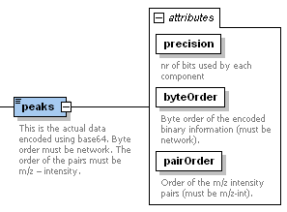
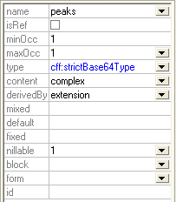
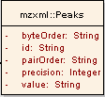
Connecting the caDSR and GME (the problem)
As the caDSR ensures semantic interoperability, the GME ensures programmatic data exchange (syntactic) interoperability on the grid
Many applications need to work at both the CDE level and the XML level
Names different
Attribute or element?
What about Collection associations
?

Slide 14
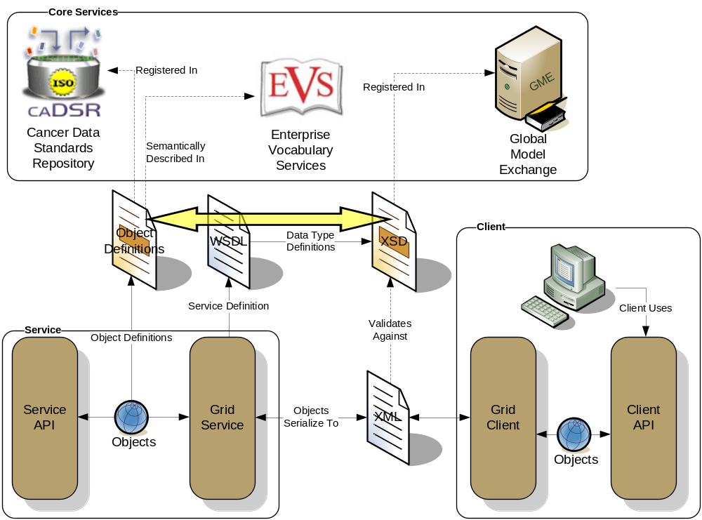
Conceptual View of the Problem

Slide 15
caGrid 0.5 Approach
Previous “solution” was to require an XML Schema for each package that followed a namespace construction rule
Had several limitations:
  Several caBIG projects wish to reuse existing XML Schemas, which have existing namespaces (can’t be changed for interoperability reasons)
  Some uniqueness constraints assumed are not strictly enforced
  Does not support “reverse lookup” (XSD -> caDSR)
  Does not provide fine grain mapping necessary for some applications/infrastructure
  Somewhat prescriptive (namespaces, naming conventions, etc) when ideal solution is entirely descriptive

Slide 16
XML Schema Existence Rules
Each caDSR data object (as part of a specific Project version) used in the grid must have its XML format modeled in an XML Schema that is registered in the GME
Within each data object, the format of its attributes and associations must be modeled in the corresponding XML Schema type
Every caDSR Package (as part of a specific Project version) must have a corresponding XML Schema that is registered in the GME, even if it just imports a series of other XML Schemas and doesn’t define any of its own types
Every caDSR Project must have a corresponding XML Schema registered in the GME; It will most likely just imports a series of other XML Schemas (corresponding to its Packages’ schemas), though it may define its own types
These rules let the XSD modeler create any level of schema granularity from 1 per project, down to 1 per Class, but there is always a defined way to retrieve all of the types for a given Project, Package, and Class

Slide 17
Binding the XML Schemas and caDSR
Preceding rules only detail the necessity of existence of the various XML Schemas and schema entities, they do not specify how a particular instance can be located
A detailed bidirectional mapping/binding between the schema entities and caDSR items is required to support the use cases

Slide 18
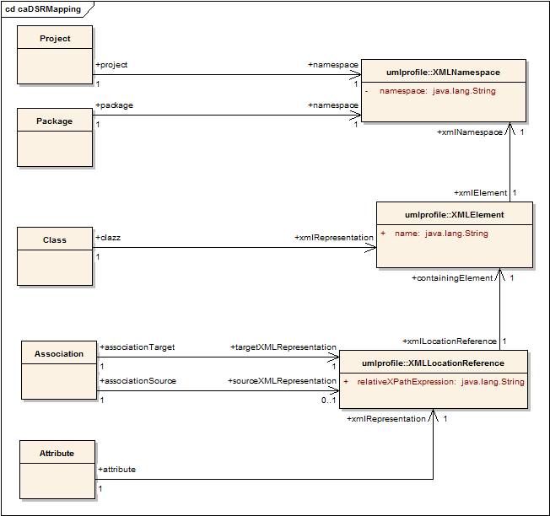
Connecting the caDSR and GME (the solution)
Planned definition of mapping rules specify how a given UML entity is represented in XML over the grid

Slide 19
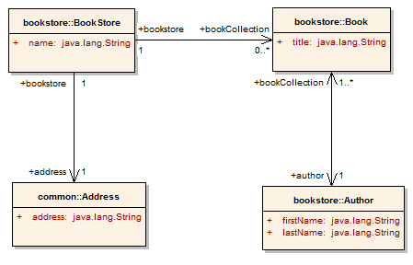
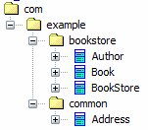
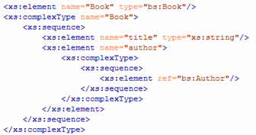
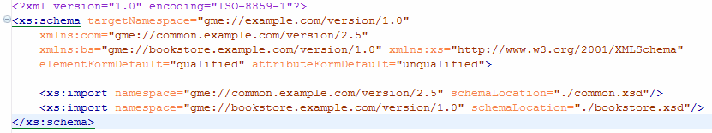
Partial Mapping Example
Project:
BookStore
Version:
1.0
Attribute Mapping
XPath:
title
Element:
Book
Namespace: gme://bookstore.example.com/version/1.0
Project’s Namespace (gme://example.com/version/1.0)

Slide 20
Mapping Realization
Planned to be maintained in the caDSR
API to query and lookup bindings
Access will be available through caDSR Grid Service

Slide 21
Storing Namespaces in caDSR
Namespace of an XML schema for a domain object will be captured as alternate name of type “XML_SCHEMA_NAMESPACE”
May be specified as a tagged value in the UML Model at design time
By default, it will constructed based on metadata registered in caDSR
gme://<project_gme_name>.<project_context_name>/<project_version>/<package_name>

Slide 22
Project XML Schema Namespace Name
A project/domain model is mapped to a Classification Scheme in caDSR
CS preferred name was used in caGrid 0.5
  Has several issues
Will be captured as an alternate name of type “XML Schema Namespace Name”
Will need to be specified in the UML Loader submission checklist
Will satisfy the following constraints:
  Cannot change for a given CS version
  Cannot have empty spaces

Slide 23
Domain Object Syntactic Reuse
A specific domain object may be re-used across different projects
  Example: Participant class from caTissue Core project (edu.wustl.catissuecore.domainobject.Participant) may be re-used in caTRIP project
  XML schema should to be re-used
Reuse is captured by classifying the XML schema namespace alternate name for the Object Class “Participant”
  XML Schema Namespace: gme://caTissueCore.caBIG/1.0/edu.wustl.catissuecore.domainobject
  Classification 1: caTissueCorev1.0 - edu.wustl.catissuecore.domainobject
  Classification 2: caTRIPv1.0 – edu.duke.catrip.domain

Slide 24
Domain Object Semantic Re-use
Two domain objects may be semantically equivalent but syntactically non-equivalent
  Example: Diagnosis class in CTOM and Diagnosis class in caTRIP, which has a sub-set of CTOM Diagnosis class attributes
  Will be mapped to same Object Class in caDSR
  Both will have different XML schemas
Two XML schema namespace alternate names will be created for Object Class
  Gme://CTOM.caBIG/1.0/gov.nih.nci.ctom.domain
    Classification : CTOMv1.0 - gov.nih.nci.ctom.domain
  Gme://caTRIP.caBIG/1.0/edu.duke.catrip.domain
    Classification: caTRIPv1.0 - edu.duke.catrip.domain

Slide 25
caGrid 0.5 Migration
Can still use existing caGrid 0.5 schemas and even the schema conventions it specified, though it is no longer required
Just need to register the mapping

Slide 26
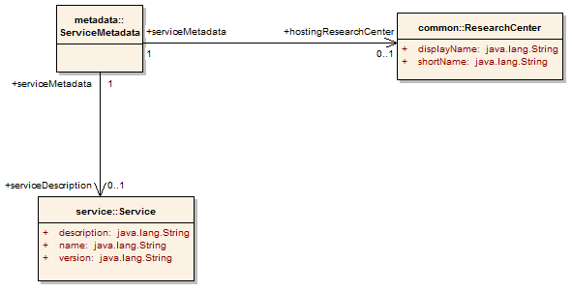
caGrid 1.0 Service Metadata
All caGrid Services are expected to publish a set of standard metadata which draws heavily from the metadata registered in caDSR and EVS
It details the functionality of the service, and the institution providing it

Slide 27
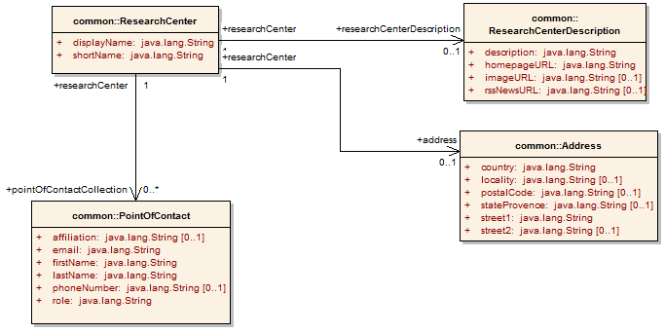
caGrid 1.0 Research Center Metadata
Associated from a Service’s Metadata, the Research Center information describes the service/data provider

Slide 28
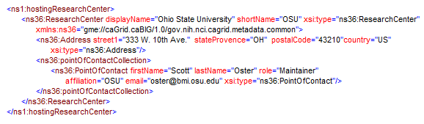
Example ResearchCenter portion of metadata
Center’s name and address are described
Points of contact for the center are provided
Web presence would also be described by ResearchCenterDescription (omitted)

Slide 29
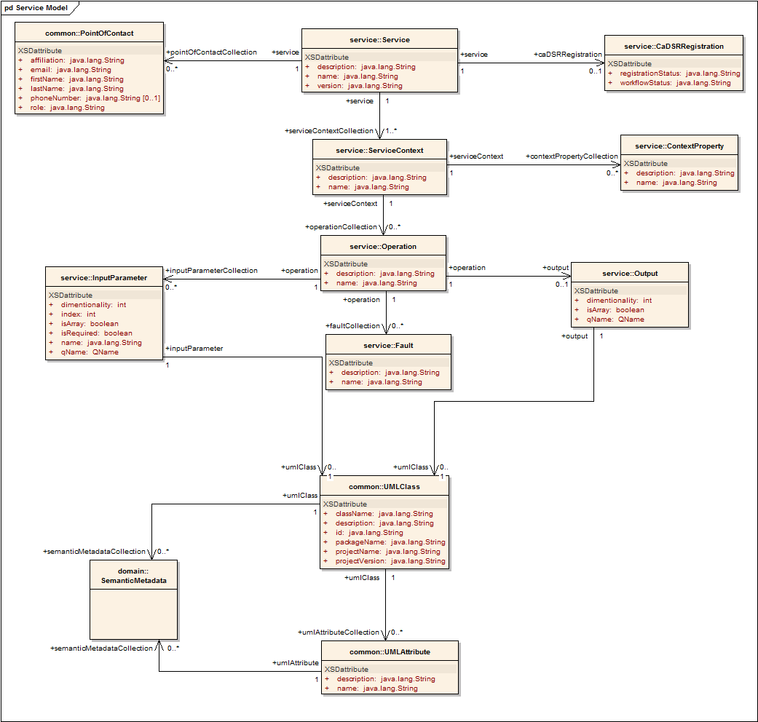
caGrid 1.0 Service Metadata
The Service’s operations are defined and their inputs and outputs link to Classes described in caDSR using semantics from EVS concepts
Contains Semantic Information caDSR

Slide 30
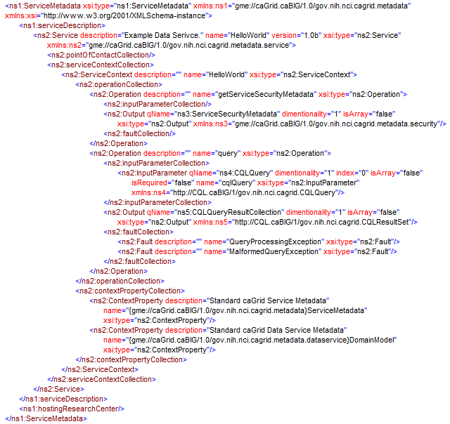
Example Service Metadata portions
Service’s name and description are provided
Each operation is defined (query, and getServiceSecurityMetadata) in terms of its signature
UMLClass (omitted) would be linked for each input and output

Slide 31
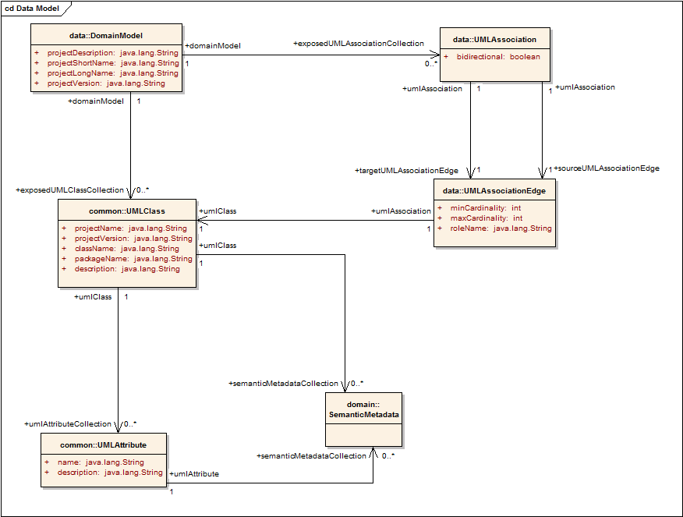
caGrid 1.0 Data Service Metadata
Standard metadata exposed by all Data Services describes the UML model being exposed, and contains links to semantic underpinnings
Provides information needed to formulate the Object-Oriented Query
Contains Semantic Information caDSR

Slide 32
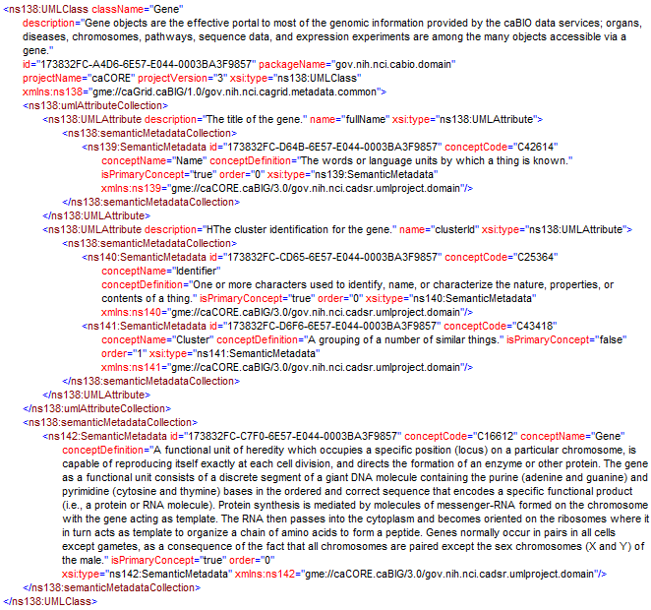
Example UMLClass portion of metadata
The UML Class describes the Project, Package, and Class of the registered UML Class
Its attributes are defined
The semantics of it and its attributes are described
Notes:
Why isn’t the public id and version of these entities in the xml? The attributes should have the CDE identifiers, the Class…we need to work that out….?

Slide 33
Application or Domain Specific Metadata
Specific Applications or Domains may also publish their own metadata
  E.g. LexBIG
Enable specialized discovery or other application use cases

Slide 34
Metadata: Advertisement and Discovery
Advertisement:
  The caGrid Grid Service Owner composes service metadata describing the service to the grid and publishes it to grid. The service metadata describes properties of the grid services that caGrid users and other grid services may query.
Discovery:
  A caGrid Researcher specifies search criteria describing a service. The research submits the discovery request to a discovery service, which identifies a list of services matching the criteria, and returns the list to the researcher.
Use Cases:
  Publish advertisement a Grid Service
  Remove advertisement of a Grid Service
  Update advertisement of a Grid Service
  Discover advertisement a Grid Service

Slide 35
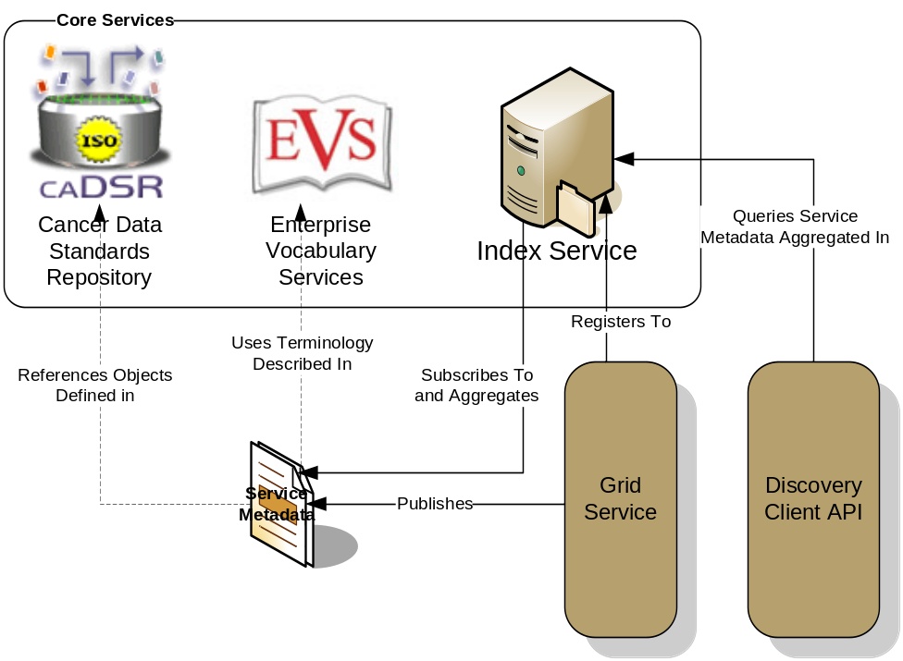
caGrid Advertisement and Discovery
All services register their service location and metadata information to an Index Service
The Index Service subscribes to the standardized metadata and aggregates their contents
Clients can discover services using a discovery API which facilitates inspection of data types
Leveraging semantic information in EVS (from which service metadata is drawn), services can be discovered by the semantics of their data types

Slide 36
Service Discovery Process
Clients formulate a query over the caGrid standard metadata
  Examples:
    “Find me all the services from Cancer Center X”
    “Which Analytical services take Genes as input?”
    “Which Data services expose data relating to lung cancer?”
    “Find me all the services with some metadata mentioning the string ‘macromolecules’”
This query is sent to the caGrid Index Service which returns the Address of the services satisfying the query
The client can then further interrogate the satisfying services by asking for all of their metadata or service descriptions
Finally the client invokes the desired services as appropriate

Slide 37
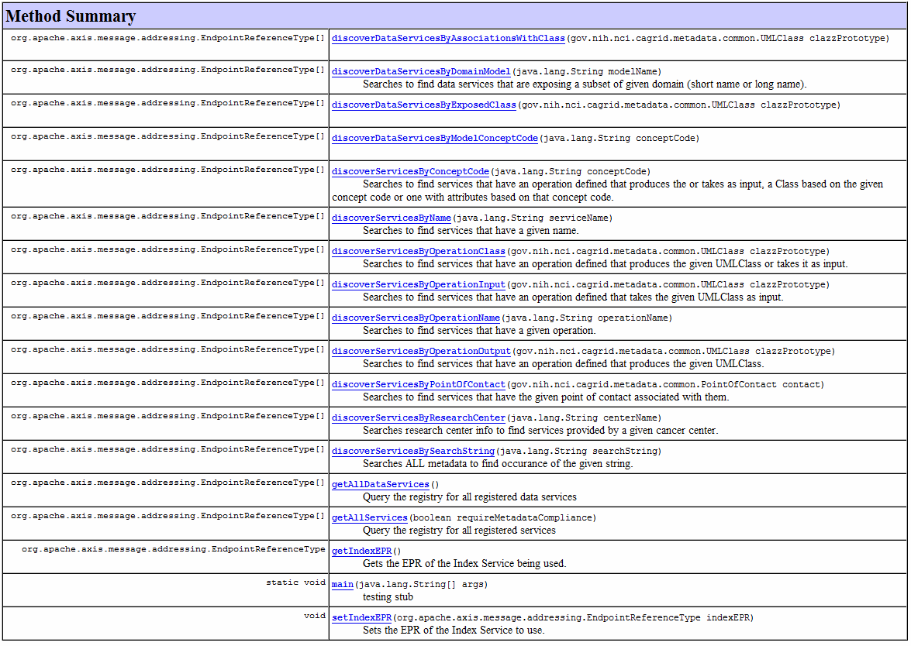
Discovery API

Slide 38
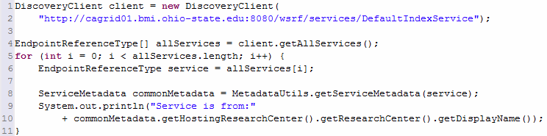
Example Discovery API Usage
Create a new DiscoveryClient
Ask for all registered services
Retrieve the Service Metadata of each
Print the name of the hosting research center

Slide 39
Metadata and Introduce
Introduce not only allows service developers to add metadata to services, but it provides tools for browsing and discovering registered data models
Metadata instances can also be created for developed services
Future capability will facilitate registration of services in caDSR (when the caDSR supports it)
Notes:
Do you want to mention the use of workflow and registration statuses?

Slide 40
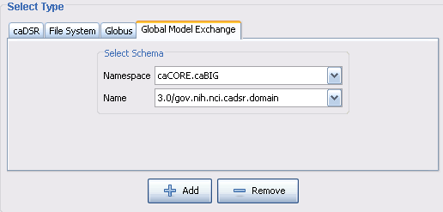
GME Type Discovery
Introduce leverages the GME grid service to allow service developers to browser registered XML Schemas
Selected XML schema, and any of its dependencies are downloaded

Slide 41
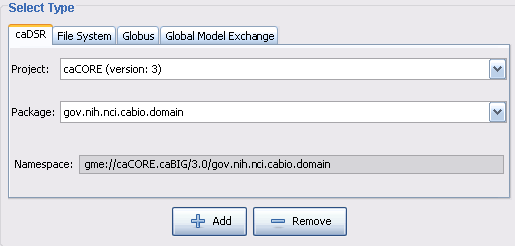
caDSR Type Discovery
Introduce leverages the caDSR grid service to allow service developers to browser registered models
Appropriate XML schema, and any of its dependencies, are automatically located in the GME and downloaded

Slide 42
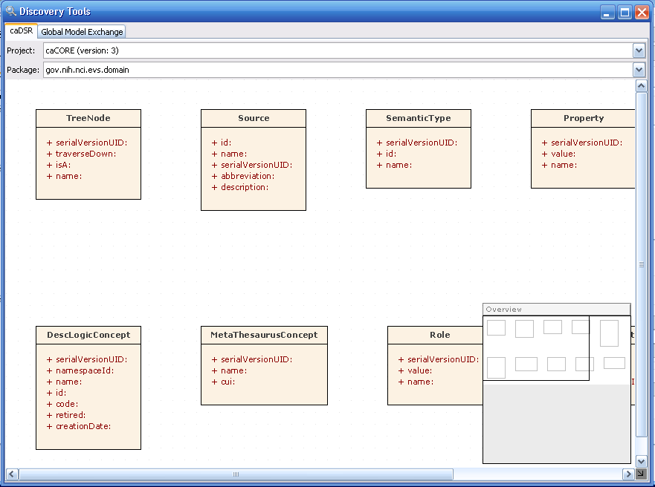
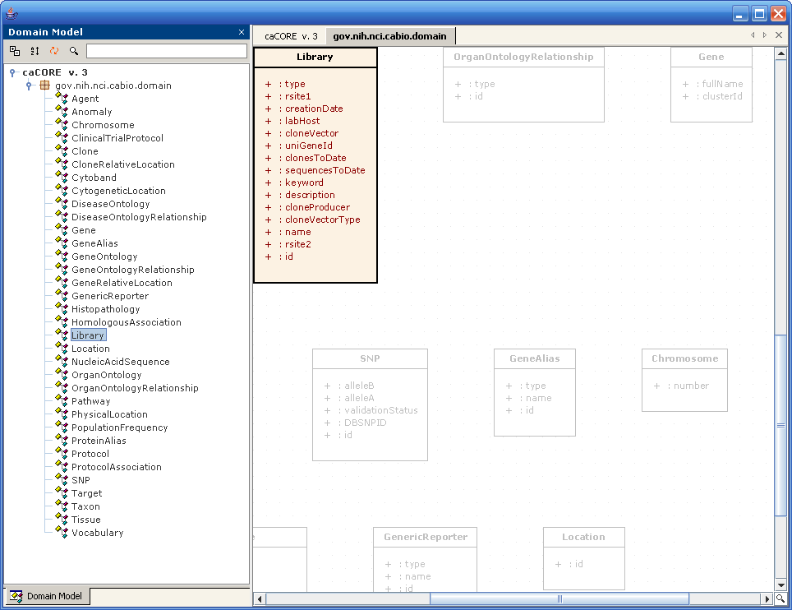
caDSR Type Browser
Introduce leverages the caDSR grid service and the graph library to display a graphical view of registered UML models

Slide 43
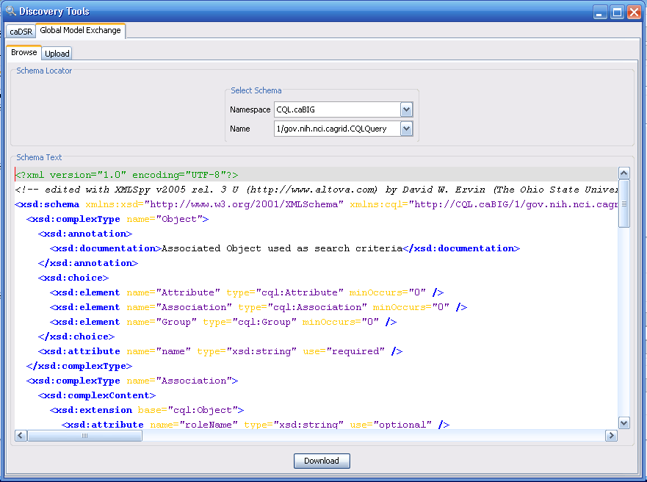
Simplified GME Management Tools
Introduce also provides the ability to browse and download XML Schemas registered in the GME grid service
New XML Schemas can also be registered

Slide 44
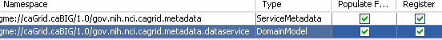
Metadata Creation
Metadata can be added to services in Introduce by selecting the desired XML type
The “caGrid Metadata” extension automatically synchronizes the Service Metadata instance using the local Introduce service model and the caDSR grid service
The “Data” extension automatically synchronizes the Domain Model instances using the information in the Data tab, and the caDSR grid service

Slide 45
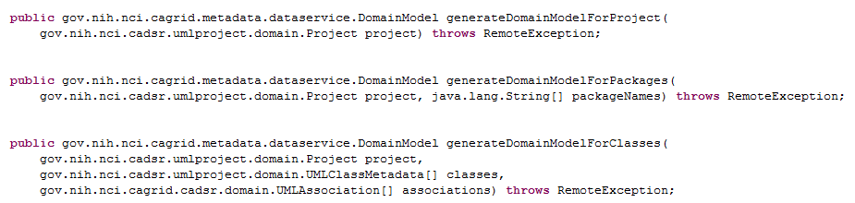
caDSR Grid Service Metadata Capabilities
The caDSR grid service provides operations for generating instances of the Data Service metadata, Domain Model
Future work will support stateful non-blocking invocations with service-side caching

Slide 46
caGrid 1.0 Beta
Metadata Design
caBIG Architecture/VCDE Workspaces
Joint Face to Face
July 12-14, 2006
Scott Oster (oster@bmi.osu.edu) - Ohio State University
Ram Chilukuri (ram.chilukuri@semanticbits.com) - Semantic Bits
Denise Warzel (warzeld@mail.nih.gov) - NIH/NCI

Slide 47
BACK UP SLIDES

Slide 48
Globus MDS
WS MDS Index Service -- This service contains a registry of grid resources and collects information from them, making it accessible and queryable from one location. Generally, a virtual organization deploys one or more index services, which then collect data on all of the grid resources available within that VO.
WS MDS Trigger Service -- This service collects data from grid resources and passes the data to appropriate programs to perform various actions in response to events. (not currently used by the caGrid metadata infrastructure).
WS MDS Aggregator -- This is the infrastructure on which the previous services are built. It collects, manages, and indexes data from an aggregator source and sends that data to an aggregator sink for processing.

Slide 49
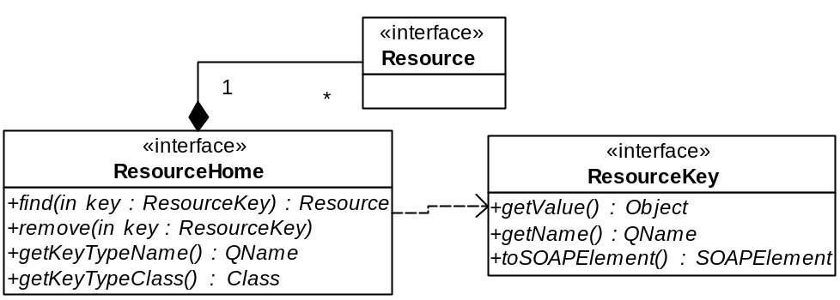

Slide 50
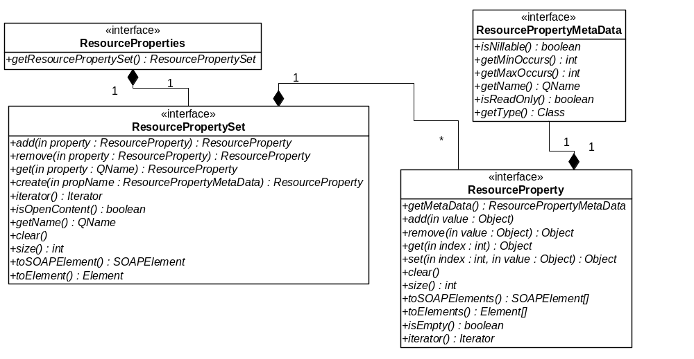

Slide 51
GetResourceProperty: allows access to the value of any resource property given its QName
GetMultipleResourceProperties: allows access to the value of several resource properties at once, given each of their Qnames
QueryResourceProperties: allows complex queries on the resource properties document (Currently, the query language used is XPath)

Slide 52
