Slide 1
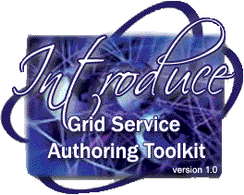
Introduce
Grid Service Authoring Toolkit
Shannon Hastings
hastings@bmi.osu.edu
Multiscale Computing Laboratory
Department of Biomedical Informatics
The Ohio State University

Slide 2
Outline
caGrid Grid Service
  Driving requirements
  Architecture
Introduce
  What can it do?
  Architecture
  Toolkit
Future work

Slide 3
caGrid Service Overview
Accessing data in caBIG will not be enough. The data will need to be processed, transformed, analyzed, integrated, etc
It should be very easy for service providers to deliver these services
The services will take in and return strongly typed and semantically harmonized data types
These services will need to be easily discovered and invoked
These services will need to be easily configured for security

Slide 4
caGrid Service Requirements
All services must be presented to the caBIG as Grid Services
They must have strongly typed interfaces using types which are registered in the caDSR and can be verified by an XML schema registered in the caGrid GME.
Must provide caGrid standard service metadata as well as service specific metadata.
The service must register itself and it’s metadata to a caGrid Index Service
The service must provide object oriented client API for locating and invoking the service

Slide 5
Addressing the Requirements
Grid Services
  We will be fulfilling the requirement that each operation is available through grid services by utilizing the Globus 4.0.2 toolkit and Axis
  Service developers will describe the grid service interface they wish to provide.
  We will use the Globus Toolkit and Axis for creating, registering, discovering, and invoking these service operations as grid services
    Client will be using the operation through a grid service interface and will not need to be aware of any implementation specific details of the grid service

Slide 6
Addressing the Requirements (cont)
Strongly typed interfaces:
  Introduce will enable schema extraction from a GME and from the caDSR via the GME so that the wsdl, beans, and service metadata can be automatically populated and the service will be using strongly typed and publicly accessible data types.
  Data model schema, and any referenced schemas, are extracted and placed in the schema directory of the analytical build skeleton and imported into the services WSDL.
    types can be used at service build time to generate the objects and create strongly-typed grid service interfaces

Slide 7
Addressing the Requirements (cont)
Providing Service Metadata:
  Leverage Globus’ use of Java Naming and Directory Interface (JNDI) in order to support WSRF.
  caGrid metadata is provided as resource properties on the base service’s singleton resource.
  These resource properties are defined by xml schema.

Slide 8
Addressing the Requirements (cont)
Index Service Registration
  Leverage Globus MDS in order to configure the base resource on the service to be published to an official caGrid MDS based Index Service.
  Provide configuration options for registration of static and dynamic service metadata which can then be used at runtime for service discovery.

Slide 9
Addressing the Requirements (cont)
Security:
  Enable configuration for each service and for each method in a service.
  Support complete GSI security configuration for authentication and support for an authorization plug-in.
  Require service security metadata to be available anonymously via the grid service interface (getServiceSecurityMetadata()) or the grid service’s resource properties.

Slide 10

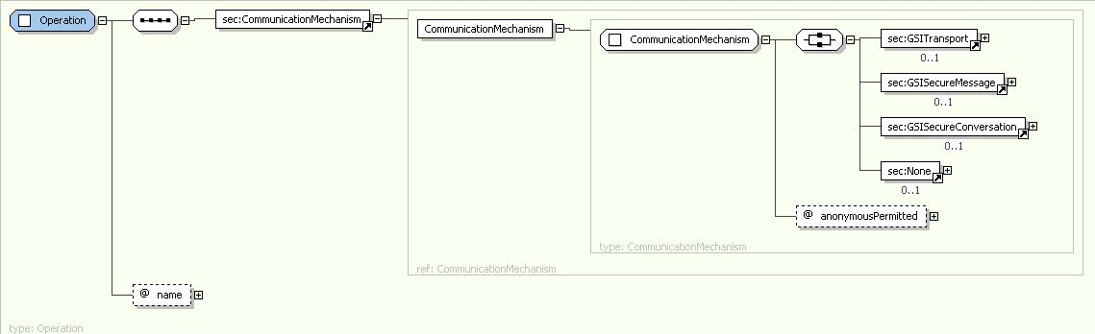
Addressing the Requirements (cont)
Security:

Slide 11
Addressing the Requirements (cont)
Providing Client Side Object API
  Globus/Axis build process will automatically generate a client side object oriented API
  We will generate a wrapper for this API which matches the service designers interface to make a clean mapping from client to service.
    This wrapper will handle auto boxing/unboxing of the parameters into and out of document literal form.

Slide 12
Core caGrid Service Architecture
Base service is a GT4 based WSRF capable grid service.
Utilize compositional inheritance (in lieu of non-standard port type extensions) to enable the service to inherit required features such as providing service security metadata and access to resource properties.
Utilize JNDI for registration configuration, server side configuration properties, and resources and resource properties.
Provide client and service side wrappers which implement the service designers interface as opposed to the document literal interface generated by Axis.
Provide metadata registration to the index service by configuring the Resource to register it’s service groups to a predefined caGrid MDS based Index Service.

Slide 13
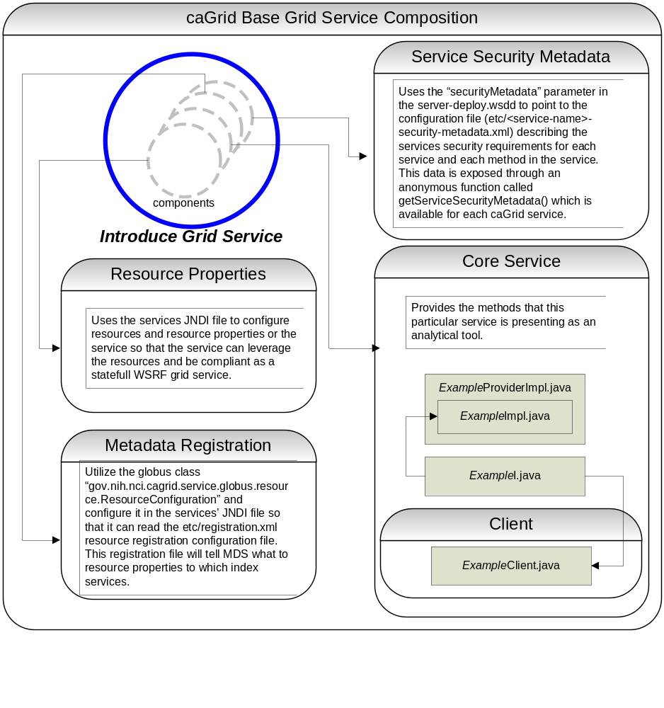

Slide 14
Introduce Goals
A framework which enables fast and easy creation of caGrid compatible services whether they are data, analytical, or core services.
Provide easy to use graphical service authoring tool.
Hide all “grid-ness” from the developer.
Utilize best practice layered grid service architecture.
Handle all service architecture requirements of the caGrid.
Toolkit for creating and manipulating caGrid compliant analytical services
  Command line and GUI tools for service skeleton generation and automatic service/client code generation
Utilizes other caGrid services and architecture components
  GME for schemas of caDSR registered data types
  Security service architecture (GSI, DORIAN, CAMS)
  Advertisement and Registration configuration and caGrid Index Service for discovery

Slide 15
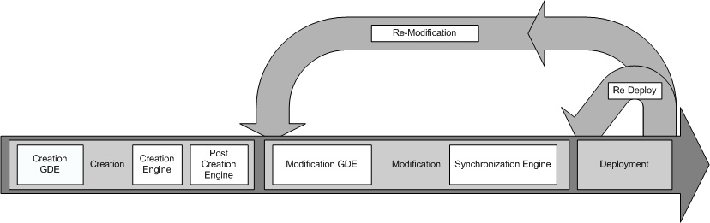
Introduce Service Development Overall Flow

Slide 16
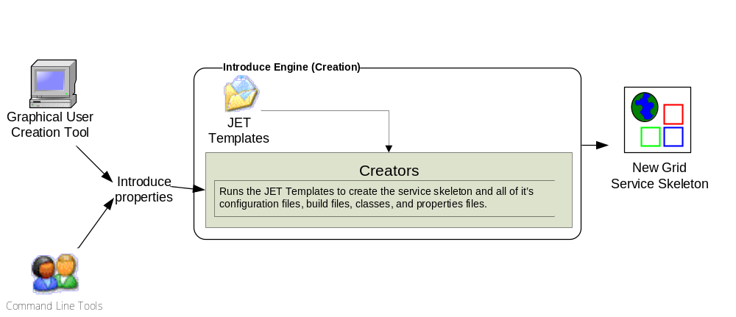
Introduce Service Creation Architecture
The Introduce Service Properties are a set if base properties
required for creating this service such as desired location to
create the service, namespace to use, package name to use,
and service name.

Slide 17
Command Line Creation
Variables can be preset in a properties file to use non-interactively
  call the ant target and set the introduce.properties variable to point to this properties file:
    ant –Dintroduce.properties=myAnalytical.properties createService
An example properties file:
introduce.skeleton.destination.dir=C:\HelloWorld
introduce.skeleton.service.name=HelloWorld
introduce.skeleton.namespace.domain=http\://cagrid.nci.nih.gov/HelloWorld
introduce.skeleton.package=gov.nih.nci.cagrid.helloworld

Slide 18
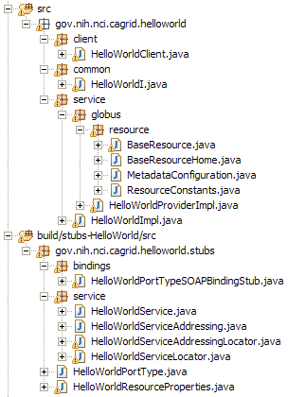
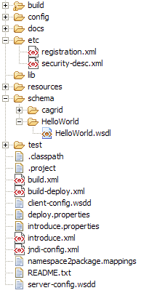
Created Skeleton Layout
= Introduce
generated
= Globus/Axis
generated
= developers
contribution

Slide 19
Created Skeleton Layout (cont)
= implements the developer
defined interface and calls into
the generated client port type
stub.
= the developer defined grid
service interface
= manages the resources
of this grid service
= implements the port type
and calls into the actual
clean unboxed interface
the developer defined.
= developers implementation
of the defined interface.

Slide 20
Created Skeleton Layout (cont)
= service metadata registration configuration
= describes the services security configuration
= services WSDL file for axis
= configuration files for eclipse development
= ant build files
= client configuration file for axis
= deployment time service properties
= introduce representation of service
= JNDI service resources configuration
= namespace mappings for axis
= server configuration file for axis

Slide 21
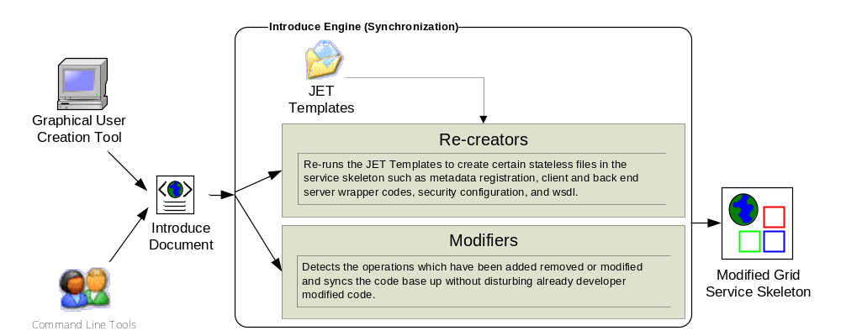
Introduce Service Modification Architecture
The Introduce Service Description document is the input
to the introduce engine. The user can hand craft this
document and call the engine via command line or API
or can use the Introduce GDE to modify this document
and execute the engine

Slide 22
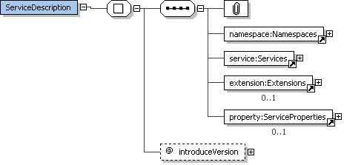
The Service Description Document
XML document used to describe the service interface and it’s security requirements
Introduce Toolkit uses this description document as the complete representation for the service.

Slide 23
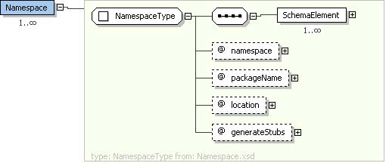
The Namespaces Element
The list of namespaces defines all the possible namespaces, their types, how they should be mapped into java classes, and how they should be serialized.

Slide 24
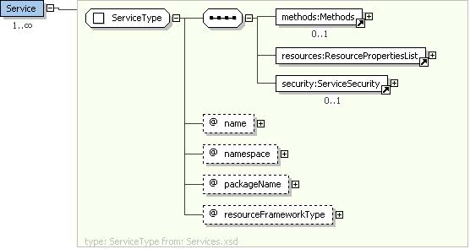
The Services Element
The services element contains a description for this service and any sub-service this service contains.

Slide 25
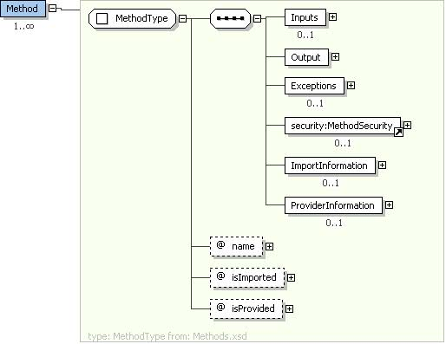
The Methods Element
A method describes information about an operation on a service so that the synchronization tools can edit all aspects of the service necessary in order for the service to reflect the description or this particular method.

Slide 26
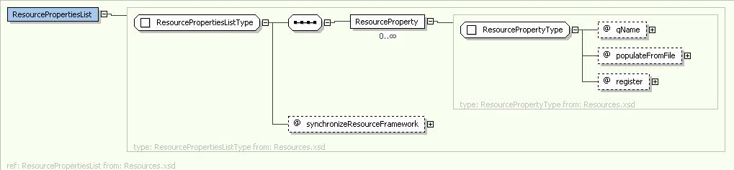
The ResourcePropertiesList Element
Each resource property description in the list will become a resource property in the resource represented by this service which can be used dynamically by the service at runtime and/or published to an index service to be used during service discovery.

Slide 27
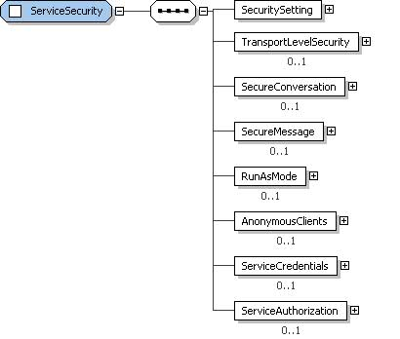
The ServiceSecurity Element
The ServiceSecurity element describes the base level security configuration and requirements for any access to this service, unless overwritten by the method level security setting.
This model describes transport layer, message layer, authentication, and authorization requirements for any access to this service.

Slide 28
Introduce Command Line Service Modification
run the command
  “ant resync” –Dintroduce.skeleton.destination.dir=<path of service>
  will read in the “introduce.xml” document and determine the changes between the developers new description of the service and the actual code
  will then modify the skeleton appropriately:
    Modify all source files
    Modify all security configuration files
    Modify the WSDL, JNDI, and other configuration files for the service

Slide 29
Inside the Introduce created service
Services have many moving and configurable parts which support features such as:
  Advertisement
  Discovery
  Invocation
  Security
The Introduce Toolkit can keep all these features in sync as the developer creates and modifies his/her grid service

Slide 30
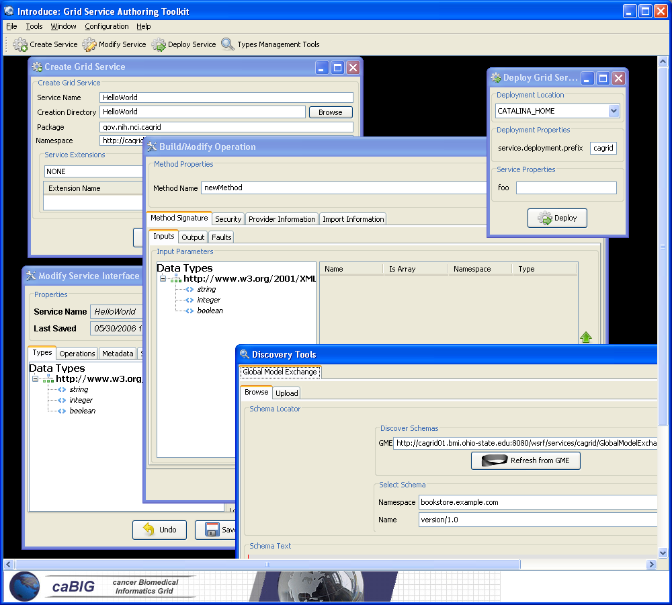
Introduce Graphical Development Environment (GDE)
GUI for creating and manipulating a grid service
  Provides means of simple creation of service skeleton that a developer can then implement, build, and deploy
  Automatic code generation of complete caBIG compliant grid service which is configured to provide:
    Security
    Advertisement
    Discovery
    Complete Client API
  Provides a set of tools which enable the developer to add/remove/modify/import methods of the service as well create sub-services.
    Automatic code generation of all the required code, Globus grid service code/configuration, service configuration, implementation of the client, and stubbed implementation of the service

Slide 31
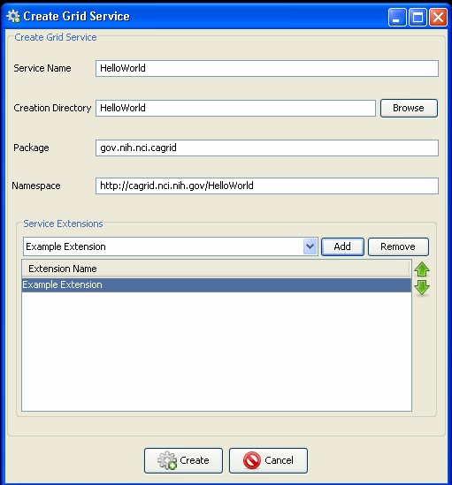
Introduce GDE Service Creation
Populate required variables for service creation
  Name = published service name
  Creation Direction = directory to create the skeleton
  Package = the java package you wish to use for your service
  Namespace Domain = the namespace to be used to define the service interface and types
  Extensions =
  extensions are plugins that
  you want to be executed during the development of this service

Slide 32
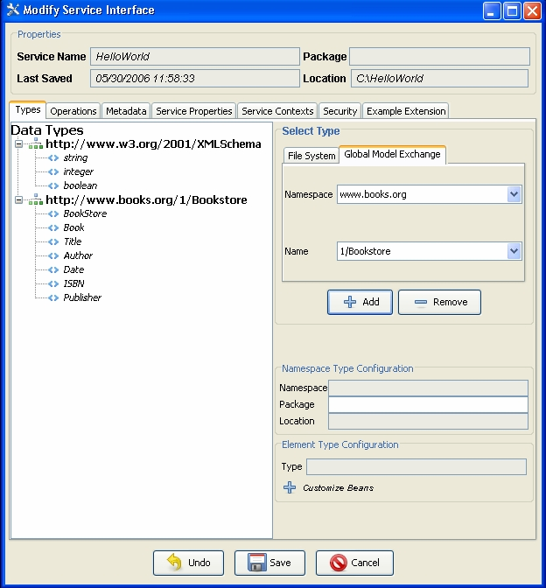
Introduce GDE Service Modification
Service modification is the main GDE component. It enables the modification of all caGrid grid service features.
The first main task of any service modification is to discover and add the Types to be used for operation input/output and/or metadata.

Slide 33
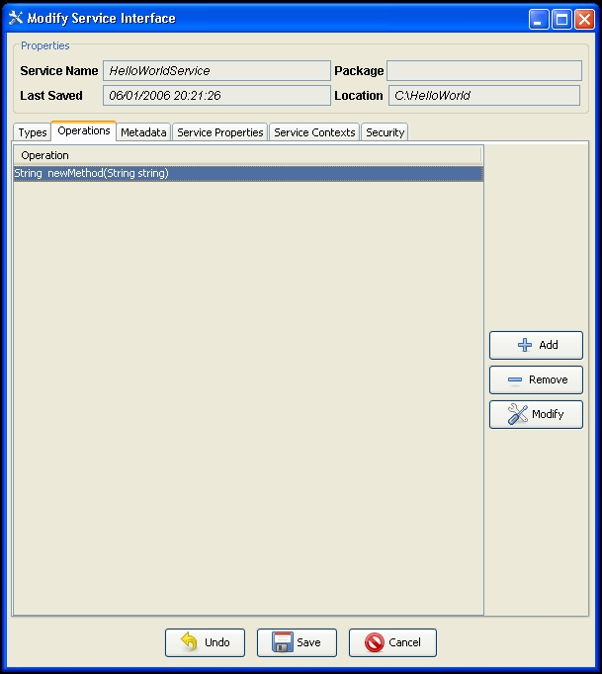
Introduce GDE Operations Modification
Once types are discovered and added to the grid service operations can be added/removed/modified or imported.

Slide 34
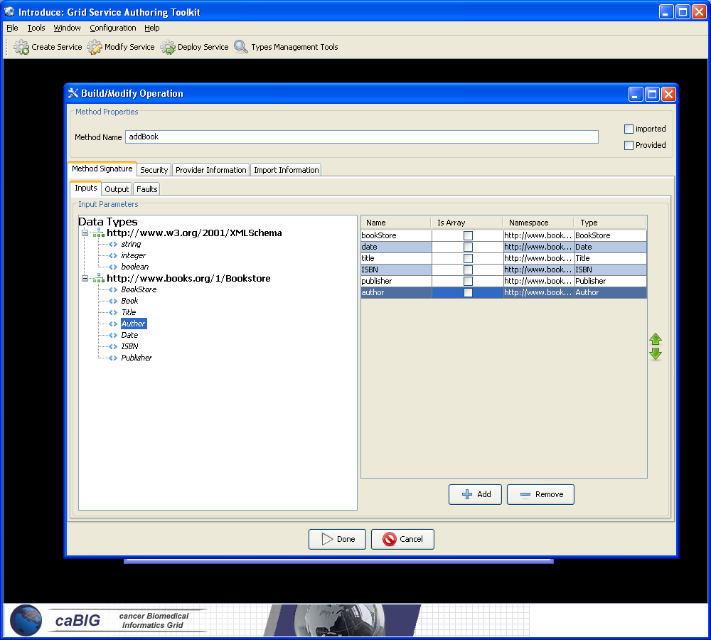
Introduce GDE Operations Modification
The operation modification screen will enable the complete description of the method signature, including inputs output and faults, it’s security configuration, and options for importing the definition and/or the implementation from another grid service.

Slide 35
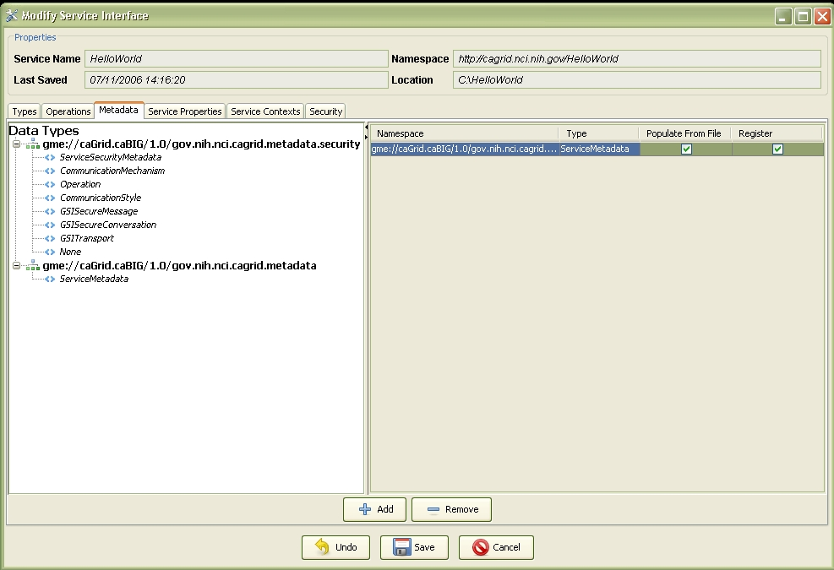
Introduce GDE Metadata Modification
Adding and removing service metadata (resource properties) to the service is done under the Service Metadata tab.
This feature enables the addition or removal of metadata types which will be populated at deployment time and can be accessed at runtime.
Each metadata property can be loaded file statically at grid service startup or populated by the service dynamically at run time.
Each metadata property can be selected to be registered with an index service so that they can be used during discovery.

Slide 36
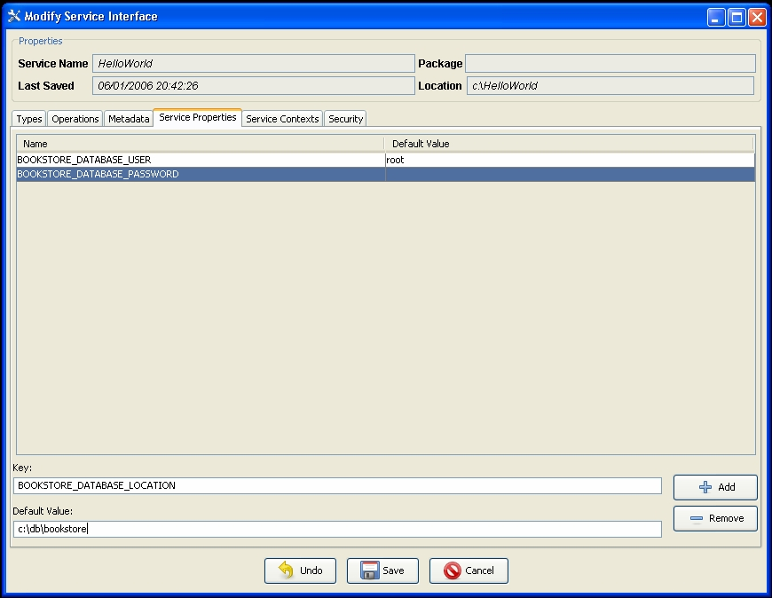
Introduce GDE Service Properties Modification
Service properties are properties which only the service itself is exposed to.
These properties are intended to be configured at deployment time to enable the service leverage them for it’s own configuration.

Slide 37
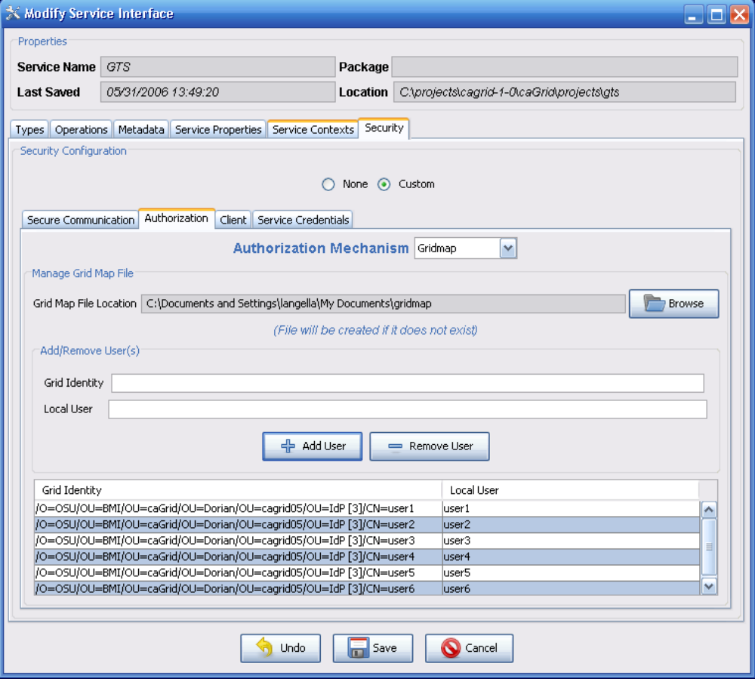
Introduce GDE Service Security Modification
Service security, as with operation security, enables the developer to create specific security constraints which the caller must meet in order to execute any method of the service.
Operation security configuration will take precedence over this overall service security configuration.

Slide 38
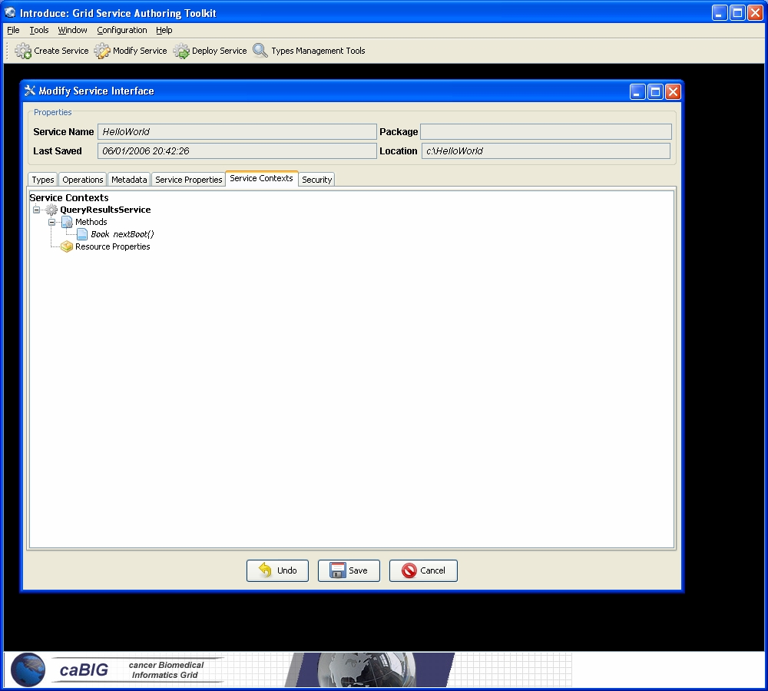
Introduce GDE Service Contexts Modification
The Service Contexts tab in the Modification View is intended to address enable developers to take advantage of the WSRF support provided by the Globus Toolkit.
Each service context added is essentially another resource definition in the service. With each new service definition the developer can add methods which are specific to that resource as well as properties to that resource.

Slide 39
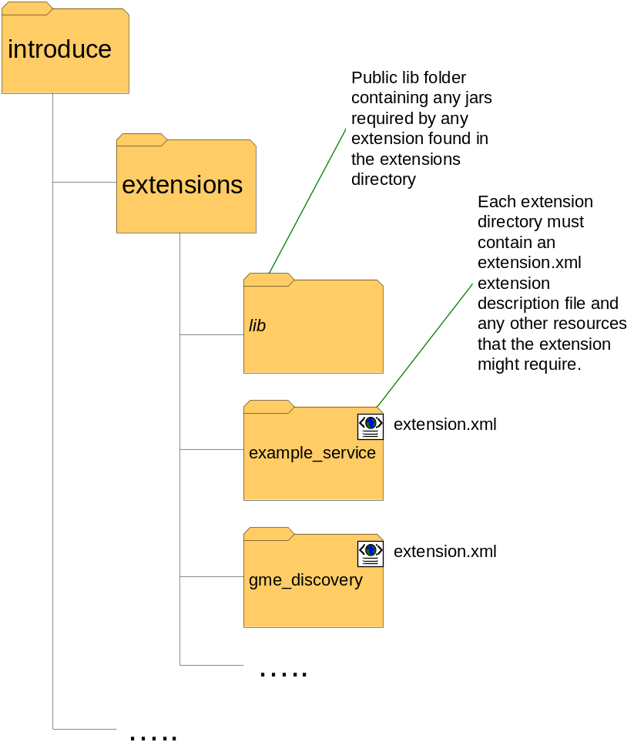
Introduce Extension Framework
Introduce is provides an extension framework where it’s core functionality can be extended to provide customized solutions by leveraging the introduce toolkit.
There are currently two types of extensions in Introduce
  Service
  Types Discovery
Extensions provide an “extension.xml” extension description and configuration. The “extensions” directory of introduce hold the extensions in separate folders enabling them to easily be added and removed from the Introduce toolkit.

Slide 40
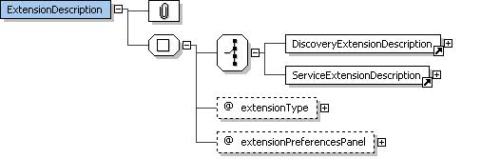
Introduce Extension Framework (cont)

Slide 41
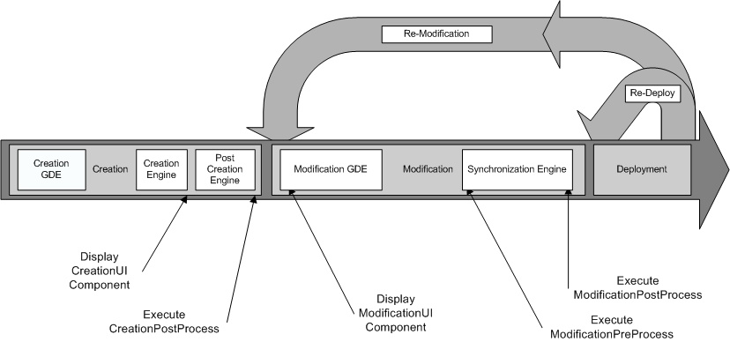
Service Development Extensions
Timeline for execution of service extension components.

Slide 42
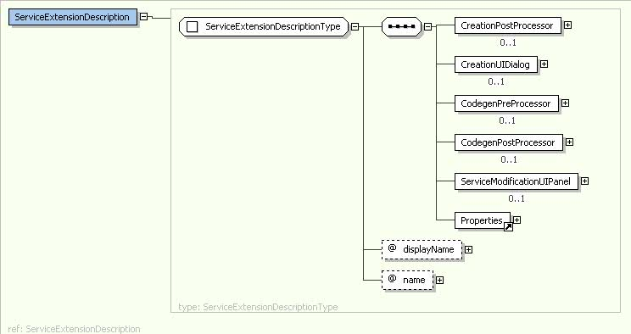
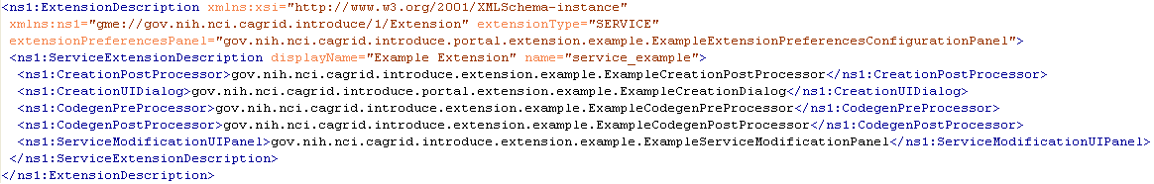
Service Development Extensions

Slide 43
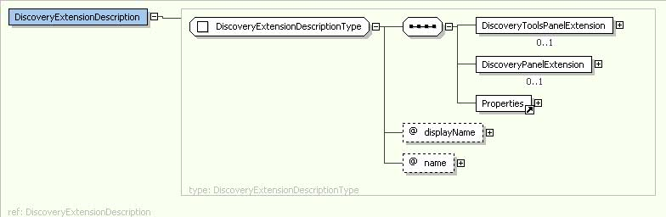
Data Type Discovery Extensions
Data type discovery extensions are plugins to introduce to enable the discovery and usage of data types in the grid service.
Currently there are discovery tools for GME and caDSR as well as utility ones for globus and the file system.

Slide 44
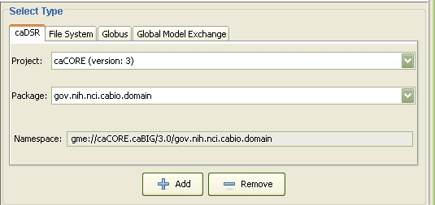
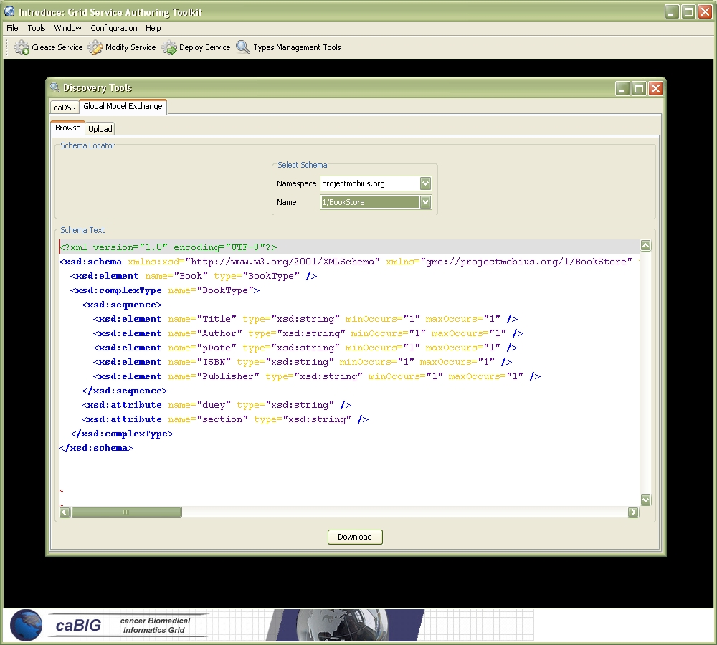
Data Type Discovery Extensions

Slide 45
Conclusion
Requirements
  Basic strongly typed grid requirements plus semantically interoperable caBIG requirements
Architecture
  Grid service framework which is encapsulated and layered on Globus 4.0.2
Introduce Service Layout
  Simple grid service layout making it easy to locate and manage pieces of the implementation
Introduce Toolkit
  Enables easy development of caBIG compliant grid service of any type size of shape.

Slide 46
Future Work
Stabilization, clean up.
Creation of Metadata population utilities.
Registration of service descriptions to caDSR.
Streamline common caBIG usage scenarios such as wizards for SDK data services.
Enhanced user documentation.

Slide 47
Introduce Team
Shannon Hastings
Scott Oster
Stephen Langella
David Ervin
Tahsin Kurc
Joel Saltz

Slide 48
Introduce
Grid Service Authoring Toolkit
Shannon Hastings
hastings@bmi.osu.edu
Multiscale Computing Laboratory
Department of Biomedical Informatics
The Ohio State University

