Slide 1
caGrid 1.0 Workflow
caBIG Joint VCDE-Architecture F2F
April 14th, 2006
Ravi Madduri, Argonne / U of Chicago
Patrick McConnell, Duke University
Mike Wilde, Argonne / U of Chicago

Slide 2
What is workflow?
High-level scripting for frequently executed tasks
  Often automates a manually driven sequence
  Powerful manner of composing scripts from services
Benefits over regular programming
  Parallelism: not as easy to do in Java
  Persistence: keeps track of state for long-running scripts
  Better fault recovery: engine automatically retries failing calls
  Powerful semantics for failure action – compensation handling
Canonical pattern for service workflows
  receive – input message and trigger to start
  declare variables – all local to the workflow
  Invoke services, assign variables, loops, etc
  Return final results.

Slide 3
caGrid Workflow - High Level Objectives
Compose workflows integrating data and analytic services in flexible patterns
Flexible control-flow patterns: loops, conditionals, iteration over collections
Type-safety: verifying data-type correctness of arguments passed between services
Robustness: recover and continue long running workflows after failures
Usability and integration: specify workflows in graphical interfaces and scripted textual form
Record data provenance of workflow results

Slide 4
BPEL Workflow specifics
BPEL: Business Process Execution Language
Described in an XML document
Work done via Service invocations
  “partner links” represent service endpoints
Looping, conditionals, parallel flows
  Specifies the order in which services are executed
Data objects copied from outputs to inputs
  Variables hold data
  XPath used to select data
Event-driven message exchanges allowed
Dynamic service discovery (to be developed)

Slide 5
Basic BPEL Workflow Model
Receive
Inputs
Assign
args
Invoke
Service
Assign
results
Send
results
Analytic
Service

Slide 6
BPEL Workflow Model – Pipelines (sequences)
Receive
Inputs
Assign
args
Invoke
Service
Assign
args
Invoke
Service
Assign
args
Invoke
Service
Assign
results
Send
results
Analytic
Service
Analytic
Service
Analytic
Service

Slide 7
BPEL Workflow Model – Parallelism (flows)
Assign
args
Invoke
Service
Assign
args
Invoke
Service
Assign
args
Invoke
Service
Assign
results
Receive
Inputs
Assign
args
Invoke
Service
Assign
args
Invoke
Service
Assign
args
Invoke
Service
Assign
results
Send
results
Assign
args
Invoke
Service
Assign
args
Invoke
Service
Assign
args
Invoke
Service
Assign
results

Slide 8
BPEL Workflow Model – Conditional (select)
Assign
args
Invoke
Service
Assign
args
Invoke
Service
Assign
args
Invoke
Service
Assign
results
Receive
Inputs
Select
Assign
args
Invoke
Service
Assign
args
Invoke
Service
Assign
args
Invoke
Service
Assign
results
Send
results
Assign
args
Invoke
Service
Assign
args
Invoke
Service
Assign
args
Invoke
Service
Assign
results

Slide 9
BPEL Workflow Model – Loops (while)
Receive
Inputs
Assign
args
Invoke
Service
while
Assign
args
Invoke
Service
Assign
args
Invoke
Service
Assign
results
Send
results
Analytic
Service
Analytic
Service
Analytic
Service

Slide 10

Service-oriented Science via caGrid workflow
Data Service
@ uchicago.edu
Workflow script:
Fetch data from
data service in Chicago
Perform step 1
using service at Duke
Perform step 2
using service at OSU
Workflow
Results
Analytic service
@ duke.edu
Analytic service
@ osu.edu

Slide 11

caGrid workflow implementation
Data Service
@ uchicago.edu
<BPEL
Workflow
Doc>
<Workflow
Inputs>
link
BPEL
Engine
Analytic service
@ duke.edu
link
link
<Workflow
Results>
link
Analytic service
@ osu.edu
Each workflow is also a service
  Enacted by BPEL Engine
  Typically runs like a script (synchronous)
  Other powerful models are possible

Slide 12
Accessing caGrid workflow - Design
Data Service
@ uchicago.edu
BPEL
Workflow
Doc
Workflow
inputs
Workflow
Mgmt
Service
BPEL
Engine
Analytic service
@ duke.edu
Workflow
Results
Analytic service
@ osu.edu
Workflow management service
  Sharing workflows
  Get workflow status

Slide 13
caGrid Workflow - Architecture Components
Workflow engine
  Centrally deployed and managed
Workflow documents
  Workflow description forms and creation tools
Workflow management client
  Required: submit, check status, cancel
  Desired: pause, resume
Grid Security in Workflows
  Basic security: Each engine instance runs as a specific Grid user
  Delegation of user credentials for “run-as” scenarios
Service Descriptions
  Need to interface to the workflow tools
Service locator / selector
  Select specific service instances when choices are available
  Workflow Planner turns abstract workflow into concrete form

Slide 14






Workflow components in caGrid 1.0
Analytical Service
Grid-Enabled Client
Tool 1
Gene
Database
caArray
Tool 2
Research
Center
NCICB
Grid Services Infrastructure
(Metadata, Registry, Query,
Invocation, Security, etc.)
Grid Data Service
Protein Database
Tool 3
Tool 4
Workflow
State
BPEL
Engine
Grid Portal
Microarray
Workflow
Storage
Workflow
Manager
Workflow
Document

Slide 15
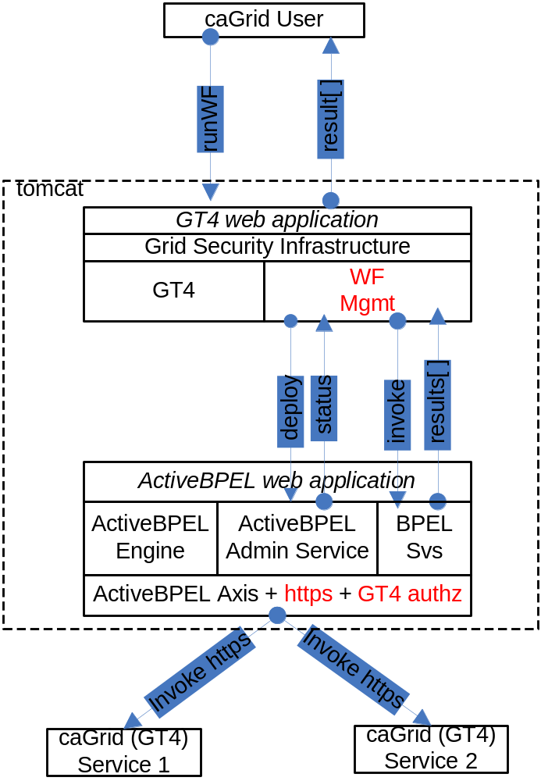
Workflow Management Service

Slide 16
caGrid Workflow – Overall Plan
Year 1
  Compose workflows integrating data and analytic services in flexible patterns (BPEL)
  Flexible control-flow patterns: loops, conditionals, iteration over collections
  Type-safety: verifying data-type correctness of arguments passed between services
  Dynamic service discovery
Year 2+
  Manage and share workflows
  Robustness: recover and continue long running workflows after failures
  Record data provenance of workflow results
  Usability and integration: specify workflows in graphical interfaces and scripted textual form

Slide 17
Workflow Management Service Design
A Standard caGrid 1.0 service built using Introduce
Uses Standard Grid Security configuration to control access.
  User needs a valid grid credential to invoke any operation on the service
Synchronous operation runWorkflow()
  Deploys and runs a workflow

Slide 18
Workflow Management Service Design
Operation runWorkflow()
  Input: WMSInputType
    String WorkflowName
    String BPELDoc
    Array of WSDLReferences (service endpoints)
      String wsdlNamespace
      String wsdlLocation
      anyURI serviceUrl
    Array of WorkflowInputType
      Unbounded list of xsd:any
  Output: WMSOutputType
    Unbounded sequence of WorkflowOutputType
      List of xsd:any types.

Slide 19
Workflow Management Service Design
Verifies that the workflow doc is
well-formed
Generates a ActiveBPEL Process Deployment Descriptor (PDD)
Generates a deployable BPEL archive (BPR) containing BPEL document and PDD
Deploys this BPR using the ActiveBPEL Admin service

Slide 20
Deploying and Running Workflows
ActiveBPEL Admin Service
  WS interface to deploy BPRs
  Takes BPRs as base64 encoded string
  Returns status as Deployment Summary
Once the workflow is deployed successfully, it is exposed as a web service inside ActiveBPEL.
To start the workflow, a message is sent to the receiving partnerLink in the workflow.
After the workflow successfully executes the results are returned to the client app/user.

Slide 21
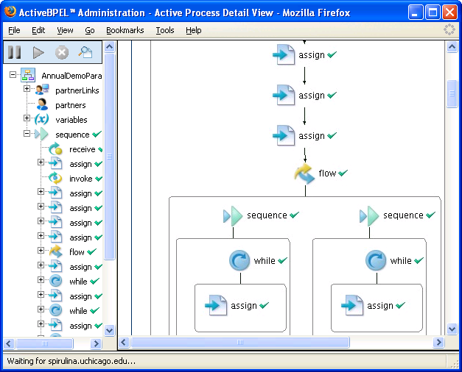
ActiveBPEL Engine Interface

Slide 22

Workflow demo overview
CQL
5x
Argonne
Data Service
Duke
5x
5x
interpolate
removeBG
denoise
align
normalize
plot
iterate
10x
10x
OSU
10x
5x
5x
interpolate
removeBG
denoise
align
normalize
iterate
5x

Slide 23
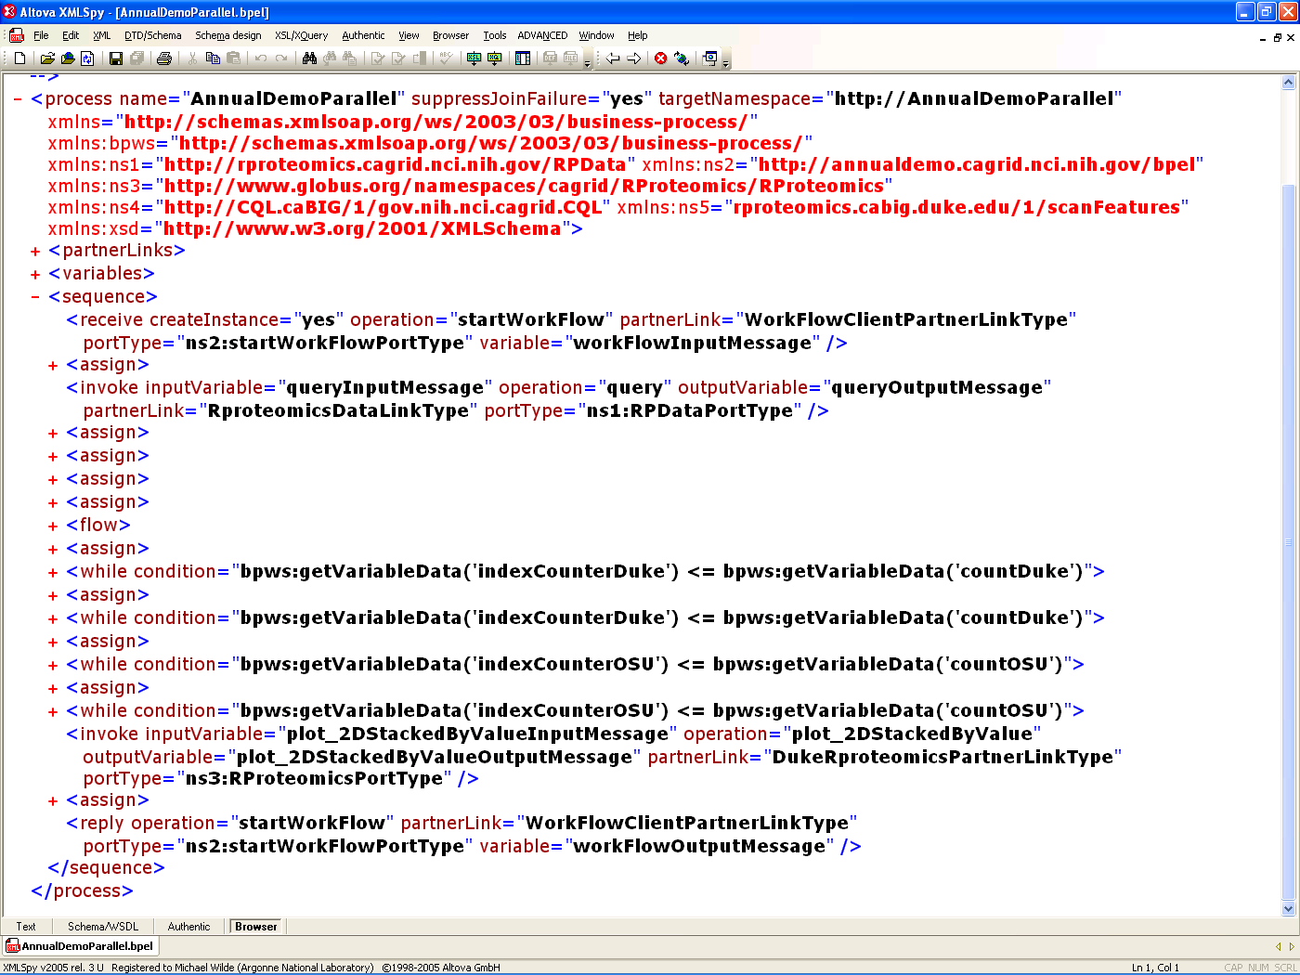
Workflow Document
</FOO>

Slide 24
BPEL Workfow Document Excerpt
<receive createInstance="yes" operation="startWorkFlow“
partnerLink="WorkFlowClientPartnerLinkType“
portType="ns2:startWorkFlowPortType“
variable="workFlowInputMessage" />
<assign>
  <copy>
  <from expression=""1"" /> <to variable="indexCounterDuke" />
  </copy>
  <copy>
  <from part="parameters" query="/ns1:WorkFlowInputType/query"
  variable="workFlowInputMessage" />
  <to part="parameters" query="/ns1:query" variable="queryInputMessage" />
  </copy>
  </assign>
  <invoke inputVariable="queryInputMessage" operation="query“
  outputVariable="queryOutputMessage"
  partnerLink="RproteomicsDataLinkType" portType="ns1:RPDataPortType" />
  <assign>
  <copy>
  <from expression="count(bpws:getVariableData('queryOutputMessage', 'parameters',
  '/ns1:queryResponse')/response/ns4:CQLQueryResult) div 2" />
  <to variable="countDuke" />
  </copy>
  </assign>

Slide 25
BPEL Document – Iterate over a service call
<while condition="bpws:getVariableData('indexCounterDuke')
<= bpws:getVariableData('countDuke')">
<sequence>
  <assign> ... </assign>
  <invoke operation="denoise_waveletUDWTWByValue"
  inputVariable=
  "denoise_waveletUDWTWByValueInputMessageDuke"
  outputVariable=
  "denoise_waveletUDWTWByValueOutputMessageDuke"
  partnerLink="DukeRproteomicsPartnerLinkType“
  portType="ns3:RProteomicsPortType" />
  <assign> ... </assign>
  </sequence>
  </while>

Slide 26
Future Work
Workflow management service enhancements
  Deploy workflows as services
Indentifier Integration
  Demonstrate use of identifiers and out-of-band data transfer
Optimized data flow
  Pass data directly from service to service
Provenance
  Tracking all actions of workflows
Grid cache
  Storing intermediate results
  Manipulate data by reference
  (via identifiers)

Slide 27
Future Work
Workflow engine
  How many? where? how managed?
WS-RF Resource Pattern
  Asynchronous submission
Support for WS-SecureConv, WS-SecureMessage
Credential Delegation
  Engine invokes services using calling user’s credential
Provenance
  Tracking your workflow
Abstract Workflows
  Reusable workflows
Sharing workflows, composing workflows of workflows

Slide 28
Questions /
Discussion

