Slide 1
caGrid Installer
Installing caGrid and Grid services
Vinay Kumar
SemanticBits

Slide 2
Overview
Process of Installation is
Cumbersome
Manual
Complex
Issues
Error Prone
Lengthy
Notes:
caGrid is a complex piece of software, installing which may be a non-trivial process
Installing caGrid requires
installing various minimum required softwares
configuring these softwares
configuring the grid container and/or tomcat
Manually performing these operations are not only cumbersome but error prone
To make this process simple and easy, there was a need for a user interface.

Slide 3
Overview (cont.)
The Installer
Easy
Automatic
Simple
Benefits
Error free
User Friendly
Notes:
caGrid is a complex piece of software, installing which may be a non-trivial process
Installing caGrid requires
installing various minimum required softwares
configuring these softwares
configuring the grid container and/or tomcat
Manually performing these operations are not only cumbersome but error prone
To make this process simple and easy, there was a need for a user interface.

Slide 4
Characteristics
Wizard like
Configurable
Extensible
For special purpose and complex tasks the installer should be extensible
There should be step by step guidance for installation
The user inputs and the number of steps should be configurable

Slide 5
Characteristics (Cont.)
XML Based
Customizable
Platform independent
The software should be installable on any platform
The configuration should be XML based
The look and feel should be customizable

Slide 6
The installer should be able to support the following features.
Features
 | Install necessary prerequisite software. - It should be able to Download and install - Java,Ant,WS Core and Tomcat if they are not present - If already present it should be able to point to these Software
 | Deploy Globus onto tomcat. - (There are some security issues being worked on)
 | Install caGrid with the required configurations.

Slide 7
The installer should be able to support the following features.
Features (Cont)
 | Installer should support 2 kinds of services. - Services requiring prerequisite software only - Services requiring additional software
 | Provide support for introduce created Services . - Read introduce.xml to determine the metadata to be populated - Invoke ant targets to deploy - Support deployment of cagrid core services
 | Support configuration during deployment.

Slide 8
The installer should be able to support the following features.
Features (Cont)
 | Store and cache user preferences and settings.
 | Provide on demand download.

Slide 9
Design
Three types of installers
  System check installer
  Master Installer
  Component Installer
System Check
Launches
Master Installer
Master Installer
Component
Component
………….
Component
Component

Slide 10
SystemCheck Installer
Invoked from a URL (JNLP)
What it does?
  Checks if caGrid installation exist
  If not, then downloads the caGrid pack and master and component installer.
  Set the Grid home.

Slide 11
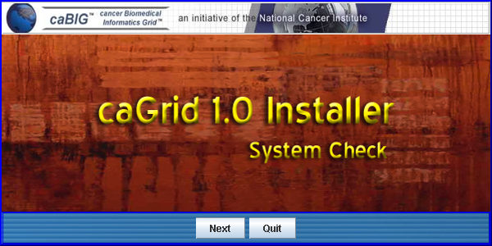
SystemCheck Installer (Cont.)

Slide 12
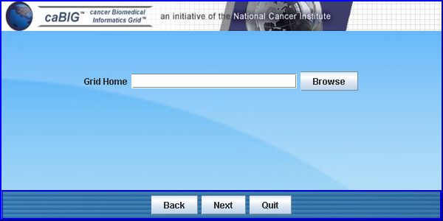
SystemCheck Installer (Cont.)

Slide 13
Master Installer
Master Installer is a container for all the installers for the components.
This installer gives the user the options to choose the services or components to install.
Once the components are selected, installers for those components are invoked one after the another.

Slide 14
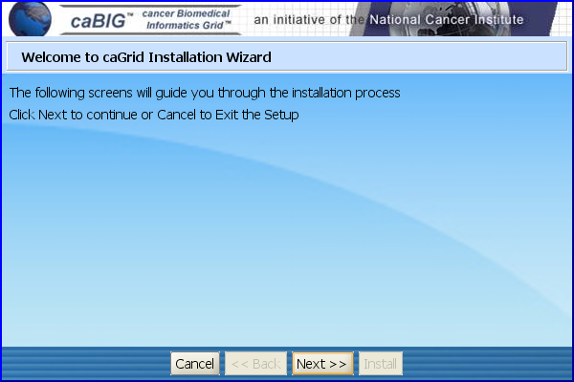
Master Installer (Cont.)

Slide 15
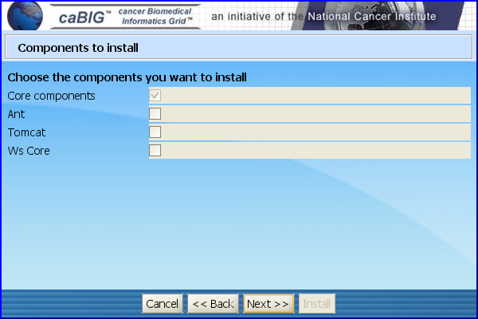
Master Installer (Cont.)

Slide 16
Component Installer
Every component or service may have its own unique way of installation. User input and configuration parameters may vary from services to services.
To address the uniqueness of every installation, a dedicated installer is provided.

Slide 17
Implementation of Installer
Do we
Create our own Installer
or
Use existing Framework
Does not meet our requirements
Ant Installer
IZ Pack

Slide 18
Implementation of Installer (cont)
So what’s the solution
Hybrid Solution
Extend Ant Installer and Ant Targets
Custom Swing Application
Descriptive, Configurable, Extendable
Its Descriptive

Slide 19
Questions

