Slide 1
GridCAD overview
Computer Aided Detection (CAD) algorithms exposed as analytical services interacting with DICOM image data services
  Remote execution of multiple CAD algorithms with multiple image sources
  Support human markup of images by radiologists
Facilitate research and clinical decision support with large number of subjects and multiple CAD algorithms.
  Parameter studies, clinical and preclinical trials, etc
Enable better algorithm development and validation through the use of many distributed, shared image datasets
Support remote algorithm execution – reduce data transfer and avoid the need to transmit PHI
Reduce overall processing time and algorithm development cycle through remote compute resource recruitment and CAD compute farms
Scalable and open source — caGrid 1.0 based

Slide 2
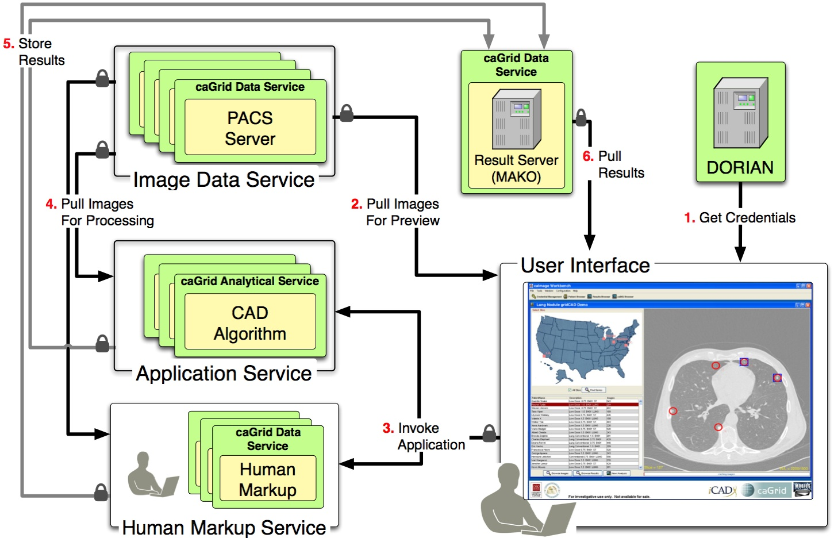
GridCAD screenshot

Slide 3
GridCAD as a reference implementation
caBIG Technologies
  caGrid 1.0
    Introduce toolkit for service creation and deployment
    Dorian for user and service authentication and authorization
  caDSR (CIP compliant vocabulary for DICOM data elements)
  CQL based query and retrieve for “data services”
Image Data Service
  Expose data in PACS servers as caGrid Data Service
  An open source DICOM server — Pixelmed
  Support third party high performance image data transfer using gridFTP
CAD Analytical Service
  Invoke algorithm with required inputs
  Transform and report results to results data service
Human Markup Service
  Query a work-order queue to detect any new markup requests
  Capture markups and save to results data service

