Slide 1
caGrid 1.0 Workflow
Patrick McConnell
Duke Comprehensive Cancer Center

Slide 2
Agenda
caGrid background
  System types, components, conceptual view, service
What is workflow?
  Description, conceptually, example
Workflow in caGrid 1.0
  Implementation, BPEL, features
Demo
  RProteomics at OSU, Duke, and U. Chicago
Discussion
  Use cases, feedback, new features

Slide 3
caBIG system types
Data services
  Information model exposed to a query method
  Information model registered in the caDSR/EVS
  Query is described by an object (CQL for grid services)
  Query works on classes, associations, and attributes
Analytical services
  Provides methods to algorithmically manipulate data
  Parameters are registered in the caDSR/EVS
  Tweaking parameters can be grouped into parameter objects
  Can accept an “information model” as input (e.g. MAGE)
Analytical tools
  Do not produce any CDEs
  Consume CDEs via an API call or a data import (e.g. file)

Slide 4
caGrid components
Grid use cases
  Advertisement, discovery, invocation, metadata, security
Infrastructure for grid services
  Baseline infrastructure: Globus Toolkit 4.0
  Index Service
  Metadata: caDSR, EVS, GME
  Service creation: Introduce
  Security: Dorian, GridGrouper
  Identifiers
  Workflow

Slide 5






caGrid conceptual view
Analytical Service
Grid-Enabled Client
Gene
Database
Tool 1
caArray
Tool 2
Research
Center
NCICB
Grid Services Infrastructure
(Metadata, Registry, Query,
Invocation, Security, etc.)
Protein Database
Grid Data Service
Tool 3
Tool 4
Image
Grid Portal
Microarray
Tool 2
Research
Center
Tool 3
http://gforge.nci.nih.gov/plugins/scmcvs/cvsweb.php/cagrid-1-0/Documentation/presentations/200604_AnnualMeeting/caGrid-1.0-Architecture_caBIG-Annual-Meeting06.ppt?cvsroot=cagrid-1-0

Slide 6
Grid service overview
A service is created graphically with the Introduce toolkit
  Service type is defined via an extension (metadata also)
  Types are added from the caDSR, GME
  Analytical service: operations are added with parameters
  Data service: the domain model and query processor are selected
Implementation is plugged in
Service-level metadata is defined
The service is deployed to a container (Globus or Tomcat)
The service registers itself with an Index Service (optional)
A client discovers the service via the Index Service (optional)
A client invokes the service

Slide 7
What is caGrid workflow?
Workflow is not
  LIMS: tracking information and experimental steps in a lab setting
  CTMS: tracking patient data as they move through the clinic
  Pathways: modeling biological processes
Workflow is modeling a bioinformatics pipeline on the grid
  Invoking of grid services
  Piping data between the services
  Logical decisions can be made (programmatically) along the way
  Data transformations can occur
Workflow is a grid aware scripting language

Slide 8
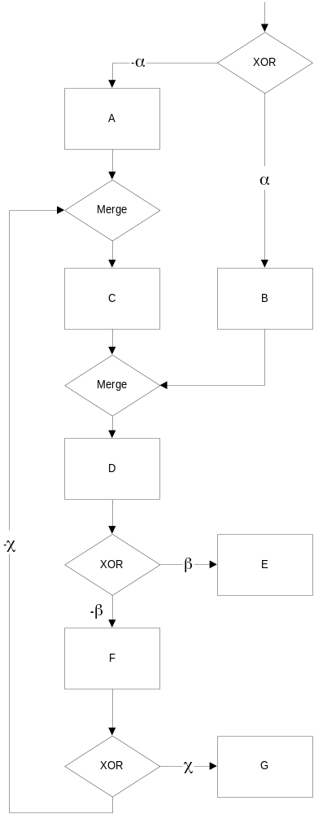
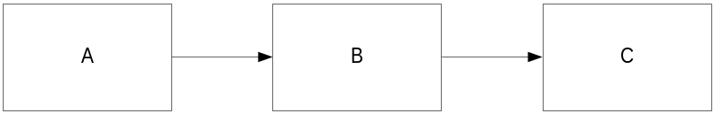
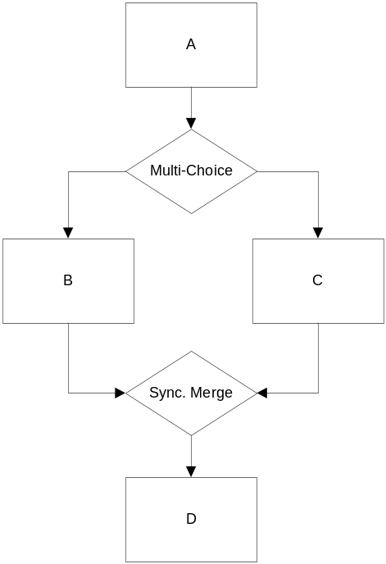
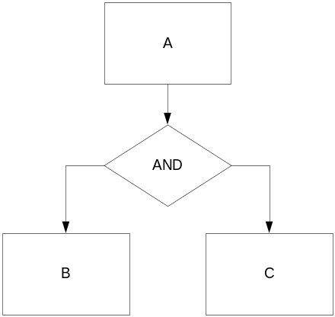
Workflow conceptually

Slide 9
Workflow example
subject
list
caArray
upstream genes
User output
expression data
caBIO Pathway
PSA
filtered genes
genes of interest
apoptosis filter
caBIO GO
gene ontology

Slide 10

caGrid 1.0 workflow implementation
<BPEL
Workflow
Doc>
<Workflow
Inputs>
Data Service
@ uchicago.edu
<Workflow
Results>
link
link
BPEL
Engine
Analytic service
@ duke.edu
link
link
Analytic service
@ osu.edu

Slide 11
BPEL
Business process execution language
Defacto standard for describing workflows
  XML-based language
  “Orchestration” of services
Describes the workflow in great detail
  What services to invoke (partner links)
  Data is stored in variables
  Conditionals, looping, error handling, parallelism
Relies on existing technologies
  Web services, XML, XPath, XML Schema
Supports abstract and executable processes

Slide 12
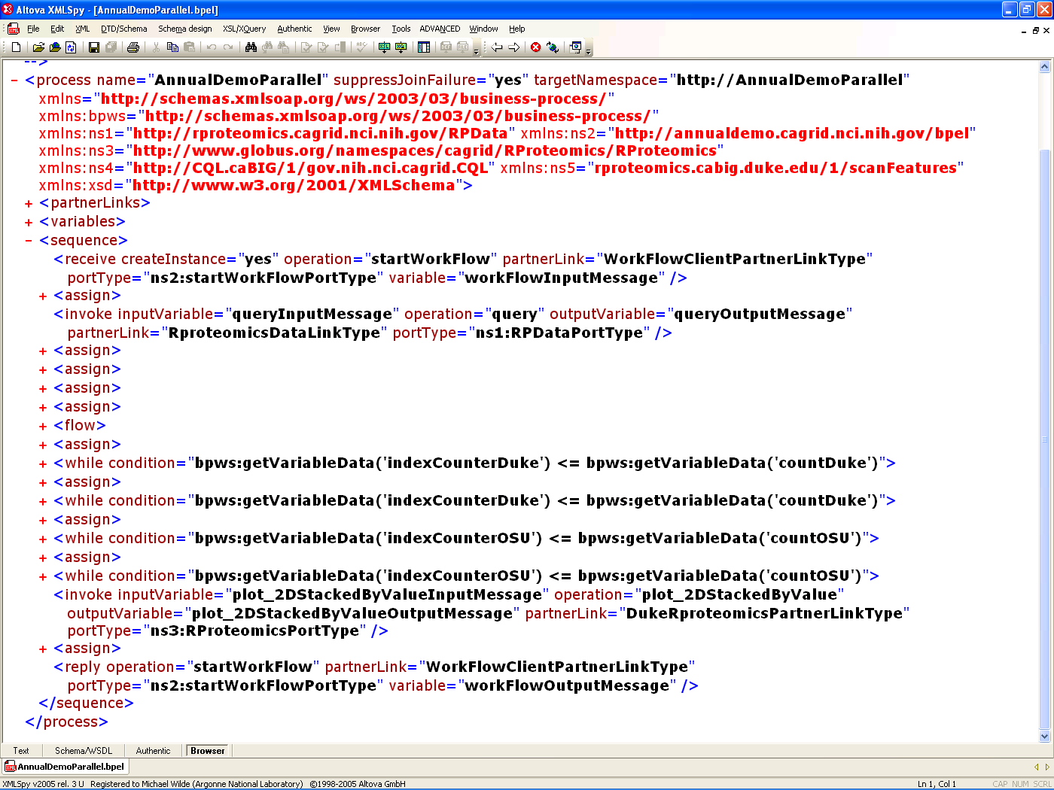
BPEL example
</FOO>

Slide 13
BPEL features
Variables to store data (assignment)
Type checking of data
Service invocation
Conditionals (if, switch)
Looping (while)
Parallelism
Fault handling
ftp://www6.software.ibm.com/software/developer/library/ws-bpel.pdf

Slide 14
Workflow features for caGrid 1.0
Adapt ActiveBPEL to work with grid services
Workflow Management Service
  createWorkflow: pass in BPEL and input data
  start, stop, pause, cancel, getStatus
  getResults: return output objects
Grid features
  Dynamic service discovery
  Security (delegation)
  Resource framework (WS-RF) resources (a.k.a. factory-based services)

Slide 15
Potential future features
Provenance
  Tracking your workflow
Grid cache
  Storing intermediate results
  Manipulate data by reference (via identifiers)
Optimized data flow
  Pass data directly from service to service
  Use grid identifiers

Slide 16
Comparing workflow and distributed query
Workflow engine
  Inputs: BPEL and input objects
  Output: result objects
  Orchestrates any grid service
  Arbitrary logic: conditionals, looping, parallelism
  BPEL is very complex
Distribute query engine
  Inputs: DCQL
  Output: result objects
  Queries across data services
  Filtering logic only
  DCQL is not too complex

Slide 17
Workflow clients
caGrid 1.0 workflow is not user friendly
  End users interact with GUIs, not grid services
  caGrid workflow will enable fancy GUIs
  Other caGrid components will help
    Dynamic service discovery
    Metadata
caB2B (presenting tomorrow afternoon)
  caB2B’s goal is to create a workflow UI that will perform the above and will be capable of:
    Performing serial, parallel, and/or iterative workflows using analytical services for the analysis of microarray data
      Example: Filter -> Normalize -> Cluster
      Example: Filter -> Normalize -> Classify -> Test samples using signature
        Loop to perform cross-validation
  Missing feature- Workflow steps to include user intervention (e.g. review classification results prior to testing step)

Slide 18

Workflow demo overview
CQL
5x
Argonne
Data Service
Duke
5x
5x
interpolate
removeBG
denoise
align
normalize
plot
iterate
10x
10x
OSU
10x
5x
5x
interpolate
removeBG
denoise
align
normalize
iterate
5x

Slide 19
Discussion
Use cases
  How can ICR leverage workflow?
Feedback
  Any thoughts on the existing infrastructure?
New features
  What features do you think would be important for post caGrid 1.0 development?

Slide 20
Workflow Backup Slides
Patrick McConnell
Duke Comprehensive Cancer Center

Slide 21
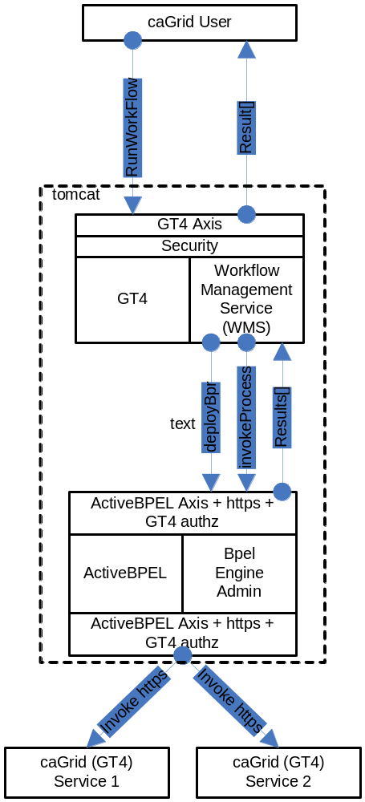
Workflow implementation details

Slide 22
Provenance Defined
The concept of Provenance is already well understood in the study of fine art where it refers to the trusted, documented history of some work of art. Given that documented history, the object attains an authority that allows scholars to understand and appreciate its importance and context relative to other works of art. Objects that do not have a trusted, proven history may be treated with some scepticism by those that study and view them. This same concept of Provenance may also be applied to data and information generated within a computer system; particularly when the information is subject to regulatory control over an extended period of time.
http://twiki.gridprovenance.org/bin/view/Provenance/ProjectAbstract

Slide 23
Provenance is a really hard problem
Data can be large (GB datasets in proteomics)
  Lifetime: when does the data “expire”
  Choice: how to decide which to keep
Where to store it
  Client
    Size is a big issue
    Workflow engine doesn’t generally run on client
  Grid cache
    Would be convenient
    Security transport
    Access control
    Size is still an issue

Slide 24
Use Cases for Provenance
Track analyses/workflow
  Where did these results come from?
  What parameters were used?
Analysis reproducibility (GenePattern does this)
  I read a paper published with results from a caBIG-based analysis, so how can I reproduce these results?
Viewing intermediate steps
  I’ve run a workflow, and I got unexpected results. I think step C might be wrong – what was the output?
Branching from intermediate steps
  Step C of my workflow was indeed flawed. I’d like to substitute with another service and rerun the rest of the workflow – how can I do that?
Automatically handled by the grid
  I want analysis and data provenance tracking support in my application, but I don’t have the resources to install databases, build models, etc. Can’t this be handled automatically by the grid?

Slide 25
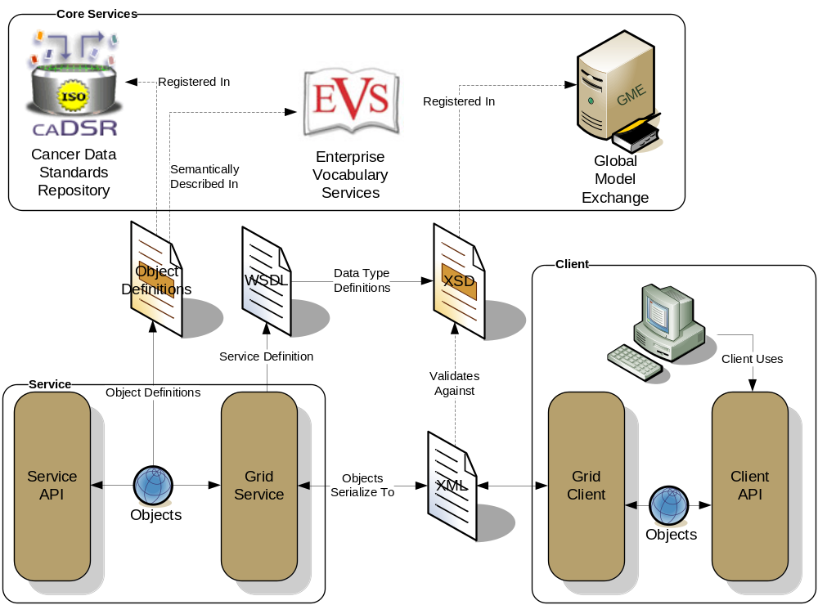
caGrid metadata infrastructure
Client and service APIs are object oriented, and operate over well-defined and curated data types
Objects are defined in UML and converted into ISO/IEC 11179 Administered Components, which are in turn registered in the Cancer Data Standards Repository (caDSR)
Object definitions draw from vocabulary registered in the Enterprise Vocabulary Services (EVS), and their relationships are thus semantically described
XML serialization of objects adhere to XML schemas registered in the Global Model Exchange (GME)

Slide 26
Service-level metadata
Common service metadata
  Research center: short name, long name
  RC description: description, homepage URL, image URL, rssNewsURL
  Point of contact: email, name, phone number, role, affiliation
  RC address: state, zip, etc.
Analytical service metadata (really all services)
  Service: name, description, version
  POC: email, name, phone number, role, affiliation
  Operation: description, name
  Fault: description, name
  Input parameter: dimensionality, index, isArray, isRequired, name, qname
  Output: dimensionality, isArray, qname
  UML class: class name, description, package, project, project version
  UML attribute: description, name

Slide 27
Service-level metadata continued
Data
  Domain model, class, association, edge, attribute
Security
  Operation: name
  Communication mechanism: anonymous permitted
    Transport, secure message, secure conversation, none
  Protection level: integrity, privacy, either

Slide 28
Service-level metadata: what’s not there
Computational information
  Example: service load, CPU speed, number of nodes, average execution time
Platform information
  Example: OS, hardware, cluster configuration
The grid abstracts this away
  Users should have to “worry” about these details
  These details are not trivial to get anyway
The metadata infrastructure is extensible
  You can add whatever metadata you’d like

