Slide 1
caGrid 1.1 Demonstration and Training
Scott Oster, Shannon Hastings, Stephen Langella, David Ervin
Ohio State University
{oster,hastings,langella,ervin}@bmi.osu.edu
August 6th, 2007

Slide 2
Agenda
caGrid 1.1 Highlights
Demos

Slide 3
caGrid Team
Ohio State University - Biomedical Informatics Department
  Dave Ervin
  Shannon Hastings
  Tahsin Kurc
  Stephen Langella
  Scott Oster - Chief Architect - caGrid
  Joel Saltz
University of Chicago/Argonne National Laboratory
  Ravi Madduri
  Ian Foster
SemanticBits, LLC.
  Joshua Phillips
Duke Comprehensive Cancer Center
  Patrick McConnell
Ekagra Software Technologies, Ltd.
  Vijay Parmar

Slide 4
caGrid Team (Continued)
Northern Taiga Ventures, Inc. (NTVI)
  Wendy Erickson-Hirons
Science Applications International Corporation (SAIC)
  Aynur Abdurazik
  Ye Wu
Terrapin Systems LLC (TerpSys)
  Chet Bochan
  Vanessa Caldwell
  Craig Fee
  Alan Klink
  Gavin Brennan
NCI - Center for Biomedical Informatics and Information Technology (CBIIT)
  Todd Cox
Booz Allen Hamilton
  Michael Keller
  Arumani Manisundaram
caGrid - Product Manager
  Avinash Shanbhag
  Director, Core Infrastructure Engineering
  NCI – Center for Biomedical Informatics and Information Technology (CBIIT)

Slide 5
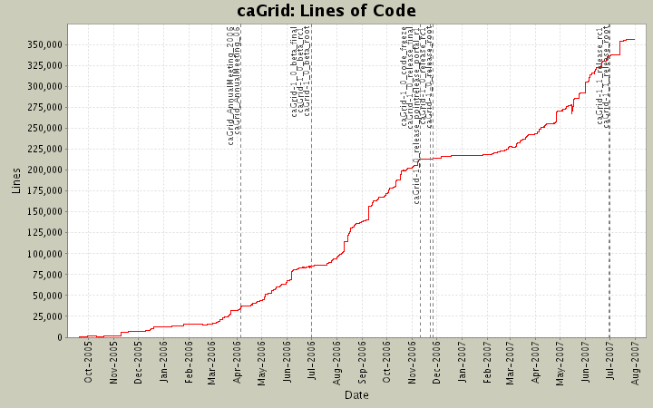



caGrid 1.1 Changes Overview
Services are backwards compatible with 1.0 release
Automated migration of 1.0 services to 1.1
Coordination with Security Working Group to create policy for credentialing in production deployment
Complete “training grid” deployment
Support for simple switching between grid deployments (production, training, local, etc)
Significant feature enhancements (detailed later)
> 40 fixed bugs (see gforge)
Usability improvements
Documentation improvements
Even more testing
Significant installation improvements

Slide 6
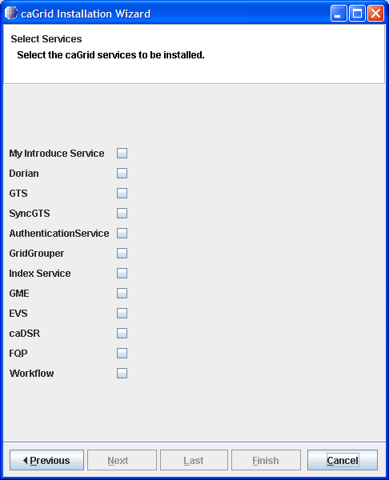

caGrid 1.1 Installer
Complete overhaul of caGrid 1.0 Installer
Simplified wizard-style user interface
Designed for repeated use
  stores state and allows partial reconfiguration and reinstallation
  detects and verifies environment
Small installer download (< 6MB), downloads components as necessary from Internet

Slide 7
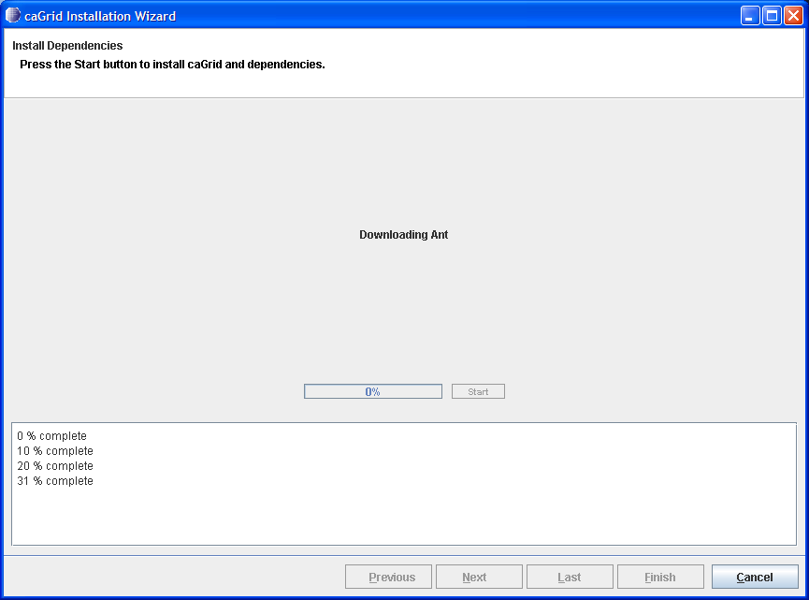
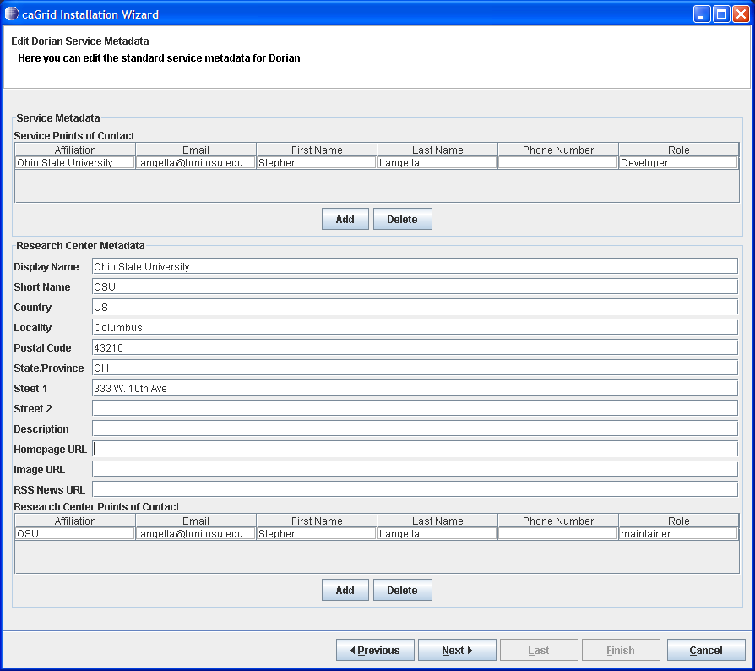
caGrid 1.1 Installer cont.
Downloads, installs, and configures prerequisites
  Ant, Globus, Tomcat, ActiveBPEL
Downloads, and builds caGrid
Provides ability to configure service containers
Provides ability to install and configure all core caGrid services
Provides ability to install and configure arbitrary Introduce services
Supports multiple deployment grids (training, production, etc)
“We eat our own dog food”
  Installer will be used for production deployment of caGrid 1.1; already used to deploy training grid

Slide 8
Installer Demo

Slide 9
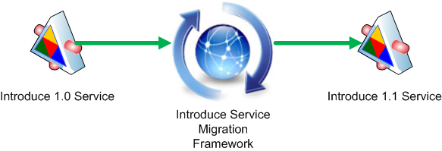
Introduce 1.1 Service Migration
New Introduce Service Migration Framework enables introduce and it’s extensions to provide upgraders which can run against services built with older versions of introduce and/or it’s extensions and migrate the services forward.
  1.0 services and forward will now be able to be migrated to work with newer versions of introduce with very little effort on the developers part.
Changes in the service structure introduced in 1.1 better isolate developer editable aspects of the service to make future migrations smoother

Slide 10
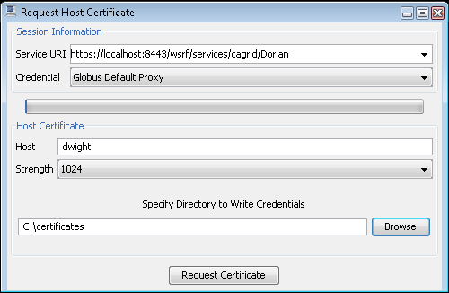
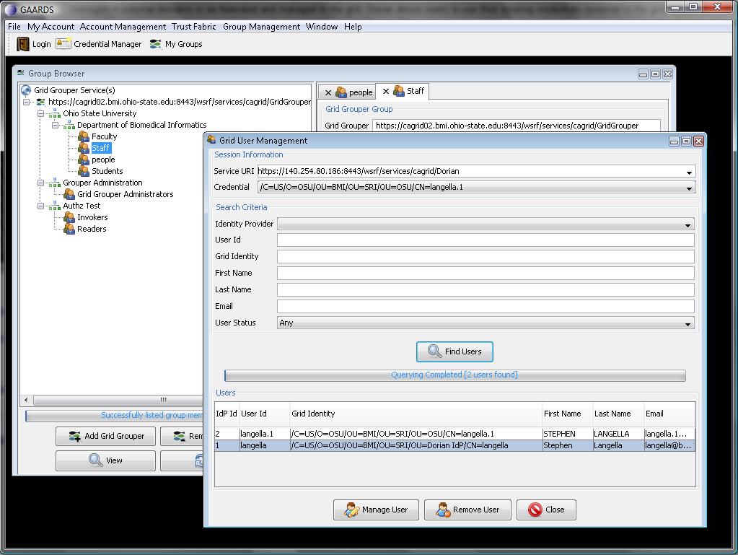
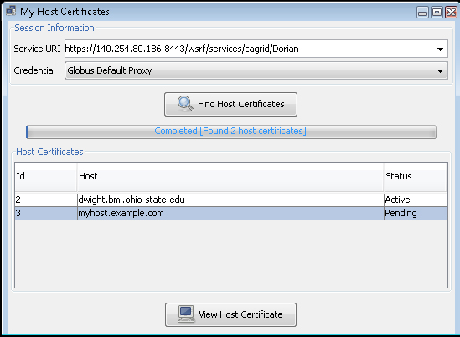
caGrid 1.1 Security UI
The security user interface has been overhauled for increased usability
Support in Dorian for requesting, retrieving, and managing host credentials

Slide 11
Remaining Demo

Slide 12
DEMONSTRATION
Use installer to show how one can install caGrid (and its dependencies).
With the installed caGrid (1.1), launch Introduce and open and upgrade the caGrid 1.0 Tutorial service
  Explain the process and caveats to the users (talk about build file changes, etc).
  Show the changes in Introduce layout (documentation tags, etc)
With the installed caGrid (1.1), launch the security UI, briefly show and explain the new menu layout
  Register for a Dorian account
  Request host credentials with that account
Re-run the installer, to configure a secure tomcat container to use the credentials we just received by deploying the upgraded service
Run the client (issue a query to the data service)
Time permitting: As a separate process, show new Data Service creation wizard (local API for SDK 3.2.1)

