Slide 1
caGrid 1.1 Overview
Scott Oster
Ohio State University
oster@bmi.osu.edu
August 7th, 2007

Slide 2
Agenda
High level changes (5 min)
Component changes (25 min)
  Installer
  Introduce
  Metadata
  Data Services
  Security
  Workflow

Slide 3
caGrid Team
Ohio State University - Biomedical Informatics Department
  Dave Ervin
  Shannon Hastings
  Tahsin Kurc
  Stephen Langella
  Scott Oster - Chief Architect - caGrid
  Joel Saltz
University of Chicago/Argonne National Laboratory
  Ravi Madduri
  Ian Foster
SemanticBits, LLC.
  Joshua Phillips
Duke Comprehensive Cancer Center
  Patrick McConnell
Ekagra Software Technologies, Ltd.
  Vijay Parmar

Slide 4
caGrid Team (Continued)
Northern Taiga Ventures, Inc. (NTVI)
  Wendy Erickson-Hirons
Science Applications International Corporation (SAIC)
  Aynur Abdurazik
  Ye Wu
Terrapin Systems LLC (TerpSys)
  Chet Bochan
  Vanessa Caldwell
  Craig Fee
  Alan Klink
  Gavin Brennan
NCI - Center for Biomedical Informatics and Information Technology (CBIIT)
  Todd Cox
Booz Allen Hamilton
  Michael Keller
  Arumani Manisundaram
caGrid - Product Manager
  Avinash Shanbhag
  Director, Core Infrastructure Engineering
  NCI – Center for Biomedical Informatics and Information Technology (CBIIT)

Slide 5
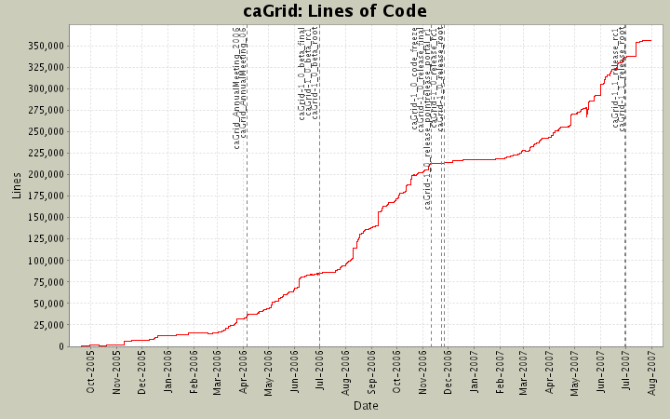



caGrid 1.1 Changes Overview
Services are backwards compatible with 1.0 release
Automated migration of 1.0 services to 1.1
Coordination with Security Working Group to create policy for credentialing in production deployment
Complete “training grid” deployment
Support for simple switching between grid deployments (production, training, local, etc)
Significant feature enhancements (detailed later)
> 40 fixed bugs (see gforge)
Usability improvements
Documentation improvements
Even more testing
Significant installation improvements

Slide 6
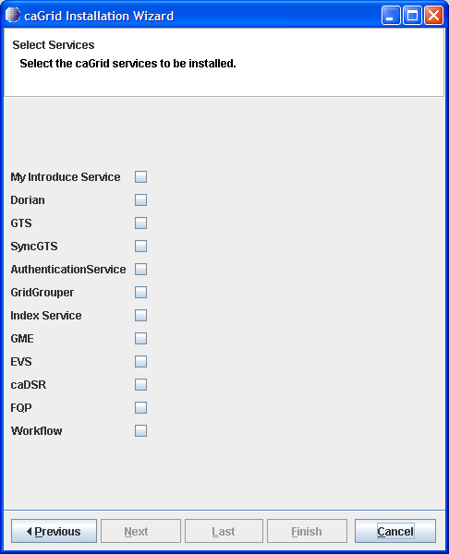

caGrid 1.1 Installer
Complete overhaul of caGrid 1.0 Installer
Simplified wizard-style user interface
Designed for repeated use
  stores state and allows partial reconfiguration and reinstallation
  detects and verifies environment
Small installer download (< 6MB), downloads components as necessary from Internet

Slide 7
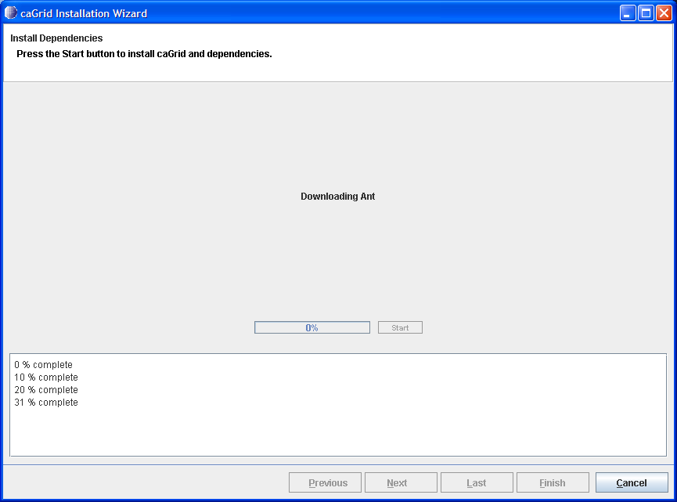
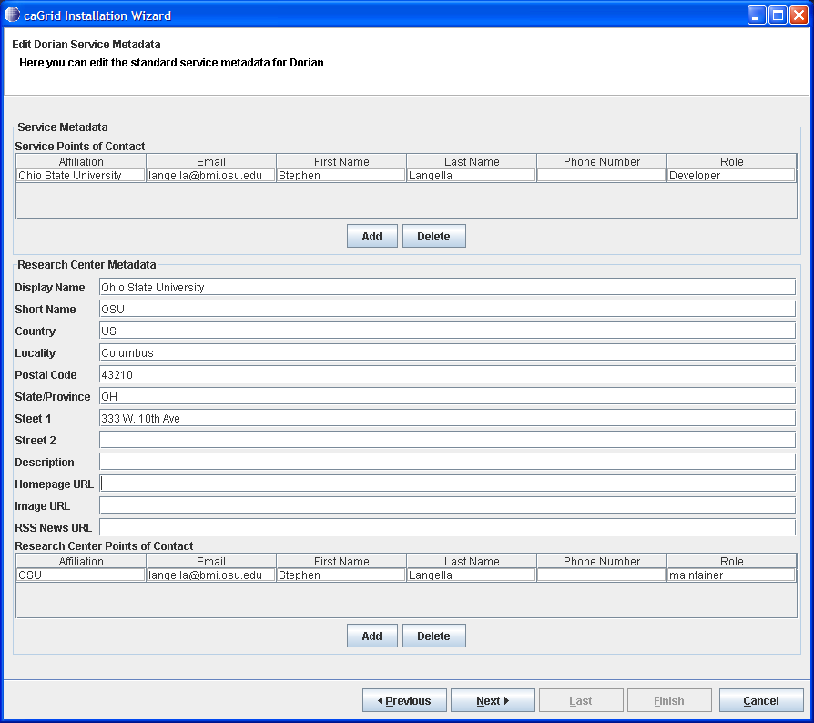
caGrid 1.1 Installer cont.
Downloads, installs, and configures prerequisites
  Ant, Globus, Tomcat
Downloads, and builds caGrid
Provides ability to configure service containers
Provides ability to install and configure all core caGrid services
Provides ability to install and configure arbitrary Introduce services
Supports multiple deployment grids (training, production, etc)
“We eat our own dog food”
  Installer will be used for production deployment of caGrid 1.1; already used to deploy training grid

Slide 8
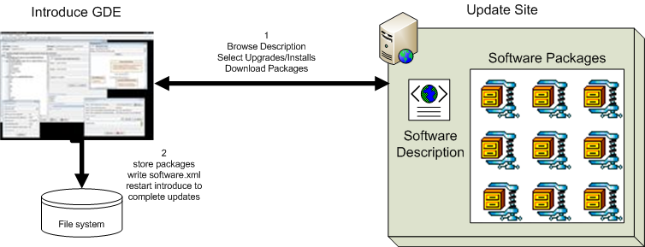
Introduce 1.1 Software Updater
New update support enables introduce to role updates out and move to newer versions of itself and it’s extensions.

Slide 9
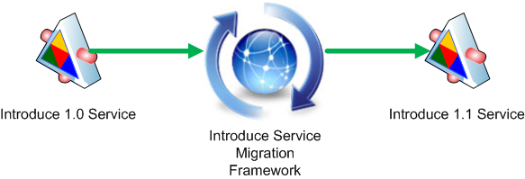
Introduce 1.1 Service Migration
New Introduce Service Migration Framework enables introduce and it’s extensions to provide upgraders which can run against services built with older versions of introduce and/or it’s extensions and migrate the services forward.
  1.0 services and forward will now be able to be migrated to work with newer versions of introduce with very little effort on the developers part.
Changes in the service structure introduced in 1.1 better isolate developer editable aspects of the service to make future migrations smoother

Slide 10
Introduce 1.1 Service Security
Now using Globus Policy Decision Point (PDP) based authorization.
  Introduce by default will generate the PDP authorization class from the requirements selected by the service creator using GridGrouper and/or CSM.
  Developer has the choice to use a custom PDP class which will enable them to create custom authorization login and use other external attribute or group authorities.
  Much more flexible and actually enables authorization policy to be applied to imported operations which 1.0 did not as well as directly to dynamically created resources.

Slide 11
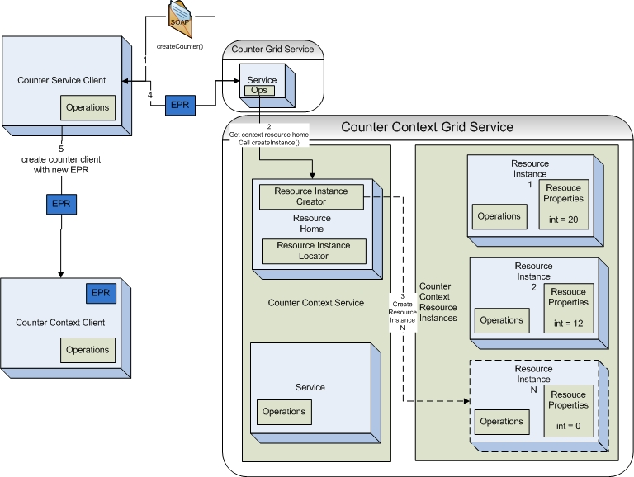
Introduce 1.1 Service Resource Contexts
Enhanced Resource Pattern Support
  now supports automated code generation of resource creation.
  Many bug fixes to support dynamic factory patterns to be created for creating and managing resources.

Slide 12
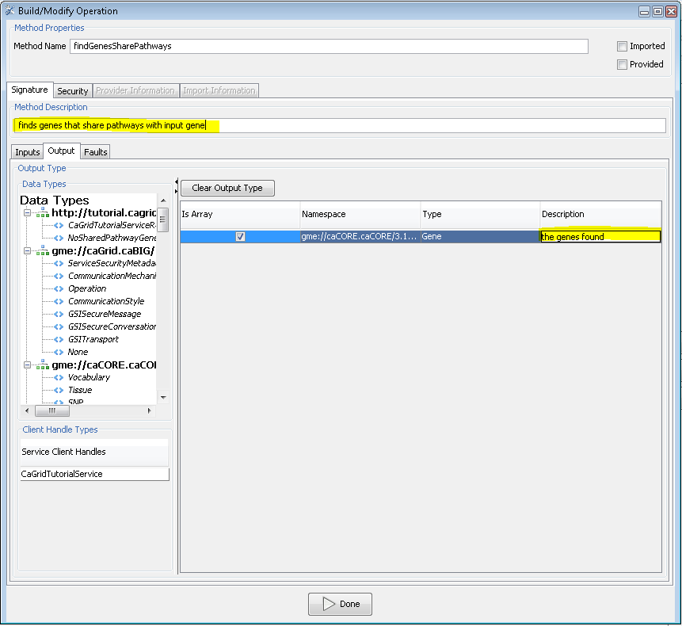
Introduce 1.1 Service Documentation
Introduce now enables descriptions and or comments to be added to virtually every aspect of the service.
  Descriptions are used to comment the generated API and to describe better the service metadata.

Slide 13
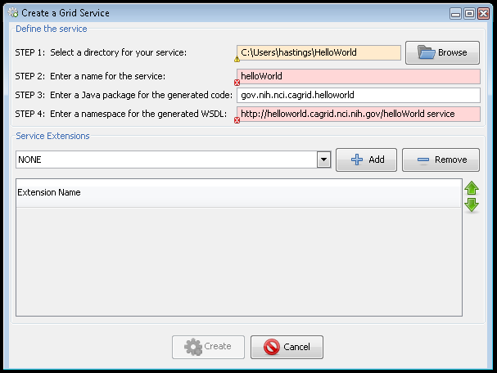
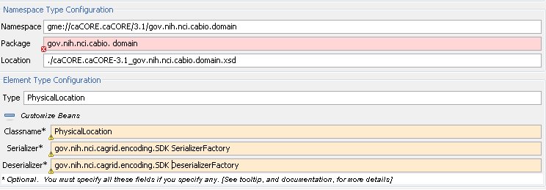
Introduce 1.1 Graphical Validators
All aspects of user input into the Introduce tool are now validated and visual feedback is dynamically given to the user.

Slide 14
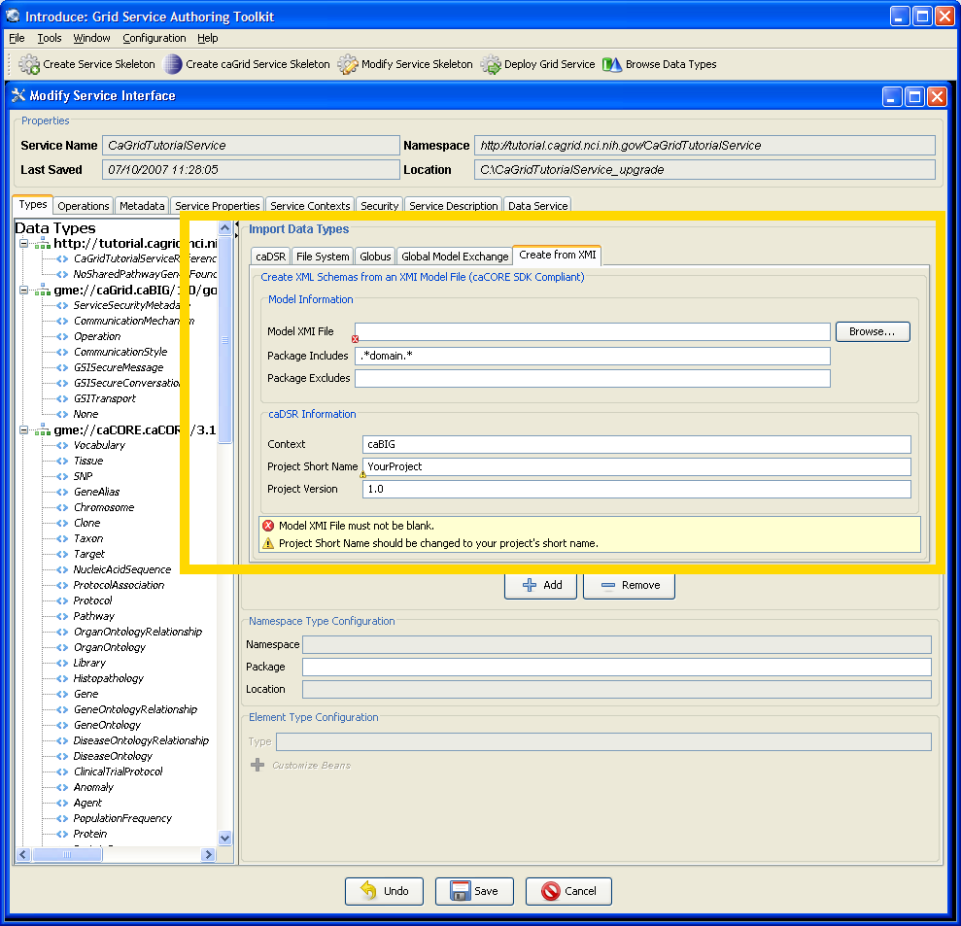
Introduce 1.1 XSD Generation from XMI
Introduce 1.1 provides the ability to create Classes/XSD/Serialization from XMI for analytical services
  Internally leverages new caCORE SDK features requested to make SDK useful for Analytical Service developers (in addition to existing Data Service utility)
Introduce Types integration provides graphical interface and completely automates process

Slide 15
caGrid 1.1 Metadata
Service metadata models are equivalent to 1.0 metadata models
Custom editors for service metadata (had to edit XML in 1.0)
  Introduce editor (has ability to pull information from caDSR)
  caGrid Installer editor
Introduce metadata generation makes use of new Introduce documentation tags (had to edit XML in 1.0)
  Service upgrade process migrates any existing manual edits into Introduce model
Advertisement improvements
  can be disabled at deploy time for local testing
  automatic deregistration at service shutdown

Slide 16
caGrid 1.1 Data Services
1.1 services backwards compatible with 1.0 clients (no service interface or CQL changes)
Automatic service migration from 1.0 Data Services
Integration with Bulk Data Transfer
  Allows for seamless use of alternate results delivery mechanisms, including WS-Enumeration
Support for caCORE SDK 3.2 & 3.2.1
  Local (as well as remote) API supported
  Better CSM support (leverages authz framework)
Initial auditing support (callback framework)
Overhaul of Introduce user interface for increased usability
Introduce Data Service styles
  Repeatable configuration patterns
  Custom creation and code generation logic
  Allows for drop-in support for additional data services types (e.g caCORE SDK 4.0)

Slide 17
caGrid 1.1 Security
Support for Hardware Security Model (HSM) in Dorian, and CA tools
  Tamper-proof, FIPS-compliant, hardware key storage and management
Working with Security Working Group to establish official policies and procedures for deployment and management
  Official process for obtaining credentials in the production grid
  Publishing of official Certificate Policy and Practice Statement for Dorian CAs
Complete graphical deployment configuration through caGrid 1.1 Installer
GAARDS Integration with GridFTP

Slide 18
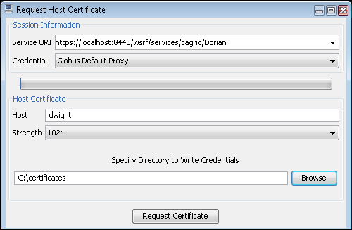
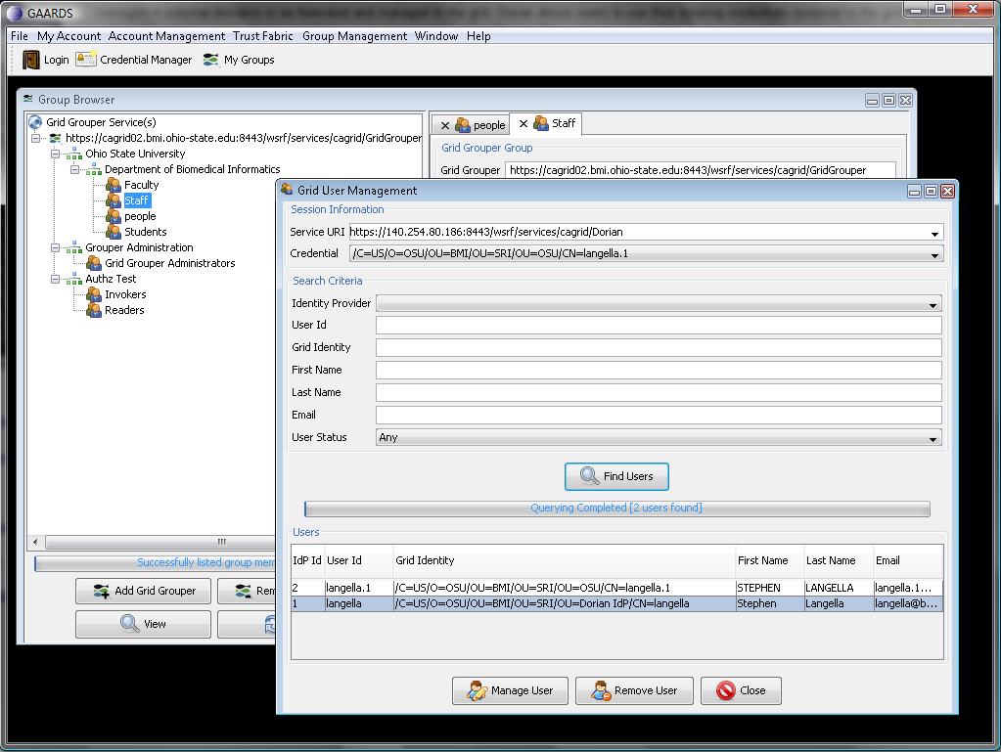
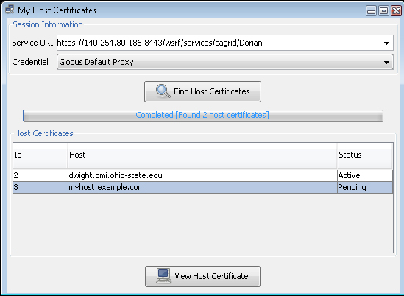
caGrid 1.1 Security UI
The security user interface has been overhauled for increased usability
Support in Dorian for requesting, retrieving, and managing host credentials

Slide 19
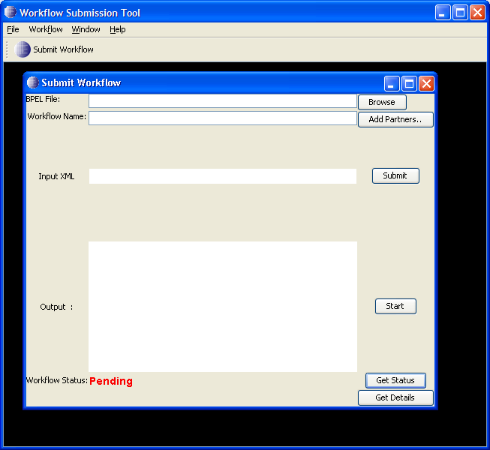
caGrid 1.1 Workflow
Added support for later release of ActiveBPEL engine which includes important bug fixes and features
Created user interface for submitting and monitoring workflows
Complete graphical deployment configuration through caGrid 1.1 Installer
Added operations to service to monitor workflow status

Slide 20
caGrid 1.1 Overview
Scott Oster
Ohio State University
oster@bmi.osu.edu
August 7th, 2007

