Slide 1
Overview of caGrid Workflow Infrastructure
Orchestrating Workflow
Ravi Madduri¹, Patrick McConnell², Shannon Hastings³
¹Argonne National Labs
²Duke Comprehensive Cancer Center
³Ohio State University

Slide 2
Participants
caGrid/Workflow
  Ravi Madduri, Argonne National Labs (madduri@mcs.anl.gov)
  Patrick McConnell, Duke (patrick.mcconnell@duke.edu)
  Mike Wilde, Argonne National Labs (wilde@mcs.anl.gov)
  Shannon Hastings, OSU (hastings@bmi.osu.edu)
  Scott Oster, OSU (oster@bmi.osu.edu)
GenePattern
  Ted Liefeld, Broad Institute (liefeld@broad.mit.edu)
  Jared Nedzel, Broad Institute (jnedzel@broad.mit.edu)
geWorkbench
  Kiran Keshav, Columbia University (keshav@c2b2.columbia.edu)
  Aris Floratos, Columbia University (floratos@c2b2.columbia.edu)
caBioconductor
  Martin Morgan, Fred Hutchinson Cancer Center (mtmorgan@fhcrc.org)
caArray
  Joshua Phillips (joshua.phillips@semanticbits.com)

Slide 3
Agenda
caGrid Background (5 mins)
  What is caGrid?
  Where does workflow fit in?
Workflow background (10 mins)
  What is workflow?
  How does workflow fit into caBIG?
  What is BPEL?
Workflow in caGrid (10 mins)
  How does caGrid implement workflow?
  How can I use caGrid workflow?
Demonstration (20 mins)
  Microarray analysis workflow
The future of caGrid workflow (2 mins)
Discussion (28 mins)

Slide 4
caGrid background
What is caGrid?
What is Grid?
  Evolution of distributed computing to support sciences and engineering
  Sharing of resources (computational, storage, data, etc)
  Secure Access (global authentication, local authorization, policies, trust, etc.)
  Open Standards
  Virtualization
What is caGrid?
  Development project of Architecture Workspace
    Helping define and implement Gold Compliance
  Implementation of Grid technology
    Leverages open standards, community open source projects
  No requirements on implementation technology necessary for compliance
    Specifications will be created defining requirements for interoperability
    caGrid provides core infrastructure, and tooling to provide “a way” to achieve Gold compliance
  Gold compliance creates the G in caBIG™
    Gold => Grid => connecting Silver Systems

Slide 5
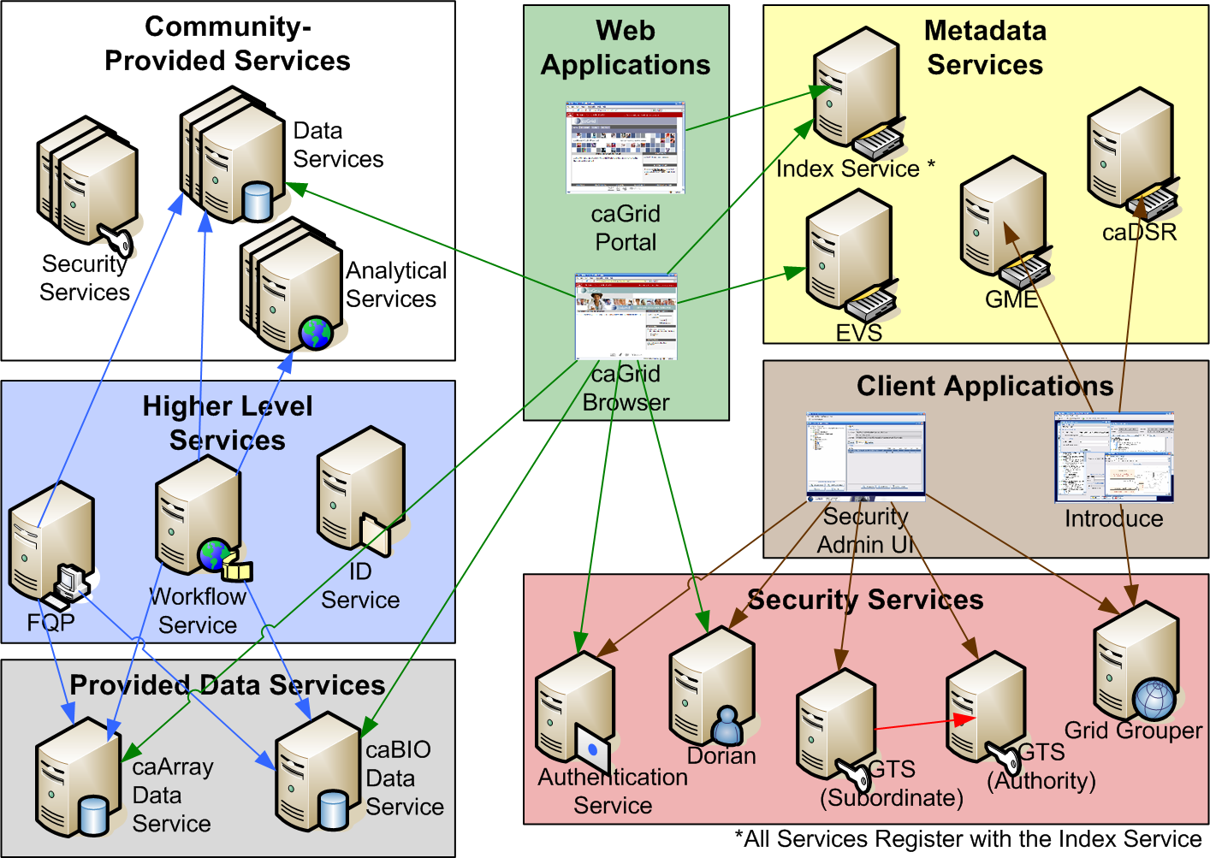
caGrid background caGrid overview

Slide 6
caGrid background
Where does workflow fit in?
^{Integrates}
^{Semantically}
^{annotated data}
^{Orchestrates}
^{caGrid-build services}
^{caGrid} ^{clients}
^{build/run workflows}
^{caGrid security}
^{supported}

Slide 7
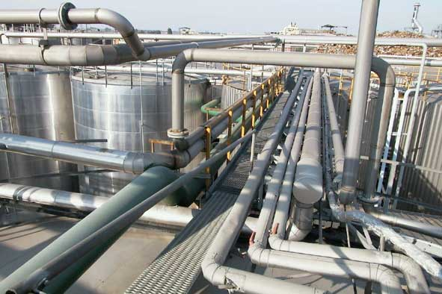
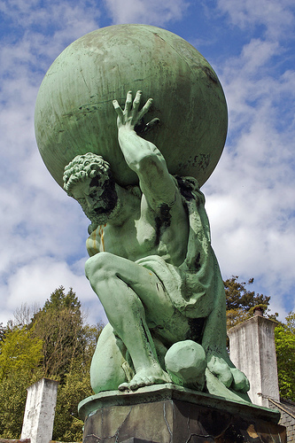

Workflow background
What is workflow?
The connecting of services to solve a problem that each individual service could not solve
In bioinformatics, this is sometimes referred to as a pipeline
Could mimic to some process in the real world
Grid-aware scripting language
Other possible definitions/uses of workflow
  Tracking samples in a LIMS
  Tracking patient data through protocols in CTMS

Slide 8
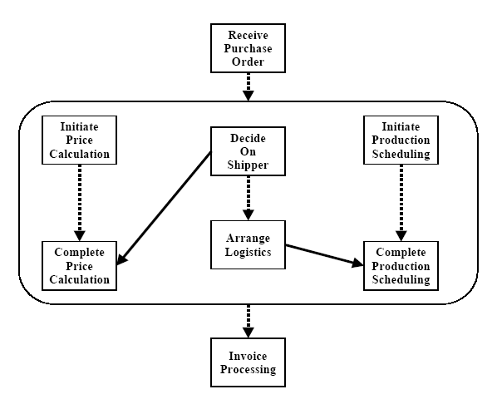
Workflow background
What is a service workflow?
High-level scripting for frequently executed tasks
  Often automates a manually driven sequence
  Powerful manner of composing scripts from services
Benefits over regular programming
  Parallelism: not as easy to do in Java
  Persistence: keeps track of state for long-running scripts
  Better fault recovery: engine automatically retries failing calls
  Powerful semantics for failure action –
  compensation handling
Canonical pattern for service workflows
  receive – input message and trigger to start
  declare variables – all local to the workflow
  Invoke services, assign variables, loops, etc
  Return final results.

Slide 9
Workflow background
How does workflow fit into caBIG?
caBIG is a…
  Common, widely distributed infrastructure that permits the cancer research community to focus on innovation
  Shared, harmonized set of terminology, data elements, and data models that facilitate information exchange
  Collection of interoperable applications developed to common standards
  Cancer research data is available for mining and integration
Workflow enables…
  Accessing distributed services in flexible patterns
  Integrating data and analytic services with flexible control-flow patterns
    Loops, conditionals, iteration over collections
  Type-safety: verifying data-type correctness of arguments passed between services
  Robustness: recover and continue long running workflows after failures
  Usability and integration: specify workflows in graphical interfaces and scripted textual form
  Record data provenance of workflow results

Slide 10
Workflow background
What is the BPEL?
Workflows in caGrid are described by the Business Process Execution Language (BPEL)
  Under standardization at OASIS
  Integrates well with web services (WSDL)
Described in an XML document
Work done via Service invocations
  “partner links” represent service endpoints
Looping, conditionals, parallel flows
  Specifies the order in which services are executed
Data objects copied from outputs to inputs
  Variables hold data
  XPath used to select data
Event-driven message exchanges allowed
Dynamic service discovery

Slide 11
Workflow background
BPEL: basic workflow model
Receive
Inputs
Assign
args
Invoke
Service
Assign
results
Send
results
Service

Slide 12
Workflow background
BPEL: pipelines
Receive
Inputs
Assign
args
Invoke
Service
Assign
args
Invoke
Service
Assign
args
Invoke
Service
Assign
results
Send
results
Analytic
Service
Analytic
Service
Analytic
Service

Slide 13
Workflow background
BPEL: parallelism
Assign
args
Invoke
Service
Assign
args
Invoke
Service
Assign
args
Invoke
Service
Assign
results
Receive
Inputs
Assign
args
Invoke
Service
Assign
args
Invoke
Service
Assign
args
Invoke
Service
Assign
results
Send
results
Assign
args
Invoke
Service
Assign
args
Invoke
Service
Assign
args
Invoke
Service
Assign
results

Slide 14
Workflow background
BPEL: conditionals
Assign
args
Invoke
Service
Assign
args
Invoke
Service
Assign
args
Invoke
Service
Assign
results
Receive
Inputs
Select
Assign
args
Invoke
Service
Assign
args
Invoke
Service
Assign
args
Invoke
Service
Assign
results
Send
results
Assign
args
Invoke
Service
Assign
args
Invoke
Service
Assign
args
Invoke
Service
Assign
results

Slide 15
Workflow background
BPEL: looping
Receive
Inputs
Assign
args
Invoke
Service
while
Assign
args
Invoke
Service
Assign
args
Invoke
Service
Assign
results
Send
results
Analytic
Service
Analytic
Service
Analytic
Service

Slide 16
Workflow background
BPEL example
<receive createInstance="yes" operation="startWorkFlow“
partnerLink="WorkFlowClientPartnerLinkType“
portType="ns2:startWorkFlowPortType“
variable="workFlowInputMessage" />
<assign>
  <copy>
  <from expression=""1"" /> <to variable="indexCounterDuke" />
  </copy>
  <copy>
  <from part="parameters" query="/ns1:WorkFlowInputType/query"
  variable="workFlowInputMessage" />
  <to part="parameters" query="/ns1:query" variable="queryInputMessage" />
  </copy>
  </assign>
  <invoke inputVariable="queryInputMessage" operation="query“
  outputVariable="queryOutputMessage"
  partnerLink="RproteomicsDataLinkType" portType="ns1:RPDataPortType" />
  <assign>
  <copy>
  <from expression="count(bpws:getVariableData('queryOutputMessage', 'parameters',
  '/ns1:queryResponse')/response/ns4:CQLQueryResult) div 2" />
  <to variable="countDuke" />
  </copy>
  </assign>

Slide 17
Workflow background
BPEL iteration example
<while condition="bpws:getVariableData('indexCounterDuke')
<= bpws:getVariableData('countDuke')">
<sequence>
  <assign> ... </assign>
  <invoke operation="denoise_waveletUDWTWByValue"
  inputVariable=
  "denoise_waveletUDWTWByValueInputMessageDuke"
  outputVariable=
  "denoise_waveletUDWTWByValueOutputMessageDuke"
  partnerLink="DukeRproteomicsPartnerLinkType“
  portType="ns3:RProteomicsPortType" />
  <assign> ... </assign>
  </sequence>
  </while>

Slide 18
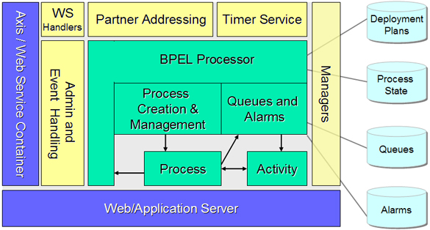
Workflow in caGrid
How does caGrid implement workflow?
Workflow Factor Service (WFS)
  Grid service to create a new workflow
Workflow Service
  Grid service to access your created workflow
  Start, pause, resume, cancel, getWorkflowOutput
caGrid integration
  Invoke grid services
  Security (communication, message, conversation)
caGrid implementation
  Leverages the ActiveBPEL workflow engine
  Workflows exposed as web services in
  ActiveBPEL, wrapped as grid services
  Wraps the ActiveBPEL Admin Service
    WFS submits a BPR (workflow package)
    Accesses the created stateful web service

Slide 19

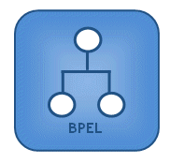




Workflow in caGrid
Accessing caGrid workflow
^{BPEL}
^{createWorkflow}
^{Workflow Factory}
^{Service}
^{Workflow Client}
^{EPR}
^{Input Object}
^{start}
^{status}
^{getStatus}
^{while active}
^{status}
^{getWorkflowOutput}
^{Workflow Service}
^{Output Object}

Slide 20
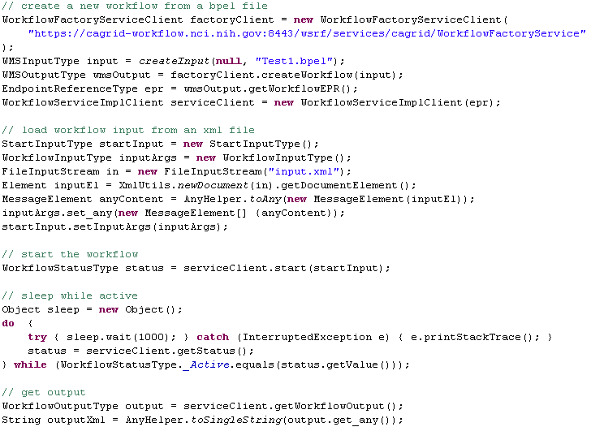
Workflow in caGrid
Accessing caGrid workflow programmatically
Create a new workflow by submitting a BPEL file to the WFMS
Start the workflow by submitting an input object to the created workflow service
Keep checking the status of the workflow until it is
^{not active}
^{Get the output of the workflow}

Slide 21
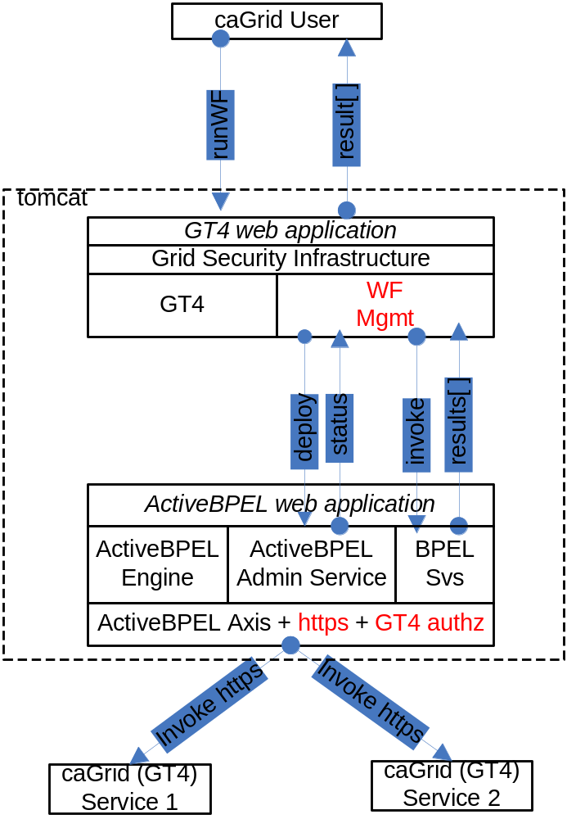
Workflow in caGrid
Workflow Management Service architecture

Slide 22
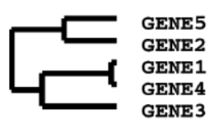
Workflow Demonstration
Overview
^{query}
^{caArray}
^{GenePattern}
^{CQL}
^{MAGE}
^{normalize}
^{mageToMicroarraySet}
^{mageToStatML}
^{MicroarraySet}
^{StatML}
^{MicroarraySet}
^{Microarray}
^{Translator}
^{mageToMicroarraySet}
^{StatML}
^{StatML}
^{cluster}
^{StatML}
^{Cluster}
^{cdt}
^{gtr}
^{atr}
^{geWorkbench}
^{clusterToTree}
^{cluster}
^{Cluster}
^{Cluster}
^{Translator}
^{TreeViewer}
^{GenePattern}
^{HierarchicalCluster}
^{HierarchicalCluster}
^{hClusterToTree}

Slide 23
The future of caGrid workflow
Dynamic discovery
  Select workflow endpoints based on search criteria
Provenance
  Tracking all actions of workflows
Workflow management service enhancements
  Share workflows
Identifier Integration
  Demonstrate use of identifiers and out-of-band data transfer
Optimized data flow
  Pass data directly from service to service
Grid cache
  Storing intermediate results
  Manipulate data by reference (via identifiers)

Slide 24
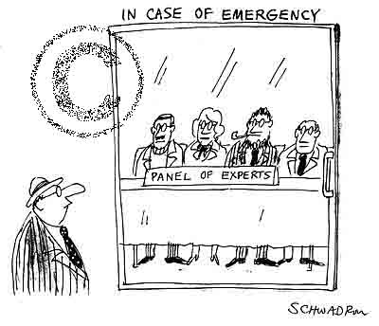
Discussion
caGrid Background (5 mins)
  What is caGrid?
  Where does workflow fit in?
Workflow background (10 mins)
  What is workflow?
  How does workflow fit into caBIG?
  What is BPEL?
Workflow in caGrid (10 mins)
  How does caGrid implement workflow?
  How can I use caGrid workflow?
Demonstration (20 mins)
  Microarray analysis workflow
The future of caGrid workflow (2 mins)
Discussion (28 mins)

Slide 25
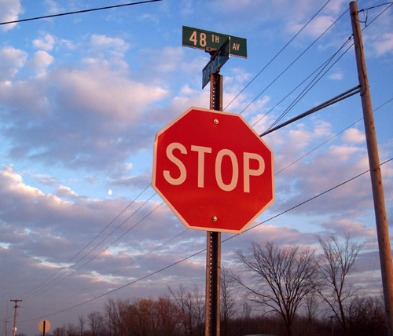
Backup slides

Slide 26
Images

Slide 27
Workflow Demonstration
Scenario 1
^{query}
^{caArray}
^{caBioconductor}
^{CQL}
^{MAGE}
^{normalize}
^{mageToMicroarraySet}
^{mageToStatML}
^{MicroarraySet}
^{MicroarraySet}
^{Microarray}
^{Translator}
^{mageToMicroarraySet}
^{MAGE}
^{StatML}
^{mageToStatML}
^{cluster}
^{StatML}
^{Cluster}
^{cdt}
^{gtr}
^{atr}
^{geWorkbench}
^{clusterToTree}
^{cluster}
^{Cluster}
^{Cluster}
^{Translator}
^{TreeViewer}
^{GenePattern}
^{HierarchicalCluster}
^{HierarchicalCluster}
^{hClusterToTree}

