Slide 1
caCORE / caGrid 1.x Overview
Overview, Status, and Future Direction
Denise Warzel, Scott Oster
caBIG Architecture/VCDE Joint Face-to-Face
Salt Lake City, UT
January 28th-30th, 2008

Slide 2
Agenda
caCORE Overview
  Status
  Future Direction
caGrid Overview
  Brief review of what caGrid is and isn’t
  Current Status
  Future Direction
Wrap up

Slide 3

caCORE

Slide 4

caCORE Overview
‘But I don't want to go among mad people,’ Alice remarked.
‘Oh, you can't help that,’ said the Cat
‘we're all mad here. I'm mad. You're mad.’
‘How do you know I'm mad?’ said Alice.
‘You must be,’ said the Cat,
‘or you wouldn't have come here.’
Alice in Wonderland – Lewis Caroll

Slide 5
caCORE
caCORE Team
caCORE Infrastructure Overview
  What is meant by “caCORE” and “caCORE-like” systems?
What is caCORE 4.0?
caCORE 4.0 Highlights
Subproject:
  Metadata Registry Futures

Slide 6
caCORE Team
Developers, QA, Traikning, Technical Writers
NCI
  Frank Hartel
  George Komatsoulis
  Sichen Liu
  Dianne Reeves
  Avinash Shanbhag
  Denise Warzel – caCORE Product Line, caDSR
Oracle
  Steve Alred
  Prerna Aggarwal
  Sharad Bhardwaj
  Christophe Ludet
  Brett Novak
Ekagra Software Technologies, Ltd
  Satish Patel
  JJ Maurer
  Denis Avdic
  Nadine
ScenPro
  Jennifer Brush
  Larry Hebel
  Sumana Hedge
  Charles Yaghmour

Slide 7
caCORE Team
Developers, QA, Technical Writers
Northrop Grumman
  Wilberto Garcia
  Kim Ong
  David Yee
Mayo (LexBig Team)
  Thomas Johnson
  James Buntrock
  Russ Hamm
  …..
Lockheed Martin Management Systems Designers
  Eddie VanArsdell
  Sarah Gill
  Ann Wiley
Northern Taiga Ventures
  Wendy Erickson-Hirons
Science Applications International Corporation (SAIC)
  Johnita Beasley
  Rui Chen
  Jyothsna Chilukuri
  Tommie Curtis
  Brenda Maeske
  Mary Cooper
  Konrad Rokicki
  Tracy Safran
  Ye Wu

Slide 8



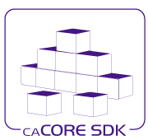





caCORE Product Line
S
I
W
M
A
P
P
I
N
G
S
E
C
U
R
I
T
Y
L
O
G
G
I
N
G
S
D
K
Biomedical Domain
Objects
Common
Metadata
Enterprise Vocabulary

Slide 9

What is caCORE?
Cancer Common Ontologic Research Environment
caCORE is the open-source foundation upon which to build interoperable research information systems
Building caBIG compliant Application Software and Programming Services
→ “Develop, Access, Consume”
50th Anniversary of Lego

Slide 10
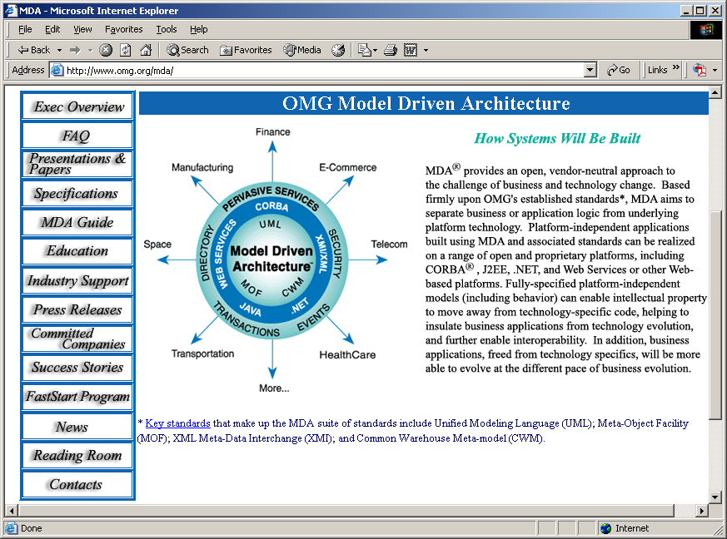
caCORE-Like Systems
Model Driven (MDA)
  Unified Modeling Language (UML)
    Business process models
    Use Case development
    Domain Modeling describes high level reusable classes of data
Agile software development
  Incremental Development
  RUP methodology
Object Oriented
Open Source
Services Oriented Architecture (SOA)
  Application Programming Interfaces, web services
XML Schema (xsd) Transport
  syntax for object representation
Registered ISO 11179 Metadata – (caDSR Repository)
  syntax for data semantics
Uses Controlled vocabularies - (EVS Terminologies)
  concept binding to ISO 11179 metadata represents data semantics (“semantic signatures”)

Slide 11
caBIG “Levels of Maturity”
Guidelines four levels of maturity/degrees of interoperability between systems
Legacy
  Implies no interoperability with an external system or resource. A system that was designed without awareness of or prior to the availability of these compatibility guidelines, and which does not meet any of the requirements for interoperability.
  Bronze
  Classifies the minimum requirements that must be met to achieve a basic degree of interoperability.
  Silver
  A rigorous set of requirements that, when met, significantly reduce the barrier to use of a resource by a remote party who was not involved in the development of that resource.
  Gold
  Currently being defined by caBIG. Is expected to provide for a formalized grid architecture and data standards that will enable standardized advertising, discovery, and use of all federated caBIG resources.

Slide 12
caCORE Infrastructure Products
Current caCORE Product Line
EVS 4.0
    Metathesaurus, NCIt, and other non-NCICB vocabulary services, LexBig, NCI BioPortal
caDSR Tools Suite (3.2.X.X)
    Curation Tool, Sentinel Tool, CDE Browser, Form Builder, UML Model Browser, Database Admin Tool, Data Repository, SIW, UML Loader
XMI Handler 4.0
    Read/Write XMI
Common Security Module (CSM) 4.0
Common Logging Module (CLM) 4.0
???
caCORE 4.0 “unbundled” Services
    EVS – Jan 2008
    caDSR – March 2008
      Grid, Java, SOAP/web services
SDK 4.0
    Code Generation, Schema Generation
caAdapter 4.0
    Core Engine
    Mapping Tool
      Model Mapping Service map an object model to a data model
      CSV to HL7 v3 mapping and transformation
      HL7 v2 to HL7 v3 conversion
      CSV and Database to RDS mapping and transformation
      Web service
caGrid 1.1
    Introduce, Portal, Browser, Global Model Exchange (GME), Service Index

Slide 13
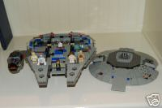
caCORE Infrastructure
Why build use caCORE to create
caBIG systems ?
Bragging Rights
  Its caBIG Compliant!
Sense of Accomplishment
  I did it!
Funding
  Mom and Dad will buy be another one!
Millennium Falcon™

Slide 14
Why Bother?
“we have what we need”
Simple program = primary use of data within the immediate original context
  spreadsheet/statistical packages
  classic closed world RDBMS
  file server/web server
  Messaging systems
  E.g. Clinical Trial System, Patient Care, Image Analysis
Enabling “Discovery” requires we get more out of data
  reuse of data outside of primary or original context
  integrate data from disparate sources
  interoperability between systems
    Unambiguous meaning (semantics)
    Unambiguous syntax
Adapted from Steve Harris, University of Oxford
Notes:
A study I did using the data dictionaries from 4 studies conducted by the same PI, at the same medical institution, on the same disease, only 2% of the data was reusable without translation - single purpose, wasted public funding, and limited PIs ability to harvest even more from his studies than he originally had planned.

Slide 15
Harmonization and Mapping Services
… Values and structures are the same,
but ‘007’ and ‘Taxol” are still
NOT semantically the same
XML Schema!
<agent
authority=“2.123.456.02-3">
<identifier identifier-type=“nSC_number”>
<value>007</value>
</identifier>
<identifier identifier-type=“name">
<value>Taxol</value>
</identifier>
</agent>
<agent
authority="2.433.987702-3">
<identifier identifier-type=“nSC_number”>
<value>007</value>
</identifier>
<identifier identifier-type=“name">
<value>Taxol</value>
</identifier>
</agent>

Slide 16
caCORE 4.0 – “caCORE Unbundled”
SDK 4.0: Dec 2008
      Support for connecting multiple remote services from the same Java API client
      Support for open source UML tool ArgoUML
      Relaxed restrictions on UML Model development
      Tighter integration with Common Security Module (CSM) for instance and attribute security
      Simplified system generation process
      Enhanced generation of JavaDocs for java classes based on UML model
CSM 4.0: instance level security
CLM 4.0: logging facilities tighter integration with SDK
caCORE 3.2 Services “bundled”
  caDSR, EVS, Common

Slide 17
What does “caCORE 4.0” Mean?
Unbundled Services and Software Applications
    Independent Releases of caCORE applications/tools
    Independent Release of caCORE Services
      http://evsapi.nci.nih.gov/evsapi40
      http://cadsrapi.nci.nih.gov/cadsrapi40
      http://cabioapi.nci.nih.gov/cabioapi40
  Note 1 caCORE 3.2 Services (http://cabio.ncil.nih.gov/cacore32) will continue to be supported 9-12 mos after caDSR 4.0 released
  Note 2 caBIO services moved to ICR product line, no longer part of “caCORE”

Slide 18
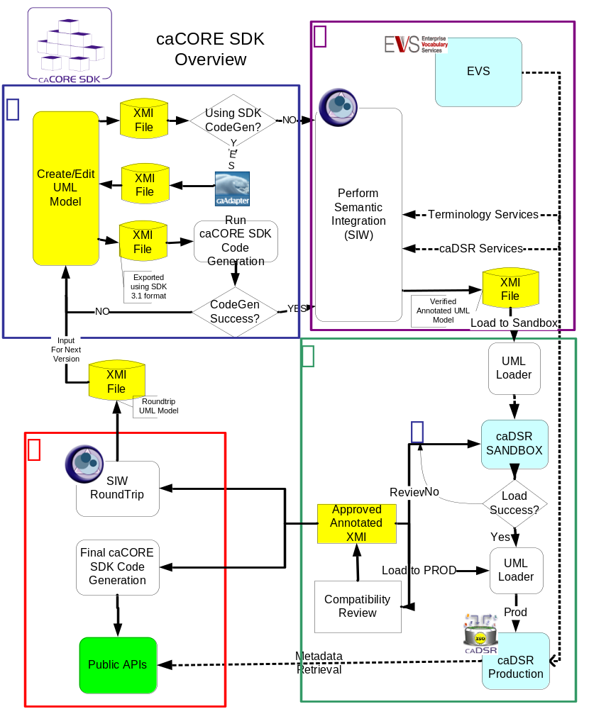
Building caCORE-Like Systems
1. Design system and create domain model
(UML tool)
2. Perform Semantic Integration (SIW - Semantic Integration Workbench)
3. Register metadata
(UML Loader)
4. Compatibility Review
5. Generate and deploy system

Slide 19
caCORE Infrastructure Products
What to do when things go wrong?
Ask for help!
  Call Claire!
Reread Instructions
  caCORE SDK Programmers Guide
Take it apart and start over!
  Analytical Service Best Practices!
Millennium Falcon™

Slide 20
Where is caCORE going?
Strategy session in March 2008
Themes will include:
  Simplified and Improved tools – “develop, access, consume”
    Improve/simplify Models or parts of Models “Just-In-Time”
  Support HL7 Datatypes – building a roadmap for HL7 caBIG participants
  Services to leverage semantic metadata
    User friendly web interfaces - ‘flatten’ semantic metadata
  Collaborative Terminology and caDSR Metadata development
    Semantic Media Wiki, workflow support
  Simplified Granular Interoperability (Object and CDE level)
  Reusable ‘plug-ins’ to support building interoperable systems and grid services e.g. validation services, subscription services
  Optimized caDSR and UIs to support faster/simplified access
    Forms Catalog for finding/sharing forms
    Semantic “data warehouse”

Slide 21
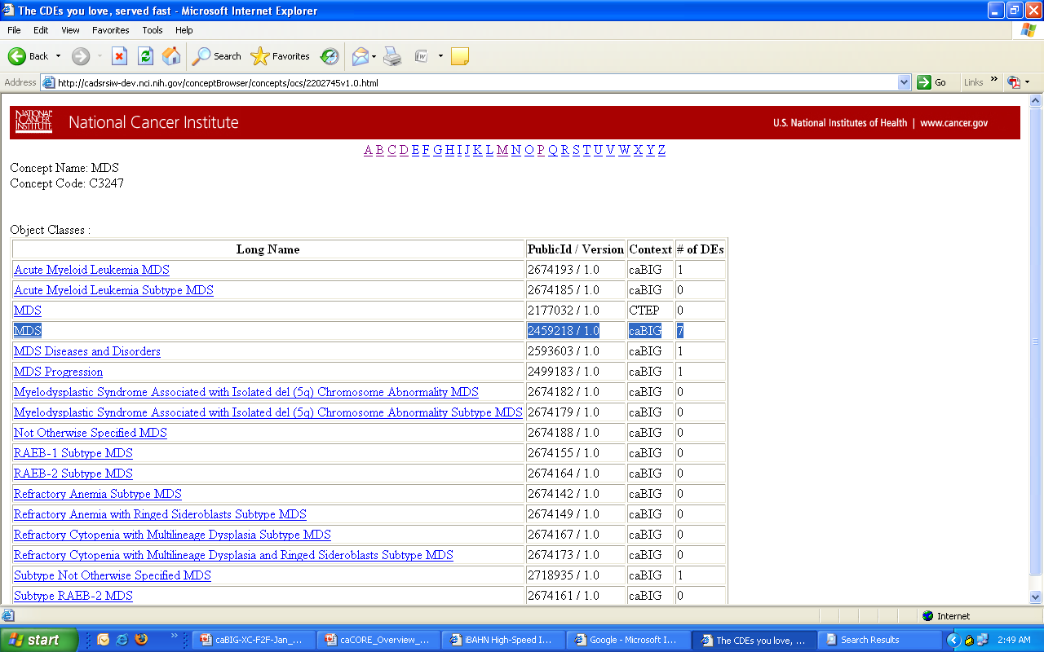
Select all Classes related to “MDS” C3247
- Could be anywhere in the semantics of the components Primary Concept, Qualifier, Value Domain

Slide 22
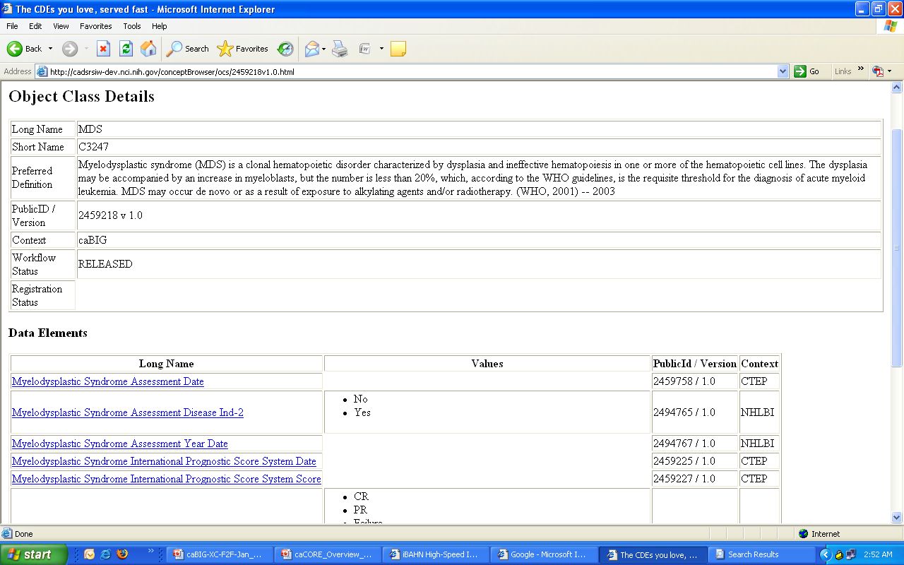
View all CDEs related to “MDS” C3247
‘Quick view’ of Class details, all CDEs including Value lists
Select CDE, ‘import to model’

Slide 23
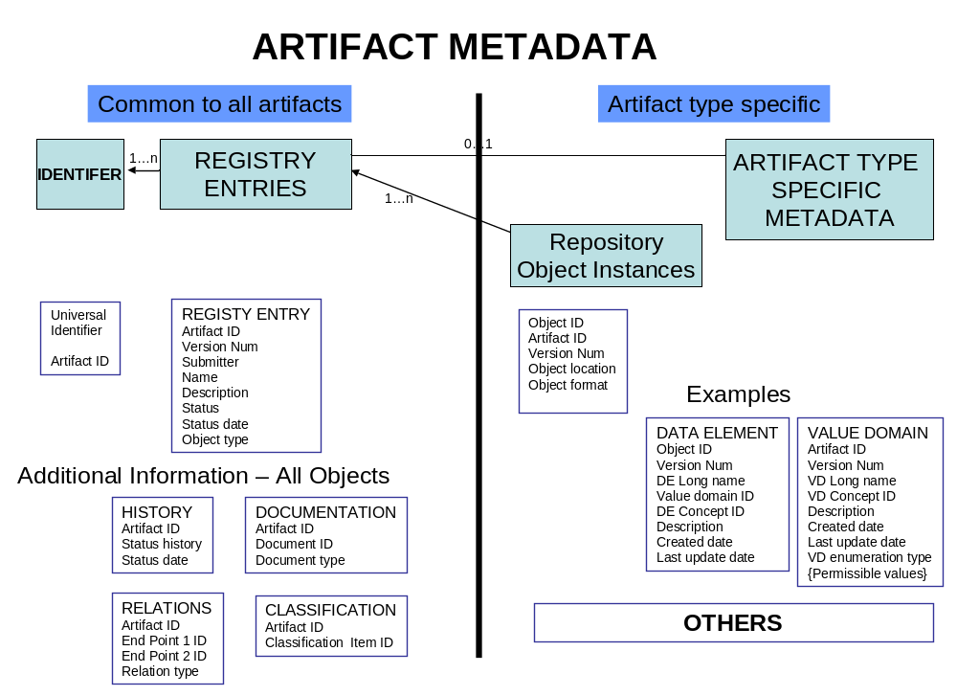
Metadata Registry Futures

Slide 24
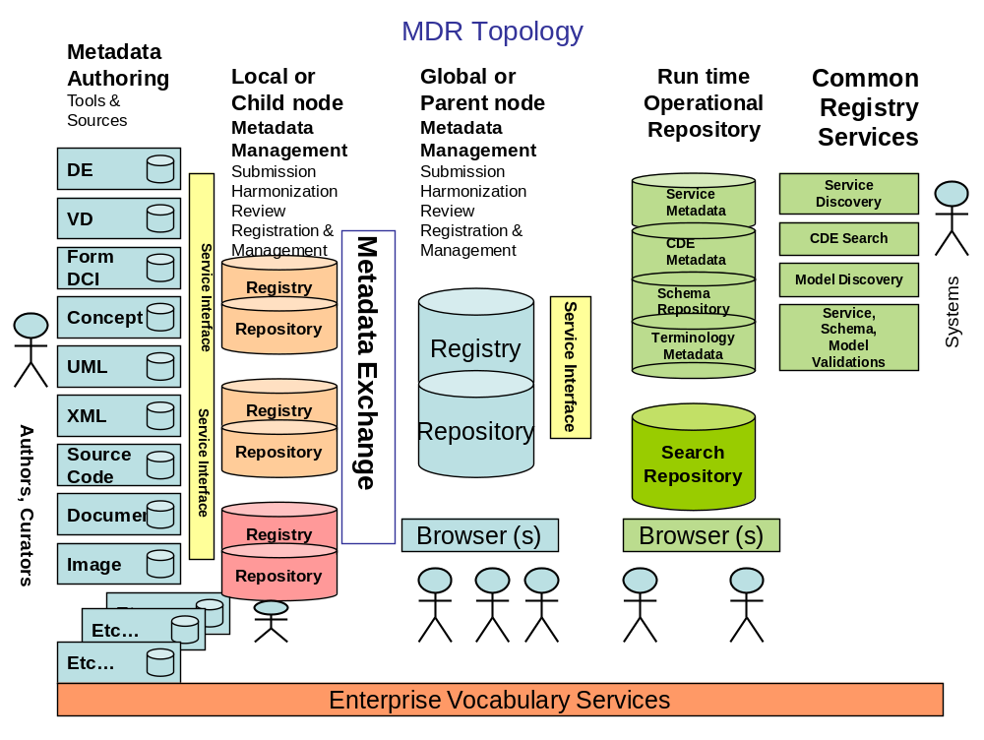
MDR Futures
Metadata Registry Futures

Slide 25
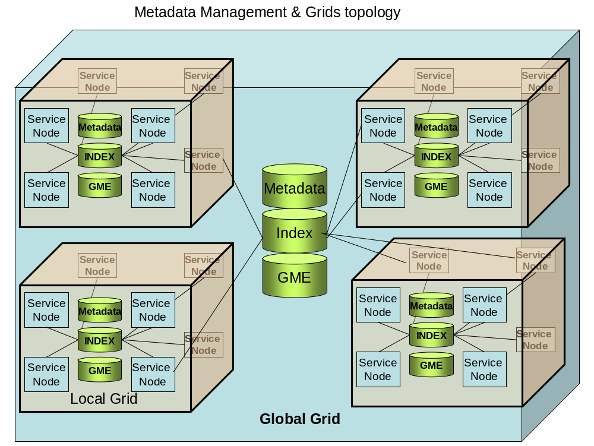
Metadata Registry Futures

Slide 26
Where do caCORE products come from?
  Product Lines and caBIG Workspaces Alignment
    ICR WS → ICR Product Line
    TBPT WS → TBPT Product Line
    Imaging WS → Imaging Product Line
    CTMS WS → CTMS Product Line
    VCDE/ARCH WS → caCORE Product Line
* Challenge: Cross Domain Requirements/Prioritization Process

Slide 27
Where will caCORE products come from?
Anywhere from within NCICB or caBIG Workspaces
    ICR WS
      caBIO → caCORE SDK
    TBPT WS
      Dynamic Extensions, caB2B
    CTMS WS
      HL7 SDK → caAdapter
    VCDE/ARCH WS
      Compatibility Review Software, caGrid

Slide 28
caGrid

Slide 29
caGrid Team
Ohio State University - Biomedical Informatics Department
  Dave Ervin
  Shannon Hastings
  Tahsin Kurc
  Stephen Langella
  Scott Oster - Chief Architect - caGrid
  Joel Saltz
University of Chicago/Argonne National Laboratory
  Ravi Madduri
  Ian Foster
SemanticBits, LLC.
  Joshua Phillips
Duke Comprehensive Cancer Center
  Patrick McConnell
Ekagra Software Technologies, Ltd.
  Kunal Modi

Slide 30
caGrid Team (Continued)
Lockheed Martin Management Systems Designers
  Eddie Vanarsdall
Science Applications International Corporation (SAIC)
  Aynur Abdurazik
  Ye Wu
  Peter Yan
Terrapin Systems LLC (TerpSys)
  Chet Bochan
  Vanessa Caldwell
  Craig Fee
  Alan Klink
  Gavin Brennan
NCI - Center for Biomedical Informatics and Information Technology (CBIIT)
  Todd Cox
  Mary Jo Deering
  George Komatsoulis
  Wendy Patterson
  Avinash Shanbhag
  Denise Warzel
Booz Allen Hamilton
  Michael Keller
  David Wu
5AM Solutions
  John Eisenschmidt

Slide 31

What is caGrid?
A grid based software infrastructure consisting of services, toolkits, APIs, and applications
A production grid deployment of the core services provided by that infrastructure
A community of developers leveraging that grid and infrastructure to provide applications and services to the cancer research community

Slide 32
Infrastructure Focus Areas
Leveraging Grid technologies and standards as an interoperability platform
Metadata Infrastructure
  Surfacing wealth of existing caBIG data-oriented metadata on the grid
  Providing new service-oriented metadata
Security
  Integrating existing systems and applications with Grid security
  Lowering burden of implementation of grid-wide and local policy
Service Developer Tooling
  Powerful platform for bringing applications and data to the grid
Facilitating Grid wide operations
  Federated query, workflow execution, resource discovery
Making the Grid more accessible
  Graphical installation and configuration, higher-level object-oriented APIs, web portals, graphical administrative applications
Quality
  Comprehensive testing infrastructure, automated builds and test execution on multiple platforms, dashboard with historical archive

Slide 33
Non-Infrastructure Focus Areas
General support, technical guidance, and facilitating adoption
  Training, mailing list, user’s group
  Targeted support of Life Science and Clinical Trials Bundles
Participation in numerous working groups:
  Analytical Services Best Practices
  Binary Data Format
  caGrid/TeraGrid
  Compatibility Guidelines v3.0
  High Throughput Data
  Security
  Terminology Metadata
  Workflow
Helping to define the overall Grid approach for caBIG
  Standards, technologies, etc
External community outreach
  Standards organizations, other domain communities, groups interested in adopting our technology, etc

Slide 34
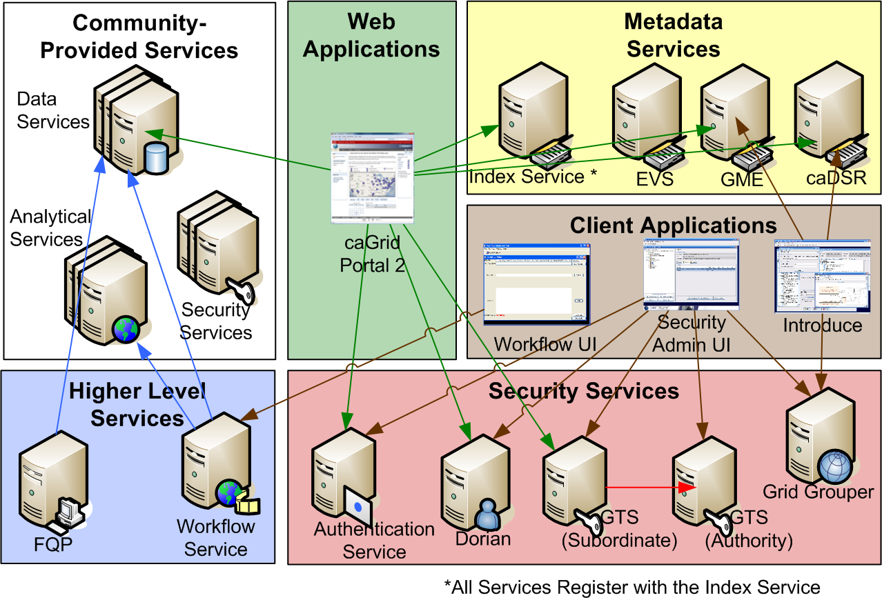
caGrid Production Environment

Slide 35
caGrid Community Involvement
caGrid itself provides no real “data” or “analysis” to caBIG™; its the enabling infrastructure which allows the community to do so
Community members add value to the grid as applications, services, and processes (for example: shared workflows)
  caGrid provides the necessary core services, APIs, and tooling
The real “value” of the grid comes from bringing this information to the “end user”
Community members develop end user applications which consume of the resources provided by the grid

Slide 36
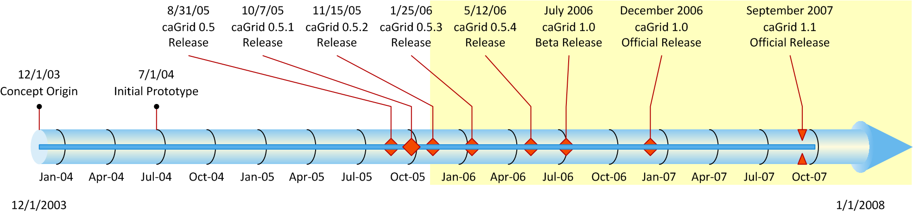
History of caGrid
caGrid 1.0 was a revolutionary release of the caGrid infrastructure, replacing the 0.5.x stream
The last release of caGrid was version 1.1, released mid September 2007
The next release version 1.2, will be released this quarter

Slide 37
caGrid 1.2 Highlights
General theme of integration and usability
caCORE SDK 4.0 support
Stable release of WebSSO (from milestone release)
Stable release of CDS (from milestone release)
New portal distribution
Variety of community bugs and feature requests addressed
Introduce Enhancements
  Service Undeployment Support ☺
  Simplified resource framework
  WS-Notification
Improved build and dependency system

Slide 38
What will be in the next caGrid release?
Not yet finalized timeline or scope
It depends on the community
  Feedback from adopters
  Input from User’s Group / User Workshops
  Workspaces’ priorities
  Working Groups’ features/issues
  NCI priorities
  Use cases solicited by scientific liaison
Items which missed caGrid 1.2
Items identified as gaps by the team

Slide 39
Philosophies on Releases
Releases are versioned as <Major>.<Minor>.<Point>
  Major versions generally make no claims to backward or forward compatibility; these are used for large new features or significant changes in behavior.
  Minor versions generally should be backwards compatible, and may be forward compatible; these are used for significant bug fixes and feature additions.
  Point versions should be both backwards and forwards compatible; these are used almost exclusively for bug fixes (one should expect to be able to use the versions interchangeably, with the only difference being related to the behavior of the bugs being addressed).
Currently defining compatibility with respect to service interfaces and client APIs (not for internal APIs or service implementations)

Slide 40
Philosophies on Releases cont.
Major version changes represent an unattractive grid-incompatibility, but are necessary for large changes
caGrid originally released as a single “product”
Starting to look at finer grain organizations:
  Creation of separate releases for caGrid Core, Portal, Workflow UI, WebSSO
  Milestone release approach used for WebSSO/CDS may be an attractive way to get new features out to early adopters sooner
  Developing infrastructure to better enable multi-component, multi-version, dependencies in caGrid (used both internally, as well as for projects which depend on caGrid)

Slide 41
Works in Progress
  Simplified alternative to GridFTP for binary data transfer (caGrid transfer service)
    Eliminate the need for a separate installation (GridFTP only runs on unix, requires a C platform build, uses a different authorization infrastructure)
    Builds on simple GSI sockets, with simple GET/PUT semantics
    Leverage the application container’s ability to balance connections
  Enhancements to Data Service query language to meet community needs (CQL 2.0)
    Associated Objects, aggregations, attribute typing, subclass handling, etc
  Designing approach for metrics collection

Slide 42
Future Focus Areas
Incorporating outcomes from working groups:
  Analytical Services Best Practices
    Enhancements to metadata and/or Introduce
  Binary Data Format
    Very relevant to large data transfer and BDT
  caGrid/TeraGrid
    Additional tooling to support this approach is possible if deemed important
  Compatibility Guidelines v3.0
    Infrastructure for identification, validation, and enforcement
  High Throughput Data
    Very relevant to large data transfer and BDT
  Security
    Enforcement of policies identified
  Terminology Metadata
    Support for terminology grid services
  Workflow
    Incorporation of scientifically meaning user interfaces

Slide 43
Future Focus Areas cont.
Integrating with forthcoming registered UML/XML binding information
  Introduce integration, caDSR grid service, GME enhancements
Integration of delegation and persistent resources to relevant core services:
  FQP, Workflow, etc
Planning approach for introduction of necessary major incompatible changes
  Movement to final versions of some grid specifications
  CQL 2.0
Tighter integration with other tools/projects relevant to the “caBIG Process”
  e.g. caCORE SDK
Support for metrics collection and statistics aggregation
Continued improvement for more complex service requirements

Slide 44
caCORE 4.0 / caGrid 1.x Overview
Overview, Status, and Future Direction
Denise Warzel, Scott Oster
caBIG Architecture/VCDE Joint Face-to-Face
Salt Lake City, UT
January 28th-30th, 2008

Slide 45
Backup Slides

Slide 46
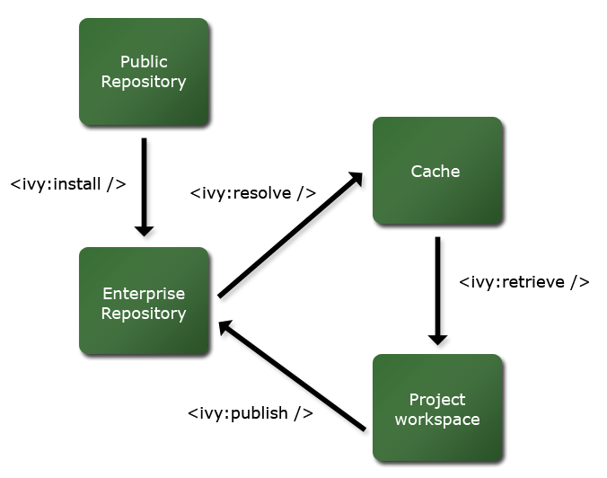
caGrid Ivy Build
caGrid release directory contains an Enterprise Repository for all external dependencies
caGrid build process resolves against this repository, and publishes to an integration repository
Releases will publish the integration repository and Enterprise Repository to a publicly accessible location
External projects/components can depend on a local caGrid integration and Enterprise Repository, or the remote publicly accessible one

Slide 47
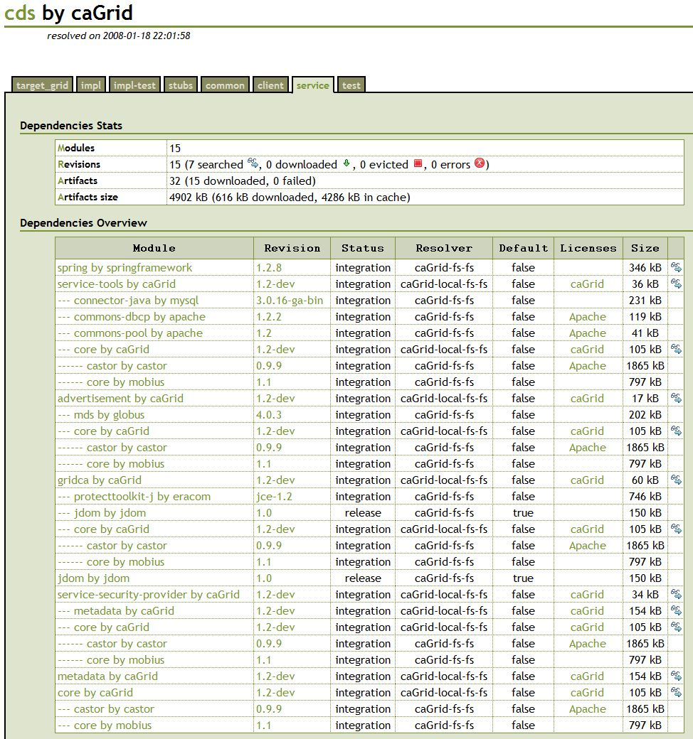
caGrid Ivy Build cont.
Transitive dependencies are formally managed
Supporting multiple configurations and version constraints
Configurable conflict management
Detailed dependencies reports are generated

Slide 48
caGrid Ivy Example Usage
What jars do I need to use the Dorian client API?
  Just define the dependency:
    <dependency org="caGrid" name=“dorian“ rev=“1.2" conf=“*->client"/>
  Tell Ivy where to copy it:
    <ivy:retrieve pattern=“lib/[originalname](.[ext])" sync="true" />
  Everything you need will be copied where you want it

