Slide 1
caGrid Infrastructure and Tools in the Future
Scott Oster, Ohio State University
Lawrence Brem, SAIC-Frederick, Inc.
caBIG® Architecture/Vocabularies & Common Data Elements Workspaces
Joint Face-to-Face Meeting
Northwestern University, Evanston, Illinois
October 27-29, 2008

Slide 2
Agenda
The state of the grid, today
caGrid 1.3 release
In the future there will be…
  more metadata
  better metadata
  better use of metadata
The plan forward

Slide 3
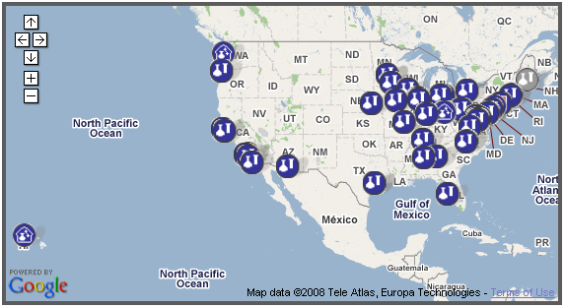
The state of the grid, today
With the successful efforts of the community, the Deployment team, and the caBIG Application Bundles, there are well over 100 registered services on the production grid, running across the country
Building upon these and other deployments, a movement towards further collaborations and real world data sharing will follow, driving new requirements in functionality and scalability

Slide 4
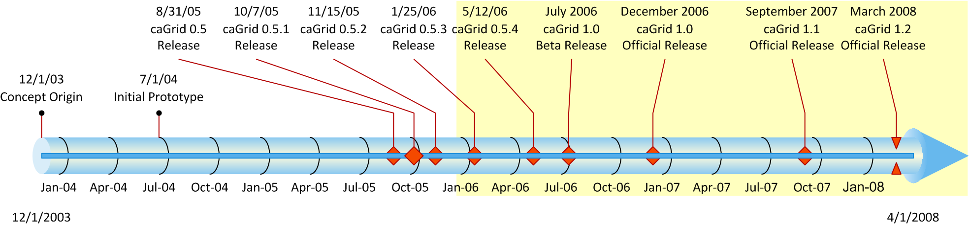
caGrid Releases
Last stable release of caGrid was caGrid 1.2 in March of 2008
Next stable release, caGrid 1.3, planned for first quarter 2009 will maintain the 1.x line of compatibility
Following release currently expected to be caGrid 2.0

Slide 5
caGrid 1.3 Highlights
CBIIT 2008 Future Technology Stack Support
Significant feature enhancements to federated query support including support for ws-notification, delegation, transfer and ws-enumeration of results
Significant improvements to global model exchange including support for any schema/namespace, update/delete, include/redefine, imports cycles, and grid service overhaul
caCORE SDK 4.1 integration

Slide 6
caGrid 1.3 Highlights cont.
Numerous security enhancements to Introduce and generated APIs
Support for multiple authentication profiles (such as one time password), and secure discovery of identity providers
Certificate/Credential enhancements including use of short term certificates to support document signing
WebSSO improvements including “single sign out” and additional supported clients (acegi)
Numerous bug fixes and minor feature requests addressed

Slide 7

And now…

Slide 8

In the future there will be… more metadata

Slide 9
Beyond Data Semantics
Today:
  Current emphasis in caBIG is on the semantics of the data itself
    provides a programmatic means to discover and query for data of interest
  Processing of retrieved data is done either locally via tools/applications or on the grid via analytical services
    analytical services can be discovered by many aspects, including input data types, and are formally described
  It is possible to automatically discover and construct a workflow which queries for data from one data service and passes the results as input into an operation provided by another service, and know the data is syntactically and semantically interoperable
What’s missing?
  There’s really no way to programmatically determine if that workflow “make’s sense” (or build a tool that automatically creates “meaningful workflows”)
Future:
  Services and their operations could be annotated by a rich ontology describing “what” the service/operation does (and potentially how it does it); this is actually supported in the current metadata model but not used
    Enabling not only discovery, but composition

Slide 10
Uncompromising Performance
Today:
  To overcome inherent performance and scalability inefficiencies in XML and SOAP for large data sets, a variety of alternate transfer mechanisms are provided
    GridFTP, ws-enumeration, transfer service
What’s missing?
  Semantic metadata is anchored from the XML view of data, when transferring data in “binary,” this connection is no longer explicit
Future:
  Emerging standards like Data Format Description Language (DFDL) can formally define non-XML formats (like binary or compact text), as annotations on XML schemas
    Parsers can be used to seamlessly convert or interpret either form
  Such descriptions can be advertised as metadata about the data being transferred (such as via transfer), and as part of the definition of the data model
  Data elements in a binary stream can carry just as much semantics as their XML form (via transitive association in the XML Schema)

Slide 11

In the future there will be… better metadata

Slide 12
Quality over Quantity
  Today:
    Anyone with data or analytics of value is encouraged to provide it as a resource to the community though most (not all!) of the available services are from funded participants or projects
    The hardware requirements for most services are fairly simple given their modest use
  What’s missing?
    As the community, resources available, and number of users grow
      some resources will be in much higher demand (think google or wikipedia of the www)
      it will be more difficult to distinguish between the plethora of resources
  Future:
    Social networking, “friend of a friend”, peer rating technologies, and/or comprehensive statistics may be useful to help find quality resources on the grid, probably via computable assertions
    Formal service level agreements may be desirable for high demand resources; third party computing providers may be necessary to meet demand

Slide 13
Functional Monitoring and Verification
Today:
  Tools like the caGrid portal provide a valuable resource for viewing the grid in aggregate, while providing some ability to “drill down” to service level details and integrate distributed resources
  Services provide extensive metadata detailing their functionality, data models, semantics, and hosting information
What’s missing?
  The details of Index Service and the Portal are mostly a “snapshot in time,” where historical information may be useful (e.g historical service uptime)
  Functional characteristics are not readily available (amount of data, usage loads, etc)
  Metadata is mostly non-authoritative, such that a service could be misrepresent functionality
Future:
  A wealth of useful statistics could be made available via a combination of service support and active “grid crawling” (think www search engine crawlers)
    service-level information about data being provided, performance and availability metrics, results of functional verification (e.g. verification of some functional Gold compatibility criteria)
    aggregate information about most useful serivces/models/operations, reused data types/models
  Metadata could be authoritatively verified and asserted using a combination of community review and digital signatures; the Index Service could enforce authorization policies which restrict who can register

Slide 14

In the future there will be… better use of metadata

Slide 15
A Reasoning Grid
Today:
  Services and the data they provide, are self-describing through the semantically annotated metadata they expose
  Distributed queries which cross service and model boundaries can be constructed in a semantically consistent manner by discovering and inspecting metadata
What’s missing?
  While the infrastructure provides the capabilities for very advanced functionality, the application developer must still leverage numerous information sources (Index, caDSR, EVS, service metadata, etc) and APIs
Future:
  Common usage scenarios, such as ontology-driven query construction, can be facilitated by higher-order, integrative APIs
  Semantic reasoning and inference could be integrated into the infrastructure instead of layered upon it (e.g. S-MDS)

Slide 16
Outreach and Interoperation
Today:
  The community, infrastructure, applications, and data available currently on the grid are beginning to make the caBIG vision a reality
What’s missing?
  While caBIG draws heavily upon relevant industry standards, full participation does require some acceptance of custom tooling and community-centric policies
    Some communities have significant existing resources (models, technologies, etc)
Future:
  By adopting (or adapting into) additional industry standards and technologies, the information available in caBIG can be accessible to a larger community
    Semantic Web technologies: OWL, SWRL, SAWSDL, SPARQL, etc
  While made possible through the current use of language-agnostic standards, additional user communities can be reached by providing tooling in other languages (e.g. .Net)
  Infrastructure and policies can be adapted to support the notion of distributed metadata registries, allowing other communities to maintain their own policies/standards yet participate in a single interconnected grid; potentially lowering the barriers to entry

Slide 17
A plan forward
The development team will work towards publishing a longer term release schedule and scope
The caGrid Knowledge Center will facilitate gathering community consensus on future priorities
The Knowledge Center will also grow the community be providing means to incorporate community contributions and projects into the codebase, provide comprehensive support and guidance

Slide 18
caGrid Infrastructure and Tools in the Future
Scott Oster, Ohio State University
Lawrence Brem, SAIC-Frederick, Inc.
caBIG® Architecture/Vocabularies & Common Data Elements Workspaces
Joint Face-to-Face Meeting
Northwestern University, Evanston, Illinois
October 27-29, 2008

