Slide 1

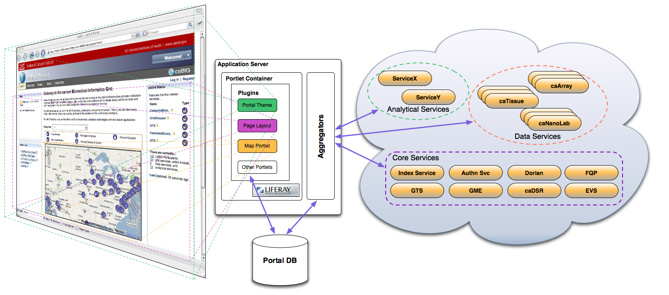
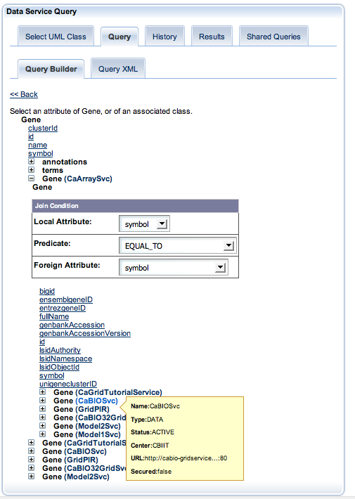
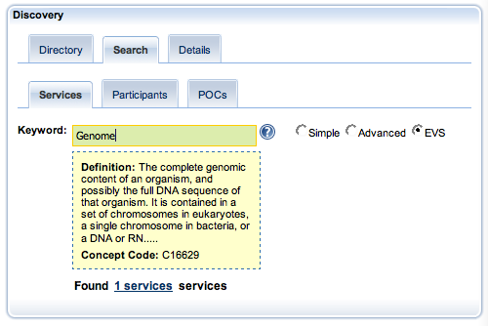
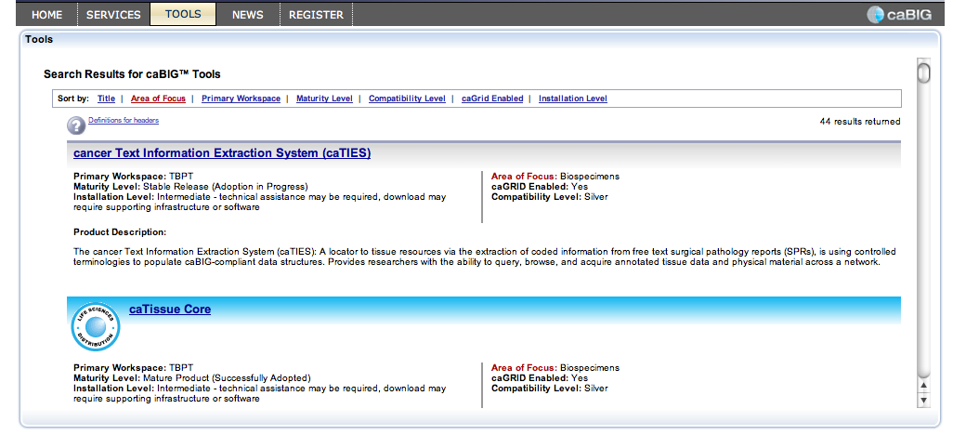
caGrid Portal 2.0
Joshua Phillips¹, Manav Kher¹, David Ervin², Shannon Hastings², Tahsin Kurc²,
Stephen Langella², Scott Oster², Joel Saltz², Ravi Madduri³, Ian Foster³, Kunal Modi⁴
1 - SemanticBits, LLC., 2 - Ohio State University, 3 - University of Chicago/Argonne National Laboratory
4 - Ekagra Software Technologies Limited
Abstract
The caGrid Portal is a Web-based application that enables users to discover and interact with the services that are available on the caGrid infrastructure. It serves as the primary visualization tool for the caGrid middleware and provides a standards-based platform for hosting caBIG-related tools. It also supports multiple modes for discovering caGrid services, as well as finding caBIG participants, caGrid points of contact (POCs), and caGrid-related news and events. The portal is built on a standards-based that platform provides a clear path for developers to create and integrate new tools. The latest release of the portal includes significant enhancements to service discovery and support for building and executing federated queries.
Standards Based Platform
caGrid Middleware Visualization
caGrid Portal is built on the Liferay platform, which provides a JSR-168 compliant portlet container. The standard allows multiple, discrete portlet applications to be managed as components and even wired together in various ways. The Liferay platform supports development of custom themes and layouts that can be deployed as plugins. The platform enables a high degree of customization - functionality, appearance, and security policy can be customized at run time on a per-community, or per-user bases.
In the image to the right, the home page of the portal consists of multiple portlet applications that have been wired together and placed within a page layout. The custom caGrid Portal theme is applied to the entire page and each portlet, providing a common look-and-feel.
Portal users can see and interact with core caGrid services, as well as data and analytical services. The portal periodically queries the index service to find newly registered services. Once new services are found, the portal pulls metadata directly from them and caches in its local database. Once a service has been encountered, the portal will track its status over time allowing users to quickly see if the service is active or inactive.
The following portal features all provide ways for the users to see and interact with caGrid services:
Service Discovery
Metadata Exploration
Data Service Query
Query Sharing
caGrid Account Registration
Grid Status Overview
Graphical Query Builder
EVS Based Service Discovery
Simple point and click Graphical User Interface to build caGrid Query Language (CQL) and Distributed caGrid Query Language (DCQL) queries
Able to query a single caGrid data service, aggregate data from multiple services and create joins across multiple services.
User can create complex and deeply nested queries with the query builder
Query builder will dynamically link caGrid data services based on semantic equivalence of its UML classes
Asynchronous execution of CQL and DCQL queries
Ability to share CQL queries with other users of the caGrid Portal
EVS based service discovery will search for caGrid services based on concept codes from NCI Thesaurus.
Specialized Aggregators periodically update semantic concepts from the NCI Thesaurus, for services in the Portal and also maintain concept code hierarchy graphs.
Searches are performed using an auto-completer text field. The auto-completer will first display aggregated concepts and will also dynamically fetch concepts from NCI Thesaurus.
caBIG Tools
In addition to discovery and query of caGrid services, Portal also maintains a comprehensive list of caBIG applications and Tools. These applications are grouped by caBIG workspace, caGrid compatibility, area of focus etc.

