Slide 1
Identity Management and Federation Working Group
Kickoff Meeting
March 21, 2006
Stephen Langella
Ohio State University
langella@bmi.osu.edu

Slide 2
Outline
Goals
Dorian
Proposed Approach
Proposed Schedule

Slide 3
Goals
Shape Dorian
  Dorian, is a grid service infrastructure being developed by the caGrid team for satisfying the Identity Management and Federation requirements of caBIG.
SAML Authentication Assertion Standardization
  One of the cornerstones of Dorian is the SAML Authentication assertions that enable the federation of institutional identities to the grid.
Identify/Facilitate Integration with Dorian

Slide 4
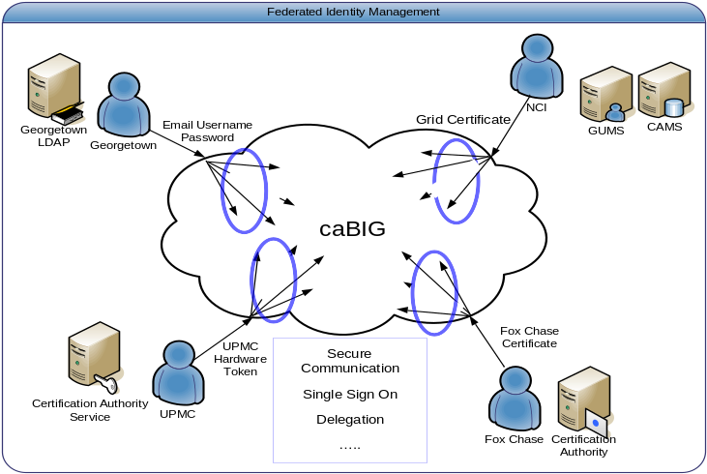
Identity Management and Federation
A system that allows individuals to use the same user name, password or other personal identification to sign on to the systems of more than one enterprise in order to conduct transactions.
Enable users to use their institution provided identity for authenticating to a Grid.
User should be able to authenticate to the Grid using their institution’s existing mechanisms.
Image taken from the caBIG Security Evaluation White Paper

Slide 5
Identity Management and Federation
Identity Provider (IdP)
  Federation partner that vouches for the identity of a user. The Identity Provider authenticates the user, and provides an authentication token to the service provider.
  The identity provider either directly authenticates the user, such as by validating a user name and password, or by indirectly authenticating the user, by validating an assertion about the user's identity, as presented by a separate identity provider.
  The identity provider handles the management of user identities in order to free the service provider from this responsibility.
  Enable users to use their institution provided identity for authenticating to a Grid.

Slide 6
Identity Management and Federation
Service Provider (SP)
  A service provider is a federation partner that provides services to end user. Typically, service providers do not authenticate users but instead request authentication decisions from an identity provider. Service providers rely on identity providers to assert the identity of a user, and rely on identity providers to manage user identities for the federation.
  Service providers can maintain a local account for the user, which can be referenced by an identifier for the user.

Slide 7
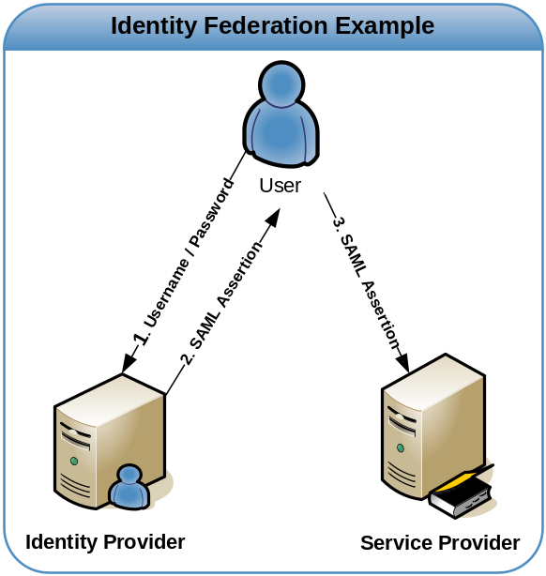
Identity Management and Federation
Security Assertion Markup Language (SAML)
  XML Based Security Language for exchanging authentication and authorization information.
  Authentication Assertions
    Vouches where, when, how, the entity authenticated.
  Attribute Assertion
    Vouches information about an entity

Slide 8
Grid Security Infrastructure
Map to
local name
Based on standard Public Key Infrastructure (PKI) technologies
  SSL protocol for authentication, message protection
  CAs allow one-way, light-weight trust relationships (not just site-to-site)
X.509 Certificates for asserting identity
  for users, services, hosts, etc.
Proxy Certificates
  GSI extension to X.509 certificates for delegation, single sign-on
Grid
Identity
Local
Policy
Map to
local name
Local
Policy

Slide 9
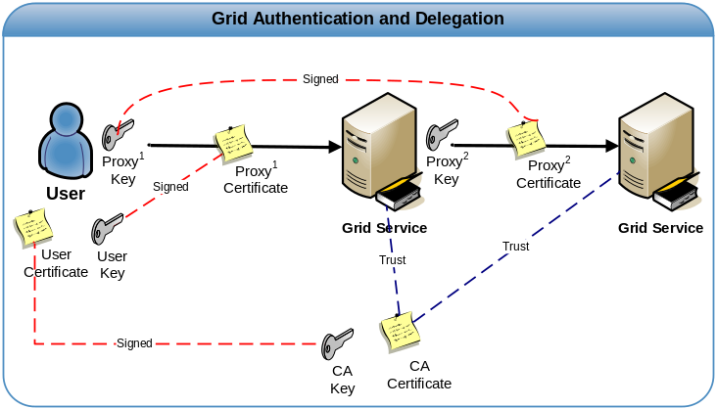
Grid Security Infrastructure
Proxy Certificates
GSI Extension to X.509 Identity Certificates
Short Term Certificate
Enables single sign-on
Delegation
  Allow user to dynamically assign identity and rights to service
  Users allow service to act on there behalf
What is effectively happening is the user is creating their own trust domain of services
  Services trust each other with user acting as the trust root

Slide 10
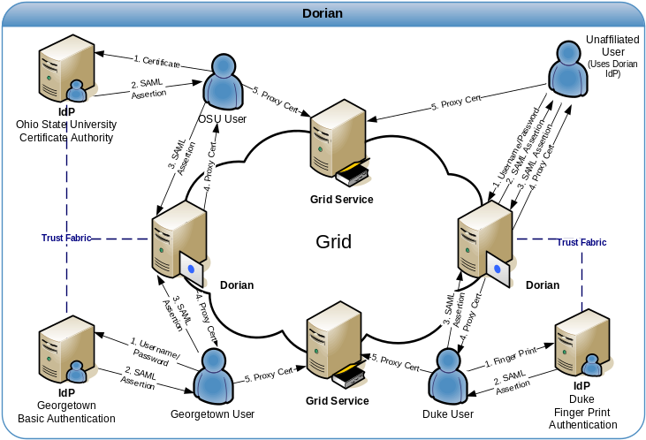
Dorian – Grid Identity Management and Federation
WSRF Compliant Grid Service
Enables Users to utilize their institution provided credentials to authenticate to the Grid
  SAML- XML Standard for the exchange of authentication and authorization data between security domains
Creates and manages user grid credentials
  Internal Certificate Authority
Internal Dorian IdP allows unaffiliated users or small institutions without an IdP to access to the grid.
Administrated through grid service interface

Slide 11
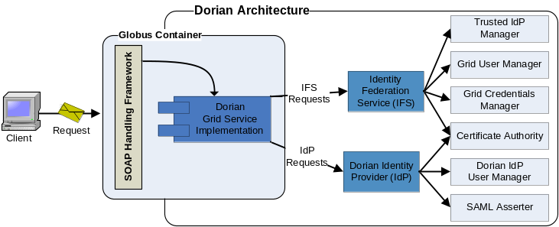
Dorian Architecture
WSRF Compliant Web / Grid Service
All interactions are through the web/grid service interface
  Dorian is administered through its grid service interface.
Two Core Components
  Identity Federation Service (IFS)
  Dorian Identity Provider (Dorian IdP)

Slide 12
Dorian Architecture - IFS
Identity Federation Service (IFS)- Facilitates the federation of local user accounts from multiple institutions to the grid.
  Trusted IdP Manager – Manages a list of IdPs in which Dorian will accept SAML assertions as a mechanism of authentication.
  Grid User Manager – Manages account information for each user.
  Certificate Authority- Create, Renews, and manages grid credentials of users.

Slide 13
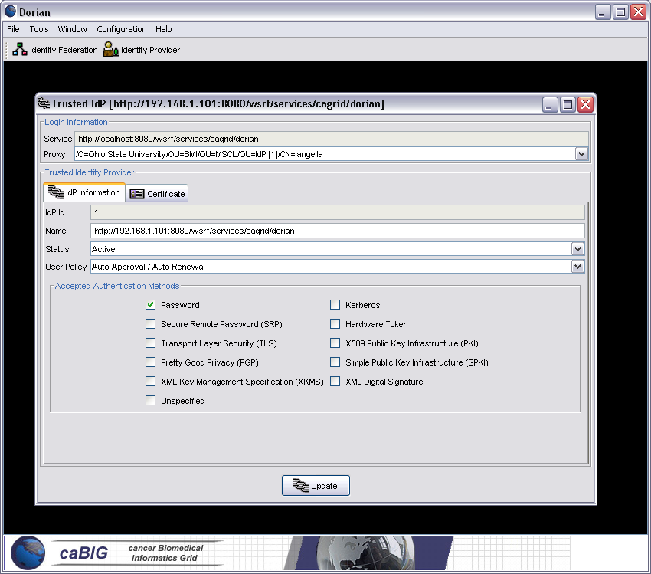
Dorian IFS – Managing Trusted IdPs
Trusted IdPs – An IdP which Dorian is configured to trust and manage grid user accounts.
  Name – Human Readable Name for easy identification
  Status – Active / Suspended
  User Policy – Executed when users authenticate, dictates a policy to apply to a user’s account
    Auto Approval, Auto Renewal, Custom
  Authentication Method
  Certificate whose corresponding private key will be used in signing SAML assertions.
Trusted IdPs are maintained and managed through the Grid Service interface, Dorian Administrative Proxy Required.

Slide 14
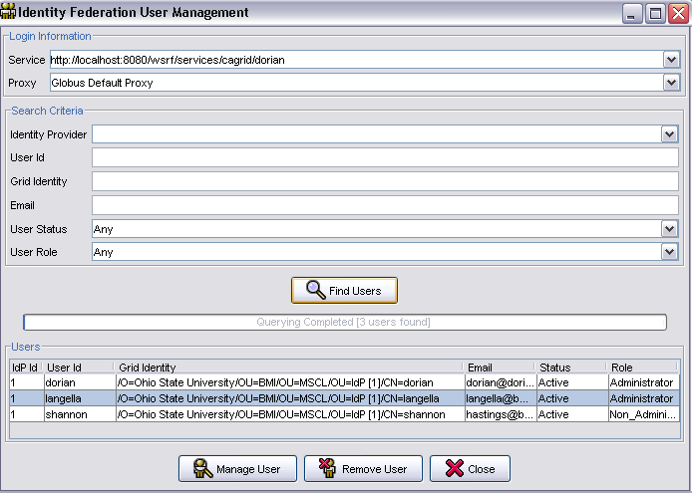
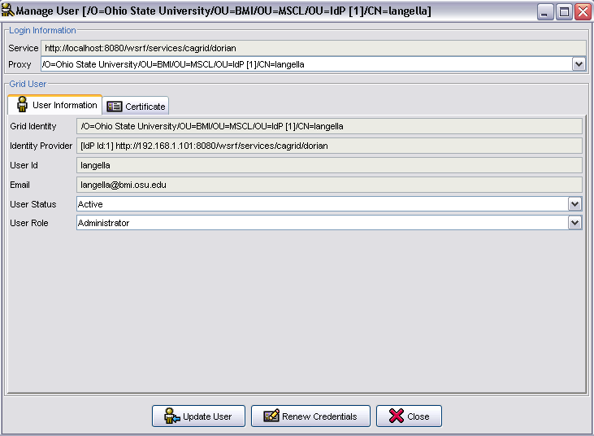
Dorian IFS - User Management
Dorian IFS User Account
  User Information (email)
  User Status: Active, Suspended, Pending, Expired, etc
  User Role: Administrator, Non Administrator
  Grid Credentials, Certificate and Private Key used in issuing grid proxies
Account Creation
  An account is created for a user the first time they submit a SAML assertion from a Trusted IdP
  The status of the newly created account depends on the TrustedIdP’s configured User Policy.
User accounts can be maintained and managed through the Grid Service interface, Dorian Administrative Proxy Required.

Slide 15



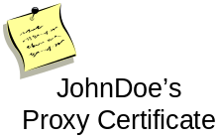



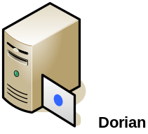

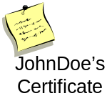
Dorian IFS – Proxy Creation
SAML
Assertion
Proxy Creation Workflow
  Client authenticates with Local IdP
  Client creates public/private key pair to use for grid proxy.
  Client requests Dorian to create a grid proxy.
  Dorian verifies that the SAML assertion provide by the user is signed by a Trusted IdP and that the user has a valid account.
  Dorian locates the uses grid credentials, private key and certificate
  Dorian uses the public key provided to create a proxy certificate and signs it with the users private key
  Dorian returns the proxy certificate to the user.
  The user may now use the proxy to authenticate to grid services
SAML Assertion
Username / Password
SAML Assertion
Signed

Slide 16
Dorian Architecture – IdP
Dorian Identity Provider (Dorian IdP)- Enables developers, smaller groups, research labs, unaffiliated users, and other groups without an IdP to use Dorian as their IdP, such that they may leverage Dorian for creating grid credentials.
  Dorian IdP User Manager – Coordinates the registration process and manages user accounts for Dorian IdP users.
  SAML Asserter – Creates and signs SAML Assertions for Dorian IdP members such that they may authenticate with the Dorian IFS.
  Certificate Authority- Creates and manages a certificate and private key which is used in signing SAML Assertions.

Slide 17
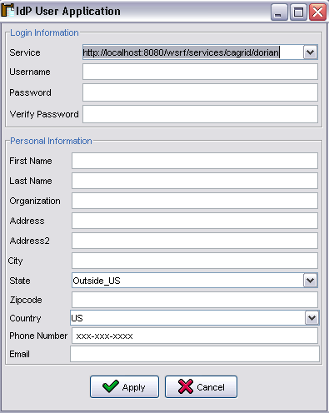
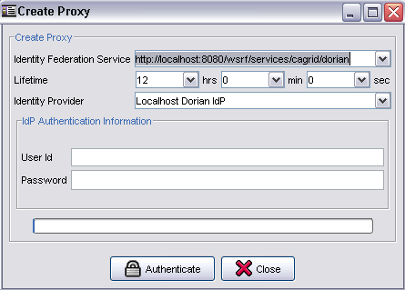
Dorian IdP - Registration
Grid Service Interface provides a mechanism for registering with the Dorian IdP account.
Dorian IdP can be configured with a registration approval policy
  Automatic Approval
  Manual Approval
    Requires an administrator to approve the account
  Custom
Once Approved, registered users can authenticate (username, password) to the Dorian IdP to obtain a SAML Assertion which can be used to create a proxy with the Dorian IFS.

Slide 18
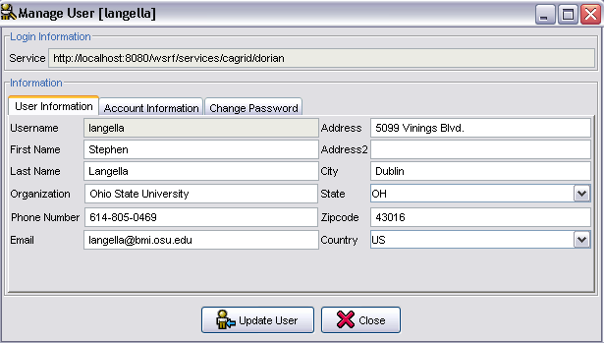
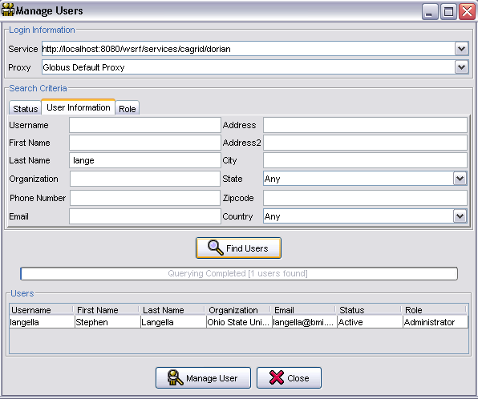
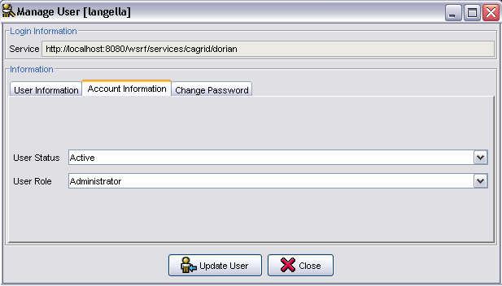
Dorian IdP – User Management
Grid Service Interface provides a mechanism for finding and managing Dorian IdP users.

Slide 19
Dorian – Current Status
Initial Implementation Completed
  Fully Functioning Grid Service
  Fully Functioning Client API
  Fully Functioning Administrative Portal
  SAML Authentication Assertions need to be discussed and standardized
  Still requires bells and whistles.
Integrated with Ohio State University Identity Provider
Whitepaper accepted
  IEEE International Symposium on Computer-Based Medical Systems (CBMS 2006)
  Will be published in June 2006

Slide 20
Proposed Approach
Task 0: Review Security Whitepaper
  Participants should all read as a starting point.
Task 1: Dorian Review
  Working group members may propose additional feature/changes to the WG.
  All propositions should be fully documented by the proposer and submitted to the working group.
  It is not a proposition if it is not documented.

Slide 21
Proposed Approach
Task 2: Standardization of SAML Assertions
  What information about users should we require be made available in the SAML Authentication Assertions
  Things to take in account
    What does Dorian require?
      Unique user identify within and IdP.
      Email address for the user.
    Making something required, requires all center integrating with Dorian to supply it. We need to make sure we choose information that most/all cancer center can provide.
    Get centers involved in this effort.
  Deliver a Specification Document

Slide 22
Proposed Approach
Task 3: Center Integration with Dorian
  Actively recruit adopters
  Start Integration with Dorian upon completion of task 2.
  Provide an integration package
    Documentation
    Common Source Code Libraries
    Example Source Code

Slide 23
Proposed Schedule
Now – Next Meeting
  Task 1 Kickoff
    Review Dorian
    Propose Changes / Additions
April 4, 2006
  Task 1 – Present/Discuss Proposals
  Task 2- Kickoff/Discussion
April 18, 2006
  Task 1 Review Proposals
  Task 2 Discussion Ends
May 2, 2006
  Task 1 – Prioritize/Finalize Proposals
  Task 2 –Draft Reccomendation
May 22, 2006
  Task 2 Draft Review Period
  Task 3 Kickoff
June 6, 2006
  Task 2 End of Draft Review, Final Reccomendation

