Slide 1

Introduce
Grid Service Authoring Toolkit
Shannon Hastings, Scott Oster,
Stephen Langella, David Ervin
Ohio State University
Software Research Institute
{hastings,oster, langella,ervin}@bmi.osu.edu
OGF 21 Oct 2007

Slide 2
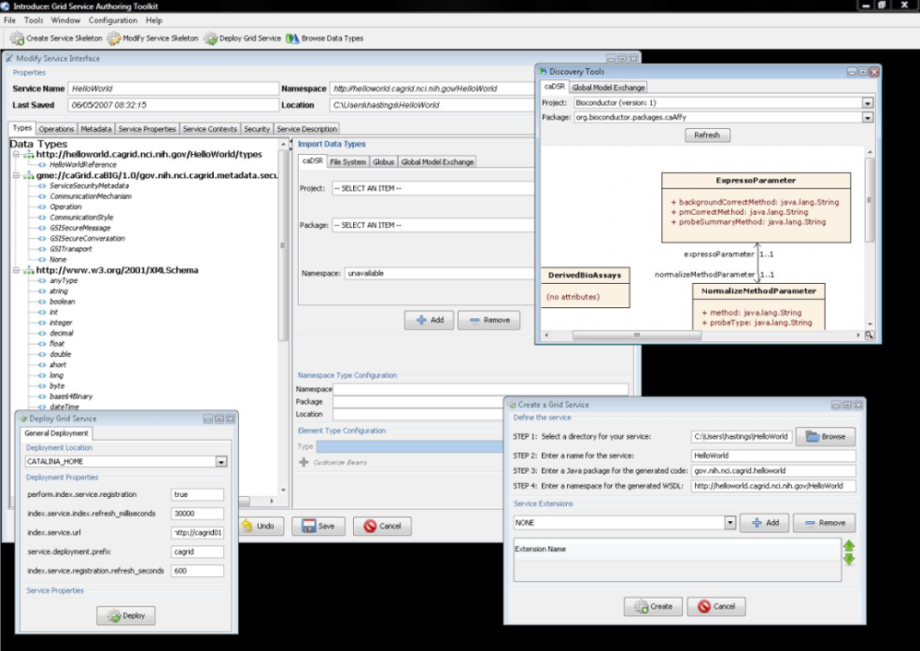
Introduce
A framework which enables fast and easy creation of Globus based grid services.
Provide easy to use graphical service authoring tool.
Hide all “grid-ness” from the developer.
Utilize best practice layered grid service architecture.
Integration with other core grid services and architecture components.
  GAARDS Security Infrastructure (Dorian, GridGrouper, CSM)
  Globus Index Service
  Global Model Exchange (GME)
  Cancer Data Standards Repository
Extension Framework for integrating with other architecture components

Slide 3
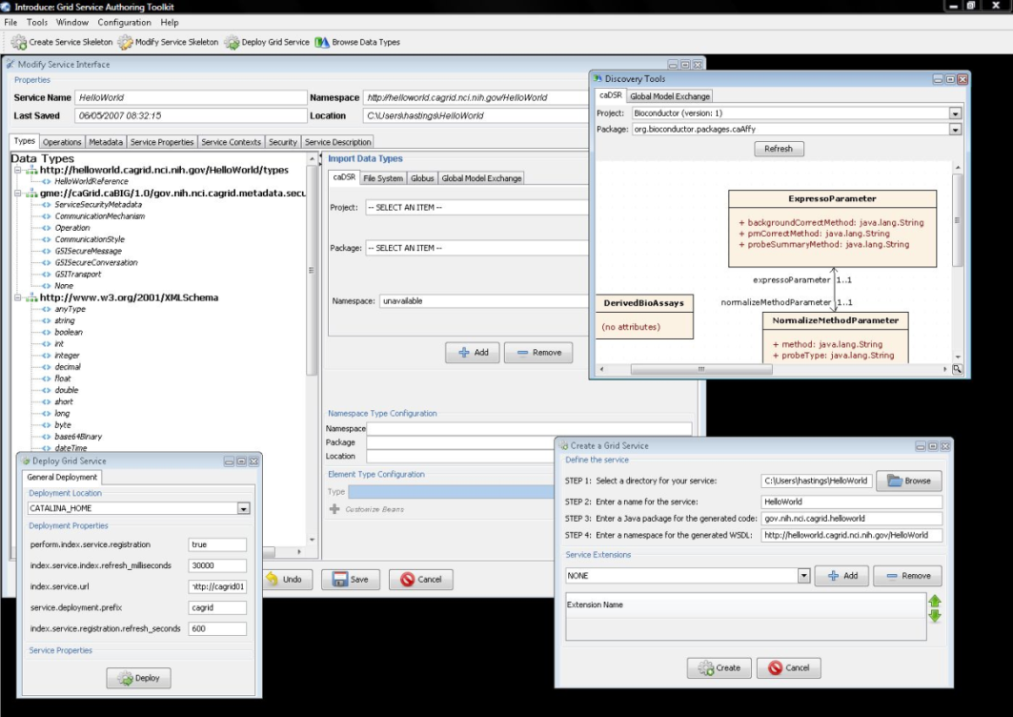
Introduce
Supports modification of operations
  Adding operations
  Removing Operations
  Updating Operations
  Importing Operations
Graphical Configuration
  Advertisement
  Security
  Service Metadata Specification
  Service Metadata Editing
  Service Configuration Properties
Auto Generates Code for Service
Auto generates a client API for service.
Graphical Deployment of Service
  Globus
  Tomcat
  JBoss

Slide 4
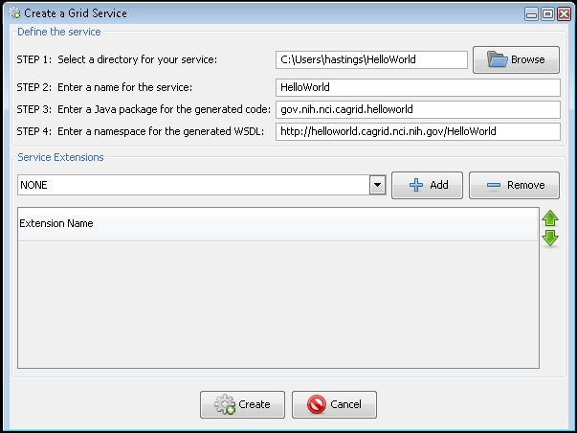
Service Creation
Populate required variables for service creation
  Name = published service name
  Creation Direction = directory to create the skeleton
  Package = the java package you wish to use for your service
  Namespace Domain = the namespace to be used to define the service interface and types
Choose Extensions

Slide 5
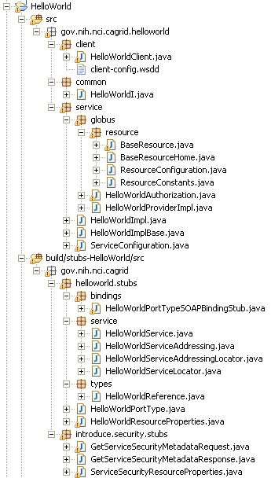
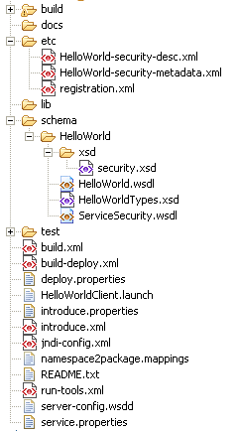
Created Skeleton Layout
= introduce managed
= globus/axis managed
= developer implements

Slide 6
Created Skeleton Layout (cont)
= implements the developer
defined interface and calls into
the generated client port type
stub.
= the developer defined grid
service interface
= manages the resources
of this grid service
= implements the port type
and calls into the actual
clean unboxed interface
the developer defined.
= developers implementation
of the defined interface.

Slide 7
Created Skeleton Layout (cont)
= service metadata registration configuration
= describes the services security configuration
= services WSDL file for axis
= introduce properties for this service
= ant build files
= client configuration file for axis
= deployment time service properties
= introduce representation of service
= JNDI service resources configuration
= namespace mappings for axis
= server configuration file for axis

Slide 8

Inside the Introduce created service
Services have many moving and configurable parts which support features such as:
  Advertisement
  Discovery
  Invocation
  Security (Authentication/Authorization)
  Stateful Resources
The Introduce Toolkit can keep all these features in sync as the developer creates and modifies the grid service

Slide 9
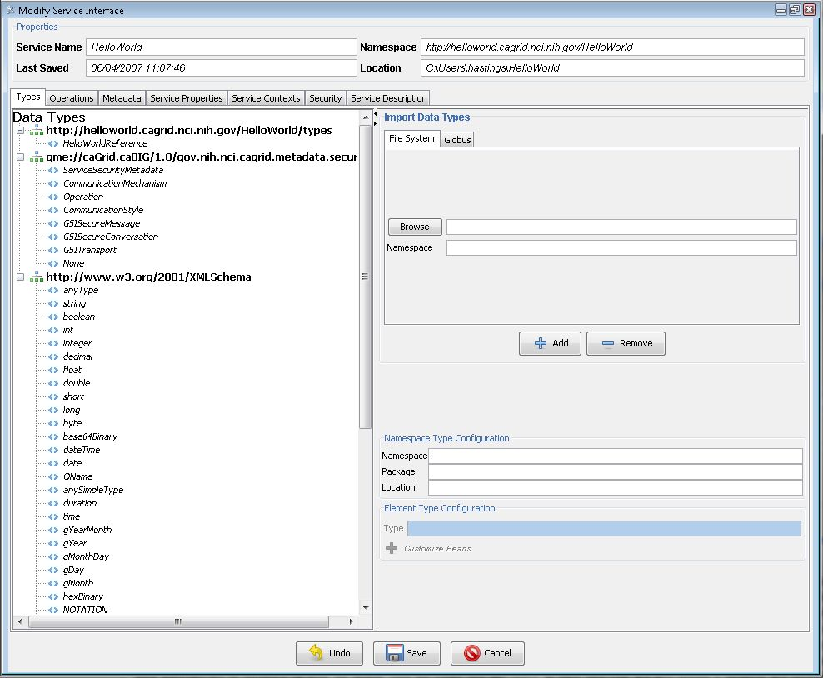
Modification
Add/Remove/Modify
Operations
Resource properties
Service properties
Service contexts (services and resources)
Service, method, and resource level security settings

Slide 10
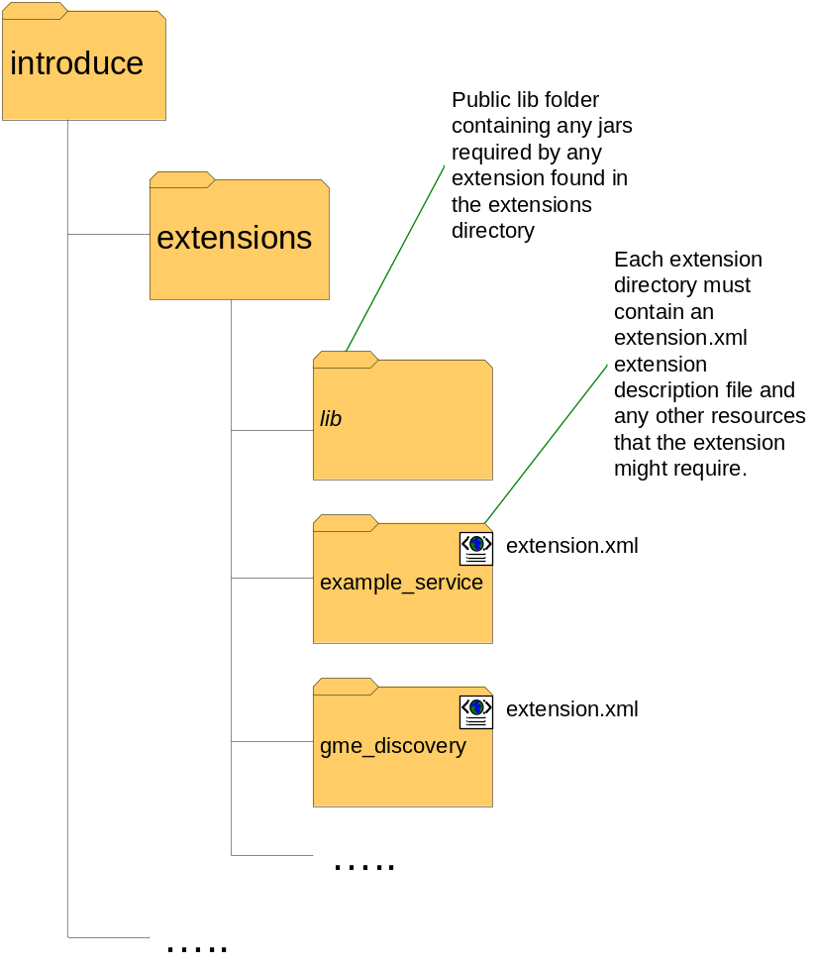
Introduce Extension Framework
Introduce provides an extension framework where it’s core functionality can be extended to provide customized solutions by leveraging the introduce toolkit.
There are currently two types of extensions in Introduce
  Service
  Types Discovery
Extensions provide an “extension.xml” extension description and configuration. The “extensions” directory of introduce hold the extensions in separate folders enabling them to easily be added and removed from the Introduce toolkit.

Slide 11
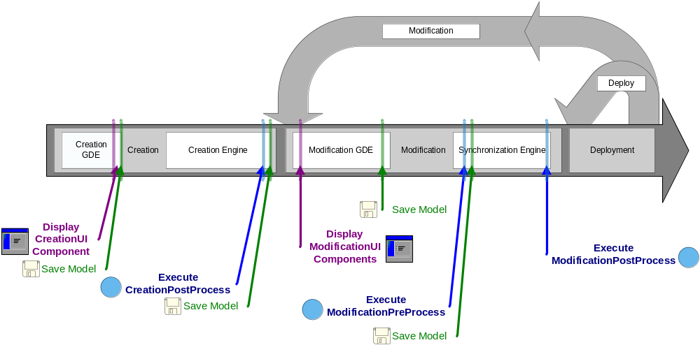
Service Development Extensions
Flow of execution for service extension components.

Slide 12
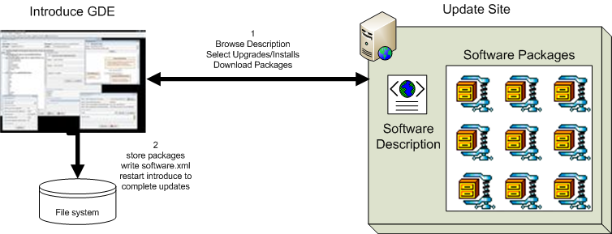
Introduce 1.1 Software Updater
New update support enables introduce to role updates out and move to newer versions of itself and it’s extensions.

Slide 13
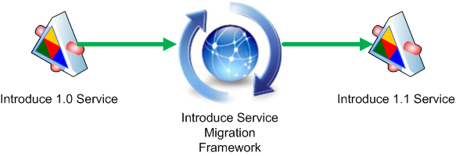
Introduce 1.1 Service Migration
New Introduce Service Migration Framework enables introduce and it’s extensions to provide upgraders which can run against services built with older versions of introduce and/or it’s extensions and migrate the services forward.
  1.0 services and forward will now be able to be migrated to work with newer versions of introduce with very little effort on the developers part.

Slide 14
Introduce 1.1 Service Security
Now using Globus Policy Decision Point (PDP) based authorization.
  Introduce by default will generate the PDP authorization class from the requirements selected by the service creator using GridGrouper and/or CSM.
  Developer has the choice to use a custom PDP class which will enable them to create custom authorization login and use other external attribute or group authorities.
  Much more flexible and actually enables authorization policy to be applied to imported operations which 1.0 did not as well as directly to dynamically created resources.

Slide 15
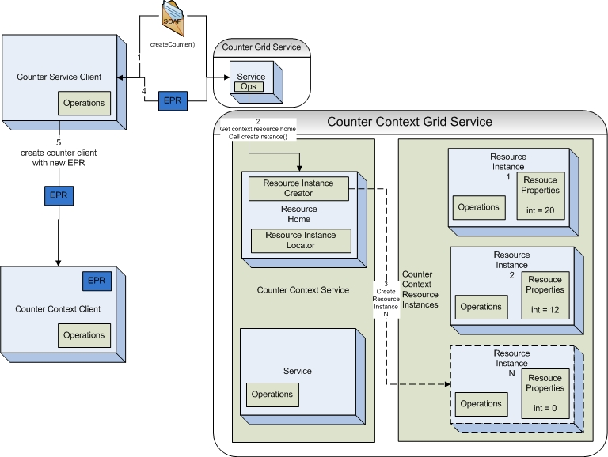
Introduce 1.1 Service Resource Contexts
Enhanced Resource Pattern Support
  now supports automated code generation of resource creation.
  Many bug fixes to support dynamic factory patterns to be created for creating and managing resources.

Slide 16
Introduce 1.1 Service Documentation
Introduce now enables descriptions and or comments to be added to virtually every aspect of the service.
  Descriptions are used to comment the generated API and to describe better the service metadata.

Slide 17
Future Features of Introduce 1.2
WS-Notification Support
  Support for subscribing/unsubscribing to resource properties.
Persistent Resources Support
  Support for automatic storing and loading introduce generated resources.
Service Refactoring
  Renaming packages, namespaces, methods, etc.
Deployment time security configuration.

Slide 18
References
Web
  http://dev.globus.org/wiki/Incubator/Introduce
  http://cagrid.org
Online Tutorial
  http://www.cagrid.org/mwiki/index.php?title=Introduce:1.1:Tutorial
Mail
  Introduce-users@dev.globus.org
  CAGRID_USERS-L@LIST.NIH.GOV

