Slide 1

caGrid Compatibility Tools:
Introduce
Joel Saltz
Shannon Hastings
Denise Warzel
Scott Oster
Stephen Langella
David Ervin
NIH Natcher Center October 18, 2007

Slide 2
Agenda
caGrid Compatibility Tools Overview
  EVS
  caDSR
  caCore
  GME
  Introduce
Introduce Overview
Introduce Demonstration
  Grid Enabling a Silver Level caCore data service.

Slide 3
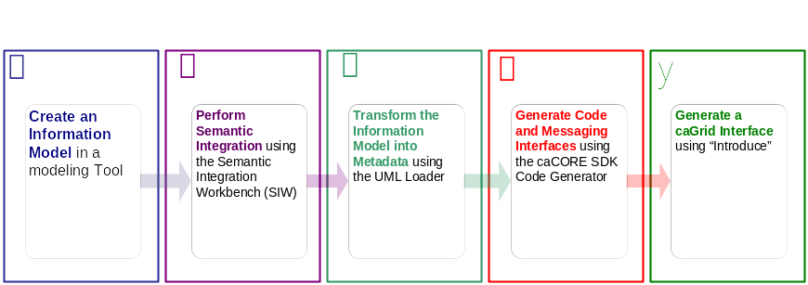




Getting Connected:
An example development process using caCORE to generate a data resource.
Create Semantically Harmonized Data Model
Generate
Data Resource
Grid-ify

Slide 4

Getting Connected: Deploying to caGrid
Grid-ify

Slide 5
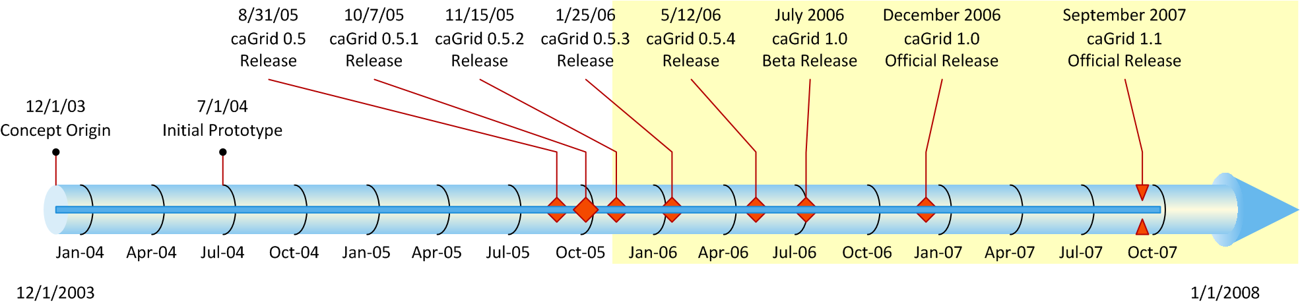
Introduce Overview
caGrid has been an evolutionary development process
Initially provided separate tools for analytical and data service development
After 0.5 development tools were brought together into an extendable framework called Introduce.
At 1.0 Introduce is the core development environment of caGrid and also is the tool that generated all core services, i.e. generates the services of the actual caGrid middleware
At 1.1 Introduce is hardened into more production quality tool and is now enhanced to provide easier service development by domain experts.

Slide 6
Introduce
A framework which enables fast and easy creation of Globus and Standards based grid services.
Provide easy to use graphical service authoring tool.
Hide all “grid-ness” from the developer.
Utilize best practice layered grid service architecture.
Handle all core service architecture requirements for strongly typed and highly interoperable grid services.
Toolkit for creating and manipulating strongly typed grid services
  Command line and GUI tools for service skeleton generation and automatic service/client code generation
Utilizes other core grid services and architecture components
  caDSR and GME for schemas of registered data types
  Security service architecture (Dorian, GridGrouper, CSM)
  Advertisement and Registration configuration and
  Index Service for discovery

Slide 7
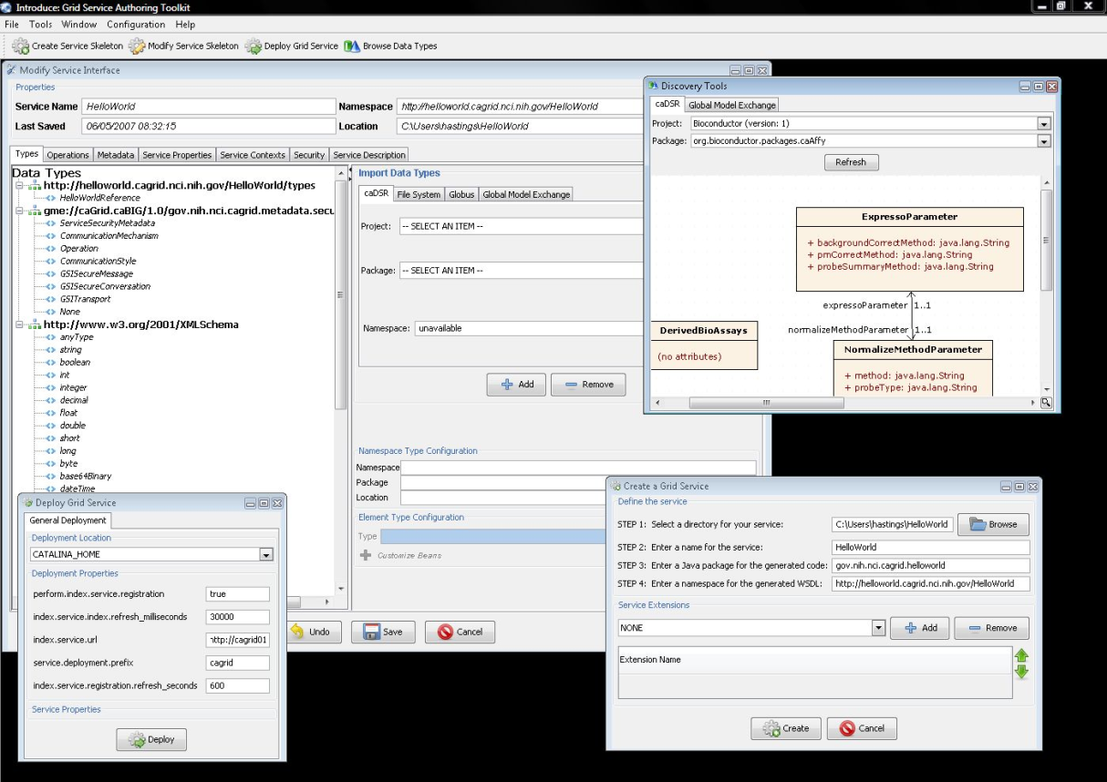
Introduce Graphical Development Environment (GDE)
GUI for creating and manipulating a grid service
  Provides means of simple creation of service skeleton that a developer can then implement, build, and deploy
  Automatic code generation of complete WSRF compliant grid service which is configured to provide:
    Security
    Advertisement
    Discovery
    Complete UnBoxed Client API
  Provides a set of tools which enable the developer to add/remove/modify/import methods of the service as well create sub-services/resources.
    Automatic code generation of all the required code, Globus grid service code/configuration, service configuration, implementation of the client, and stubbed implementation of the service

Slide 8
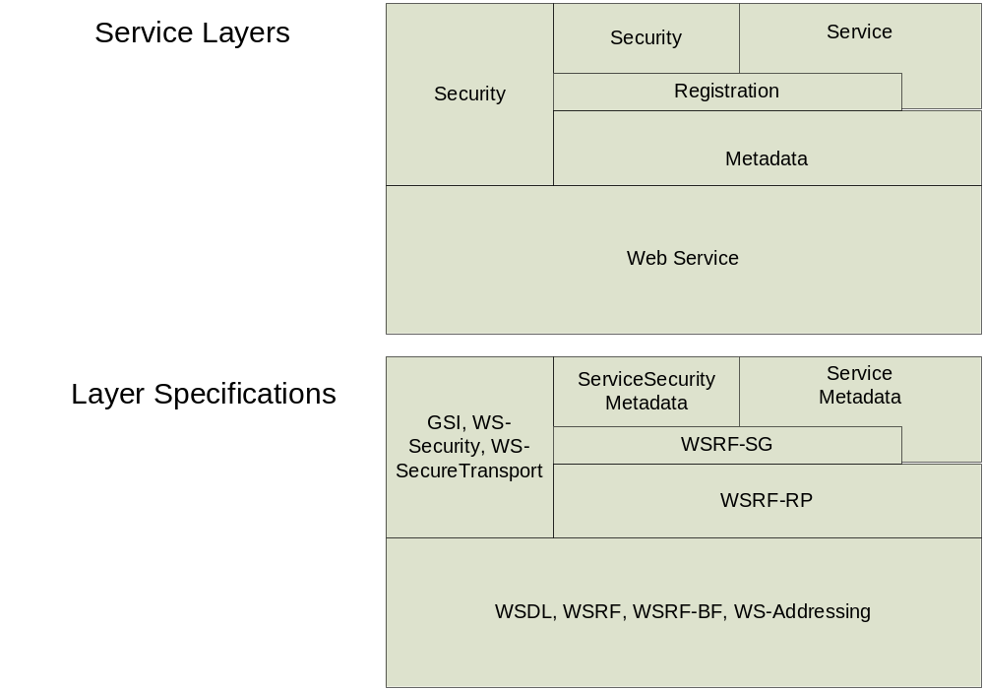
Addressing the Requirements
Grid Services
  Introduce uses the Globus Toolkit and Axis for creating, registering, discovering, and invoking these service operations as grid services
    Client uses the operation through a grid service interface and does not need to be aware of any implementation specific details of the grid service

Slide 9
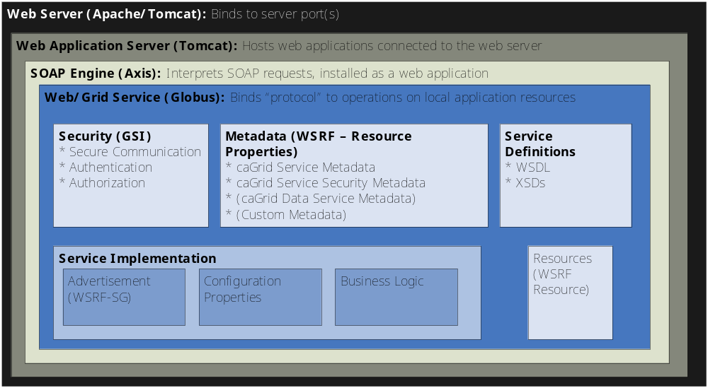
Service Layers

Slide 10
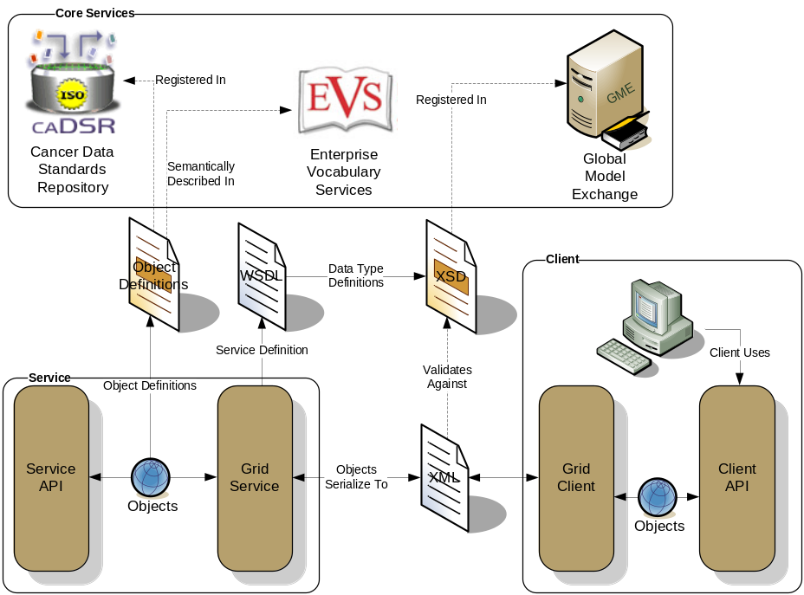
Addressing the Requirements (cont)
Strongly typed interfaces:
  Introduce enables schema extraction from a GME or any other data model registry service so that the wsdl, beans, and service metadata can be automatically populated and the service will be using strongly typed with publicly accessible data types.
  Data model schema, and any referenced schemas, are extracted and placed in the schema directory of the services build skeleton and imported into the services WSDL.
    types can be used at service build time to automatically generate the objects and create strongly-typed grid service interfaces
Example from caGrid

Slide 11
Addressing the Requirements (cont)
Providing Service Metadata:
  Leverage Globus’ use of Java Naming and Directory Interface (JNDI) in order to support WSRF.
  Service metadata is provided as resource properties on the base service’s singleton resource.
  These resource properties are defined by xml schema.

Slide 12
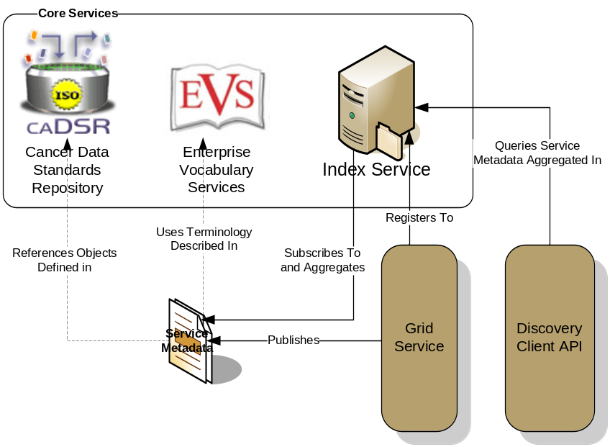
Addressing the Requirements (cont)
Index Service Registration
  Leverage Globus MDS in order to configure properties on the base resource of the service to be published to an MDS based Index Service.
  Provide configuration options for registration of static and dynamic service metadata which can then be used at runtime for service discovery.
Example from caGrid

Slide 13
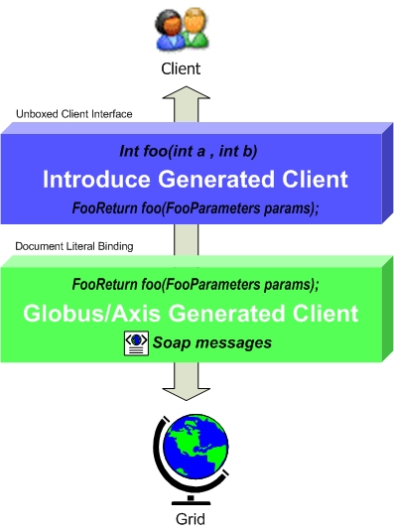
Addressing the Requirements (cont)
Providing Client Side Object Oriented API
  Globus/Axis build process will automatically generate a client side object oriented API
  Introduce generates a wrapper for this API which matches the service designers interface to make a clean mapping from client to service.
    This wrapper will handle auto boxing/unboxing of the parameters into and out of document literal form.

Slide 14
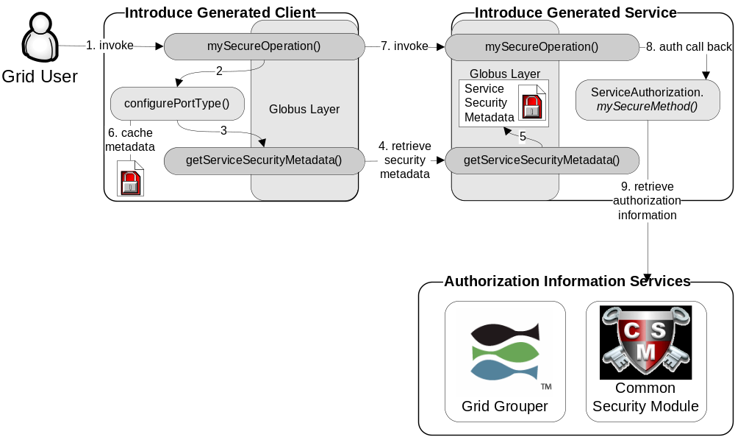
Addressing the Requirements (cont)
Security:
  Enable configuration for each service and for each method in a service.
  Support complete GSI security configuration for authentication and support for an authorization plug-in framework.
  Require service security metadata to be available anonymously via the grid service interface (getServiceSecurityMetadata()) or the grid service’s resource properties.

Slide 15
Recap Core Service Architecture
Base service is a GT4 based WSRF capable grid service.
Utilize compositional inheritance (in lieu of non-standard port type extensions) to enable the service to inherit required features such as providing service security metadata and access to resource properties.
Utilize JNDI for registration configuration, server side configuration properties, and resources and resource properties.
Provide client and service side wrappers which implement the service designers interface as opposed to the document literal interface generated by Axis.
Provide metadata registration to the index service by configuring the Resource to register it’s service groups to a predefined MDS based Index Service.
ServiceSecurityMetadata and it’s access operation enables programmatic bootstrapping of connection security configuration.

Slide 16
Demonstration
A caCORE generated data resource which is not connected to the grid.
Grid
caBIO

Slide 17

Exposing the Resource:
We will use the Introduce data service wizard to describe our data resource and generate a grid service.
Grid
caBIO

Slide 18


Exposing the Resource:
Introduce will enable the user to browse data model in the caDSR and chose the ones which they are going to be exposing.
GME
Grid
CQL query
processor
caBIO

Slide 19

Exposing the Resource:
Then they will locate the schemas which describe the data models and will provide the wire protocol for transferring data instances.
GME
Grid
CQL query
processor
caBIO

Slide 20

Exposing the Resource:
Lastly the user will have to provide a CQL query processor to enable CQL query to be executed against the data resource.
GME
Grid
CQL query
processor
caBIO

Slide 21


Exposing the Resource:
Introduce will create a grid service which can expose the data resource we described to the grid
Grid
caGrid
Data
Service
caBIO
caCORE CQL query
processor

Slide 22
Data now available.
Now that our service is generated we can deploy it so that the resource can be used.
Grid
GridService
caBIO
Grid
Service
caGrid
Data
Service
caBIO
caCore CQL query
processor

Slide 23
How will users find me
We need to expose metadata to a registry so that a user/service can locate and use our service
Grid
GridService
caBIO
Grid
Service
caGrid
Data
Service
caBIO
caCore CQL query
processor

Slide 24

How will users find me
We will send our metadata to an index service that can be queried by grid users.
Grid
GridService
caBIO
Grid
Service
caGrid
Data
Service
caBIO
caCore CQL query
processor
Index Service

Slide 25

Service Creation Demonstration
Service Creation Demonstration:
create a caBIO grid data service

Slide 26
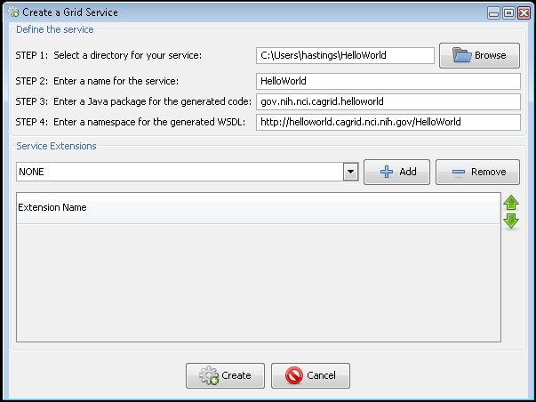
Service Creation
Populate required variables for service creation
  Name = published service name
  Creation Direction = directory to create the skeleton
  Package = the java package you wish to use for your service
  Namespace Domain = the namespace to be used to define the service interface and types
Choose Extensions

Slide 27
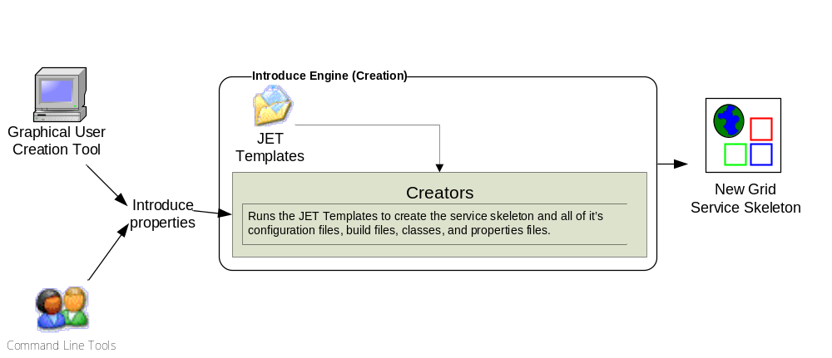
Introduce Service Creation Architecture
The Introduce Service Properties are a set if base properties
required for creating this service such as desired location to
create the service, namespace to use, package name to use,
and service name.

Slide 28
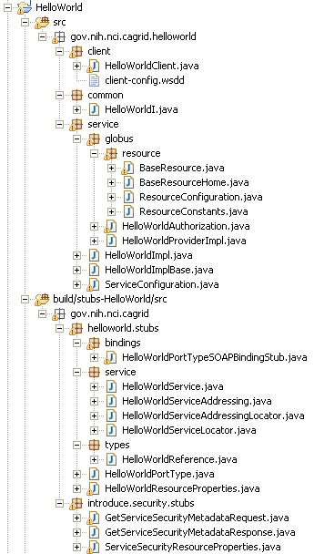
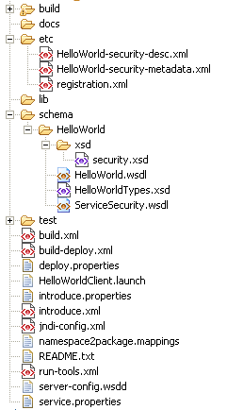
Created Skeleton Layout
= introduce managed
= globus/axis managed
= developer implements

Slide 29
Created Skeleton Layout (cont)
= implements the developer
defined interface and calls into
the generated client port type
stub.
= the developer defined grid
service interface
= manages the resources
of this grid service
= implements the port type
and calls into the actual
clean unboxed interface
the developer defined.
= developers implementation
of the defined interface.

Slide 30
Created Skeleton Layout (cont)
= service metadata registration configuration
= describes the services security configuration
= services WSDL file for axis
= introduce properties for this service
= ant build files
= client configuration file for axis
= deployment time service properties
= introduce representation of service
= JNDI service resources configuration
= namespace mappings for axis
= server configuration file for axis

Slide 31

Inside the Introduce created service
Services have many moving and configurable parts which support features such as:
  Advertisement
  Discovery
  Invocation
  Security (Authentication/Authorization)
  Stateful Resources
The Introduce Toolkit can keep all these features in sync as the developer creates and modifies the grid service

Slide 32
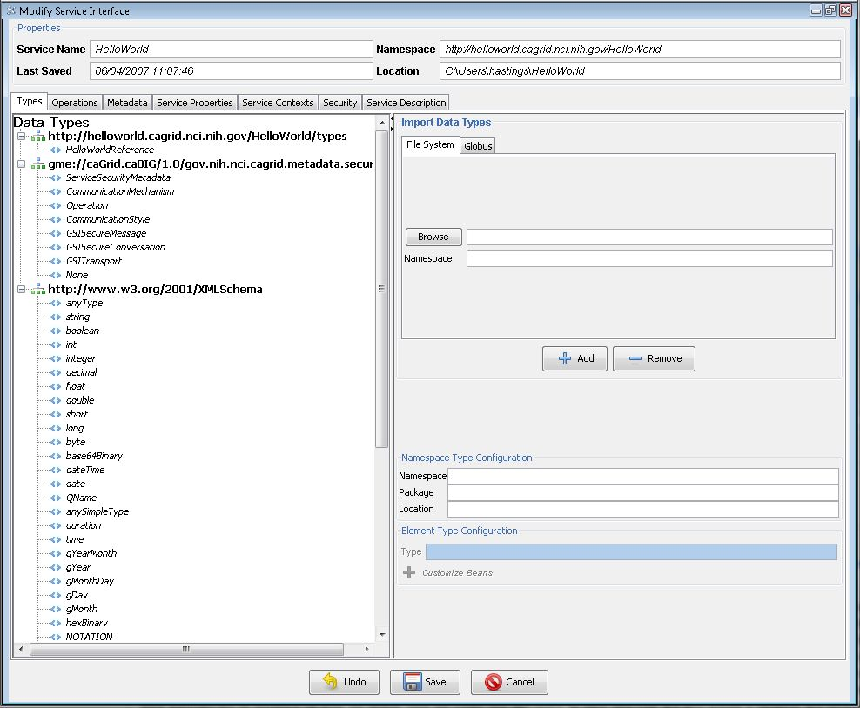
Modification
Add/Remove/Modify
Operations
Resource properties
Service properties
Service contexts (services and resources)
Service, method, and resource level security settings

Slide 33
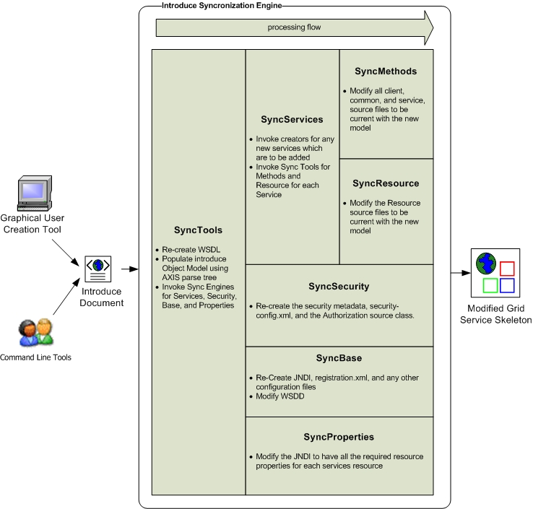
Introduce Service Modification Architecture
The Introduce Service Description document is the input to the introduce engine. The user can hand craft this document and call the engine via command line or API or can use the Introduce GDE to create and modify this document and execute the synchronization engine

Slide 34
Service Deployment and Invocation Demonstration
Service Deployment and Invocation Demonstration
Implement client test function
Deploy caBIO grid service
Start up service container
Invoke client to with CQL query

