Slide 1
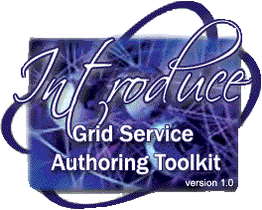
http://dev.globus.org/wiki/Incubator/Introduce
Multiscale Computing Laboratory
Department of Biomedical Informatics
The Ohio State University

Slide 2
Introduce Goals
A framework which enables fast and easy creation of Globus based grid services.
Provide easy to use graphical service authoring tool.
Hide all “grid-ness” from the developer.
Utilize best practice layered grid service architecture.
Handle all core service architecture requirements for strongly typed and highly interoperable grid services.
Toolkit for creating and manipulating strongly typed grid services
  Command line and GUI tools for service skeleton generation and automatic service/client code generation
Utilizes other core grid services and architecture components
  caDSR and GME for schemas of registered data types
  Security service architecture (Dorian, GridGrouper, CSM)
  Advertisement and Registration configuration and
  Index Service for discovery

Slide 3
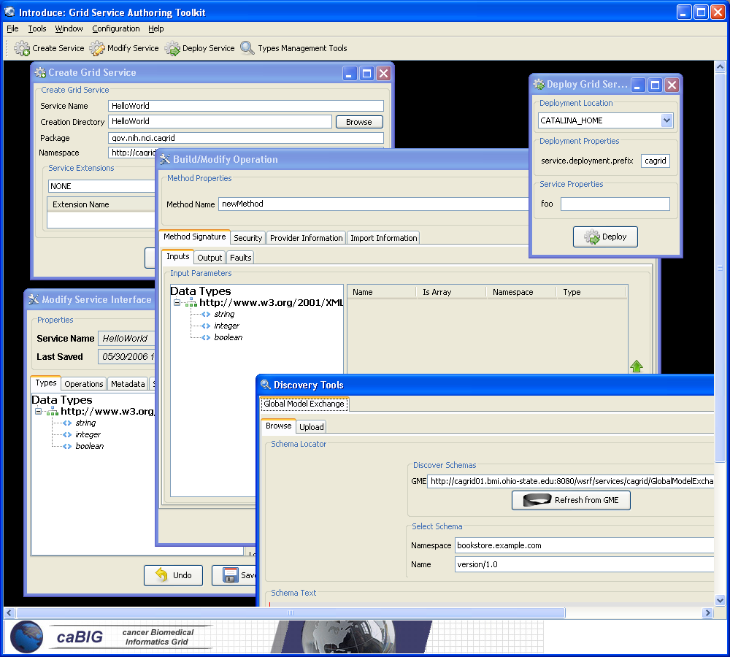
Introduce Graphical Development Environment (GDE)
GUI for creating and manipulating a grid service
  Provides means of simple creation of service skeleton that a developer can then implement, build, and deploy
  Automatic code generation of complete WSRF compliant grid service which is configured to provide:
    Security
    Advertisement
    Discovery
    Complete UnBoxed Client API
  Provides a set of tools which enable the developer to add/remove/modify/import methods of the service as well create sub-services/resources.
    Automatic code generation of all the required code, Globus grid service code/configuration, service configuration, implementation of the client, and stubbed implementation of the service

Slide 4
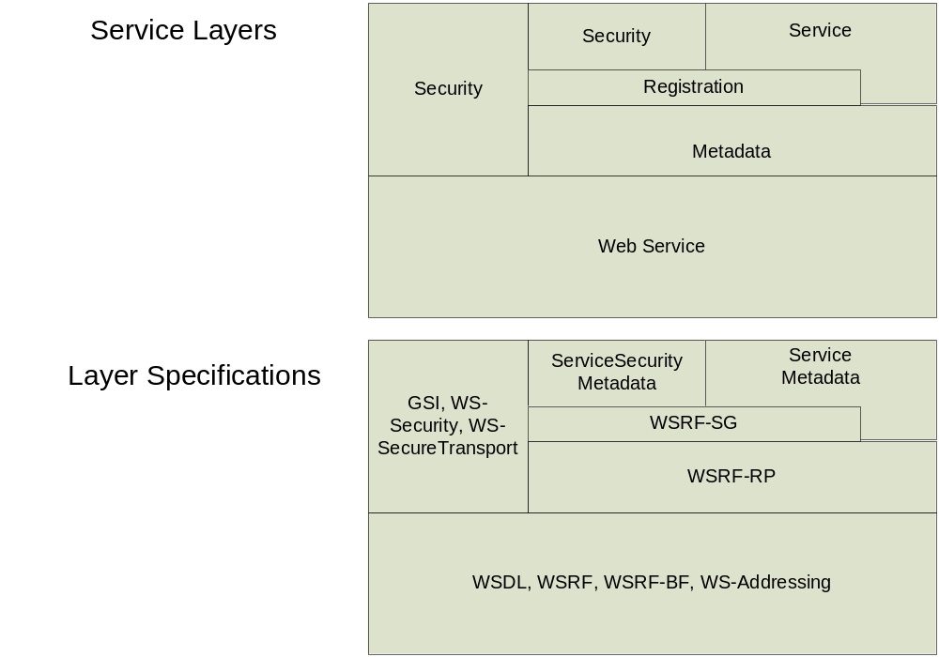
Addressing the Requirements
Grid Services
Introduce uses the Globus Toolkit and Axis for creating, registering, discovering, and invoking these service operations as grid services
  Client uses the operation through a grid service interface and does not need to be aware of any implementation specific details of the grid service

Slide 5
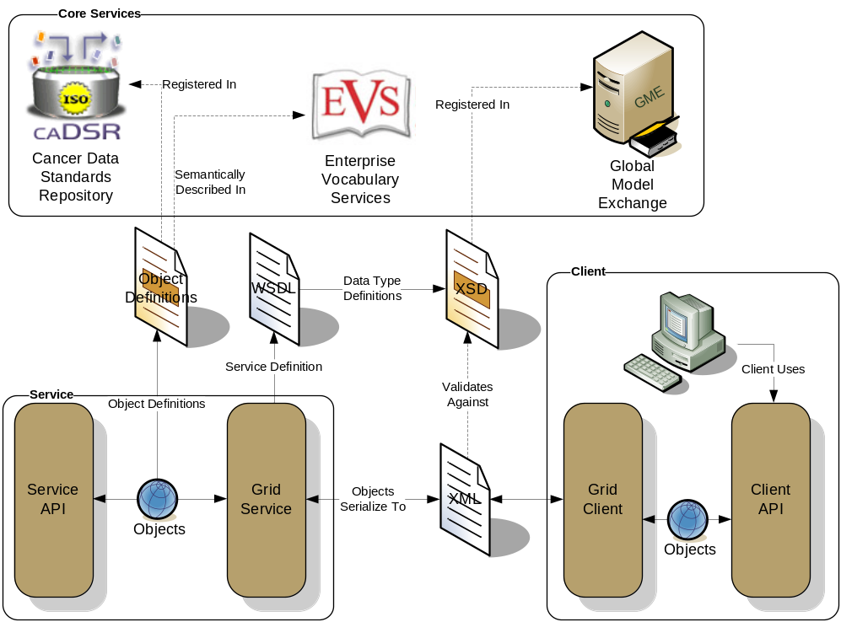
Addressing the Requirements (cont)
Strongly typed interfaces:
  Introduce enables schema extraction from a GME or any other data model registry service so that the wsdl, beans, and service metadata can be automatically populated and the service will be using strongly typed with publicly accessible data types.
  Data model schema, and any referenced schemas, are extracted and placed in the schema directory of the services build skeleton and imported into the services WSDL.
    types can be used at service build time to automatically generate the objects and create strongly-typed grid service interfaces

Slide 6
Addressing the Requirements (cont)
Providing Service Metadata:
  Leverage Globus’ use of Java Naming and Directory Interface (JNDI) in order to support WSRF.
  Service metadata is provided as resource properties on the base service’s singleton resource.
  These resource properties are defined by xml schema.

Slide 7
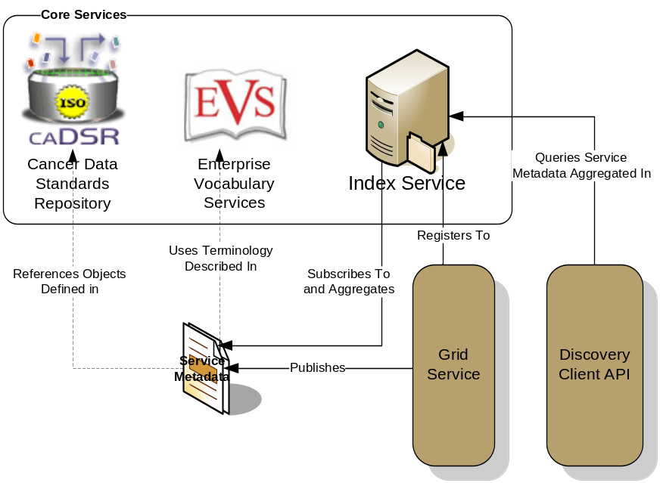
Addressing the Requirements (cont)
Index Service Registration
  Leverage Globus MDS in order to configure properties on the base resource of the service to be published to an MDS based Index Service.
  Provide configuration options for registration of static and dynamic service metadata which can then be used at runtime for service discovery.

Slide 8
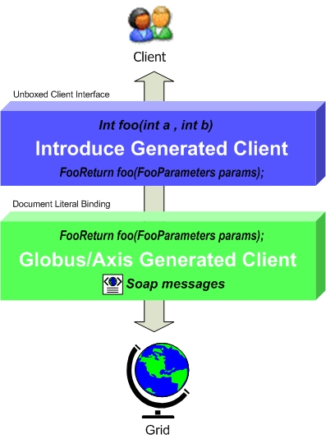
Addressing the Requirements (cont)
Providing Client Side Object API
  Globus/Axis build process will automatically generate a client side object oriented API
  Introduce generates a wrapper for this API which matches the service designers interface to make a clean mapping from client to service.
    This wrapper will handle auto boxing/unboxing of the parameters into and out of document literal form.

Slide 9
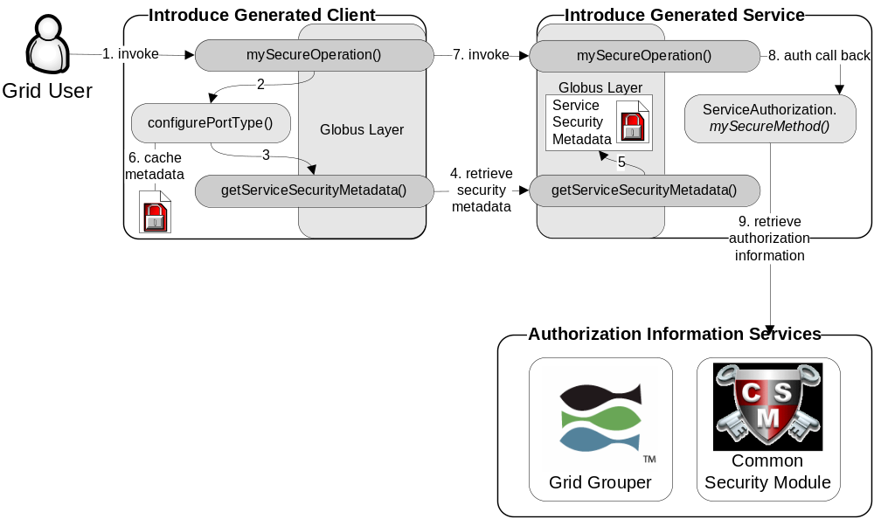
Addressing the Requirements (cont)
Security:
  Enable configuration for each service and for each method in a service.
  Support complete GSI security configuration for authentication and support for an authorization plug-in framework.
  Require service security metadata to be available anonymously via the grid service interface (getServiceSecurityMetadata()) or the grid service’s resource properties.

Slide 10
Recap Core Service Architecture
Base service is a GT4 based WSRF capable grid service.
Utilize compositional inheritance (in lieu of non-standard port type extensions) to enable the service to inherit required features such as providing service security metadata and access to resource properties.
Utilize JNDI for registration configuration, server side configuration properties, and resources and resource properties.
Provide client and service side wrappers which implement the service designers interface as opposed to the document literal interface generated by Axis.
Provide metadata registration to the index service by configuring the Resource to register it’s service groups to a predefined MDS based Index Service.
ServiceSecurityMetadata and it’s access operation enables programmatic bootstrapping of connection security configuration.

Slide 11
The Problem:
A data resource not connected to the grid.
Grid
caBIO

Slide 12
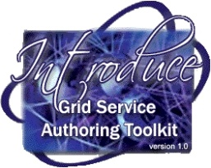

Exposing the Resource:
We will create a grid service which can expose the data resource to the grid
Grid
caBIO
Grid
Service
caBIO

Slide 13
Data now available.
Now that our service is up the resource can be used.
Grid
GridService
caBIO
Grid
Service
caBIO
Grid
Service
caBIO

Slide 14
How will users find me
We need to expose medatata to a registry that user can locate and use our service
Grid
GridService
caBIO
Grid
Service
caBIO
Grid
Service
caBIO

Slide 15

How will users find me
We will send our metadata to an index service that can be queried by grid users.
Grid
GridService
caBIO
Grid
Service
caBIO
Grid
Service
caBIO
Index Service

Slide 16
Demo
Create the simple service.

Slide 17
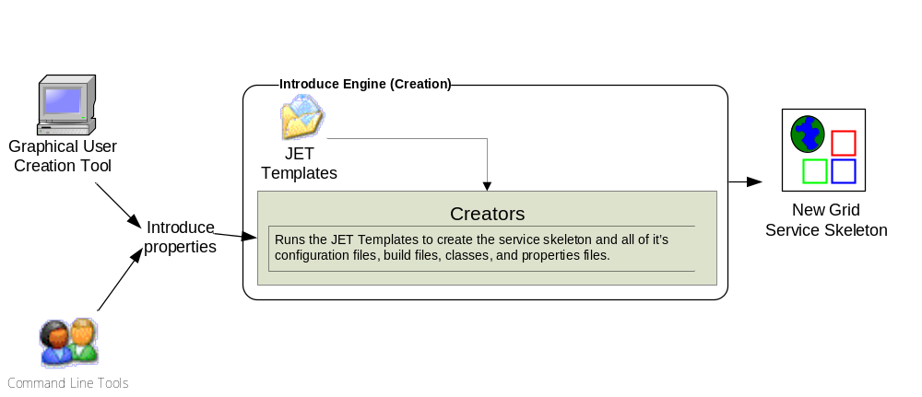
Introduce Service Creation Architecture
The Introduce Service Properties are a set if base properties
required for creating this service such as desired location to
create the service, namespace to use, package name to use,
and service name.

Slide 18
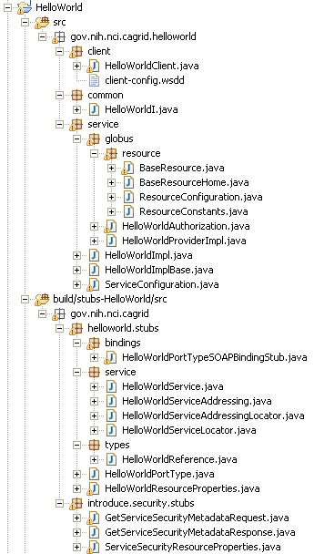
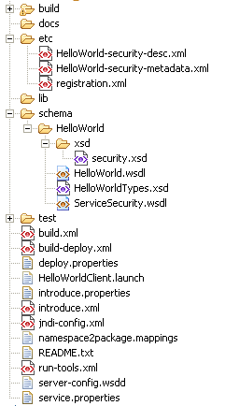
Created Skeleton Layout
= introduce managed
= globus/axis managed
= developer implements

Slide 19
Created Skeleton Layout (cont)
= implements the developer
defined interface and calls into
the generated client port type
stub.
= the developer defined grid
service interface
= manages the resources
of this grid service
= implements the port type
and calls into the actual
clean unboxed interface
the developer defined.
= developers implementation
of the defined interface.

Slide 20
Created Skeleton Layout (cont)
= service metadata registration configuration
= describes the services security configuration
= services WSDL file for axis
= introduce properties for this service
= ant build files
= client configuration file for axis
= deployment time service properties
= introduce representation of service
= JNDI service resources configuration
= namespace mappings for axis
= server configuration file for axis

Slide 21

Inside the Introduce created service
Services have many moving and configurable parts which support features such as:
  Advertisement
  Discovery
  Invocation
  Security (Authentication/Authorization)
  Stateful Resources
The Introduce Toolkit can keep all these features in sync as the developer creates and modifies the grid service

Slide 22
Demo
Modify the service by adding a simple method.

Slide 23
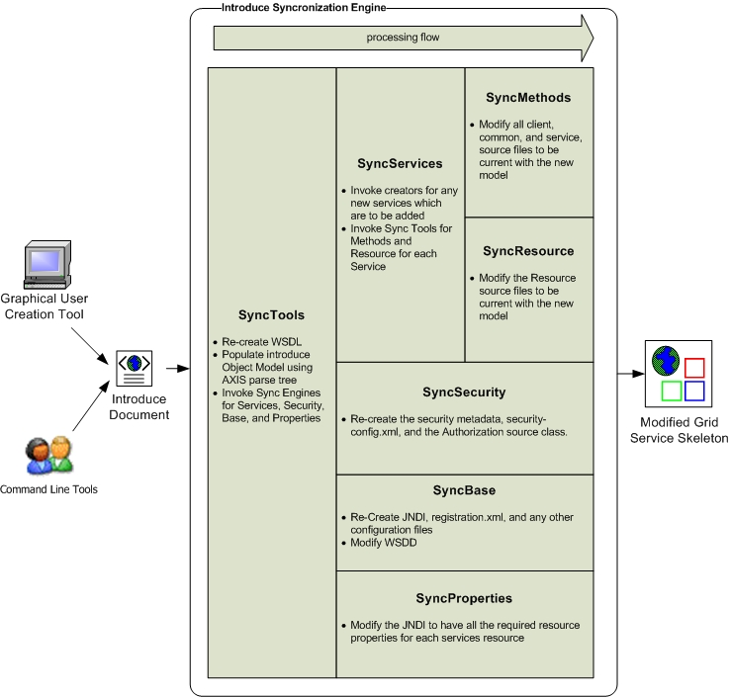
Introduce Service Modification Architecture
The Introduce Service Description document is the input to the introduce engine. The user can hand craft this document and call the engine via command line or API or can use the Introduce GDE to create and modify this document and execute the synchronization engine

Slide 24
Demo
Implement the simple method, deploy, and invoke.

Slide 25
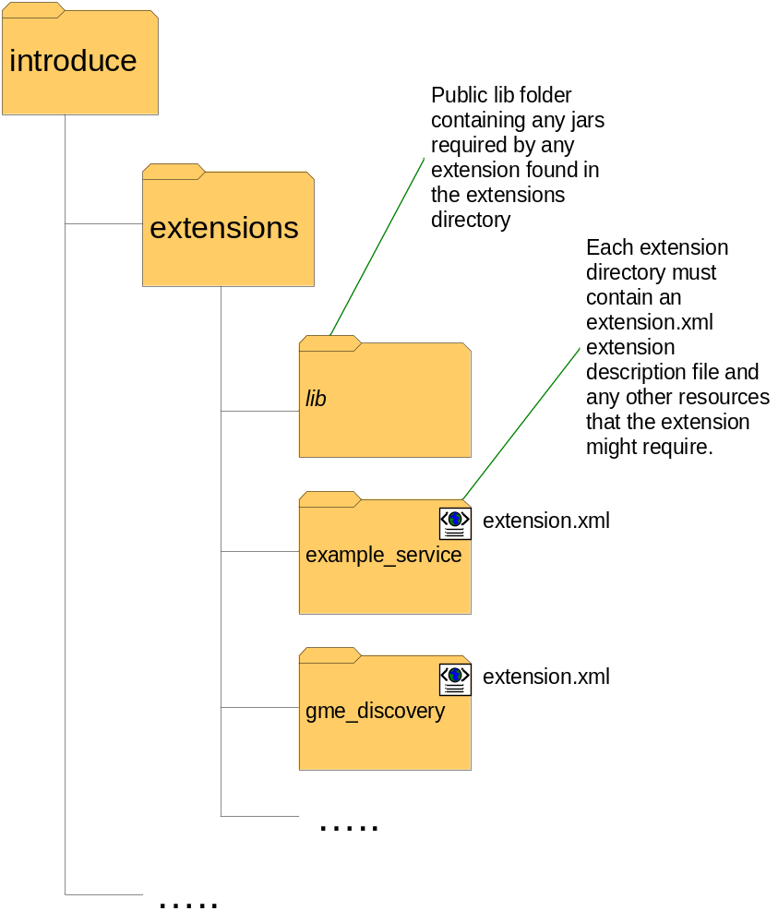
Introduce Extension Framework
Introduce provides an extension framework where it’s core functionality can be extended to provide customized solutions by leveraging the introduce toolkit.
There are currently two types of extensions in Introduce
  Service
  Types Discovery
Extensions provide an “extension.xml” extension description and configuration. The “extensions” directory of introduce hold the extensions in separate folders enabling them to easily be added and removed from the Introduce toolkit.

Slide 26
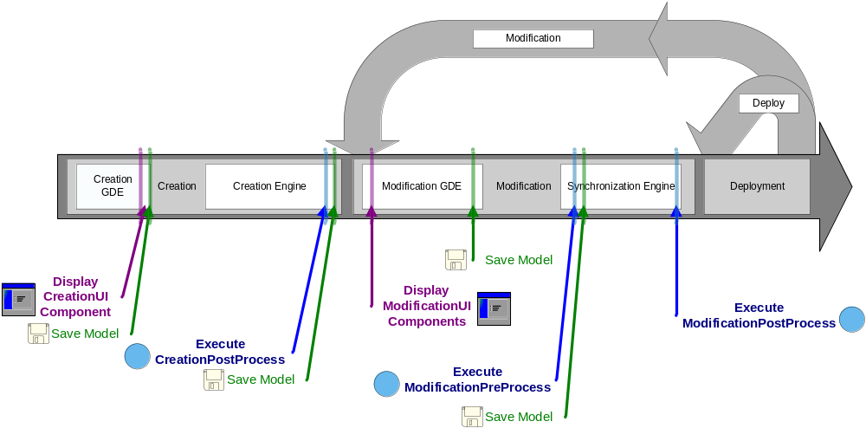
Service Development Extensions
Flow of execution for service extension components.

Slide 27
Conclusion
Requirements
  Basic strongly typed grid requirements via extensions which enable using data model services.
Architecture
  Grid service framework which is encapsulated and layered on Globus 4.0.3 (extensions exist that can use the WS-Enum patch)
Introduce Service Layout
  Simple grid service layout making it easy to locate and manage pieces of the implementation
Introduce Toolkit
  Enables easy development of grid services of any type, size, and shape.

Slide 28
Introduce Team
Shannon Hastings
Scott Oster
Stephen Langella
David Ervin
Ravi Madduri
Tahsin Kurc
Joel Saltz

Slide 29
http://dev.globus.org/wiki/Incubator/Introduce
Multiscale Computing Laboratory
Department of Biomedical Informatics
The Ohio State University

