Slide 1
Introduce
Grid Service Authoring Toolkit
Shannon Hastings
hastings@bmi.osu.edu
Multiscale Computing Laboratory
Department of Biomedical Informatics
The Ohio State University

Slide 2
caGrid Service Overview
Accessing data in caBIG will not be enough. The data will need to be processed, transformed, analyzed, integrated, etc
It should be very easy for service providers to deliver these services
The services will take in and return strongly typed and semantically harmonized data types
These services will need to be easily discovered and invoked

Slide 3
caGrid Service Requirements
All services must be presented to the caBIG as Grid Services
They must have strongly typed interfaces using types which are registered in the caDSR and can be verified by an XML schema registered in the caGrid GME.
Must provide CommonServiceMetadata as well as service specific metadata.
The service must register itself and it’s metadata to a caGrid Index Service
The service must provide object oriented client API for locating and invoking the service

Slide 4
Introduce Goals
A framework which enables fast and easy creation of caGrid compatible services whether they are data, analytical, or core services.
Provide easy to use graphical service authoring tool.
Hide all “grid-ness” from the developer.
Utilize best practice layered grid service architecturese.
Handle all service architecture requirements of the caGrid.

Slide 5
Addressing the Requirements
Grid Services
  We will be fulfilling the requirement that each operation is available through grid services by utilizing the Globus 4.0 toolkit
  Tool providers will describe the grid service interface they wish to provide.
  We will be using the Globus toolkit for creating, registering, discovering, and invoking these service operations as grid services
    Client will be using the operation through a grid service interface and will not need to be aware of any implementation specific details of the grid service

Slide 6
Addressing the Requirements (cont)
Strongly typed interfaces:
  Introduce will enable schema extraction from a GME so that the wsdl, beans, and service metadata can be automatically populated and the service will be using strongly typed and publicly accessible data types.
  Data model schema, and any referenced schemas, extracted and placed in the schema directory of the analytical build skeleton
    types can be used at service build time to generate the objects and create strongly-typed grid service interfaces

Slide 7
Addressing the Requirements (cont)
Providing Client Side Object API
  Globus build process will automatically generate a client side object oriented API
  We will generate a wrapper for this API which matches the service interface to make a clean mapping from client to service.
    This wrapper will handle auto boxing of the parameters into document literal form.

Slide 8
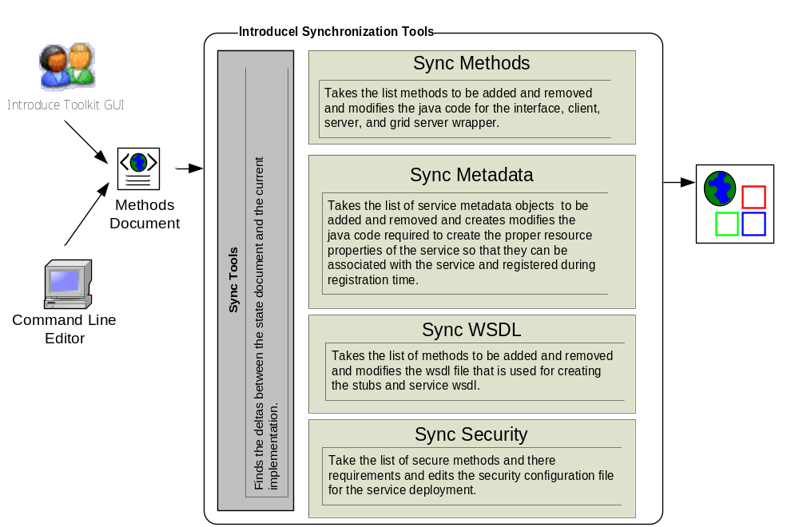
Skeleton Synchronization Process

Slide 9
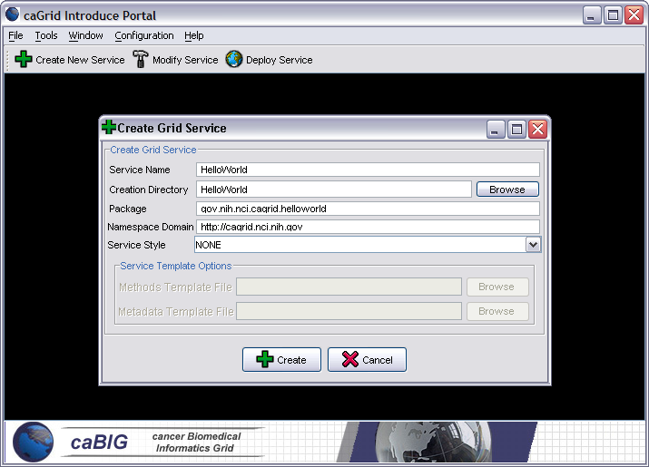
Introduce Portal Service Creation
Populate required variables for service creation
  Name = published service name
  Creation Direction = directory to create the skeleton
  Package = the java package you wish to use for your service
  Namespace Domain = the namespace to be used to define the service interface and types

Slide 10
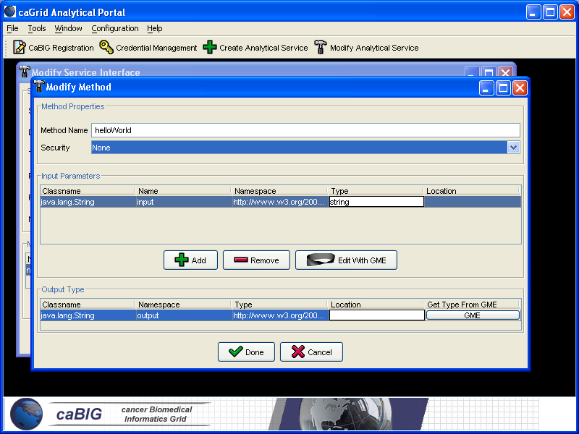
Introduce Service Modification Tool
Graphical tool to automatically create source code, configuration files, and build process for new analytical services
Developer defines the operations of the service and just has to focus on the implementation of them
Generated service is caBIG compliant in its mechanisms to register, advertise, and secure

Slide 11
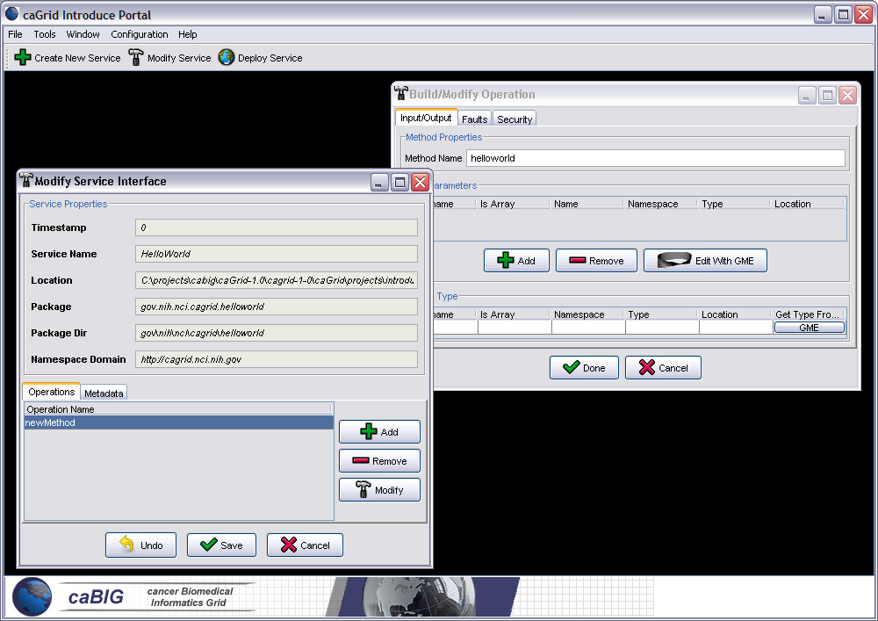
Introduce Service Modification Tool cont.
Input and output parameters can be discovered from GME
Schema types can be automatically downloaded and configured as operation parameters
Specified types are used to create necessary Java Objects using Globus behind the scenes

Slide 12
Command Line Tools
Creation tool – tool to enable the easy creation of a new service skeleton
  Will prompt for input on name, package, directory, namespace, etc
  Can take in a properties file instead
  Can be called with ant “ant createServiceSkeleton”
Sync tools – set of tools which enable the modification of caGrid compliant grid services
    Keeps mirror of service interface in a configuration/state document and regenerates the grid service skeleton upon changes
      Creates/Modifies
        service interface
        wsdl
        client/server implementation
        build files
        Security and registration configuration files
      Can be called with ant “ant resync”

Slide 13
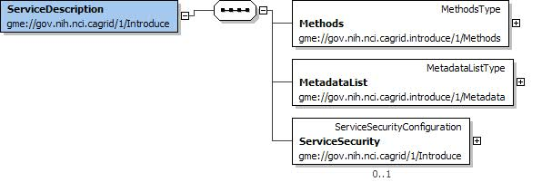
The Methods Document
XML document used to describe the service interface and it’s security requirements
Introduce Toolkit uses it for code generation and skeleton synchronization

Slide 14
Conclusion
Requirements
  Basic strongly typed grid requirements plus semantically interoperable caBIG requirements
Architecture
  Grid service framework which is encapsulated and layered on Globus
Introduce Toolkit
  Enables easy development of caBIG compliant grid service
Introduce Service Layout
  Simple grid service layout making it easy to locate and manage pieces of the implementation

