Slide 1

Introduce Overview
OGF 22Workshop
February 25-29, 2008

Slide 2

Introduce Vision
Become the one stop shop for grid service development
  Provide a simple, yet powerful, graphical user interface (GUI) to encapsulate complexities of grid service development
  Provide an extensible toolkit with which grid services can be created and modified programmatically

Slide 3
Introduce Roadmap
1.2 Release (expected 3/08)
  Supports WS-Notification and Persistence
  Expanded extension capabilities
  Service clean undeployment support
1.1Release (posted 9-17-07)
  Supported more robust resource framework patterns
  Services now use Globus PDP based authorization solution (GridGrouper and CSM built in capabilities)
1.0 Release (posted 11-1-06)
  Introduce first public version
  Full featured Globus service authoring framework

Slide 4
Introduce Overview
A framework which enables fast and easy creation of Globus based grid services
Provide easy to use graphical service authoring tool.
Hide all “grid-ness” from the developer
Utilize best practice layered grid service architecture
Integration with other core grid services and architecture components
  GAARDS Security Infrastructure (Dorian, GridGrouper, CSM)
  Globus Index Service
  Global Model Exchange (GME)
  Cancer Data Standards Repository
Extension Framework for integrating with other architecture components

Slide 5
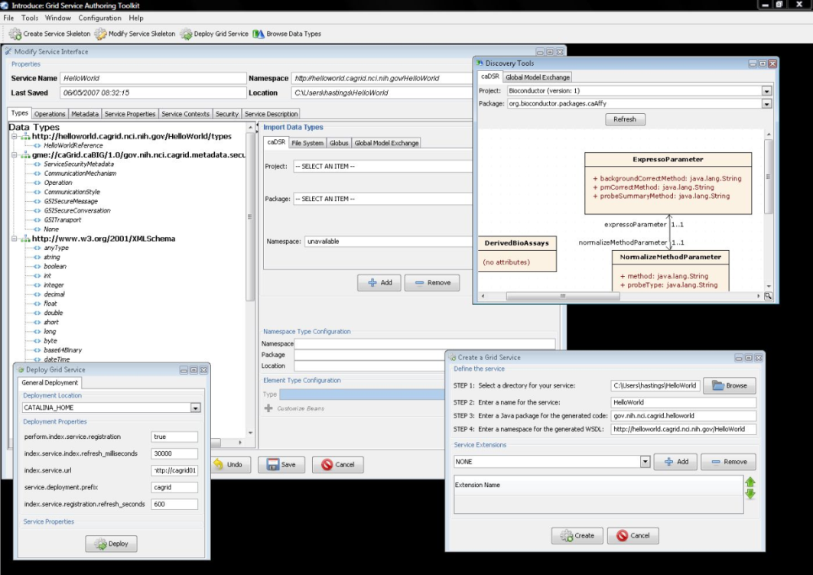
Introduce Features
Supports modification of operations
  Adding operations
  Removing Operations
  Updating Operations
  Importing Operations
Graphical Configuration
  Advertisement
  Security
  Service Metadata Specification
  Service Metadata Editing
  Service Configuration Properties
Auto Generates Code for Service
Auto generates a client API for service.
Graphical Deployment of Service
  Globus
  Tomcat
  JBoss

Slide 6
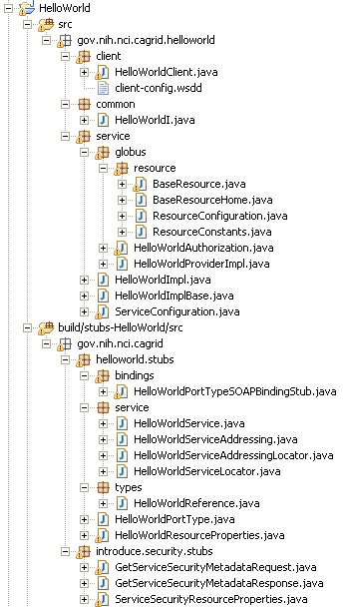
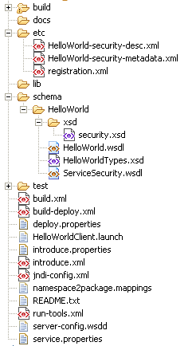
Created Skeleton Layout
= introduce managed
= globus/axis managed
= developer implements

Slide 7
Introduce Requirements
Utilize best practice layered grid service architecture
Enable development of strongly-typed services
  discovery and use of published data types
  self describing services through use of metadata
  advertisement and registration configuration with Index Service
Generate meaningful object-oriented client APIs
Customizable and extensible via the use of plug-ins
Allow for implementation of secure services
  provide customizable service-, method-, and resource- level security

Slide 8
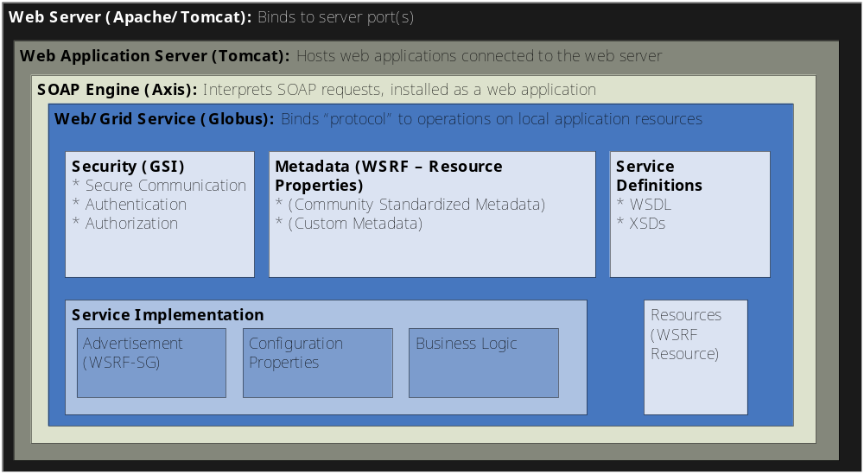
Addressing the Requirements:
Best practice service architecture (cont)

Slide 9
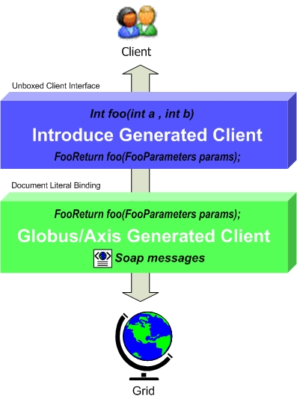
Addressing the Requirements:
Object Oriented Client API
Globus/Axis build process will automatically generate a client side object oriented API
Introduce generates a wrapper for this API which matches the service designers interface to make a clean mapping from client to service
Handle auto boxing/unboxing of the parameters into and out of document literal form

Slide 10
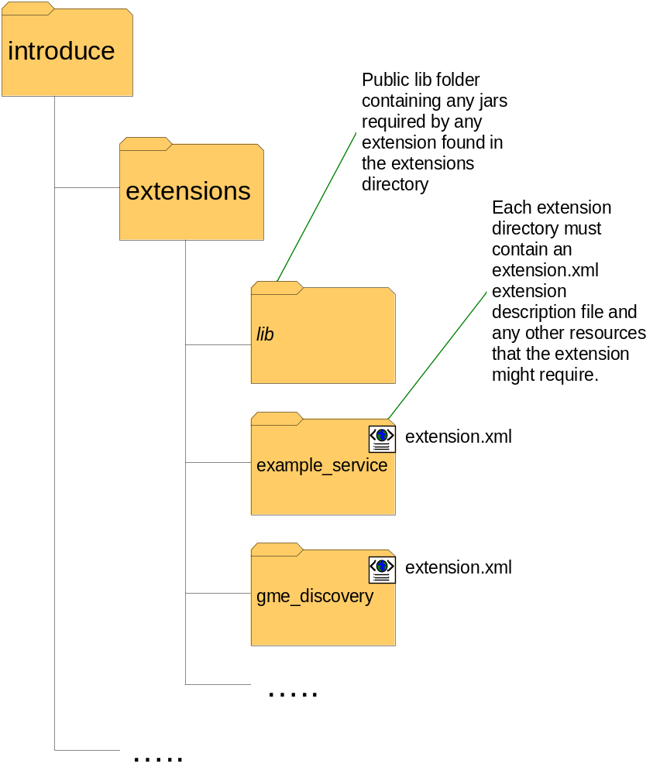
Addressing the Requirements:
Extensible Architecture
Introduce provides an extension framework where it’s core functionality can be extended to provide customized solutions by leveraging the Introduce toolkit.
There are currently two types of extensions in Introduce
  Service
  Types Discovery
Extensions provide an “extension.xml” extension description and configuration. The “extensions” directory of introduce hold the extensions in separate folders enabling them to easily be added and removed from the Introduce toolkit.

Slide 11
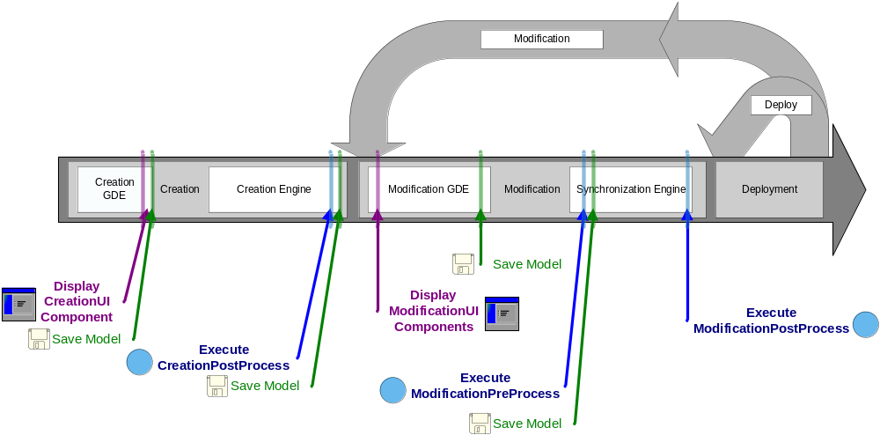
Addressing the Requirements:
Extensible Architecture (cont)
Flow of execution for service extension components.

Slide 12
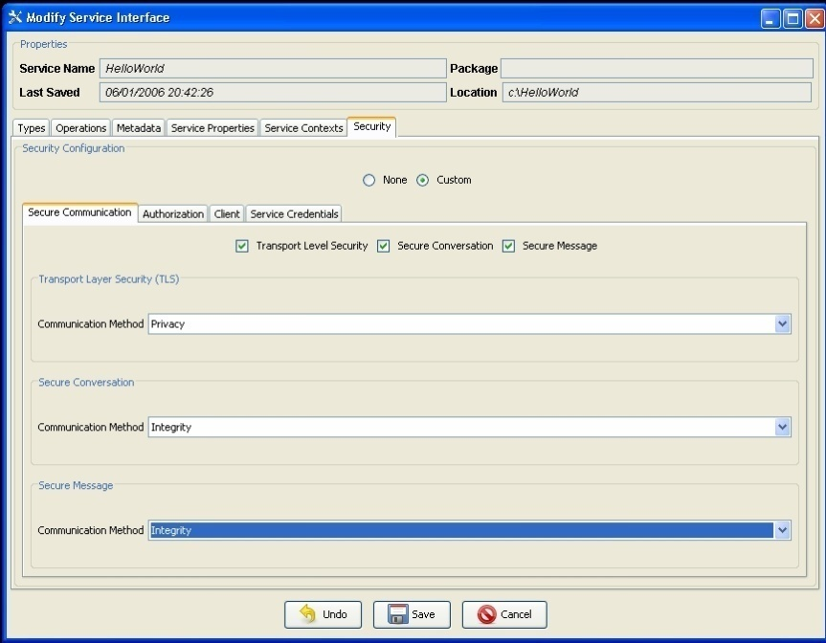
Addressing the Requirements:
Security (communication channel)
Grid Services can support multiple communication protocols.
Different methods in a grid service can be configured to use different communication mechanisms.
Configuration of the communication mechanisms can be complex.
Introduce manages this complexity for the user allowing them to configure security graphically.

Slide 13
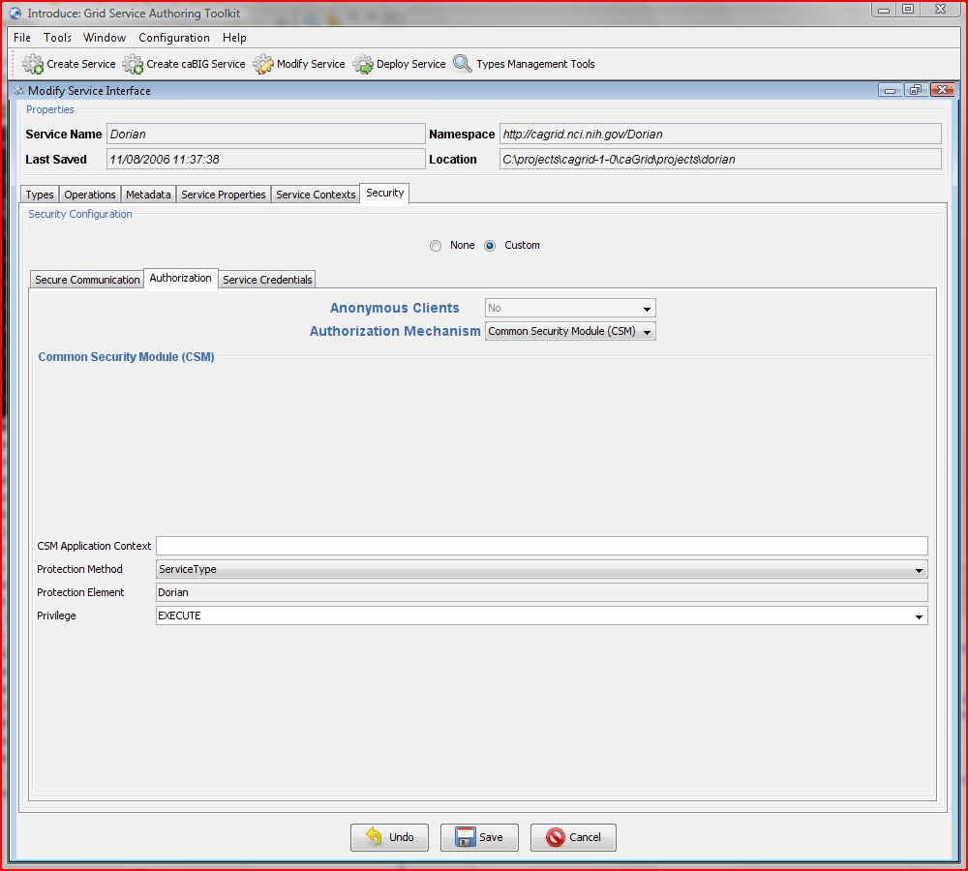
Addressing the Requirements:
Security (authorization cont)
Integration with CSM for authorization policy enforcement
Supports both service and operation level authorization
App. Context
Protection Method
  Service Type
  Service URI
  Custom
Protection Element
Privilege
  Standard CSM
Notes:
caGrid provides Introduce tooling to support the API-based approach. Introduce will generate the code required to use CSMGridAuthorizationManager in your service. One can choose to enforce authorization at the service and/or operation level.

Slide 14
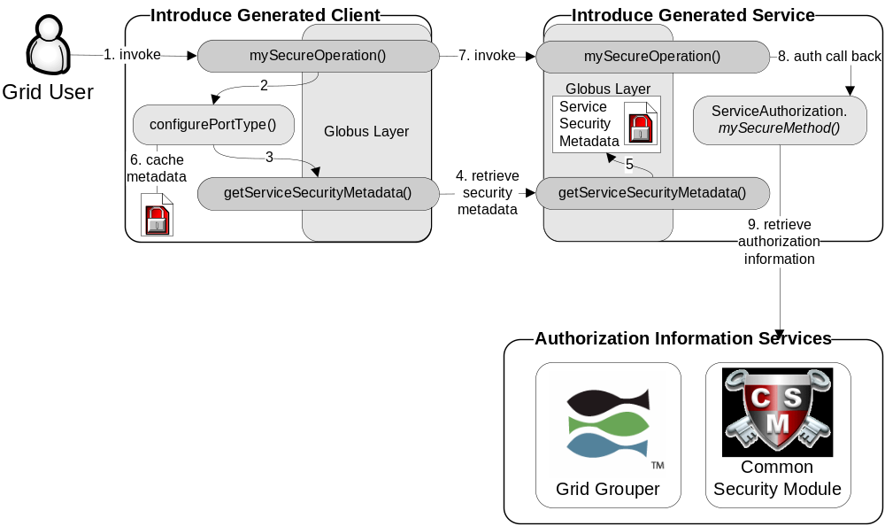
Addressing the Requirements:
Security (example)

