Slide 1


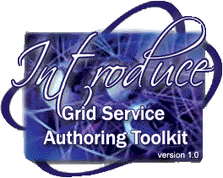
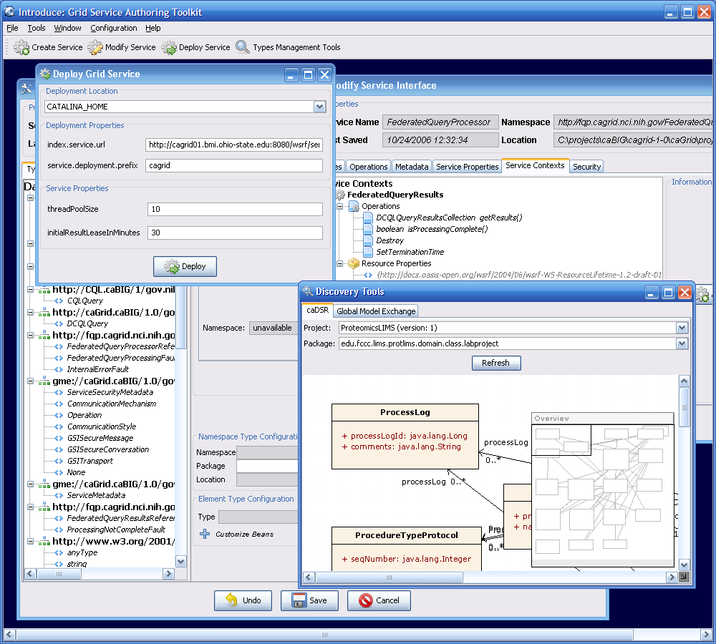
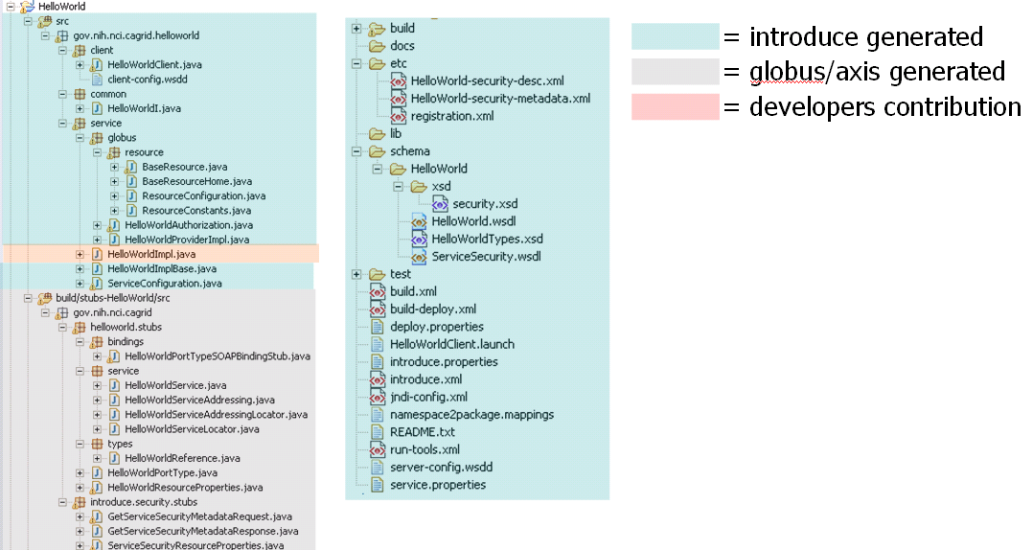
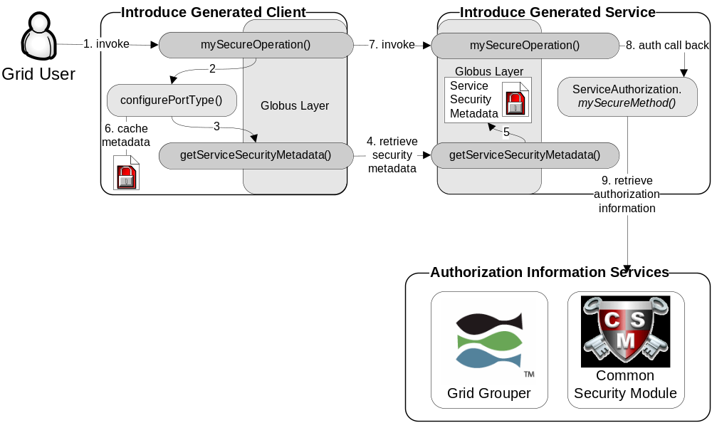
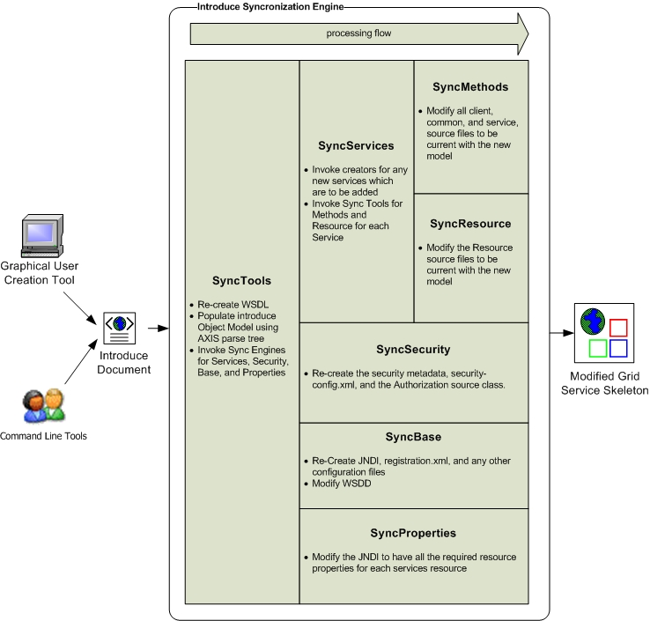
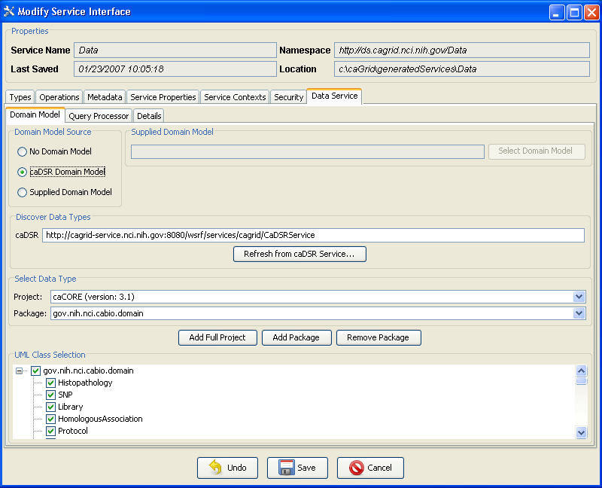
Introduce: Grid Service Authoring Toolkit
Development of Strongly Typed and Interoperable Grid Services
Shannon Hastings, David Ervin, Scott Oster, Stephen Langella, Tahsin Kurc, Joel Saltz
Introduce: an open-source, extensible toolkit to support easy development and deployment of WS/WSRF compliant Grid services. Introduce was designed to be the development platform for caGrid service developers. It’s extensibility has enabled customization to create services specifically designed to meet the needs of caGrid Gold compliant grid services. Introduce aims to reduce the service development and deployment effort by hiding low level details of the Globus Toolkit and to enable the implementation of strongly-typed and semantically harmonized Grid services. It enables easy access to caDSR and GME based data types so that they can be used in analytical routines or by exposing data resources as grid services.
Features
Dynamic discovery and use of published data types
Creates WSDL2.0 / WSRF Compliant Services
Supports Creating Multiple Resource/Services using the WSRF
Globus GSI Security Configuration
CSM and GridGrouper Authorization Support
Resource Property Configuration and Index Service Registration
Rich extension/plug-in framework for creating custom services or adding custom functionality to Introduce
Architecture
Service Model maintains the complete representation of the services, methods, resources, resource properties, data types, security configuration, index service registration, etc
Graphical Development Environment modifies service model and passes the modified model to the engine
Introduce Engine re-syncs the service with changes with the modified model
Use of Java Emitter Templates (JET) for creation and modification of source code and configuration files required in the service
Auto generation of unboxed complete client and stubbed service implementation
Strongly Typed Services
Type discovery extensions enable the discovery and usage of data types which exist in external grid services which act as registries.
Data Service Development
Enabled by leveraging Introduce’s extensible and pluggable design. Both the Graphical Development Environment and code generation facilities are extended and specialized
Automates integration of query method and required data types
Simplifies selection and configuration of exposed data model using caDSR and GME
Allows selection and configuration of query processing engine, responsible for querying a data resource
Provides facilities for both syntactic and semantic query validation
Eases caBIG Gold Level compatibility for existing Silver systems
Specialized wizard interface for moving caCORE SDK systems to the grid
Questions or Comments?
http://dev.globus.org/wiki/Incubator/Introduce

