Slide 1
Biomedical Infrastructure for Community: caCORE and caGrid
Avinash Shanbhag
Director, Core Infrastructure Engineering, NCICB
Sept. 30th, 2008

Slide 2
Agenda
Background on caBIG, caGrid and core infrastructure
Architecture Workspace Activities
caCORE Tools Overview
caGrid Overview

Slide 3
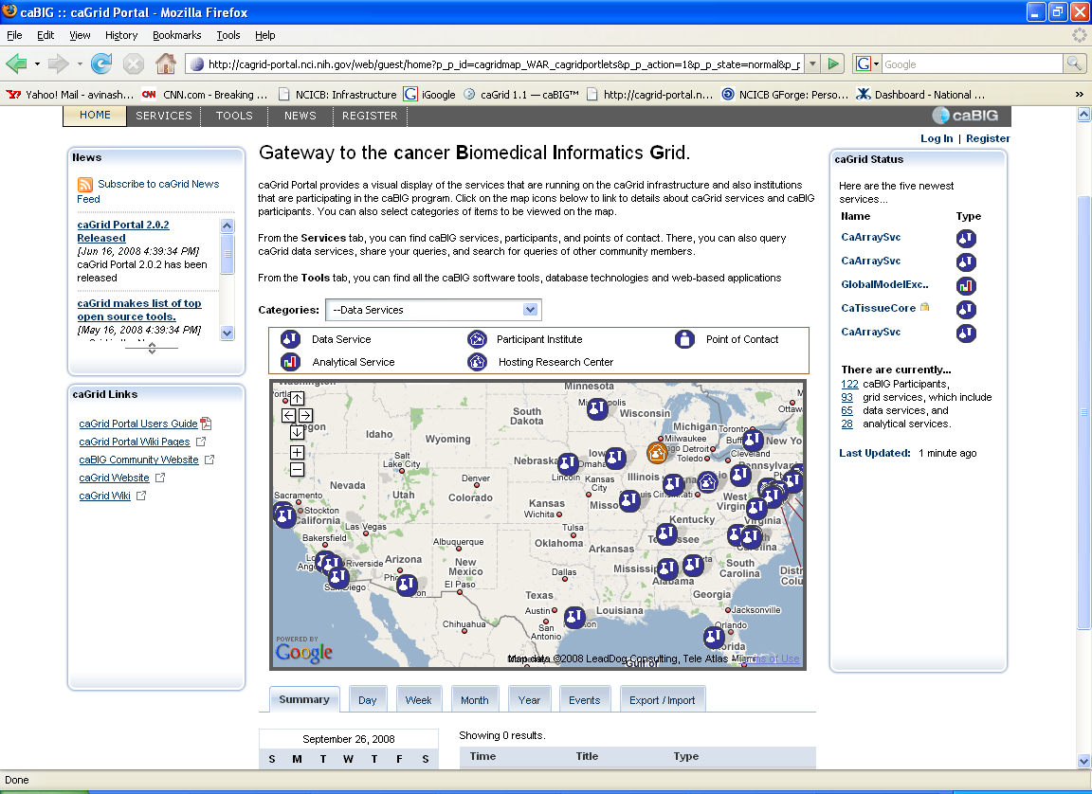
>100 grid services
>50 Institutions

Slide 4
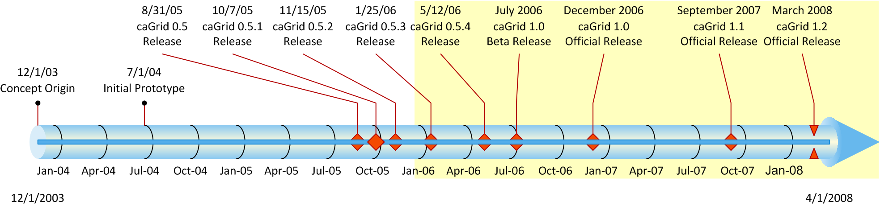
History of caGrid
Developed as the Grid toolkit for caBIG, 2004
caGrid 1.0 was a revolutionary release of the caGrid infrastructure, replacing the 0.5.x test bed stream
The last stable release of caGrid was version 1.2, released mid March 2008

Slide 5
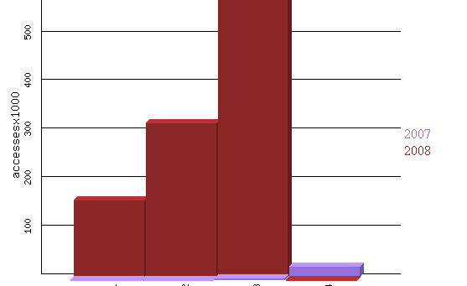
caGrid Community
Number of software downloads (from Gforge): 1041
Number of subscribers to the caGrid users’ listserv: 215
Average number of queries answered/day: 10
Portal Access

Slide 6
caGrid Technologies in Use
caGrid and caCORE technology was listed as “available for reuse” in the Federal National Health Information Network (NHIN) Gateway Solicitation
UK National Cancer Research Institute (NCRI) Informatics Platform is based on caGrid platform
NHLBI’s CardioVascular Research Grid (CVRG) reuses caGrid and makes data available via caBIG compatible interfaces

Slide 7
caBIG Program
Structure

Slide 8
caBIG® Organization
caBIG Program Management and Contracting
Clinical Trials Mgmt Systems
Integrative Cancer Research
In Vivo Imaging
Tissue Banks & Pathology Tools
Strategic Planning
Clinical Sciences
Documen-
tation and Training
Basic Sciences
Data Sharing & Intellectual Capital
Vocabularies and Common Data Elements
Architecture, core infrastructure

Slide 9
Architecture Management
caGrid Technical Management
  Larry Brem
Architecture Workspace Management
  Michael Keller
NCI Management
  Avinash Shanbhag

Slide 10
Key Elements for Interoperability

Slide 11
Interoperability: Defined
  ability of a system to access and use the parts or equipment of another system
Syntactic
interoperability
Semantic
interoperability
Notes:
Fundamental Goal of caBIG. We need to resolve both questions, although at some level the former is easier than the latter. Modern object oriented programming techniques that produce Application Programming Interfaces or APIs, provide a convenient mechanism to connect to and extract information from a system. A more difficult problem is ‘semantic interoperability’, actually understanding the meaning of the content once it is received.

Slide 12
Four Pillars of Interoperability
Interface Integration
Controlled Biomedical Terminology
Data Elements
Information Models
Notes:
With apologies to T.E. Lawrence. These pillars resolve questions of syntactic interoperability (Interface Integration) and Semantic Interoperability (Term and DE’s). Information models bind the semantic and syntactic components. Although technical details vary, a variety of organizations that are looking to build interoperable data systems have concluded that these pillars are required for integration

Slide 13
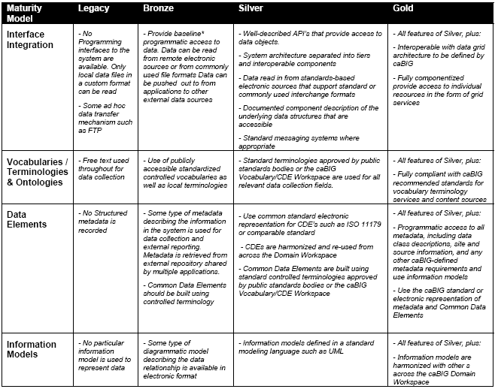
Compatibility Guidelines
Notes:
The caBIG compatibility guidelines are designed to provide a specification that meets the four pillars of interoperability. Without going into great and gory detail about the compatibility guidelines, it is worth noting that there are no formal technology specifications. The key to interoperability with caBIG is the existence of an object-oriented interface bound to semantics rather than the use of any particular interface implementation. So, a caBIG Silver system could utilize WSDL compliant web services, Java, .NET, etc. Binding to caGrid eliminates the technical issues associated with invoking the service, and it means that caBIG compatible systems should be able to communicate (with at most a relatively simple adapter) with any other standards based query or messaging system.

Slide 14
Path to caBIG Compatibility
Step 1: Develop caBIG “Silver” compliant System using caCORE tools and supported infrastructure
Step 2: Grid enable the “silver” System using caGrid tools

Slide 15
caCORE
Developing
“Silver” Compliant System

Slide 16
Modeling for Interoperability
UML Cass diagram models target domain
Logical model is basis for semantic integration
Focus on attributes and relationships of domain objects

Slide 17
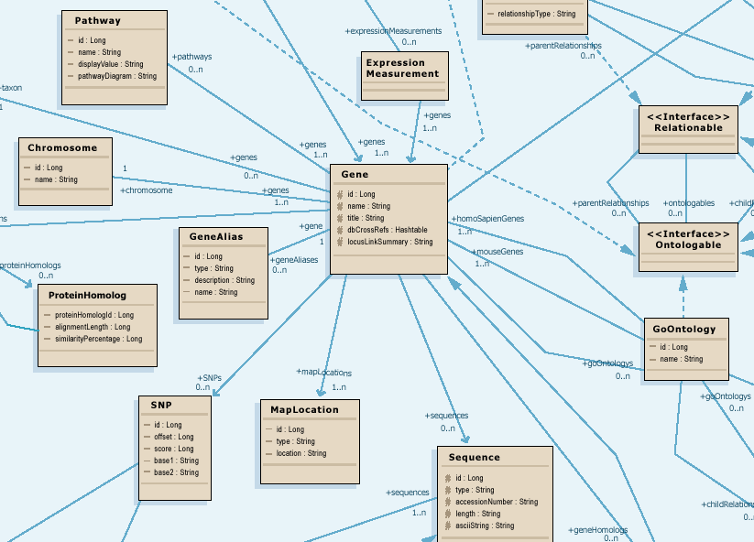
Example UML Class Model

Slide 18

Cancer Data Standards Repository
Implementation of ISO/IEC 11179 Registry for Common Data Elements – units of semantic metadata
Precise specification of Classes, Attributes, Data Types, Permissible Values: Strong typing of data objects.
Tools:
  UML Loader: automatically register UML models as metadata components
  CDE Curation: Fine tune metadata and constrain permissible values with data standards
  Form Builder: Create standards-based data collection forms
  CDE Browser: search and export metadata components

Slide 19

Enterprise Vocabulary Services (EVS)
Controlled vocabulary resources for cancer research community
  Manages the concepts
NCI Thesaurus
  NCI reference terminology (public domain, open source)
  46,000 concepts covering agents, anatomy, biological processes, diseases, genes, gene products, and techniques/equipment
  Built using description logic
  Designed for application development: database coding, searching, and data mining
NCI Metathesaurus
  Online dictionary and thesaurus
  Adaptation of National Library of Medicine’s Unified Medical Language System (UMLS) Metathesaurus
  930,000+ concepts; 2,200,000 terms and phrases
  Built using lexical matching
  Designed for term mapping and document indexing across vocabularies

Slide 20
Foundation for Developing Silver System
caCORE infrastructure
  Model Driven Architecture (UML Model) - OMG
  Terminology Service using Enterprise Vocabulary Service (EVS) – W3C
  Metadata Registration using Cancer Data Standards Repository (caDSR) -ISO
Model Driven Architecture + Computable Semantics =
Platform for Syntactic and Semantic Interoperability

Slide 21
Tools Used for developing Silver or “caCORE-like” System
UML Modeling Tool
  Not supplied as part of the toolkit
  We use Enterprise Architect (EA) at NCICB, but any modeling tool that supports XMI 1.2 with the Rose/Unisys extensions will work
  Open Source tool ArgoUML is supported
caCORE Software Development Kit
  Supplied by NCICB
  Input is an XMI representation of a UML model
  Creates runtime software system with standard client APIs using Domain Model classes
  Provides middleware infrastructure via n-tier architecture
  Provides ability to create XSDs for the model required by grid enablement process
Semantic Integration Workbench
  Supplied by NCICB
  Assists with the semantic integration component by searching for concepts and annotating the XMI representation of a UML model.
UML Loader
  Available at NCICB
  Takes the semantically annotated XMI file, creates appropriate CDEs from the UML model and loads them into the caDSR.
  UML loading is done at NCICB.

Slide 22
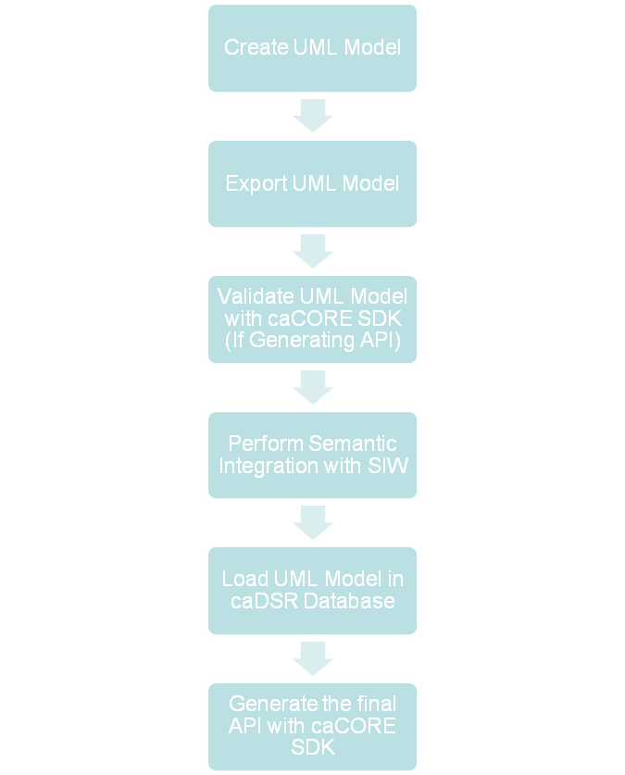
The Silver “Process”
UML Modeling Tool
  Use Enterprise Architect (EA) or ArgoUML
  Export to XMI 1.2
caCORE SDK
  Input is XMI 1.2
  Build System
Semantic Integration Workbench
  Input is XMI 1.2
  Output is XMI annotated with terminology binding
UML Loader
  Input is annotated XMI
  NCICB Staff loads into caDSR

Slide 23
Summary
caCORE
  Standards based architecture and infrastructure for semantic and syntactic interoperable systems
  Set of open source tools to develop caBIG™ “Silver” compatible systems

Slide 24
Use cases not satisfied by caCORE alone
Advertisement
  Service Provider composes service metadata describing the service and publishes it to grid.
Discovery
  Researcher (or application developer) specifies search criteria describing a service of interest
  The research submits the discovery request to a discovery service, which identifies a list of services matching the criteria, and returns the list.
Invocation
  Researcher (or application developer) instantiates the grid service and access its resources

Slide 25

What is caGrid?
A grid based software infrastructure consisting of services, toolkits, APIs, and applications
A production grid deployment of the core services provided by that infrastructure
A community of developers leveraging that grid and infrastructure to provide applications and services to the cancer research community

Slide 26

Platform for Interoperability: caGrid
caCORE
  Terminology Services
  Data element metadata registry
  Model-driven architecture
  Globus based data and analytical service grid
  Strongly typed data objects
  Registered data models
  XML transport format
  Federated security and identity management
  Rapid service creation tools
Mobius
  Global Model Exchange (GME) XML Infrastructure
Globus
  Standards based toolkit for grid computing

Slide 27
History of caGrid
Developed as the Grid toolkit for caBIG, 2004
caGrid 1.0 was a revolutionary release of the caGrid infrastructure, replacing the 0.5.x test bed stream
The last stable release of caGrid was version 1.2, released mid March 2008

Slide 28
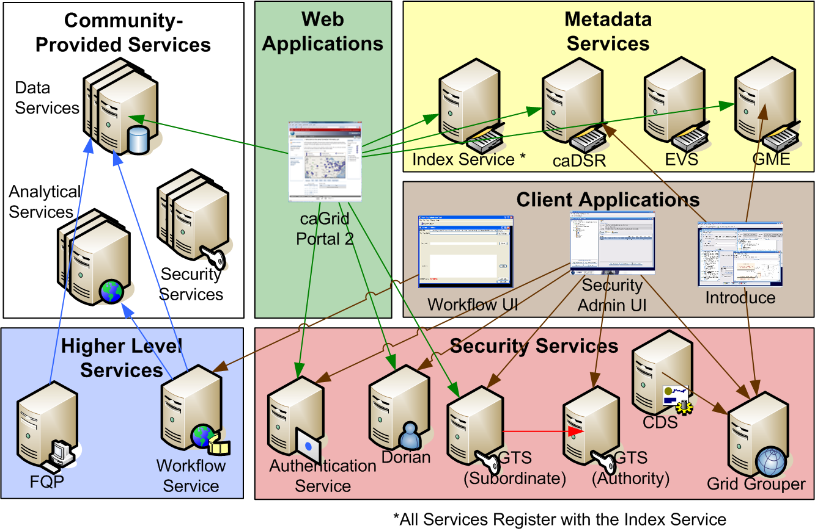
caGrid Production Environment

Slide 29
Grid Enabling
“Silver” Compliant System

Slide 30
Steps to follow for Grid Enabling Silver System
Install caGrid 1.2
Configure installation to “Training” instance of caGrid
Use caGrid Introduce Toolkit to automatically generate a caGrid compliant grid service from caCORE SDK generated system
  This requires loading the SDK generated XSD to Global Model Exchange (GME) service of caGrid prior to creating the grid service
Use the installer to deploy your “Introduce generated” grid service

Slide 31
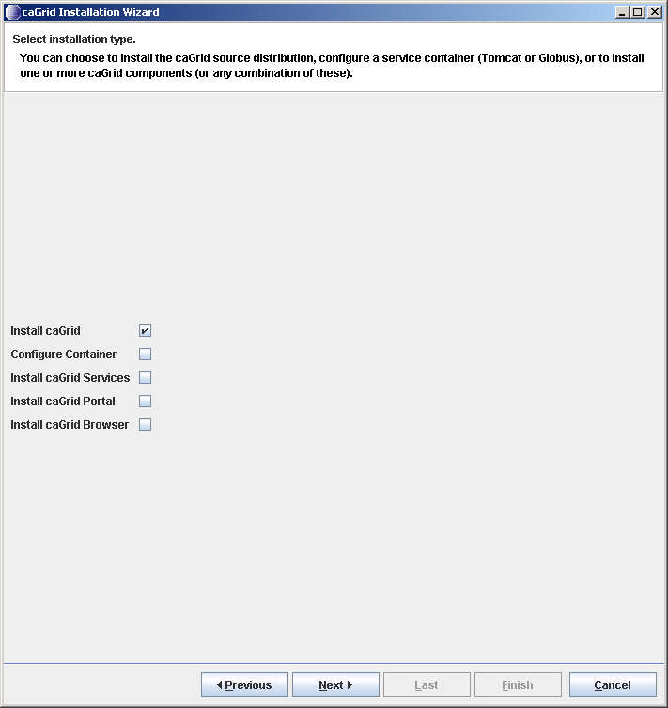
Install caGrid 1.2 and Configure “Training” Environment
Downloads, installs, and configures prerequisites
  Ant, Globus, Tomcat
Downloads, and builds caGrid 1.2
Provides ability to configure service containers
Provides ability to install and configure Introduce built services
Supports “Training” grid deployment used as “sandbox”

Slide 32
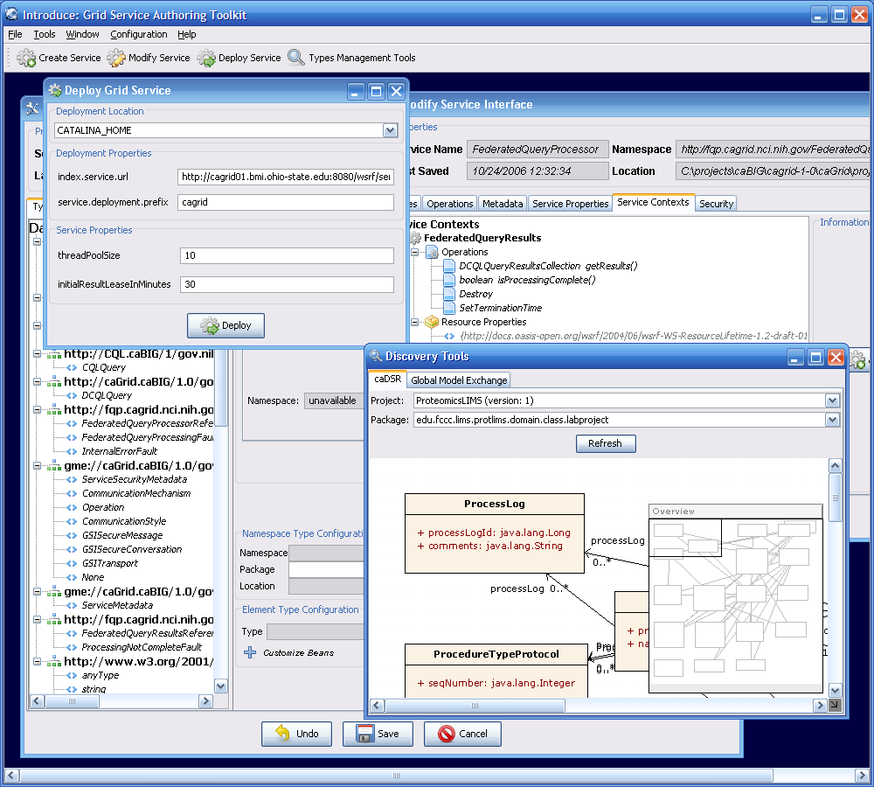
Use Introduce Graphical Development Environment for grid-enablement
GUI for creating and manipulating a grid service
  Provides means to automatically generate a caGrid compliant grid service from caCORE SDK generated system
  Configured to provide:
    Advertisement
    Standard Metadata
    Security
    Complete Client API

Slide 33
caGrid Resources
https://cabig.nci.nih.gov/workspaces/Architecture/caGrid/
www.cagrid.org
  Download Software
  Documentation
  Tutorials
  Technical Paper and Presentations
caGrid GForge Home
  Feature Requests
  Bug Reports
  Downloads / Source Repository
  http://gforge.nci.nih.gov/projects/cagrid-1-0/
caGrid Users Mailing List
  https://list.nih.gov/archives/cagrid_users-l.html
  cagrid_users-l@list.nih.gov

Slide 34
Questions?

