Slide 1
caGrid
Overview

Slide 2
caGrid Team
Ohio State University - Biomedical Informatics Department
  Dave Ervin
  Shannon Hastings
  Tahsin Kurc
  Stephen Langella
  Scott Oster - Chief Architect - caGrid
  Joel Saltz
University of Chicago/Argonne National Laboratory
  Ravi Madduri
  Ian Foster
SemanticBits, LLC.
  Joshua Phillips
Duke Comprehensive Cancer Center
  Patrick McConnell
Ekagra Software Technologies, Ltd.
  Vijay Parmar

Slide 3
caGrid Team (Continued)
Northern Taiga Ventures, Inc. (NTVI)
  Wendy Erickson-Hirons
Science Applications International Corporation (SAIC)
  Aynur Abdurazik
  Ye Wu
Terrapin Systems LLC (TerpSys)
  Chet Bochan
  Vanessa Caldwell
  Craig Fee
  Alan Klink
  Gavin Brennan
NCI - Center for Biomedical Informatics and Information Technology (CBIIT)
  Todd Cox
  George Komatsoulis
  Denise Warzel
  Wendy Patterson
  Mary Jo Deering
Booz Allen Hamilton
  Michael Keller
  Arumani Manisundaram

Slide 4
Agenda
caBIG
caGrid Overview
Exposing resources as grid services
Metadata Infrastructure
Data Services Infrastructure

Slide 5
Driving needs
A multitude of “legacy” information systems, most of which cannot be readily shared between institutions
An absence of tools to connect different databases
An absence of common data formats
A huge and growing volume of data must be collected, analyzed, and made accessible
Few common vocabularies, making it difficult, if not impossible, to interlink diverse research and clinical results
Difficulty in identifying and accessing available resources
An absence of information infrastructure to share data within an institution, or among different institutions

Slide 6

What is caBIG?
Common, widely distributed infrastructure that permits the cancer research community to focus on innovation
Shared, harmonized set of terminology, data elements, and data models that facilitate information exchange
Collection of interoperable applications developed to common standards
Cancer research data available for mining and integration

Slide 7
Interoperability
The ability of multiple systems to exchange information
and to be able to use the information that has been exchanged.
Semantic
interoperability
Syntactic
interoperability

Slide 8

What is caGrid?
A grid based software infrastructure consisting of services, toolkits, APIs, and applications
A production grid deployment of the core services provided by that infrastructure
A community of developers leveraging that grid and infrastructure to provide applications and services to the cancer research community

Slide 9
caGrid Software Infrastructure
Leverage existing technologies:
  caDSR, EVS, Mobius GME: Common data elements, controlled vocabularies, schema management
  Globus Toolkit (currently version 4.0.3)
    Core grid services infrastructure
    Service deployment, service registry, invocation, base security infrastructure
Additional Core Infrastructure
  Higher-level security services
  Grid service access to metadata components (caDSR, EVS, GME, etc)
  Workflow, Federated Query services
Service Provider Tooling (Introduce)
  Graphical service development and configuration environment
  Abstractions from grid service infrastructure for Data and Analytical services
  Deployment wizards
Client Tooling
  Installer
  High-level APIs for interacting with core components and services
  Graphical Tools (administration tools, sample applications, etc

Slide 10
caGrid Quality
Testing
  Unit, System, and Integration
Automated Builds/Tests on multiple nodes
  Nightly (on a schedule)
  Continuous (every CVS check in)
Quality Dashboards
  DART (multi-site, historical archive of quality)
    http://quality.cagrid.org:8081/caGrid-1.0/Dashboard/
  CruiseControl
Code Test Coverage

Slide 11
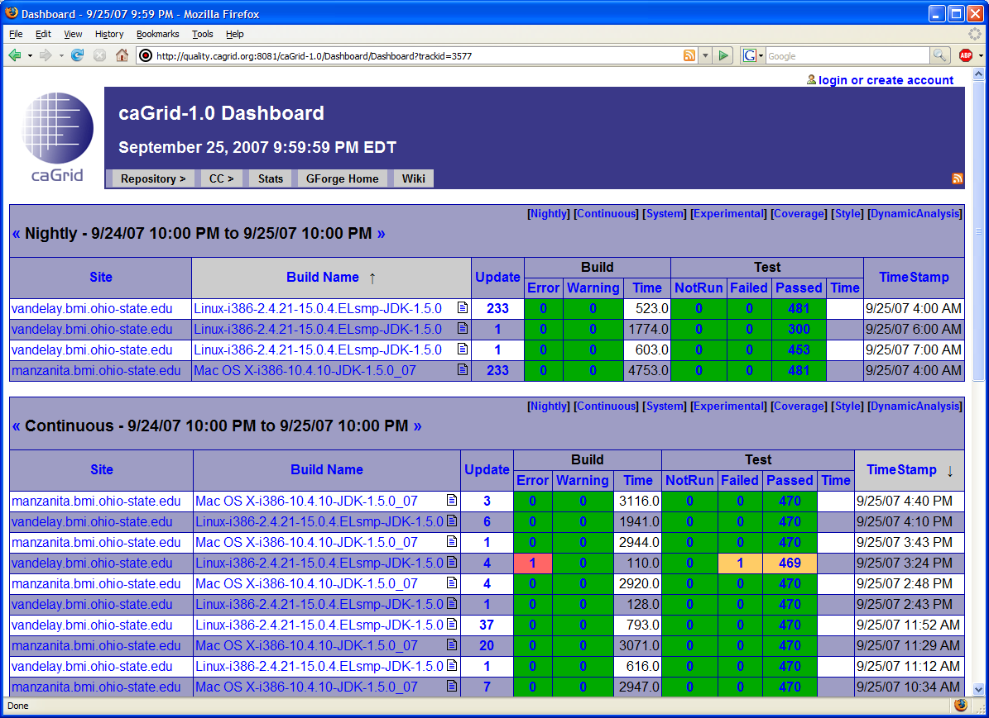
caGrid Quality Dashboard

Slide 12
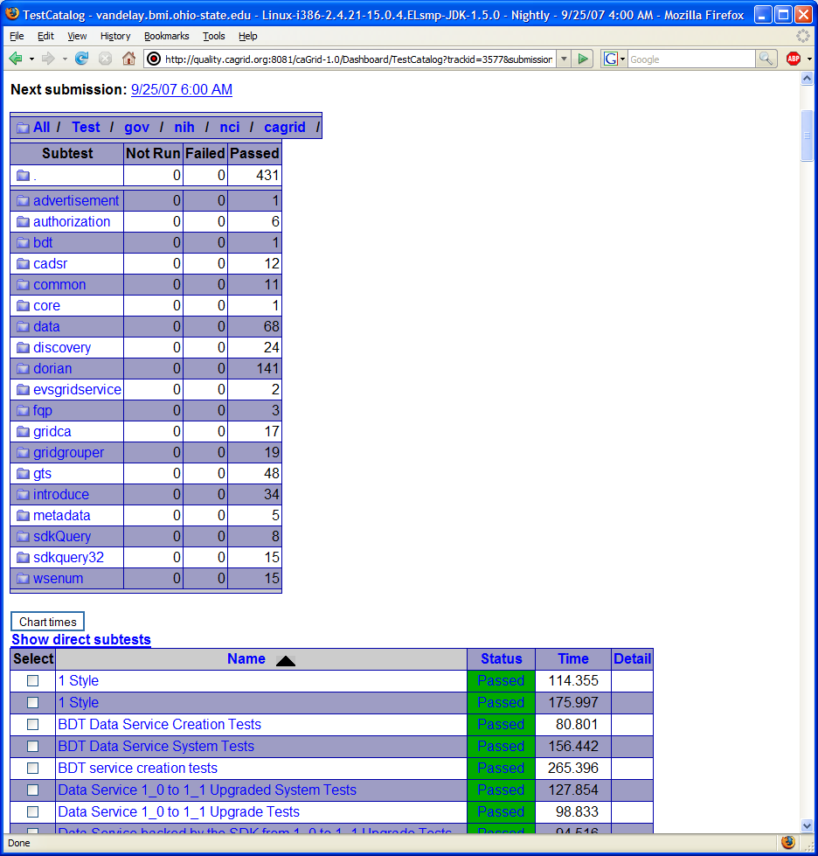
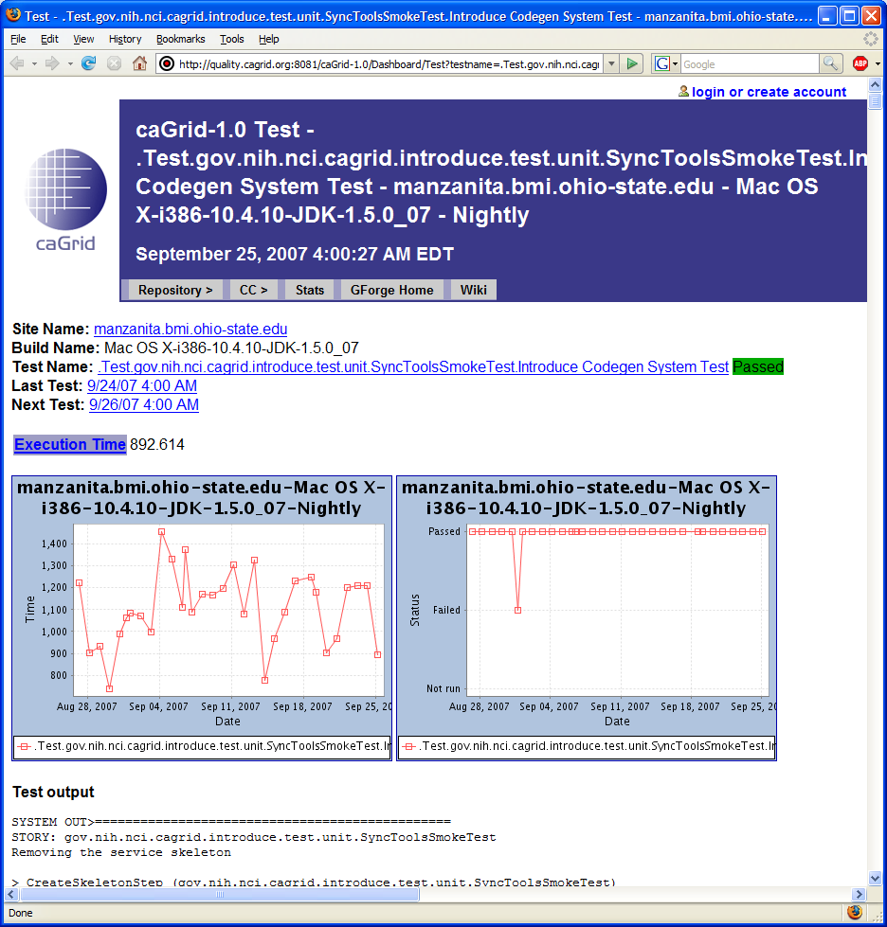
caGrid Quality Dashboard cont.

Slide 13
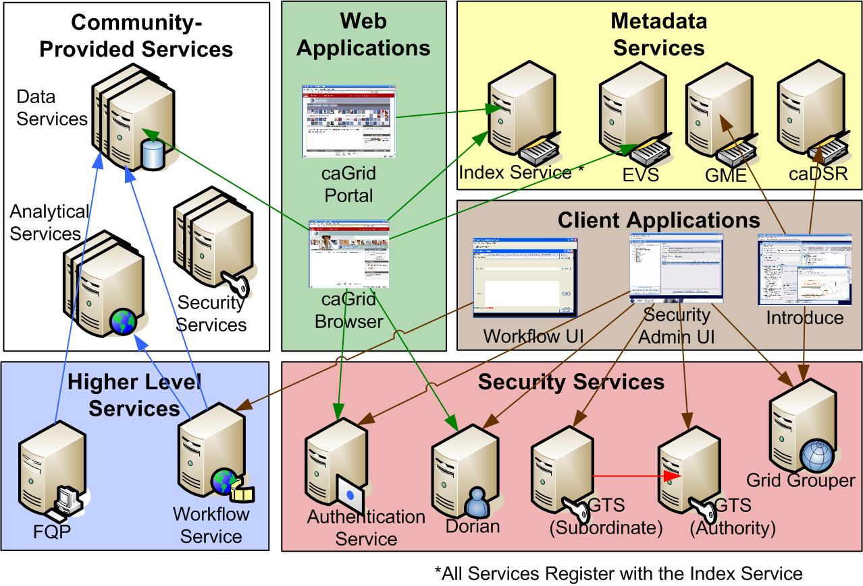
caGrid Production Environment

Slide 14
caGrid Community Involvement
caGrid itself provides no real “data” or “analysis” to caBIG™; its the enabling infrastructure which allows the community to do so
Community members add value to the grid as applications, services, and processes (for example: shared workflows)
  caGrid provides the necessary core services, APIs, and tooling
The real “value” of the grid comes from bringing this information to the “end user”
Community members develop end user applications which consume of the resources provided by the grid

Slide 15
What is a Community Provided caGrid Service?
Silver compatible systems are exposed to the Grid as caGrid Services
  Curated models are used for all data types, and transported over the grid in a common fashion
Standardized, common pattern and mechanism for remote access
  Language and implementation technology independent
Common security infrastructure for authentication and authorization
Standardized service metadata models and metadata advertisement mechanisms
Community provided service types:
  Data Services
    Expose data to the grid in a unified way
  Analytical Services
    Expose analytical operations to the grid

Slide 16
caGrid exposing Silver Systems
Object Oriented APIs and data resources are developed using Object types and information models registered in the Cancer Data Standards Repository (caDSR)
These “silver systems” are grid-enabled by defining a grid service interface that defines the functionality to be exposed to the grid
The grid service interface uses the same Object types as the existing system, but leverages a platform and language neutral representation (XML) of them
The grid service implementation maps service invocations to API calls or queries into the existing system

Slide 17
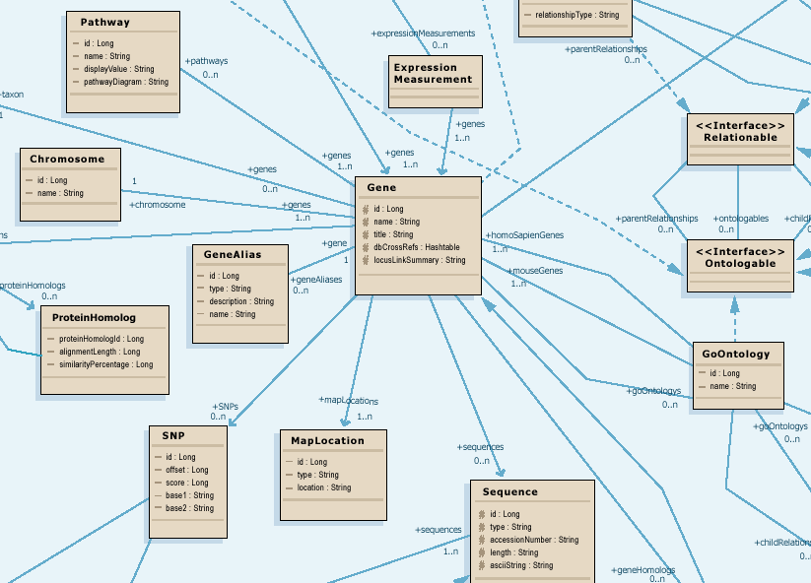
Modeling for Interoperability
Class diagram models target domain
Logical model is basis for semantic integration
Focus on attributes and relationships of domain objects

Slide 18
Data Model Meaning
What do all those data classes and attributes actually mean, anyway?
Data descriptors or “semantic metadata” required
Computable, commonly structured, reusable units of metadata are “Common Data Elements” or CDEs
NCI uses the ISO/IEC 11179 standard for metadata structure and registration

Slide 19

caDSR Mapping of UML to ISO/IEC 11179
UML Class is mapped to an Object Class
Attribute of a UML Class is mapped to a Property
Combination of UML Class and Attribute is mapped to Data Element Concept
Stereotyped caDSR Value Domain Class is mapped to a Value Domain, its attributes as permissible values
Combination of UML Class, Attribute and either it’s Datatype or Value Domain are mapped to Data Element (CDE)
UML Class and it’s attributes, including the Value Domain class and permissible values, are based on EVS concepts
UML Model/Project is mapped to Classification Scheme
Packages are mapped to classification scheme items
UML Model
ISO/IEC 11179
Common Data Element
DEC + Value Domain
UMLClass
Data Element Concept
Object Class + Property
UMLAttribute : UMLDataType
Object Class
Permissible Value
Permissible Value
Property
CADSR Value Domain Class
Value Domain
Permissible Values

Slide 20
Metadata Services
Cancer Data Standards Repository (caDSR)
  caBIG projects register their data models as Common Data Elements (CDEs) which are semantically harmonized and then centrally stored and managed the caDSR
  The caDSR grid service provides:
    Model discovery and traversal
    caGrid standard metadata generation capabilities
Enterprise Vocabulary Services (EVS)
  EVS is set of services and resources that address the need for controlled vocabulary
  The EVS grid service provides:
    Query access to the data semantics and controlled vocabulary managed by the EVS
Global Model Exchange (GME)
  GME is a DNS-like data definition registry and exchange service that is responsible for storing and linking together data models in the form of XML schema.
  The GME grid service provides:
    Access to the authoritative structural representation of data types on the grid
Globus Information Services: Index Service
  The Globus Information Services infrastructure provides a generic framework for aggregation of service metadata, a registry of running Grid services, and a dynamic data-generating and indexing node, suitable for use in a hierarchy or federation of services
  The Index grid service provides:
    Yellow and white pages for the grid

Slide 21
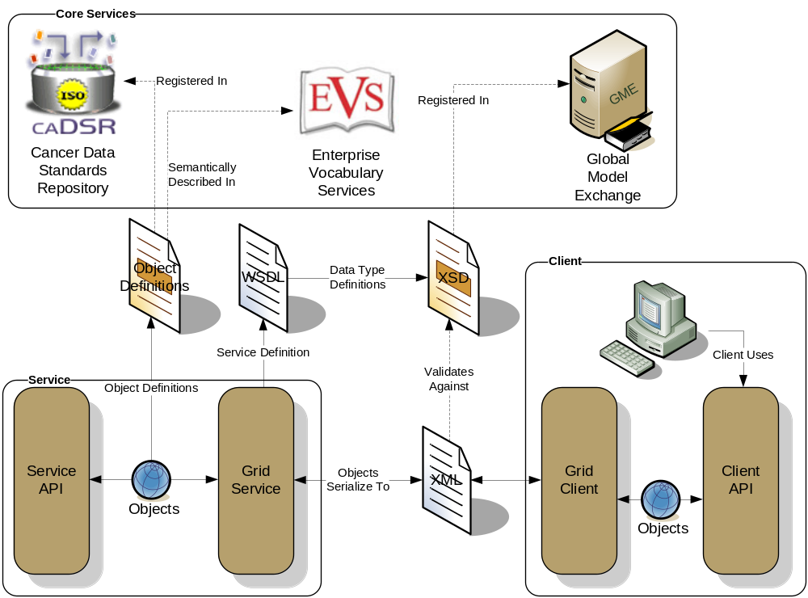
caGrid Data Description Infrastructure
Client and service APIs are object oriented, and operate over well-defined and curated data types
Objects are defined in UML and converted into ISO/IEC 11179 Administered Components, which are in turn registered in the Cancer Data Standards Repository (caDSR)
Object definitions draw from controlled terminology and vocabulary registered in the Enterprise Vocabulary Services (EVS), and their relationships are thus semantically described
XML serialization of objects adhere to XML schemas registered in the Global Model Exchange (GME)

Slide 22
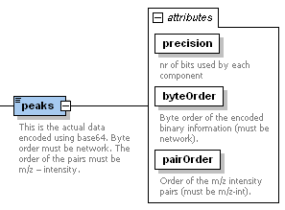
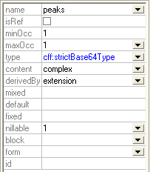
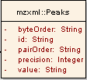
Connecting the caDSR and GME (the problem)
As the caDSR ensures semantic interoperability, the GME ensures programmatic data exchange (syntactic) interoperability on the grid
Many applications need to work at both the CDE level and the XML level
Names different
Attribute or element?
What about Collection associations
?

Slide 23
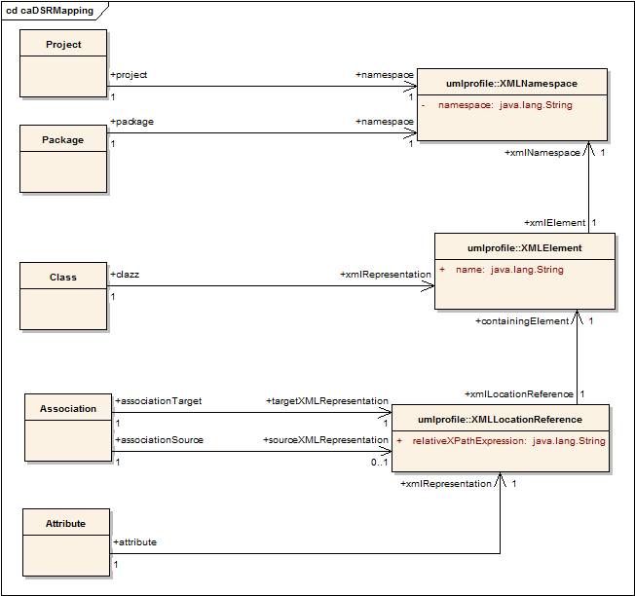
Connecting the caDSR and GME (the solution)
Planned definition of mapping rules specify how a given UML entity is represented in XML over the grid
Maintained in the caDSR, lookup and query available through caDSR grid service

Slide 24
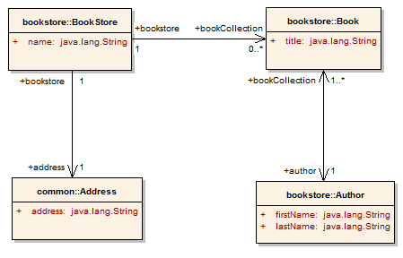
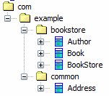
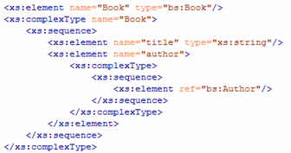
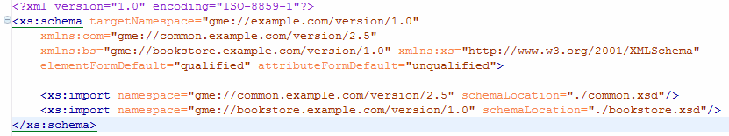
Partial Mapping Example
Project:
BookStore
Version:
1.0
Attribute Mapping
XPath:
title
Element:
Book
Namespace: gme://bookstore.example.com/version/1.0
Project’s Namespace (gme://example.com/version/1.0)

Slide 25
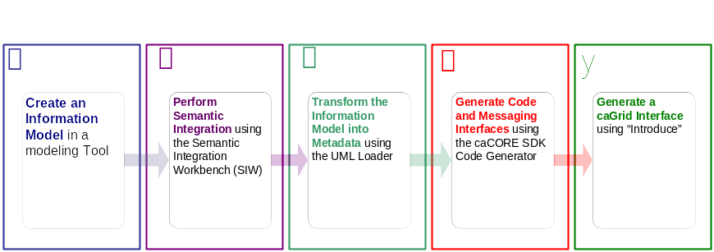




An example development process using caCORE SDK
Create Semantically Harmonized Data Model
Generate
Data Resource
Grid-ify

Slide 26
Demonstration
A caCORE SDK generated data resource which is not connected to the grid.
Grid
caBIO

Slide 27

Exposing the Resource:
We will use the Introduce data service wizard to describe our data resource and generate a grid service.
Grid
caBIO

Slide 28


Exposing the Resource:
Introduce will enable the user to browse data model in the caDSR and chose the ones which they are going to be exposing.
GME
Grid
CQL query
processor
caBIO

Slide 29

Exposing the Resource:
Then they will locate the schemas which describe the data models and will provide the wire protocol for transferring data instances.
GME
Grid
CQL query
processor
caBIO

Slide 30

Exposing the Resource:
Lastly the user will have to provide a CQL query processor to enable CQL query to be executed against the data resource.
GME
Grid
CQL query
processor
caBIO

Slide 31


Exposing the Resource:
Introduce will create a grid service which can expose the data resource we described to the grid
Grid
caGrid
Data
Service
caBIO
caCORE CQL query
processor

Slide 32
Data now available.
Now that our service is generated we can deploy it so that the resource can be used.
Grid
GridService
caBIO
Grid
Service
caGrid
Data
Service
caBIO
caCore CQL query
processor

Slide 33
How will users find me
We need to expose metadata to a registry so that a user/service can locate and use our service
Grid
GridService
caBIO
Grid
Service
caGrid
Data
Service
caBIO
caCore CQL query
processor

Slide 34

How will users find me
We will send our metadata to an index service that can be queried by grid users.
Grid
GridService
caBIO
Grid
Service
caGrid
Data
Service
caBIO
caCore CQL query
processor
Index Service

Slide 35
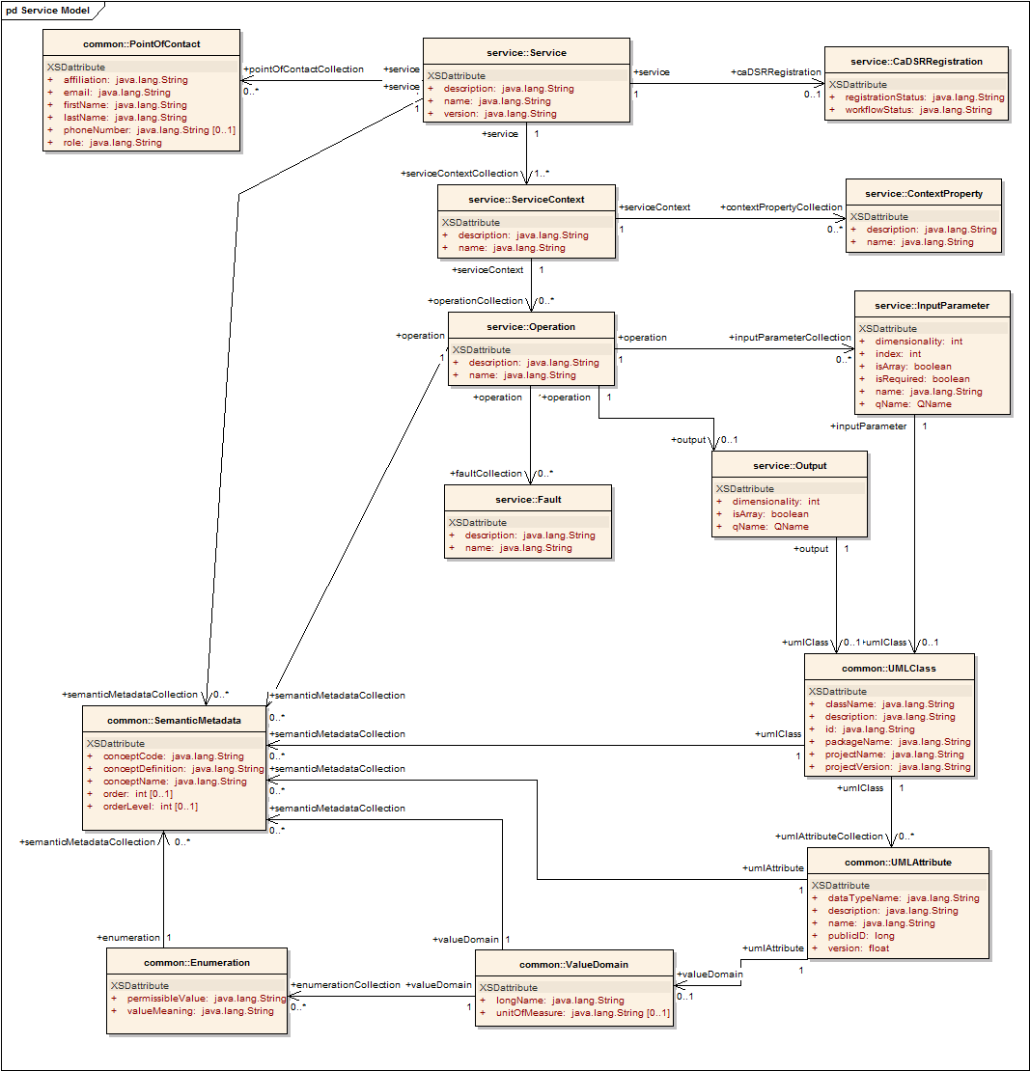
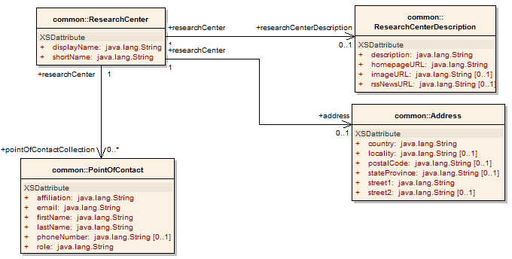
Service Metadata: All Services
Common Service Metadata
  Provided by all services
  Details service’s capabilities, operations, contact information, hosting research center
  Service operation’s inputs and outputs defined in terms of structure and semantics extracted from caDSR and EVS
  Majority auto-generated by Introduce

Slide 36
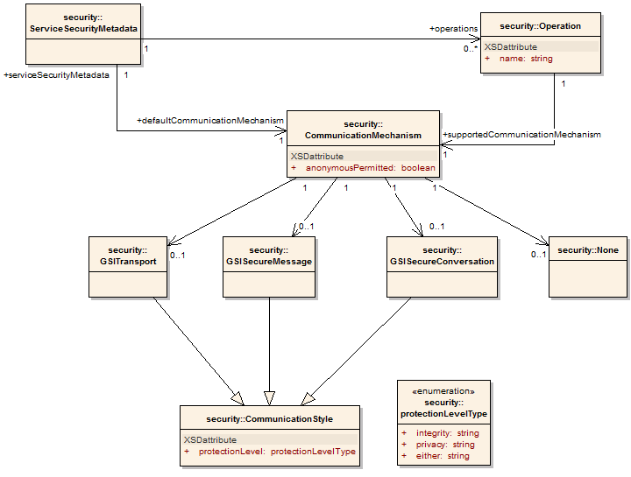
Service Metadata: Service Security
Service Security Metadata
  Provided by all services
  Details the service’s requirements on communication channel for each operation
  Can be used by client to programmatically negotiate an acceptable means of communication
  For example: Does operation X allow anonymous clients, or are credentials required?
  Auto-generated by Introduce

Slide 37
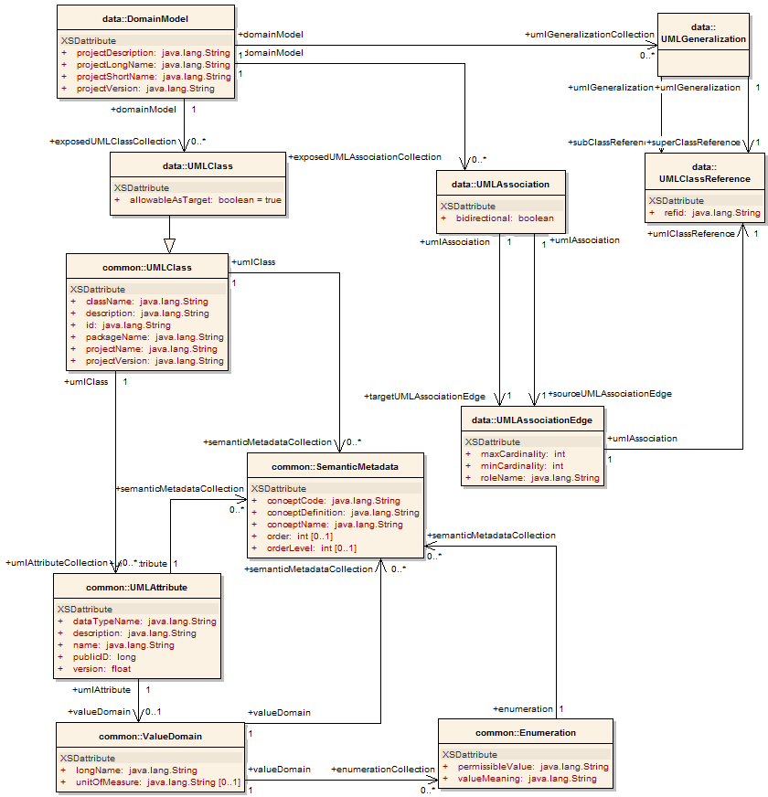
Service Metadata: Data Service
Data Service Metadata
  Provided by all data services
  Describes the Domain Model being exposed, in terms of a UML model linked to semantics
  Provides information needed to formulate the Object-Oriented Query
  As with common metadata, data types defined in terms of structure and semantics extracted from caDSR and EVS
  Auto-generated by Introduce

Slide 38
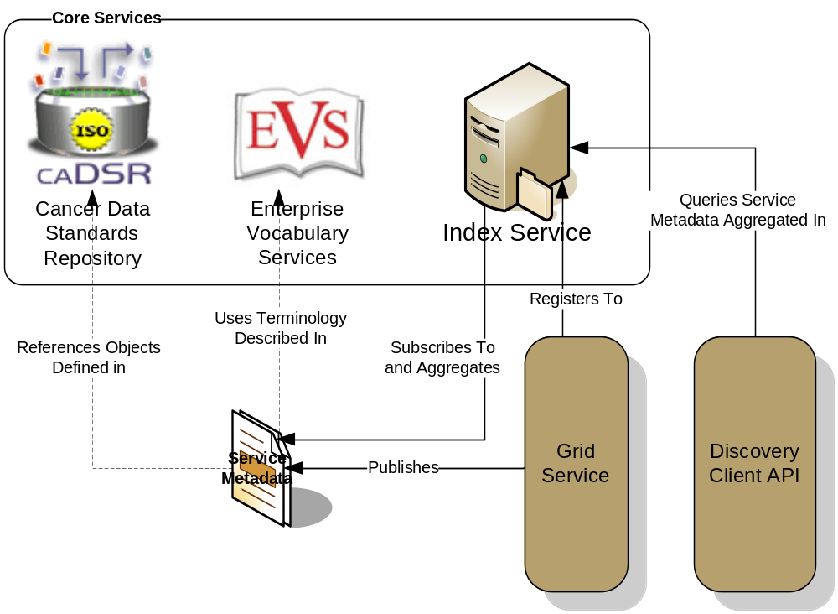
Advertisement and Discovery Process
All services register their service location and metadata information to an Index Service
The Index Service subscribes to the standardized metadata and aggregates their contents
Clients can discover services using a discovery API which facilitates inspection of data types
Leveraging semantic information in EVS (from which service metadata is drawn), services can be discovered by the semantics of their data types

Slide 39
Service Discovery Process
Clients formulate a query over the caGrid standard metadata
  Examples:
    “Find me all the services from Cancer Center X”
    “Which Analytical services take Genes as input?”
    “Which Data services expose data relating to lung cancer?”
    “Find me all the services with some metadata mentioning the string ‘macromolecules’”
This query is sent to the caGrid Index Service which returns the Address of the services satisfying the query
The client can then further interrogate the satisfying services by asking for all of their metadata or service descriptions
Finally the client invokes the desired services as appropriate

Slide 40
Data Service Overview
caGrid Data Services provide capability to expose silver data resources to the Grid
Specialization of caGrid grid services to expose data through a common query interface
  Meet all base service requirements of caGrid services
Present an object view of data sources
  Exposed objects are registered in caDSR and their XML representation in GME
  Data Service Metadata describes information model
  Queries made with CQL Query objects
    Results returned as objects nested in a CQL Query Result Set
Graphical Development tool, implemented as an extension to the Introduce Toolkit, is used to create the new grid service

Slide 41
Data Service Querying
Primary query method
  Required for all data services
  Takes single CQL query parameter
  Returns CQL Query Results instance
Alternate results delivery
  WS-Enumeration
    Returns enumeration context
    Allows client to consume results as it is able
  caGrid Bulk Data Transport (BDT)
    Returns BDT Reference
    Supports WS-Enumeration, WS-Transfer, and GridFTP

Slide 42
Data Service Query Language
Specifies a target object (result) type and selects the instances which satisfy the specified properties and nested object properties
  Allows path navigation
  Provides logical grouping
  Provides name/predicate/value filtering on properties of objects
Recursively defined
Ability to return full Objects, Set of attributes, count of results, or distinct attribute values

Slide 43
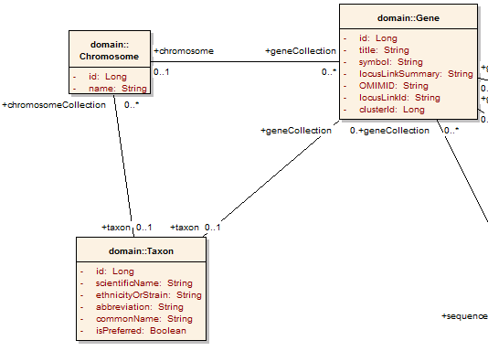
Example CQL Query
Return all Genes with a symbol beginning with BRCA and have an associated Taxon with a scientificName equal to “Homo sapiens”:
<CQLQuery xmlns="http://CQL.caBIG/1/gov.nih.nci.cagrid.CQLQuery"> <Target name="gov.nih.nci.cabio.domain.Gene"> </Target> </CQLQuery>

Slide 44
Example CQL Query
LIKE “BRCA%”
Return all Genes with a symbol beginning with BRCA and have an associated Taxon with a scientificName equal to “Homo sapiens”:
<CQLQuery xmlns="http://CQL.caBIG/1/gov.nih.nci.cagrid.CQLQuery"> <Target name="gov.nih.nci.cabio.domain.Gene"> <Attribute name="symbol" predicate="LIKE“ value="BRCA%"/> </Target> </CQLQuery>

Slide 45
Example CQL Query
LIKE “BRCA%”
Return all Genes with a symbol beginning with BRCA and have an associated Taxon with a scientificName equal to “Homo sapiens”:
<CQLQuery xmlns="http://CQL.caBIG/1/gov.nih.nci.cagrid.CQLQuery"> <Target name="gov.nih.nci.cabio.domain.Gene"> <Group logicRelation="AND"> <Attribute name="symbol" predicate="LIKE“ value="BRCA%"/> <Association roleName="taxon“ name="gov.nih.nci.cabio.domain.Taxon"> </Association> </Group> </Target> </CQLQuery>

Slide 46
Example CQL Query
LIKE “BRCA%”
Return all Genes with a symbol beginning with BRCA and have an associated Taxon with a scientificName equal to “Homo sapiens”:
<CQLQuery xmlns="http://CQL.caBIG/1/gov.nih.nci.cagrid.CQLQuery"> <Target name="gov.nih.nci.cabio.domain.Gene"> <Group logicRelation="AND"> <Attribute name="symbol" predicate="LIKE“ value="BRCA%"/> <Association roleName="taxon“ name="gov.nih.nci.cabio.domain.Taxon"> <Attribute name=“scientificName" predicate=“EQUAL_TO” value=“Homo sapiens"/> </Association> </Group> </Target> </CQLQuery>
= “Homo sapiens”

Slide 47
Federated Query Processor
Provides a mechanism to perform basic distributed aggregations and joins of queries over multiple data services
As caGrid data services all use a uniform query language, CQL, the Federated Query Infrastructure can be used to express queries over any combination of caGrid data services
Federated queries are expressed with a query language, DCQL, which is an extension to CQL to express such concepts as joins, aggregations, and target services
Implemented as a stateful grid service, queries may be executed asynchronously and results retrieved at a later time
  Supports secure deployments wherein result ownership is enforced
Coupled with semantic discovery capabilities of caGrid, provides a powerful framework for data discovery, mining, and integration

Slide 48
Federated Query Language (DCQL)
DCQL derives from CQL
  Hierarchal approach
  Recursively defined
Data Model drives the query
  Underlying data service domain model used
CQL is context dependent
  Depend on data model of target service
DCQL identifies context
  Identifies service each part of the query targets

Slide 49
Federated Query Language (DCQL)
Foreign Association
  Describes a relationship between the containing object and an object on another data service
  Processing results in a new CQL subquery directed to the target data service
Join Condition
  Specifies attribute relationship
  Local and remote attribute names
  Predicate (EQUAL, LESS_THAN, etc)

Slide 50
Workflow Service
Provides capability to describe “orchestrations” of service invocations and data movement
  Uses existing defacto standard language: Business Process Execution Language (BPEL)
    Interoperability with other clients, editors, engines
Implemented as a stateful grid service, workflows can be created, stopped, paused, resumed, and cancelled and results retrieved at a later time
Coupled with semantic discovery, service metadata, and registration of data type structures in caGrid, provides a powerful framework for analyzing data
  Services can be dynamically discovered and federated queries can be invoked as part of a workflow

Slide 51
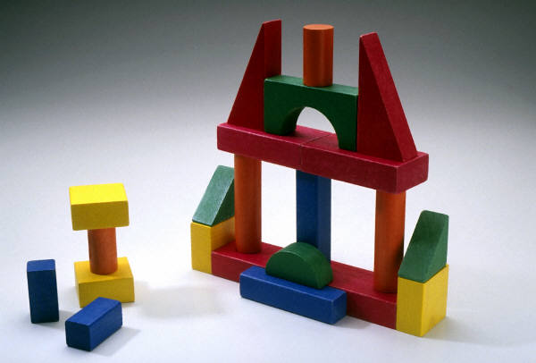
Future Structures from the Building Blocks
The semantic data registration, data type registration, standard service metadata aggregation and registration, and service interface description provide the building blocks for interesting higher level applications and services
Workflow/Data Pathway Discovery
  Create a graph of potential data flow scenarios from one service to another from a starting data type (type matching)
Identify Semantically compatible Services
  Identify services which work with the same EVS concepts, but use different data models (create a data mapping, prompt for harmonization)
Dynamic Graphical Invocation
  Starting with an EVS concept, find Data Services providing data types based on that concept, query for data from one, find Analytical Services operating on that data type, request the WSDL/XSD of the operation, create a GUI dynamically from that information to fill out the additional parameters, invoke the service

Slide 52
caGrid
Overview

Slide 53
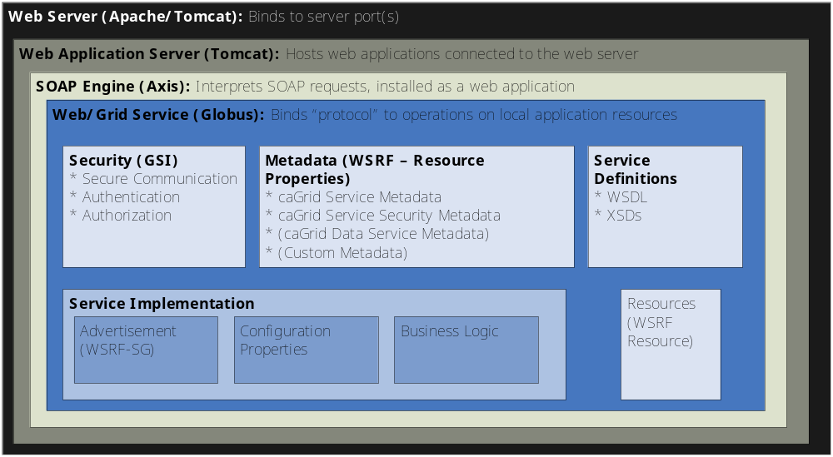
Service Layers

Slide 54
Backup Material

Slide 55
Federated Query Engine
Requires no direct support from Data Services
Joining offloaded to FQP service
Engine may be reused in a client application
  Simplicity over efficiency
  Portability over optimization

Slide 56
Federated Query Engine
Three Core components
Federated Query Engine
  Client facing API accepts DCQL
  Orchestrates use of other components
Federated Query Processor
  Traverses the query, executes engine logic, handles intermediate aggregations
Data Service Executor
  Invokes standard CQL against data services

Slide 57
Federated Query Processor (Functionality)
Converts DCQL to standard CQL
  Traverses query recursively
Foreign Associations are resolved
  Processed against target data service
  Utilizes CQL Query Modifier to obtain attribute values from target
  Produces CQL Group based on result values

Slide 58
Federated Query Client
Three ways to invoke
Execute
  Blocks until processing is complete
  Results maintain information about source
executeAndAggregateResults
  Blocks until processing is complete
  Standard CQL Query Results
executeAsynchronously
  Creates resource to handle processing

Slide 59
Federated Query Security
May be deployed securely (TLS)
  Asynchronous processing uses resource security – Creator only, single gridmap entry
Security configured with Introduce
  Standard Introduce service
  Methods / service may be secured via Introduce
No delegated credentials
  Remote data services must trust FQP service

Slide 60
caGrid exposing caDSR data
In caDSR, nearly all items can be individually versioned, but a specific Project version represents a curated collection of Packages, Classes, and Attributes with consistent semantics
Data is exposed in caGrid as instances defined in a specific Project
  Data Services expose instance data as a subset of Classes from a given Project
  Analytical Services operate over instances of Classes from potentially numerous Projects

Slide 61
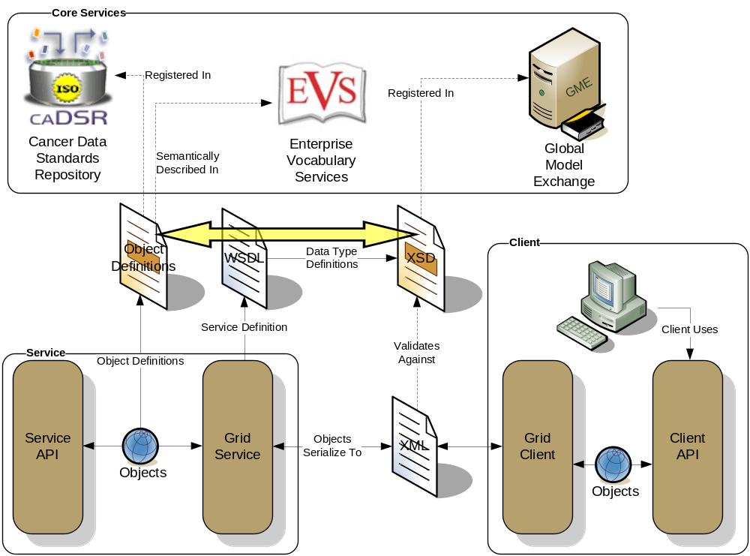
Conceptual View of the Problem

Slide 62
caGrid 0.5 Approach
Previous “solution” was to require an XML Schema for each package that followed a namespace construction rule
Had several limitations:
  Several caBIG projects wish to reuse existing XML Schemas, which have existing namespaces (can’t be changed for interoperability reasons)
  Some uniqueness constraints assumed are not strictly enforced
  Does not support “reverse lookup” (XSD -> caDSR)
  Does not provide fine grain mapping necessary for some applications/infrastructure
  Somewhat prescriptive (namespaces, naming conventions, etc) when ideal solution is entirely descriptive

Slide 63
XML Schema Existence Rules
Each caDSR data object (as part of a specific Project version) used in the grid must have its XML format modeled in an XML Schema that is registered in the GME
Within each data object, the format of its attributes and associations must be modeled in the corresponding XML Schema type
Every caDSR Package (as part of a specific Project version) must have a corresponding XML Schema that is registered in the GME, even if it just imports a series of other XML Schemas and doesn’t define any of its own types
Every caDSR Project must have a corresponding XML Schema registered in the GME; It will most likely just imports a series of other XML Schemas (corresponding to its Packages’ schemas), though it may define its own types
These rules let the XSD modeler create any level of schema granularity from 1 per project, down to 1 per Class, but there is always a defined way to retrieve all of the types for a given Project, Package, and Class

Slide 64
Binding the XML Schemas and caDSR
Preceding rules only detail the necessity of existence of the various XML Schemas and schema entities, they do not specify how a particular instance can be located
A detailed bidirectional mapping/binding between the schema entities and caDSR items is required to support the use cases

Slide 65
Mapping Realization
Planned to be maintained in the caDSR
API to query and lookup bindings
Access will be available through caDSR Grid Service

