Slide 1
Grid Authentication and Authorization with Reliably Distributed Services (GAARDS)
Open Grid Forum 19
January 31, 2007
Chapel Hill, NC
Stephen Langella
Ohio State University
langella@bmi.osu.edu

Slide 2
Agenda
caBIG
caGrid
caGrid Security Overview (GAARDS)

Slide 3
National Cancer Institute 2015 Goal
Relieve suffering and death due to cancer by the year 2015

Slide 4









Cancer Biomedical Informatics Grid (caBIGTM)
Need: Enable investigators and research teams nationwide to combine and leverage their findings and expertise in order to meet NCI 2015 Goal.
Strategy: Create scalable, actively managed organization that will connect members of the NCI-supported cancer enterprise by building a biomedical informatics network
  National Cancer Institute Initiative
  Over 800 Participants
  Over 80 Organizations
  Over 70 Projects

Slide 5
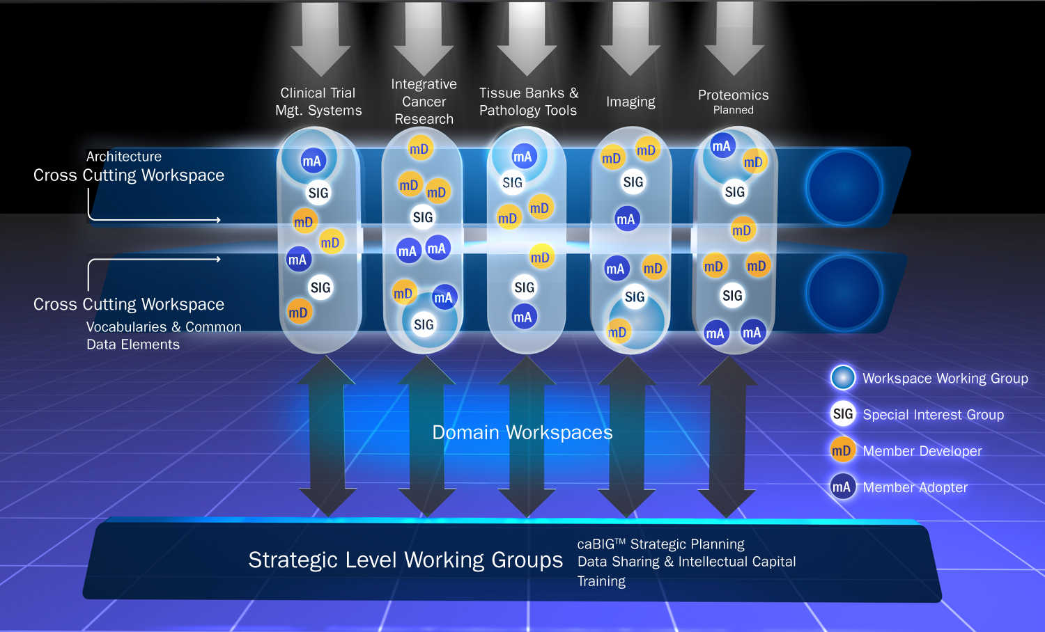
caBIG Community Organization

Slide 6
caGrid
Grid Infrastructure for caBIG
Enterprise Level Grid Components
caGrid Components
  Grid Service Graphical Development Toolkit (Introduce)
  Metadata
  Advertisement and Discovery
  Semantic Services
  Data Service Infrastructure
  Analytical Service Infrastructure
  Identifiers
  Workflow
  Security
www.cagrid.org

