Slide 1
caGrid 1.0 Security
Stephen Langella langella@bmi.osu.edu
Architecture/VCDE Workspaces
Joint Face to Face
February 1st-2nd, 2006

Slide 2
Agenda
Overview
Federated Identity Management
Trust Management
Service Provider Credential Provisioning
Authorization / Virtual Organizations
caGrid Integration

Slide 3
Overview
caGrid 0.5 Security
  Focus was on getting the basic building blocks in place to facilitate the secure deployment of reference implementations in the caBIG test bed.
caGrid 1.0 Security
  Focus is on getting the basic building blocks in place to facilitate the secure deployment of multi-institutional production applications.
  Leveraging/Extending work done in the Grid, caBIG, and other related communities to provide a enterprise solution.
  caGrid implementation efforts are not focused on policy but on providing the building blocks that the community can use for implementing policy.

Slide 4
Overview
What will the infrastructure be based on?
  Relevant existing caGrid 0.5 security
  caGrid 0.5 lessons learned
  caBIG Security Evaluation White Paper
  Use cases submitted by the community
  Requirement Solicitation for caGrid Security
  Architecture Working Groups
What areas will the security infrastructure focus on?
  Federated Identity Management
  Building a Trust Fabric / Trust Management
  Authorization
  Service Provider Credential Provisioning
  Virtual Organizations
  caGrid Integration

Slide 5
Overview
Requirement Solicitation Document for caGrid Security
  Breaks down security into focused Subject Areas
    Federated Identity Management
    Attribute Based Authorization
    Trust Management
    Virtual Organizations
    Service Provider Credential Provisioning
  Identifies issue and raises questions in each subject area
  Solicits the community to help resolve and answer these questions.
Community Participation Encouraged
  Submission of use cases
  Responses to the white paper
  Participation in working groups
  Responses to Requirement Solicitation Document
  Direct contact with caGrid team.

Slide 6
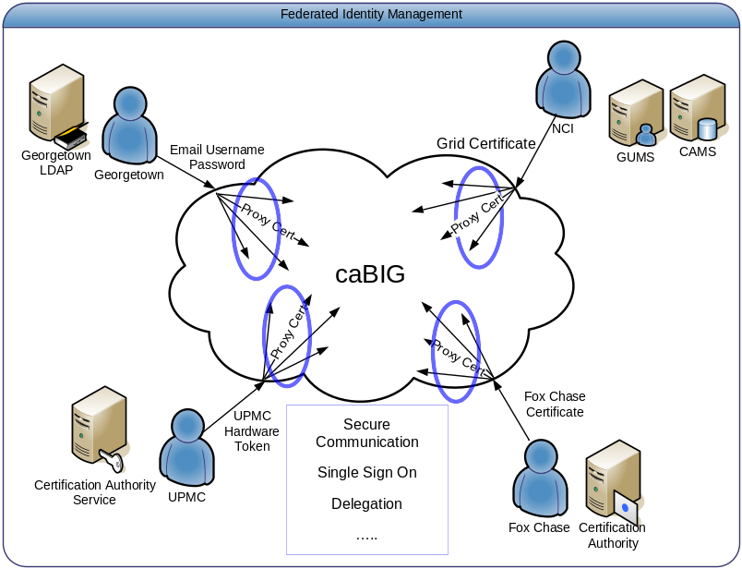
Federated Identity Management - Overview
Major Focus of the caBIG Security Evaluation White Paper
Enable users to use their institution provided identity for authenticating to the Grid.
User should be able to authenticate to the Grid using their institution’s existing mechanisms.
Image taken from the caBIG Security Evaluation White Paper

Slide 7
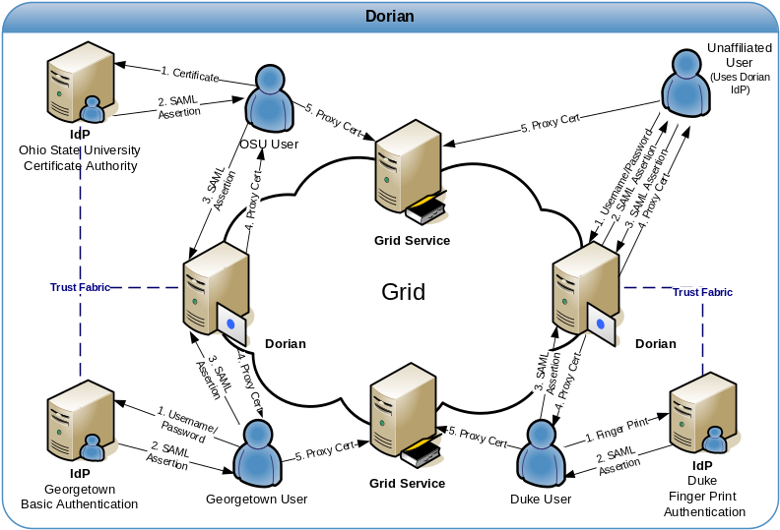
Federated Identity Management – Current Status
Dorian
  Successor of GUMS, redesigned to address Federated Identity Management Requirement.
  WSRF compliant Grid service
  Manages user’s Grid credentials
  Enables users to authenticate and create grid proxies via their institution’s Identity Provider (IdP)
  Internal Dorian IdP allows unaffiliated users or small institutions access to the grid.
  Internal Certificate Authority / ability to integrate with existing Certificate Authorities
  Administration Interface
    Configurable/Extensible User Policies
    User Management
    Trusted IdP Management
  Full Client API / Administrative Portal

Slide 8
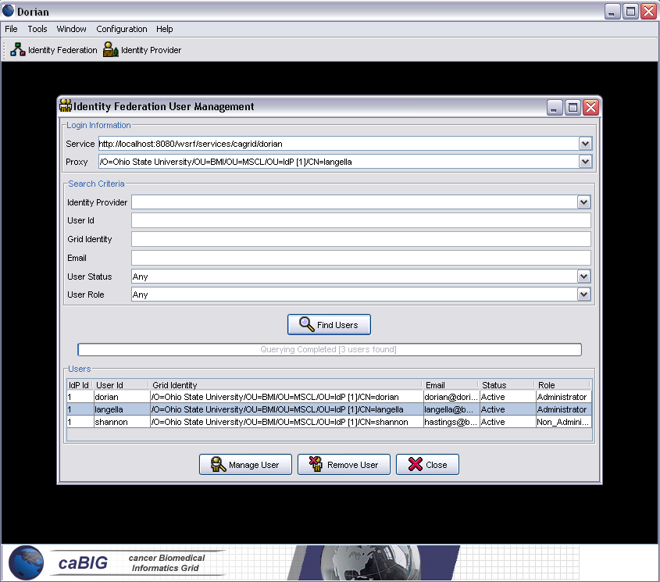
Federated Identity Management
Dorian Current Status
  Initial service implementation completed
  Initial administration portal completed
  Integrated with Ohio State University IdP
  Dorian technical paper completed.
Community Participation Needed
  Community standardization of the SAML authentication assertions.
    Probably will need a small working group with members from ARCH and VCDE
  Early adopters needed
    Integration between Cancer Center IdPs and Dorian

Slide 9
Proposed Federated Identity Management Working Group
Goals
  Develop Cancer Center Integration Process
  Identity Early Adopters to Integrate with Dorian
  Facilitate the Integration Process
  Standardize SAML Authentication Assertions
Timeline
  1-2 Months

Slide 10
Service Provider Credential Provisioning
In order for services to invoke other services, they will need to have credentials.
How will service credentials be provisioned and at what level?
  Services use host credentials
  Services are assigned their own credentials
  Services run as users. (Leverage user credentials)
Current Approach (Globus, caGrid 0.5)
  Service Provider (SP) creates a certificate request.
  SP emails request to a CA administrator for approval
  CA administrator signs request and mails back to SP.
  SP copies relevant files around and configures service to use credentials.
  Cons
    Security is configured separately from the rest of the service. (Outside of Introduce)
    Long turnaround time as opposed to a “real time” approach.
    Hands-on.

Slide 11
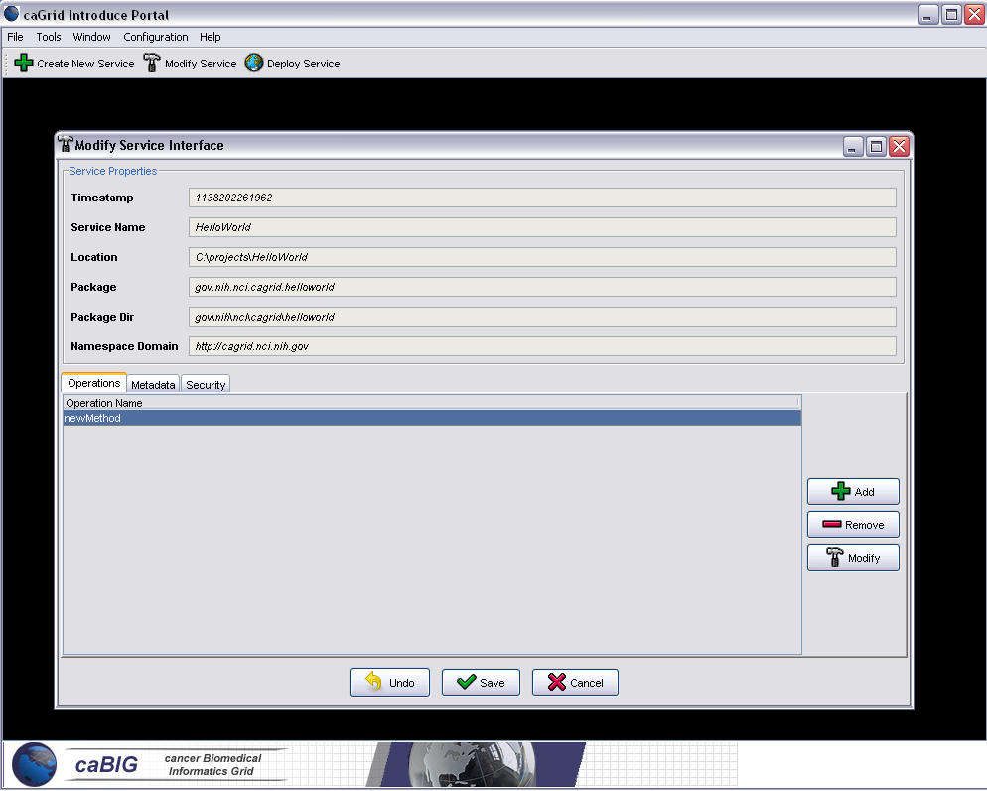
Service Provider Credential Provisioning
Recommended Approach
  Streamline service credential assignment using Introduce Toolkit
  Instantiate an Online Certificate Authority (OnlineCA).
  Service credentials are created and assigned through the Introduce Toolkit at deployment time.
  Introduce Toolkit communicates with OnlineCA to obtain credentials.
  OnlineCA would only issue credentials to authorized users.

Slide 12
Trust Management
PKI (Public Key Infrastructure) is the cornerstone of grid security; grid users authenticate themselves to the grid via certificates.
Grid Services accept certificates as valid credentials if they are signed by trusted authorities.
Grid services must be configured to trust certificate authorities
Current Approach (Globus, caGrid 0.5)
  Service Container and or Service can be configured by specifying a trusted ca certificates directory in the server/service configuration directory.
  Drawbacks
    Hard for grid administrators to manage.
    Every time a new trusted authority comes on line, all the services in the grid must re-configured to trust that authority

Slide 13
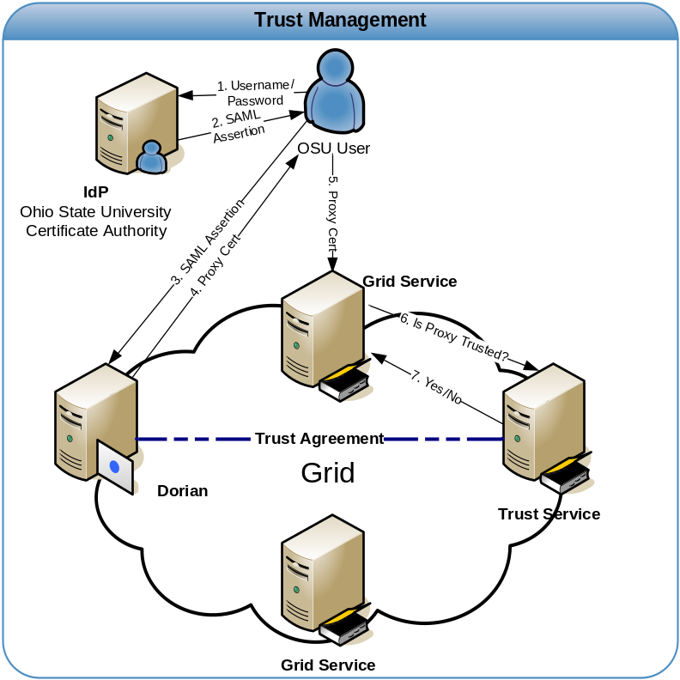
Trust Management
Trust / Validation Service Approach
  Create a Trust Service for Managing Trusted Authorities
  Pros
    Much easier to manage.
    More up to date
    Support for CRLS
  Cons
    Implementation Required
    Performance Tradeoff
  Issues
    Trust Levels
    Centralized, Distributed, Other?
    Caching and Performance
  Current Planned Approach
    In Design Phase
    Implementation Start (1-2 months)
    Community Participation Encouraged

Slide 14
Authorization - Overview
Authorization is finding out if the person, once identified, is permitted to have the resource. Authorization is equivalent to checking the guest list at an exclusive party, or checking for your ticket when you go to the opera.
Authorization Mechanisms
  Host/Domain/Identity Authorization
  Attribute Based Authorization
  VO/Role/Group Based Authorization
  Integration with existing Authorization Systems.
  Many More….
In caGrid we want to empower service providers to make authorization decisions.
We will provide a callout mechanism which service providers can implement for providing custom authorization.
  Empowers authorization decisions to be made locally.

Slide 15
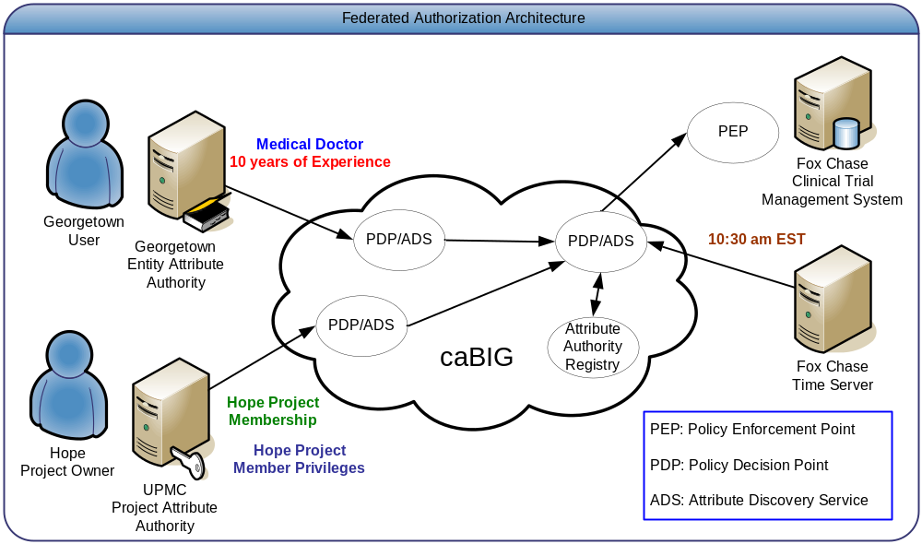
Attribute Based Authorization
Services use available user attributes for determining authorization.
Service obtain attributes from an attribute authority.
Do we need attribute based authorization in caBIG or is a more simplistic approach sufficient?
Image taken from the caBIG Security Evaluation White Paper

Slide 16
Attribute Based Authorization
Issues
1.0 Attribute Standardization
    1.1 What is the process for standardizing attributes?
    1.2 What attributes are required for all users?
  2.0 Attribute Management
  2.1 Who will be responsible for persisting user attributes? Institutions? Grid? Both?
  2.2 How and when will attributes be created? What if they already exist?
  2.3 Is their a need to be able to create/update attributes through the Grid?
  2.4 How will access to attributes be controlled?
  2.5 Can there be multiple attribute authorities for a given user?
  3.0 Attribute Discovery and Resolution?
  3.1 How will a service provider determine where to get a particular attribute from?
  (This can get very complicated if users have multiple attribute authorities)

Slide 17
Virtual Organizations
Virtual Organization (VO)
  Users with common attributes should be able to be grouped into organizations based on common characteristics, and should be able to manage resource usage, permissions, and group membership.
Organize users in Virtual Organization (VOs) based on shared characteristics.
  Application VOs
  Clinical Trial VOs
  caGrid Administrator VO
VOs can exist at any level, they can be shared across the grid, or used by just one application
VOs cross organizational boundaries
Requires a VO Management at the Grid Layer
Group/Role Base Authorization
  Services can authorize users based on whether they have a certain role (within a specified VO)

Slide 18
Authorization Summary
VO/Group Authorization
  More Static
    Easy to determine which users have access to you resources.
    Tighter Control
  Does not take a heroic community standardization effort.
    Need a VO, create one.
    Standard Groups should exist.
  From a policy and technical point of view there are far less issues to resolve.
  Easier to deploy and implement.
Attribute Based Authorization
  More Dynamic
    Users do not have to be added to a group to leverage a service, if they have an attribute they will be allowed.
  More Refined Authorization
    Services can obtain information about a user which might be useful in making an authorization decision.
How do we get the benefits of both?

Slide 19
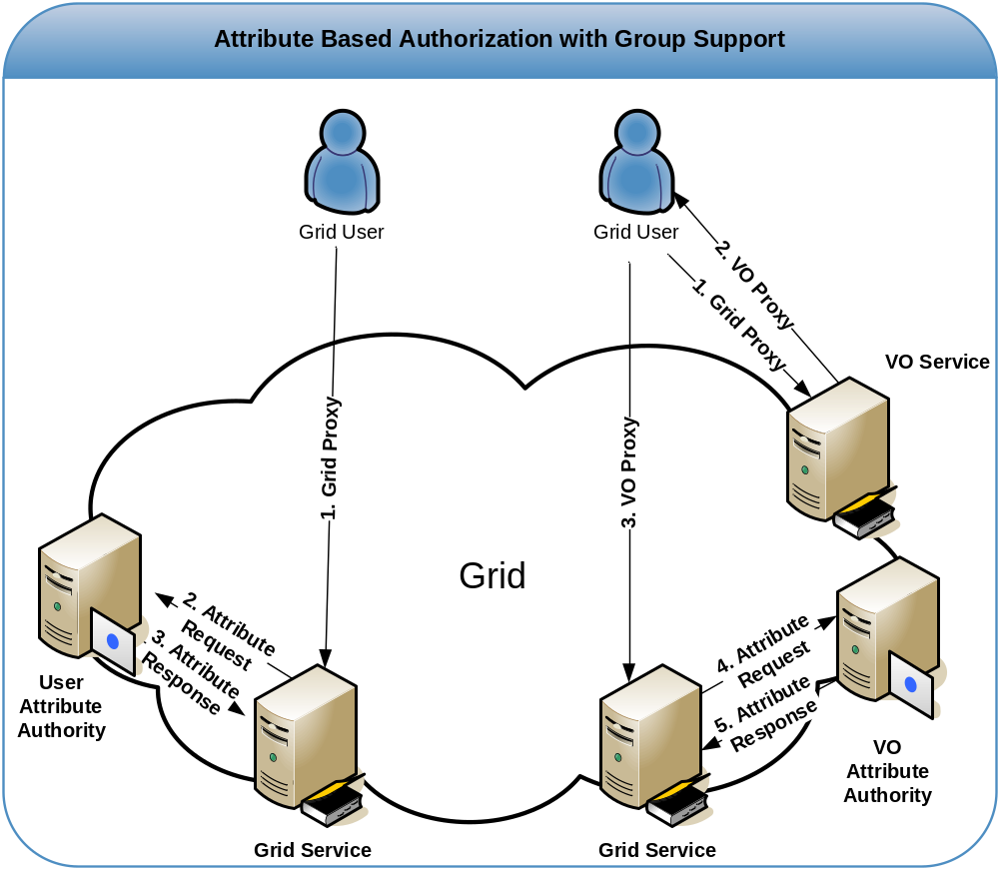
Authorization (Possible Approach)

Slide 20
Proposed Authorization Working Group
Goals
  Identify what is needed in terms of Grid Infrastructure such that services may efficiently make authorization decisions.
  Identify and resolve issues with the infrastructure identified.
  Spawn additional working groups if needed.
  Recommendation Document
    Overview of Review
    Choices Made
    Issues / Resolution
Timeline
  2-3 Months

Slide 21
caGrid Integration
Streamline all aspects of security into the service development and deployment process.
Introduce Toolkit
  Development Toolkit for building and deploying caGrid 1.0 Services
  Service Security will be configurable through the Introduce Toolkit.

