Slide 1
caGrid 0.5 Reference Implementations
caBIG Annual Meeting
April 9th-11th, 2006

Slide 2
Agenda
caGrid Architecture Overview
  caGrid 0.5
  caGrid 1.0
Need for and use of
Reference Implementations

Slide 3
caGrid Overview
Development project of Architecture Workspace, aimed at helping define and implement Gold Compliance
No requirements on implementation technology will be necessary for Gold compliance
  Specifications will be created defining requirements for interoperability
  caGrid provides core infrastructure, and tooling to provide “a way” to achieve Gold compliance
Gold compliance creates the G in caBIG
  Gold => Grid => connecting Silver Systems

Slide 4
caGrid 0.5
Prototype release of caGrid architecture and tools.
  September 05
Provides core services for data type discovery, metadata registration and security.
  caGrid Index Service
  Global Model Exchange
  CAMS / GUMS
Provides tools for creating “gold” services from inception through grid service deployment.
  Analytical and Data creation
  Schema types discovery
  Basic service security

Slide 5
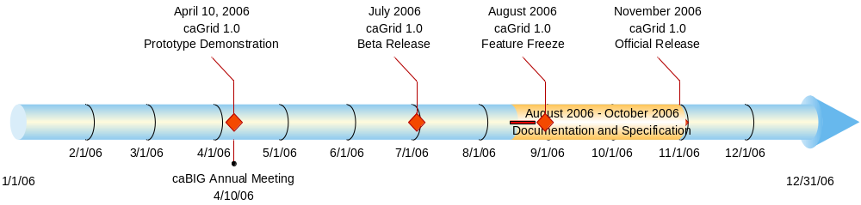
caGrid 1.0
New Features:
Introduce Grid Service Authoring Toolkit
Dorian Identity Management and Federation Service
Workflow Support
Grid Identifiers
Production Level Packaging

Slide 6
Reference Implementations
3 caGrid0.5 reference implementations spanning all basic styles of grid services as well as service level security.
  RProteomics
    Duke (Patrick McConnell)
  PIR
    Georgetown (Baris Suzek)
  caTies
    Pittsburgh (Rebecca Crowley)

Slide 7
The Need for Reference Implementations
Reference implementers are able to provide valuable feedback to caBIG in many forms.
  Performance Problems
  Usability
  Missing pieces
  Convenience tools
  Errors
Reference implementation teams are able to be the first groups to get hands on experience with the caGrid tools.

Slide 8
The Use of Reference Implementations
Valuable and continuous information about analytical and data service support was obtained via reference implementations from the RProteomics and PIR teams.
  Analytical tool errors and support
    Continual feedback from RProteomics during the development process
  Desire to better handle moving around large objects
    Request for identifiers support to be able to pass pointers to large objects without paying the cost of data transfer
  Data service creation framework feedback
Critical feedback about service security and security policy was provided by caTies.
  Unify caCORE SDK, caGRID 1.0 security
      Need for single web application entry point with GSI security
      Can GT4 GSI provide fine-grained CSM-like security?
      Can security provisioning be simplified?
  Need for an Authorization Manager
      User provisioning nightmare. Need a more centralized mechanism for managing user attributes.
  Need for a more versatile Application Level security solution
  Need for support for collaborative research - “Virtual Organizations”.

Slide 9
Project Resources and Communication
caGrid 1.0 GForge Home:
  Feature Requests
  Bug Reports
  Discussion Forums
  Public Wiki
  Downloads / Source Repository
  http://gforge.nci.nih.gov/projects/cagrid-1-0/
caGrid Users Mailing List
  https://list.nih.gov/archives/cagrid_users-l.html
  cagrid_users-l@list.nih.gov
Architecture Workspace
  Community direction from Working Groups
  Report out and feedback during WS calls

