Slide 1
caGrid Reference Implementation Plan
Architecture/VCDE Workspaces
Joint Face to Face
July 12-14, 2006
Patrick McConnell
Duke Comprehensive Cancer Center

Slide 2
Agenda
Reference implementation goals
ICR
  caTRIP, caBioconductor, GenePattern, geWorkbench, GeneConnect
TBPT
  Integrated caTissue Suite
Imaging
  GridCAD, NCIA
Next steps
  Timelines, using beta 1.0, team interactions
Discussion

Slide 3
Reference implementation goals
Cover variety of services, domains, object models
Both analytical and data services
Cover full range of caGrid features/tooling
  Security, identifiers, workflow, metadata, advertisement, discovery, enumeration, Introduce, etc.
Variety of security needs
  Authentication: different types of IdP integrations
  Authorization: different granularities and schemes
Different types of data
  Large, small, many records, few records
Low hanging fruit

Slide 4
caTRIP overview
Cancer Translational Research Informatics Platform
  Bench-to-bedside
  Problem scenario: outcomes analysis
Gridifying a number of TBPT, CTMS, and basic science models into data services
  caTissue CORE: tissue banking data
  caTIES: pathology reports (free text + keywords)
  CAE: clinical annotations (pathology results)
  CTOM: clinical data (specifically trials)
  caIntegrator: SNP (Illumina)
Extending caGrid federated querying processor (FQP) – will be called DQE
  Enhancing DCQL
Securing patient data

Slide 5
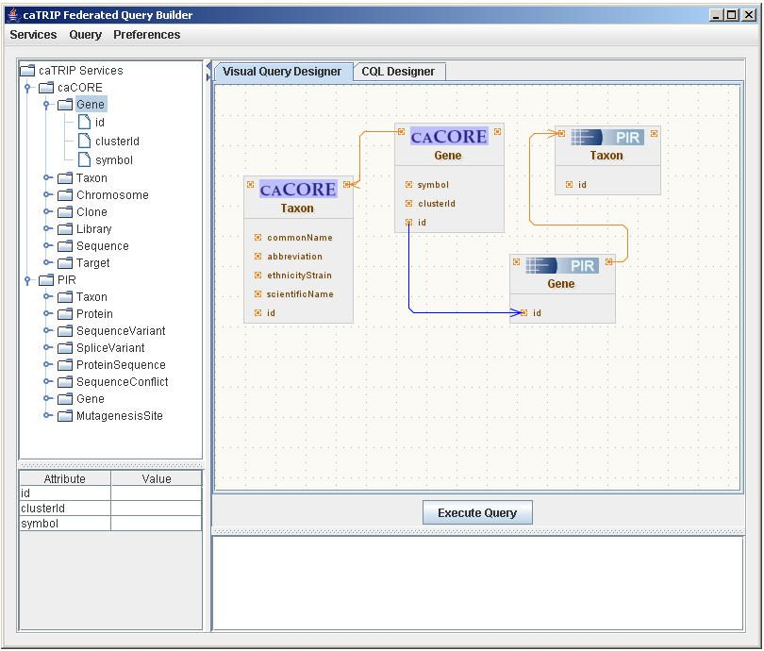
caTRIP screenshot

Slide 6
caTRIP as a reference implementation
Expose a number of data services
  Advertisement (local IndexService)
  Potentially use enumeration
  Potentially use identifiers
  Use Introduce
Integrate discovery into GUI
Use (and enhance) FQP
Heavily use security infrastructure
  Authentication: plugin to IdP service
  Authorization: utilize grid authorization via CSM

Slide 7

caBioconductor overview
Bioconductor is a collection of open-source software components based on the R programming language
Bioconductor is used for gene expression and other high-throughput analysis in molecular biology
  Statistical analysis
  Microarray, SAGE, SNP, proteomics, array CGH, others
Analytics accessible primarily through the R programming language
Focus is developing tools to automate the development of converting existing Bioconductor packages to silver and ultimately gold analytical services

Slide 8
caBioconductor as a reference implementation
Expose analytic services
  Microarray analysis: useful to community
  Proteomics analysis: large data
  Array CGH: image results
Advertisement
Desire to interact with the workflow team
Potential tooling to interact with caGrid in an automated fashion
No security constraints

Slide 9

GenePattern overview
Modular architecture that allows the inclusion of additional analytic or visualization modules
  Microarray, proteomics, SNP, data visualization, data conversion
Modules must provide a command-line interface allowing them to be called and have parameters passed to them from a normal command line.
  Facilitates independent development and testing of Modules external to the GenePattern environment
  Also has Java, Matlab, and R integration
Analysis pipeline with workflow functionality
  Chain together analyses
Goal is to integrate the GenePattern environment into caGRID both as a consumer and as a producer of analytic services on caGRID

Slide 10
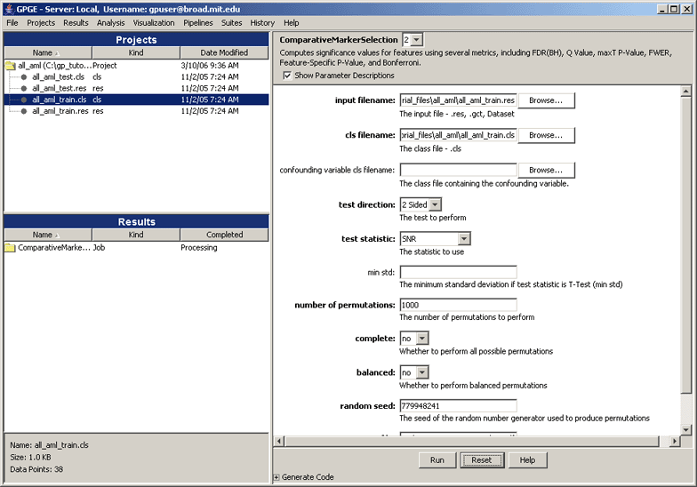
GenePattern screenshot

Slide 11
GenePattern as a reference implementation
Expose analytical service for microarray analysis
  Input MAGE-ML, produce MAGE-ML or image?
Consume arbitrary data/analytical service from GenePattern
Consume arbitrary data/analytical service from GenePattern module
No security constraints
Potential interaction with workflow
http://gforge.nci.nih.gov/plugins/scmcvs/cvsweb.php/genepattern/gridExtensions_y3/other_docs/GP_GridExtensions_Use_Case.doc?cvsroot=genepattern

Slide 12

geWorkbench overview
Genomics Workbench is a Java-based open-source platform for integrated genomics
  Microarray, DNA, pathways, patterns, GO, networks
  Message-based
Visualization and analysis
  Pluggable architecture with 30+ plugins
  Message-based architecture allows for sophisticated interactions between components
caScript
  Java-like programming interface to running geWorkbench
  Allows workflow-like interactions
Goal is to expose analytics via grid services and discover them in the GUI
  Self-Organizing Map (SOM), Hierarchal Clustering and Aracne

Slide 13
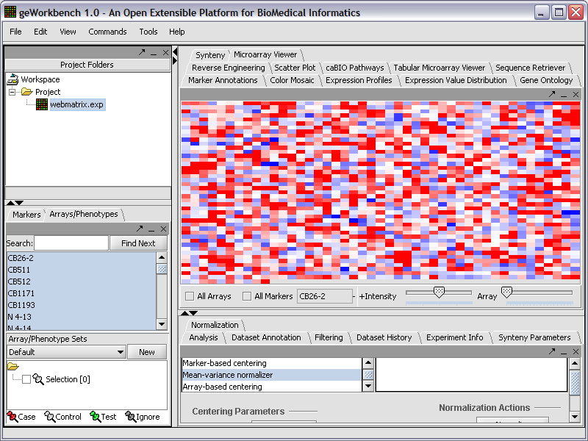
geWorkbench screenshot

Slide 14
geWorkbench as a reference implementation
Exposing microarray analytical services
  Advertisement and discovery
  Using Introduce?
Interaction with workflow
  Translate caScript into workflows
  Invoke workflows
Will be implementing security
  Authentication and probably authorization

Slide 15
GeneConnect overview
Mapping service that will facilitate interoperability by interlinking approved genomic identifiers
  Ensembl Gene ID
  Ensembl Transcript ID
  Ensembl Protein ID
  Entrez Gene ID
  UniGene ID
  GenBank mRNA Accession Number
  GenBank Protein Accession Number
  RefSeq mRNA Accession Number
  RefSeq Protein Accession Number
  UniProtKB/Swiss-Prot Accession Number
  UniProtKB/TrEMBL Accession Number
Database annotations will be used to construct pair wise connections
All-to-all relationships will be calculated by traversing all possible combinations of edges in the graph using every node as the starting point
Provide database schema, tooling to populate database, web interface, grid interface

Slide 16
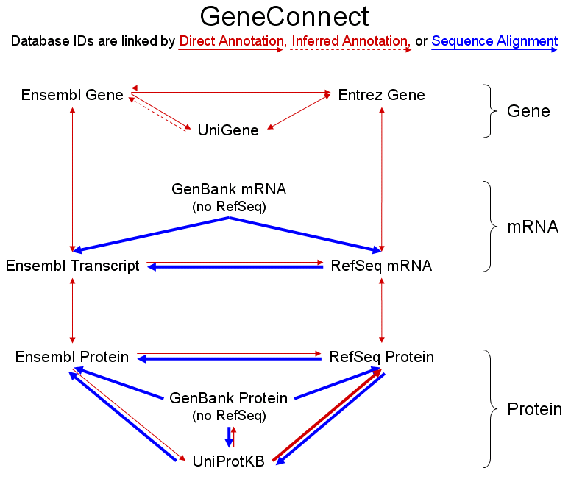
GeneConnect screenshot

Slide 17
GeneConnect as a reference implementation
Expose data service
  Genomic Identifier object in -> Genomic identifier object out or
  geneconnect object(s) in -> geneconnect object(s) out
Potential interaction with grid identifiers
No security constraints

Slide 18
caTissue Suite overview
Integration of the three existing TB&PT applications using a common model and user interface
  caTissue CORE, caTIES, CAE
Entire unified UML model will be exposed on the grid

Slide 19
caTissue Suite as a reference implementation
Expose data service
  Unification of three models
Variety of security constraints
  Authorization

Slide 20
GridCAD overview
Computer Aided Detection (CAD) algorithms exposed as analytical services interacting with DICOM image data services
  Remote execution of multiple CAD algorithms with multiple image sources
  Support human markup of images by radiologists
Facilitate research and clinical decision support with large number of subjects and multiple CAD algorithms.
  Parameter studies, clinical and preclinical trials, etc
Enable better algorithm development and validation through the use of many distributed, shared image datasets
Support remote algorithm execution – reduce data transfer and avoid the need to transmit PHI
Reduce overall processing time and algorithm development cycle through remote compute resource recruitment and CAD compute farms
Scalable and open source — caGrid 1.0 based

Slide 21
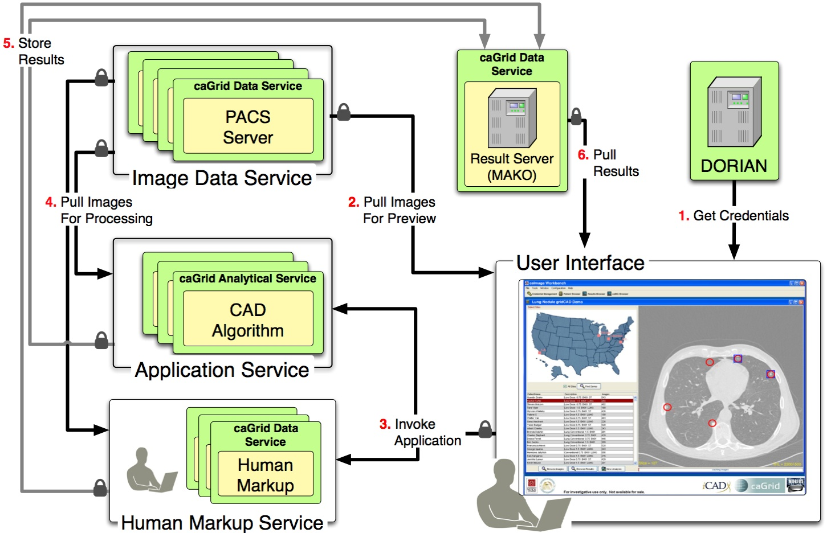
GridCAD screenshot

Slide 22
GridCAD as a reference implementation
caBIG Technologies
  caGrid 1.0
    Introduce toolkit for service creation and deployment
    Dorian for user and service authentication and authorization
  caDSR (CIP compliant vocabulary for DICOM data elements)
  CQL based query and retrieve for “data services”
Image Data Service
  Expose data in PACS servers as caGrid Data Service
  An open source DICOM server — Pixelmed
  Support third party high performance image data transfer using gridFTP
CAD Analytical Service
  Invoke algorithm with required inputs
  Transform and report results to results data service
Human Markup Service
  Query a work-order queue to detect any new markup requests
  Capture markups and save to results data service

Slide 23
NCIA overview

Slide 24
NCIA screenshot

Slide 25
NCIA as a reference implementation

Slide 26
Project feature summary
 | Data | Anal | Sec Authent | Sec Author | ‘duce | Advertise/ Discover | Metadata API | Ident | WF | Data size
caTRIP | X |  | X | X | X | X | X | ? |  | S
caBioconductor |  | X |  |  |  | X |  |  | X | L
GenePattern |  | X |  |  | X | X |  |  | X | M
geWorkbench |  | X | X | X | X | X |  |  | X | M
GeneConnect | X |  |  |  | X | X |  | ? |  | S
caTissue Suite | X |  | ? | ? | X | X | ? | ? |  | S
GridCAD | X | X | X | X | X | X | X | ? |  | M
NCIA

Slide 27
Project timelines
 | July | Aug | Sept | Oct | Nov | Dec | Jan | Feb
caTRIP
caBioconductor
GenePattern
geWorkbench
GeneConnect
caTissue Suite
GridCAD
NCIA

Slide 28
Recommendation
All projects have gridification in their SOWs
Early adopters: caTRIP and GridCAD
  Covers analytical and data
  Introduce, security, advertisement, discovery
Mid-term adopters: GeneConnect, caBioconductor, GenePattern
  Covers analytical and data
  Introduce, advertisement, discovery
  No security constraints
  Begin engagement of workflow
Post-release adopters: geWorkbench, caTissue Suite
  Covers analytical and data
  Introduce, security, advertisement, discovery
  Continue engagement of workflow

Slide 29
Reference implementation process
Build using caGrid beta 1.0 release
Provide feedback on
  Bugs
  Tooling features
  Tooling usability
Comprise the testbed grid
  Expose services at local institution
  Expose services at caGrid developer testbeds
Migrate to 1.0
  caGrid team will provide a migration path from 1.0 beta to release

Slide 30
Discussion

