Slide 1
caGrid 1.0 Workflow
Architecture
caBIG Annual Meeting
April 9th-11th, 2006

Slide 2
What is workflow?
Bioinformatics pipeline
  A common pattern that motivates this work
Canonical pattern for service workflows
  receive – input message and trigger to start
  declare variables – all local to the workflow
  Invoke services, assign variables, loops, etc
  Return final results.

Slide 3
Workflow specifics
Described in a document
Service invocation
Variables hold data
  copied from outputs to input
  xpath used to select data
Looping, conditionals
Parallelism
Dynamic service discovery (to be devel.)

Slide 4
Basic BPEL Workflow Model
Receive
Inputs
Assign
args
Invoke
Service
Assign
results
Send
results
Analytic
Service

Slide 5
BPEL Workflow Model – Pipelines (sequences)
Receive
Inputs
Assign
args
Invoke
Service
Assign
args
Invoke
Service
Assign
args
Invoke
Service
Assign
results
Send
results
Analytic
Service
Analytic
Service
Analytic
Service

Slide 6
BPEL Workflow Model – Parallelism (flows)
Assign
args
Invoke
Service
Assign
args
Invoke
Service
Assign
args
Invoke
Service
Assign
results
Receive
Inputs
Assign
args
Invoke
Service
Assign
args
Invoke
Service
Assign
args
Invoke
Service
Assign
results
Send
results
Assign
args
Invoke
Service
Assign
args
Invoke
Service
Assign
args
Invoke
Service
Assign
results

Slide 7
BPEL Workflow Model – Conditional (select)
Assign
args
Invoke
Service
Assign
args
Invoke
Service
Assign
args
Invoke
Service
Assign
results
Receive
Inputs
Select
Assign
args
Invoke
Service
Assign
args
Invoke
Service
Assign
args
Invoke
Service
Assign
results
Send
results
Assign
args
Invoke
Service
Assign
args
Invoke
Service
Assign
args
Invoke
Service
Assign
results

Slide 8
BPEL Workflow Model – Loops (while)
Receive
Inputs
Assign
args
Invoke
Service
while
Assign
args
Invoke
Service
Assign
args
Invoke
Service
Assign
results
Send
results
Analytic
Service
Analytic
Service
Analytic
Service

Slide 9
caGrid Workflow - High Level Objectives
Compose workflows integrating data and analytic services in flexible patterns
Record data provenance of workflow results
Flexible control-flow patterns: loops, conditionals, iteration over collections
Type-safety: verifying data-type correctness of arguments passed between services
Robustness: recover and continue long running workflows after failures
Usability and integration: specify workflows in graphical interfaces and scripted textual form

Slide 10
caGrid Workflow - Architecture Components
Workflow engine
  How many? where? how managed?
Workflow documents
  Workflow description forms and creation tools
Workflow management client
  Required: submit, check status, cancel
  Desired: pause, resume
Grid Security in Workflows
  Delegation of user credentials.
  “run-as” scenarios
Service Descriptions
  Need to interface to the workflow tools
Service locator / selector
  Select specific service instances when choices are available
  Workflow Planner turns abstract workflow into concrete form

Slide 11

Accessing caGrid workflow
Data Service
@ uchicago.edu
BPEL
Workflow
Doc
Workflow
inputs
BPEL
Engine
Analytic service
@ duke.edu
Workflow
Results
Analytic service
@ osu.edu
Workflow service
  Implemented by BPEL Engine
  Submit BPEL – async or sync

Slide 12
Accessing caGrid workflow - Design
Data Service
@ uchicago.edu
BPEL
Workflow
Doc
Workflow
inputs
Workflow
Mgmt
Service
BPEL
Engine
Analytic service
@ duke.edu
Workflow
Results
Analytic service
@ osu.edu
Workflow management service
  Sharing workflows
  Get workflow status

Slide 13






Workflow components in caGrid 1.0
Analytical Service
Grid-Enabled Client
Tool 1
Gene
Database
caArray
Tool 2
Research
Center
NCICB
Grid Services Infrastructure
(Metadata, Registry, Query,
Invocation, Security, etc.)
Grid Data Service
Protein Database
Tool 3
Tool 4
Workflow
State
BPEL
Engine
Grid Portal
Microarray
Workflow
Storage
Workflow
Manager
Workflow
Document

Slide 14
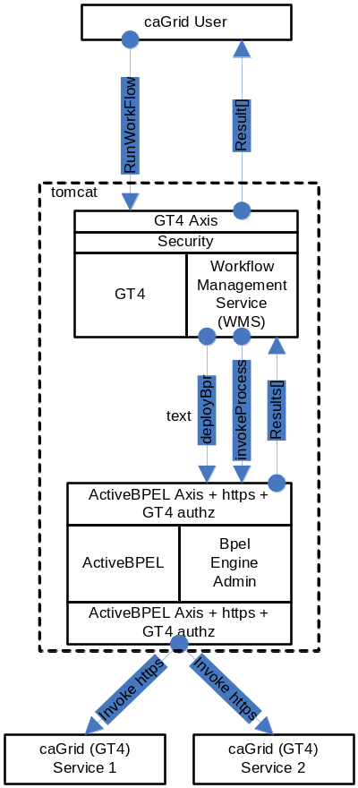
Workflow Management Service

Slide 15
Workflow Management Service Design
A Standard caGrid 1.0 service built using Introduce.
Uses Standard Grid Security configuration to control access.
User needs a valid grid credential to invoke any operation on the service
Synchronous operation runWorkflow()
  Deploys and runs a workflow

Slide 16
Workflow Management Service Design
Operation runWorkflow()
  Input: WMSInputType
    String WorkflowName
    Array of WSDLReferences
      String wsdlNamespace
      String wsdlLocation
      anyURI serviceUrl
    Array of WorkflowInputType
      Unbounded list of xsd:any

Slide 17
Workflow Management Service Design
Operation runWorkflow
  Output: WMSOutputType
    Unbounded sequence of WorkflowOutputType
      List of xsd:any types.
Verifies if the workflow doc is well-formed
Generates a ActiveBPEL Process Deployment Descriptor
Generates a deployable BPEL archive called BPR which contains BPEL + PDD

Slide 18
Deploying and Running Workflows
ActiveBPEL Admin Service
  Plain WS interface to deploy BPRs
  Takes BPRs as base64 encoded string
  Returns Deployment Summary
Once the workflow is deployed successfully, it is deployed as a web service inside ActiveBPEL.
To start the workflow, a message is sent to the receiving partnerLink in the workflow.
After the workflow successfully executes the results are returned to the client app/user.

Slide 19
caGrid Workflow - Implementation Plans
Phase I
  Adapt ActiveBPEL Open Source Engine to caGrid Services
  Security, WS-RF resource-passing conventions
caBIG Annual Meeting Target
  Create meaningful scientific workflow over services
  Query multiple data services, aggregate and iterate over results invoking analytics
Phase II
  Workflow control
  Workflow dynamics: service selection
  Type Checking
Phase III
  Scalability: multiple concurrent workflows
  Robustness: restartability, recoverability

Slide 20

Sample Workflow
CQL
UChicago
Data Service
Duke
interpolate
removeBG
denoise
align
normalize
plot
iterate
OSU
interpolate
removeBG
denoise
align
normalize
iterate

Slide 21
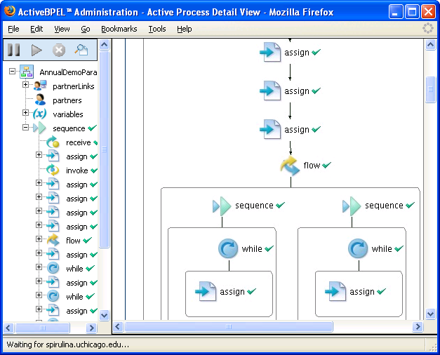
ActiveBPEL Engine Interface

Slide 22
Future Work
WS-RF Resource Pattern
  Asynchronous submission
Support for WS-SecureConv, WS-SecureMessage
Credential Delegation
  Make the engine invoke a service using a credential
Provenance
  Tracking your workflow
Abstract Workflows
  Reusable workflows
Much More!

