Slide 1
caGrid Portal
Design Evaluation
December 20, 2007
Prepared By: Persistent Systems Ltd

Slide 2
Contents
Homepage: existing design analysis
Homepage: design recommendations
Homepage: proposed design
Discovery flow: existing (Steps involved.)
Discovery flow: proposed (Steps involved.)
Query flow: existing (Steps involved.)
Query flow: proposed (Steps involved.)

Slide 3
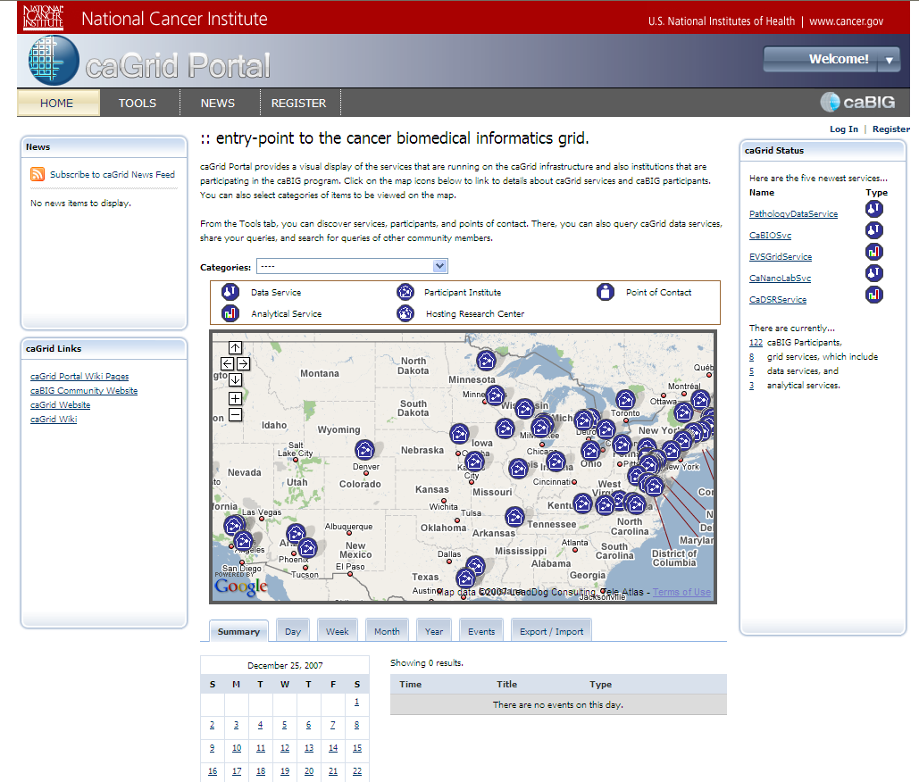
Homepage: existing
Comments:
5
Category filter for map is still looking like a part of the text above. Also, the calendar is placed too close to the map above.
Body text below the headline ‘entry-point….’ appears small.
Icons in front of new services appear clickable, but do not support this interaction.
The calendar is going in scroll at resolution 1024px X 768px.
The logo text is not clearly visible.
2
1
3
4

Slide 4
Design Recommendations
The text in middle panel and the ‘Categories’ filter for the caGrid map should have a visual demarcator between them. (Refer to the visual look an feel provided by Persistent Systems Ltd).
Increase the size of the body text below headline ‘Entry-point…’ It should be minimum of 11 pts.
Use icons in grey, they might appear less clickable. Otherwise, allow the user to navigate to the page corresponding to the icon. (Take the user to the ‘details page’ for that service.)
Try out the logos in black, provided by Persistent systems Ltd.

Slide 5
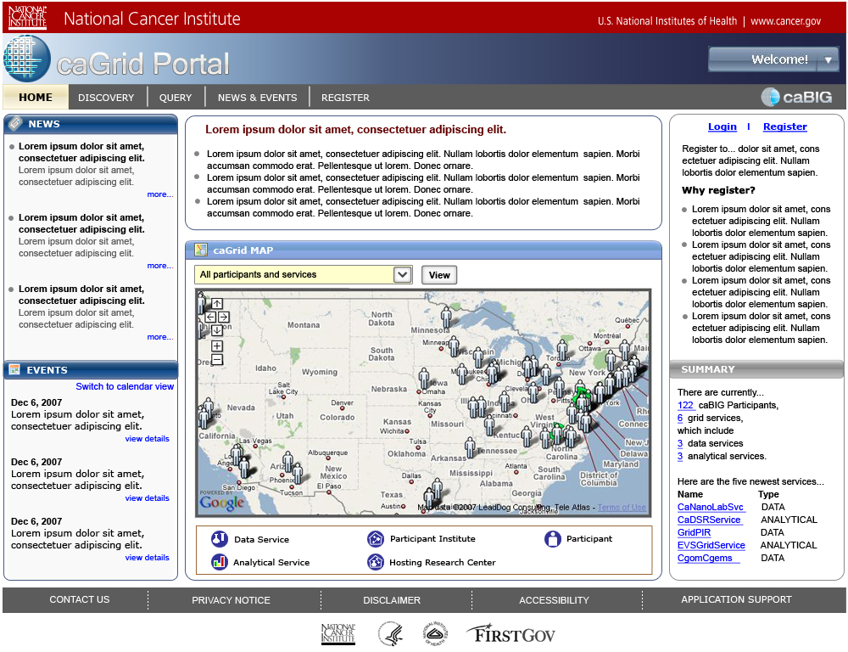
Homepage: proposed

Slide 6
Discovery: Existing flow
Tasks:
Alternative step
Search for an entity ( service, participant or point of contact) and view search results
View details of a chosen entity. ( Service, participant or POC)
Select a service to proceed for query building.
4a
5a
Page refresh
Directory tab
Select category to view
(Open by default)
(‘All services’ open by default)
3a
Discovery portlet
Select an entity: services, participants or POCs
5b
6
7
1
2
4b
Type in keyword
Click on ‘Search’ button
A
Homepage
Tools
Search tab
Results
(click to open tab)
(‘All services’ open by default)
6.1
Select fields
(‘1 click = 1 condition.
Ctrl + click = select multiple)
B
8
Click on ‘More details’
Details
9
C
Browse details
Select a UML class to query
3b
Data service Query portlet

Slide 7
Observations
The nomenclature ‘TOOLS’ is not intuitive enough for a new user to understand the function the section serves.
The action of browsing entities is hidden in ‘directory’ tab. The user needs to read the long list of objects in the dropdown to understand the scope of the search.
There are two ways of discovering information: browsing the directory & keyword search. The sub-tabs within these two main tabs are not consistent. ‘Keyword search’ has three sub-levels of searches across services, participants and POCs. On the other hand, the ‘Directory’ offers two ways (List view and Map view) of viewing the same information as sub-tabs.
The user can select multiple fields in step ,by pressing ‘Ctrl’ key selecting fields one by one. This is not conveyed clearly in the current portal.
Viewing the details of a chosen service / participant/ POC is a secondary step after result view. But still, it is placed at the same level of ‘Directory’ and ‘Search’.

Slide 8
Discovery: Proposed flow
Tasks:
Alternative step
Search for an entity ( service, participant or point of contact) and view search results
View details of a chosen entity. ( Service, participant or POC)
Select a service detail to query
Choose a category type
4a
3
1
2
Select Entity service/ participant /POCs
5
A
Homepage
Discovery
Click on ‘GO’ button
Results
Type in keyword
4b
6
Click on ‘View details’
4b.1
(‘1 click = 1 condition.
Ctrl + click = select multiple)
Details
(browse)
B
Select fields
C
Select UML class to query

Slide 9
Advantages of proposed flow:
The action of discovering a caGrid entity is converted into a high level section, clearly defining its purpose.
The ability to choose a caGrid entity (Services, participant or POCs) first allows the user to clearly visualize the path towards his goal clearly.
The linear flow of current design removes the redundancy of steps and reduces the time required to complete a task.
The details of a chosen service / participant/ POC are displayed a page that opens on top of the search results, but under the same tab. User can easily go back to the search results by following a simple link.

Slide 10
Query: existing flow
Alternative step
3
4
Discovery flow
Select a UML class to query
1
2
(Refer to slide 6 for ‘Discovery flow)
Homepage
Tools
User, who does not know the service URL, has to go through the discovery flow to search for the URL.
5
6b
Data service Query portlet
Build CQL query
7
8
9
6a
Click on ‘Select’ button
Browse through list of UML classes
Click & select a UML class to query
Type in the service URL
10a
10b
10c
10d
Add criterion
Edit query modifiers
Export to XML
Submit query
Query running
Go to results tab
11
Results: XML view
Fb
Results: list view
Fa
Default view

Slide 11
Observations:
The user can see just the path, but not the attributes (like in the discovery flow) of the selected UML class. Clicking on a selected class takes the user to query building section.
‘Add Criterion’ and ‘Edit query modifier’ involve a lot of steps by users, to be able to go to the next step.
‘Add criterion’ and ‘Edit query modifier’ steps are placed at the same level as that of ‘Export to XML’ and ‘Submit Query’, allowing the user to submit a query at any point of time. This might lead the users towards submitting a query before they have completely defined the parameters, which would result in users performing the same task again and again.
If a user chooses to build CQL without adding any criterion or editing the query modifier, the result tab is empty. The current design does not convey the necessity to add criterion and define query modifiers to successfully build a query, to the user in any way.
Clocking on ‘Export to XML’ in the CQL builder takes the user to tab displaying the XML for the query conditions. User can build query from here.

Slide 12
Query building: Proposed flow
Alternative step
2
3
Discovery flow
Select UML class to query
(Refer to slide 8 for ‘Discovery flow)
User, who does not know the service URL, has to go through the discovery flow to search for the URL.
1
Homepage
8b
CQL query
5
Type in service URL
5
7
Query
Select type of query
8a
9
10
11
13
Build query
Select UML class to query
Apply query criterion
Define Output
Submit query
12
Export to XML
Results: XML view
Fb
Results: list view
Fa
Default view

Slide 13
Advantages: proposed flow
The proposed flow allows the user to build a query in logical sequence of actions: user can define the output type after applying query criterion.
The user can see the attributes of the selected UML class before going to the next step.
The linear flow clearly defines the chronology of steps involved in building query and generating it., removing the redundancy.

Slide 14

Thank You.

