Slide 1
caGrid 1.0 Monitoring and Discovery Portal
Manav Kher (SAIC)
Architecture/VCDE Workspaces
Joint Face to Face
July 12th–14th, 2006

Slide 2
Agenda
Overview
Project Scope
Portal Components
Portal Architecture
Timeline and current status

Slide 3
Portal - Overview
caGrid 1.0 Portal:
  Provide an overivew of the status all services (Data, Analytical and Infrastructure) based on aggregated information.
caGrid Portal provides:
  Geographic map of grid nodes (cancer centers)
  Service Discovery facility
  Cancer Center information
  Grid service information
  Geographical map driven User Interface
  Reusable components for use in other web clients

Slide 4
Portal - Scope
What is in scope?
Provides near-time view of the grid
  Information cached for functional and performance reasons
  Local cache periodically refreshed
Map driven service discovery
Provides extensible framework and reusable components
What is not in scope?
Invoke or query caGrid services or any real time interaction with other grid resources
Single sign on capability or credential based acess to grid resources

Slide 5
Portal – User Interface
Will follow NCICB standard look and feel (http://ncicb.nci.nih.gov/about/UILibrary)
Component based UI (Java Server Faces) will be used to develop reusable components
Map centric user interface

Slide 6
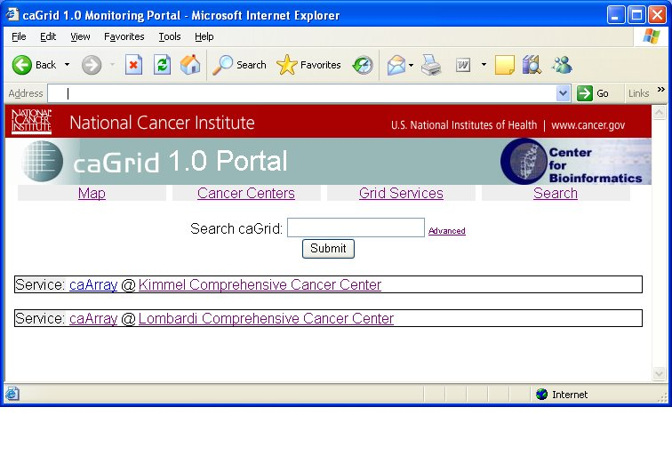
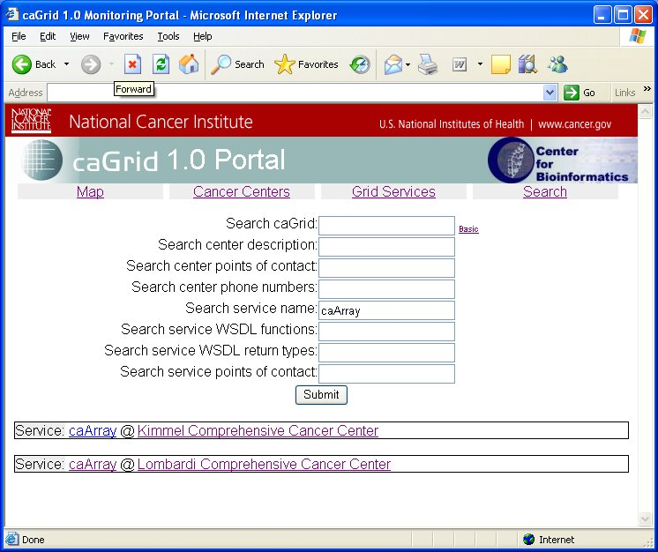
Portal – Service Discovery
Basic & Advanced Discovery
  Provides a mechanism to search (discover) caGrid services based on service metadata
  Basic search looks for text in metadata elements
  Advanced search allows for filtering on a per-element basis
  Ability to discover services that are not active
  Ability to do discovery (service filtering) through the Map UI

Slide 7
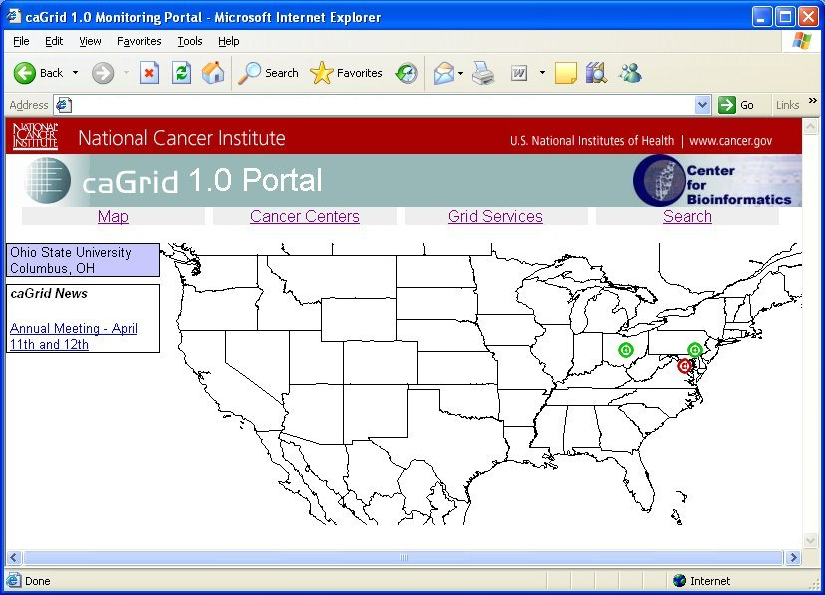
Portal – Map view
Map displays
caGrid service nodes
Type of service
Geographical Location
Service availability indication
All service nodes or filtered set

Slide 8
Portal – Service Details
Service List and Service Details
List
  A categorized list of all service instances currently known to the portal. Services can be active or inactive
Details
  Display the complete set of service metadata
  Service functions and domain model information from WSDL
  Service uptime and performance graph
  Last known status of service availability
  Hosting cancer center information

Slide 9
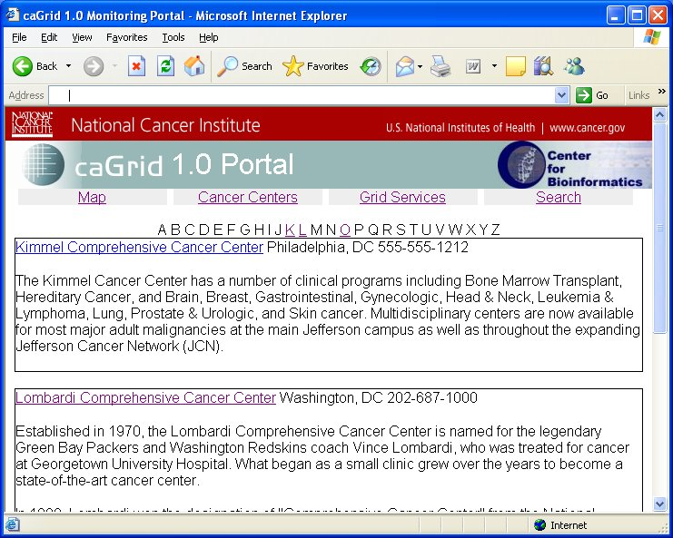
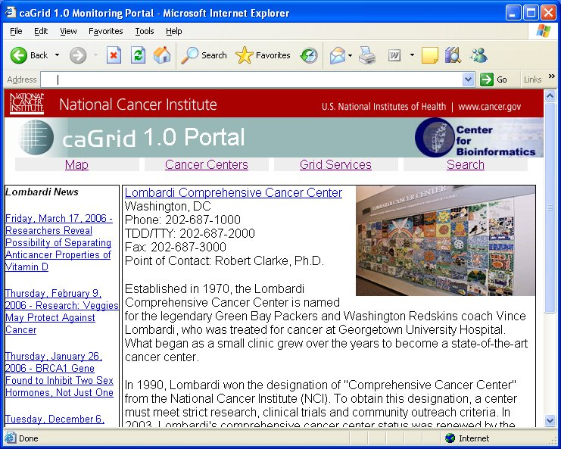
Portal – Cancer Center Details
Center Center List and Details
List
  Provides a listing of all cancer centers participating in caGrid
Details
    Address
    Point of Contact(s)
    caGrid Services (Reverse lookup)

Slide 10
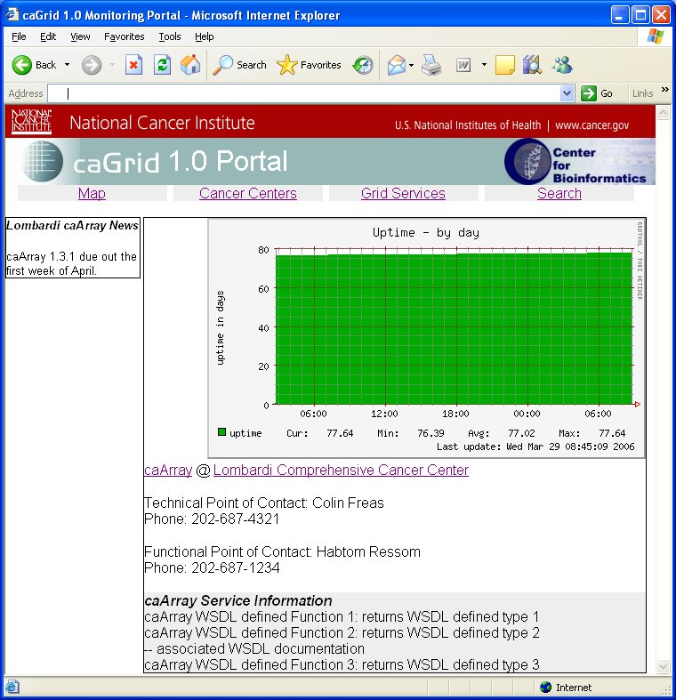
Portal - Service availibility graph
Complete known history of Service availability and performance
Compiled by scheduled jobs known as “performance aggregators”
Performance metrics calculated by “pinging” the service endpoint. Does not gurantee actual service implementation performance

Slide 11
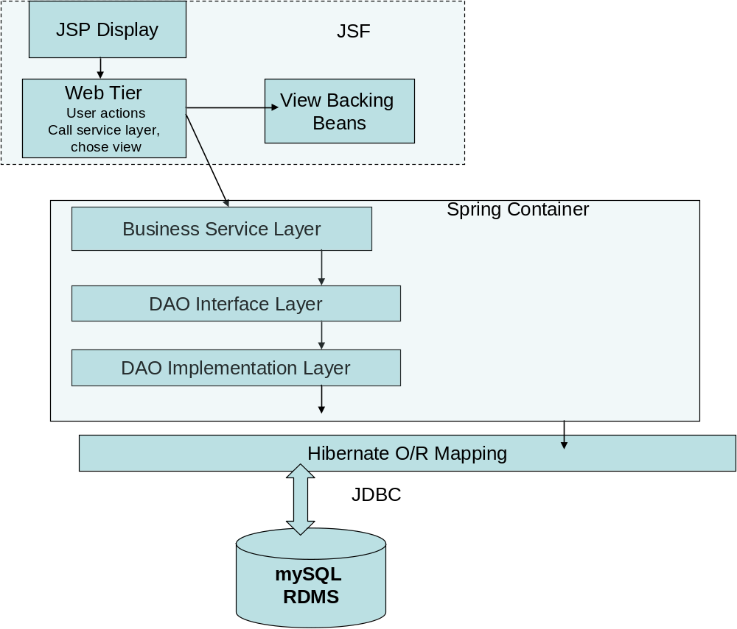
Architecture – Layered Diagram

Slide 12
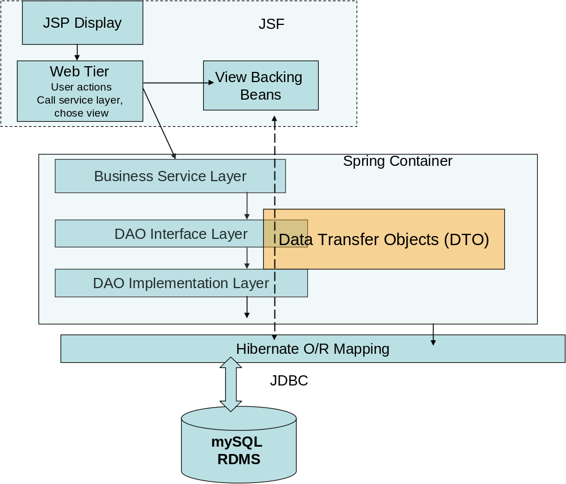
Architecture – Layered Diagram

Slide 13
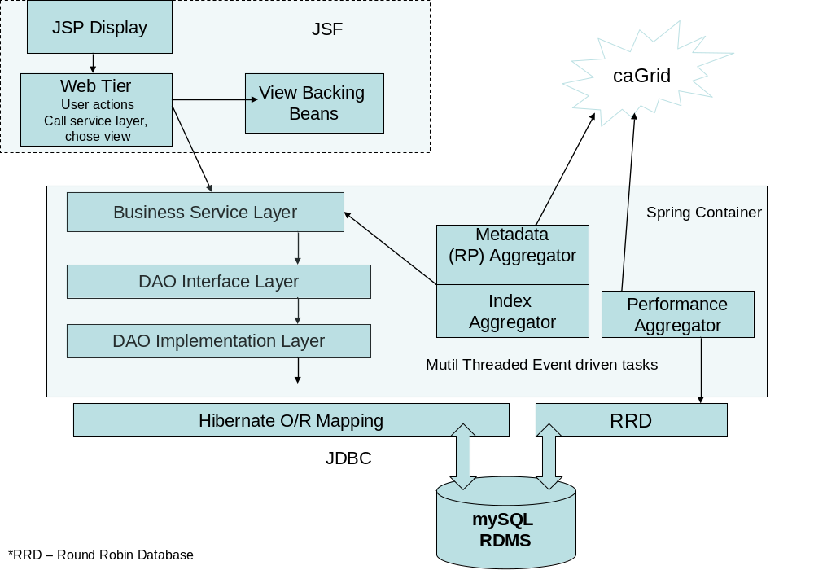
Architecture – Layered Diagram

Slide 14
Architecture - Aggregators
Aggregate information from caGrid services
Spring container managed beans. Are executed as scheduled jobs. Frequency is configurable
Can aggregate from multiple caGrid Index services
Multi-threaded to avoid blocking calls and improve perfomance
Message driven beans. Aggregators can start other aggregators. For eg. Index aggregator can start the metadata aggregator on finding a new service
Have the ability to publish messages (onComplete, foundNewService etc.)

Slide 15
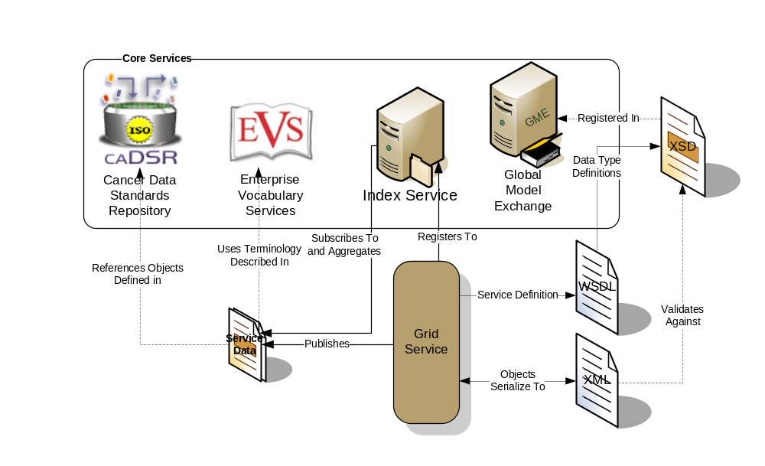
Architecture - Aggregators
Index
Aggregator
Metadata
(RP) Aggregator
Performance
Aggregator

Slide 16
Architecture – RRD
RRD is the acronym for Round Robin Database. It is a system to store and display time-series data
Stores status information data in an efficient and systematic manner.
Ability to quickly generate graphical representations of the data values collected over a definable time period.
Pre-configured database size is never exceeded. The size of an RRDtool database always remains constant.

Slide 17
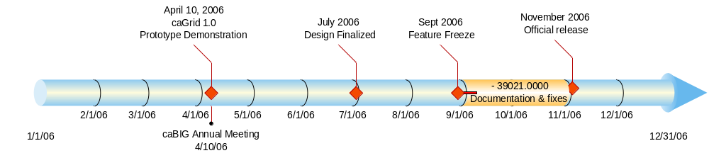
Timeline

Slide 18
Portal – Current Status
Design document finished. Will be available for community review shortly
Backend components (DB, aggregators) nearing completion
UI development begins next
Portal will go into production with the final release of caGrid 1.0

Slide 19
Portal – Team
Georgetown University
  Colin Freas
  Paul A. Kennedy
  Chad La Joie
Booz | Allen | Hamilton
  Arumani Manisundaram (Project Manager)
SAIC
  Manav Kher

