Slide 1
Introduce
Grid Service Authoring Toolkit
Dialogue Workshop II
February 9-10, 2006
Shannon Hastings
hastings@bmi.osu.edu
Multiscale Computing Laboratory
Department of Biomedical Informatics
The Ohio State University

Slide 2
Outline
Driving requirements
What can it do?
Architecture
Toolkit
Future work

Slide 3
Analytical Service Overview
Accessing data in caBIG will not be enough. The data will need to be processed, transformed, analyzed, integrated, etc
It should be very easy for analytical service providers to deliver these services
The analytical services, just as the data services, will take in and return strongly typed and semantically harmonized data types
These services will need to be easily discovered and invoked

Slide 4
caGrid Service Requirements
All services must be presented to the caBIG as Grid Services
They must have strongly typed interfaces using types which are registered in the caDSR and can be verified by an XML schema registered in the caGRID GME.
Must provide CommonServiceMetadata as well as service specific metadata.
The service must register itself and it’s metadata to a caGRID Index Service
The service must provide object oriented client API for locating and invoking the service

Slide 5
Addressing the Requirements
Grid Services
  We will be fulfilling the requirement that each analytical routine is available through grid services by utilizing the Globus 4.0 toolkit
  Analytical tool providers will be creating operationProviders that describe the interfaces their grid service will provide
  We will be using the Globus toolkit for creating, registering, discovering, and invoking these service operations as grid services
    Client will be using the operation through a grid service interface and will not need to be aware of any implementation specific details of the grid service

Slide 6
Addressing the Requirements (cont)
Strongly typed interfaces:
  Using the GME client to extract the schemas for the types which are required by the analytical service interface
  Data model schema, and any referenced schemas, extracted and placed in the schema directory of the analytical build skeleton
    types can be used at service build time to generate the objects and create strongly-typed grid service interfaces

Slide 7
Addressing the Requirements (cont)
Providing Service Metadata:
  Globus ServiceDataProviders read an XML file which represents the service metadata and publish it
    Configuration file set with the “serviceConfig” property in the severs web service deploy descriptor (wsdd)
    ServiceDataManagerProvider and NotificationSourceProvider as operation providers
    GWSDL port type definition of the service extends ogsi:NotificationSource

Slide 8
Addressing the Requirements (cont)
Index Service Registration
  Globus service registry support by creating a registry configuration file and pointing to it with the “registrationConfig” parameter in the web service deployment descriptor file
  RegistryPublishProvider as operation provider

Slide 9
Addressing the Requirements (cont)
Providing Client Side Object API
  Globus build process will automatically generate a client side object oriented API
  We will generate a wrapper for this API which matches the service interface to make a clean mapping from client to service

Slide 10
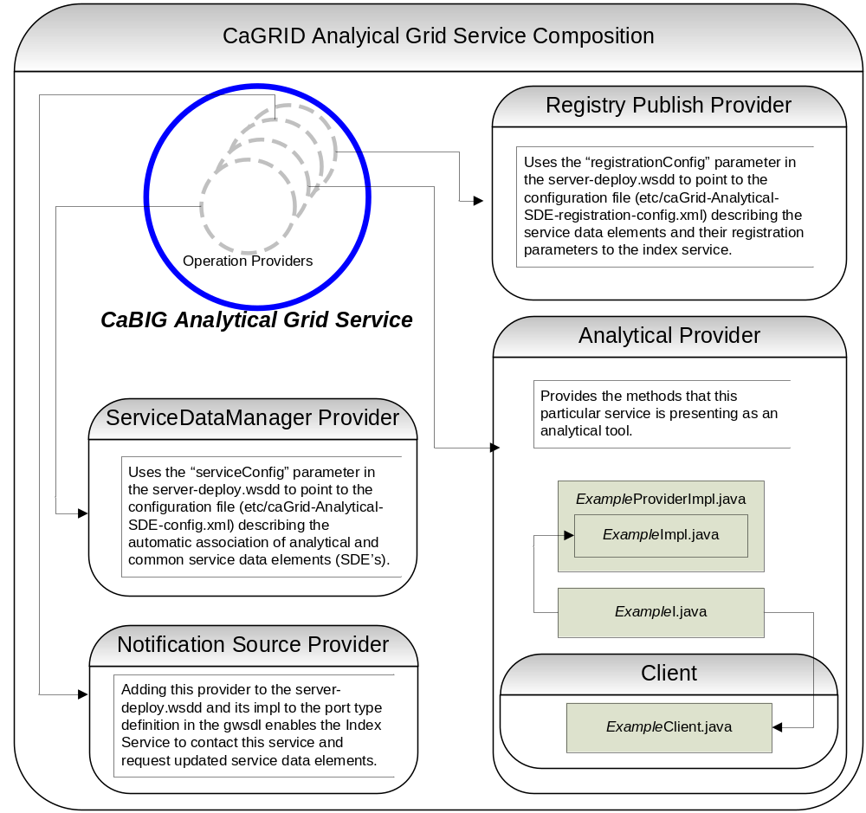
Core Analytical Service Architecture
Using delegation style of service composition
Each operation provider is used to add a particular type of functionality to the service

Slide 11
Analytical Service Creation Toolkit
Toolkit for creating and manipulating caGrid compliant analytical services
  Command line and GUI tools for service skeleton generation and automatic service/client code generation
Utilizes other caGrid services and architecture components
  GME for schemas of caDSR registered data types
  Security service architecture (GSI,GUMS, CAMS)
  Advertisement and Registration configuration and caGrid Index Service for discovery

Slide 12
Analytical Service Creation Toolkit Portal
GUI for creating and manipulating a caGrid compliant analytical service
  Provides means of simple creation of analytical service skeleton that a developer can then implement, build, and deploy
  Automatic code generation of complete caBIG compliant grid service which is configured to provide:
    Security
    Advertisement
    Discovery
    Complete Client API
  Provides a set of tools which enable the developer to add/remove/modify methods of the service
    Automatic code generation of all the required code, Globus grid service code/configuration, service configuration, implementation of the client, and stubbed implementation of the service

Slide 13
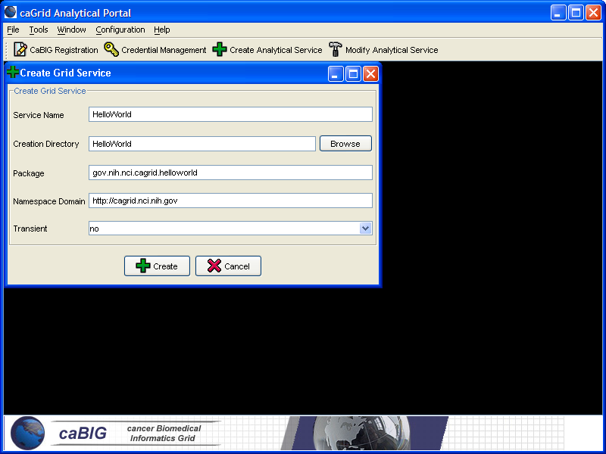
Analytical Portal Service Creation
Populate required variables for service creation
  Name = published service name
  Creation Direction = directory to create the skeleton
  Package = the java package you wish to use for your service
  Namespace Domain = the namespace to be used to define the service interface and types
  Transient = whether or not the service is to have a factory

Slide 14
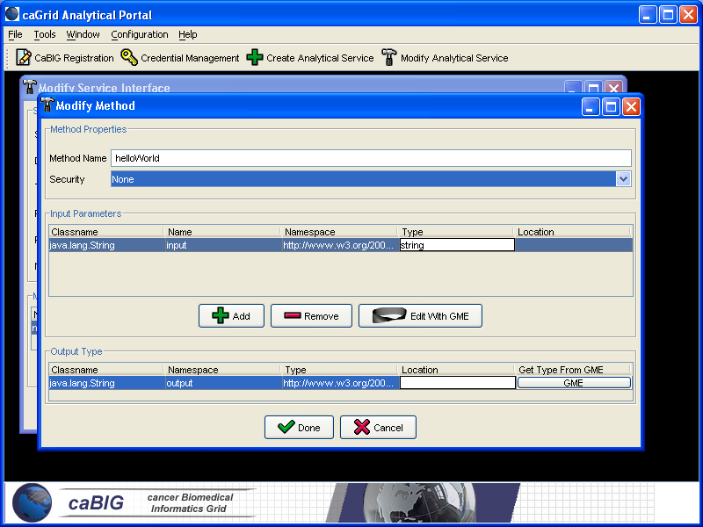
Analytical Service Modification Tool
Graphical tool to automatically create source code, configuration files, and build process for new analytical services
Developer defines the operations of the service and just has to focus on the implementation of them
Generated service is caBIG compliant in its mechanisms to register, advertise, and secure

Slide 15
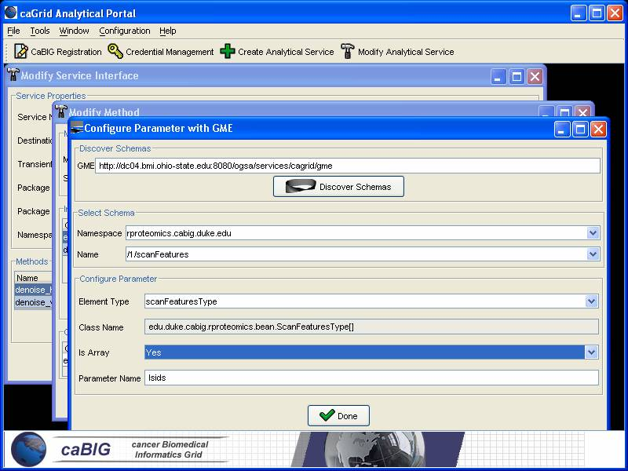
Analytical Service Modification Tool cont.
Input and output parameters can be discovered from GME
Schema types can be automatically downloaded and configured as operation parameters
Specified types are used to create necessary Java Objects using Globus behind the scenes

Slide 16
Command Line Tools
Creation tool – tool to enable the easy creation of a new analytical service skeleton
  Will prompt for input on name, package, directory, namespace, etc
  Can take in a properties file instead
  Can be called with ant “ant createAnalyticalServiceSkeleton”
Sync tools – set of tools which enable the modification of caGrid compliant grid services
    Keeps mirror of service interface in a configuration/state document and regenerates the grid service skeleton upon changes
      Creates/Modifies client/server implementation
      Creates/Modifies service interface
      Creates/Modifies globus gwsdl service configuration
    Can be called with ant “ant resync”

Slide 17
Command Line Creation
run the command “ant createAnalyticalService”
This will prompt the user for several variables which need to be defined:
  Destination directory for this new service skeleton
  Service name
  Namespace domain (the namespace to use for the services messages etc.)
  Package (the java package for the service to use)
  Package dir (same as above except written as a relative directory)
  Transience (whether or not the service is to have a factory)

Slide 18
Command Line Creation (cont)
Variables can be preset in a properties file to use non-interactively
  call the ant target and set the analytical.properties variable to point to this properties file:
    ant –Danalytical.properties=myAnalytical.properties createAnalyticalService
An example properties file:
analytical.skeleton.destination.dir=C:\RProteomics
analytical.skeleton.service.name=RProteomics
analytical.skeleton.namespace.domain=http\://analysis.cabig.duke.edu
analytical.skeleton.package=edu.duke.cabig.analysis.rproteomics
analytical.skeleton.package.dir=edu/duke/cabig/analysis/rproteomics
analytical.transient=no

Slide 19
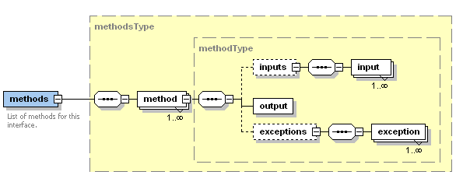
The Methods Document
XML document used to describe the service interface and it’s security requirements
Analytical Toolkit uses it for code generation and skeleton synchronization

Slide 20
Methods Document Example
<?xml version="1.0" encoding="UTF-8"?>
<methods xmlns="http://gov.nih.nci.cagrid.analytical/1/Methods" xmlns:xsi="http://www.w3.org/2001/XMLSchema-instance">
<method name="changeAddress" secure="false">
<inputs>
<input className="gov.nih.nci.cagrid.bean.PersonType" name="input“
namespace="cagrid.nci.nih.gov/1/person" type="personType" location="./person.xsd" />
<input className="gov.nih.nci.cagrid.bean.AddressType" name="address"
namespace="cagrid.nci.nih.gov/1/person" type="AddressType" location="./person.xsd" />
</inputs>
<output className="gov.nih.nci.cagrid.bean.PersonType" namespace="cagrid.nci.nih.gov/1/person"
type="personType" location="./person.xsd" />
<exceptions />
</method>
</methods>

Slide 21
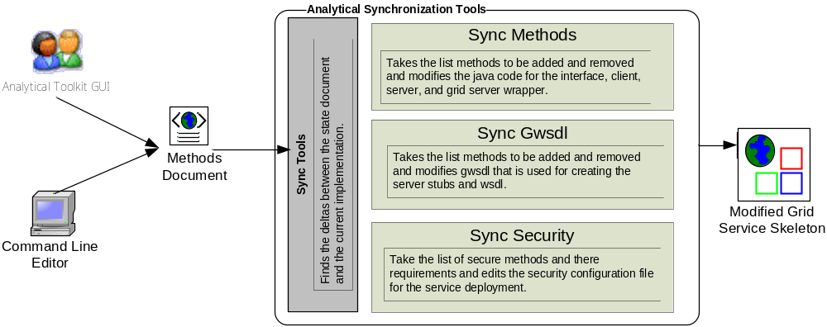
Skeleton Synchronization Process

Slide 22
Command Line Modification
run the command “ant resync” from the top level of the analytical skeleton
  will read in the “AnalyticalMethods.xml” document and determine the changes between the developers new description of the service and the actual code
  will then modify the skeleton appropriately:
    Modify all source files
    Modify all security configuration files
    Modify the gwsdl for the service

Slide 23
Inside the analytical service
Analytical services have many moving and configurable parts which support features such as:
  Advertisement
  Discovery
  Invocation
  Security
The Analytical Toolkit can keep all these features in sync as the developer creates and modifies his/her grid service

Slide 24
Inside the analytical service (cont)
Service Skeleton (all automatically generated and maintained)
  src (contains the service implementation)
  schema (contains any schemas for types and the gwsdl)
  etc (contains any additional config files needed for service)
  lib (contains required libs from the caGrid build)
  deployer (contains ant files for deploy time configuration and deployment)
  config (contains an undeployment file for this service)
  docs (contains doxygen config files for creating service API documentation)
  namespace2package.mappings (maps namespaces to packages used diring globus stub generation)
  server-deploy.wsdd (describes the server deploy parameters)
  client-config.wsdd (describes the client configuration parameters)
  build.xml (ant build file)
  deploy.properties (properties for deploying the service)

Slide 25
Ant Environment
The build.xml file is used for building and deploying the service using ant, as well as luanching supporting tools
Main ant targets:
  analyticalPortal Execute the Analytical Service Creation Toolkit Portal
  deploy Deploy a caGrid Analytical service by CLI
  guiDeploy Deploy a caGrid Analytical service by GUI
  resync Uses the analyticalMethods.xml to add and
      remove methods to this service skeleton

Slide 26
Deploy properties
The deploy.properties file is used to control deploy time parameters of the service
  Such as a name for the service and a path to have the service deployed
  Enables one compilation of a service to be deployed multiple times, even to the same container
Example deploy.properties file
service.deployment.name=CaGRIDExample
service.deployment.dir.path=cagrid/CaGRIDExample

Slide 27
Source Directory
The source directory is where the developer will place the implementation of their “OperationProvider” that they will be adding to this service. The operation provider (delegation) strategy enables us to create complexly comprised grid services while still enabling very simple implementation. The developer will simply need to write their operation provider class so that its portType can be used in this service.
Tools are provided for adding and removing methods to this skeleton. If the developer plans to do this manually he/she should be quite familiar with developing services using the globus 3.2 toolkit. If the developer uses the tools to add and remove the methods all that the developer will need to do is all the service side method implementation which are done by editing the ${analytical.skeleton.service.name }Impl.java file in the ${analytical.skeleton.package.dir }/service directory

Slide 28
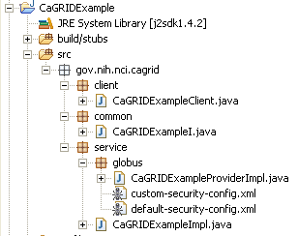
Source Directory (cont)
The creation tool creates a specific directory structure to make the development easier.
Creates the source under the specified package name used at creation time.
Creates an interface client, server, and Globus server wrapper.
Creates default and custom (edited with the GUI) security configuration files

Slide 29
Security Configuration
There are two security config files in the skeleton’s source directory. The default one which at this time is no-auth on all methods and a custom one (edited by portal) which can have method by method control on security requirements. The server deployment descriptor file configures which one of these to use at deployment time.
Default (no auth) Custom (method level control)
<securityConfig xmlns="http://www.globus.org">
<!-- default auth-method for any other method -->
<auth-method>
<none/>
</auth-method>
</securityConfig>
<?xml version="1.0" encoding="UTF-8"?>
<securityConfig xmlns="http://www.globus.org" xmlns:service="http://cagrid.nci.nih.gov">
<method name="service:changeAddress">
<auth-method>
<GSI/>
</auth-method>
</method>
<!-- default auth-method for any other method -->
<auth-method>
<none />
</auth-method>
</securityConfig>

Slide 30
Schema Directory
The schema directory is where the schemas for types and gwsdl can be found which will be used in creating the grid service
The user will not necessarily need to alter anything in this area as there are tools provided which will extract schema for types from the GME and place them into this directory so they can be used to strongly type the interface the developer will be providing

Slide 31
The service GWSDL file
<?xml version="1.0" encoding="UTF-8"?>
<definitions xmlns="http://schemas.xmlsoap.org/wsdl/" xmlns:wsdl="http://schemas.xmlsoap.org/wsdl/"
….
<types>
<xsd:schema xmlns:soapenc="http://schemas.xmlsoap.org/soap/encoding/" targetNamespace="http://cagrid.nci.nih.gov/CaGRIDExample" attributeFormDefault="qualified" elementFormDefault="qualified">
<xsd:element name="changeAddress">
<xsd:complexType>
<xsd:sequence>
<xsd:element name="input" type="ns0:personType" />
</xsd:sequence>
<xsd:sequence>
<xsd:element name="address" type="ns0:AddressType" />
</xsd:sequence>
</xsd:complexType>
</xsd:element>
<xsd:element name="changeAddressResponse">
<xsd:complexType>
<xsd:sequence>
<xsd:element name="value" type="ns0:personType" />
</xsd:sequence>
</xsd:complexType>
</xsd:element>
</xsd:schema>
</types>
<message name="changeAddressInputMessage">
<part name="parameters" element="tns:changeAddress" />
</message>
<message name="changeAddressOutputMessage">
<part name="parameters" element="tns:changeAddressResponse" />
</message>
<gwsdl:portType name="CaGRIDExamplePortType" extends="ogsi:GridService ogsi:NotificationSource">
<operation name="changeAddress">
<input message="tns:changeAddressInputMessage" />
<output message="tns:changeAddressOutputMessage" />
<fault name="Fault" message="ogsi:FaultMessage" />
</operation>
</gwsdl:portType>
</definitions>
Used to describe the gwsdl interface to Globus so that the wsdl, stubs, and bindings can be created during build time
Contains the protocol element definitions (messages) and the operations on the port type that will be exposed to the grid

Slide 32
Etc Directory
The etc directory is the developer’s directory to put resources such as configuration files and SDE files which will be deployed to the web service container
The analytical skeleton will have at least 4 files that will be deployed with he grid service and they are as follows:
  caGrid-Analytical-SDE-config.xml
    The service data providers configuration file
  caGrid-Analytical-SDE-registration.xml
    The index service registration file
  commonSDE.xml
    The common service metadata
  analyticalSDE.xml
    The analytical service metadata

Slide 33
Service Data Configuration
Configures the service to read in the SDE files to obtain the services metadata for CommonServiceMetadata and AnalyticalServiceMetadata and associate that metadata with the service
<?xml version="1.0" encoding="UTF-8" ?>
<serviceConfiguration xmlns:ogsi="http://www.gridforum.org/namespaces/2003/03/OGSI"
xmlns:aggregator="http://www.globus.org/namespaces/2003/09/data_aggregator"
xmlns:provider-exec="http://www.globus.org/namespaces/2003/04/service_data_provider_execution"
xmlns:xsd="http://www.w3.org/2001/XMLSchema">
<installedProviders>
<providerEntry class="org.globus.ogsa.impl.base.providers.servicedata.impl.AsyncDocumentProvider" />
</installedProviders>
<executedProviders>
<provider-exec:ServiceDataProviderExecution>
<provider-exec:serviceDataProviderName>AsyncDocument</provider-exec:serviceDataProviderName>
<provider-exec:serviceDataProviderImpl>org.globus.ogsa.impl.base.providers.servicedata.impl.AsyncDocumentProvider</provider-exec:serviceDataProviderImpl>
<provider-exec:serviceDataProviderArgs>-i 60000 -f FULL-ETC-PATH/commonSDE.xml </provider-exec:serviceDataProviderArgs>
<provider-exec:refreshFrequency>60</provider-exec:refreshFrequency>
<provider-exec:async>true</provider-exec:async>
</provider-exec:ServiceDataProviderExecution>
<provider-exec:ServiceDataProviderExecution>
<provider-exec:serviceDataProviderName>AsyncDocument</provider-exec:serviceDataProviderName>
<provider-exec:serviceDataProviderImpl>org.globus.ogsa.impl.base.providers.servicedata.impl.AsyncDocumentProvider</provider-exec:serviceDataProviderImpl>
<provider-exec:serviceDataProviderArgs>-i 60000 -f FULL-ETC-PATH/analyticalSDE.xml </provider-exec:serviceDataProviderArgs>
<provider-exec:refreshFrequency>60</provider-exec:refreshFrequency>
<provider-exec:async>true</provider-exec:async>
</provider-exec:ServiceDataProviderExecution>
</executedProviders>
</serviceConfiguration>

Slide 34
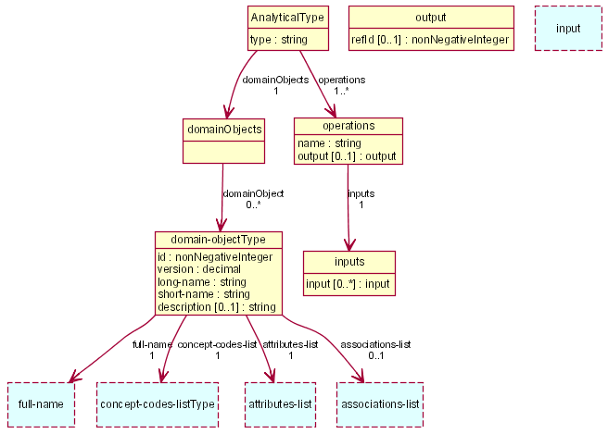
Analytical Service Metadata
Analytical Service
Metadata

Slide 35
Registration Configuration
Used to tell the RegistryPublishProvider where to register this grid service
Configures Index Service subscriptions to AnalyticalServiceMetadata and CommonServiceMetadata
<?xml version="1.0" encoding="UTF-8" ?>
<serviceConfiguration xmlns:ogsi="http://www.gridforum.org/namespaces/2003/03/OGSI" xmlns:aggr="http://www.globus.org/namespaces/2003/09/data_aggregator" xmlns:xsd="http://www.w3.org/2001/XMLSchema">
<registrations>
<registration registry="INDEX-SERVICE-REGISTRY" keepalive="true" lifetime="1200" remove="true">
<aggr:DataAggregation>
<ogsi:params>
<aggr:AggregationSubscription>
<ogsi:serviceDataNames>
<ogsi:name xmlns:a="http://cagrid.nci.nih.gov/1/AnalyticalServiceMetadata">a:AnalyticalServiceMetadata</ogsi:name>
<ogsi:name xmlns:c="http://cagrid.nci.nih.gov/1/CommonServiceMetadata">c:CommonServiceMetadata</ogsi:name>
</ogsi:serviceDataNames>
<aggr:lifetime>60000</aggr:lifetime>
</aggr:AggregationSubscription>
</ogsi:params>
</aggr:DataAggregation>
</registration>
</registrations>
</serviceConfiguration>

Slide 36
Lib Directory
Contains all required libraries from the caGrid framework
Any library dependencies that a developer will be adding should be placed in this directory
All libraries in this directory will be deployed with the service and will be accessible during runtime

Slide 37
Conclusion
Requirements
  Basic strongly typed grid requirements plus semantically interoperable caBIG requirements
Architecture
  Grid service framework which is encapsulated and layered on Globus
Analytical Toolkit
  Enables easy development of caBIG compliant grid service
Analytical Service Layout
  Simple grid service layout making it easy to locate and manage pieces of the implementation

