Slide 1

What is caGrid?
A grid based software infrastructure consisting of services, toolkits, APIs, and applications
A production grid deployment of the core services provided by that infrastructure
A community of developers leveraging that grid and infrastructure to provide applications and services to the cancer research community

Slide 2


What is caGrid to caBIG?
The “G” in caBIG
  Cancer Biomedical Informatics Grid
Provides the software foundation which underlies the tools and applications of caBIG
Analogous to the “power grid”
  A multitude of applications with differing requirements can seamlessly be plugged in to a common infrastructure

Slide 3
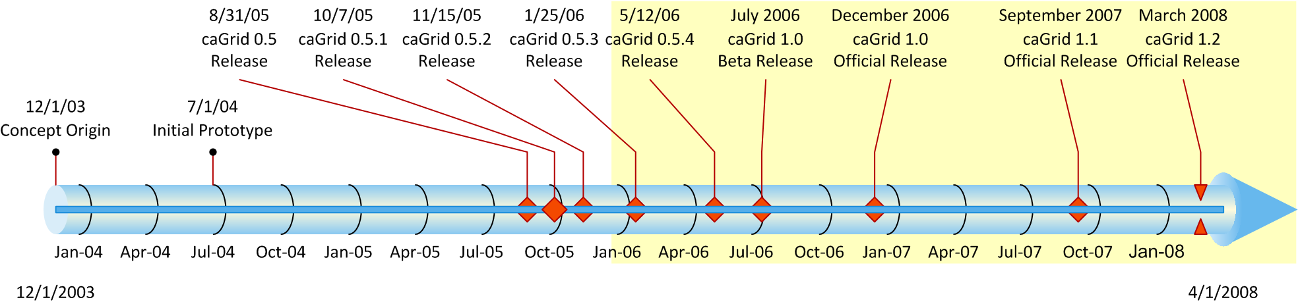
History of caGrid
Developed as the Grid toolkit for caBIG, 2004
The last stable release of caGrid was version 1.2, released mid March 2008

Slide 4

caGrid Suite
The “caGrid Suite” currently consists of 3 high-level products :
  caGrid Core Infrastructure
    consisting of the core services, APIs, and tools
    (DEMO: Introduce)
  caGrid Workflow Client
    focusing on making workflows usable by the scientific community (early integration with Taverna)
    (DEMO: Taverna Use)
  caGrid Portal
    providing a web-based application enabling discovery and interaction with the services that are available on the caGrid infrastructure
    (DEMO: Portal Use)

Slide 5
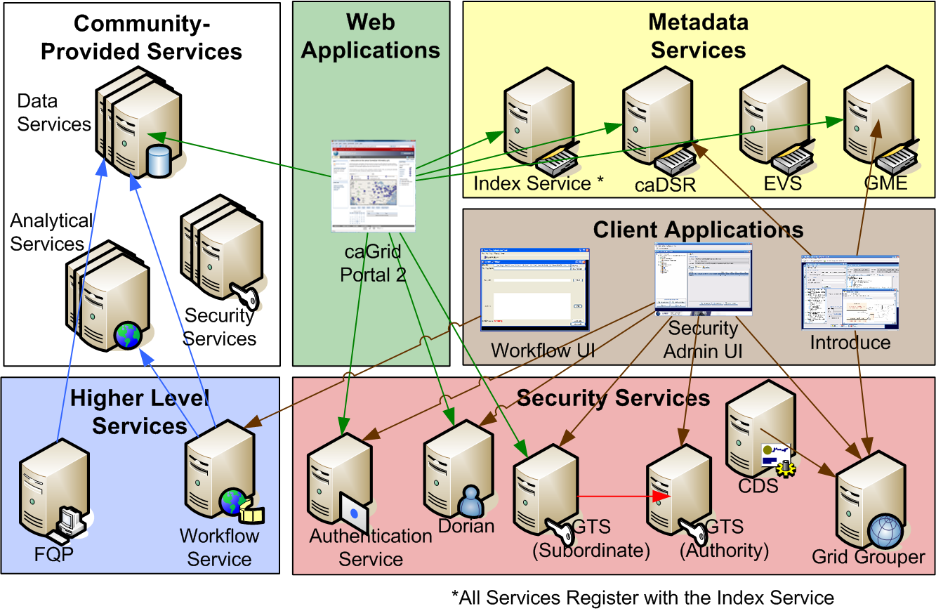
Core Infrastructure
Leveraging Grid technologies and standards as an interoperability platform
Metadata Infrastructure
Security
Service Developer Tooling
Facilitating Grid wide operations
Making the Grid more accessible
Quality

Slide 6
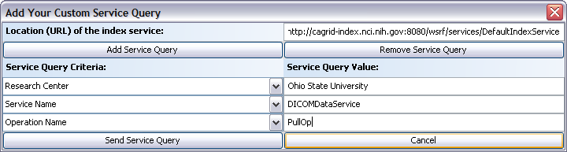
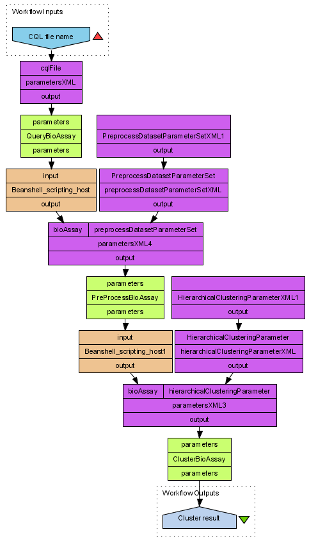
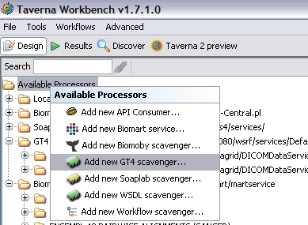
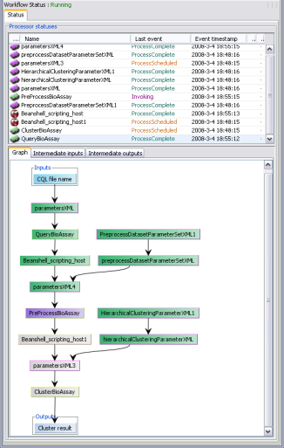
Workflow Client
Initiated as a response from user community feedback that authoring BPEL workflows was too difficult
Recommendation of working group to integrate with Taverna, a popular workflow tool created by the myGrid project, and funded through OMII-UK
  Explicit data flow modeling; implicit iteration
  Designed for scientists, not IT specialists
Integration to support locating and executing caGrid services
Ongoing work to integrate security, WSRF, and execution via caGrid workflow service

Slide 7
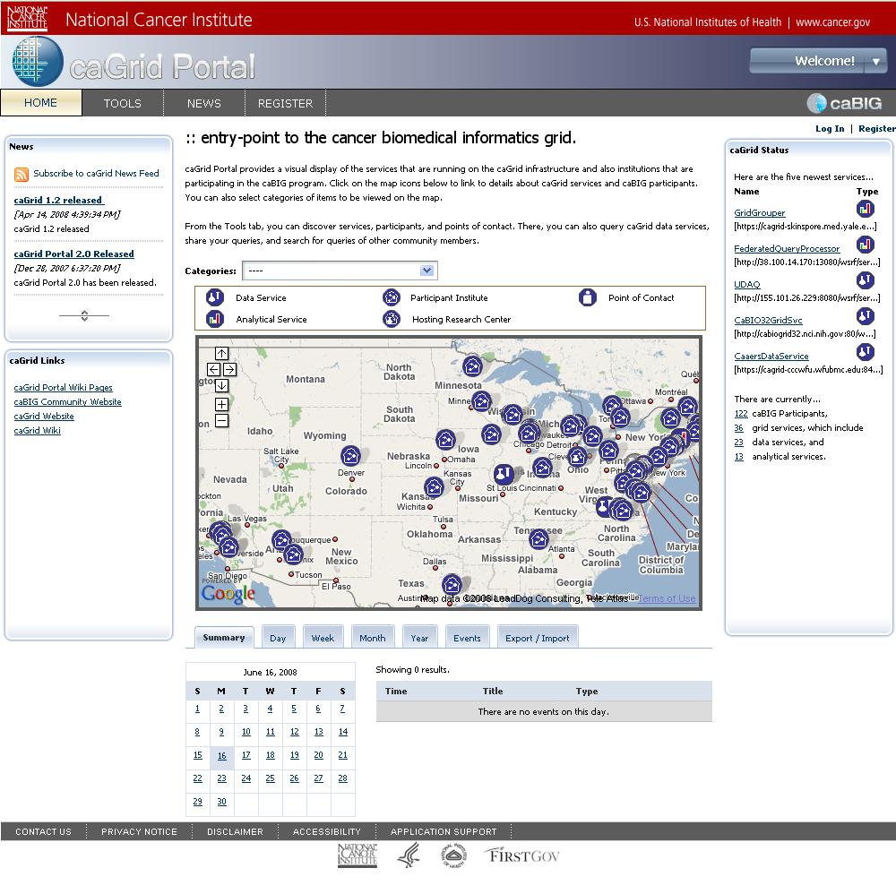
Portal 2
Created as a full-featured replacement for previous caGrid portal and caGrid browser web applications
  the primary visualization tool for the caGrid middleware
Features:
  Service Discovery
  Service Metadata Exploration
  Data Service Query
  Query Sharing
  caGrid Account Registration
  Grid Status Overview
  News and Events

