Slide 1

Generating caGrid Services
Shannon Hastings
Ohio State University
caBIG Annual Meeting
Washington D.C.
June 2008

Slide 2

Introduce Vision
Become the one stop shop for grid service development
  Provide a simple, yet powerful, graphical user interface (GUI) to encapsulate complexities of grid service development
  Provide an extensible toolkit with which grid services can be created and modified programmatically

Slide 3
Introduce
A framework which enables fast and easy creation of Globus and Standards based grid services.
Provide easy to use graphical service authoring tool.
Hide all “grid-ness” from the developer.
Utilize best practice layered grid service architecture.
Handle all core service architecture requirements for strongly typed and highly interoperable grid services.
Toolkit for creating and manipulating strongly typed grid services
  Command line and GUI tools for service skeleton generation and automatic service/client code generation
Utilizes other core grid services and architecture components
  caDSR and GME for schemas of registered data types
  Security service architecture (Dorian, GridGrouper, CSM)
  Advertisement and Registration configuration and
  Index Service for discovery

Slide 4
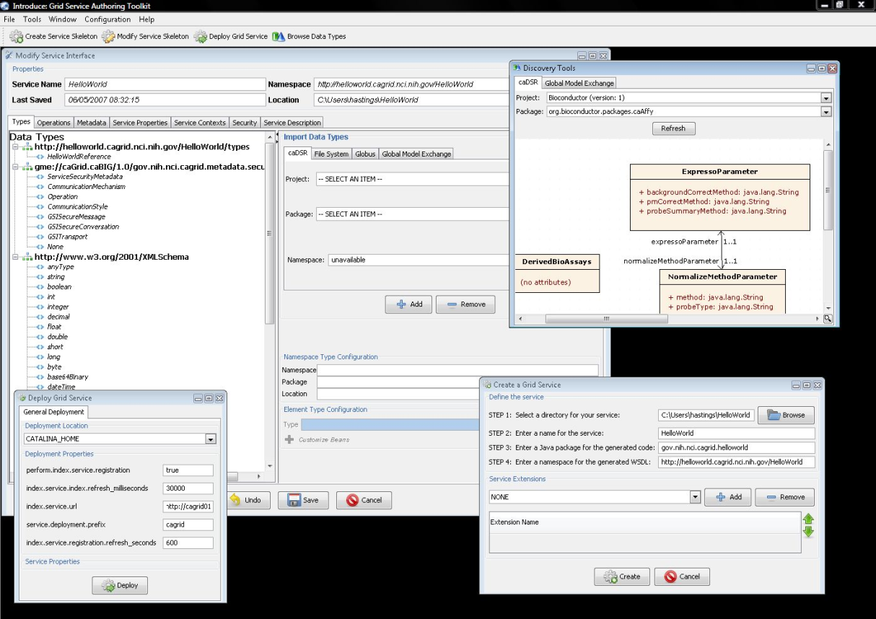
Introduce Graphical Development Environment (GDE)
GUI for creating and manipulating a grid service
  Provides means of simple creation of service skeleton that a developer can then implement, build, and deploy
  Automatic code generation of complete WSRF compliant grid service which is configured to provide:
    Security
    Advertisement
    Discovery
    Complete UnBoxed Client API
  Provides a set of tools which enable the developer to add/remove/modify/import methods of the service as well create sub-services/resources.
    Automatic code generation of all the required code, Globus grid service code/configuration, service configuration, implementation of the client, and stubbed implementation of the service

Slide 5
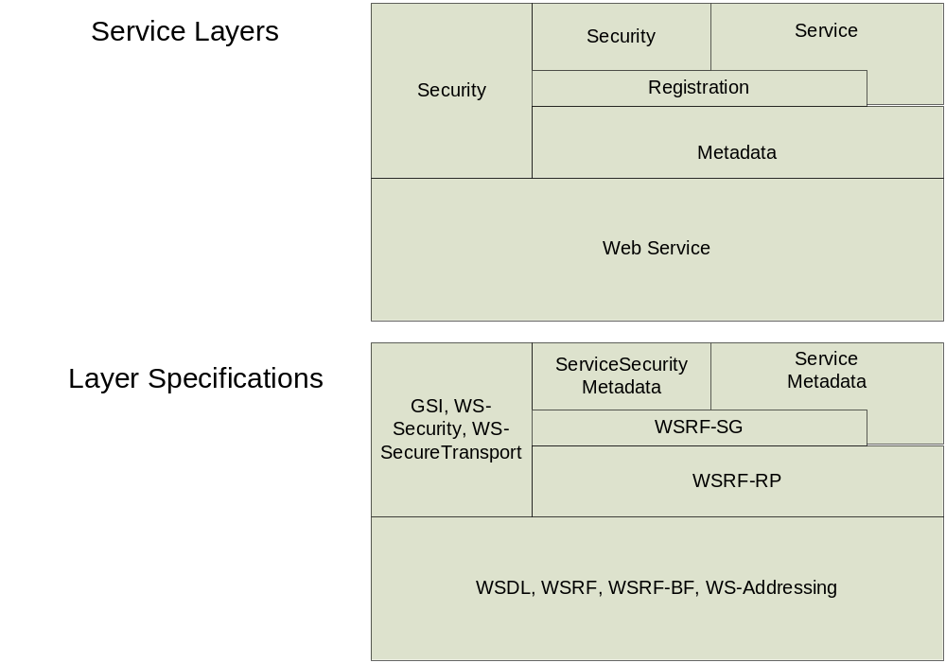
Addressing the Requirements
Grid Services
  Introduce uses the Globus Toolkit and Axis for creating, registering, discovering, and invoking these service operations as grid services
    Client uses the operation through a grid service interface and does not need to be aware of any implementation specific details of the grid service

Slide 6
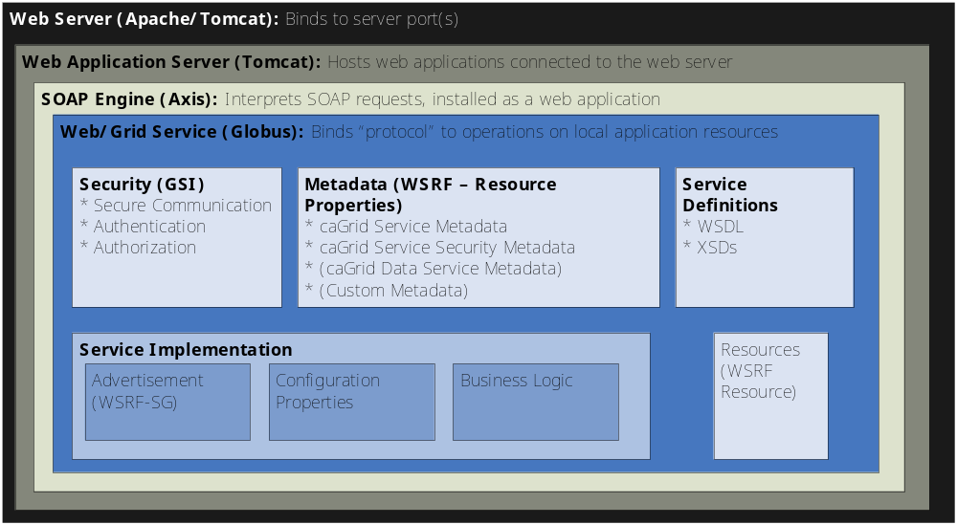
Service Layers

Slide 7
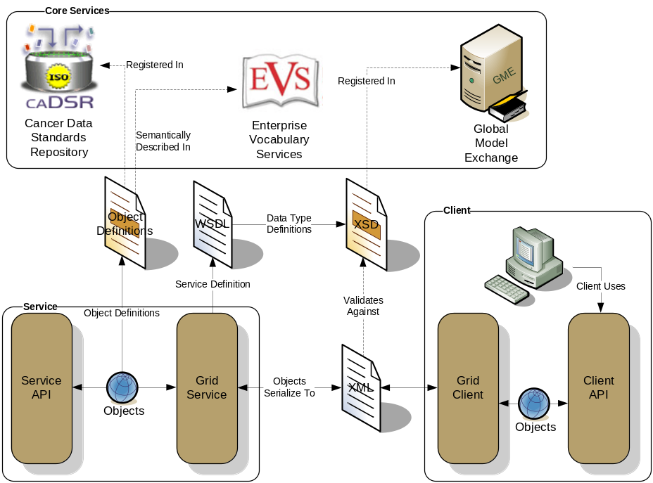
Addressing the Requirements (cont)
Strongly typed interfaces:
  Introduce enables schema extraction from a GME or any other data model registry service so that the wsdl, beans, and service metadata can be automatically populated and the service will be using strongly typed with publicly accessible data types.
  Data model schema, and any referenced schemas, are extracted and placed in the schema directory of the services build skeleton and imported into the services WSDL.
    types can be used at service build time to automatically generate the objects and create strongly-typed grid service interfaces
Example from caGrid

Slide 8
Addressing the Requirements (cont)
Providing Service Metadata:
  Leverage Globus’ use of Java Naming and Directory Interface (JNDI) in order to support WSRF.
  Service metadata is provided as resource properties on the base service’s singleton resource.
  These resource properties are defined by xml schema.

Slide 9
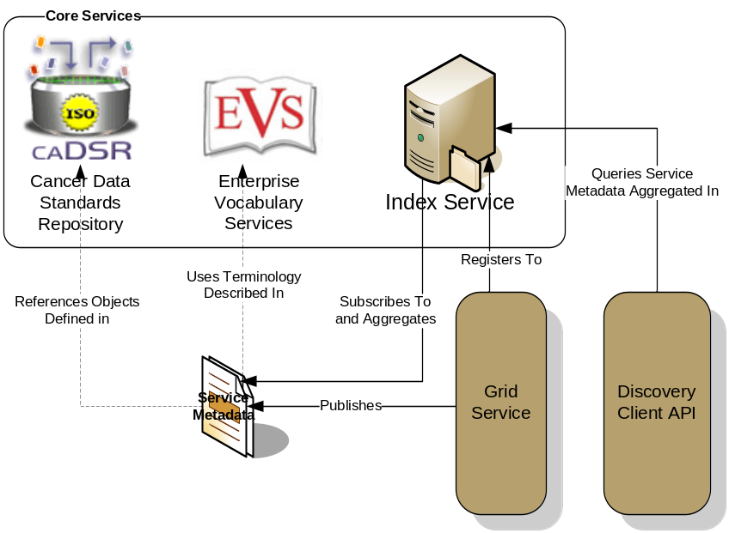
Addressing the Requirements (cont)
Index Service Registration
  Leverage Globus MDS in order to configure properties on the base resource of the service to be published to an MDS based Index Service.
  Provide configuration options for registration of static and dynamic service metadata which can then be used at runtime for service discovery.
Example from caGrid

Slide 10
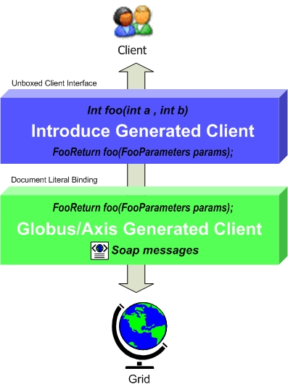
Addressing the Requirements (cont)
Providing Client Side Object Oriented API
  Globus/Axis build process will automatically generate a client side object oriented API
  Introduce generates a wrapper for this API which matches the service designers interface to make a clean mapping from client to service.
    This wrapper will handle auto boxing/unboxing of the parameters into and out of document literal form.

Slide 11
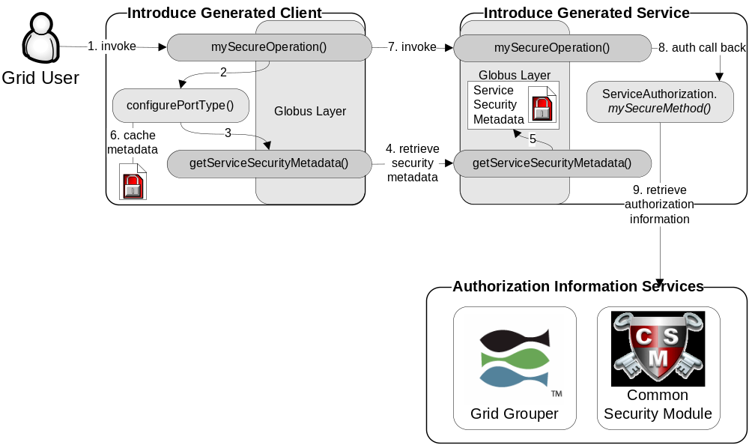
Addressing the Requirements (cont)
Security:
  Enable configuration for each service and for each method in a service.
  Support complete GSI security configuration for authentication and support for an authorization plug-in framework.
  Require service security metadata to be available anonymously via the grid service interface (getServiceSecurityMetadata()) or the grid service’s resource properties.

Slide 12
Recap Core Service Architecture
Base service is a GT4 based WSRF capable grid service.
Utilize compositional inheritance (in lieu of non-standard port type extensions) to enable the service to inherit required features such as providing service security metadata and access to resource properties.
Utilize JNDI for registration configuration, server side configuration properties, and resources and resource properties.
Provide client and service side wrappers which implement the service designers interface as opposed to the document literal interface generated by Axis.
Provide metadata registration to the index service by configuring the Resource to register it’s service groups to a predefined MDS based Index Service.
ServiceSecurityMetadata and it’s access operation enables programmatic bootstrapping of connection security configuration.

Slide 13
Demonstration
A caCORE generated data resource which is not connected to the grid.
Grid
caBIO

Slide 14

Exposing the Resource:
We will use the Introduce data service wizard to describe our data resource and generate a grid service.
Grid
caBIO

Slide 15




Exposing the Resource:
Introduce will enable the user to browse data model in the caDSR and chose the ones which they are going to be exposing.
GME
Grid
CQL query
processor
caBIO

Slide 16

Exposing the Resource:
Then they will locate the schemas which describe the data models and will provide the wire protocol for transferring data instances.
GME
Grid
CQL query
processor
caBIO

Slide 17

Exposing the Resource:
Lastly the user will have to provide a CQL query processor to enable CQL query to be executed against the data resource.
GME
Grid
CQL query
processor
caBIO

Slide 18


Exposing the Resource:
Introduce will create a grid service which can expose the data resource we described to the grid
Grid
caGrid
Data
Service
caBIO
caCORE CQL query
processor

Slide 19
Data now available.
Now that our service is generated we can deploy it so that the resource can be used.
Grid
GridService
caBIO
Grid
Service
caGrid
Data
Service
caBIO
caCore CQL query
processor

Slide 20
How will users find me
We need to expose metadata to a registry so that a user/service can locate and use our service
Grid
GridService
caBIO
Grid
Service
caGrid
Data
Service
caBIO
caCore CQL query
processor

Slide 21

How will users find me
We will send our metadata to an index service that can be queried by grid users.
Grid
GridService
caBIO
Grid
Service
caGrid
Data
Service
caBIO
caCore CQL query
processor
Index Service

Slide 22
Data Service Overview
caGrid Data Services provide capability to expose data resources to the Grid
Specialization of caGrid grid services to expose data through a common query interface
  Meet all base service requirements of caGrid services
Present an object view of data sources
  Exposed objects are registered in caDSR and their XML representation in GME
  Data Service Metadata describes information model
  Queries made with CQL Query objects
    Results returned as objects nested in a CQL Query Result Set
Graphical Development tool, implemented as an extension to the Introduce Toolkit, is used to create the new grid service

Slide 23
Data Service Query Language
Simple, “minimum entry” for data providers
Specifies a target object (result) type and selects the instances which satisfy the specified properties and nested object properties
  Allows path navigation
  Provides logical grouping
  Provides name/predicate/value filtering on properties of objects
Recursively defined
Ability to return full Objects, Set of attributes, count of results, or distinct attribute values

Slide 24
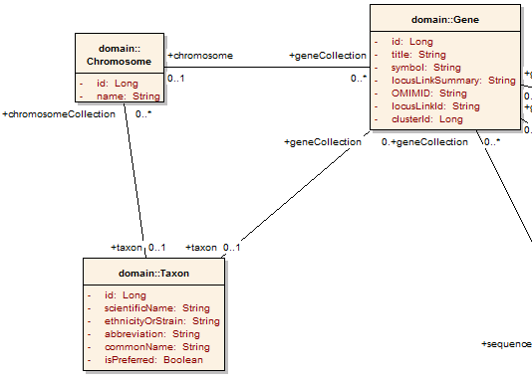
Example CQL Query
Return all Genes with a symbol beginning with BRCA and have an associated Taxon with a scientificName equal to “Homo sapiens”:
<CQLQuery xmlns="http://CQL.caBIG/1/gov.nih.nci.cagrid.CQLQuery"> <Target name="gov.nih.nci.cabio.domain.Gene"> </Target> </CQLQuery>

Slide 25
Example CQL Query
LIKE “BRCA%”
Return all Genes with a symbol beginning with BRCA and have an associated Taxon with a scientificName equal to “Homo sapiens”:
<CQLQuery xmlns="http://CQL.caBIG/1/gov.nih.nci.cagrid.CQLQuery"> <Target name="gov.nih.nci.cabio.domain.Gene"> <Attribute name="symbol" predicate="LIKE“ value="BRCA%"/> </Target> </CQLQuery>

Slide 26
Example CQL Query
LIKE “BRCA%”
Return all Genes with a symbol beginning with BRCA and have an associated Taxon with a scientificName equal to “Homo sapiens”:
<CQLQuery xmlns="http://CQL.caBIG/1/gov.nih.nci.cagrid.CQLQuery"> <Target name="gov.nih.nci.cabio.domain.Gene"> <Group logicRelation="AND"> <Attribute name="symbol" predicate="LIKE“ value="BRCA%"/> <Association roleName="taxon“ name="gov.nih.nci.cabio.domain.Taxon"> </Association> </Group> </Target> </CQLQuery>

Slide 27
Example CQL Query
LIKE “BRCA%”
Return all Genes with a symbol beginning with BRCA and have an associated Taxon with a scientificName equal to “Homo sapiens”:
<CQLQuery xmlns="http://CQL.caBIG/1/gov.nih.nci.cagrid.CQLQuery"> <Target name="gov.nih.nci.cabio.domain.Gene"> <Group logicRelation="AND"> <Attribute name="symbol" predicate="LIKE“ value="BRCA%"/> <Association roleName="taxon“ name="gov.nih.nci.cabio.domain.Taxon"> <Attribute name=“scientificName" predicate=“EQUAL_TO” value=“Homo sapiens"/> </Association> </Group> </Target> </CQLQuery>
= “Homo sapiens”

Slide 28

Service Creation Demonstration
Service Creation Demonstration:
create a caBIO grid data service

Slide 29
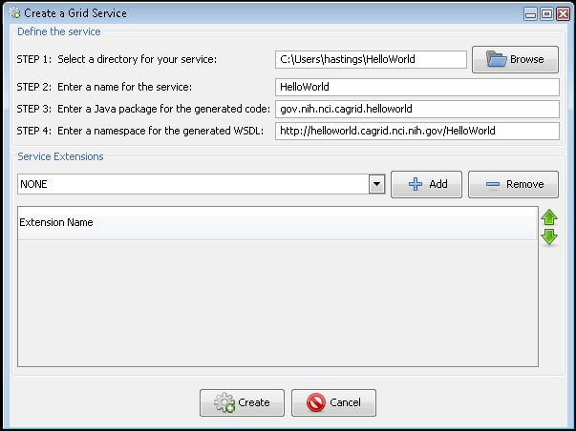
Service Creation
Populate required variables for service creation
  Name = published service name
  Creation Direction = directory to create the skeleton
  Package = the java package you wish to use for your service
  Namespace Domain = the namespace to be used to define the service interface and types
Choose Extensions

Slide 30
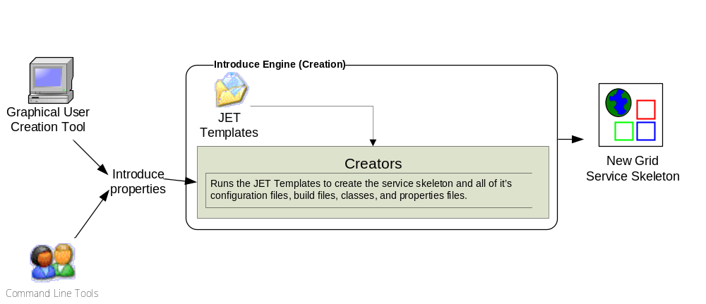
Introduce Service Creation Architecture
The Introduce Service Properties are a set if base properties
required for creating this service such as desired location to
create the service, namespace to use, package name to use,
and service name.

Slide 31
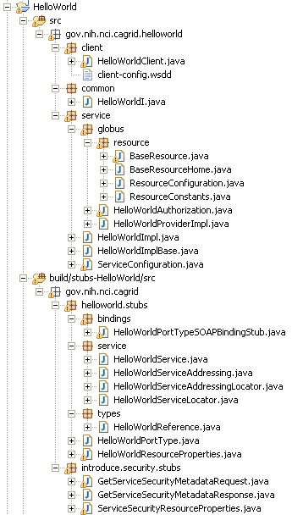
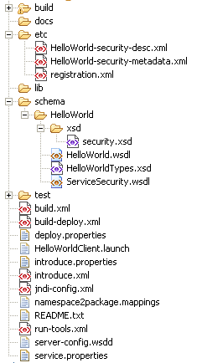
Created Skeleton Layout
= introduce managed
= globus/axis managed
= developer implements

Slide 32
Created Skeleton Layout (cont)
= implements the developer
defined interface and calls into
the generated client port type
stub.
= the developer defined grid
service interface
= manages the resources
of this grid service
= implements the port type
and calls into the actual
clean unboxed interface
the developer defined.
= developers implementation
of the defined interface.

Slide 33
Created Skeleton Layout (cont)
= service metadata registration configuration
= describes the services security configuration
= services WSDL file for axis
= introduce properties for this service
= ant build files
= client configuration file for axis
= deployment time service properties
= introduce representation of service
= JNDI service resources configuration
= namespace mappings for axis
= server configuration file for axis

Slide 34

Inside the Introduce created service
Services have many moving and configurable parts which support features such as:
  Advertisement
  Discovery
  Invocation
  Security (Authentication/Authorization)
  Stateful Resources
The Introduce Toolkit can keep all these features in sync as the developer creates and modifies the grid service

Slide 35
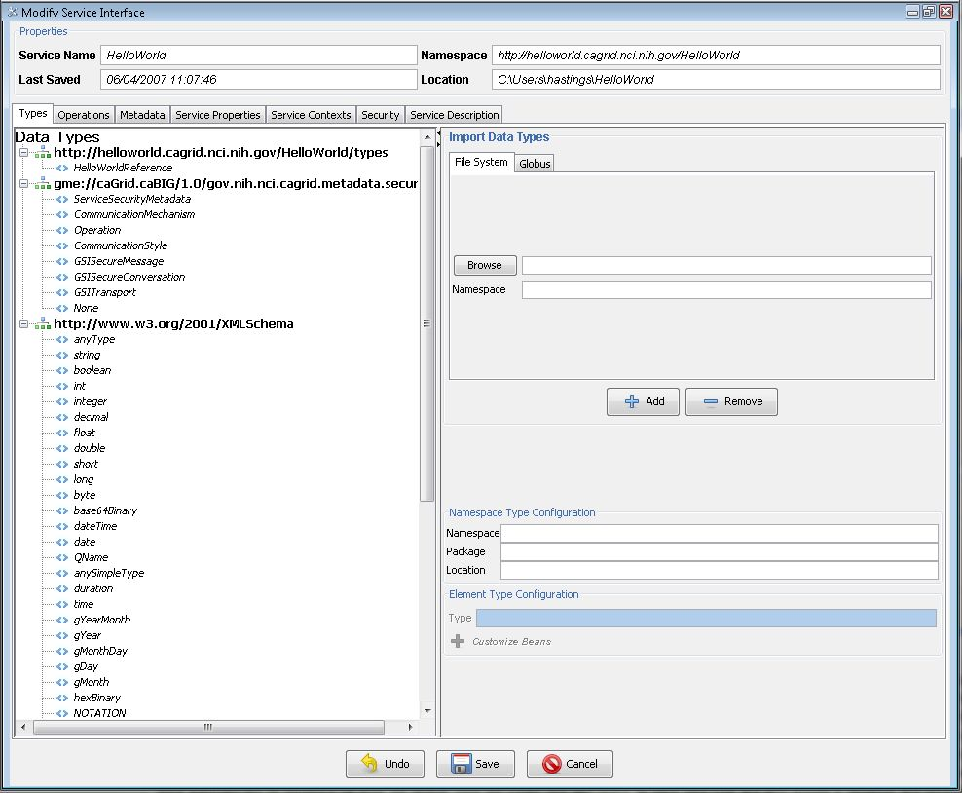
Modification
Add/Remove/Modify
Operations
Resource properties
Service properties
Service contexts (services and resources)
Service, method, and resource level security settings

Slide 36
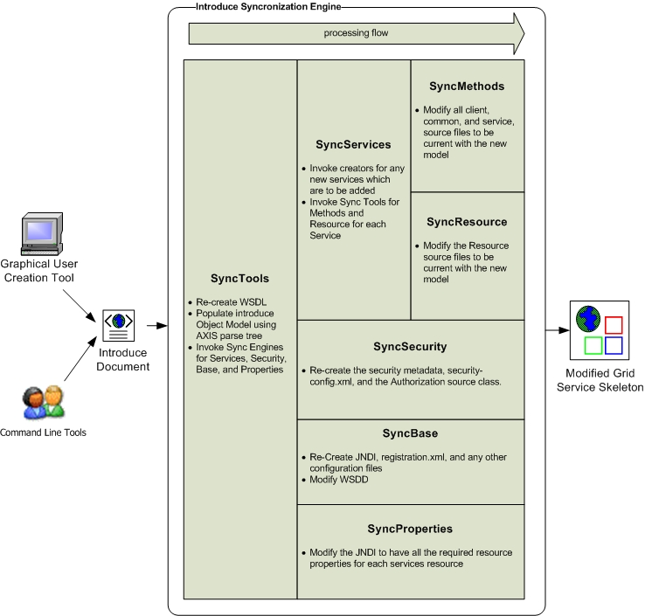
Introduce Service Modification Architecture
The Introduce Service Description document is the input to the introduce engine. The user can hand craft this document and call the engine via command line or API or can use the Introduce GDE to create and modify this document and execute the synchronization engine

Slide 37
Service Deployment and Invocation Demonstration
Service Deployment and Invocation Demonstration
Implement client test function
Deploy caBIO grid service
Start up service container
Invoke client to with CQL query

