Slide 1
caGrid 1.0 Update
Architecture/VCDE Workspaces
Joint Face to Face
February 1st-2nd, 2006

Slide 2
Overview
caGrid Team
High Level Timeline
Use cases / Requirements
  Analytical Service Enhancements
  Data Service Enhancements
  Security Infrastructure Enhancements
  Metadata Management
  Workflow Middleware
  Object Identifiers
  caGrid 1.0 Portal/Monitor
  Workflow Adoption

Slide 3
caGrid 1.0 Goals
caGrid 1.0 “Production Release” focus
  caGrid 0.5 gaps
  caGrid infrastructure components that did not make it in 0.5
System Testing
Production Deployment
Migration Support for caGrid 0.5 services and users to caGrid 1.0
End User Guides
caBIG “Gold” compliance guidelines and specification

Slide 4
caGrid 1.0 Team
Ohio State University
  Analytical Service Enhancement
  Security Infrastructure
  Metadata Management
University of Chicago
  Workflow Middleware
  Object Identifiers
  Data Service Enhancement
Georgetown University
  caGrid 1.0 Portal
Duke University
  Workflow Architecture Adopter

Slide 5
Project Resources
caGrid 1.0 GForge Home:
  Feature Requests
  Bug Reports
  Discussion Forums
  Public Wiki
  Downloads / Source Repository
  http://gforge.nci.nih.gov/projects/cagrid-1-0/
caGrid Users Mailing List
  https://list.nih.gov/archives/cagrid_users-l.html
  cagrid_users-l@list.nih.gov

Slide 6
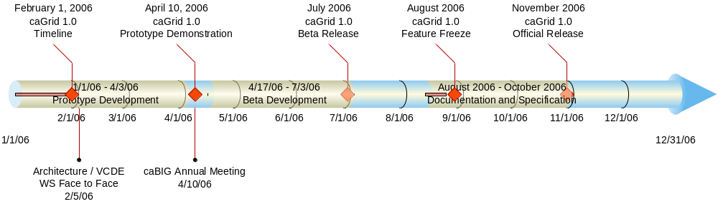
caGrid 1.0 Timeline

Slide 7
caBIG Annual Meeting Target
Integrated Scientifically Relevant Demonstration Scenario
  Creation of Grid services via Introduce
    Data and Analytical Services with “real world” overlapping data models
  Securely deploy the services
  Obtain grid credentials using Dorian leveraging an Institutional Identity Provider
  Show Portal/Monitor geospatial view of services and metadata
  Create meaningful scientific workflow over services
    Query multiple data services, aggregate and iterate over results invoking analytics
  Execute and monitor workflow
  Display results

Slide 8
Introduce Service Creation Framework
Goal:
  Enable easy path to caBIG gold compatible service creation.
Basic Features:
  Supports creation of custom caBIG compatible grid services
    Including analytical, data, as well as purely custom.
  Provides graphical service creation environment.
  Takes user from service creation through deployment.
  Enforces strongly typed interfaces via GME type discovery.
  Enables easy configuration for security, registration, and metadata publication.

Slide 9
Introduce Features
Creates Globus based grid service
  Handles the creation and synchronization of:
    Service Interface
    Client implementation
    Sever stubbed implementation
    Resource Properties for Service Metadata
    Index service registration configuration
    Method level and service level security configuration as well as client side security configuration
    Deployment configuration parameters
  Can be modified even after implementation
  Deployment scripts and configuration files
  Graphical and command line tools for all aspects.
  Creates an eclipse project for quick and easy implementation

Slide 10
Analytical Services
Introduce is the core framework for building ANY services in caGrid.
It can be used to generate Analytical , Data, or Completely Custom services such as core services.
The core service framework that Introduce creates for caGrid services handles all the basic core requirements that are expects of any grid service such as
  Service advertisement
  Service metadata registration
  Security configuration
  Strongly typed interfaces

Slide 11
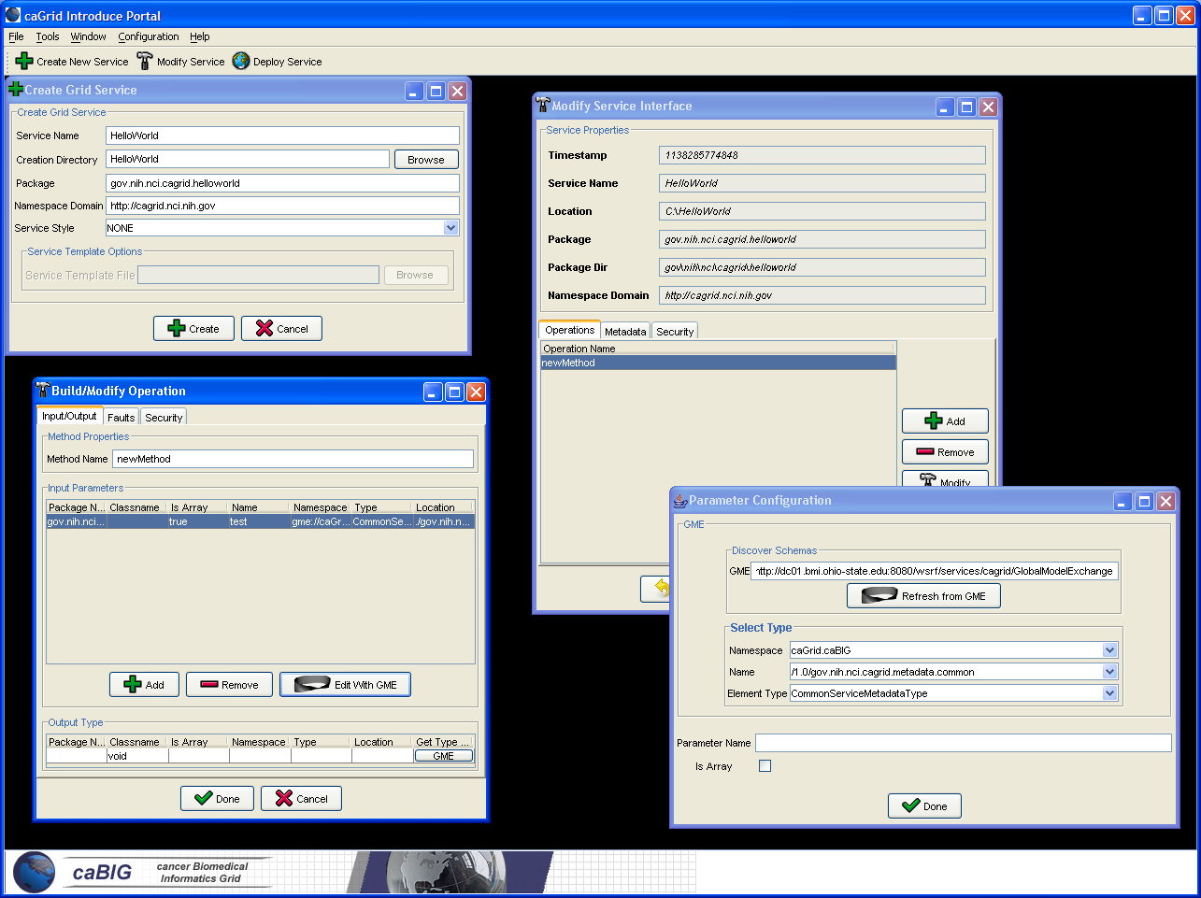

Slide 12
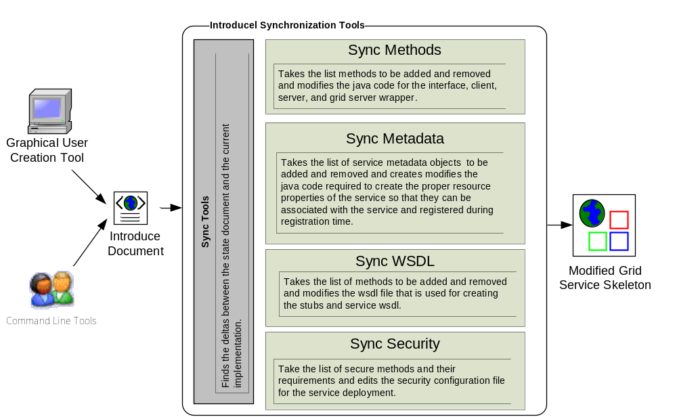
Overview of Current Introduce Framework

Slide 13
Data Service
Slides

Slide 14
caGrid 1.0 Security
Goals:
  Focus is on getting the basic building blocks in place to facilitate the secure deployment of multi-institutional production applications.
  Leveraging/Extending work done in the Grid, caBIG, and other related communities to provide a enterprise solution.
  caGrid implementation efforts are not focused on policy but on providing the building blocks that the community can use for implementing policy.
  Streamlined integration within caGrid (via Introduce)
What will the infrastructure be based on?
  Relevant existing caGrid 0.5 security
  caGrid 0.5 lessons learned
  caBIG Security Evaluation White Paper
  Use cases submitted by the community
  Requirement Solicitation for caGrid Security
  Architecture Working Groups

Slide 15
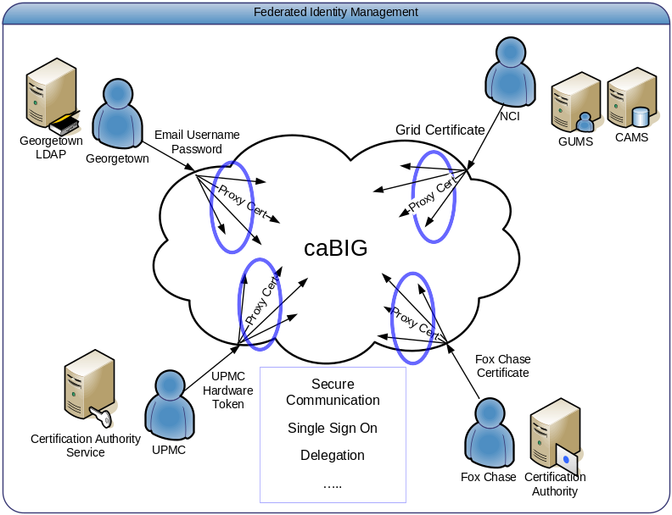
caGrid 1.0 Security – Areas of Focus
Federated Identity Management
  Enable users to use their institution provided identity for authenticating to the Grid.
Service Provider Credential Provisioning
  In order for services to invoke other services, they will need to have credentials.
  We want to provide a streamlined approach to credential provisioning
Authorization
  Authorization is finding out if the person, once identified, is permitted to have the resource.
  We want to empower service providers to make authorization decisions.

Slide 16
caGrid 1.0 Security – Areas of Focus
Building a Trust Fabric / Trust Management
  Grid Security is built on Trust
  User / Services are authenticated based on whether there credentials are signed by a trusted authority
Virtual Organizations
  Users with common attributes should be able to be grouped into organizations based on common characteristics, and should be able to manage resource usage, permissions, and group membership.
caGrid Integration
  Streamline all aspects of security into the service development and deployment process.
  Service Security will be configurable through the Introduce Toolkit.

Slide 17
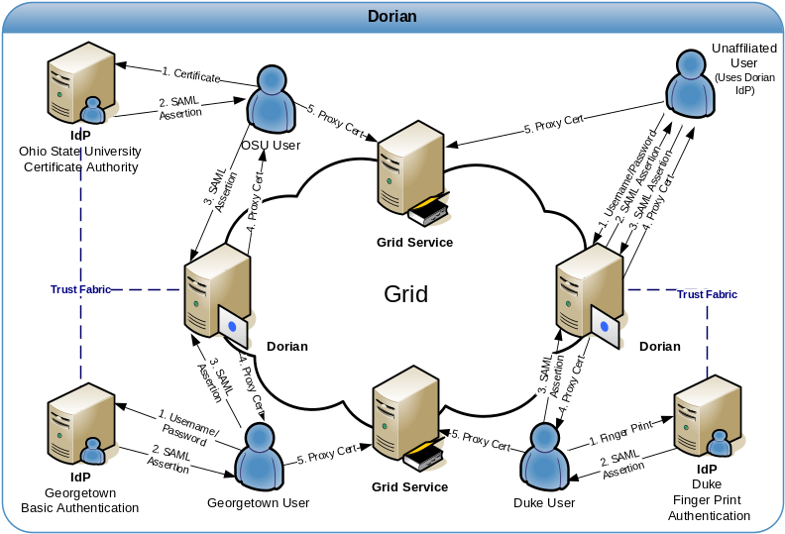
caGrid 1.0 Security – Status
Federated Identity Management
  GUMS redesigned and rename to Dorian to address Federated Identity Management Requirement.
  Prototype Completed.
Dorian
  Enables users to authenticate and create grid proxies via their institution’s Identity Provider (IdP)
  Internal Dorian IdP allows unaffiliated users or small institutions access to the grid.
  Internal Certificate Authority / ability to integrate with existing Certificate Authorities
  Administration Interface
    Configurable/Extensible User Policies
    User Management
    Trusted IdP Management

Slide 18
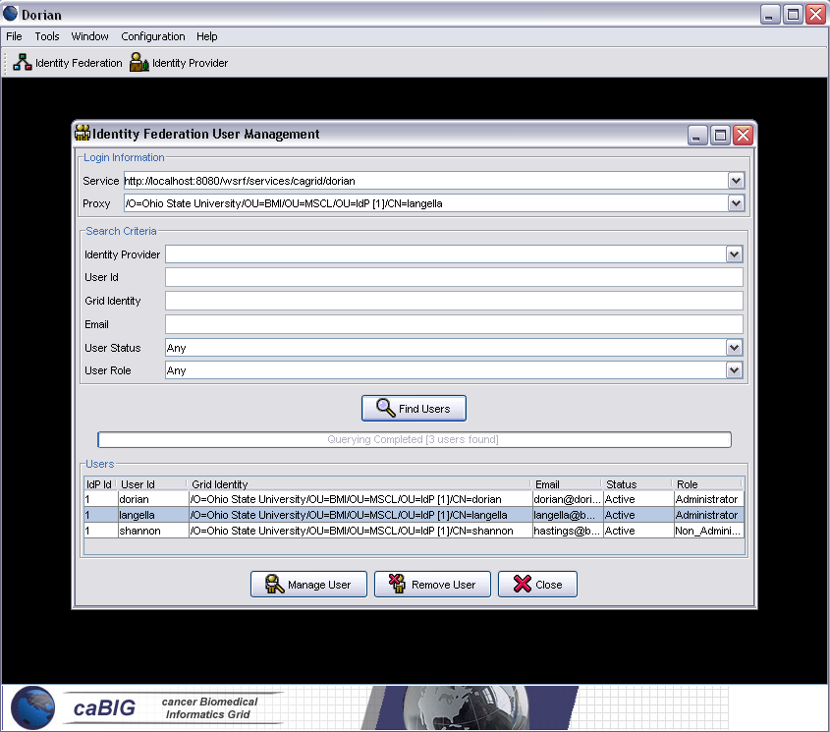
caGrid 1.0 Security – Status
Dorian Current Status
  Initial service implementation completed
  Integrated with Ohio State University IdP
  Initial administration portal completed
  ~ 100 Nightly Unit Tests
  Dorian technical paper completed.
Community Participation Needed
  Community standardization of the SAML authentication assertions.
    Probably will need a small working group with members from ARCH and VCDE
  Early adopters needed
    Integration between Cancer Center IdPs and Dorian

Slide 19
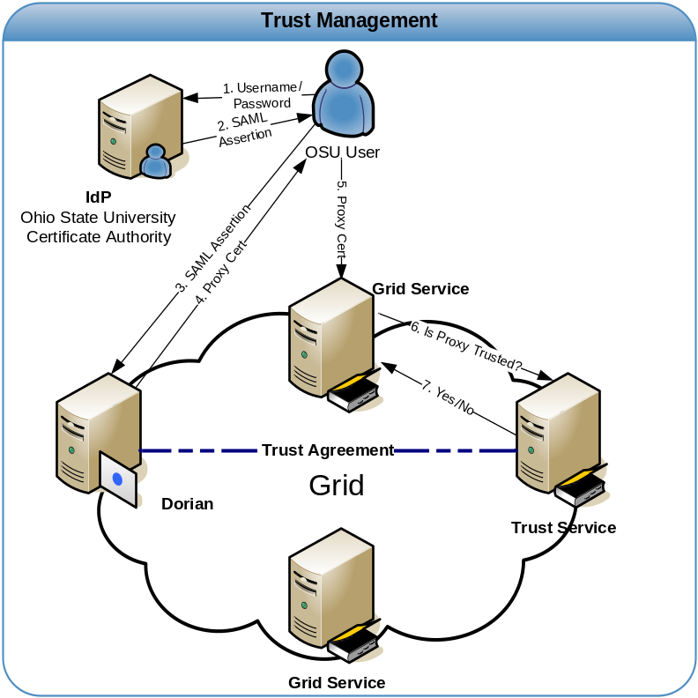
caGrid 1.0 Security – Status
Service Provider Credential Provisioning
  Middle of Design Phase
  Provide an online CA for provisioning credentials
  Integration with Introduce Toolkit
Trust Management
  Middle of Design Phase
  Create a Trust Service for Managing Trusted Authorities

Slide 20
caGrid 1.0 Security – Status
Authorization
  We will provide a callout mechanism which service providers can implement for providing custom authorization.
    Empowers authorization decisions to be made locally.
  Early Design Phase
  Discussing Possible Approaches and what is needed in terms of grid infrastructure.
  Working Group Proposed
Virtual Organizations
  Early Design Phase
  Discussing whether or not and what grid infrastructure is required
    Closely Related to Authorization

Slide 21
caGrid 1.0 Security – Annual Meeting
Federated Identity Management
  Initial Dorian Implementation Completed and Deployed
  Demonstration
Authorization
  Call back mechanism will be in place allowing locally made authorization decisions
  Design Phase Completed.
Service Credential Provisioning
  Design Phase Completed.
  Early – Mid Implementation / Deployment
  Prototype may be available
Trust Management
  Design Phase Completed.
  Early – Mid Implementation / Deployment
  Prototype may be available
Introduce Integration
  Core Grid Security Integrated
  Demonstration

Slide 22
caGrid Metadata Infrastructure Goals
Advertisement and Discovery
  New standards for service metadata (VCDE Harmonized)
  Migration of Advertisement and Indexing Infrastructure
  Migration and Enhancements of Discovery API
Data Description Metadata Management
  GME Migration
  Grid Service Access to information in caDSR
  Incorporation of existing XML schemas
  LexGrid integration

Slide 23
Metadata: Advertisement and Discovery
Advertisement:
  The caGrid Grid Service Owner composes service metadata describing the service to the grid and publishes it to grid. The service metadata describes properties of the grid services that caGrid users and other grid services may query.
Discovery:
  A caGrid Researcher specifies search criteria describing a service. The research submits the discovery request to a discovery service, which identifies a list of services matching the criteria, and returns the list to the researcher.
Use Cases:
  Publish advertisement a Grid Service
  Remove advertisement of a Grid Service
  Update advertisement of a Grid Service
  Discover advertisement a Grid Service

Slide 24
Metadata: Data Description Metadata Management
GME
  GME is a DNS-like data definition registry and exchange service that is responsible for storing and linking together data models in the form of XML schema.
  caDSR data objects which travel the grid as XML do so in the format described in GME-registered schemas
  Tasks:
    Migration of service interface to Globus 4
    Incorporation of existing XML schemas
caDSR
  Tasks:
    Grid service interface to access high-level model information
    Process for tighter mapping between caDSR (objects) and GME (XML)
LexGrid
  Designed to bridge terminologies and ontologies with a common set of tools, formats and update mechanisms. Will make information in EVS available.
  Tasks:
    Support LexGrid team needs for metadata, discovery, and grid service.

Slide 25
Metadata Functionality for Annual Meeting
Service infrastructure for service metadata creation and advertisement
Index Service
GME Service
Preliminary Discovery API Migration

Slide 26
Workflow
Slides

Slide 27
Identifiers
Slides

Slide 28
Portal
Slides

Slide 29
Duke’s Role in caBIG
ICR, VCDE, and Architecture participant
Architecture
  Liaison to ICR
  Formerly Workflow SIG Lead
  Formerly active in Data SIG
ICR
  Liaison to Architecture
  Active in Data/Analysis Tools SIG and Proteomics SIG
  Developer in proteomics SIG
VCDE
  Active in various interoperability reviews

Slide 30
Duke’s Role in caGrid
caGrid adopter
  Use case solicitation/drafting
    Binary data, metadata, provenance
  Document review
  Testing
    Introduce, analytical/data services, security, portal, etc.
  Code review
Workflow adopter
  Use case solicitation/drafting
  Document review
  Testing
    Each major milestone
    Also some home-grown multi-domain tests

Slide 31
Duke’s caGrid Role in the
Annual Meeting
Help provide use cases for demos
  Workflow, analytical, and data services
Help with deployment of demos
Help with testing of demos

Slide 32
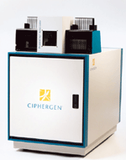

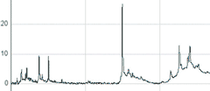
Potential Workflow Demo
Data Files
Samples
Instrumentation
Wet Lab
RProteomics
udwtW
(denoising)
Interpolation
alignx
(alignment)
Running Quantile
(bkg removal)
loess
(bkg removal)
Plot
MAD
(normalize)
Plot

Slide 33




Potential Services Demo
Grid Data Query
DWD
Grid Analysis Invocation

Slide 34
caGrid 1.0 Update
Architecture/VCDE Workspaces
Joint Face to Face
February 1st-2nd, 2006

