Slide 1

Introduce
Grid Service Authoring Toolkit
Shannon Hastings, Scott Oster,
Stephen Langella, David Ervin
Ohio State University
Software Research Institute
{hastings,oster, langella,ervin}@bmi.osu.edu
OGF 21 Oct 2007

Slide 2
Introduce
A framework which enables fast and easy creation of Globus based grid services.
Provide easy to use graphical service authoring tool.
Hide all “grid-ness” from the developer.
Utilize best practice layered grid service architecture.
Handle all core service architecture requirements for strongly typed and highly interoperable grid services.
Toolkit for creating and manipulating strongly typed grid services
  Command line and GUI tools for service skeleton generation and automatic service/client code generation
Utilizes other core grid services and architecture components
  caDSR and GME for schemas of registered data types
  Security service architecture (Dorian, GridGrouper, CSM)
  Advertisement and Registration configuration and
  Index Service for discovery

Slide 3
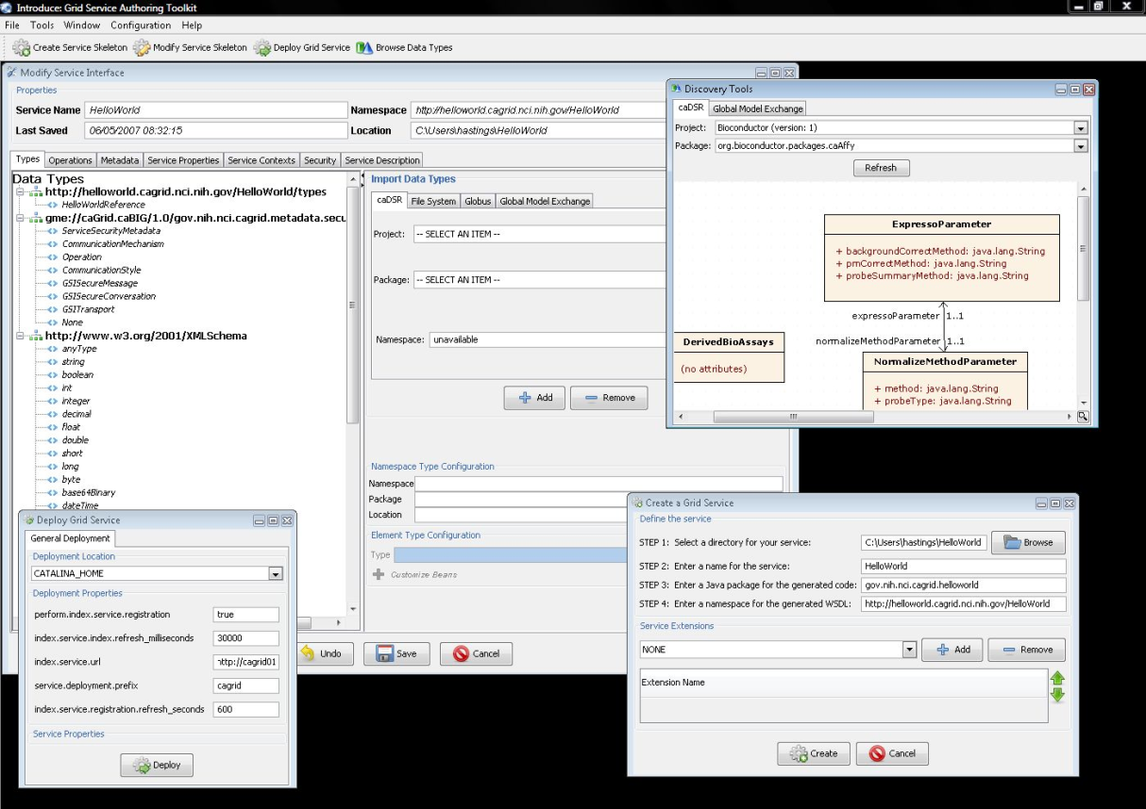
Introduce Graphical Development Environment (GDE)
GUI for creating and manipulating a grid service
  Provides means of simple creation of service skeleton that a developer can then implement, build, and deploy
  Automatic code generation of complete WSRF compliant grid service which is configured to provide:
    Security
    Advertisement
    Discovery
    Complete UnBoxed Client API
  Provides a set of tools which enable the developer to add/remove/modify/import methods of the service as well create sub-services/resources.
    Automatic code generation of all the required code, Globus grid service code/configuration, service configuration, implementation of the client, and stubbed implementation of the service

Slide 4
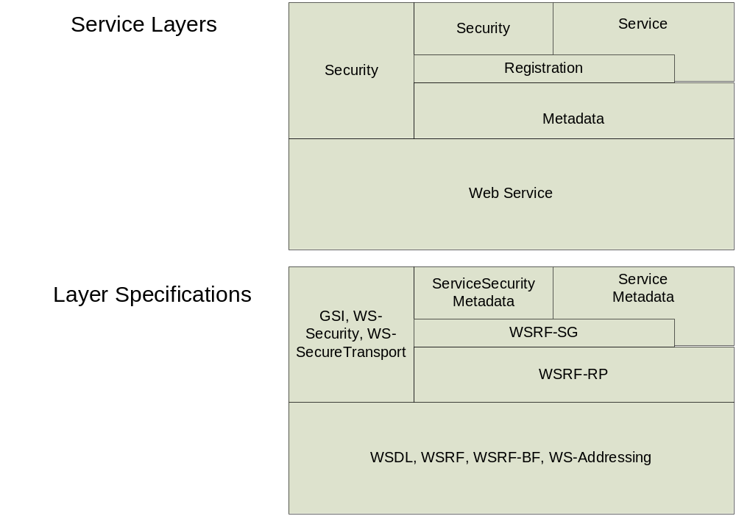
Addressing the Requirements
Grid Services
  Introduce uses the Globus Toolkit and Axis for creating, registering, discovering, and invoking these service operations as grid services
    Client uses the operation through a grid service interface and does not need to be aware of any implementation specific details of the grid service

Slide 5
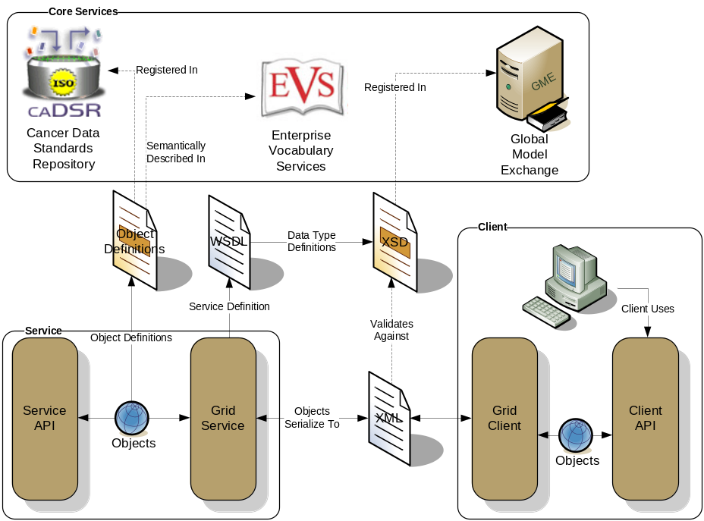
Addressing the Requirements (cont)
Strongly typed interfaces:
  Introduce enables schema extraction from a GME or any other data model registry service so that the wsdl, beans, and service metadata can be automatically populated and the service will be using strongly typed with publicly accessible data types.
  Data model schema, and any referenced schemas, are extracted and placed in the schema directory of the services build skeleton and imported into the services WSDL.
    types can be used at service build time to automatically generate the objects and create strongly-typed grid service interfaces
Example from caGrid

Slide 6
Addressing the Requirements (cont)
Providing Service Metadata:
  Leverage Globus’ use of Java Naming and Directory Interface (JNDI) in order to support WSRF.
  Service metadata is provided as resource properties on the base service’s singleton resource.
  These resource properties are defined by xml schema.

Slide 7
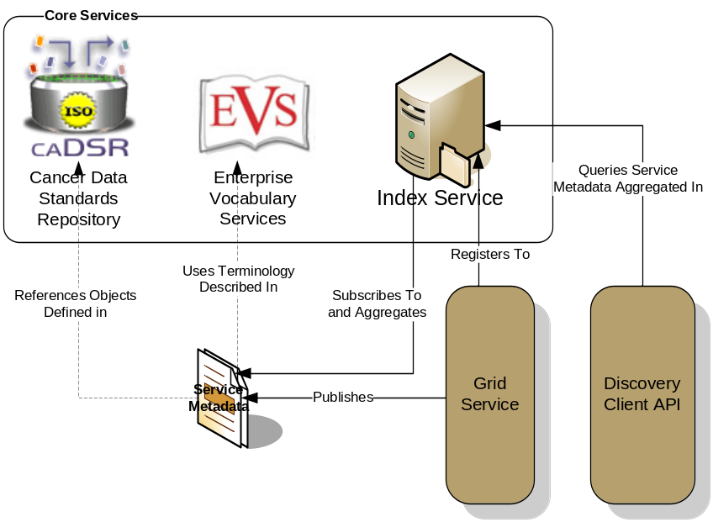
Addressing the Requirements (cont)
Index Service Registration
  Leverage Globus MDS in order to configure properties on the base resource of the service to be published to an MDS based Index Service.
  Provide configuration options for registration of static and dynamic service metadata which can then be used at runtime for service discovery.
Example from caGrid

Slide 8
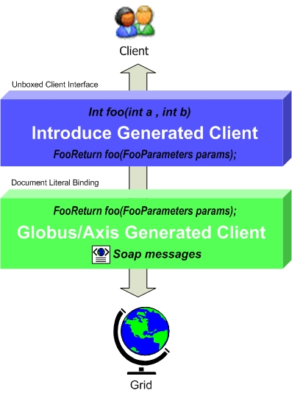
Addressing the Requirements (cont)
Providing Client Side Object Oriented API
  Globus/Axis build process will automatically generate a client side object oriented API
  Introduce generates a wrapper for this API which matches the service designers interface to make a clean mapping from client to service.
    This wrapper will handle auto boxing/unboxing of the parameters into and out of document literal form.

Slide 9
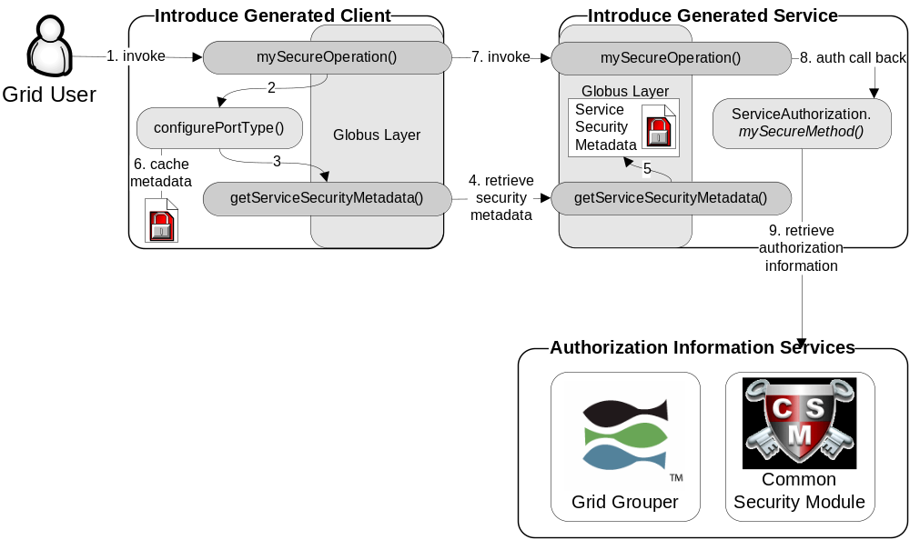
Addressing the Requirements (cont)
Security:
  Enable configuration for each service and for each method in a service.
  Support complete GSI security configuration for authentication and support for an authorization plug-in framework.
  Require service security metadata to be available anonymously via the grid service interface (getServiceSecurityMetadata()) or the grid service’s resource properties.

Slide 10
Recap Core Service Architecture
Base service is a GT4 based WSRF capable grid service.
Utilize compositional inheritance (in lieu of non-standard port type extensions) to enable the service to inherit required features such as providing service security metadata and access to resource properties.
Utilize JNDI for registration configuration, server side configuration properties, and resources and resource properties.
Provide client and service side wrappers which implement the service designers interface as opposed to the document literal interface generated by Axis.
Provide metadata registration to the index service by configuring the Resource to register it’s service groups to a predefined MDS based Index Service.
ServiceSecurityMetadata and it’s access operation enables programmatic bootstrapping of connection security configuration.

Slide 11
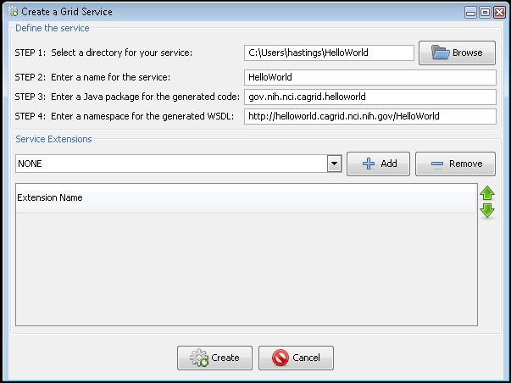
Service Creation
Populate required variables for service creation
  Name = published service name
  Creation Direction = directory to create the skeleton
  Package = the java package you wish to use for your service
  Namespace Domain = the namespace to be used to define the service interface and types
Choose Extensions

Slide 12
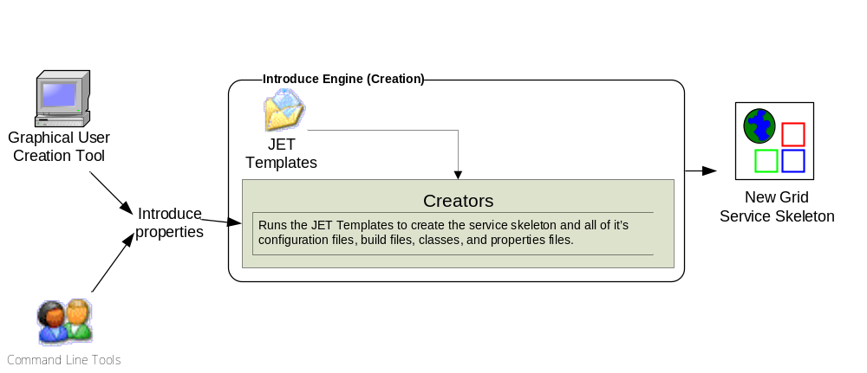
Introduce Service Creation Architecture
The Introduce Service Properties are a set if base properties
required for creating this service such as desired location to
create the service, namespace to use, package name to use,
and service name.

Slide 13
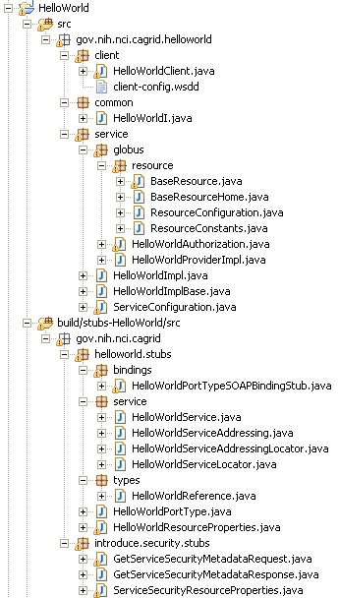
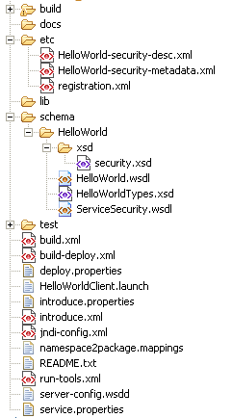
Created Skeleton Layout
= introduce managed
= globus/axis managed
= developer implements

Slide 14
Created Skeleton Layout (cont)
= implements the developer
defined interface and calls into
the generated client port type
stub.
= the developer defined grid
service interface
= manages the resources
of this grid service
= implements the port type
and calls into the actual
clean unboxed interface
the developer defined.
= developers implementation
of the defined interface.

Slide 15
Created Skeleton Layout (cont)
= service metadata registration configuration
= describes the services security configuration
= services WSDL file for axis
= introduce properties for this service
= ant build files
= client configuration file for axis
= deployment time service properties
= introduce representation of service
= JNDI service resources configuration
= namespace mappings for axis
= server configuration file for axis

Slide 16

Inside the Introduce created service
Services have many moving and configurable parts which support features such as:
  Advertisement
  Discovery
  Invocation
  Security (Authentication/Authorization)
  Stateful Resources
The Introduce Toolkit can keep all these features in sync as the developer creates and modifies the grid service

Slide 17
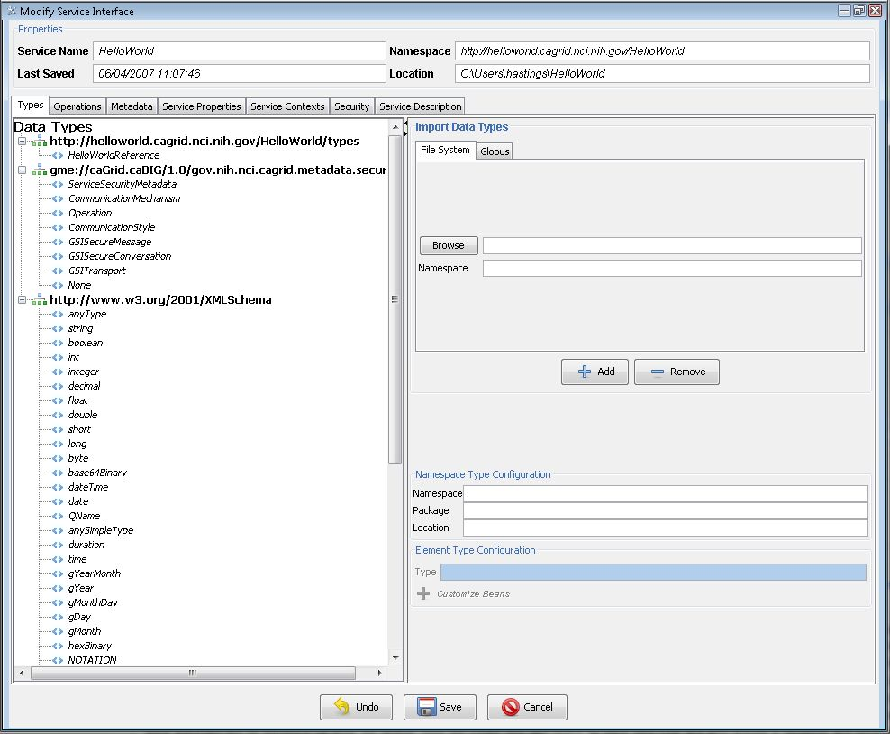
Modification
Add/Remove/Modify
Operations
Resource properties
Service properties
Service contexts (services and resources)
Service, method, and resource level security settings

Slide 18
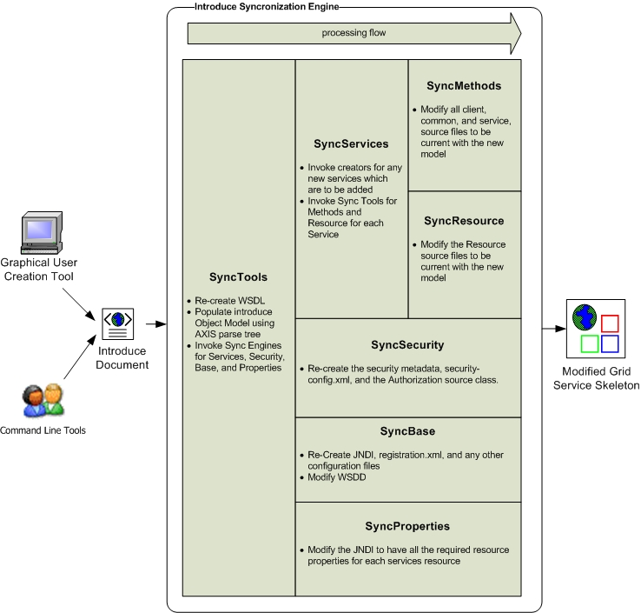
Introduce Service Modification Architecture
The Introduce Service Description document is the input to the introduce engine. The user can hand craft this document and call the engine via command line or API or can use the Introduce GDE to create and modify this document and execute the synchronization engine

Slide 19
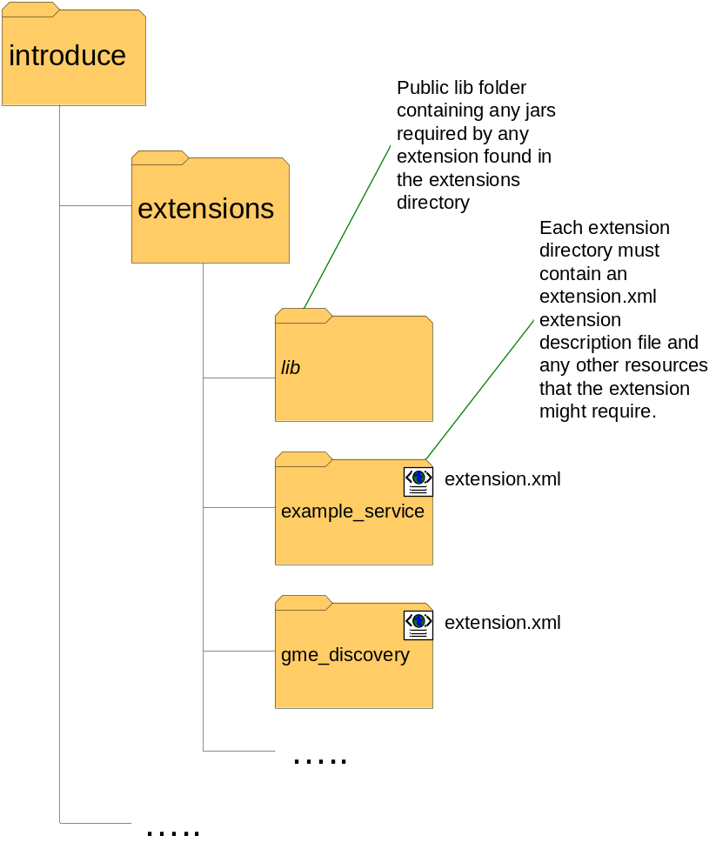
Introduce Extension Framework
Introduce provides an extension framework where it’s core functionality can be extended to provide customized solutions by leveraging the introduce toolkit.
There are currently two types of extensions in Introduce
  Service
  Types Discovery
Extensions provide an “extension.xml” extension description and configuration. The “extensions” directory of introduce hold the extensions in separate folders enabling them to easily be added and removed from the Introduce toolkit.

Slide 20
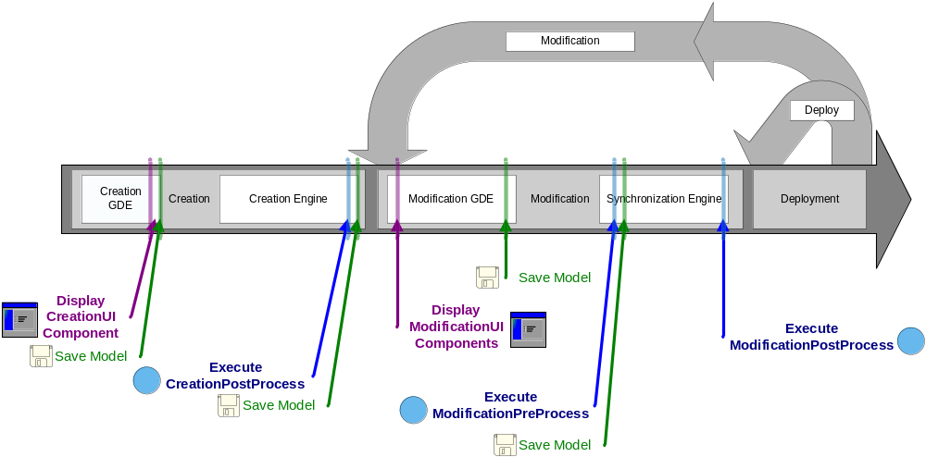
Service Development Extensions
Flow of execution for service extension components.

Slide 21
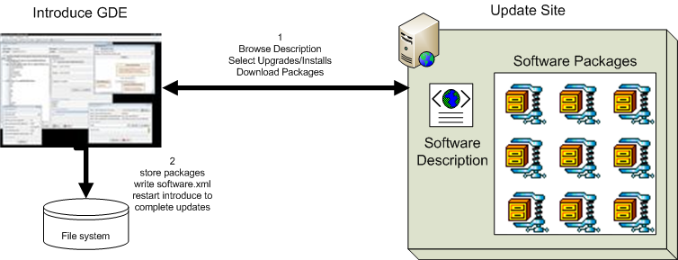
Introduce 1.1 Software Updater
New update support enables introduce to role updates out and move to newer versions of itself and it’s extensions.

Slide 22
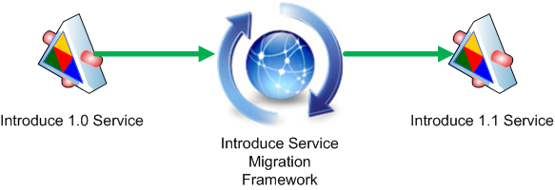
Introduce 1.1 Service Migration
New Introduce Service Migration Framework enables introduce and it’s extensions to provide upgraders which can run against services built with older versions of introduce and/or it’s extensions and migrate the services forward.
  1.0 services and forward will now be able to be migrated to work with newer versions of introduce with very little effort on the developers part.

Slide 23
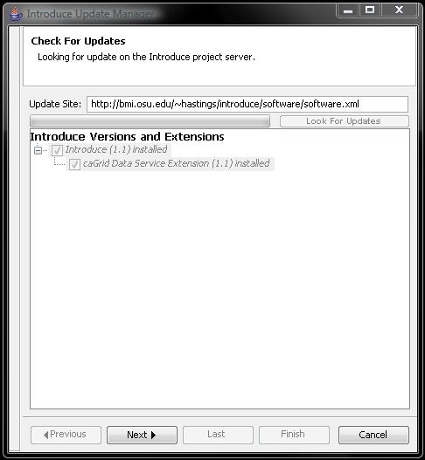
Introduce 1.1 Software Updates
Introduce is now capable of downloading and installing new extensions, upgrades to older extensions, and newer versions of itself. In the GDE there is a Help menu. In this menu there is a Check for Updates button. This button will take the user to a wizard which will walk them through looking for any software updates or new packages which they may want to download and install.

Slide 24
Introduce 1.1 Service Security
Now using Globus Policy Decision Point (PDP) based authorization.
  Introduce by default will generate the PDP authorization class from the requirements selected by the service creator using GridGrouper and/or CSM.
  Developer has the choice to use a custom PDP class which will enable them to create custom authorization login and use other external attribute or group authorities.
  Much more flexible and actually enables authorization policy to be applied to imported operations which 1.0 did not as well as directly to dynamically created resources.

Slide 25
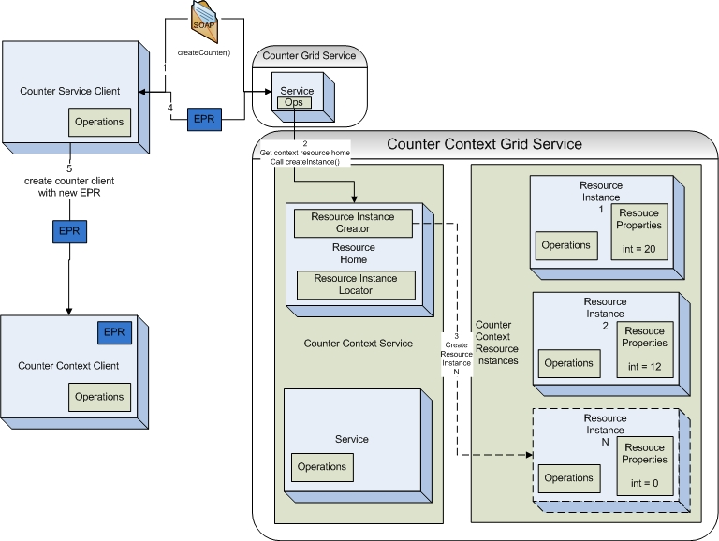
Introduce 1.1 Service Resource Contexts
Enhanced Resource Pattern Support
  now supports automated code generation of resource creation.
  Many bug fixes to support dynamic factory patterns to be created for creating and managing resources.

Slide 26
Introduce 1.1 Service Documentation
Introduce now enables descriptions and or comments to be added to virtually every aspect of the service.
  Descriptions are used to comment the generated API and to describe better the service metadata.

Slide 27
Future Features of Introduce 1.2
WS-Notification Support
  Support for subscribing/unsubscribing to resource properties.
Persistent Resources Support
  Support for automatic storing and loading introduce generated resources.
Service Refactoring
  Renaming packages, namespaces, methods, etc.
Deployment time security configuration.

Slide 28
References
Web
  http://dev.globus.org/wiki/Incubator/Introduce
  http://cagrid.org
Mail
  Introduce-users@dev.globus.org
  CAGRID_USERS-L@LIST.NIH.GOV

