Slide 1

GAARDS
Stephen Langella, Scott Oster,
Shannon Hastings, David Ervin
Ohio State University
Software Research Institute
{langella, oster, hastings,ervin}@bmi.osu.edu
OGF 21 Oct 2007

Slide 2
Agenda
Overview of GAARDS
  Creation
  Modification
  Strong Typing
  Security
Introduce Service Creation Demonstration

Slide 3
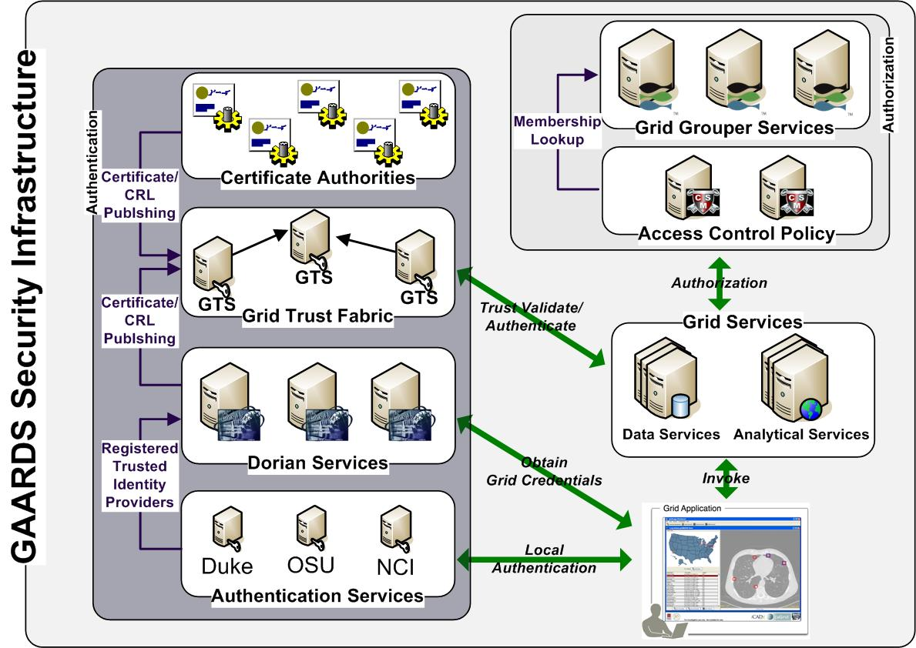
GAARDS Overview
GAARDS provides services and tools for the administration and enforcement of security policy in an enterprise Grid.
Dorian
  Grid Account Management
  Allows accounts managed in external domains to be federated and managed in the grid.
  Dorian allows users to use their existing credentials (external to the grid) to authenticate to the grid
  Issues Host Certificates.
Grid Trust Service (GTS)
  Creation and Management of a federated trust fabric.
  Supports applications and services in deciding whether or not signers of digital credentials can be trusted.
  Supports the provisioning of trusted certificate authorities and corresponding CRLS.

Slide 4
GAARDS Overview
Grid Grouper
  Group management service for the grid
  Provides a group-based authorization solution for the Grid
  Enforce authorization policy based on membership to groups
Authentication Service
  Integrates existing credentials providers into the grid.
  Provides a uniform grid interface for authenticating to existing credential providers.
  Applications can communicate with any credential provider.
Common Security Module (CSM)
  Centralize approach to managing and enforcing access control policy authorization.

Slide 5
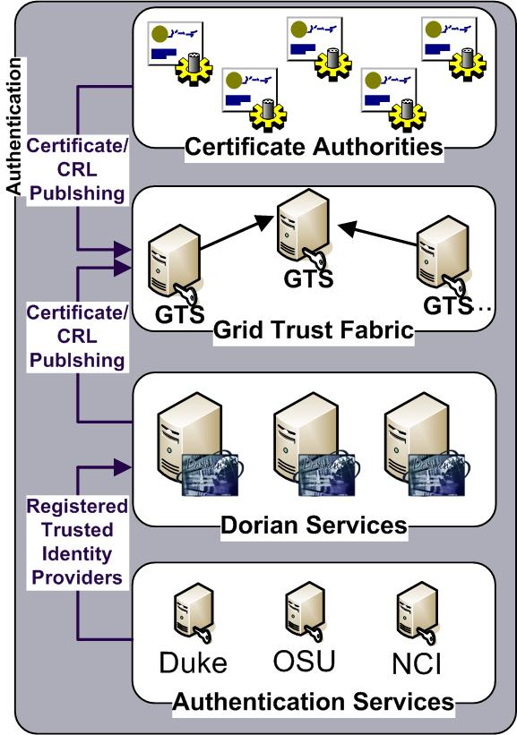
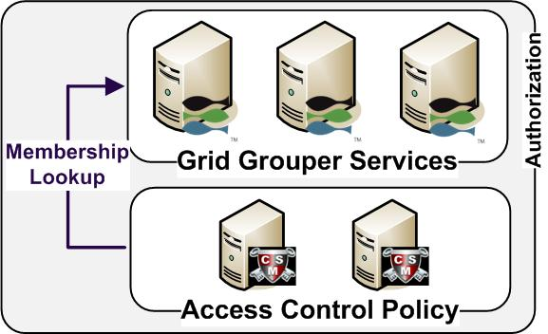
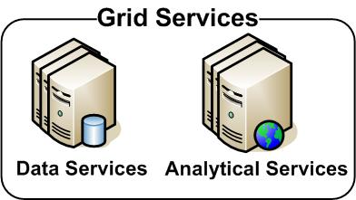
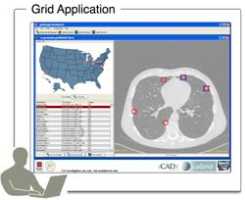
GAARDS in Action

Slide 6
GAARDS in Action
Authenticate with
Local Credential Provider
User authenticates to local credential provider using your everyday user credentials
SAML Assertion

Slide 7
GAARDS in Action
SAML Assertion
Application obtains grid credentials from Dorian using SAML provided by the local provider.
Grid
Credentials

Slide 8
GAARDS in Action
Application uses grid credentials to invoke secure grid services.
Grid
Credentials

Slide 9
GAARDS in Action
Should I trust the
credential signer?
Grid Service authenticates the user by asking the GTS whether or not the signer of the credential should be trusted.

Slide 10
GAARDS in Action
Authorization
Grid Service asks CSM or their access control policy enforcer whether or not the user can perform X and resource Y.
Is
Authorized?

Slide 11
GAARDS in Action
Is member of?
Authorization
Alternative
Grid Service can enforce local policy based on user membership to groups maintained in Grid Grouper.

Slide 12
GAARDS History and Future
GAARDS 1.0 (December 2006)
  Released inline with caGrid 1.0
GAARDS 1.1 (September 2007)
  Released inline with caGrid 1.1
  Individual Components Released
    GAARDS UI
    Dorian
    Authentication Service
    Grid Trust Service (GTS)
    SyncGTS
    GridGrouper
GAARDS 1.2 (Early 2008)

Slide 13
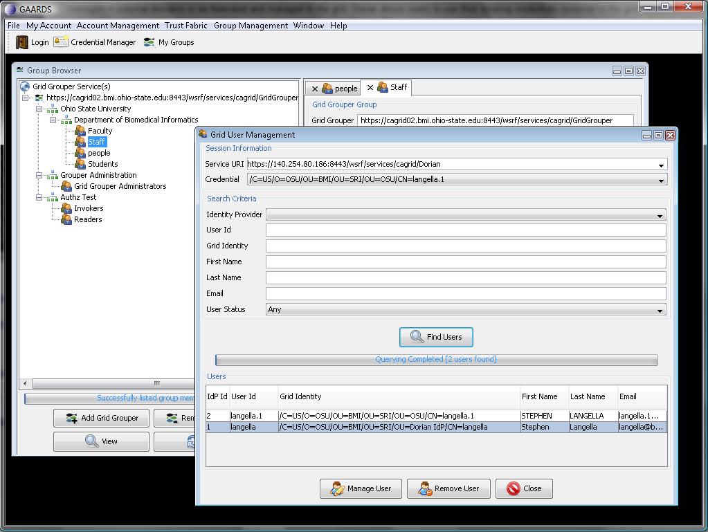
New in GAARDS 1.1
Bug Fixes
Complete graphical deployment configuration through caGrid 1.1 Installer
GAARDS UI has been overhauled for increased usability.
GAARDS Integration with GridFTP.
Increased support for meeting Federal e-Authentication Guidelines

Slide 14
New in GAARDS 1.1
Dorian
  Support for Hardware Security Model (HSM)
    Tamper-proof, FIPS-compliant, hardware key storage and management
  Support for meeting Federal e-Authentication Guidelines
  Host Credential Support
    Users with Dorian Accounts may request host credentials for the services they administrate.
Grid Trust Service (GTS)
  Command line utility for generating trust reports.
Grid Grouper
  Support for users to discover which groups they are members of.

Slide 15
GAARDS 1.2
Release targeted for early 2008, currently in the planning stages.
Additions and Extensions being CONSIDERED.
  WebSSO Framework (HIGH PRIORITY) – Integrate GAARDS with an existing WebSSO framework such that web application can be rapidly developed on top of the Grid.
  Credential Delegation Service (HIGH PRIORITY) – Develop a WSRF compliant delegation service with plug and play delegation policies.
  Event Handling and Auditing (MEDIUM PRIORITY) – Add event handling and auditing capabilities to GAARDS Services.
  Graphical Trust Root Reporting (LOW PRIORITY)- At support in the GAARDS UI for viewing/managing the Globus Trusted Certificates directory
  Web SSO Installer (LOW PRIORITY) – Develop Graphical Installer for the WebSSO framework.
  Credential Delegation Service Installer (LOW PRIORITY) – Develop Graphical Installer for the Credential Delegation Service.

Slide 16
Project Resources and Communication
www.cagrid.org
  Download Software
  Documentation
  Tutorials
  Technical Paper and Presentations
caGrid GForge Home
  Feature Requests
  Bug Reports
  Downloads / Source Repository
  http://gforge.nci.nih.gov/projects/cagrid-1-0/
caGrid Users Mailing List
  https://list.nih.gov/archives/cagrid_users-l.html
  cagrid_users-l@list.nih.gov

Slide 17
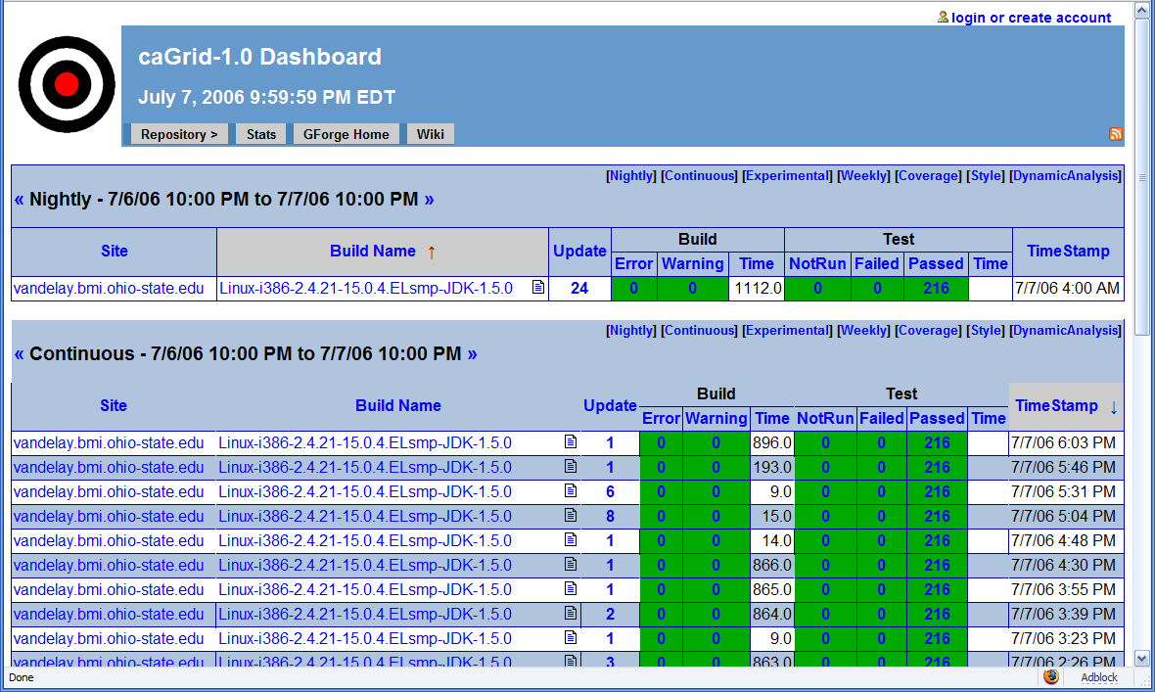
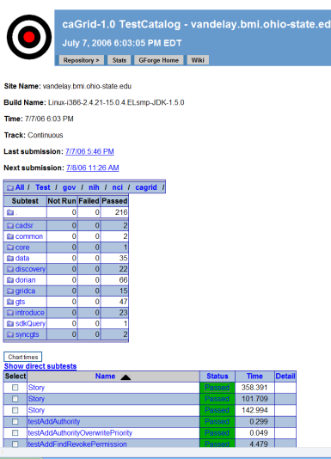
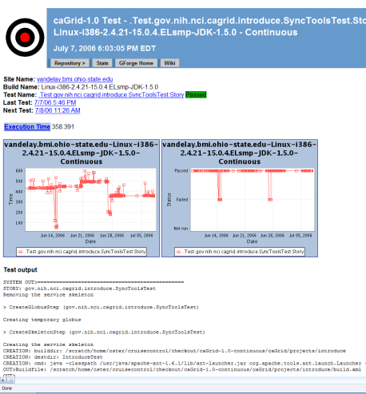
Software Quality
Testing
  Unit and System
Automated Builds/Tests on multiple nodes
  Nightly (on a schedule)
  Continuous (every CVS check in)
Quality Dashboards
  DART (multi-site, historical archive of quality)
  CruiseControl
Code Test Coverage

Slide 18
GAARDS Team
Ohio State University
  Stephen Langella
  Shannon Hastings
  Scott Oster
  David Ervin
  Tahsin Kurc
  Justin Permar
  Joel Saltz
Argonne National Labs
  Frank Siebenlist
Semantic Bits
  Joshua Phillips
Ekagra
  Kunal Modi
NCICB
  Avinash Shanbhag

