Slide 1

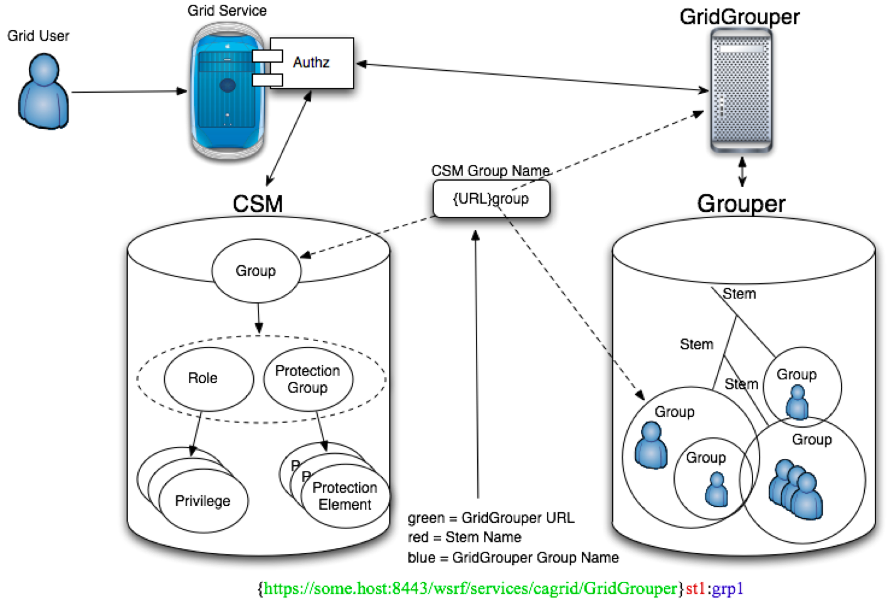
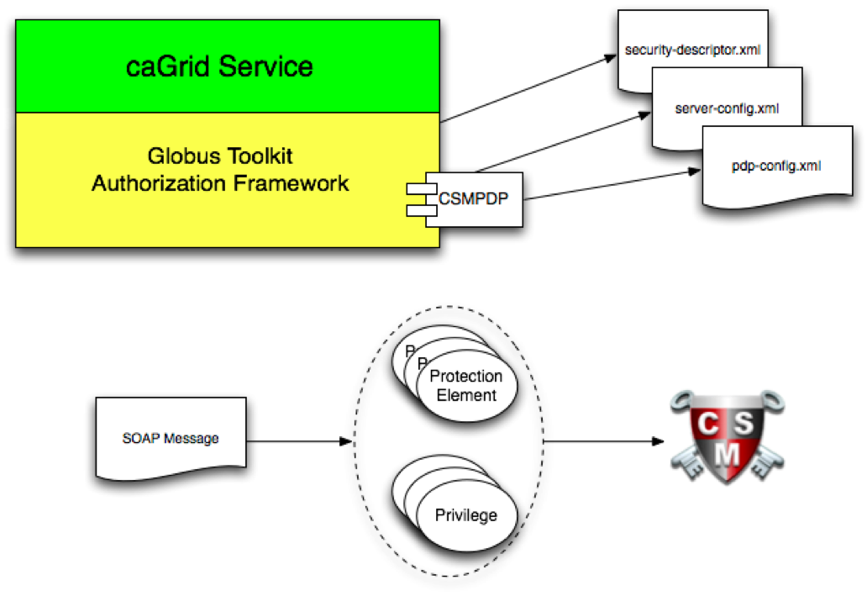
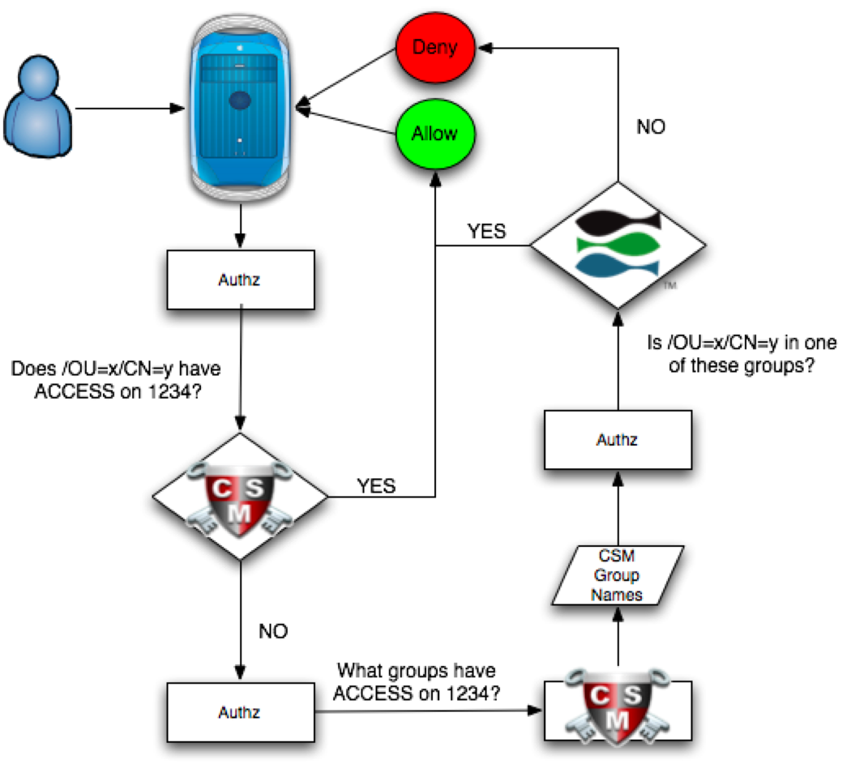
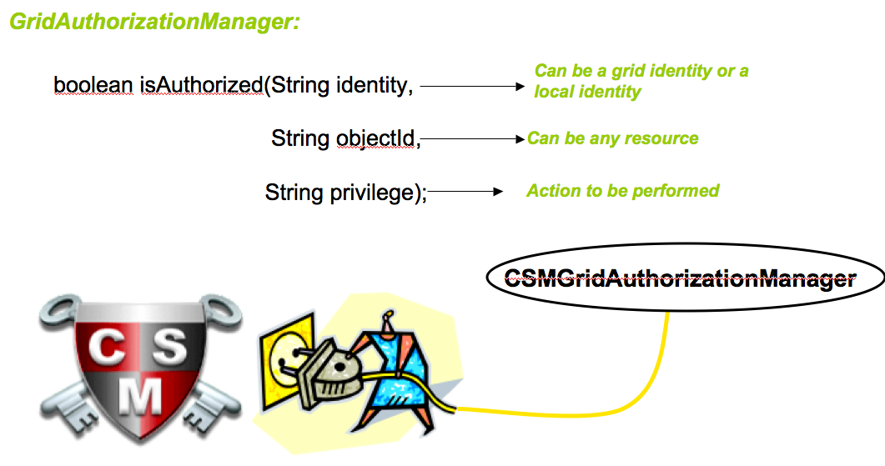
Enforcing Authorization Policy Using the caGrid Authorization Component
Joshua Phillips, SemanticBits
Vinay Kumar, SemanticBits
Authorization in the Grid Environment
Abstract
The goals of the caGrid Authz component are to 1) provide mechanisms to enforce authorization policy at any level of granularity (e.g. service, operation, object instance); 2) provide integration of local CSM-based policy and GridGrouper-based policy; and 3) make this integration work with existing applications that already use CSM. We have achieved these goals in the following ways. First, we have defined a mapping between CSM group names and GridGrouper group names. Second, we have provided a Java API that can be used from within a grid service (or application). This API knows how to interpret GridGrouper group names and interact with CSM and GridGrouper. Second, we have packaged that API so that it can be plugged into CSM, Globus Toolkit, and/or Axis using the standard extension mechanisms exposed by those frameworks.
Authorization Scenario
User A from organization X wants to invoke a grid service from organization Y
Organization Y wants to secure its data exposed by its grid service
Organization Y provisions its users for access policies in CSM
The Problem:
Organization Y does not know anything about user A. It is not feasible to provision all the users across multiple organizations for access policies
Components and their roles
  Grid grouper: Grid grouper provides the functionality to create groups at the grid level. There may be several grid groupers on the grid. Users with their grid identities can become the member of grid groups
  CSM: Common security module is security infrastructure for provisioning local users and access policy for the application.
(Right) To integrate CSM-based policy with GridGrouper-based policy, we map CSM group names to GridGrouper group names.To grant privileges on a protection element to grid users that are members of a particular GridGrouper group, the CSM administrator simply creates the group in CSM, and adds the appropriate roles and protection groups.The name of the group must follow a certain naming convention, which is described in the image to the right. The part within the curly braces must be the URL of the GridGrouper service.The remaining part must be the fully-qualified name of the GridGrouper group.
(Below) The Authz component first assumes that the user is a local user and asks CSM if the user has the required privileges on the given protection element. If so, then the operation is allowed. Otherwise, the Authz component will ask CSM what groups have the appropriate privileges. If any of the group names that CSM returns are GridGrouper group names, then the Authz component will ask GridGrouper if the user is a member of any of these groups. If not, the operation is denied. Otherwise, if the user is a member of at least one of these groups, then the operation is allowed.
(Above) caGrid also supports a declarative configuration approach that builds on the pluggable authorization framework provided by the Globus Toolkit. This framework allows one to specify a chain of Policy Decision Points (PDPs) that will be consulted before granting access to any of the service’s operations. Globus provides several built-in PDPs, and custom PDPs can be plugged in. We’ve provided a custom PDP that will map elements of the SOAP body to protection elements and privileges in CSM so that a policy decision can be made.
(Above) The main API into the Authz framework is defined by the GridAuthorizationManager interface, We provide a single implementation of this interface, called CSMGridAuthorizationManager, which plugs into the CSM framework.

