Slide 1
Overview of caGrid 1.0 Data Services
caBIG Architecture/VCDE Workspaces
Joint Face to Face
July 12-14, 2006
Scott Oster (oster@bmi.osu.edu)
Ohio State University

Slide 2
Data Service Overview
caGrid Data Services offer capability to expose silver systems to the Grid.
Specialization of caGrid grid services to expose data through a common query interface
Present an object view of data sources
Exposed objects are registered in caDSR and their XML representation in GME
Queries made with CQL Query objects
Results returned as objects (or identifiers) nested in a CQL Query Result Set
Development tool implemented as an extension to the Introduce Toolkit is used to create the new grid service.

Slide 3
0.5 vs 1.0
Removal of barrier between data service architecture and analytical service architecture (Introduce).
  Complete security integration
  Statefull services to handle pulling of results as opposed to just pushing (WSRF and WS-Enumeration and caGrid Identifiers).
  Able to customize data service by adding other methods which enhance the data service for it’s particular use and still meet core interoperability requirements.
Strongly typed inputs and outputs.
  The CQL language and query results have been modeled and registered in the GME (soon to be caDSR) and are the strongly typed input and outputs of the base data service “query” method.

Slide 4
0.5 vs 1.0 (cont.)
CQL enhancements
  CQL has been refactored to enhance it’s describe-ability and ease of use. Also, new models have been created to describe how results are to be passed back to the user.
API Enhancements
  Client API is now completely object oriented with several convenience utilities to help generate queries and manage typed results.

Slide 5
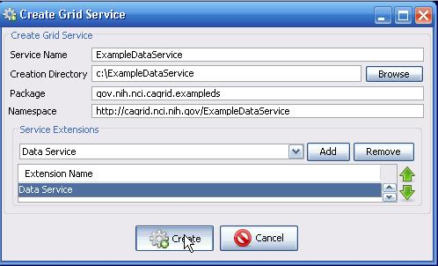
Creating a Data Service with Introduce
Once the data extensions to Introduce are installed (ant installIntroduceExtensions from data project), a Data Service can be created by selecting the “Data Service” extension, when creating a Service

Slide 6
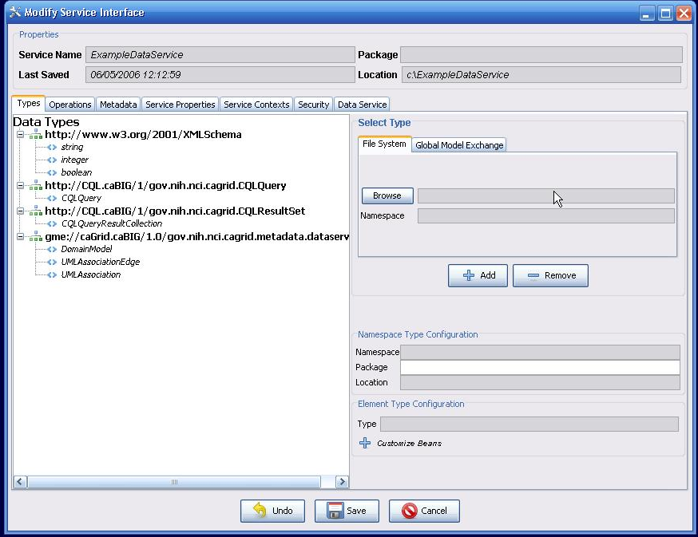
Creating a Data Service with Introduce cont.
The created Service has the necessary schemas for the data service inputs, outputs, and metadata

Slide 7
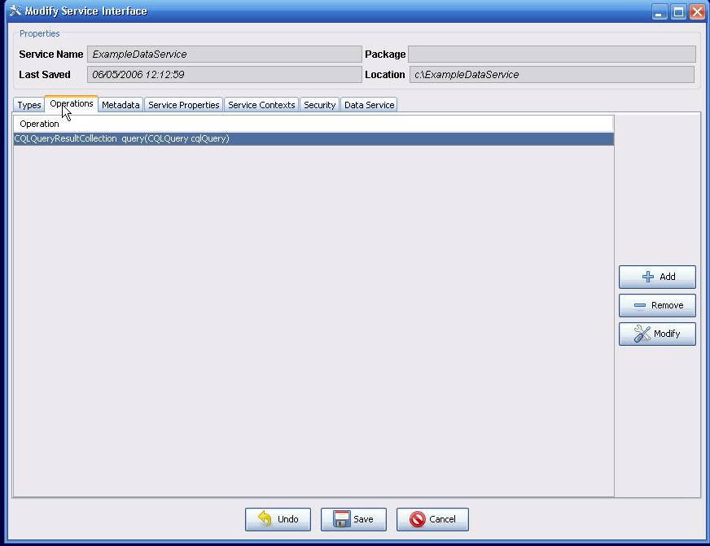
Creating a Data Service with Introduce cont.
The necessary “query” method is automatically defined for the Data Service

Slide 8
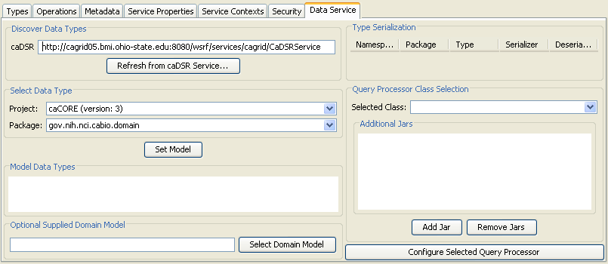
Service Modification
The service modification interface now includes a tab devoted to Data Service configuration.
  Using only this tab, a basic data service can be completely configured.

Slide 9
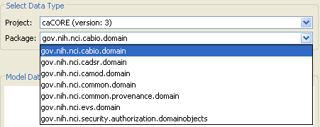
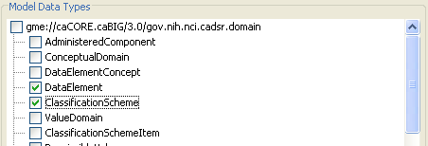
Service Modification (Cont.)
A project and package can be selected from the caDSR for the data service.
Data types to be used in queries are then selected from the model.

Slide 10
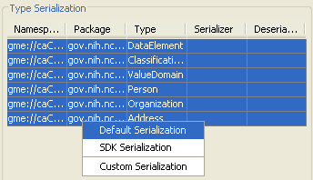
Service Modification (Cont.)
The selected data types appear in the types table, where serialization can be configured.
  A specialized serializer has been provided for types created with the caCORE SDK.

Slide 11
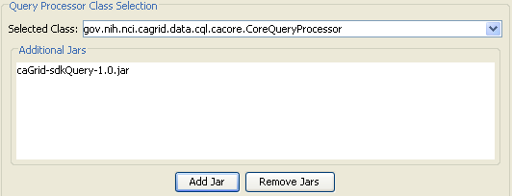
Service Modification (Cont.)
A query processor is selected by supplying the implementation Jar files and selecting a class from the drop down.
  Only classes in the Jar files which implement the base CQL query processor interface are shown in the drop down
  Other classes can be manually specified.

Slide 12
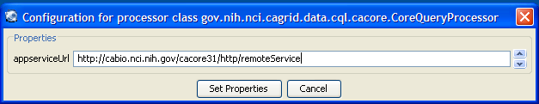
Service Modification (Cont.)
The selected query processor can be configured with the graphical interface as well.
  The configuration here appears as service properties available at runtime.

Slide 13
Data Service Interface
public abstract CQLQueryResults processQuery(CQLQuery cqlQuery)
throws MalformedQueryException, QueryProcessingException;
Data Provider’s only responsibility is to implement CQL over their local data resource
  A default implementation will be provided for caCORE SDK created systems
caGrid provides grid service implementation to invoke provider’s CQL implementation
Service provides all features necessary for compliance, such as advertisement of data service metadata, and security integration

Slide 14
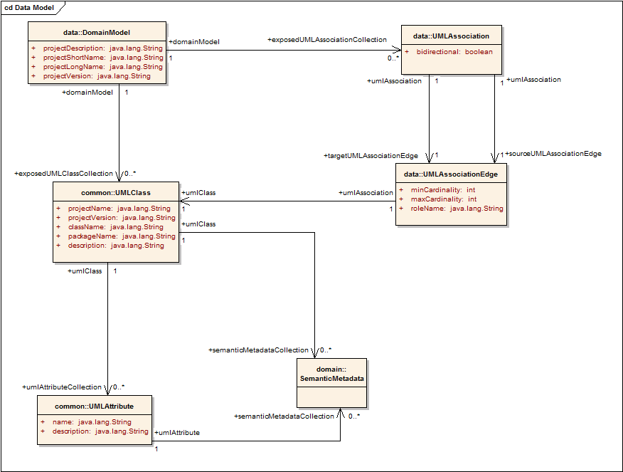
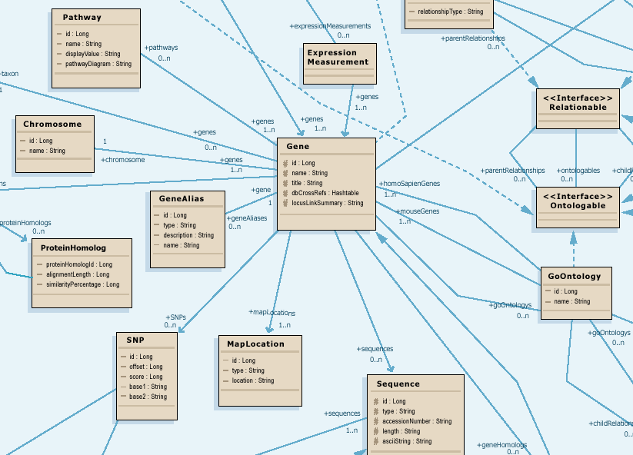
caGrid 1.0 Data Service Metadata
Standard metadata exposed by all Data Services describes the UML model being exposed, and contains links to semantic underpinnings
Provides information needed to formulate the Object-Oriented Query
Contains Semantic Information from EVS

Slide 15
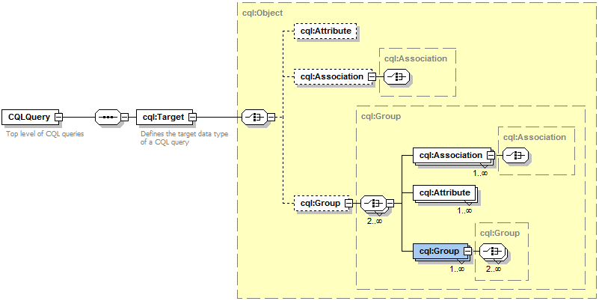
Data Service Query Language
Specifies a target object (result) type and selects the instances which satisfy the specified properties and nested object properties
Allows path navigation
Provides logical grouping
Provides name/predicate/value filtering on properties of objects
Recursively defined
Examples in CQL.doc

Slide 16
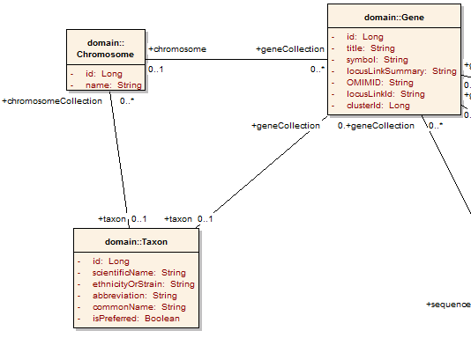
Example CQL Query
Return all Genes with a symbol beginning with BRCA and have an associated Taxon with an id equal to 6:

Slide 17
Example CQL Query
Return all Genes with a symbol beginning with BRCA and have an associated Taxon with an id equal to 6:
<CQLQuery xmlns="http://CQL.caBIG/1/gov.nih.nci.cagrid.CQLQuery"> <Target name="gov.nih.nci.cabio.domain.Gene"> </Target> </CQLQuery>

Slide 18
Example CQL Query
LIKE “BRCA%”
Return all Genes with a symbol beginning with BRCA and have an associated Taxon with an id equal to 6:
<CQLQuery xmlns="http://CQL.caBIG/1/gov.nih.nci.cagrid.CQLQuery"> <Target name="gov.nih.nci.cabio.domain.Gene"> <Attribute name="symbol" predicate="LIKE“ value="BRCA%"/> </Target> </CQLQuery>

Slide 19
Example CQL Query
LIKE “BRCA%”
Return all Genes with a symbol beginning with BRCA and have an associated Taxon with an id equal to 6:
<CQLQuery xmlns="http://CQL.caBIG/1/gov.nih.nci.cagrid.CQLQuery"> <Target name="gov.nih.nci.cabio.domain.Gene"> <Group logicRelation="AND"> <Attribute name="symbol" predicate="LIKE“ value="BRCA%"/> <Association roleName="taxon“ name="gov.nih.nci.cabio.domain.Taxon"> </Association> </Group> </Target> </CQLQuery>

Slide 20
Example CQL Query
LIKE “BRCA%”
Return all Genes with a symbol beginning with BRCA and have an associated Taxon with an id equal to 6:
<CQLQuery xmlns="http://CQL.caBIG/1/gov.nih.nci.cagrid.CQLQuery"> <Target name="gov.nih.nci.cabio.domain.Gene"> <Group logicRelation="AND"> <Attribute name="symbol" predicate="LIKE“ value="BRCA%"/> <Association roleName="taxon“ name="gov.nih.nci.cabio.domain.Taxon"> <Attribute name="id" predicate=“EQUAL“ value="6"/> </Association> </Group> </Target> </CQLQuery>
= 6

Slide 21
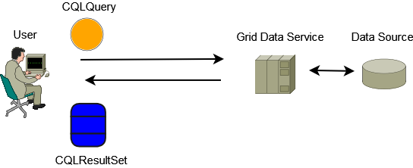
Data Service Query Scenario
Client builds a CQL Query
CQL Query is serialized and submitted to the Grid Data Service
Grid Data Service deserializes the CQL Query Object and processes it
Data Source is queried by the Grid Data Service
Grid Data Service Builds a CQL Result Set
Result Set is serialized and returned to the client
Client deserializes result set
Result set is iterated with client tools to retrieve objects

Slide 22
Data Service Features Under Development
Componentized library being developed to facilitate limited federating and aggregating queries
Service-side Query Result Management (remote cursor, data transfer, etc)
caGrid Identifiers Integration (return grid identifiers in place of materialized objects)
Result Delivery Specification (possible support for association traversal, attribute returns, range/limit operations)

Slide 23
Data Service Client Tooling
APIs provided to discover available data services on the grid based on client-defined criteria (such exposed data models and concepts)
Object-Oriented API for building queries, querying a given data service, and processing the results
Client tools available to iterate query result sets
  Object iterator deserializes XML into registered objects (deserialization controlled by client configuration)
  XML iterator simply returns XML documents

Slide 24
Data Services Service Tooling
Data services can be built via an Introduce Toolkit extension
Extension adds functionality to both service creation and modification
  Creation adds query operation
  Modification adds CQL implementation, selected data model, and appropriate metadata
  Specialized client configured to support necessary custom serialization and security settings
    Generic Data Service Client can be used to communicate with ANY data service, but a service-specific client knows what security the service is configured with, and any non-default serialization it may make use of

Slide 25
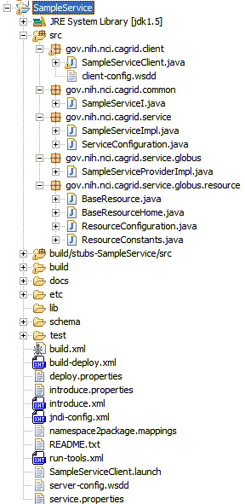
Invoking the Data Service
The service can be invoked with either the Introduce generated client class, or the provided data service client tooling.
  Data service project provides a DataServiceHandle class.
    Handle can query any standard data service.
    Handle abstracts iteration of query results.

Slide 26
Sample Code to Invoke the New Service
public static void main(String[] args) {
try {
InputStream configStream = ClassUtils.getResourceAsStream(
DataServiceInvoker.class, "client-config.wsdd");
DataServiceHandle handle =
new DataServiceHandle(new DataServiceClient(SERVICE_URL), configStream);
CQLQuery query = new CQLQuery();
Object targetObject = new Object();
targetObject.setName(Address.class.getName());
Attribute stateAttrib = new Attribute();
stateAttrib.setName("state");
stateAttrib.setPredicate(Predicate.EQUAL_TO);
stateAttrib.setValue("MD");
targetObject.setAttribute(stateAttrib);
query.setTarget(targetObject);
Iterator iter = handle.query(query);
while (iter.hasNext()) {
Address addy = (Address) iter.next();
System.out.println("--- Address ---");
System.out.println(addy.getAddressLine1());
System.out.println(addy.getAddressLine2());
System.out.println(addy.getCity());
System.out.println(addy.getState());
System.out.println(addy.getCountry());
System.out.println(addy.getPostalCode());
}
} catch (Exception ex) {
ex.printStackTrace();
System.exit(1);
}
}

Slide 27
Overview of caGrid 1.0 Data Services
caBIG Architecture/VCDE Workspaces
Joint Face to Face
July 12-14, 2006
Scott Oster (oster@bmi.osu.edu)
Ohio State University

