Slide 1
Arch/VCDE Workspace Requirements and the Impact on caBIG™ Infrastructure: Metadata
caDSR/GME Mapping
Denise Warzel, Scott Oster
caBIG Architecture/VCDE Joint Face-to-Face
Salt Lake City, UT
January 28th-30th, 2008

Slide 2
Agenda
Problem Statement
caCORE Implementation
  Current Status and Plans
  Future Work
caGrid Integration

Slide 3
caCORE 4.0 Team
Blah
  Blah
    blah

Slide 4
caGrid 1.1 Team
Ohio State University - Biomedical Informatics Department
  Dave Ervin
  Shannon Hastings
  Tahsin Kurc
  Stephen Langella
  Scott Oster - Chief Architect - caGrid
  Joel Saltz
University of Chicago/Argonne National Laboratory
  Ravi Madduri
  Ian Foster
SemanticBits, LLC.
  Joshua Phillips
Duke Comprehensive Cancer Center
  Patrick McConnell
Ekagra Software Technologies, Ltd.
  Vijay Parmar

Slide 5
caGrid 1.1 Team (Continued)
Northern Taiga Ventures, Inc. (NTVI)
  Wendy Erickson-Hirons
Science Applications International Corporation (SAIC)
  Aynur Abdurazik
  Ye Wu
Terrapin Systems LLC (TerpSys)
  Chet Bochan
  Vanessa Caldwell
  Craig Fee
  Alan Klink
  Gavin Brennan
NCI - Center for Biomedical Informatics and Information Technology (CBIIT)
  Todd Cox
  George Komatsoulis
  Denise Warzel
  Wendy Patterson
  Mary Jo Deering
Booz Allen Hamilton
  Michael Keller
  Arumani Manisundaram

Slide 6
Problem Statement
Achieving caBIG interoperability goals on the grid requires not only sound handling of both syntax and semantics, but also a formal binding between them
Previously, the binding was:
  implicit and based upon overly constraining assumptions (in some cases)
  difficult to make use of programmatically
  difficult to verify, and therefore enforce, compliance with

Slide 7
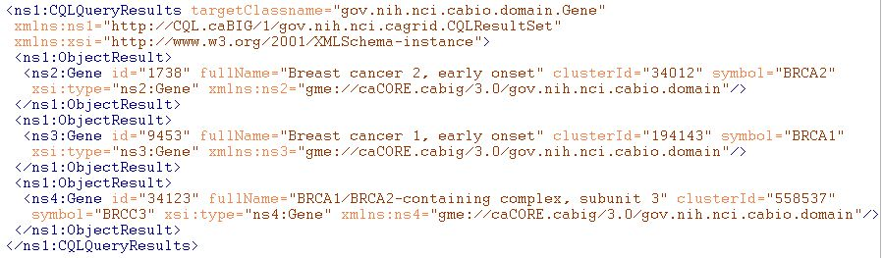
Example of Grid Data Syntax
XML of CQL Results from a query to a Data Service
Infrastructure capable of mapping directly back to corresponding programming language objects
Semantics of data are explicitly bound to the conceptual model (DomainModel) the user queried against, and implicitly associated with this XML via it’s namespace

Slide 8
Example Syntax Use Cases
I’m writing an application to process arbitrary data types, how do I know what the data will look like?
I want to build a grid service, how do I describe the inputs and outputs of its operations?
How can I be sure data I am getting is valid?
I don’t want to work with WSDL or XML, can’t I just use an object-oriented client API to talk to grid services?

Slide 9
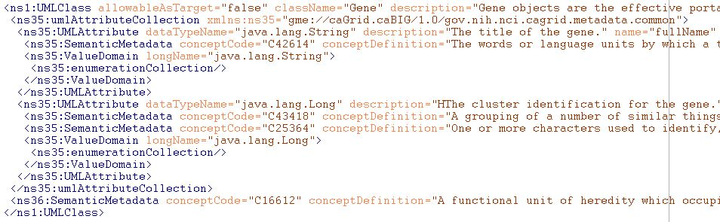
Example of Grid Data Semantics
Snippet of XML representation of DomainModel metadata from a Data Service
Describes the caDSR-registered logical structure, used to query the service; annotated with concept codes from EVS
Independent of the syntax used to realize the data types on the grid (such as in the results of a query)

Slide 10
Example Semantics Use Cases
What are the service addresses of all the running Data Services exposing data based on concept C16612?
What are the permissible values of Taxon.abbreviation in the caBIO 3.1 model?
Are there any Analytical Services on the grid which provide operations over a data type that is semantically interoperable with the caBIO 3.1 Tissue.organ?
How do I learn about the data available from an arbitrary Data Service?

Slide 11
Example Semantic/Syntax Binding
Use cases
I’ve received a generic data set (such as a CQL results object), how can I understand the semantics of the contained data?
I want to describe a workflow using either logical models or EVS concepts, how can I figure out how the XML is structured such that I can use BPEL to extract data?
  Better yet, is there a graphical tool that can do the transformation for me?
I registered my model in caDSR, why is Introduce asking me for XML Schemas?

Slide 12
Realizing the Binding Use Cases
Need the capability to formally describe, register, and access the association between a given data type’s syntax and semantics
The foundation of the grid data syntax is XML Schema; XML Schemas are identified by their namespaces
The foundation of the grid data semantics are the EVS annotated, caDSR data models; data models are identified by their caDSR identifier and version
The binding between syntax and semantics is essentially a mapping from the UML/caDSR universe to the XML/GME universe

Slide 13
Connecting UML and XML:
Current Implementation
Previous “solution” was to require an XML Schema for each package that followed a namespace construction rule
Had several limitations:
  Several caBIG projects wish to reuse existing XML Schemas, which have existing namespaces (can’t be changed for interoperability reasons)
  Some uniqueness constraints assumed are not strictly enforced
  Does not support “reverse lookup” (XSD -> caDSR)
  Does not provide fine grain mapping necessary for some applications/infrastructure
  Somewhat prescriptive (namespaces, naming conventions, etc) when ideal solution is entirely descriptive

Slide 14
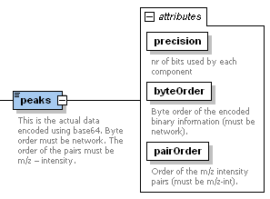
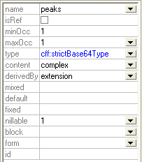
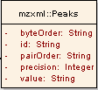
Connecting UML and XML:
The complexities
There are a large variety of options on how a conceptual UML model can be represented in XML (many in use within caBIG as well as relevant external XML standards)
  Assumptions on namespaces or structure don’t work
Most applications/services “don’t care,” so process must be simple for the default case, but sufficient for the others
Names different
Attribute or element?
What about Collection associations
?

Slide 15
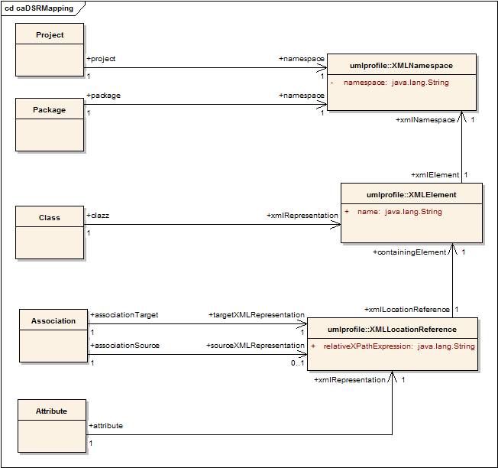
Connecting UML and XML:
The solution
Planned definition of mapping rules specify how a given UML entity is represented in XML over the grid
Maintained in the caDSR, lookup and query available through caDSR grid service

Slide 16
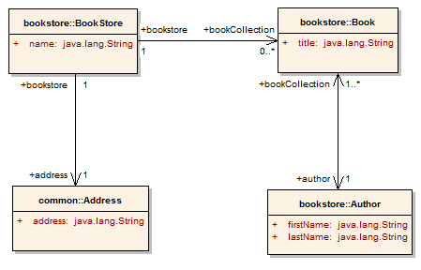
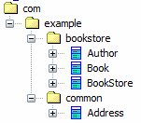
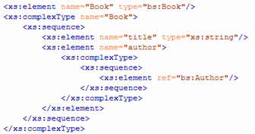
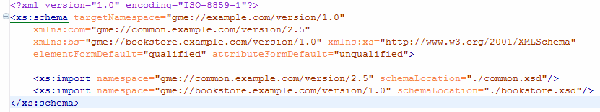
Partial Mapping Example
Project:
BookStore
Version:
1.0
Attribute Mapping
XPath:
title
Element:
Book
Namespace: gme://bookstore.example.com/version/1.0
Project’s Namespace (gme://example.com/version/1.0)

Slide 17
DENISE TO ADD MORE DETAILS ON IMPLEMENTATION AND FUTURE POSSIBILITIES

Slide 18
caGrid Integration
Grid Access:
  The caDSR Grid Service will provide grid access to the binding information registered in the caDSR
Replace existing heuristic use:
  Metadata Creation/Annotation:
    caDSR Grid Service provides ability to annotate ServiceMetadata instances generated by Introduce, with the caDSR/EVS extract information
  Introduce Data Type Browsing
    Provide ability to seamless locate and leverage XML Schemas needed for a service by selecting caDSR data models
New Potentials:
  Workflow Creation User Interface
    Workflows are described with BPEL, which uses XML constructs for things like data extraction; will be able to provide an interface to seamlessly describe workflows at the “object layer”

Slide 19
Arch/VCDE Workspace Requirements and the Impact on caBIG™ Infrastructure: Metadata
caDSR/GME Mapping
Denise Warzel, Scott Oster
caBIG Architecture/VCDE Joint Face-to-Face
Salt Lake City, UT
January 28th-30th, 2008

Slide 20
Backup Slides

Slide 21
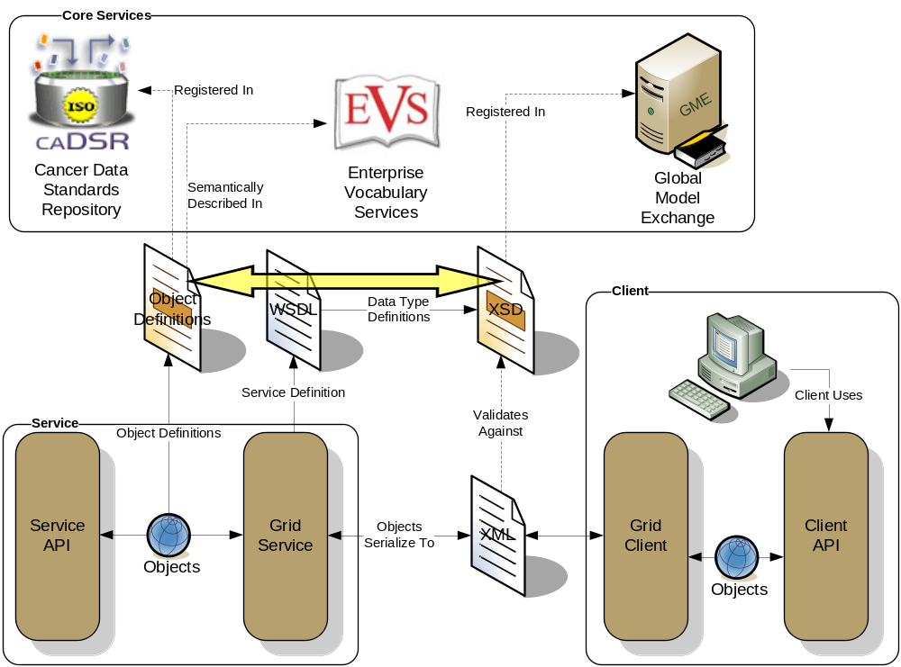
Conceptual View of the Problem

Slide 22
XML Schema Existence Rules
Each caDSR data object (as part of a specific Project version) used in the grid must have its XML format modeled in an XML Schema that is registered in the GME
Within each data object, the format of its attributes and associations must be modeled in the corresponding XML Schema type
Every caDSR Package (as part of a specific Project version) must have a corresponding XML Schema that is registered in the GME, even if it just imports a series of other XML Schemas and doesn’t define any of its own types
Every caDSR Project must have a corresponding XML Schema registered in the GME; It will most likely just imports a series of other XML Schemas (corresponding to its Packages’ schemas), though it may define its own types
These rules let the XSD modeler create any level of schema granularity from 1 per project, down to 1 per Class, but there is always a defined way to retrieve all of the types for a given Project, Package, and Class

Slide 23
Binding the XML Schemas and caDSR
Preceding rules only detail the necessity of existence of the various XML Schemas and schema entities, they do not specify how a particular instance can be located
A detailed bidirectional mapping/binding between the schema entities and caDSR items is required to support the use cases

Slide 24
Mapping Realization
Planned to be maintained in the caDSR
API to query and lookup bindings
Access will be available through caDSR Grid Service

